Slide 1






European Regional Symposium
September 28 – 29 | 2023 Matera, Basilicata Region | Italy
Second Edition of the European Regional Symposium, on space data for tourism & agriculture, by NEREUS Regions

Slide 2


Basilicata region Profile
10,000 square kilometers of territory, 46.8% mountains, 45.2% hilly and 8% with flat morphology, 40% wooded; about 570,000 inhabitants, Basilicata is a region rich in natural beauty, sparsely populated for most of its extension, ideal destination for a certain type of tourism.
Agriculture, rich in typical features strongly linked to the territory and with high nutritional and health qualities, presents, despite its limited extension, a certain variety (intensive specialized in fruit and vegetables in the Metaponto area; vines and olive in Vulture area; extensive animal husbandry in the middle area hilly-mountainous and intensive dairy farming in the valleys of Val d'Agri).

Slide 3
Basilicata region Profile
Basilicata is still a region with a strong tertiary vocation: the share of added value produced by services is about 65.3% of the regional total; 28.9% is attributable to the industrial sector and 5.8% to agriculture (ISTAT - Dec. 2021).
With regard to the primary sector, ISTAT data confirm a growth in regional wealth in terms of added value.

Slide 4
Challenges and threats
The most important challenges in regional agriculture are:
innovation
new start up enterprises of young people
via infrastructure
supply chain approach.
Threats:
demographic depopulation
hydrogeological risk
climate change (e.g. desertification in the Metaponto area; periodic intense flooding phenomena; drought)

Slide 5

Existing digital and spatial solutions
Regional Spatial Data Infrastructure of the Basilicata Region (RSDI)
The Geo Portal represent the main channel to disseminate the spatial information of the Regional Spatial Data Infrastructure of the Basilicata Region (RSDI).
The RSDI's objective is to guarantee the improvement of the services offered to citizens, facilitating the search for information and providing up-to-date material on technical and thematic cartographic production by allowing the online viewing of cartographies and the catalogue of geodata.

Slide 6
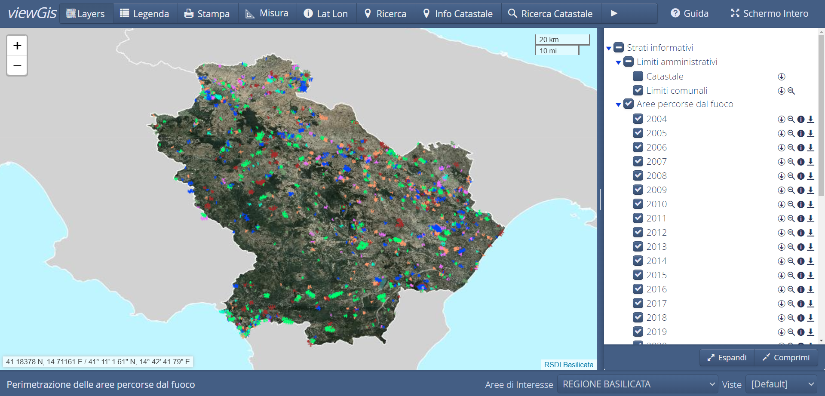
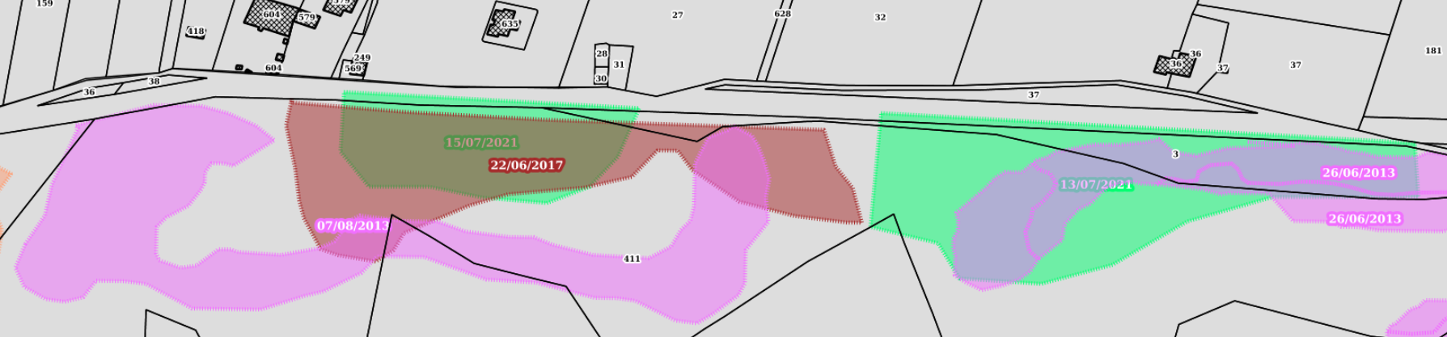
WEBGIS FIRES
Perimeter of wooded areas and pastures covered by fire in the period 2004 - 2022

Slide 7
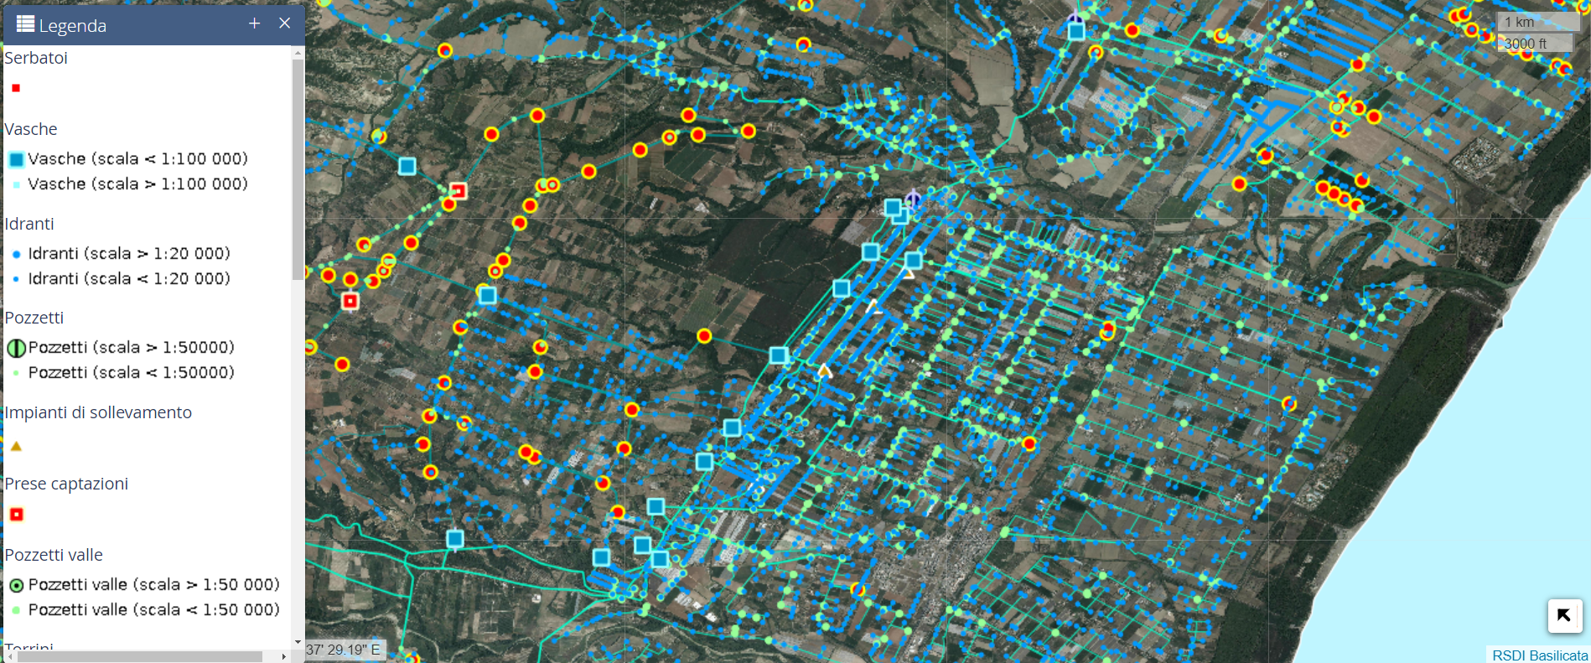
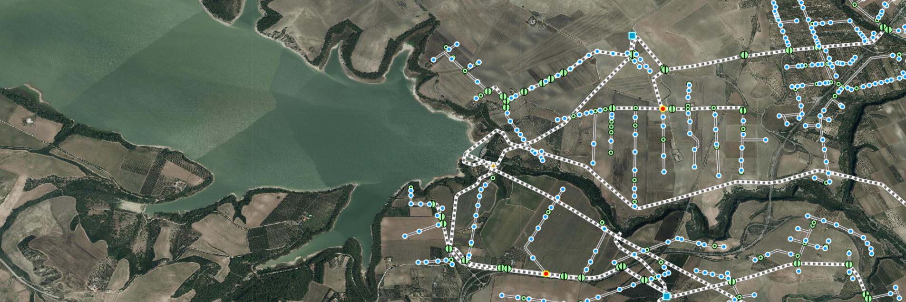
WEBGIS
Regional Consortium for hydraulic services
Irrigation service provided and hydraulic and irrigation infrastructure

Slide 8
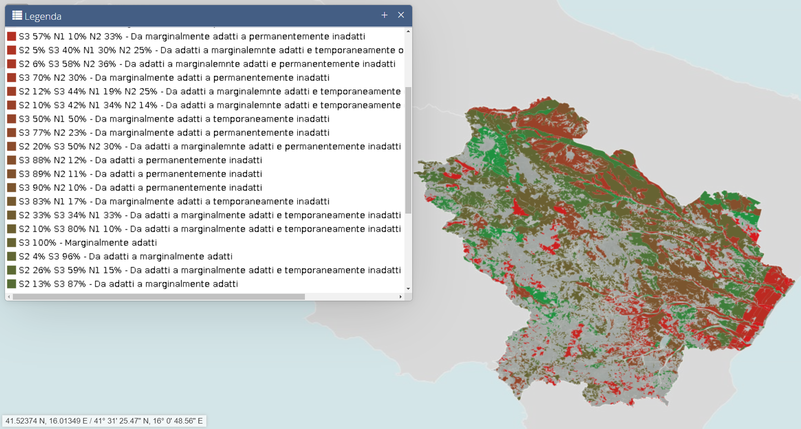
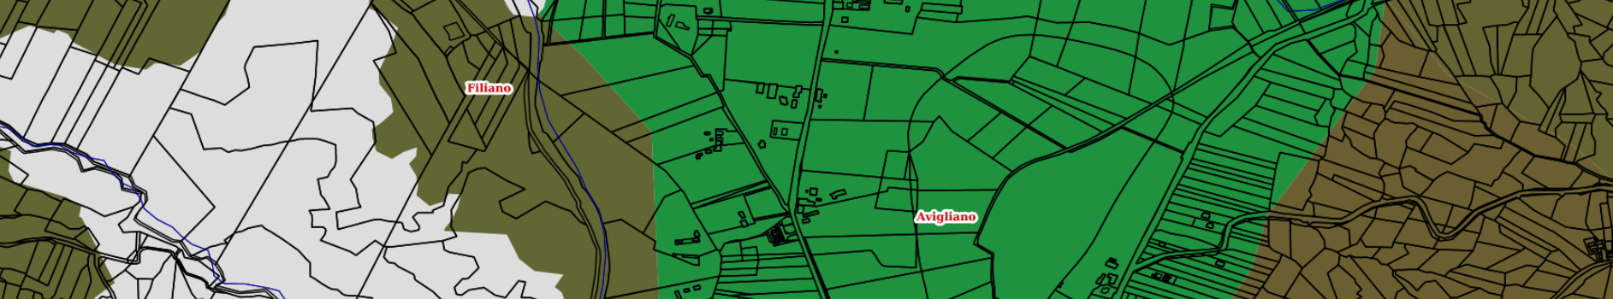
HAZELNUT CULTIVATION
Map of Hazelnut Cultivation Aptitude in Basilicata region

Slide 9
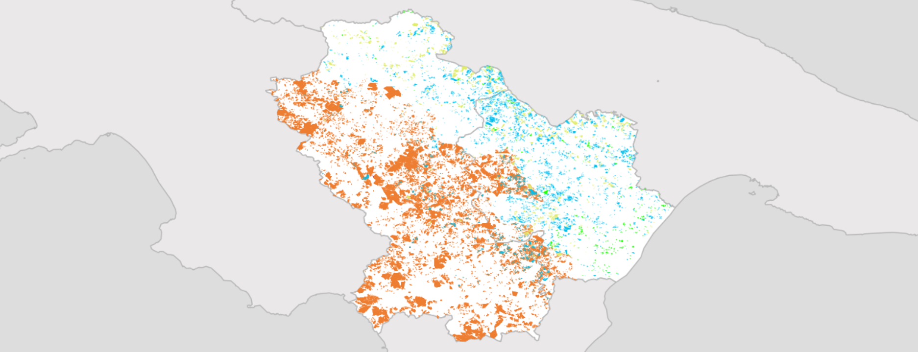
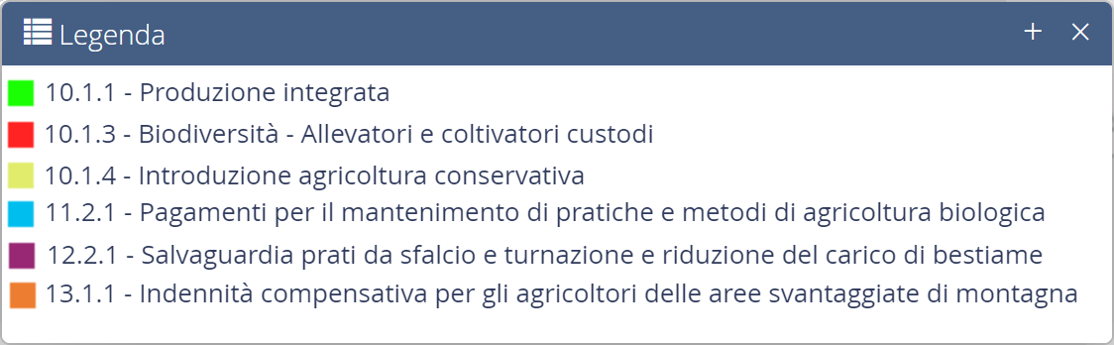
WEBGIS RURAL DEVELOPMENT PROGRAM - LOCALIZATION OF APPLICATIONS

Slide 10
Digital and space solutions
work in progress

Slide 11
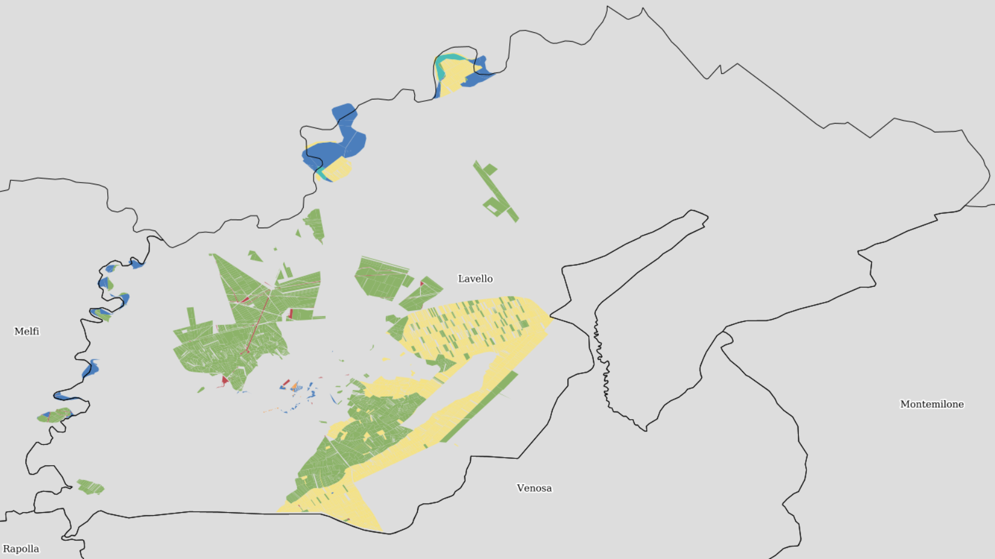
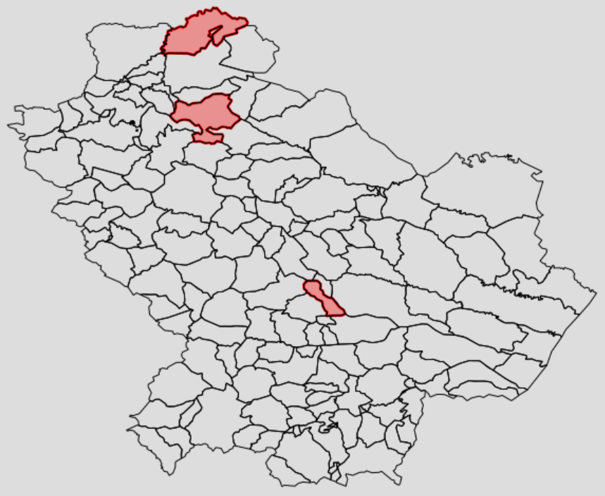
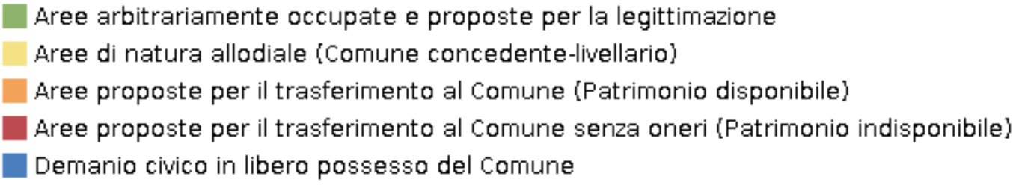
PUBLIC AREAS IN PRIVATE USE
Land register-based database

Slide 12
In the next future
Precision farming
A recent FAO definition of precision farming:
“Agriculture guided by detailed environmental information to minimise the use of water, agrochemicals and labour",
or
"agriculture that uses GPS technologies, satellites, ground sensors and information management systems to understand changes in resource conditions within the field. This information is used to apply fertilisers and other inputs more accurately, and to predict yields more accurately”.

Slide 13
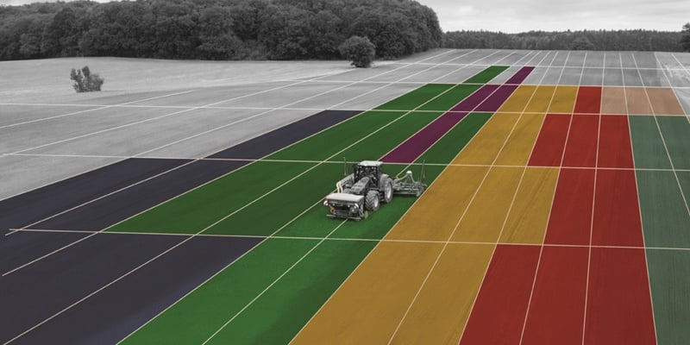
PRECISION FARMING
Prescription maps for fertilisation

Slide 14
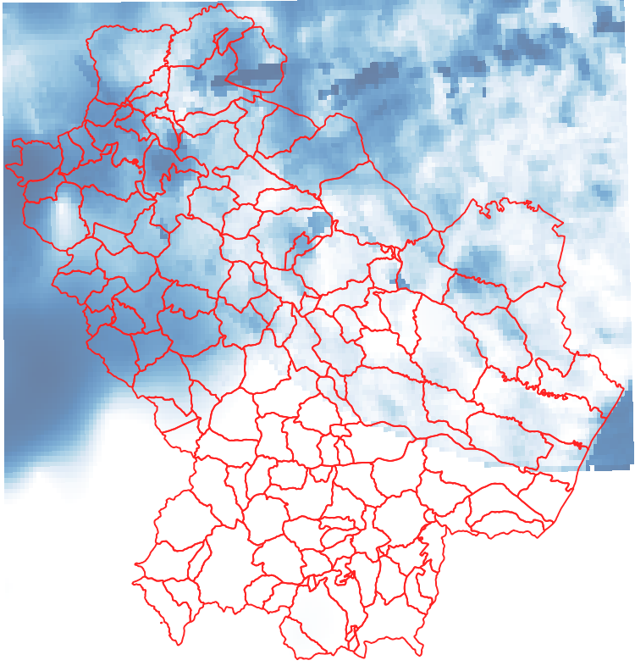
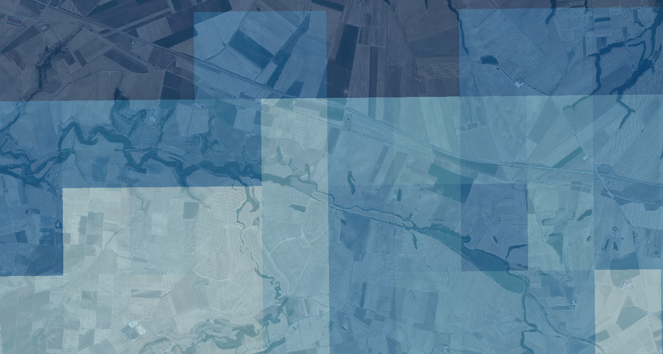
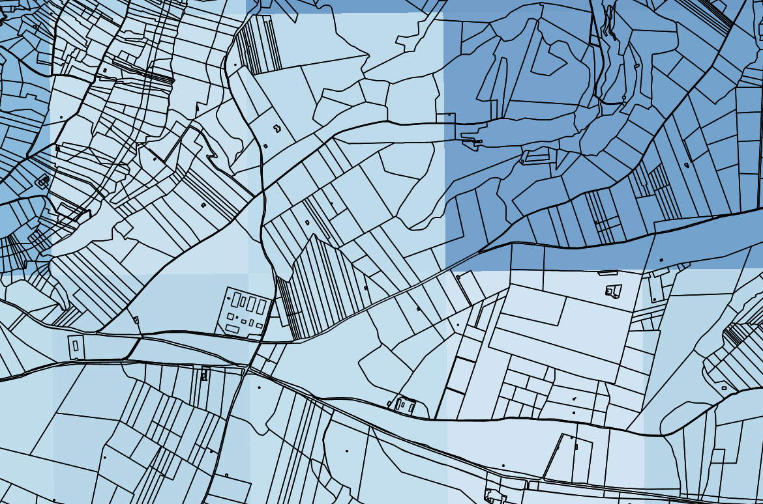
PRECISION FARMING
Rainfall MAPS

Slide 15
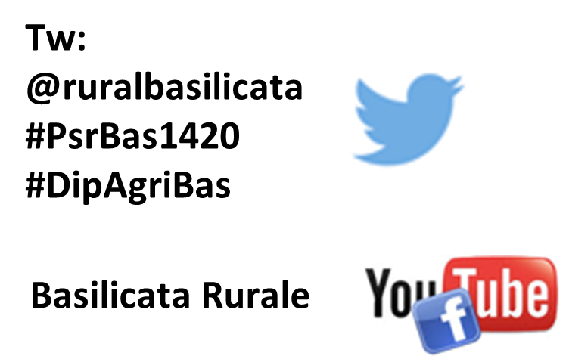
Thank you for your attention
Rocco Vittorio Restaino
Basilicata Region
Agricultural, Food and Forestry Policies Department
Managing Authority for Rural Development Program
vittorio.restaino@regione.basilicata.it
www. basilicatacsr.it

