Slide 1
The Automatic Guide in Precision Agriculture: from Remote Sensing to Prescription Maps in the Bari-Matera 5G Project
UNIVERSITÀ DEGLI STUDI
DELLA BASILICATA
Dr. Costanza Fiorentino and Prof. Paola D’Antonio

Slide 2
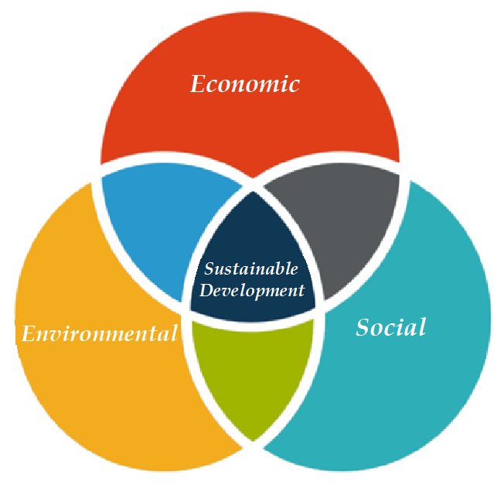
Sustainability is the balance between environmental health, social equity and economic vitality in order to create thriving, healthy, diverse and resilient communities for this generation and generations to come.

Slide 3
Why the digital transition is necessary in agriculture?
The term ''sustainable agriculture'' means an integrated system of plant and animal production practices having a site-specific application that will over the long-term:
Satisfy human food and fiber needs
Enhance environmental quality and the natural resource base upon which the agriculture economy depends
Make the most efficient use of nonrenewable resources and on-farm resources and integrate, where appropriate, natural biological cycles and controls.
Sustain the economic viability of farm operations
Enhance the quality of life for farmers and society as a whole.

Slide 4
Precision Agriculture and Digital Agriculture
UNIVERSITÀ DEGLI STUDI
DELLA BASILICATA

Slide 5
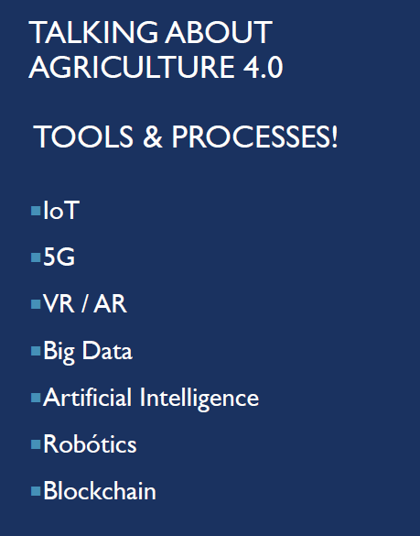
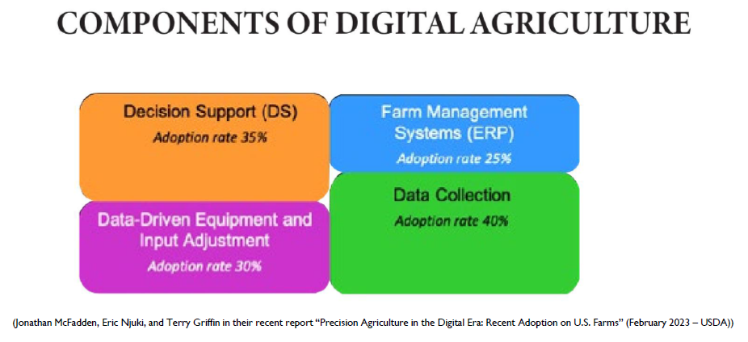
Precision Agriculture and Digital Agriculture
UNIVERSITÀ DEGLI STUDI
DELLA BASILICATA
in Italy we are still far from these results. the most widespread application is the automatic guide, direct seeding.

Slide 6
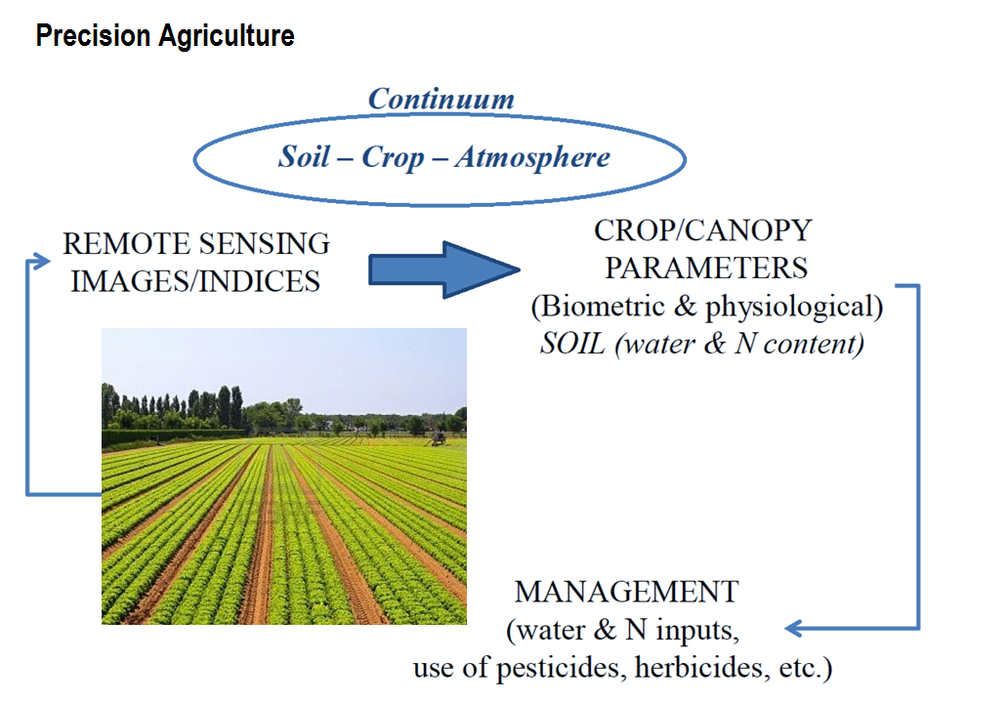
Precision Agriculture
UNIVERSITÀ DEGLI STUDI
DELLA BASILICATA
Notes:
9/28/2023
6
6

Slide 7
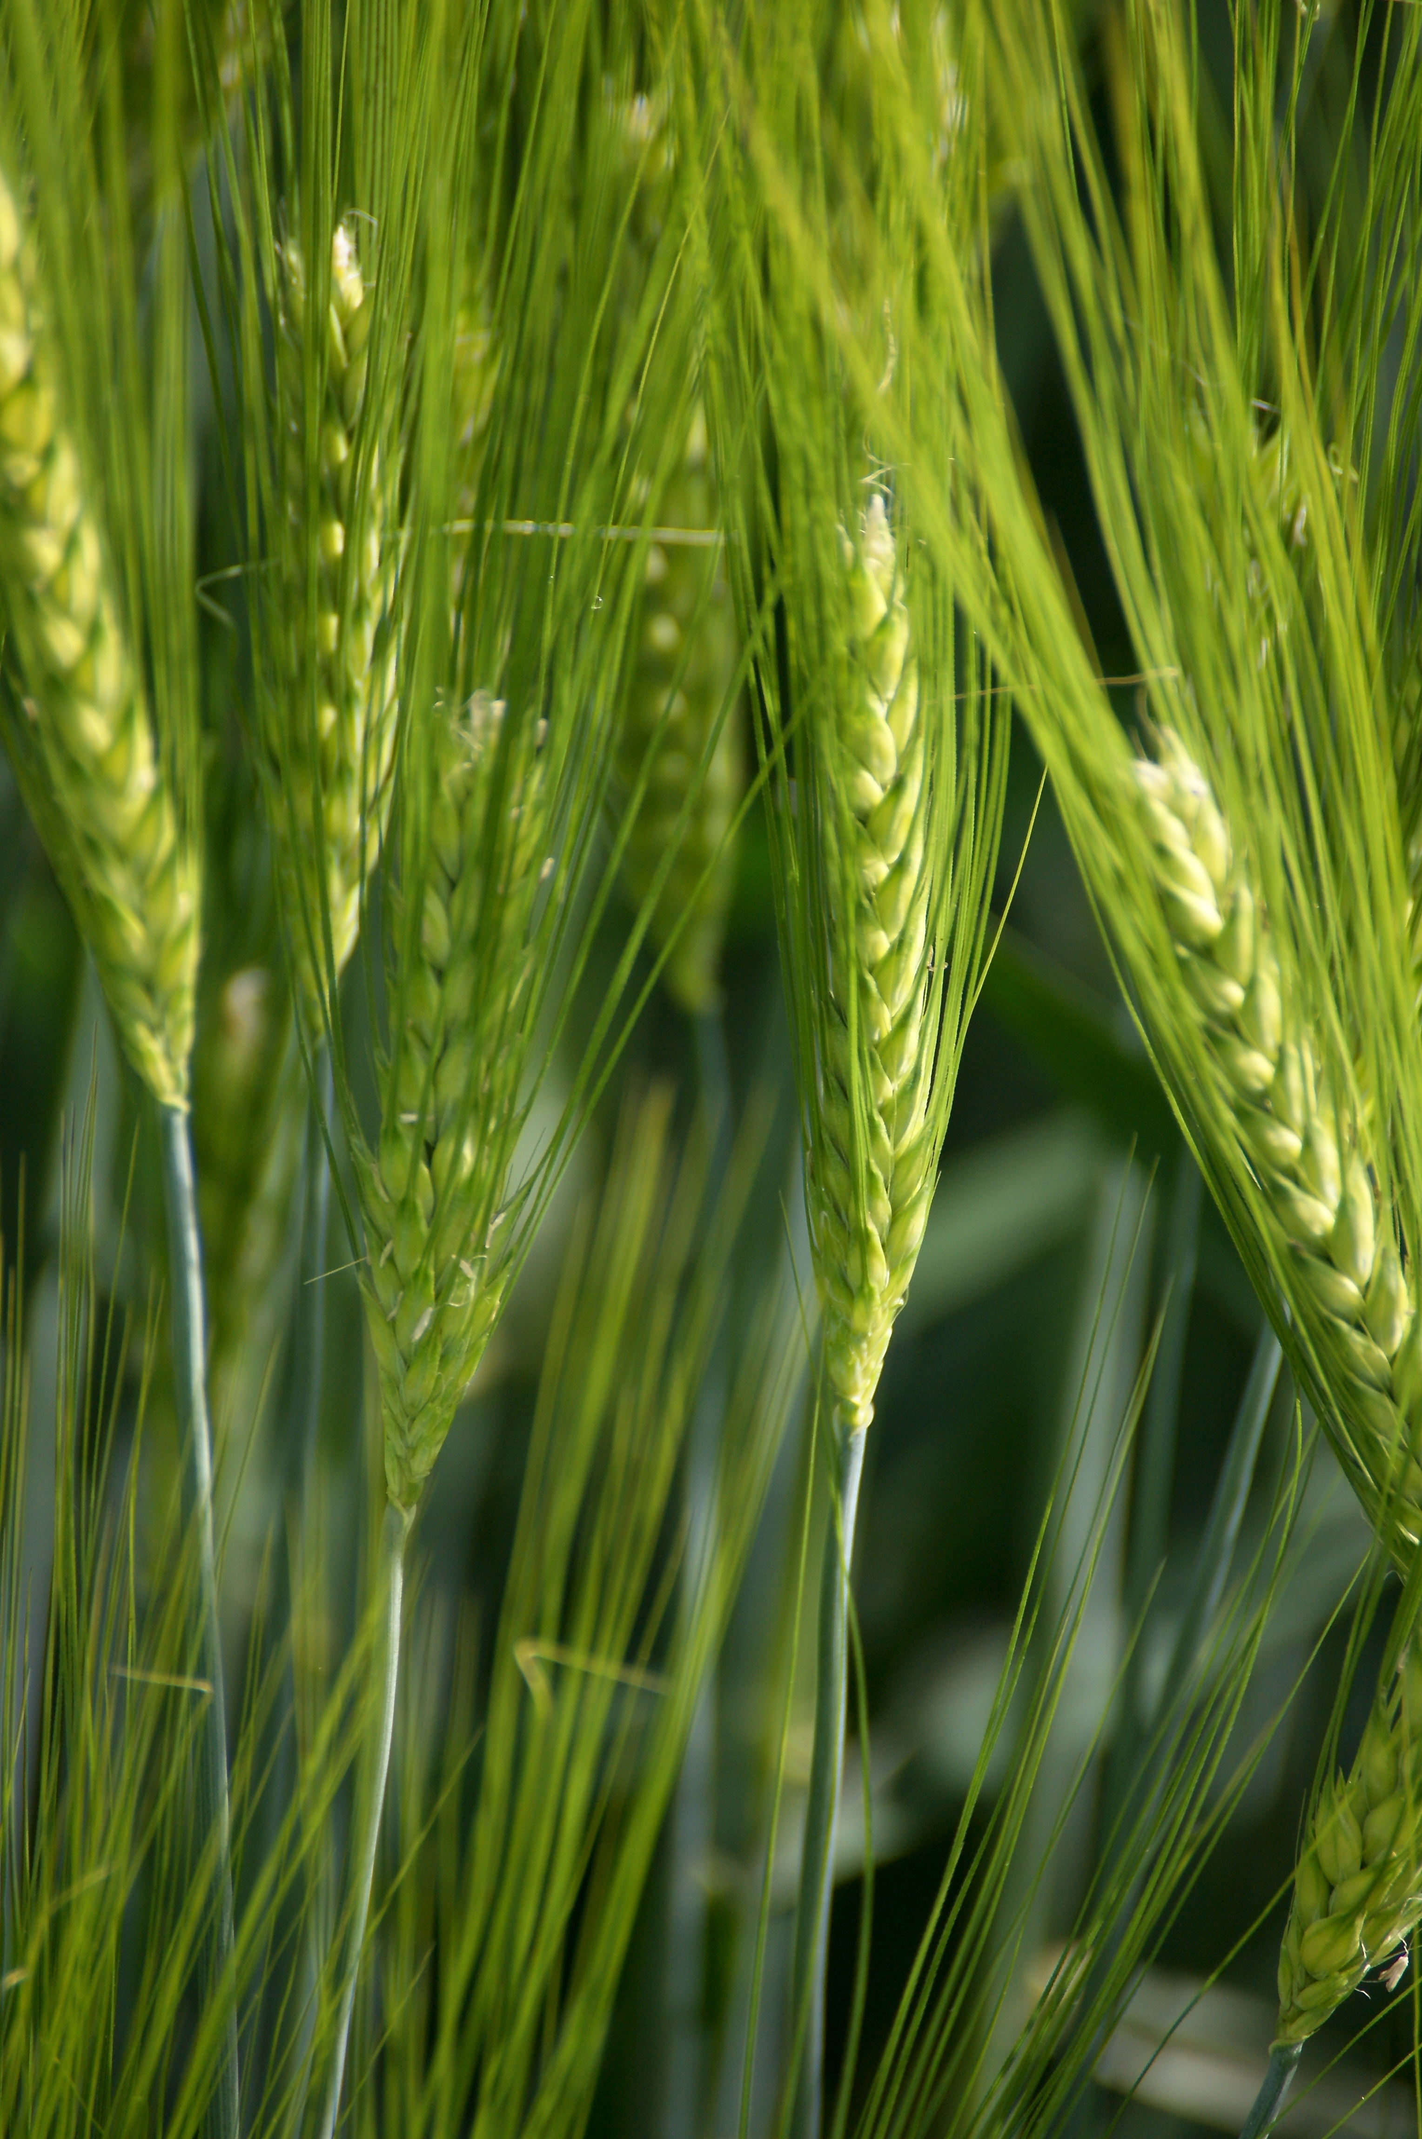
Precision Agriculture
UNIVERSITÀ DEGLI STUDI
DELLA BASILICATA
Remote sensing
(satellites, aircrafts, helicopters, UAV)
Proximal sensing
(towers, vehicles, masts, ground-based handheld, etc.)
Remote sensing images can be used to support
the large scale estimation of
Land use and planting/sowing period
Nutrient deficiencies
Plant diseases
Water deficiency (stress) or surplus
Pests attack (weed infestations, insect damage)
Herbicide damage
Crop development – phenological phases
Evapotranspiration/irrigation, biomass growth and yield
Notes:
9/28/2023
7
7

Slide 8
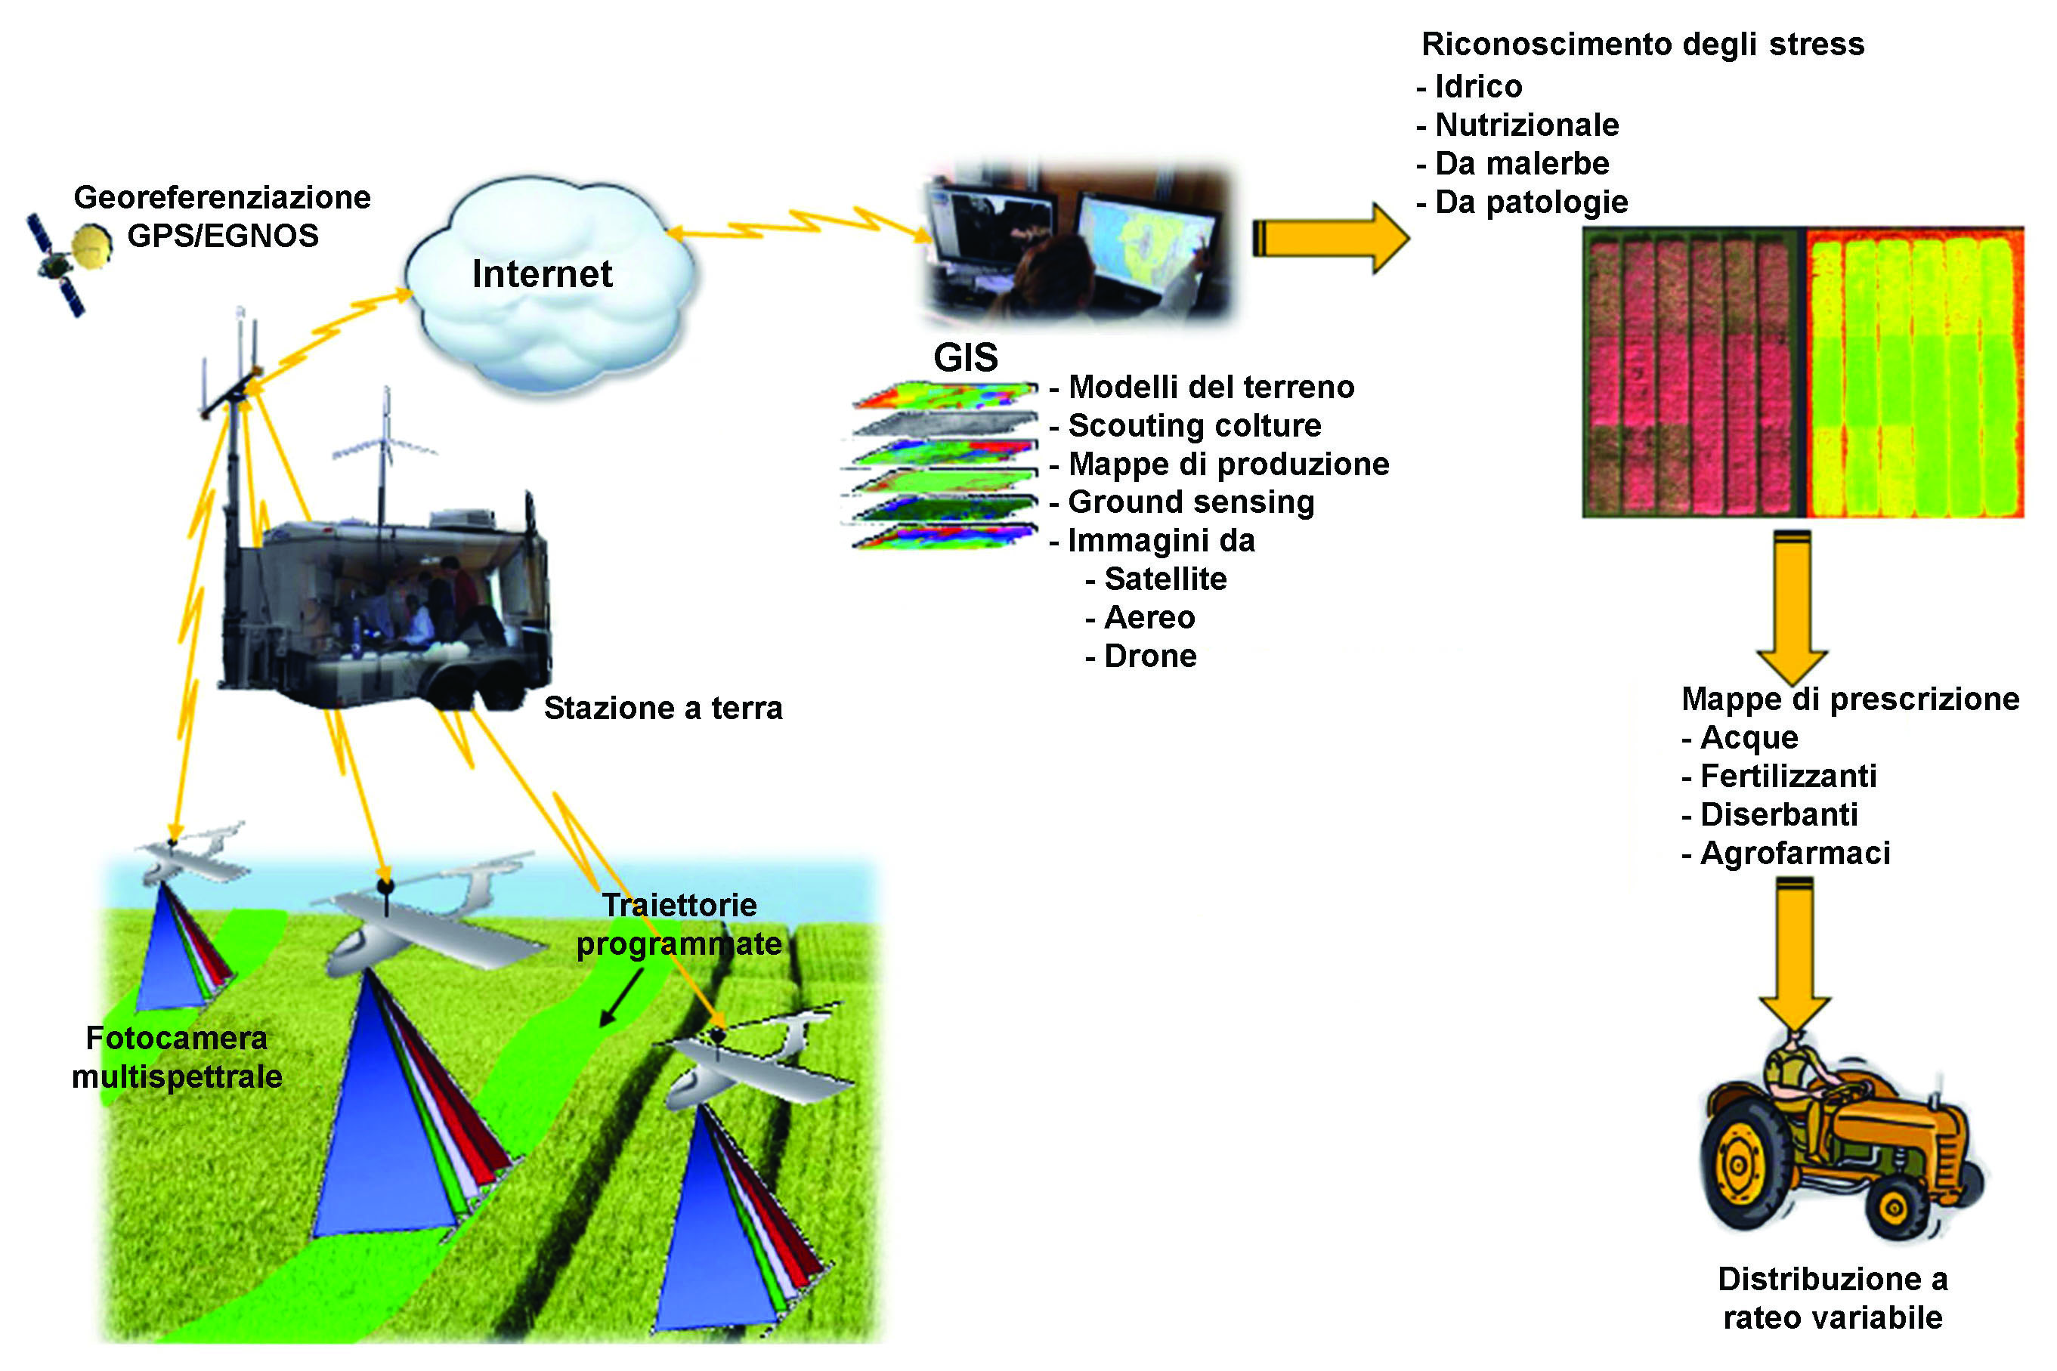
The data management system
UNIVERSITÀ DEGLI STUDI
DELLA BASILICATA
Bari –Matera 5G Project
Georeferenced maps acquired with multispectral cameras
Prescription maps
Tractors and automatic driving
The developed system for data acquisition, processing and application of a prescription map in near real time in the field

Slide 9
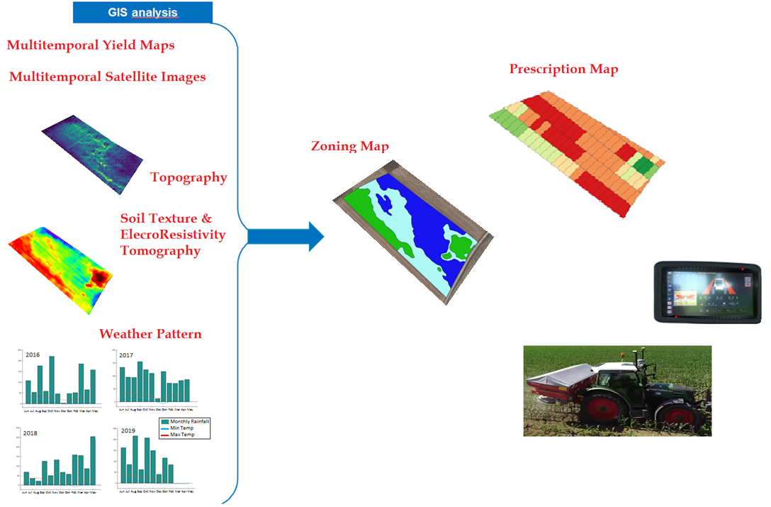
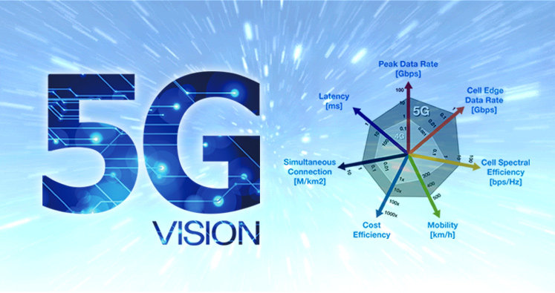
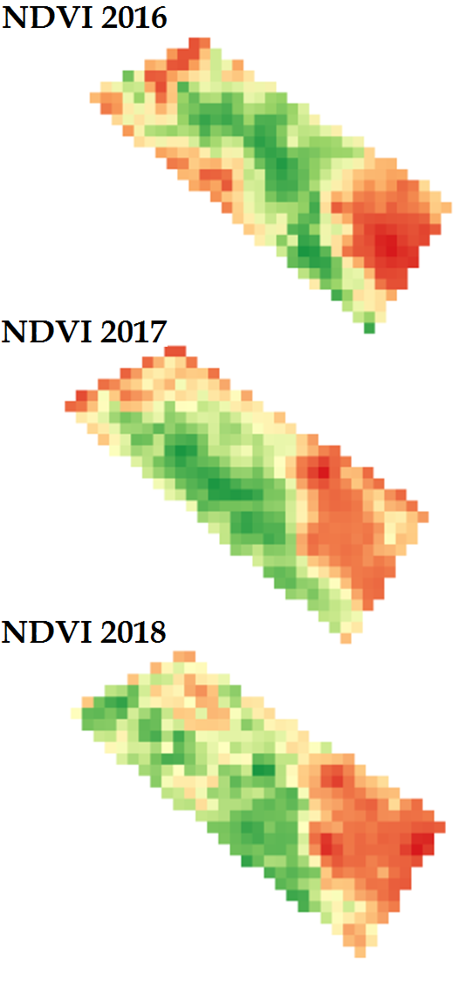
UNIVERSITÀ DEGLI STUDI
DELLA BASILICATA
1. Case Study: Masseria del Parco – Matera (Italy)
Notes:
9/28/2023
9
9

Slide 10
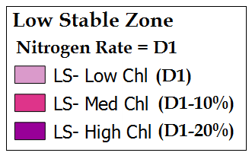
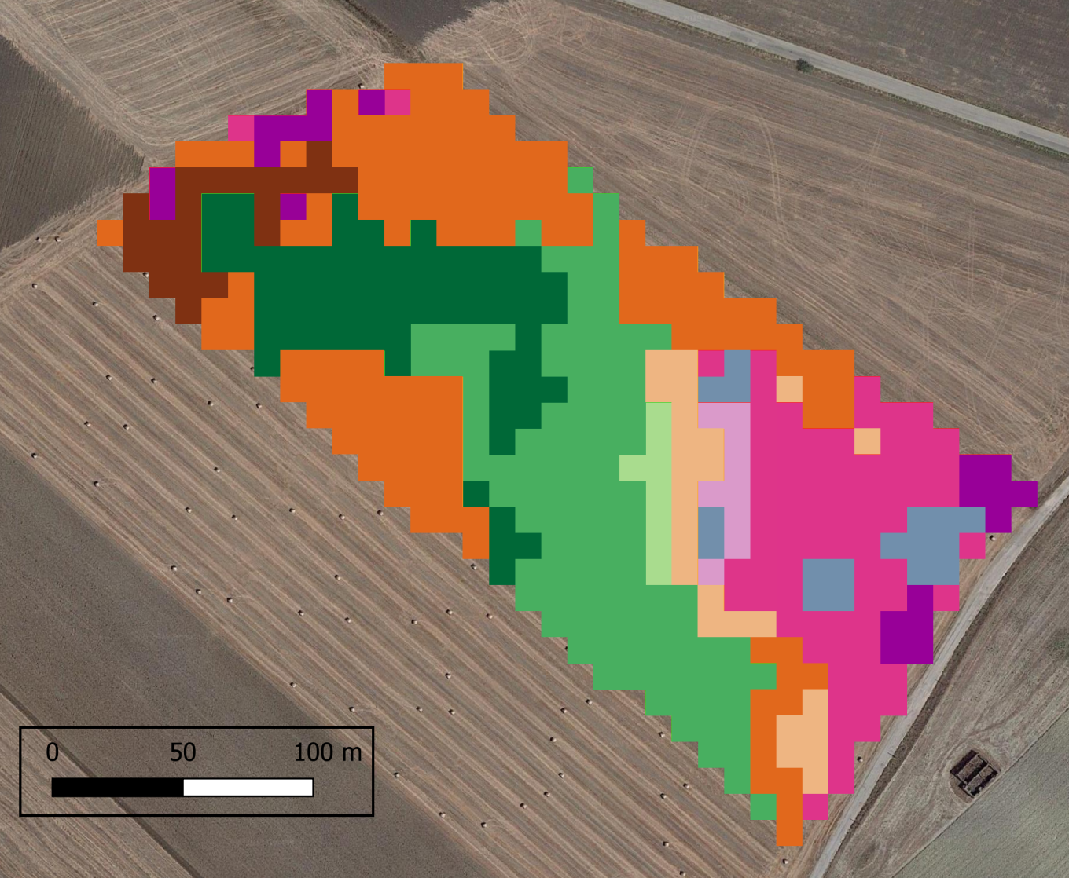
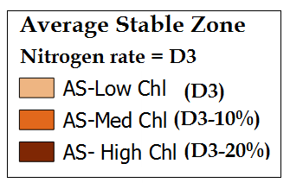
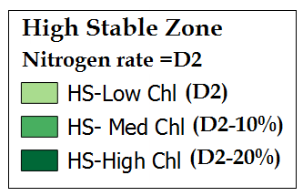
UNIVERSITÀ DEGLI STUDI
DELLA BASILICATA
2. Case Study
UNIVERSITÀ DEGLI STUDI
DELLA BASILICATA
1. Case Study
Cereal Crops
Variable rate fertilization map
Notes:
9/28/2023
10
10

Slide 11
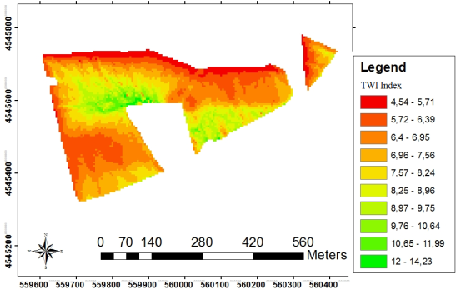
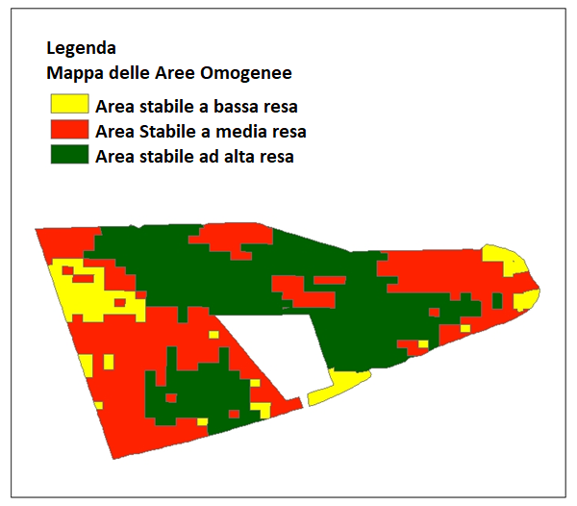
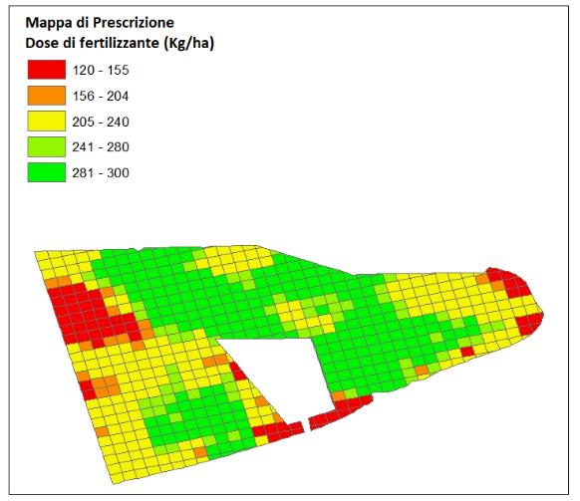
UNIVERSITÀ DEGLI STUDI
DELLA BASILICATA
UNIVERSITÀ DEGLI STUDI
DELLA BASILICATA
2. Case Study: Masseria Lopinto – Melfi (Italy)
Cereal Crops
TWI Index
Prescription Map
Zoning Map
Notes:
9/28/2023
11
11

Slide 12
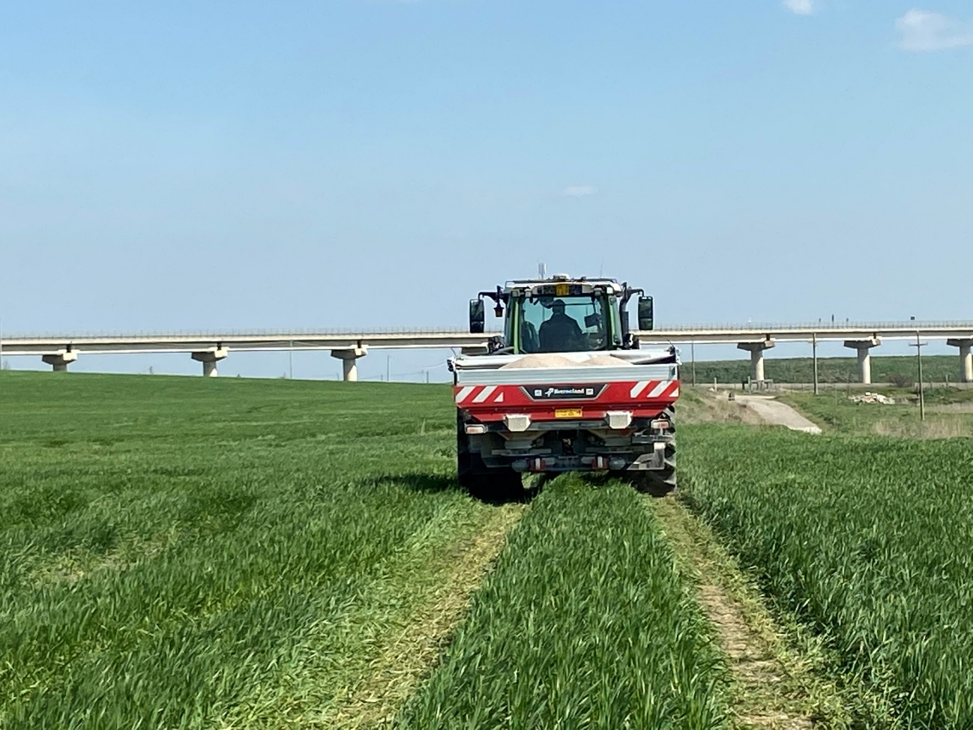
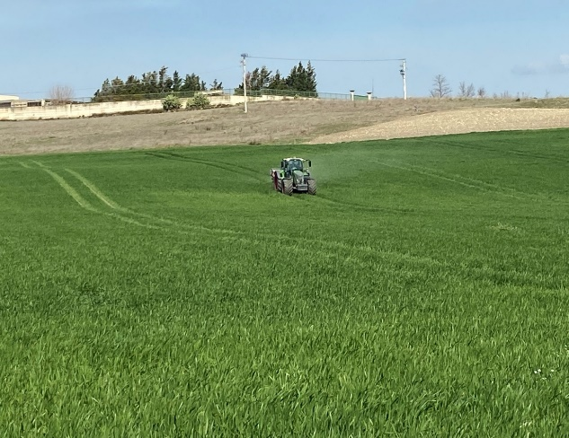
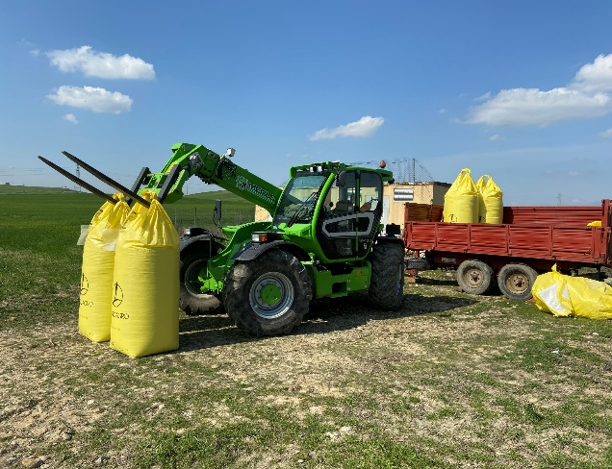
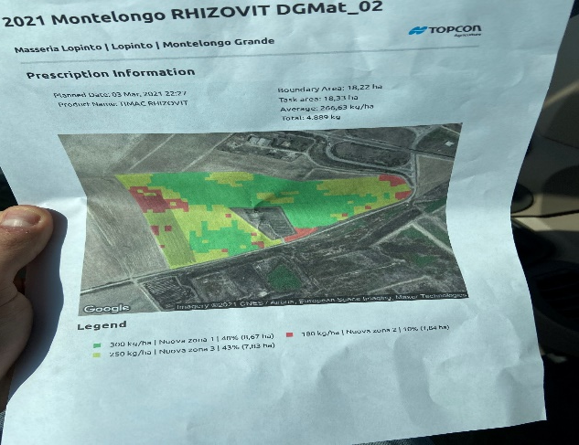
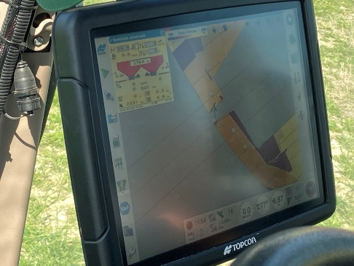
UNIVERSITÀ DEGLI STUDI
DELLA BASILICATA
UNIVERSITÀ DEGLI STUDI
DELLA BASILICATA
2. Case Study
5 March - Fertilization
17 │

Slide 13
UNIVERSITÀ DEGLI STUDI
DELLA BASILICATA
UNIVERSITÀ DEGLI STUDI
DELLA BASILICATA
2. Case Study
Prescription Map
Final Report
300 kg/ha
250 kg/ha
180 kg/ha

Slide 14
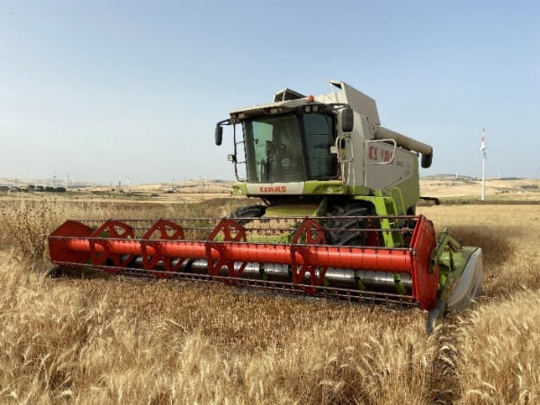
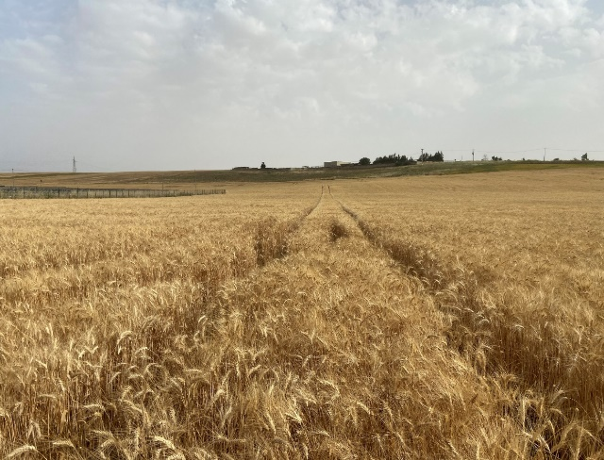
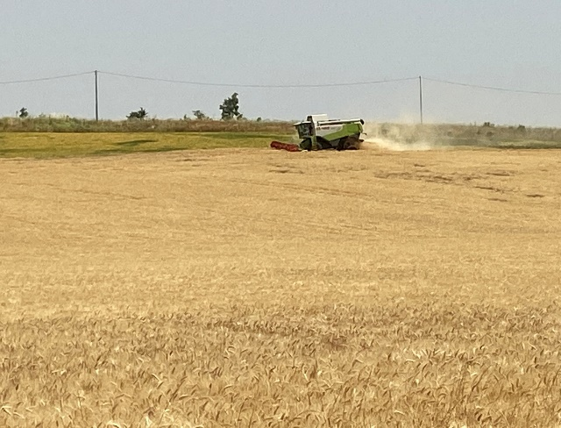
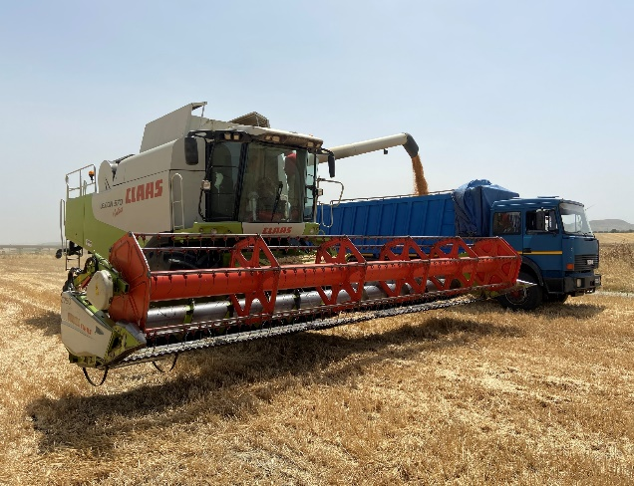
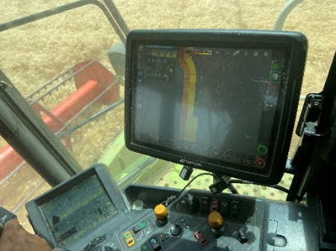
UNIVERSITÀ DEGLI STUDI
DELLA BASILICATA
UNIVERSITÀ DEGLI STUDI
DELLA BASILICATA
UNIVERSITÀ DEGLI STUDI
DELLA BASILICATA
2. Case Study
22 June - Harvest
19 │

Slide 15
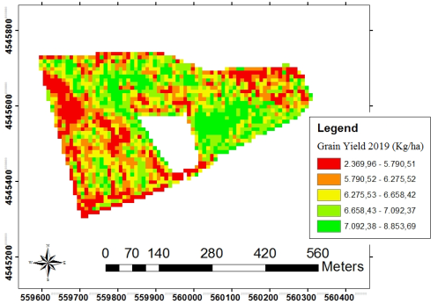
UNIVERSITÀ DEGLI STUDI
DELLA BASILICATA
2. Case Study
Yield map
Notes:
9/28/2023
15
15

Slide 16
UNIVERSITÀ DEGLI STUDI
DELLA BASILICATA
UNIVERSITÀ DEGLI STUDI
DELLA BASILICATA
2. Case Study
Environmental and Economic Advantages

Slide 17
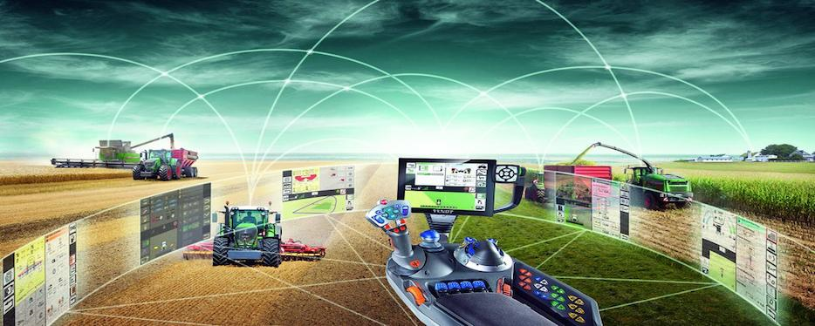
UNIVERSITÀ DEGLI STUDI
DELLA BASILICATA
UNIVERSITÀ DEGLI STUDI
DELLA BASILICATA
Conclusions
Digital agriculture is based on continuous communication between different components The vehicle is traced in real time to know position and operating data
Satellite images support sustainable agriculture, but in particular for the cereal crops where farmers' profit margins are very low, it becomes important to be able to take advantage of free data and low cost systems if we want to encourage the sustainable management of farm

Slide 18
UNIVERSITÀ DEGLI STUDI
DELLA BASILICATA

