Slide 1
PROTECT - Preparing a Pre-Commercial PROcurement for end-user services based on environmenTal obsErvation in the area of Climate change adapTation and mitigation ​
Ioana-Simona Rosca
Aerospace Valley

Slide 2
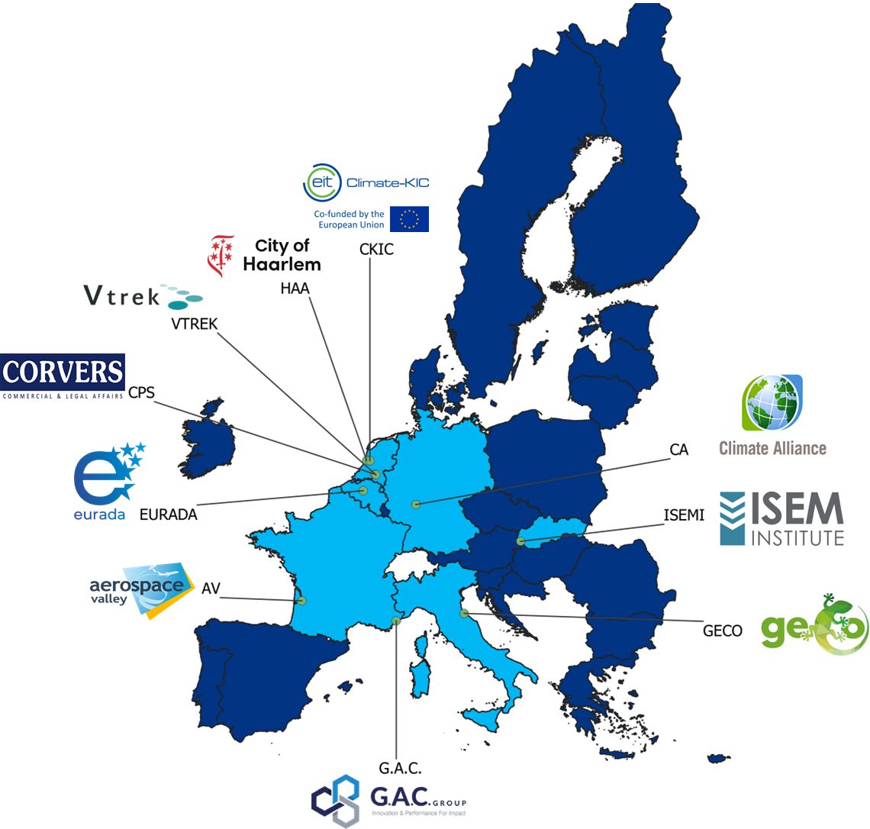
PROTECT ID Card
PROTECT is a project funded by the European Commission in the framework of the HORIZON EUROPE programme under Grant Agreement Number 101060592.
Call info: Link
PROTECT is coordinated by G.A.C Group
10 European partners
Budget 2M€
Start: 1st of June 2022
End: 31st of May 2024 (24 months)

Slide 3
PROTECT in a nutshell : five thematic priorities
PROTECT’s mission is to prepare and equip a community of public authorities/ buyers to undertake one or more joint, cross border or coordinated Pre-Commercial Procurement(s) processes in order to steer the development of the next generation of climate services based on Earth Observation data.
By taking part in PROTECT activities, public authorities/ buyers will be strategically positioned for an upcoming Horizon PCP call expected to be launched in fall 2024 with a funding amount of up to EUR 19 million: (HORIZON-CL6-2024-GOVERNANCE-01-5: Customisation/pre-operationalisation of prototypes end-user services in the area Climate Change Adaptation and Mitigation)
Through PROTECT, public authorities/ buyers facing similar pressing challenges related to climate change will be connected and supported in the formulation of concrete and realistic needs for EO-based climate services applicable to 5 selected domains that can be the subject of future PCP or PPI.
Civil security & protection
Sustainable urban communities
Agriculture, Forestry and other land use
Civil security & protection
Energy & Utilities
Sustainable urban communities
Agriculture, Forestry and other land use
Marine and coastal environments
Energy & Utilities
Marine and coastal environments
PROTECT contributes to achieving 10 of the 17 UN Sustainable Development Goals

Slide 4
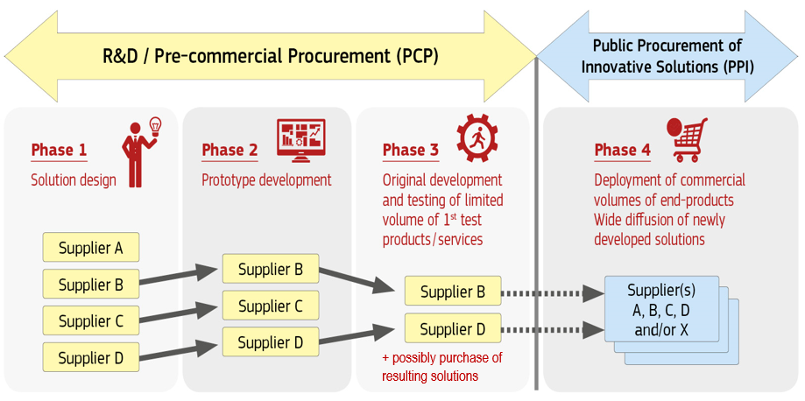
What is Innovation Procurement?
Innovation Procurement happens when public buyers acquire the development or deployment of pioneering innovative solutions to address specific mid-to-long term public sector needs.
PCP falls outside WTO GPA and EU public procurement directives (COM(2007)799 & SEC(2007)1668)

Slide 5
Definition and features of Pre-Commercial Procurement (PCP)
Definition:
Action whose primary objective is to carry out pre-market public purchases implemented by beneficiaries who are contracting authorities or contracting entities.
Groups of buyers together implement 1 common purchase:
R&D is needed to identify an innovative solution to satisfy public procurers’ needs.​
No solutions exist yet on the market that meet public procurers’ needs and, based on a search conducted by the procurers, it does not seem that such a solution will be available on a short-term notice.​

Slide 6
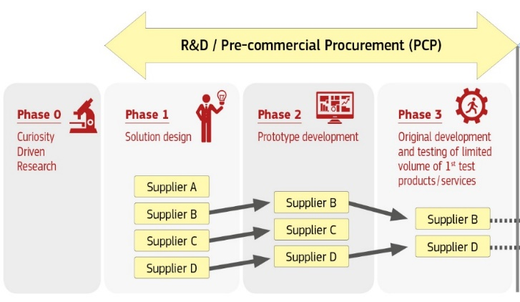
Definition and features of Pre-Commercial Procurement (PCP)
PCP is a public procurement of R&D services characterized by:
competitive development in phases
risk-benefit sharing under market conditions
a clear separation between the procurement of the R&D from the deployment of commercial volumes of end-products
Second PCP
PROTECT

Slide 7
PROTECT specific objectives
1
2
3
4
5
6
Community knowledge and capacity building
Needs identification and aggregation
Overall reduction of public demand fragmentation
Awareness raising on specific topics
Leverage additional investment
Peer to peer exchange
Create and continuously grow a community of climate services procurers and secure their engagement the future PCP
Identification, aggregation and formulation of concrete and realistic needs of in the area of climate change adaption and mitigation
Reduced fragmentation of public sector demand via networks of procurers capable of collectively implementing PCPs
Leverage of additional investment in research and innovation in the domain of environmental observation and the Copernicus Climate Change Service
Increased exchange
of experience in procurement practices and strategies - trainings, information exchange tools - in the specific area of climate services
Increased awareness in the area of relevant standards, certification and GEO data sharing principles

Slide 8
PROTECT key stakeholders
Procurers from national, regional and local public authorities and other procuring organisations from the EU 27 Member States and EEA countries & possibly private procurers
Climate services providers and specifically SMES, start-ups, and developers with ideas for innovative or disruptive climate services using EO that can help adapt and mitigate the effects of climate change
Multipliers & stakeholder associations facilitating the development of climate services through the provision and use of EO data (e.g., EARSC, NEREUS, EURISY, BUILD, PROCEDIN, FIRE Forum, e-shape, Climate Europe2, Harmonia, etc.)

Slide 9
Key thematic areas
As per the EC definition, Innovation procurement encompasses:
Pre-Commercial Procurement
Public Procurement of Innovation
Innovation Partnerships
Innovation procurement
PROTECT
PROTECT shall steer the development of solutions and services in the area of both Climate change Adaptation and Climate Change mitigation
PROTECT looks at three EO data collection modalities:
Space-based observation
In situ observation
Citizens’ observation
Earth Observation
Climate action

Slide 10
Key achievements so far (M12)
Identificationn of challenges and enabling frameworks for PCP & preliminary needs for EO climate services
Building PROTECT’s visibility and connecting with key stakeholders
Survey Link
Taxonomy of climate services
Jun 22 - Jun 24
Sep 22 - Mar 23
68 members already !
Smart City Expo World Congress
200+ providers identified
Jun 22 - ongoing
Building the PROTECT Community of public authorities/ procurers
Conference on 17 Nov 2022,
Barcelona
Mapping of EO climate service providers
Survey Link

Slide 11
PCP Call
The Pre-Commercial Procurement (PCP) call has been officially published by the European Commission on the Funding and Tenders Portal. Available here.
The goal of the PROTECT project is to support the preparation of future candidate applications to a Horizon Europe Pre-Commercial Procurement call by working both with the demand (public buyers) and supply side (providers) of Earth Observation (EO)-based climate services.
Visit the PROTECT website and get involved.
19M EUR fully funded Horizon Europe
Open on 17 October 2023
Close on 28 February 2024 at 17:00 CET.
Info days about CLUSTER 6 funding calls, on the 27th and 28th of September
Brokerage event on the 26th of September

Slide 12
PROTECT 4 Challenges
FLOODS CHALLENGE: rapid-mapping, predicting, preventing different types of floods and improving coordination efforts, relevant to marine and coastal environments, sustainable cities and civil protection and security agencies.
FIRES CHALLENGE: predicting, preventing fires, tracking and tracing causality (causers) in different scenarios (waste, forest/nature, other), relevant to environmental agencies, sustainable cities, agriculture, forestry and land use, as well as for civil protection and security agencies.
WATER CHALLENGE: climate resilient solutions for predicting, connecting data, planning, supply-demand, relevant to the application domains marine and coastal environments, energy and utilities, sustainable cities, agriculture, forestry and land use, as well as for civil protection and security agencies.
INFRASTRUCTURE CHALLENGE: sustainable and resilient re-development, buildings restoring & adaptation), relevant to sustainable cities, energy and utilities and civil protection and security agencies.

Slide 13
How to get involved?
PROTECT brings together a community of procurers , other practitioners from public authorities, as well companies and provides them with key information, knowledge, and support on innovation procurement approaches for climate change services based on Earth Observation (EO) data.
Sign up for the Community Platform to get access to its ever-expanding Knowledge Hub on Innovation Procurement, Climate Services and Earth Observation (EO) data, get invited to all PROTECT webinars, and stay up to date through our newsletter.
Join a PROTECT Buyer Group for specific challenges starting September 4, Buyer Groups will kick off, each targeting one of the identified and selected common challenges.
Apply for free on-demand consulting services
Complete this solution description form HERE before 15th of September 2023 at 11:00 CET
Access to the relevant material and documentation to best prepare for the PCP call , please visit: https://www.protect-pcp.eu/relevant-resources/
Notes:
Being part of the PROTECT Community will help you get prepared, equipped and ready to tackle the climate change risks and challenges your organisation faces.
Predicting FLOODS
Climate resilient WATER solutions
Prediction & prevention of FIRES
Sustainable & resilient infrastructures and neighbourhoods in urban and rural areas
Apply for free on-demand consulting services
We are delighted to offer you the possibility to apply for on-demand consultancy services to your organisation’s innovation procurement project or need regarding climate change adaptation and mitigation.
If you currently face challenges and needs for climate services and are interested in becoming one of the PROTECT pilot projects, you can apply to receive free on-demand consulting services through the link to the online form below.
Note: public buyers are allowed to both join one or more Buyer Group(s) and at the same time apply for free on-demand consultancy services to their own project.
In case of any questions, you can contact: info-PROTECT@group-gac.com

Slide 14
Upcoming activities
Pain point workshops with procurers’ to finetune challenges and needs and PCP use cases
Events participation and synergies with other projects
Open Market Consultations with EO climate services providers
Sep – Oct 23
Jun – Nov 23
Nov 23 - May 24
Sep 23
Training webinars with the PROTECT Community
Ongoing
E-pitching sessions with EO climate service providers
Dec 23 – Feb 24
Securing public buyers’ engagement and preparing the PCP Call

Slide 15
Pain Point Workshops
To register for the workshops click here: PROTECT PAIN POINT WORKSHOPS Tickets, Multiple Dates | Eventbrite.

Slide 16
E-pitching Sessions
To register for the e-pitching sessions, please visit this Eventbrite page: https://www.eventbrite.com/e/e-pitching-sessions-tickets-695922251187?aff=oddtdtcreator

Slide 17
Training Webinars

Slide 18
Open Market Consultations
Four virtual open market consultations will be organised on November 15th and 16th, each focusing on one of the four selected climate adaptation & mitigation challenges identified by public buyers of the PROTECT Community as a pressing issue for which no market solution has been identified yet.
Parties interested in participating in the OMC activities are requested to register here: https://www.eventbrite.co.uk/e/the-protect-open-market-consultations-omc-tickets-727504815487?aff=oddtdtcreator

Slide 19
Contact
Ioana-Simona Rosca
European Space and Climate Project Manager
www.protect-pcp.eu
rosca@aerospace-valley.com
EU PROTECT
info-protect@group-gac.com
EU_PROTECT
@protectpcp

