Slide 1
European Regional Symposium
September 28 – 29 | 2023 Matera, Basilicata Region | Italy
Second Edition of the European Regional Symposium, on space data for tourism & agriculture, by NEREUS Regions
Agrifood systems in the new climate trend.
Earth Observation products, combined with Climate data and Climate scenarios, can support the adaptation of the agrifood sector to the future climate conditions by anticipating climate trends and by suggesting proper Agritech solutions to improve the climate resilience.

Slide 2
The space-based solution
TOPICS
We Create Data Spaces Connecting EO Data Providers With Geo Information Products Users
GEO DATA BROKERING
THEMATIC DOMAINS
Discovery
Standardization
Air Quality
Super
Resolution
Catalogue
Visualization
Agriculture
Training
Interoperability
Access
Climate Risk
Dissemination

Slide 3
The space-based solution
Agrifood systems in the new climate trend.
Abandoned fields
Farming advisory
Pests risk assessment
Drought warning
Time series, change detection and data fusion of Sentinel1 and Sentinel 2
Time series, change detection, data fusion and climate data modelling
Combination of precipitation and vegetation indexes

Slide 4
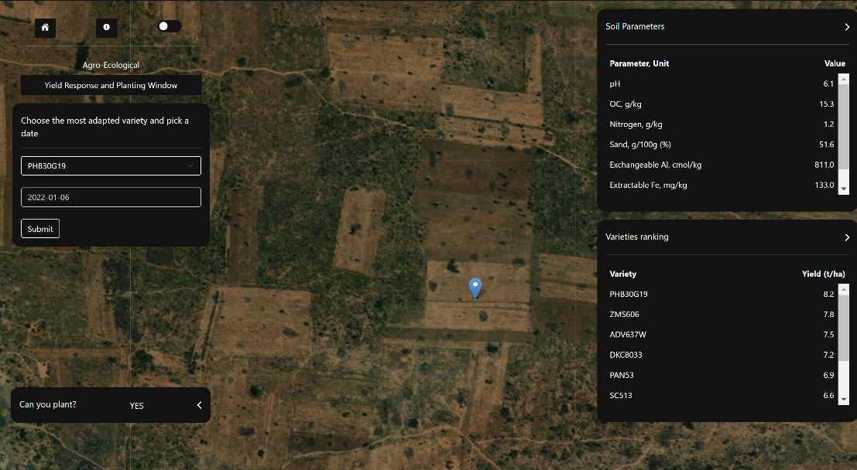
Challenges at regional and local level
Agriculture advisory services
Scope: support farmers and FAO staff on crop management activites
Problem: to provide on a point basis the following features:
The soil chemical parameters
The most productive maize variety
The optimal planting date
Solution: use of ground, satellite and weather forecast data and provide a very simplified tool (web / mobile app)

Slide 5
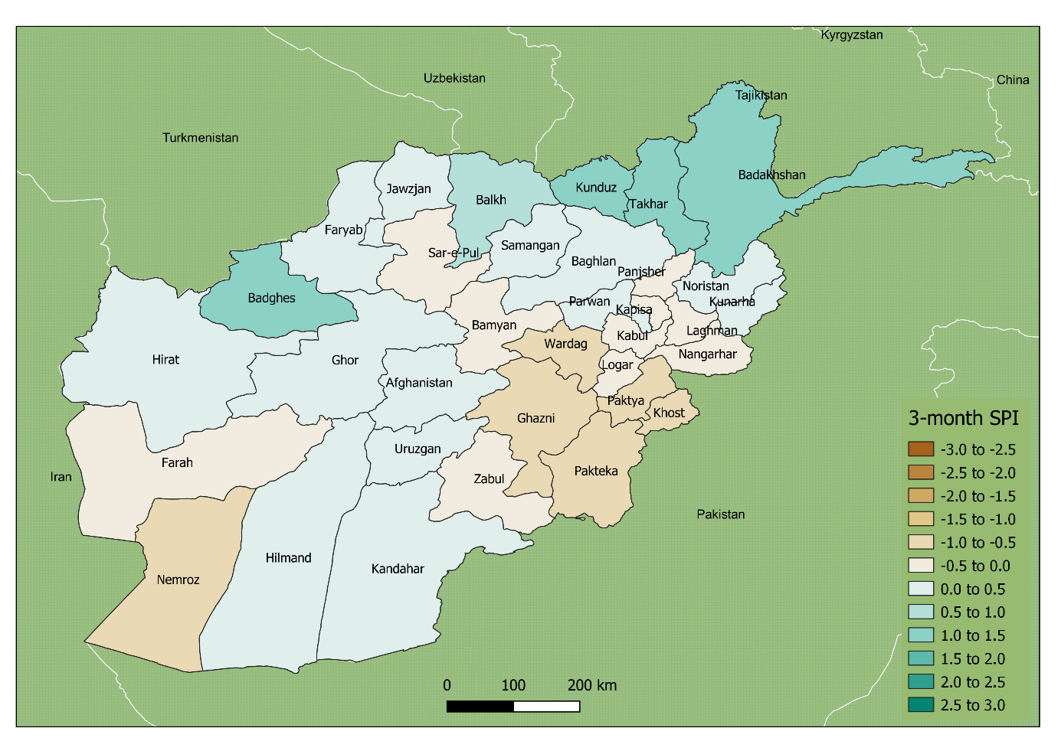
Challenges at regional and local level
Drought risk assessment
Scope: identify meteorological and agricultural drought risks
Problem: to collect past and near real time information about
Vegetation tenure
Water availability (precipitation, soil moisture)
Solution: use of satellite-retrieved products to compute monthly-based Vegetation Condition Index and Standardised Precipitation Index to assess drought risk on a seasonal basis

Slide 6
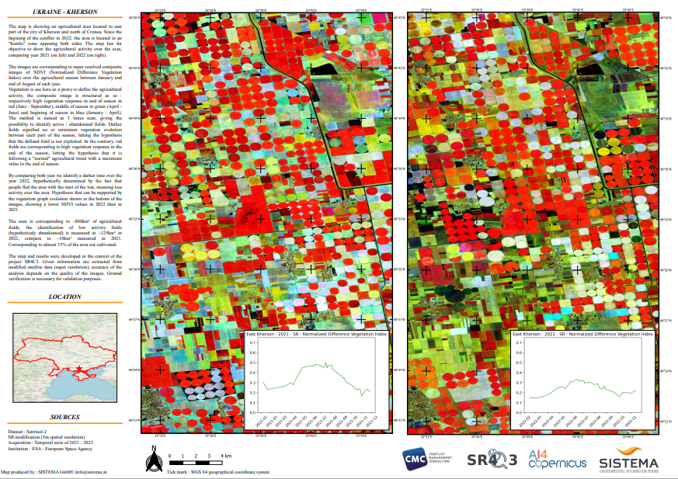
Challenges at regional and local level
Abandoned Fields

Slide 7
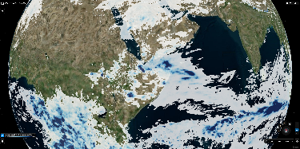
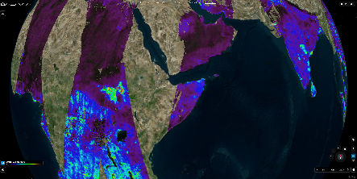
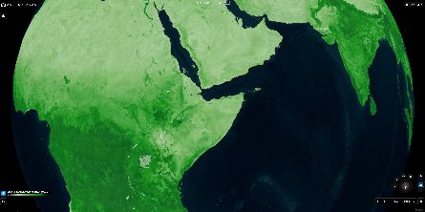
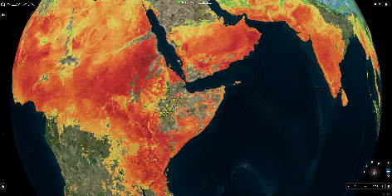
Challenges at regional and local level
Pest Risk Assessment
Precipitation
Hoppers monitoring
Soil Moisture
Suitable ecosystem identification
Vegetation
Occurence estimation
Next breeding location
Temperature
Forecast (max 10 days)
Seasonal (~ 6 months)
Projections (yearly, scenarios)

Slide 8
What is the added value?
The Agrifood domain can take advantage of :
Integration of Earth Observation and Climate data into environmental services
Advanced climate data services
Support in the digital transformation of the processes

Slide 9
What are the benefits to citizens and the region, now and in the future?
Benefits:
Short-terms Benefits from agricultural advisory and prediction services to facilitate and improve the production and to support the climate adaptation of this economic sector
Long terms Benefits from combination of climate scenarios and economical and environmental sustainability of crop productions to anticipate the long terms climate changes and their impact into the agricultural sector.
Risks:
Late adoption of the technological innovations provided by Earth Observation technology
Conclusions:
The implementation of innovative solutions needs collaborative approaches. Providers of innovative services need the support and the collaboration of informed users.

Slide 10
Thank you
Marco Folegani
MEEO folegani@meeo.it

