Slide 1
European Regional Symposium
September 28 – 29 | 2023 Matera, Basilicata Region | Italy
Second Edition of the European Regional Symposium, on space data for tourism & agriculture, by NEREUS Regions

Slide 2
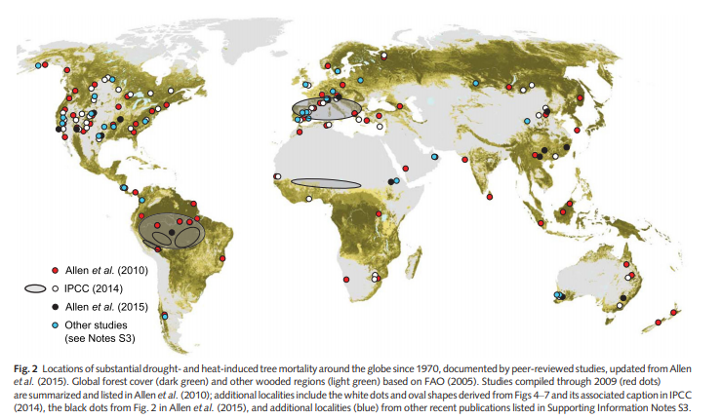
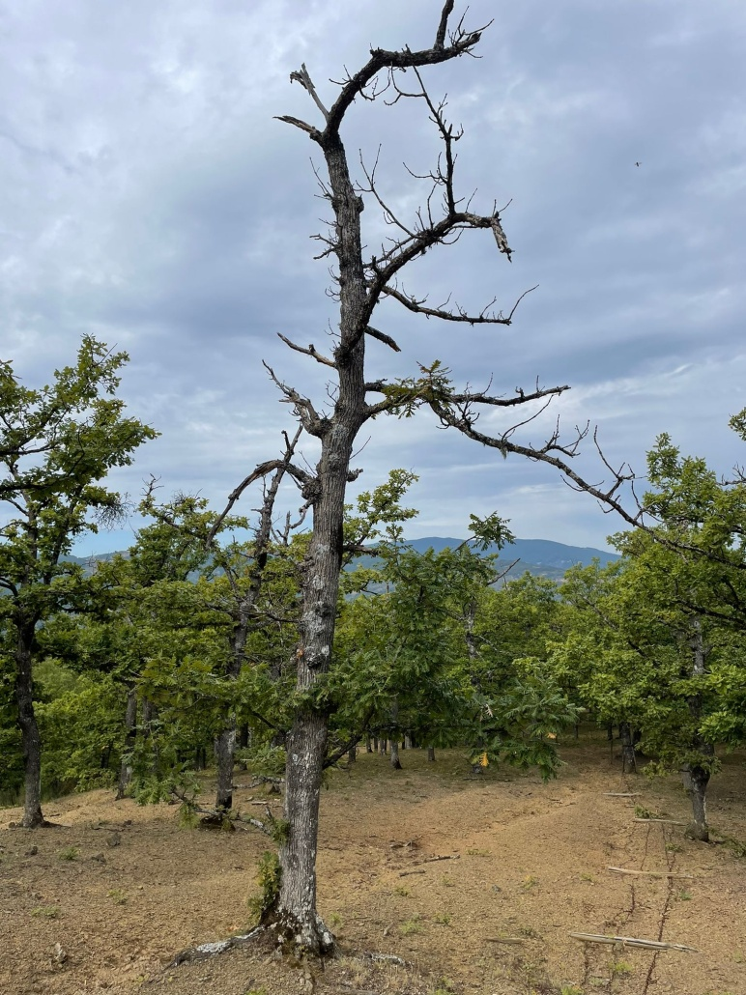
The space-based solution
Forest die-off episodes and tree mortality phenomena have been broadly reported across all biomes
Here's what we're all about
Assessing and monitoring the forest vulnerability and its capacity to recover after experiencing extreme climate events, through combined approaches :
ground-based and satellite data
phenotypic and genomic information
Agritech National Project - Task 7.1.2 by University of Basilicata "Forest Resilience to Climate Change: deciduous oak forests under climatic stress in marginal and protected areas"

Slide 3
Vegetation phenology
Impacts on spring and autumn phenology
Strongly sensitive to climate change
Key factor influencing forest growth and productivity
Implications
Species distribution and competition
Forest ecosystem performance
Canopy cover dynamics in dieback affected oak forests captured by phenological behavior
Castellaneta M. *, Rita A., Borghetti M., Ciancia E., Masiello G., Saracino A., Ripullone F.

Slide 4
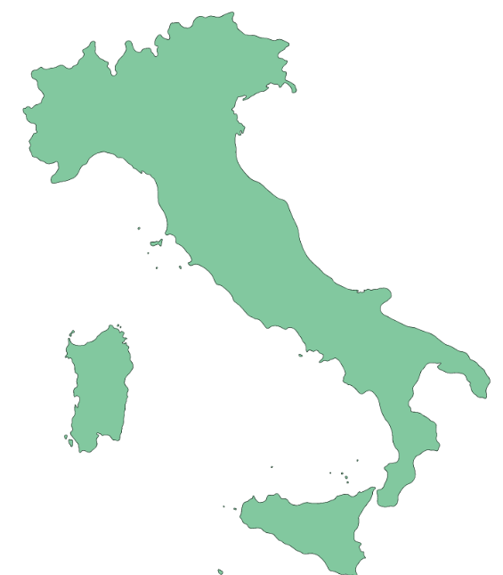
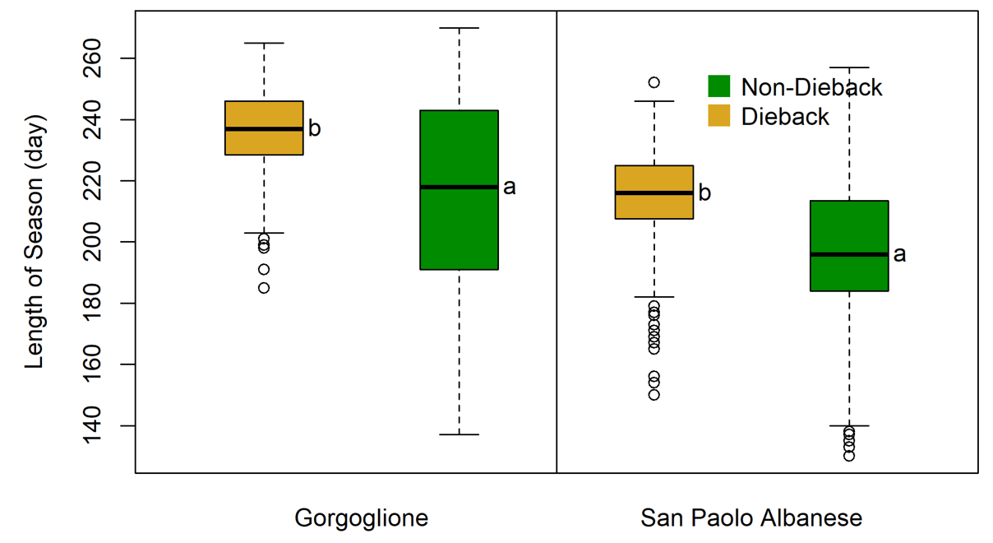
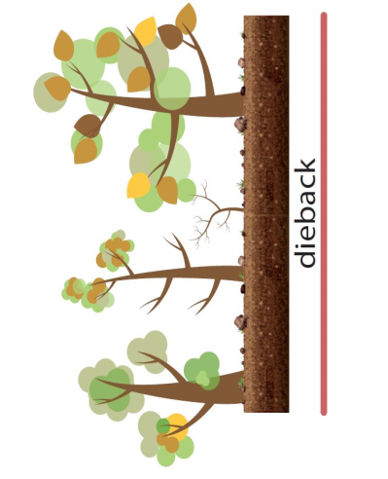
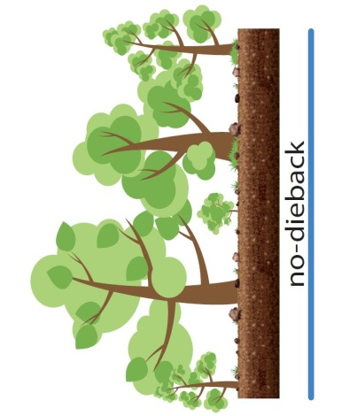
Copernicus Land Monitoring Service (CLMS)
HR-VPP product
Set of 13 Vegetation Phenology and Productivity parameters
Trees, showing clear symptoms of decline, may keep their vital activities by changing their phenological performance
Dieback
Non-Dieback

Slide 5
Potential implications of phenological shifts on the global carbon and water balance of terrestrial ecosystems under future climate change
The structure and functions of many forests would likely be affected, thus modifying their capability to provide ecosystem services
Report
SilvaCuore App
It is crucial to knowledge the localization of vulnerable forest areas
Report
new tool to detect declining forest sites in Italy
Citizen Science project

Slide 6
Thank you
Maria Castellaneta, post-doc
School of Agricultural, Forestry, Food and Environmental Sciences
University of Basilicata
maria.castellaneta@unibas.it
silvacuore.web.app/menu/home
www.silvacuore.org
safeoaks.unibas.it

