Slide 1
European Regional Symposium
September 28 – 29 | 2023 Matera, Basilicata Region | Italy
Second Edition of the European Regional Symposium, on space data for tourism & agriculture, by NEREUS Regions

Slide 2
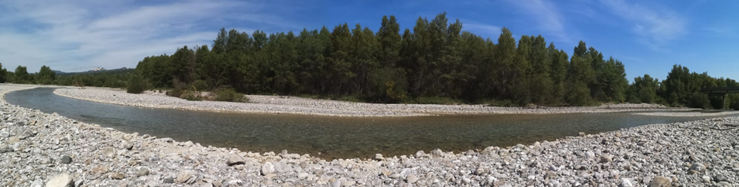
Temporal and spatial patterns assessment of riparian vegetation cover in the Mediterranean region
using Landsat spectral metrics
Nolè A., Castronuovo R., Borghetti M.
University of Basilicata
SAFE - School of Agricultural, Forest, Food and Environmental Sciences
Prof. Angelo Nolè
angelo.nole@unibas.it

Slide 3
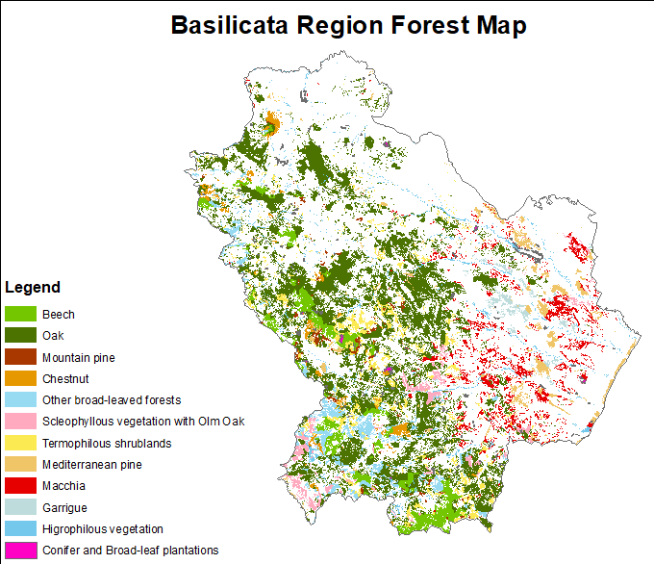
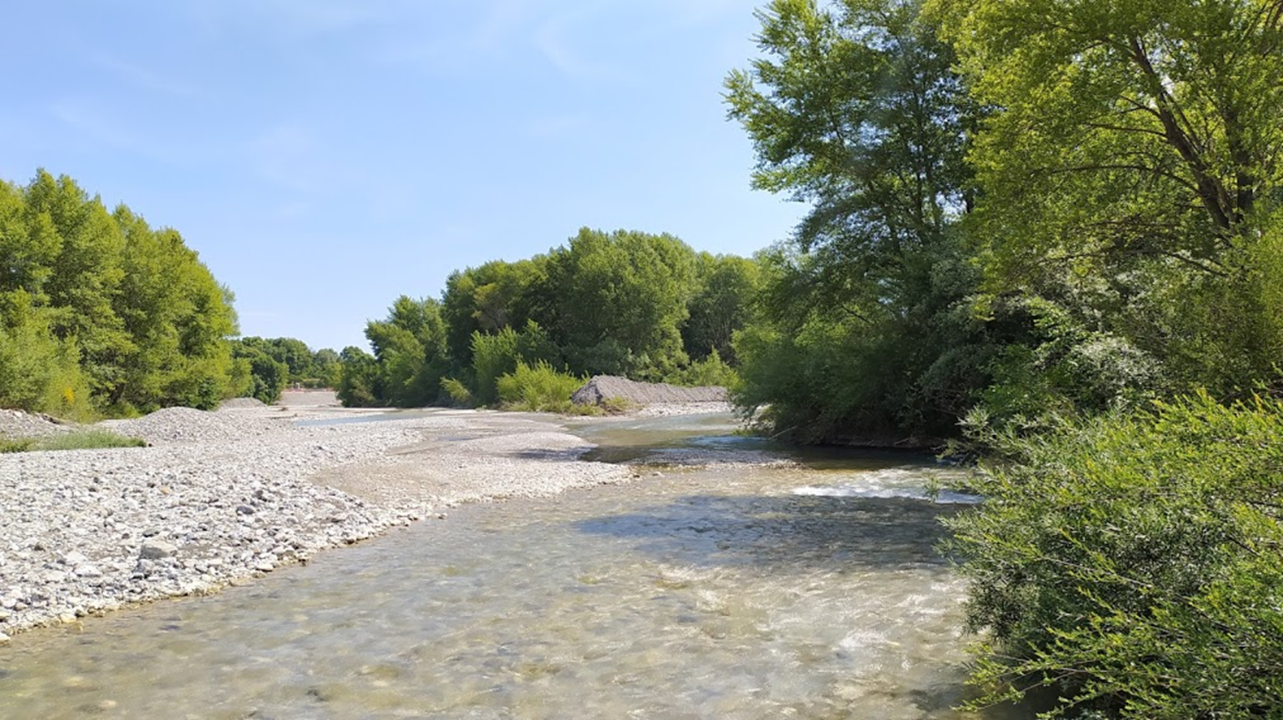
Riparian areas ≈ 7% of regional forest cover
Priority habitat
Key role in biodiversity conservation (EU Biodiversity Strategy for 2030)
Mitigation of hydrogeological risk and climate chenge impacts

Slide 4
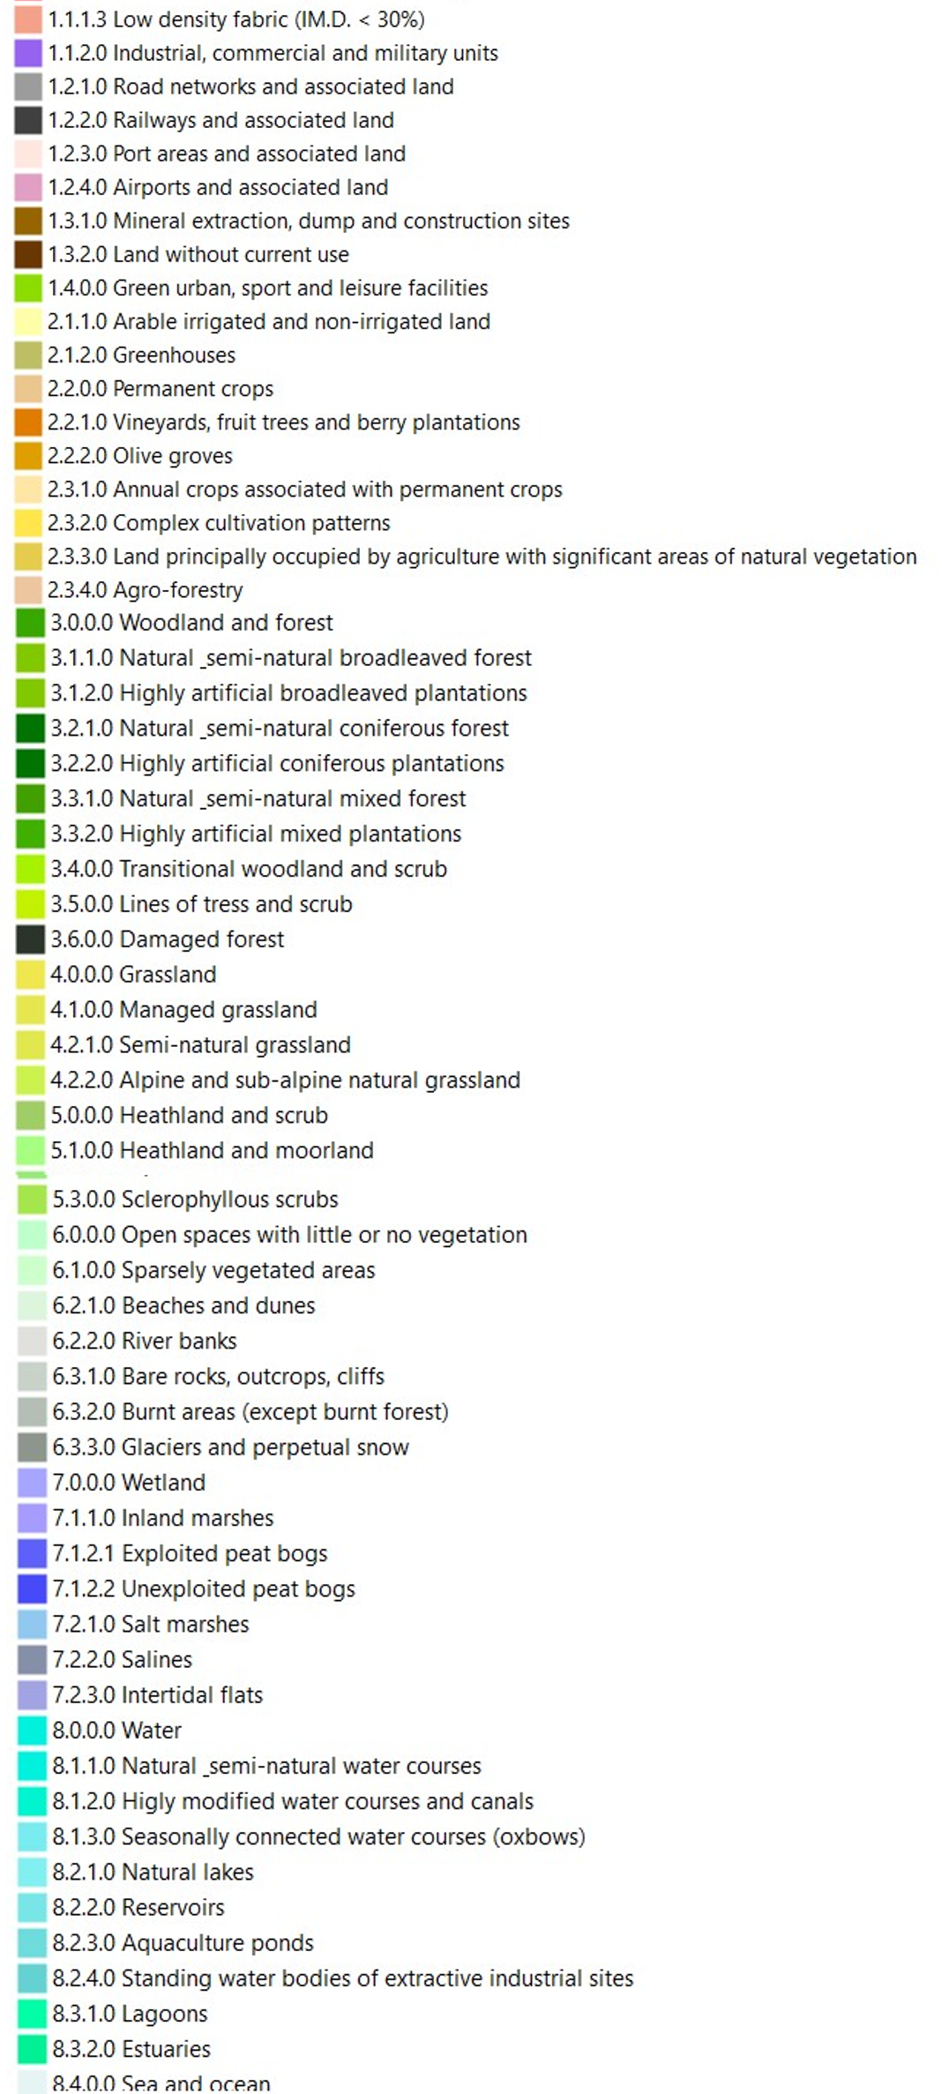
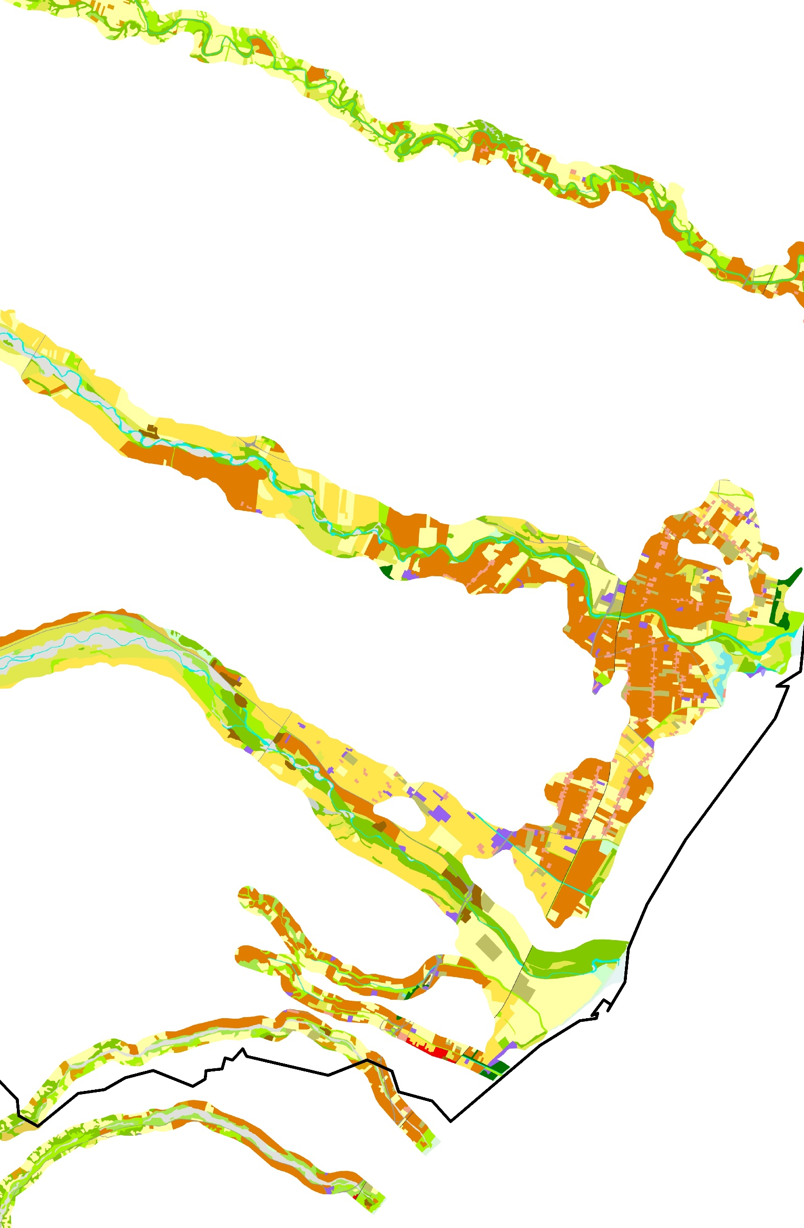
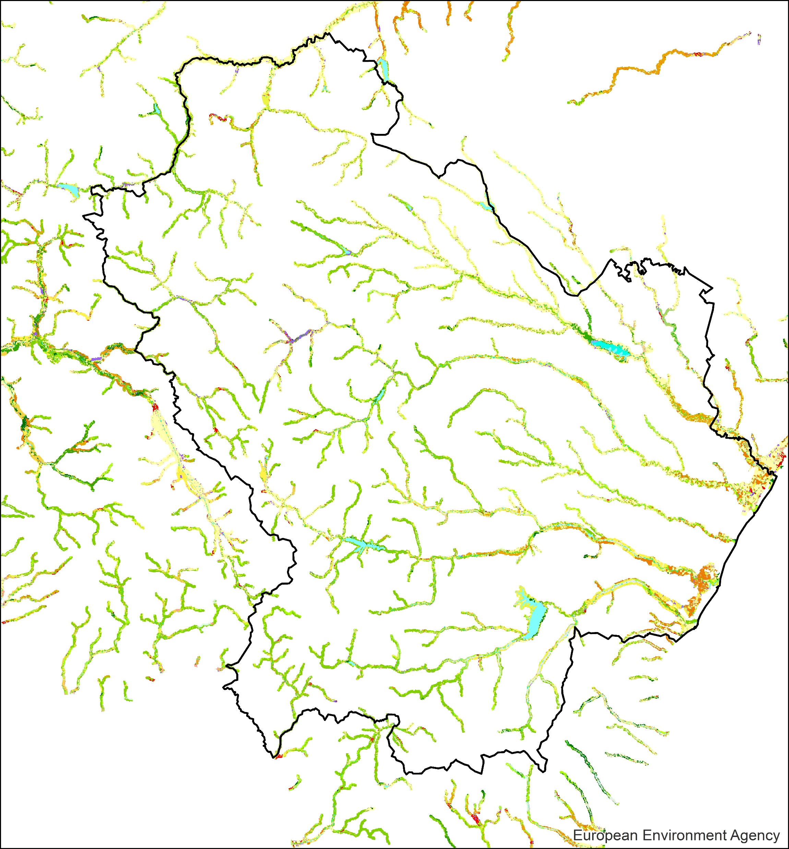
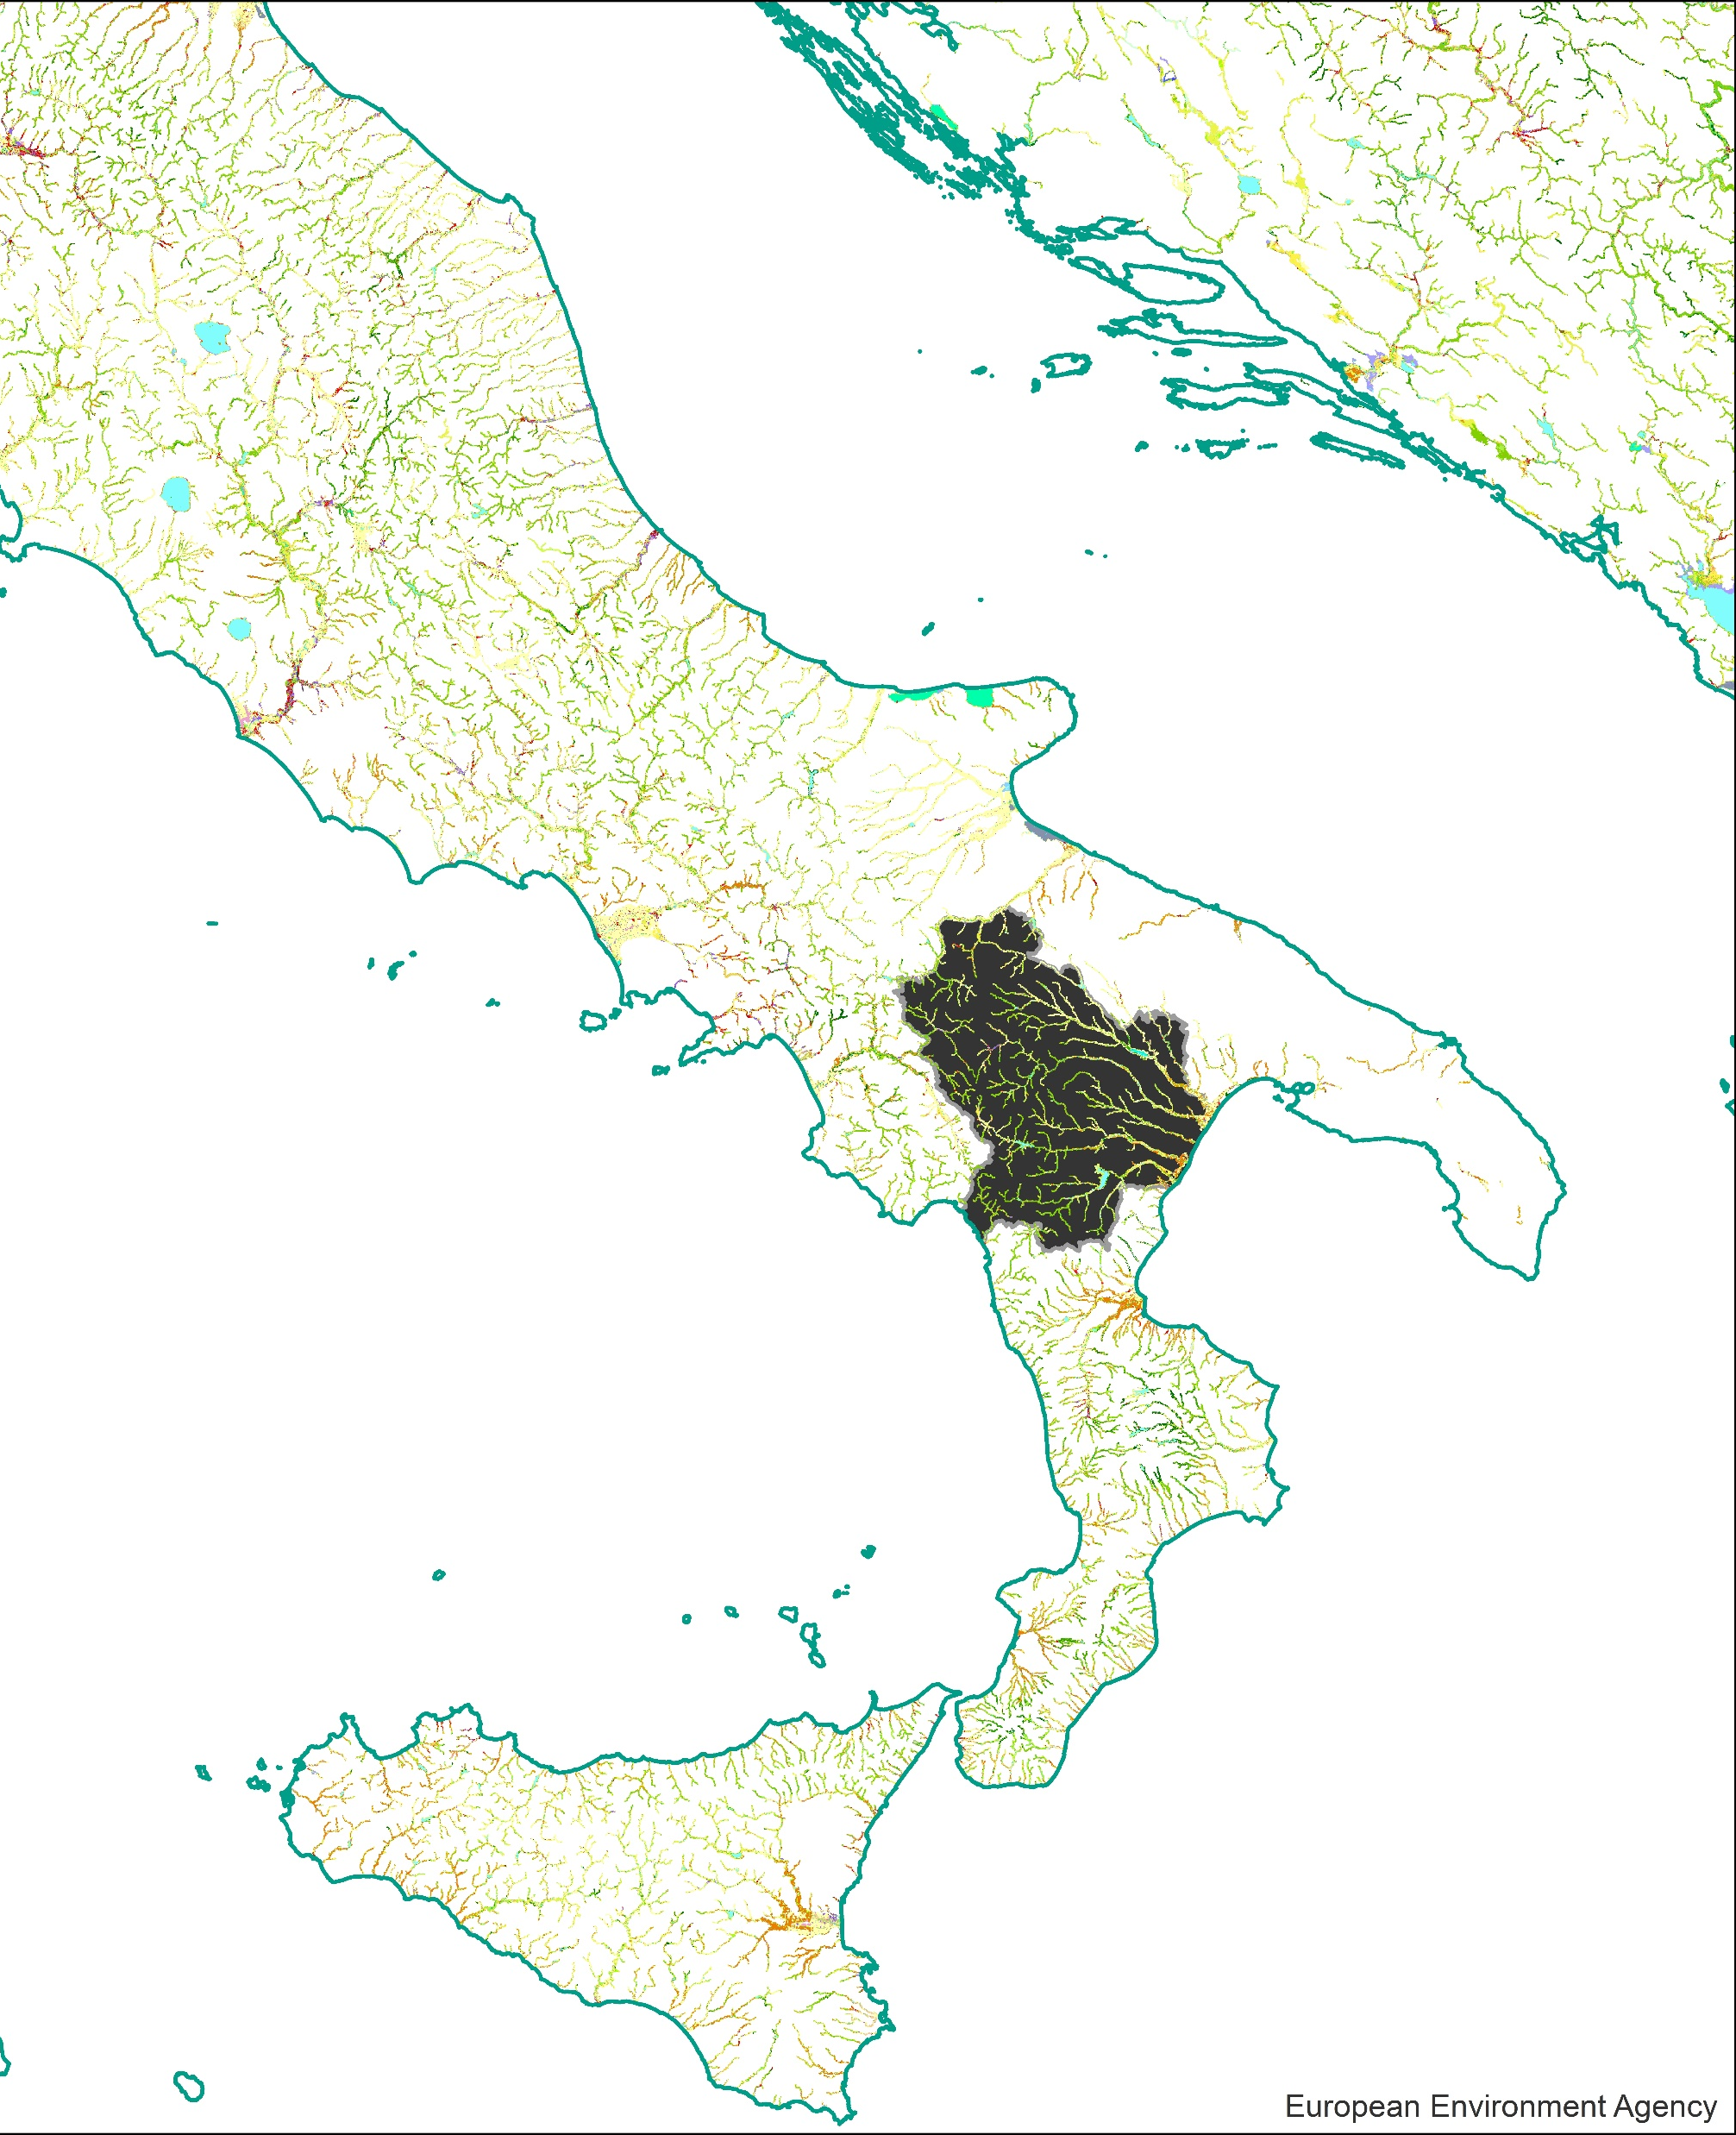
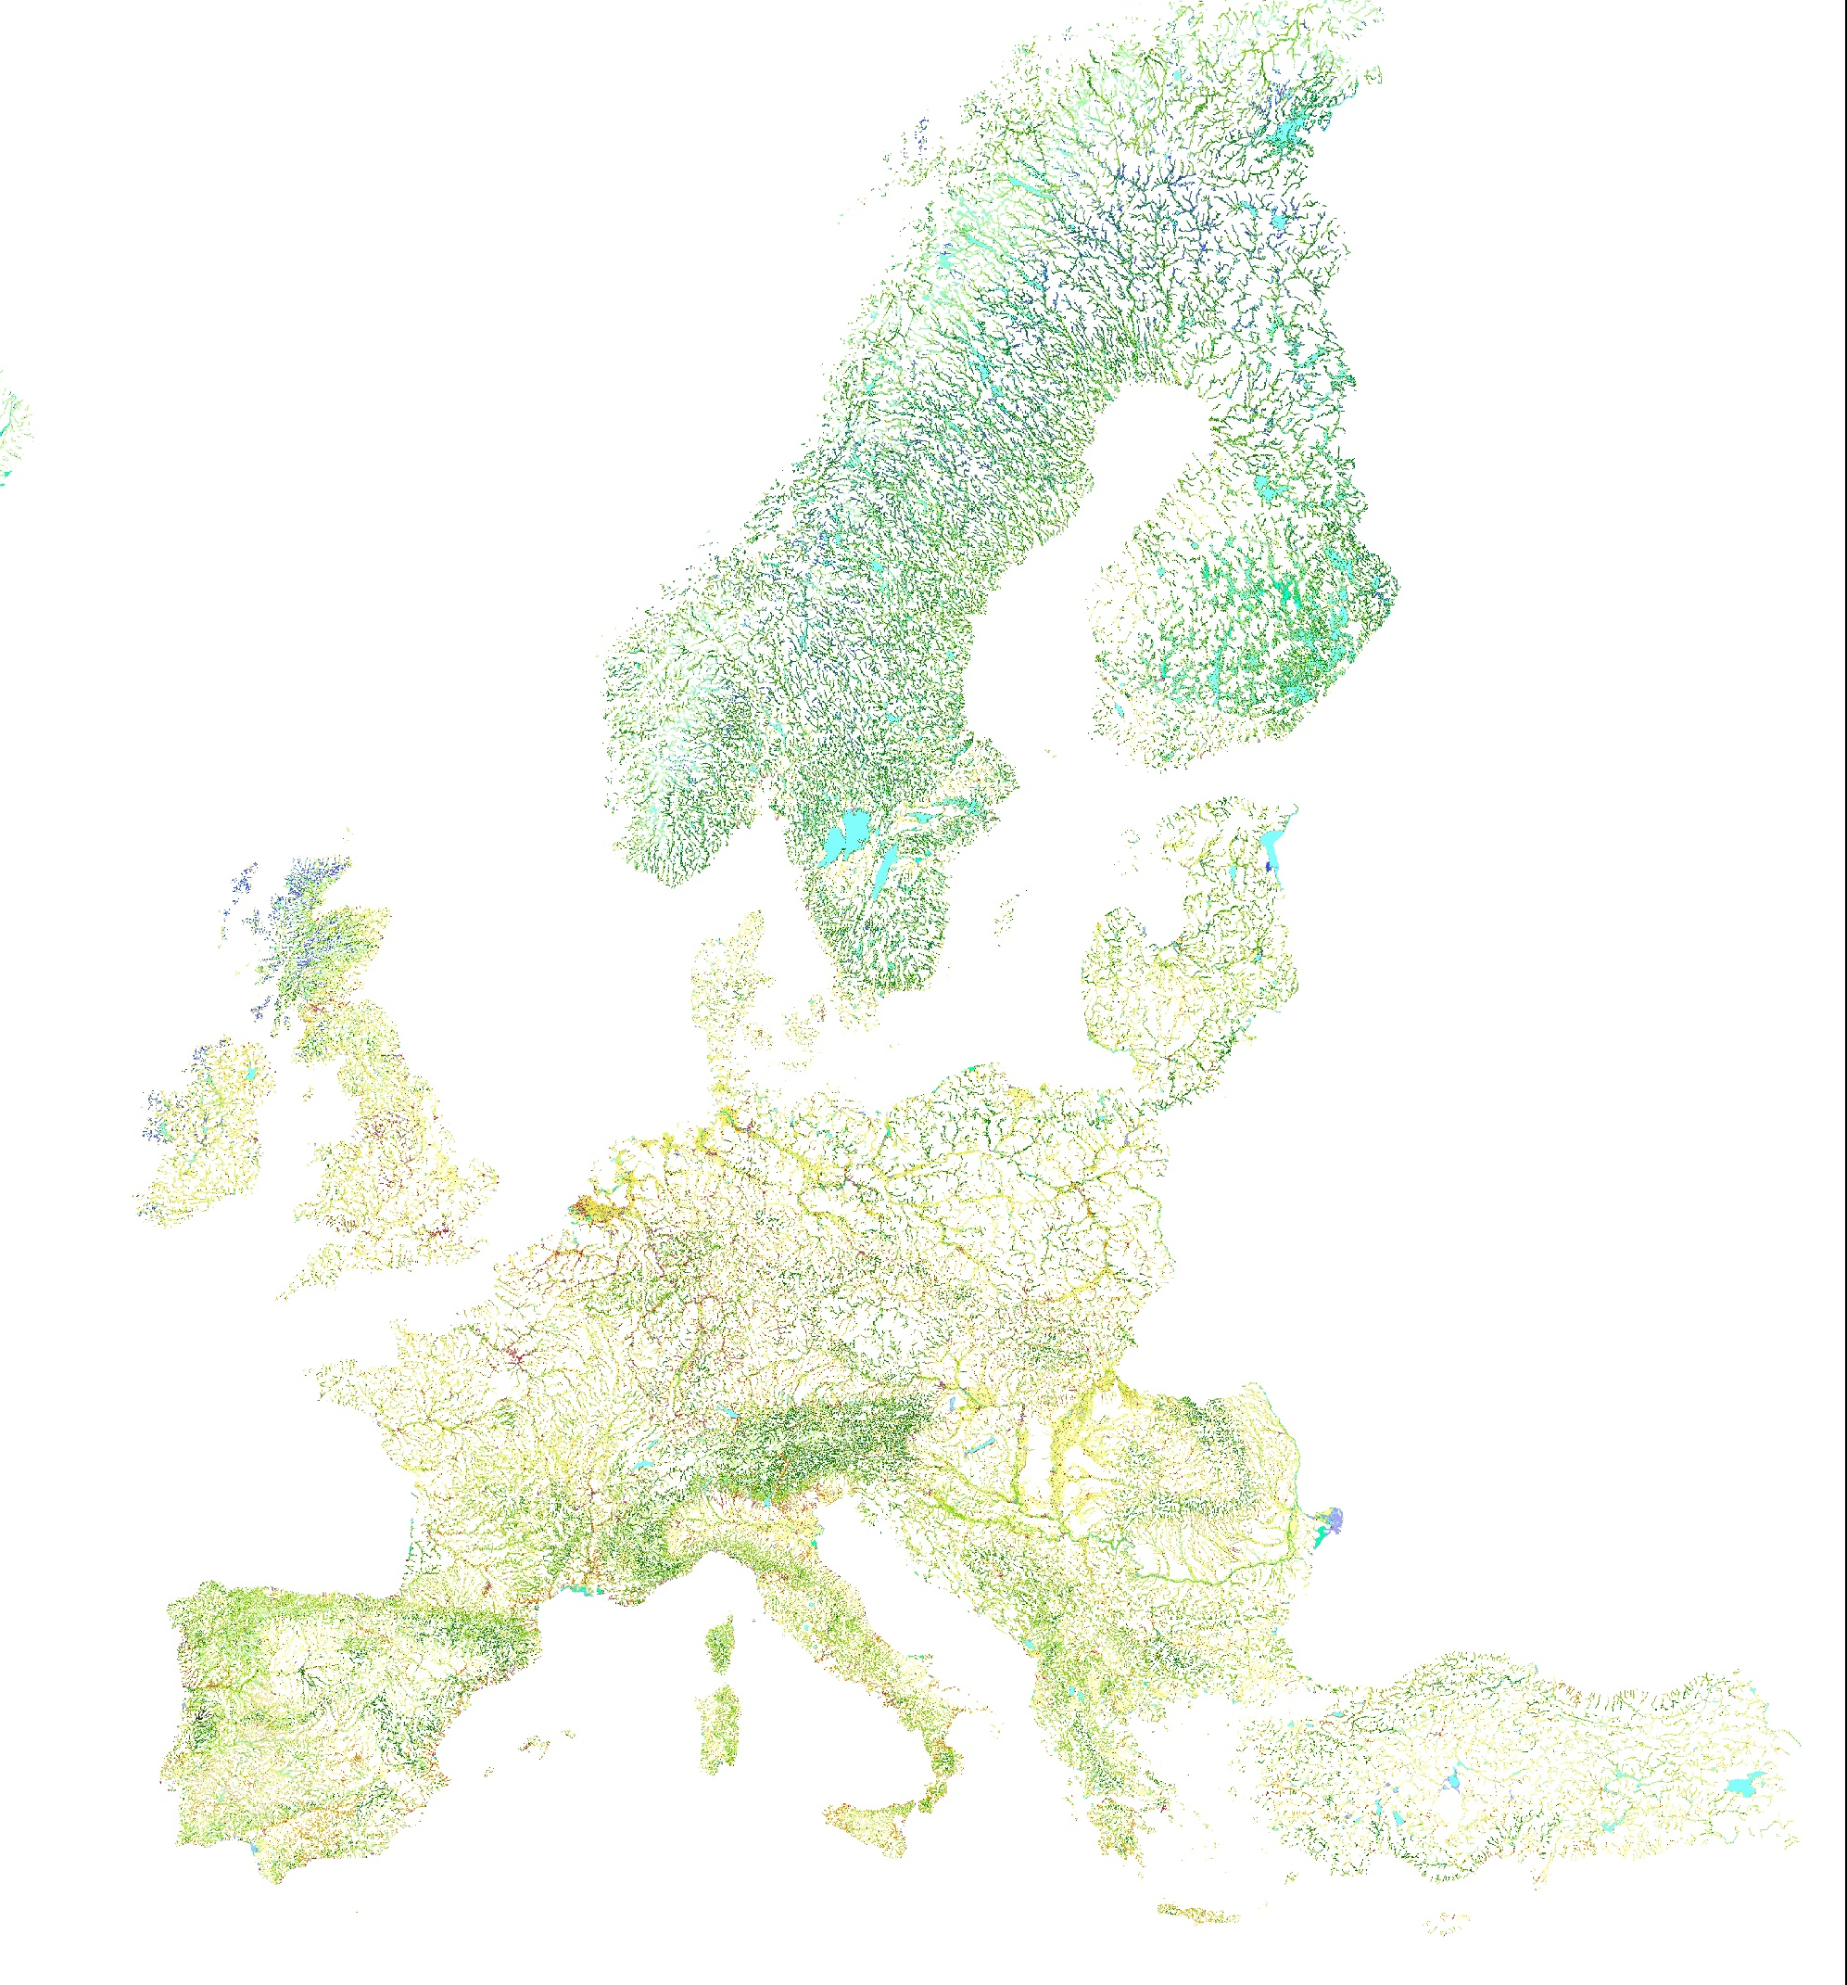
Methods - Study area
Actual and Potential Riparian Zones
Riparian Zones
Land Cover/Land Use
2018
https://doi.org/10.2909/2afca4ec-76e2-4155-b4e6-7460f9f6ae01

Slide 5
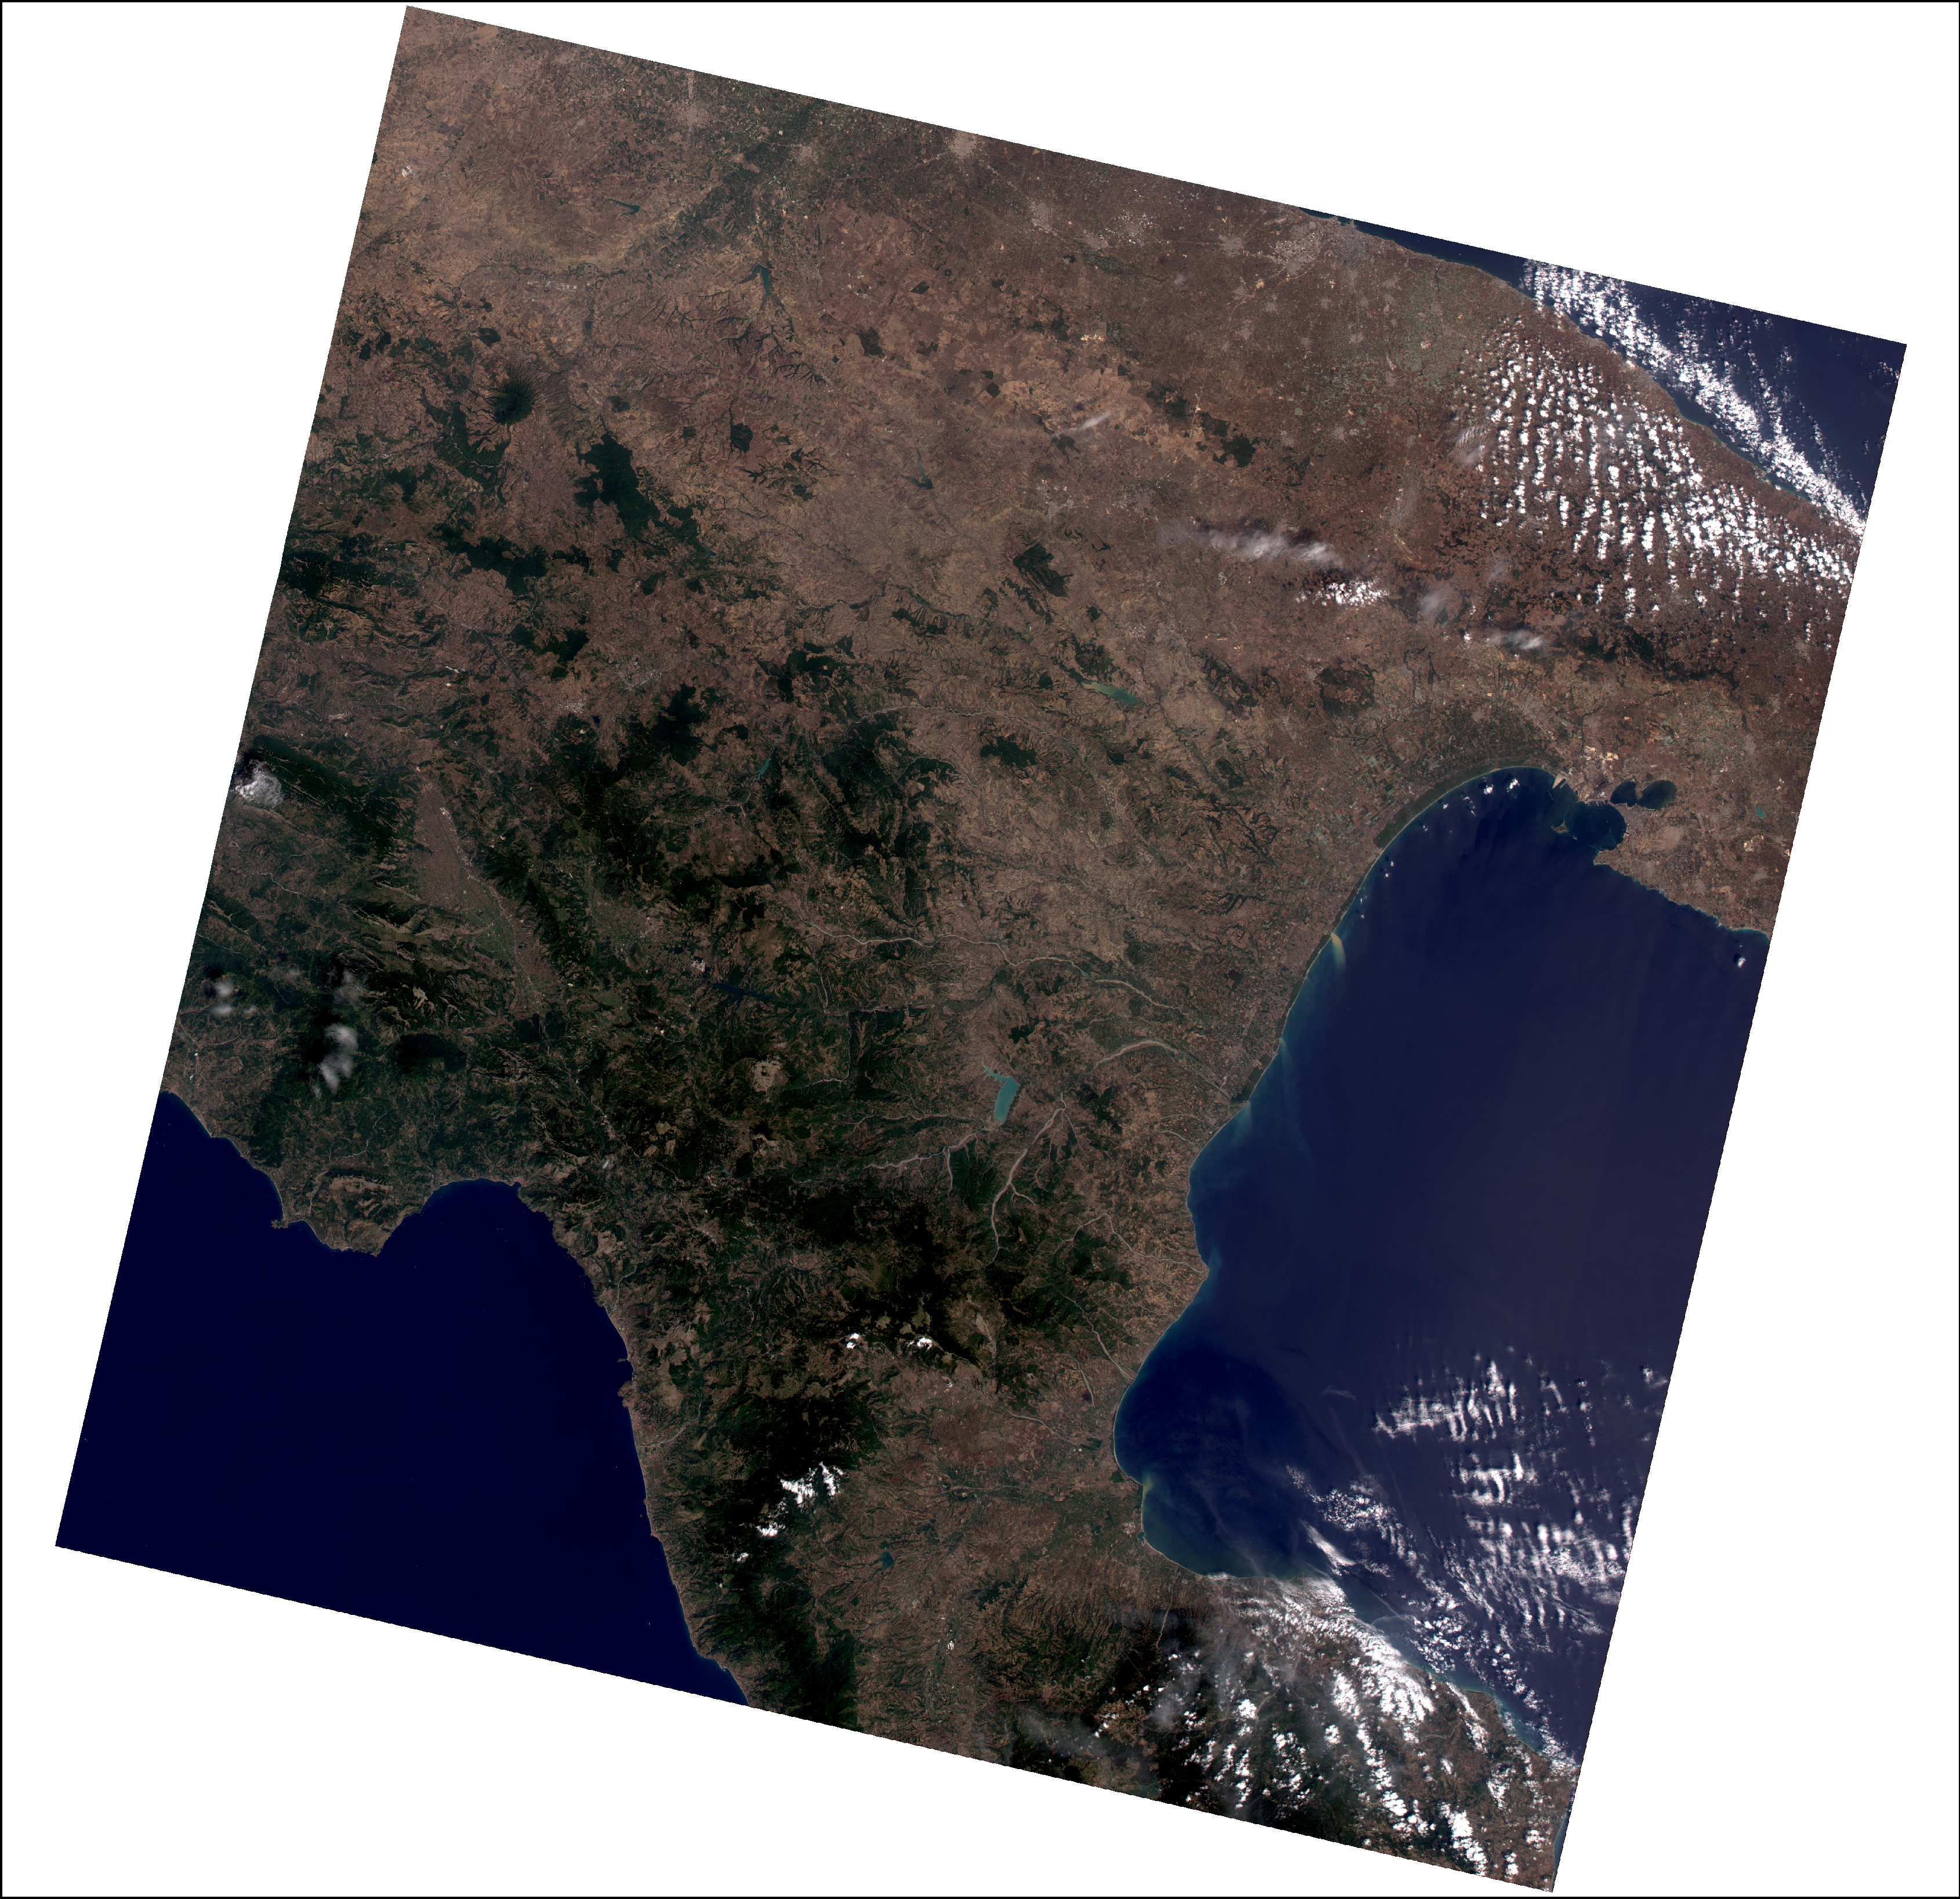
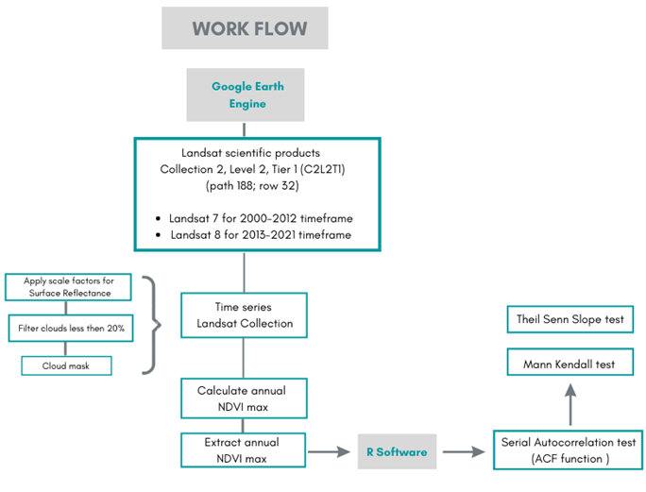
Methods – Work Flow
Vegetation trend analysis on natural areas
Sensors | Years | N° Images
Landsat (ETM+) | 2000 | 11
Landsat (ETM+) | 2001 | 10
Landsat (ETM+) | 2002 | 7
Landsat (ETM+) | 2003 | 6
Landsat (ETM+) | 2004 | 7
Landsat (ETM+) | 2005 | 6
Landsat (ETM+) | 2006 | 8
Landsat (ETM+) | 2007 | 8
Landsat (ETM+) | 2008 | 10
Landsat (ETM+) | 2009 | 5
Landsat (ETM+) | 2010 | 6
Landsat (ETM+) | 2011 | 11
Landsat (ETM+) | 2012 | 6
Landsat (OLI)/ (TIRS) | 2013 | 10
Landsat (OLI)/ (TIRS) | 2014 | 8
Landsat (OLI)/ (TIRS) | 2015 | 11
Landsat (OLI)/ (TIRS) | 2016 | 9
Landsat (OLI)/ (TIRS) | 2017 | 11
Landsat (OLI)/ (TIRS) | 2018 | 10
Landsat (OLI)/ (TIRS) | 2019 | 11
Landsat (OLI)/ (TIRS) | 2020 | 12
Landsat (OLI)/ (TIRS) | 2021 | 9
Theil Sen test
Slope >0.01
Mann Kendall test
p<0.05
Visual analysis
Orthophoto
2000 - 2013 - 2019
Validation
Ground truth
Sinni River Basin

Slide 6
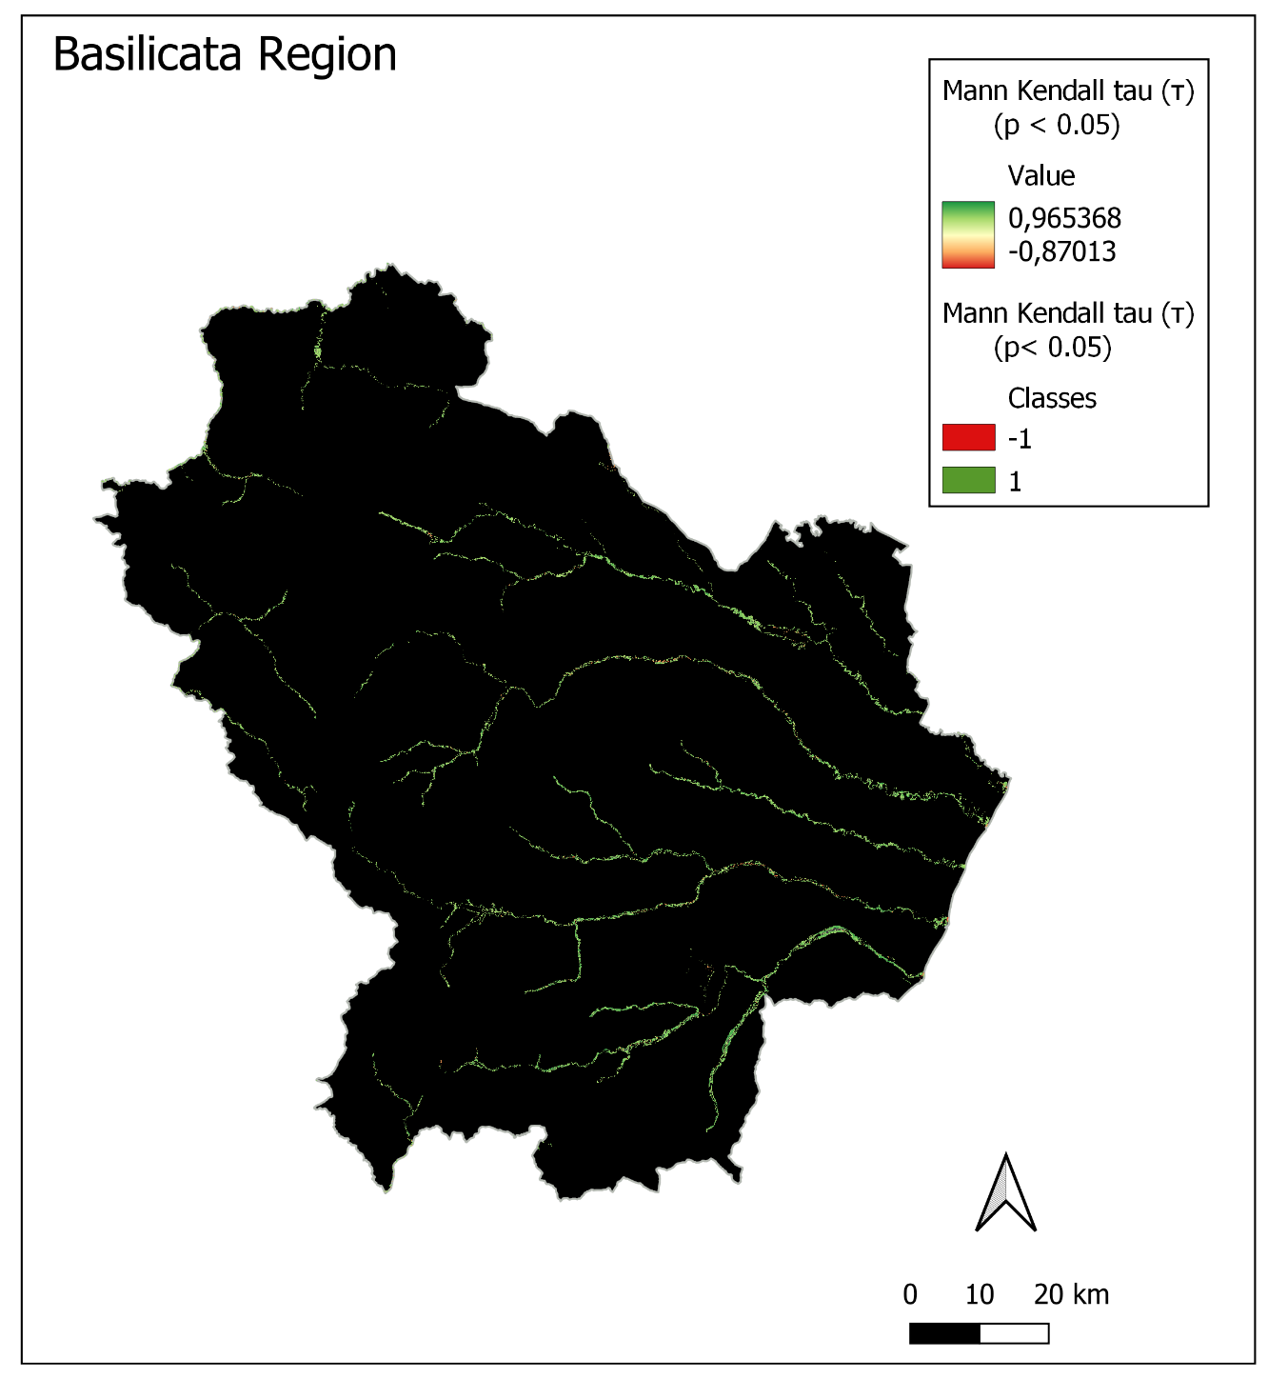
Results – Vegetation trend analysis
Mann kendall τ | ha | count
1 | 16139,07 | 179323
-1 | 542,25 | 6025
≈ 96%

Slide 7
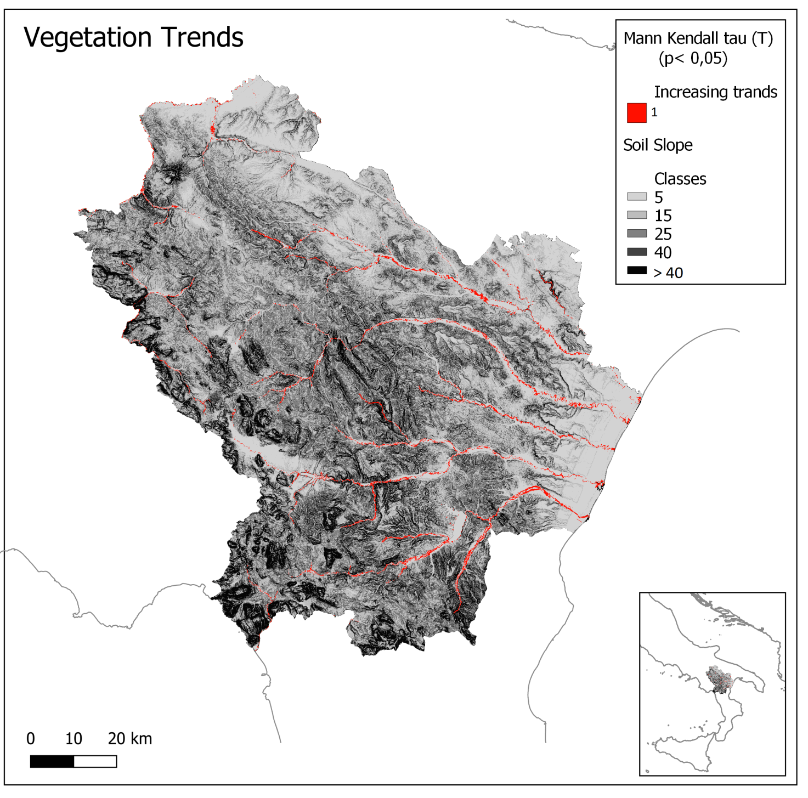
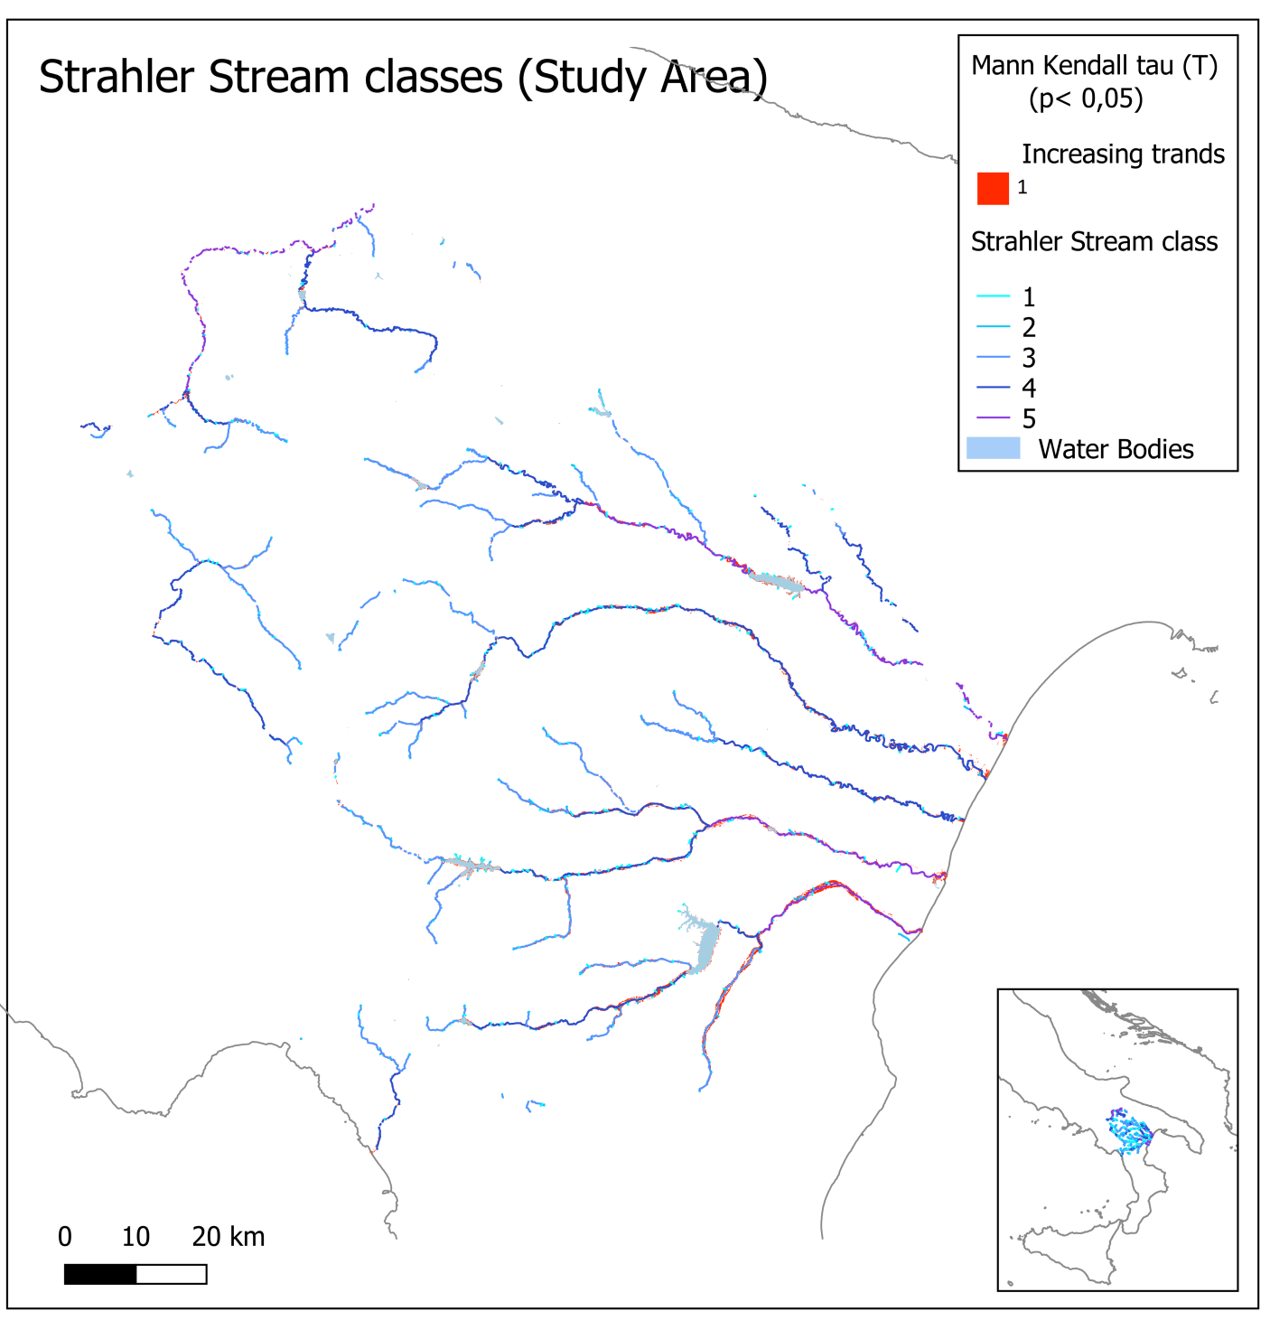
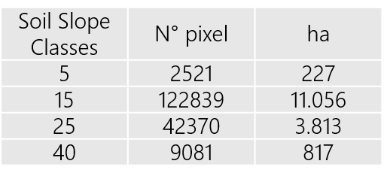
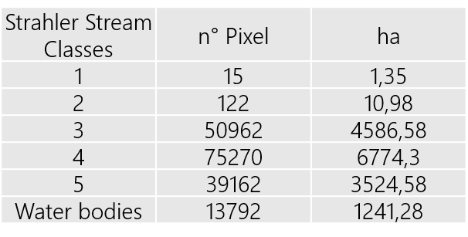
Results – Vegetation trend analysis

Slide 8
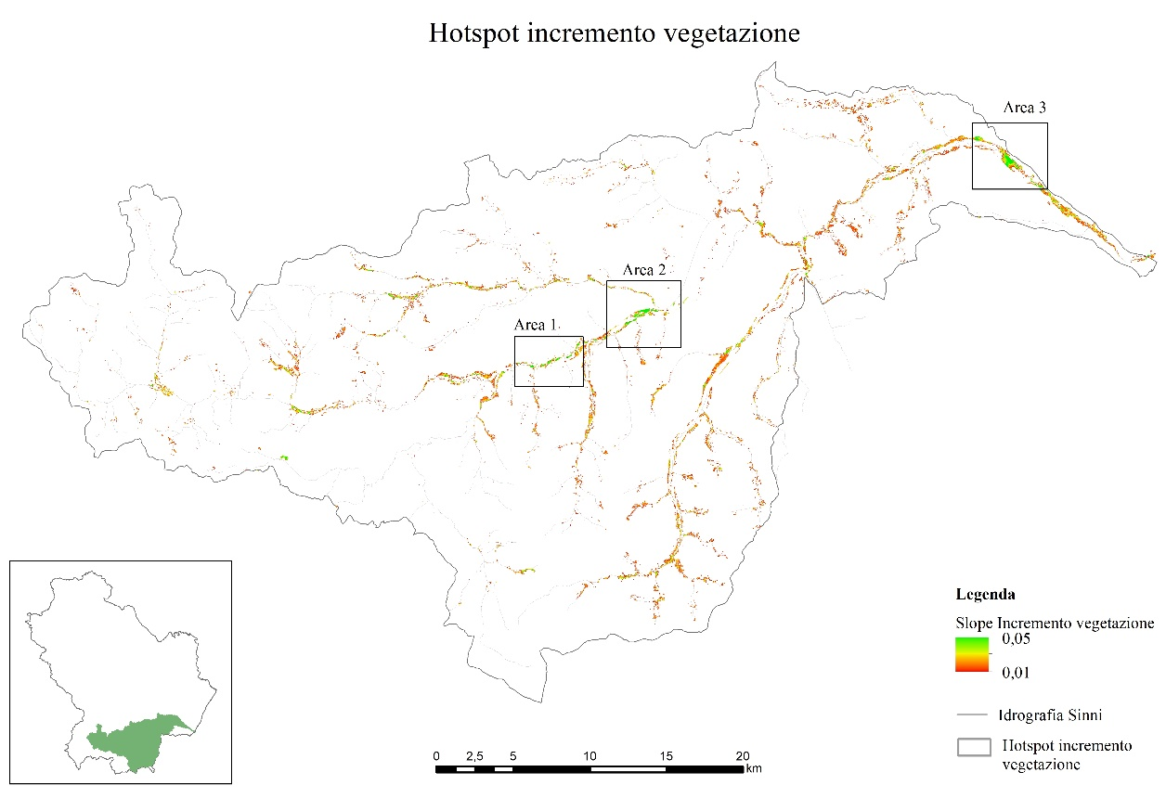
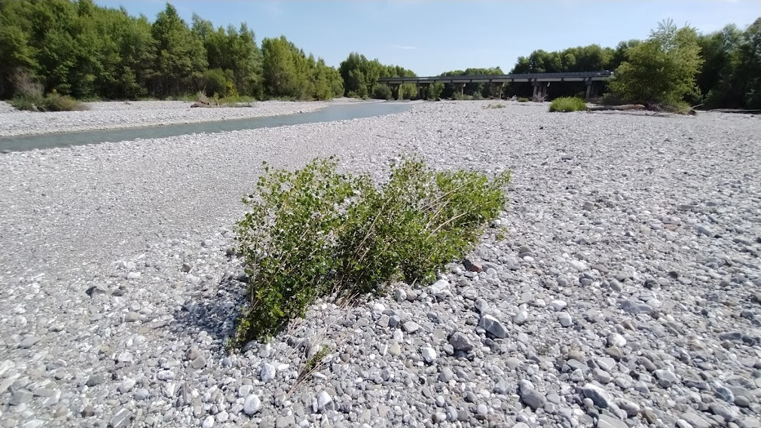
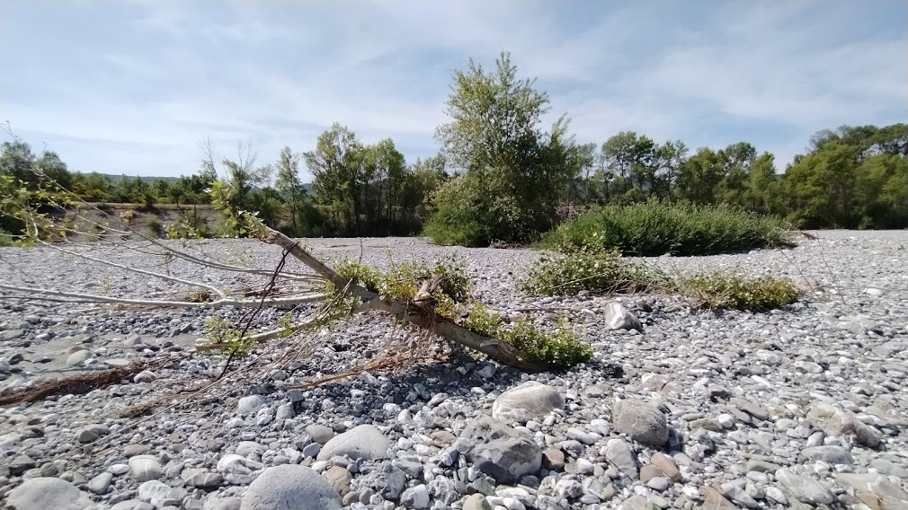
Results
Sinni river basin
Study area 1

Slide 9
Results
Sinni river basin
Study area 2

Slide 10
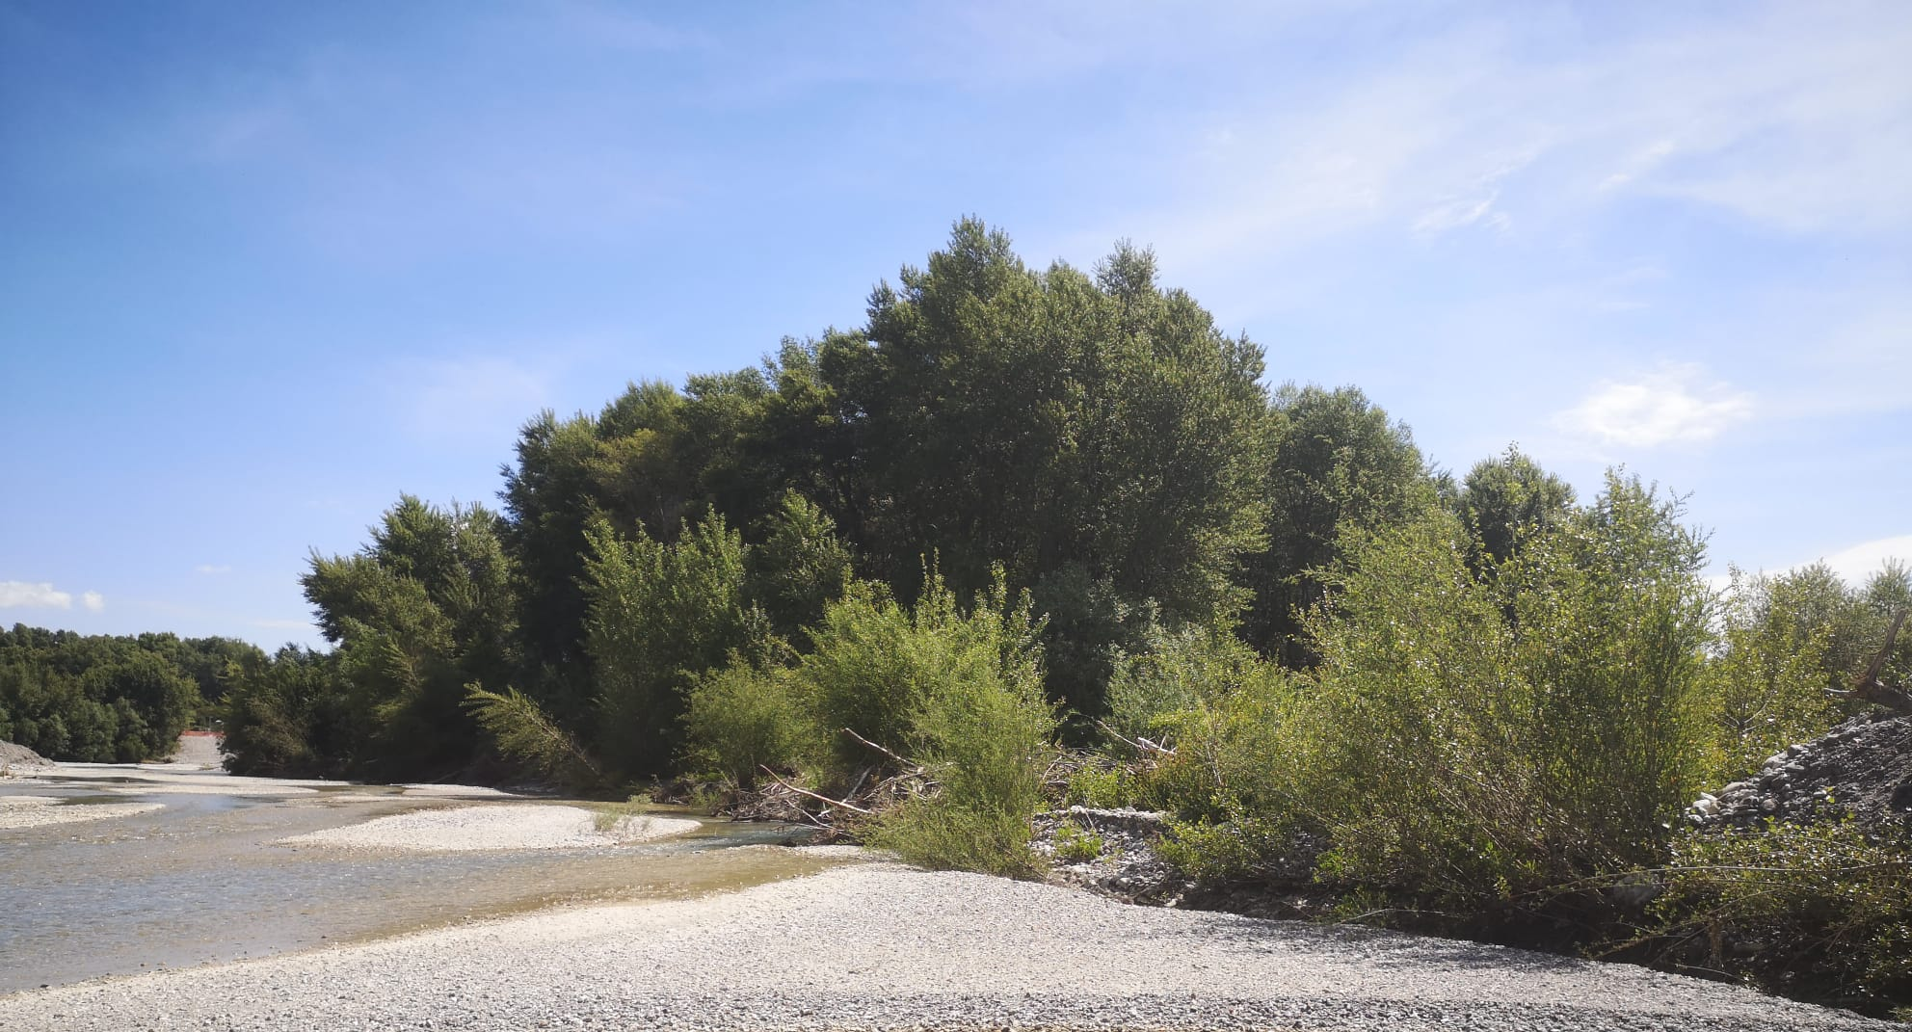
Results
Sinni river basin
Study area 2

Slide 11
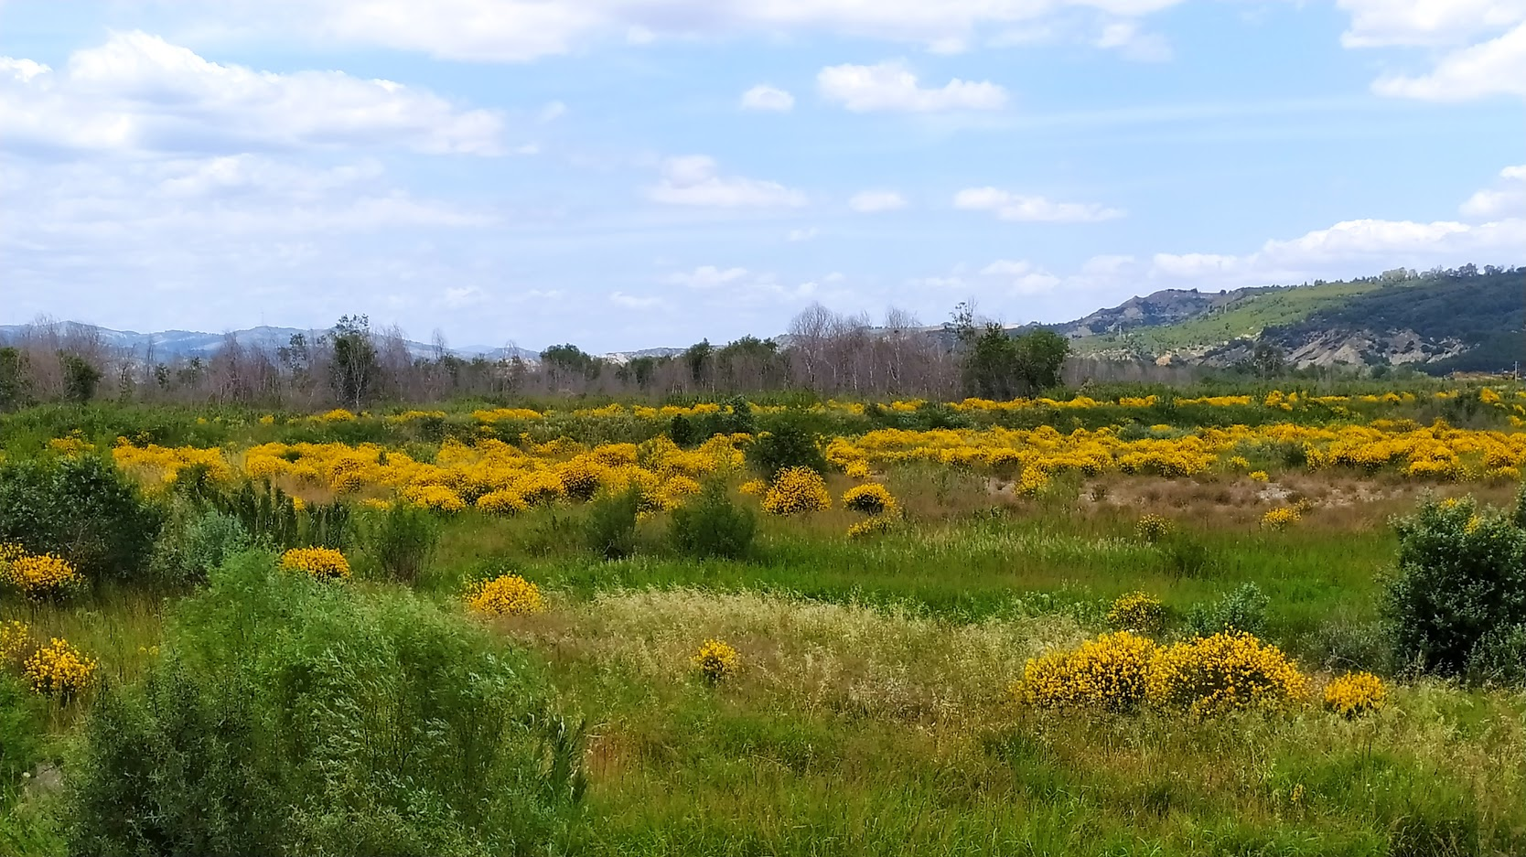
Results
Sinni river basin
Study area 3

Slide 12
Conclusions
Significative increasing trends in riparian vegetation expansion are widely distributed in Potential riparian zones
Most of these processes are related to low slope soils and flat areas, characterized by high Strahler stream classes
Main drivers could be identified in land abandonment, reduced anthropogenic pressure and reduced surface water availability due to increasing water demand for irrigation purposes and changing precipitation regime
More investigation are needed in order to analyze the impact of climate change on riparian ecosystems and vegetation expansion dynamic

Slide 13
Thank you
angelo.nole@unibas.it

