Slide 1
September 28 – 29 | 2023
Matera, Basilicata Region | Italy
European Regional Symposium
Second Edition of the European Regional
Symposium, on space data for tourism & agriculture, by NEREUS Regions
Vincenzo D'Avino
Distretto Tecnologico Aerospaziale Vincenzo.davino@dtascarl.it

Slide 2
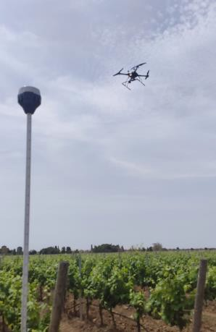
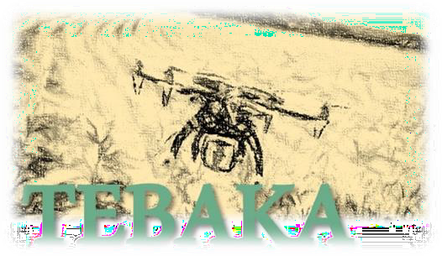
DTA
profit
(Distretto
non-
consortium company and one of Italy's most
Tecnologico Aerospaziale) s.c.a.r.l. is a
active aerospace technology clusters, whose mission is to increase the competitiveness of its members and the Apulian/Italian aerospace system.
Innovative Aerial services: flight procedures, ATM, UTM, payload and data management
Impact of SATCOM, GNSS
service in UAS flight capacity
Space-Based Solution
Integrating Space and Drone Earth Observation for agriculture applications
Track quality of plantations • Decision support systems for farmers
Xylella infections early identification

Slide 3
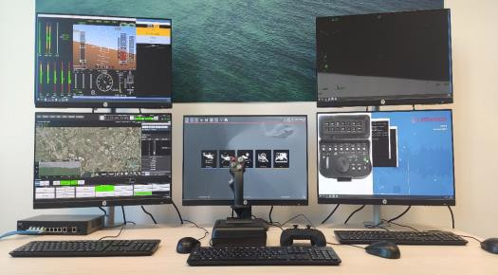
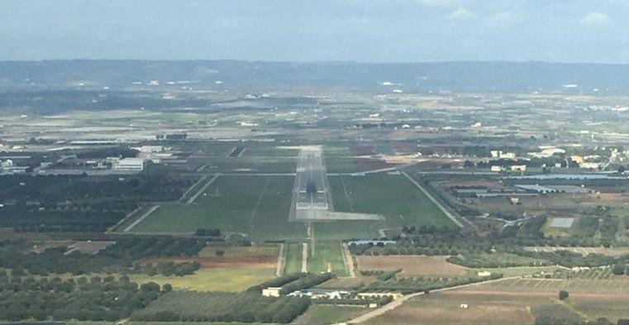
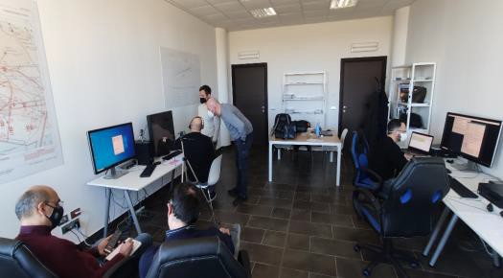
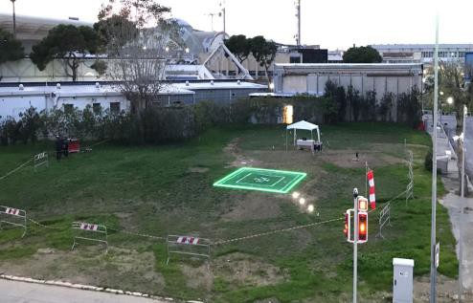
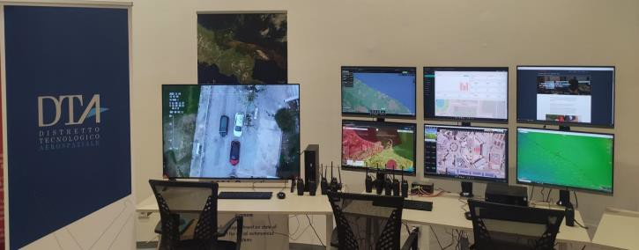
To support UAS industry development and growth, DTA is leading the deployment of Grottaglie Airport Test Bed (GATB), a research and flight test infrastructure centered in the airport of Grottaglie and networked with external laboratories and infrastructures. The main goal is to foster and support the Apulian aerospace system in the development of knowledge, skills and innovative capabilities in the UAS technology domains.
GATB is an aggregation point for a network of public and private organizations involved in research and innovation projects promoted, coordinated or participated by DTA, or, lastly, exploiting and contributing to the development of GATB.
Bari Urban Drone Range is the urban module of GATB.
Together with GATB, it addresses the maturation of innovative solutions from initial prototype experimentation (TRL5) to demonstration in operational environments (TRL7-8).
GROTTAGLIE AIRPORT
BARI URBAN DRONE RANGE

Slide 4
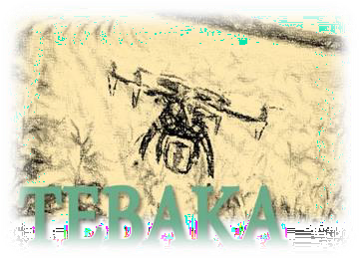
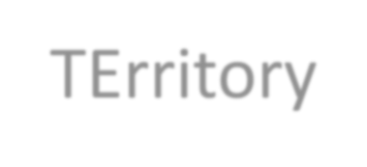
TEBAKA
TErritory BAsic Knowledge Acquisition
Problems
Lack of support for the farmer to implement decisions concerning crops
Difficulties in detecting the first symptoms of a pathogen
Simple and practical marker to provide clear information
Aim
Using remote sensing
Challenging Solution
Value
Method of intervention as reliable as possible at the best ratio of
cost-effectiveness
Understanding
Periodic
to identify critical
issues as early as possible
Localised
Ad hoc
Data
knowledge

Slide 5
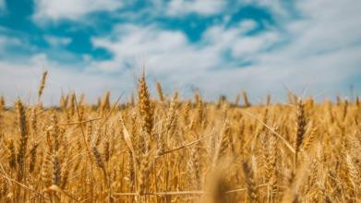
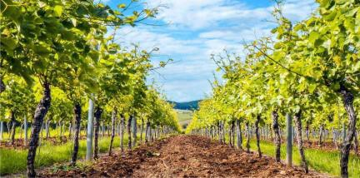
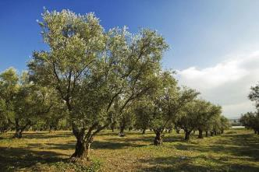
First step of the solution
The definition of a methodology to achieve ‘knowledge’ relating to some agricultural
crops:
Why Wheat?
Why grapevine?
Why Olive?
State of the
crop
SITUATION AWARENESS
PERCEPTION
of data and the elements of the environment
Level 1
COMPREHENSION
of the meaning and significance of the situation
Level 2
PROJECTION
of future states and events
PERFORMANCE OF
ACTION
DECISION
Level 3
primary
secondary
T E B A K A

Slide 6
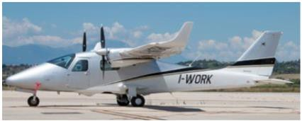
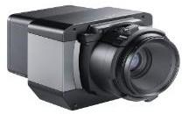
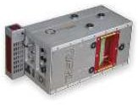
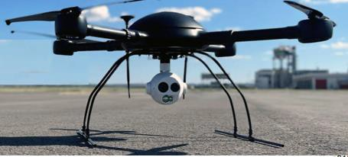
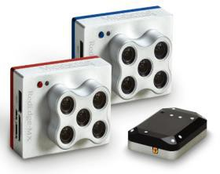
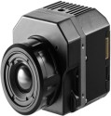
Second step of the solution
The realisation of an integrated, multiscale platform for the management of Earth observation data
Periodic
Localised
Phase-one IXU-RS-1000
P2006T
Lidar Q680i
Height
Ad hoc
SATELLITE
eXplorer 1000
AIRCRAFT
Micasense Dual-MX
FLIR VUE PRO R
DRONE
Resolution
ROVER
Multiplatform Aerial Missions Orchestrator
Verification of mission requirements and optimisation of an observation cycle
attainability of satellite observation;
mission deployability (Airplane and UAS):
availability of suitable sensors;
availability of operators;
So on…

Slide 7
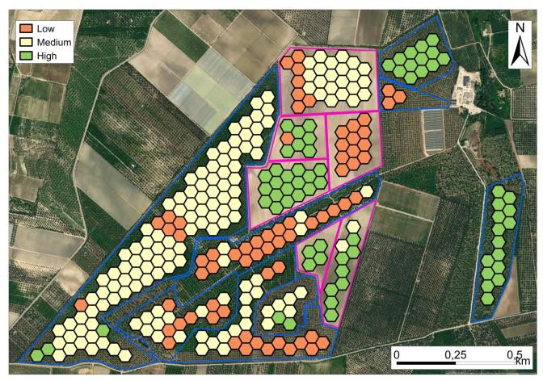
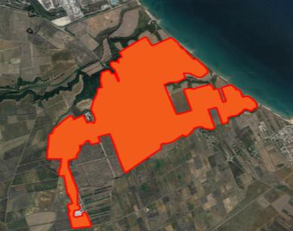
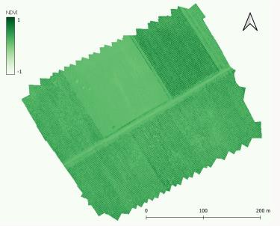
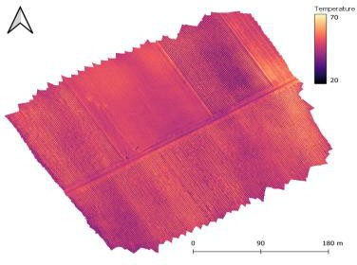
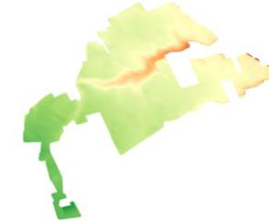
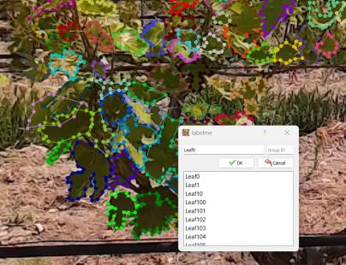
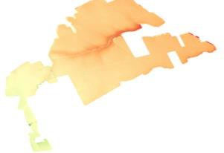
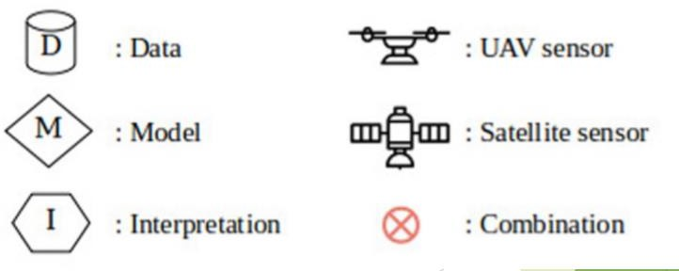
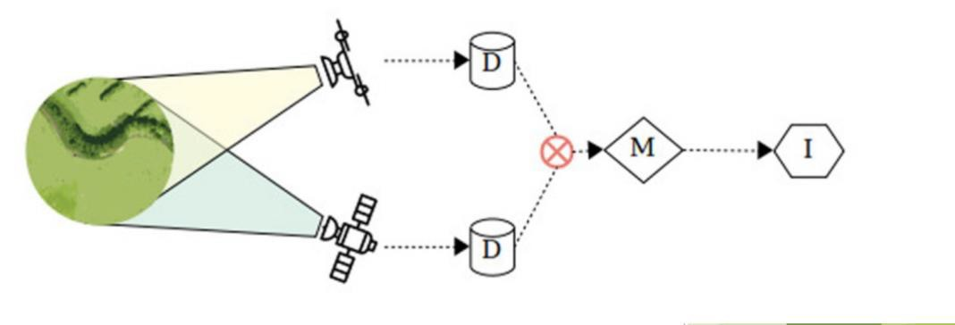
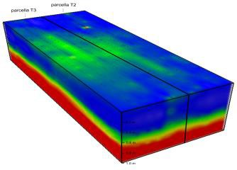
Added value
The design of a service framework for growers that, in an easy and economically sustainable manner, provides correct information to support the management of the annual production cycle - DSS – DECISION SUPPORT SYSTEMS.
NDVI
Temperature
Median NDVI
DTM-DSM
Electrical conductivity
Data-driven models obtained from the integration of data from
satellites, aircraft, drones and rover.

Slide 8
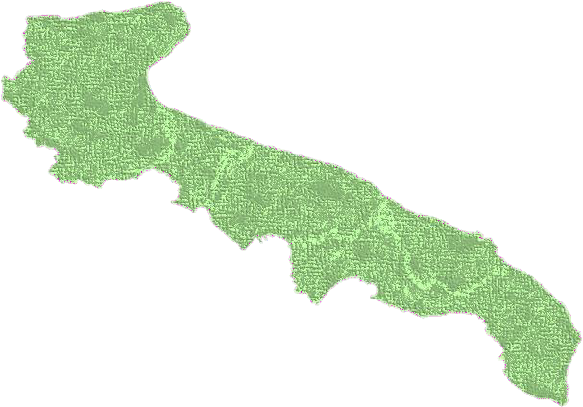
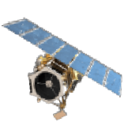
What are the benefits to citizens and the region, now and in the future?
Definition of a stable territorial acquisition architecture
Possibility of small-scale use
Possibility for public actors to support policies for the development of the agricultural sector, for private actors consulting
need for a stable ground infrastructure need for a platform managment center
difficulty in organising a synergetic effort
The expected result is the realisation of an innovative product/service for the farming industry
to provide structured knowledge and acquisition tools.
TEBAKA allows both private companies and public agencies to design services with high added value.
Benefits
Risks

Slide 9
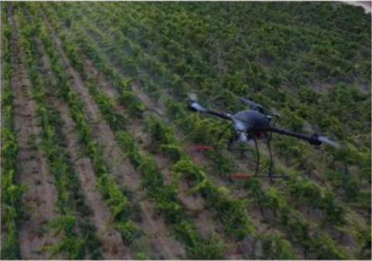
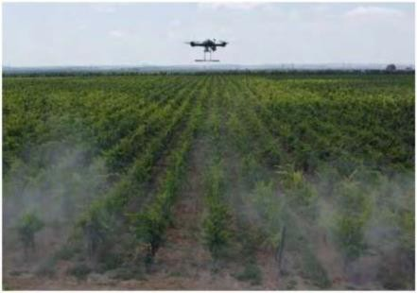
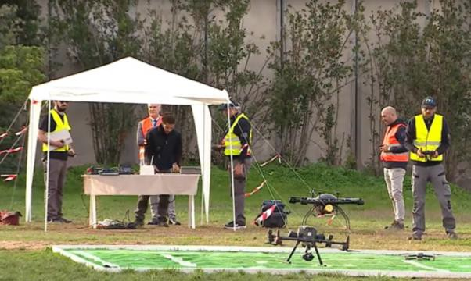
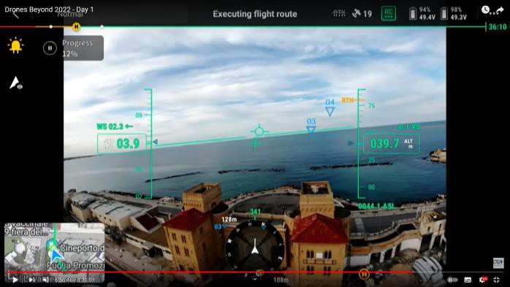
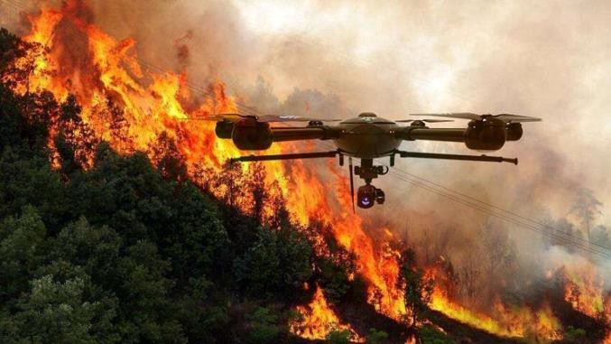
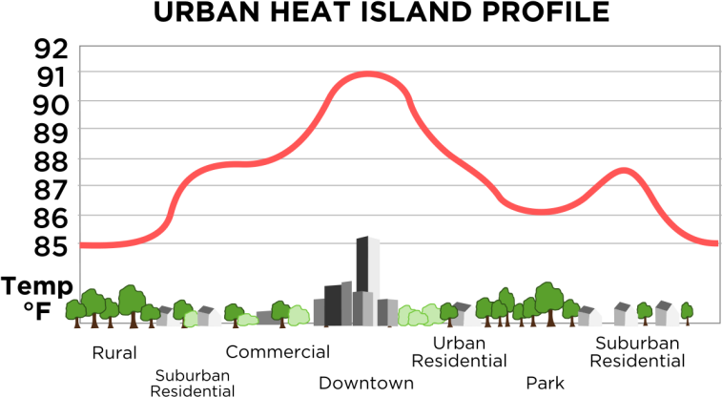
UAS Operations in Natural Areas of Smart City
Application
Urban green monitoring
Support natural park management
Risks prevention
Risks management

Slide 10
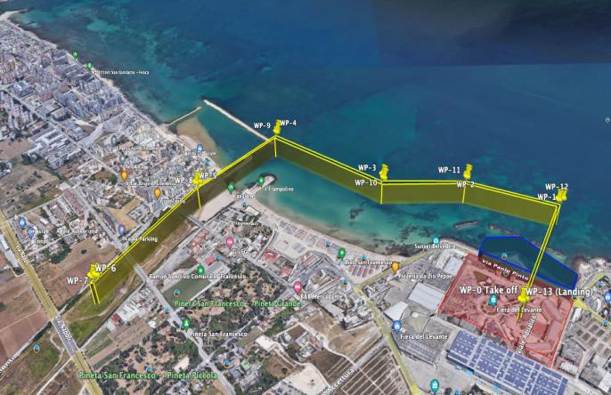
DRONES BEYOND 2023
25, 26 October, Bari
Unfolding Innovative Aerial Services in the Smart City
Live demonstrations of UAS flight operations for
Collecting and processing crops data in
TEBAKA project
Risk prevention on natural parks and urban green areas.
Territory management and farming
A Panel focused on the TEBAKA Project:
Key Supply and Demand Actors
More information at
www.dtascarl.it

Slide 11
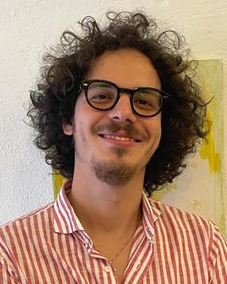
Thank you
Vincenzo D’Avino, Distretto Tecnologico Aerospaziale,
UAS flight test engineer and data management application developer
vincenzo.davino@dtascarl.it
Come on, let's meet at Drones Beyond 2023!
Register for participating: https://www.dtascarl.org/drones-beyond/

