Slide 1

Agriculture Start-Ups in the ESA BIC Hessen
Dr. Andreas Kanstein, Managing Director
September 2023

Slide 2
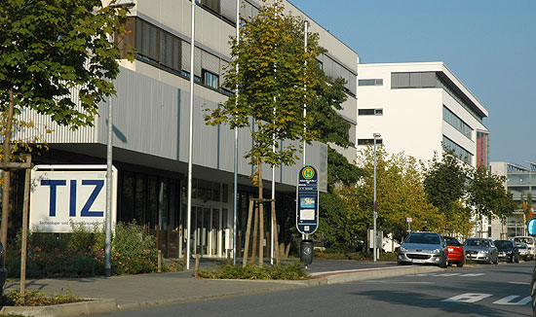







Centre for Satellite Navigation Hessen
Joint initiative of the European Space Agency ESA and the State of Hesse
Established 2006 and located next to the European Satellite Control Centre ESA / ESOC
Funded by ESA / DLR, the Federal State of Hessen and City of Science Darmstadt, with further support from ESOC
Incubated more than 110 start-ups (to 2021), +80 start-ups in 2022-2025!
Goal is to support and accelerate the development of space-related companies and create high-tech job opportunities in the region

Slide 3
The ESA BIC Network
Since 2007, cesah implements the ESA Business Incubation Centre (BIC) Darmstadt on behalf of ESA
Since 2014, cesah implements the
ESA Technology Transfer Broker Germany, together with EurA AG
Since 2018, ESA BIC Hessen & Baden-Württemberg with IHK Reutlingen & Airbus Friedrichshafen
Part of a growing network of more than 24 ESA BICs at more than 80 locations with more than 1200 Start-ups, of which around 13% are from Hessen

Slide 4
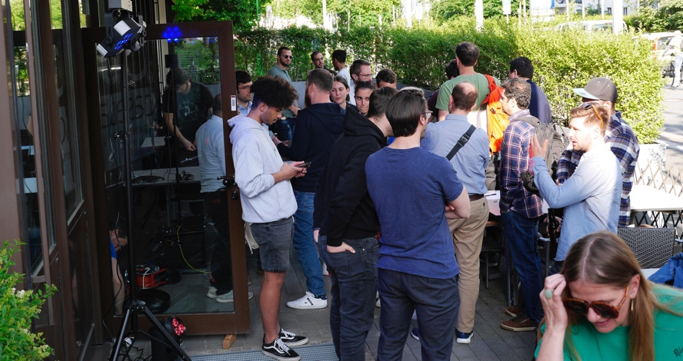
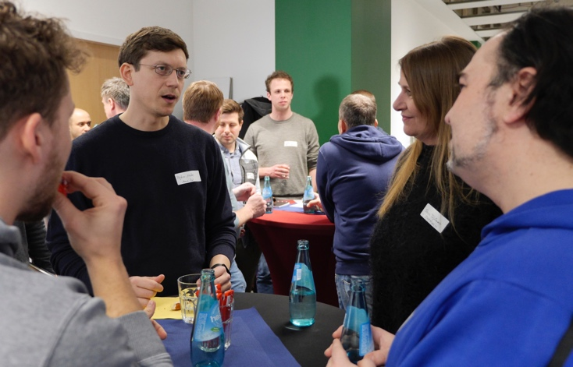
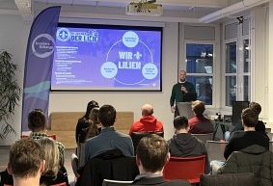
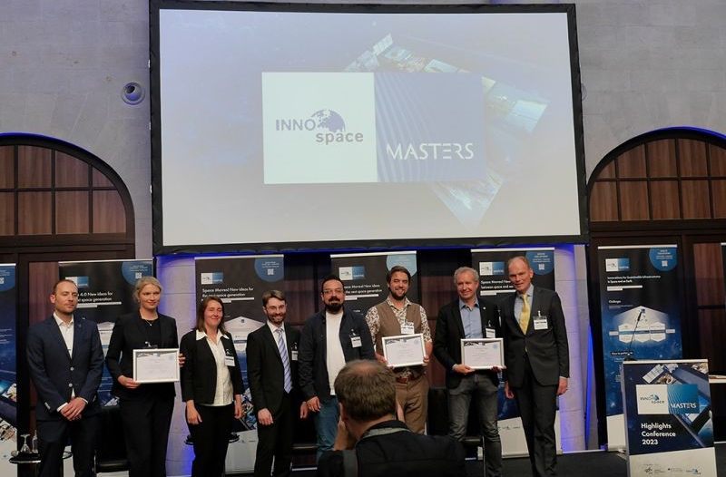
How to Find Candidates
Visibility – Fairs, Start-Up Events, Social Media – Success Stories
Hackathons – Act in Space, Climathon, Cassini Hackathons
Idea Competitions
-> Copernicus Masters was very useful since it started with a regional competition
Entrepreneurship Seminars
Partners in the Ecosystem – related programmes

Slide 5
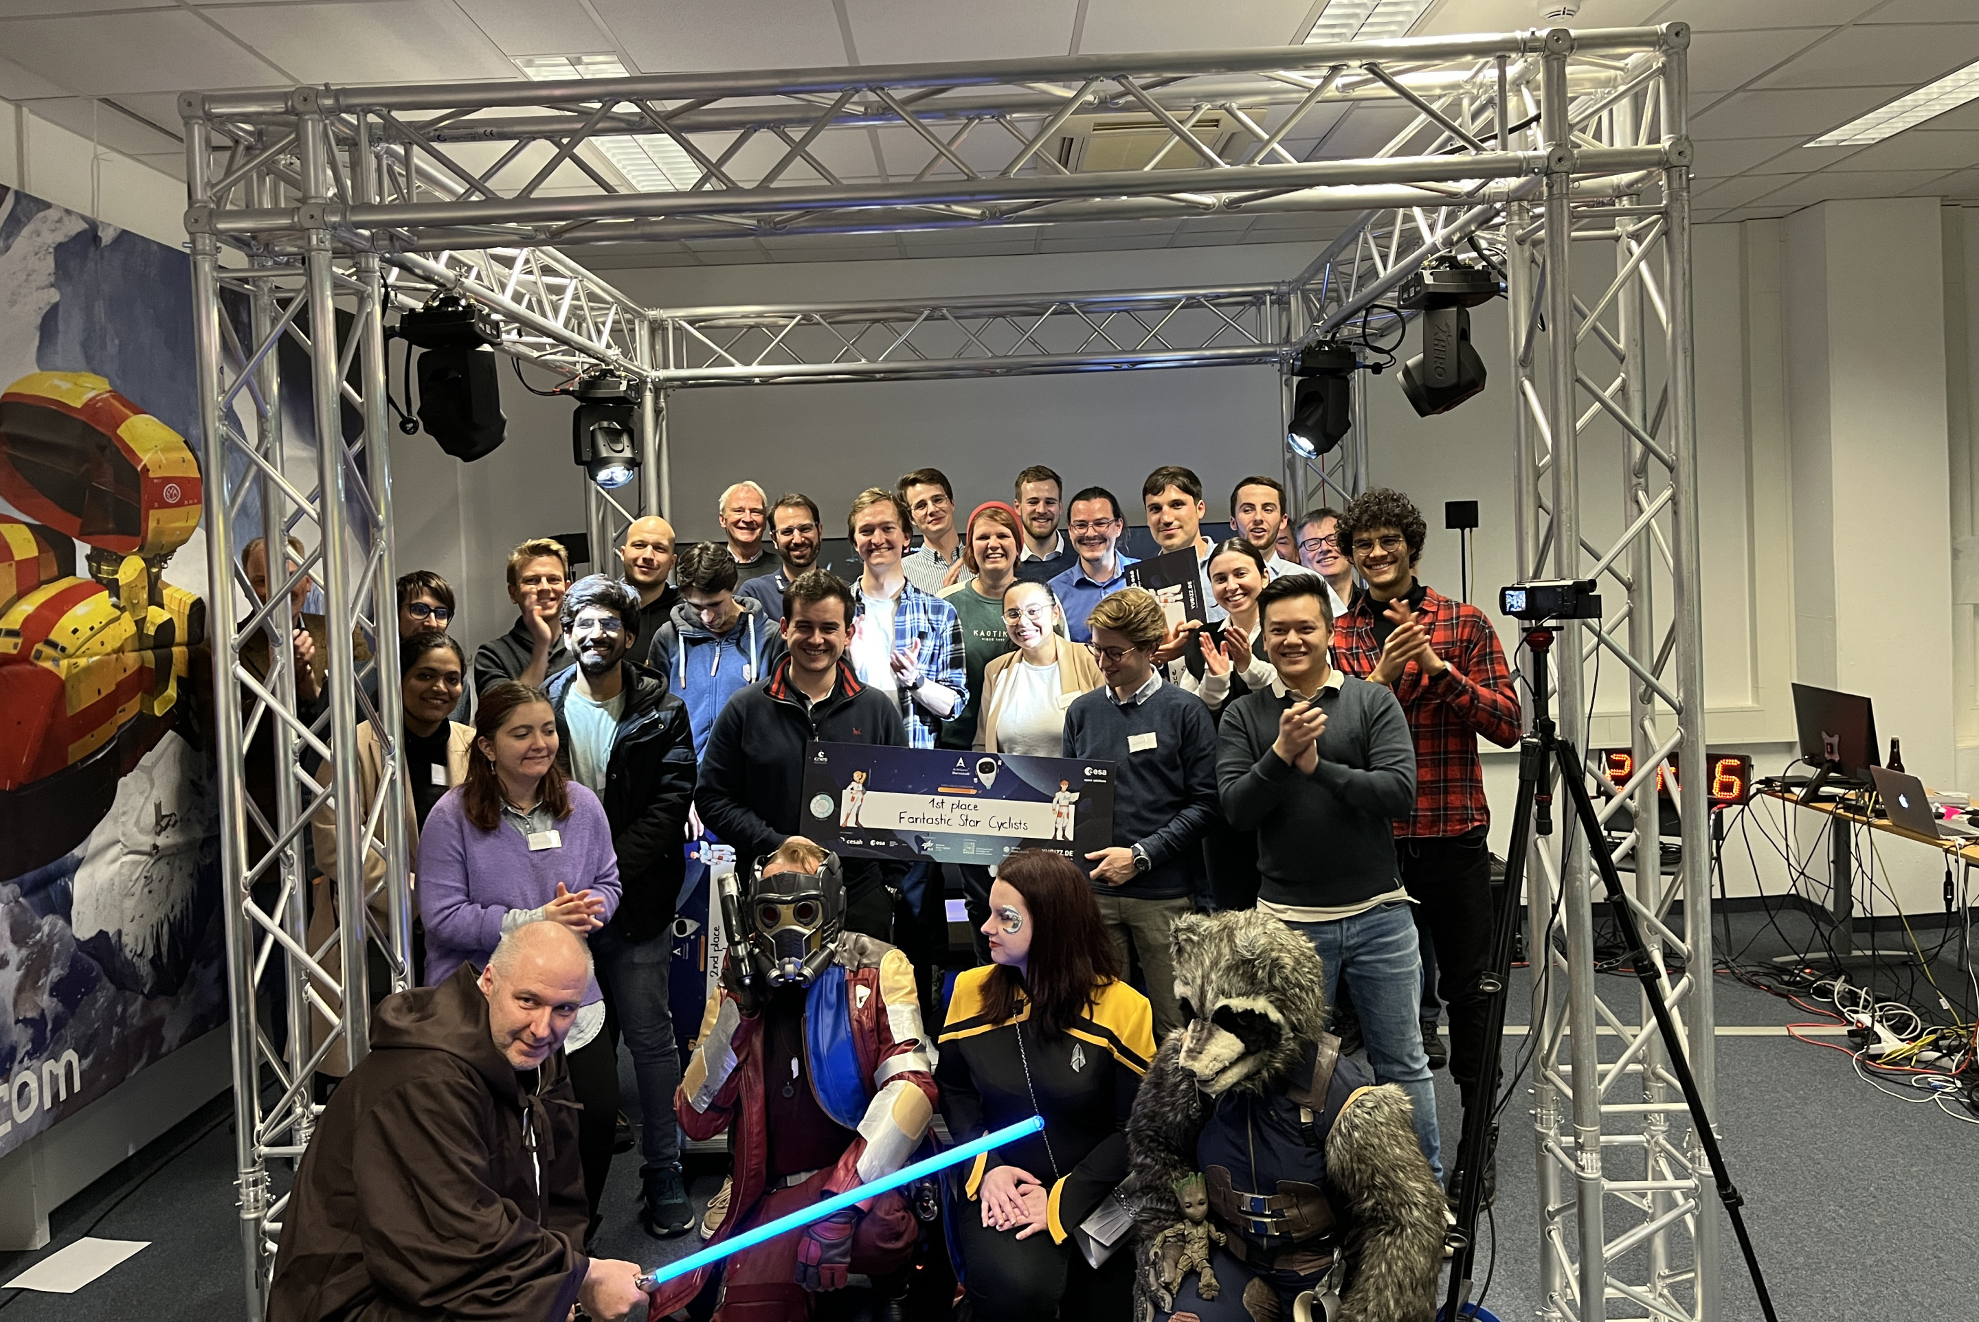
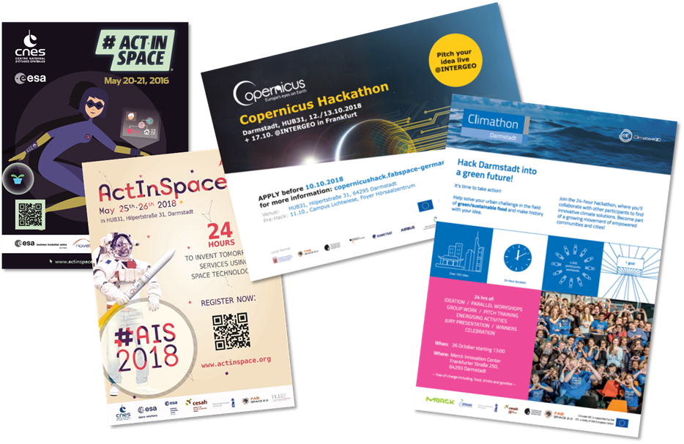
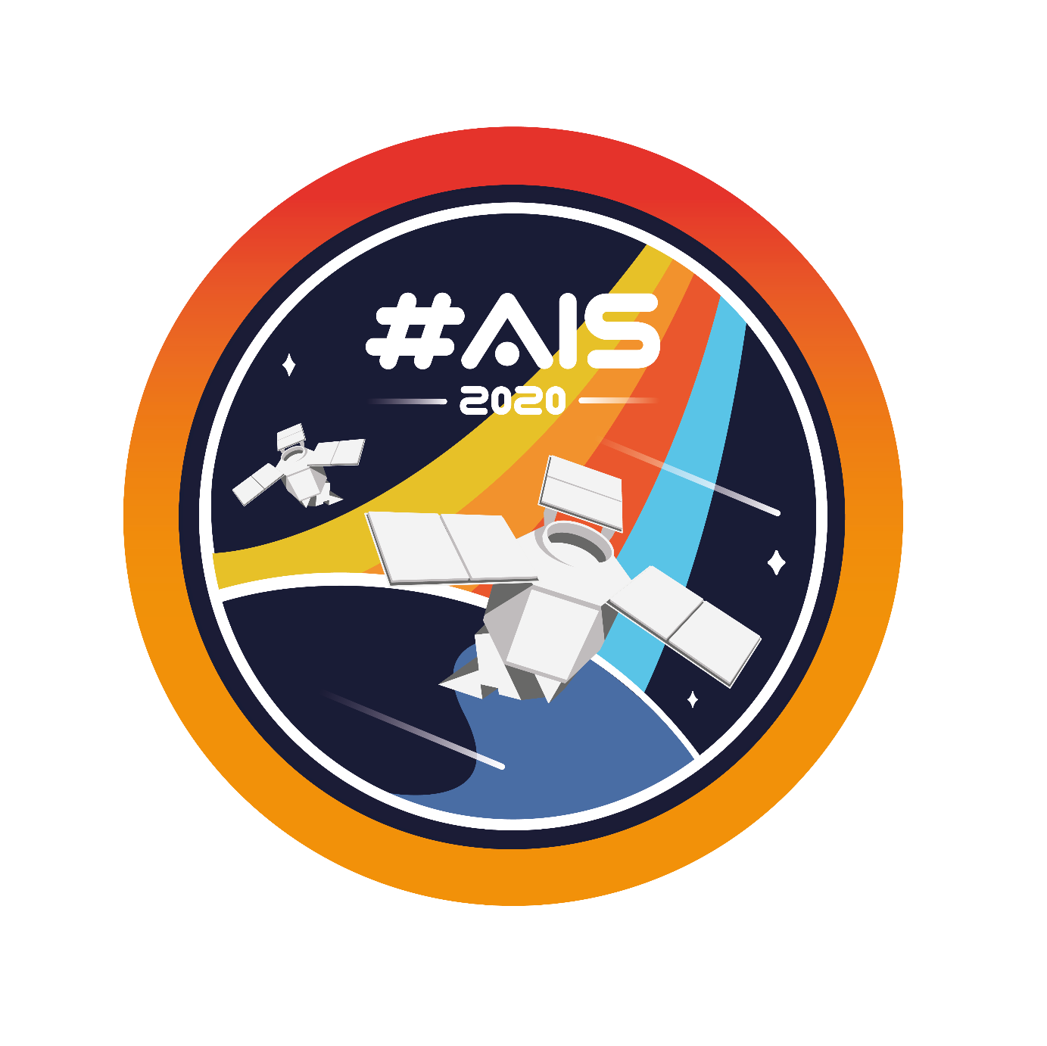



Hackathons & Open Innovation
Climathon Darmstadt
27.-28. Oktober 2023

Slide 6
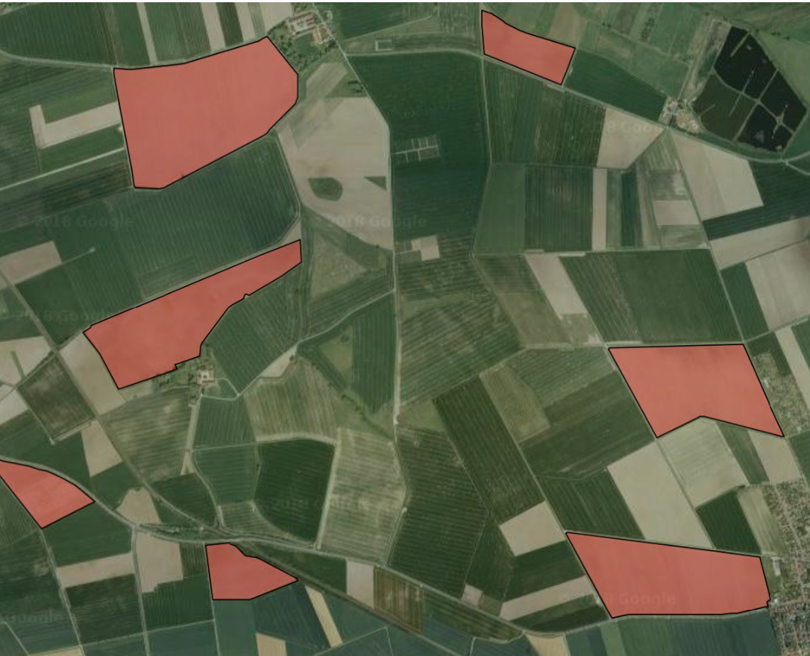
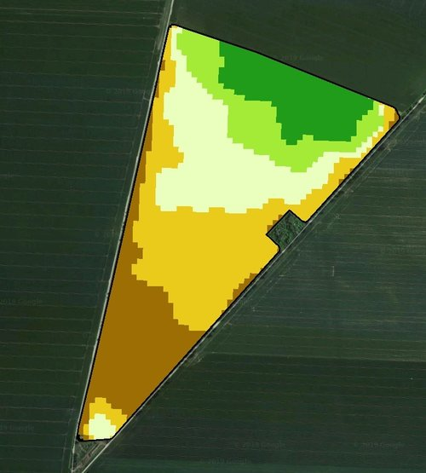
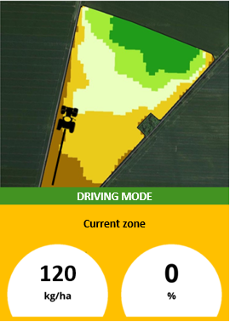

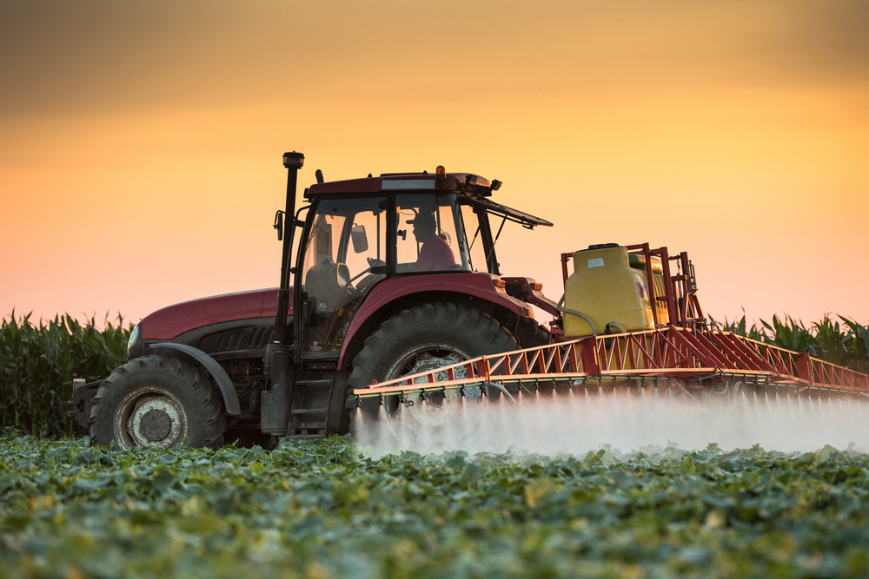
Solorrow: The mobile app for easy entry into Precision Farming
www.solorrow.com
Satellite-derived field potential analysis
Application maps for farmers with just a few clicks
Helps saving up to 20% costs for fertilizer and other chemicals
Helps farmers protecting the environment and comply with regulations

Slide 7


Other Examples
Panopterra – EO applied to agriculture and reinsurance market
agriBORA – Decision support for smallholder farmers with focus on Africa
MaVinci - autonomous micro air vehicles for aerial data acquisition
Treevolution - sustainable development of living trees and forests
easyVineyard - Navigation system for damage recording and task management in vineyards
Spacenus - ubiquitous and near-real-time information services for farming
HeraSpace - use of EO data to detect the ideal conditions for the presence of fish stocks
EO Farm Trace - application of EO to agriculture to monitor organic farming
CoraMaps - use of satellite-radar images to provide innovative crop yield prediction
Moofind – Tracking livestock
… and a few more, all from ESA BIC Hessen

Slide 8

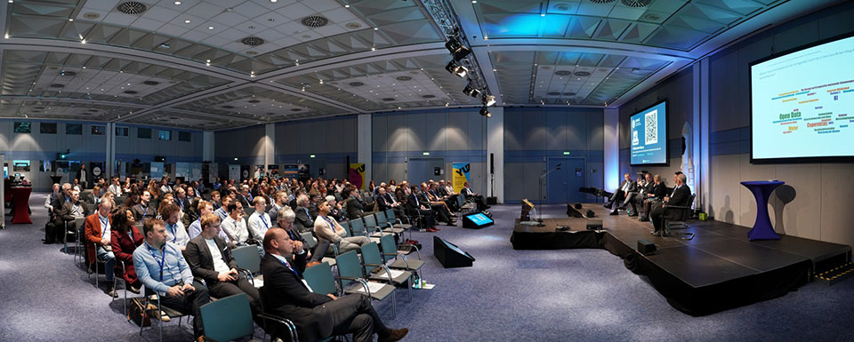
Networking
ESA BIC Alumni – mutual support
Space2Agriculture – DLR INNOspace network
Hochschule Geisenheim University – Expertise and Validation Infrastructure
Global Navigation meets Geoinformation Conference

Slide 9

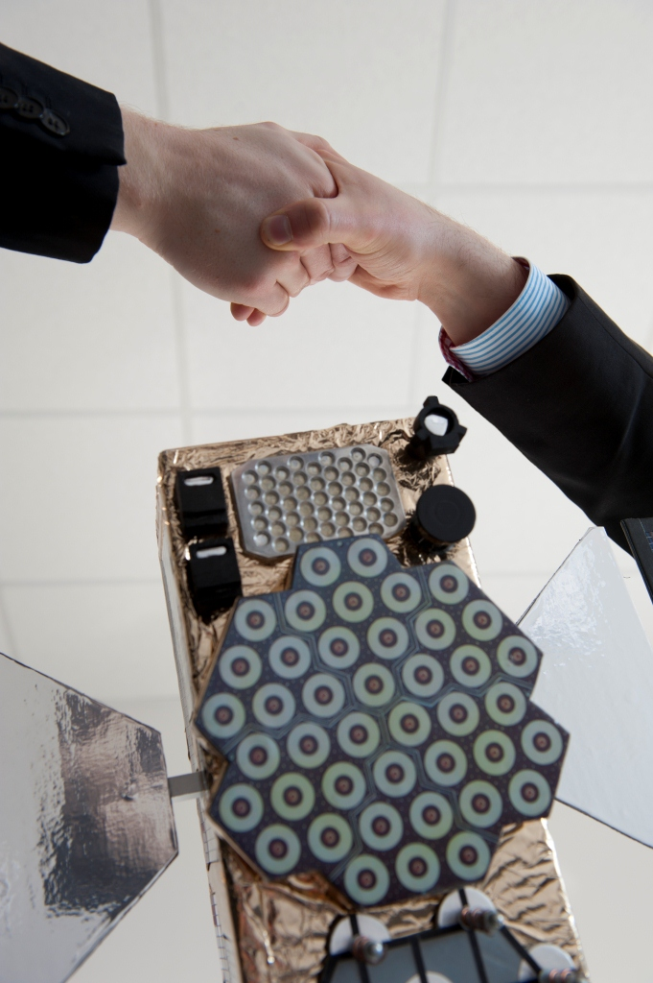
Thank you very much for your attention!
https://www.esa-bic-hessen.de
https://www.esa-technology-broker.de
Dr.-Ing. Andreas Kanstein
cesah GmbH Centrum für Satellitennavigation Hessen
kanstein@cesah.com

