Slide 1




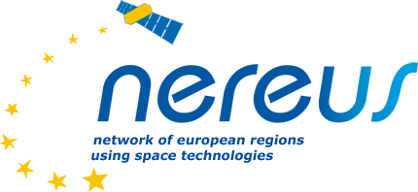


September 28 – 29 | 2023
Matera, Basilicata Region | Italy
European Regional Symposium
From Above and Below: Seismic Activity Management System optimizing tourism and agriculture.
Noemi Zabari
(former: Astrotectonic)

Slide 2
What can be worth 50 mln dollars?

Slide 3
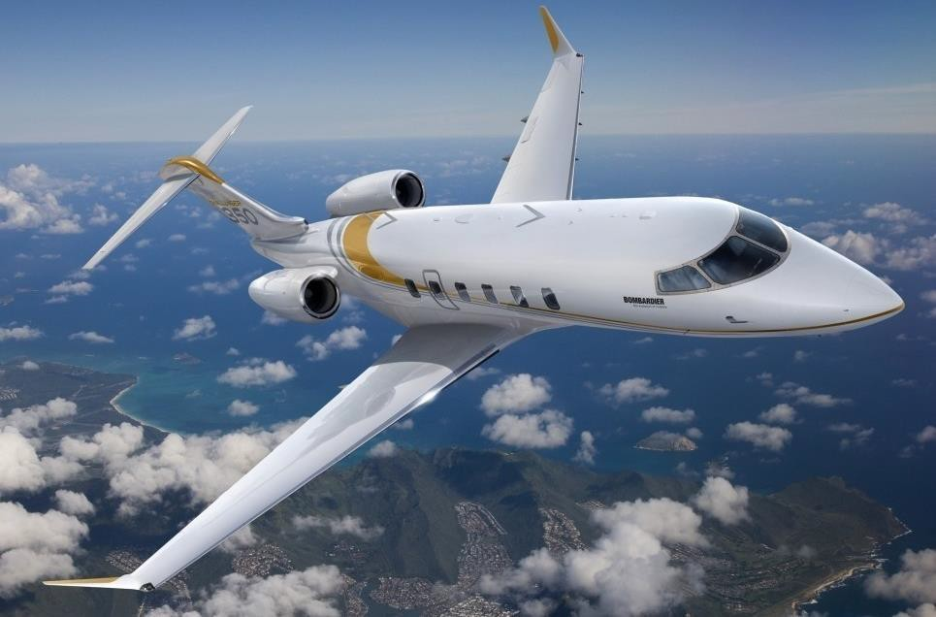

Slide 4
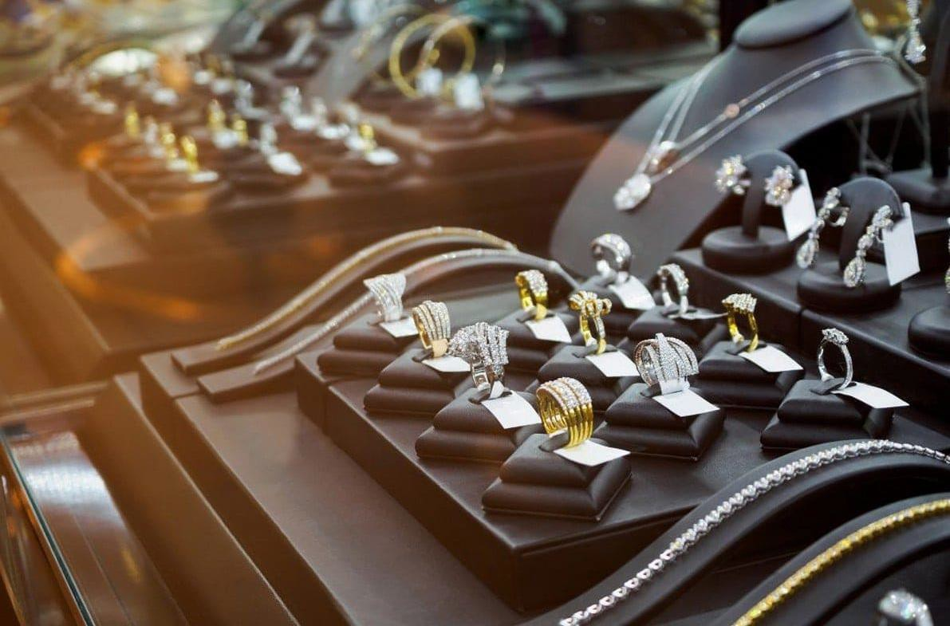

Slide 5

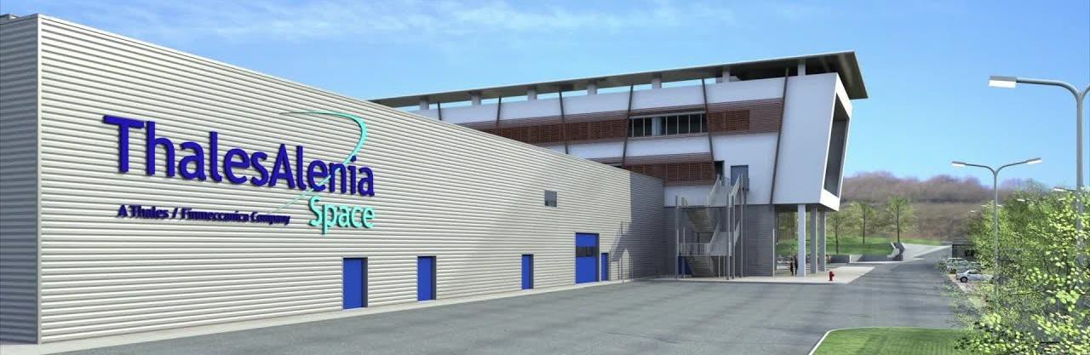
Recovery time: 3 years New facility cost: $57 mln

Slide 6
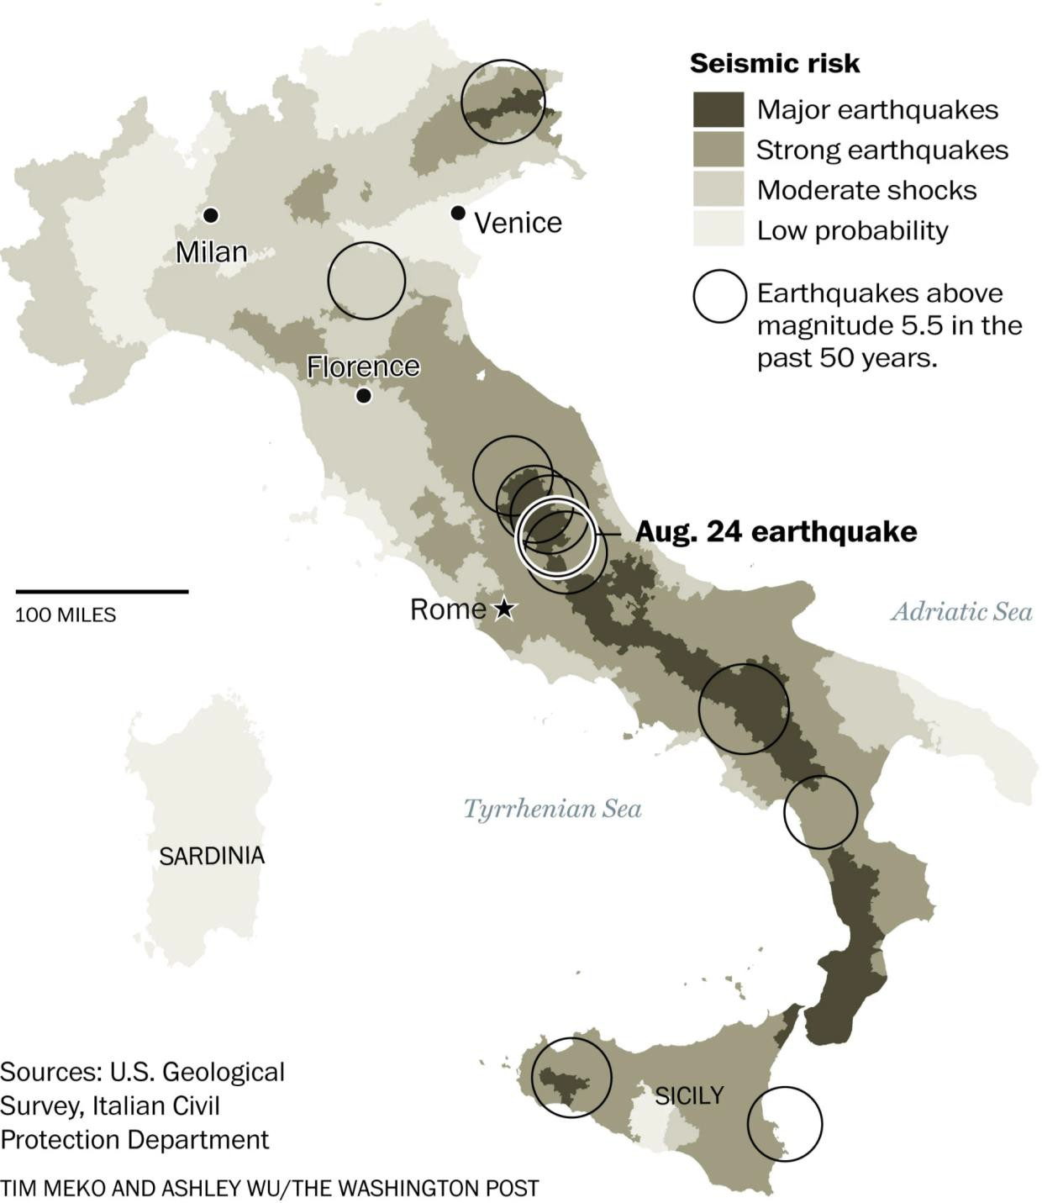

2009 L’Aquila earthquake
308 deaths
1500 injured
66000 rendered homeless
$16B in damages

Slide 7
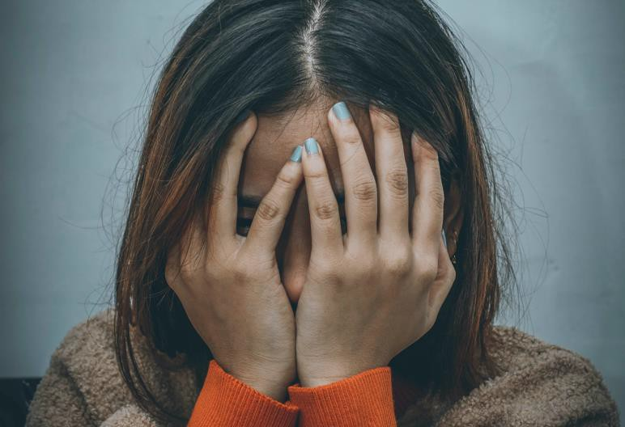
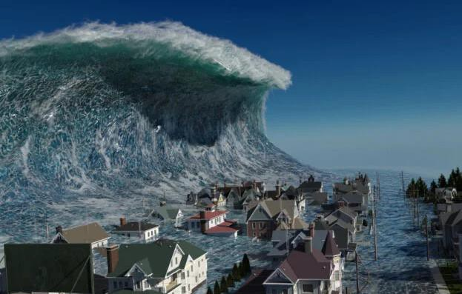
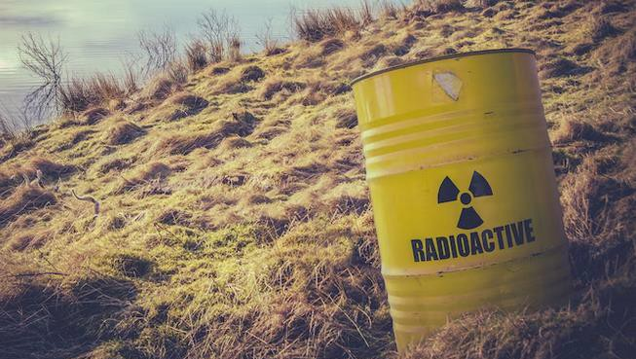
Earthquakes worldwide
31.8K deaths
$22.7B in damages on
avarage each year
Mass panic
Tsunamis
Nuclear waste spills

Slide 8
Why can't we predict earthquakes like we do the weather?

Slide 9


New game
Old game
Detection systems
Forecast system
seconds
hours
Panic. Earthquake reaction rule: drop, cover, and hold on.
New preparedness plans. Better risk
management. Increased trust and confidence.
Moving from panic to possibility to prepare

Slide 10
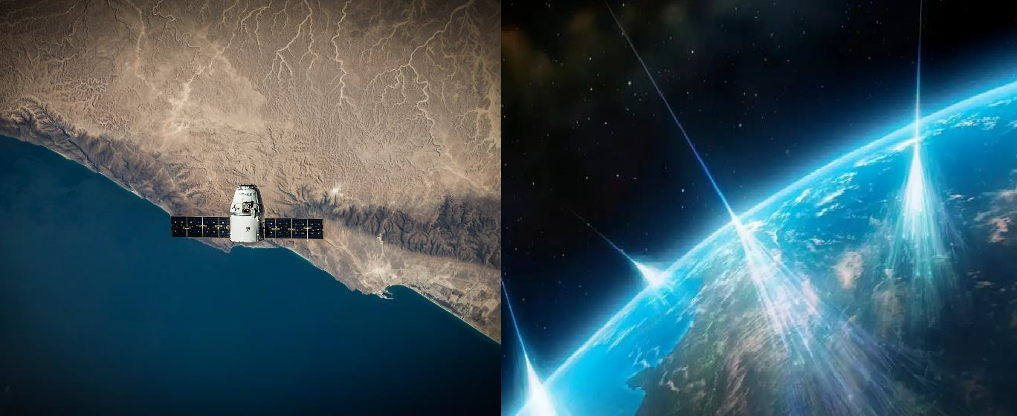
Space data gives us possibilities that were unavailable before.
Earth Observation Data
Cosmic Radiation

Slide 11
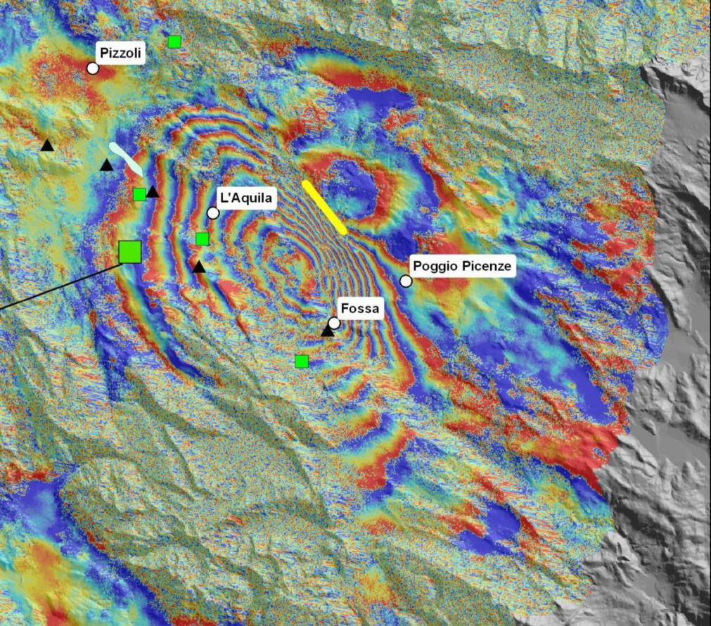
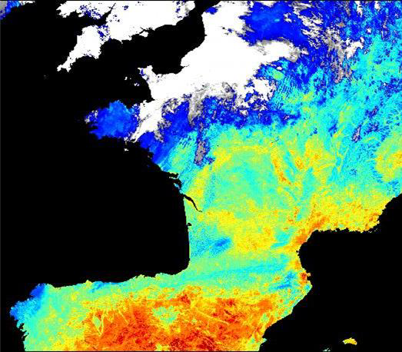
Channel 1: Earth Observation
SAR Interferometry
Thermal imaging

Slide 12
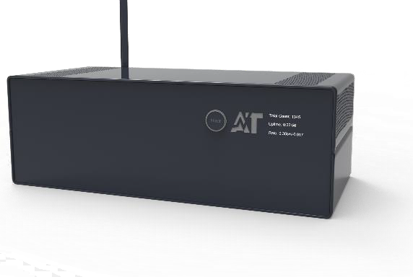
Channel 2: Cosmic Radiation
KEY INNOVATION: our own IoT device: Cosmic Ray Detector Novel channel
Ground-based | shake-resilient | compact | mobile | auto-diagnostic | user-friendly | real-time data | high accuracy

Slide 13
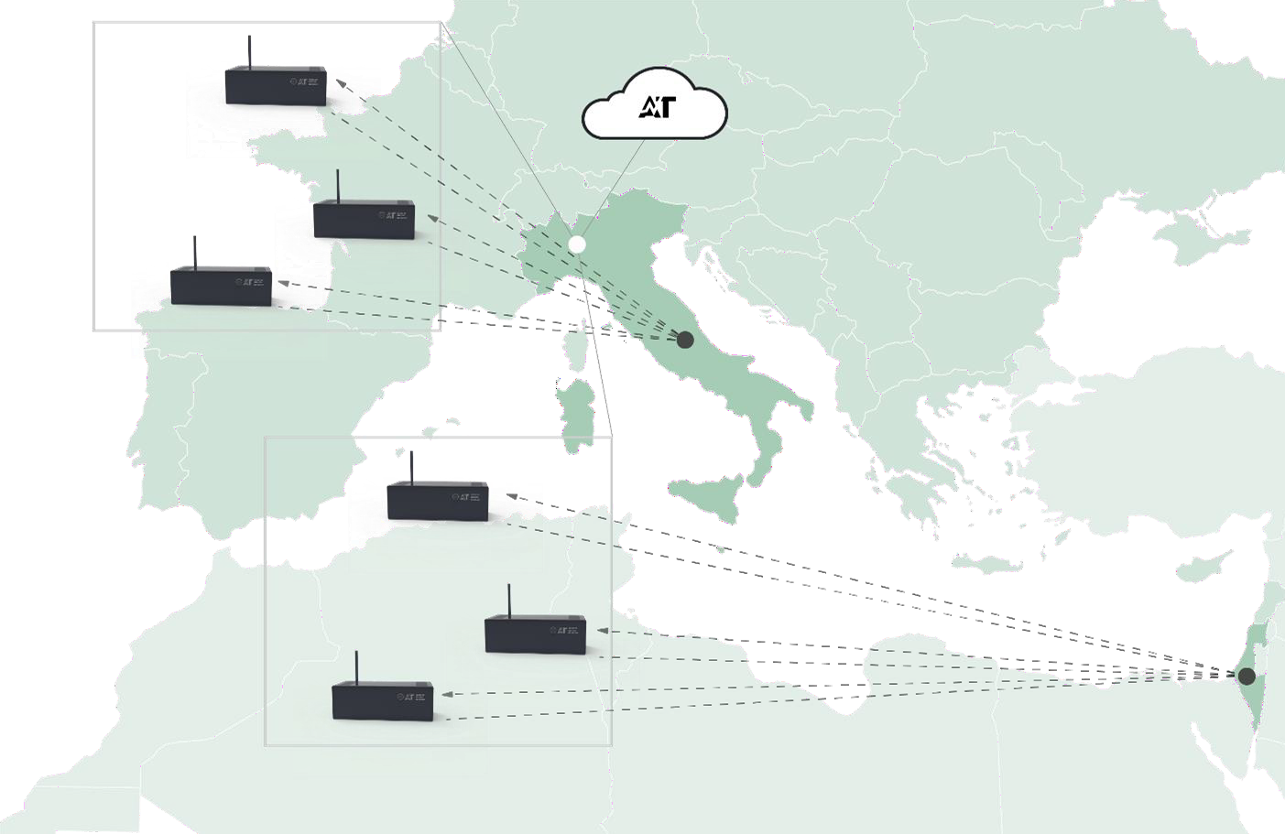



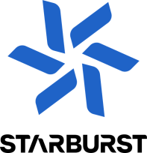

Slide 14
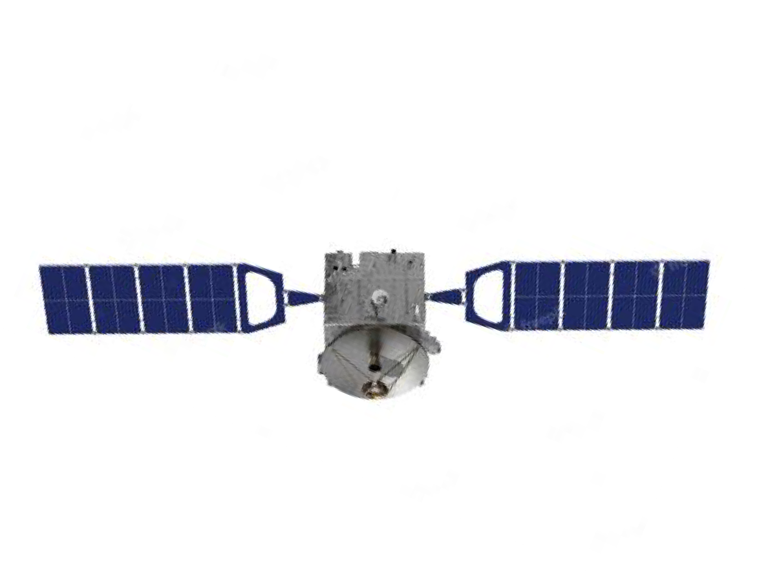
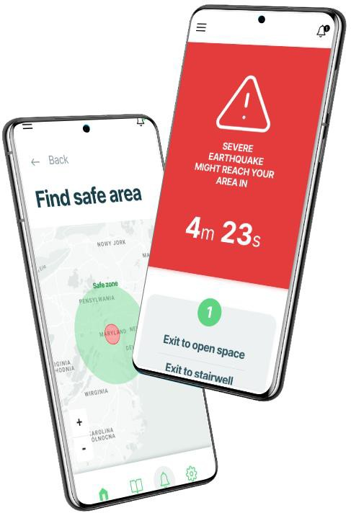

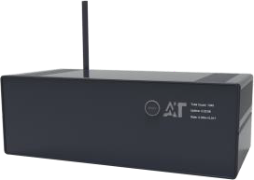




Forecast process
process center
Our proprietary detector
STEP 1
gathering data
STEP 2
deep machine learning analysis
STEP 3
alerts for end-users

Slide 15
















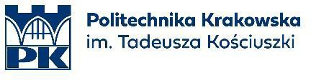
Our technology is based on worldwide research through credible industry partners.

Slide 16
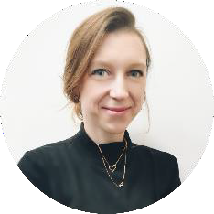
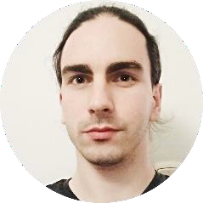
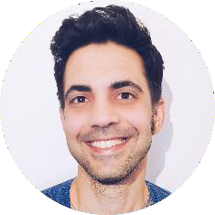

















A diverse team. Co-founders
Noemi
co-CEO
Dr. Noemi Zabari is a dedicated researcher and entrepreneur with a cross-industry mindset in theoretical physics, dense matter, and astrophysics.
Kevin CSO
Dr. Kevin Cheminant is an accomplished astrophysicist specializing in cosmic and gamma radiation research
Itamar co-CEO
Itamar Zabari is an executive leader with over 10 years of experience in operations management, R&D, and business development.

Slide 17

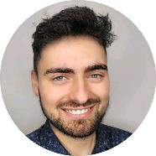
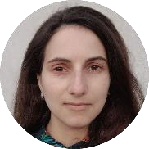






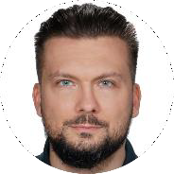
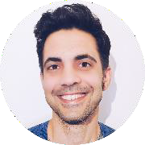
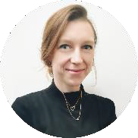
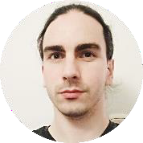
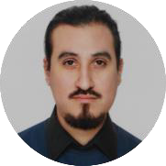




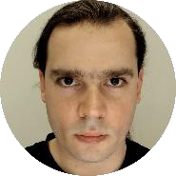



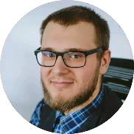
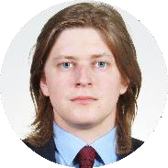
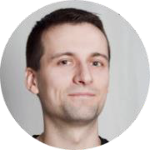

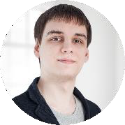
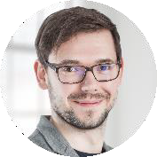
Katsiaryna Katrankova Designer
Business. Itamar Zabari co-CEO
 | Dr Noemi Dr Kevin Zabari Cheminant co-CEO CSO | Research & AI. Dr David Edwin Bartłomiej Kamil Zieliński Alvarez Castillo Roszak S. AI Engineer Data Scientist Head of AI
Software. |  |  |  |  | Hardware.
Dariusz | Mateusz | Mateusz | Piotr |  | Jakub | Konrad | Wojciech
Duda | Przenzak | Skalski | Szymkowski |  | Szuwalski | Kopański | Noga
Python Dev &AI | Frontend Dev | Team Lead &DB | Fullstack Dev |  | Mechanical Engineer | Detector constructor | Embedded engineer

Slide 18
3,000,000,000 people live in seismic zones.

Slide 19






Customer segment
Turisms, Travel Agencies
for seismic safety tours.
Governments and disaster management agencies
Insurance & Reinsurance
Agriculture and Agriquake Preparedness
Oil & Gas Operations
Infrastructure & Utilities

Slide 20
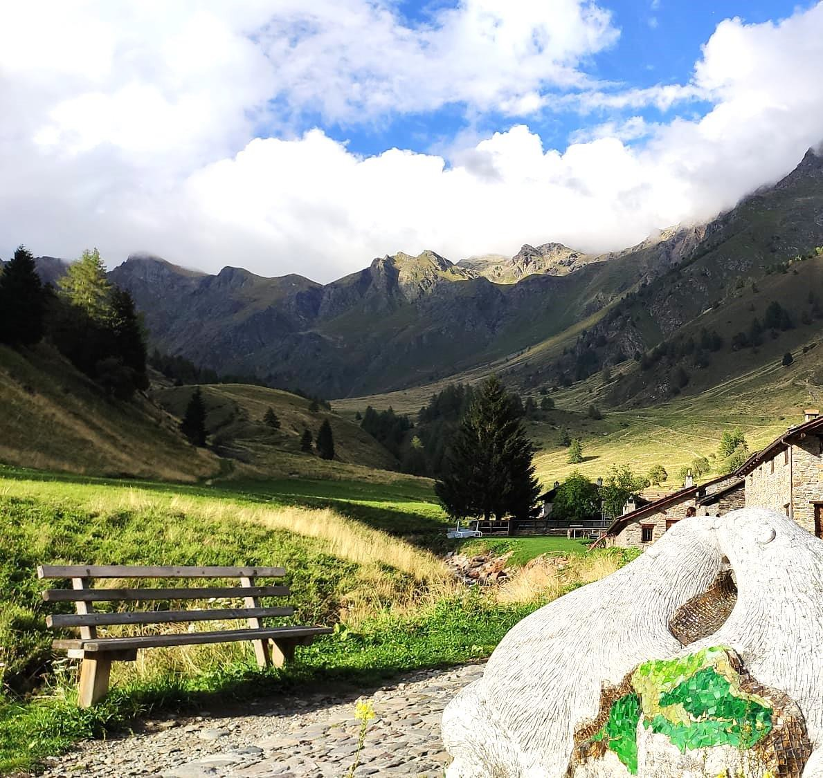
Turisms
Enhancing safety measures
Improving planning
Enriching visitor
experience.

Slide 21
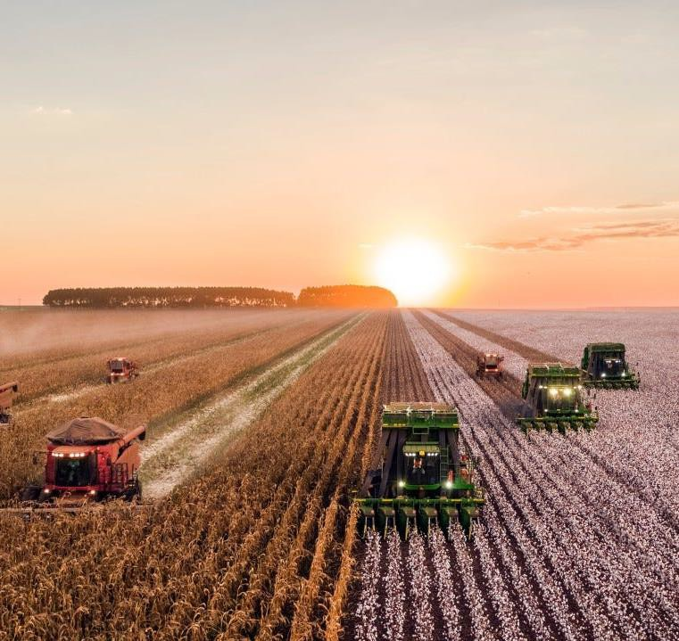
Agriculture
Risk assessment
Resource optimization
Climate change
adaptation

Slide 22
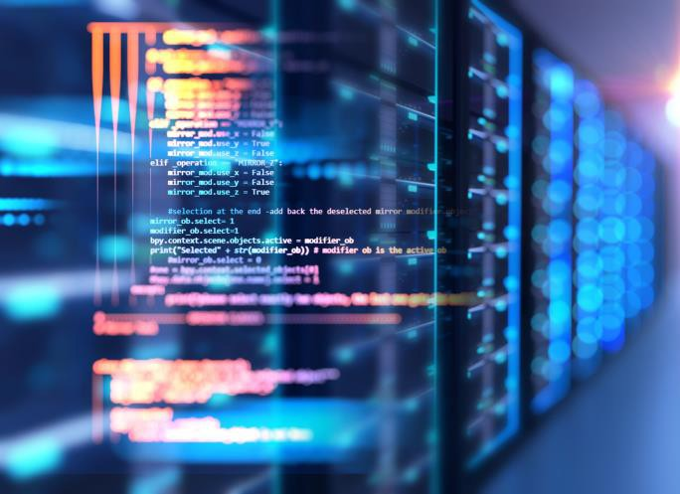
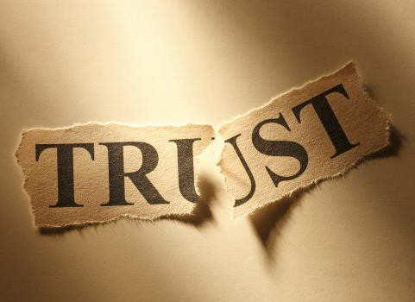

Risks
TECHNOLOGICAL
SOCIETAL ACCEPTANCE
FINANCIAL
Not enough data Mitigation: Setting up more detectors for free.
Lack of trust of people Mitigation: Intensive distribution of the results.
Abilities to raise needed funds.
Mitigation: Pre-
payments, more grants.

Slide 23
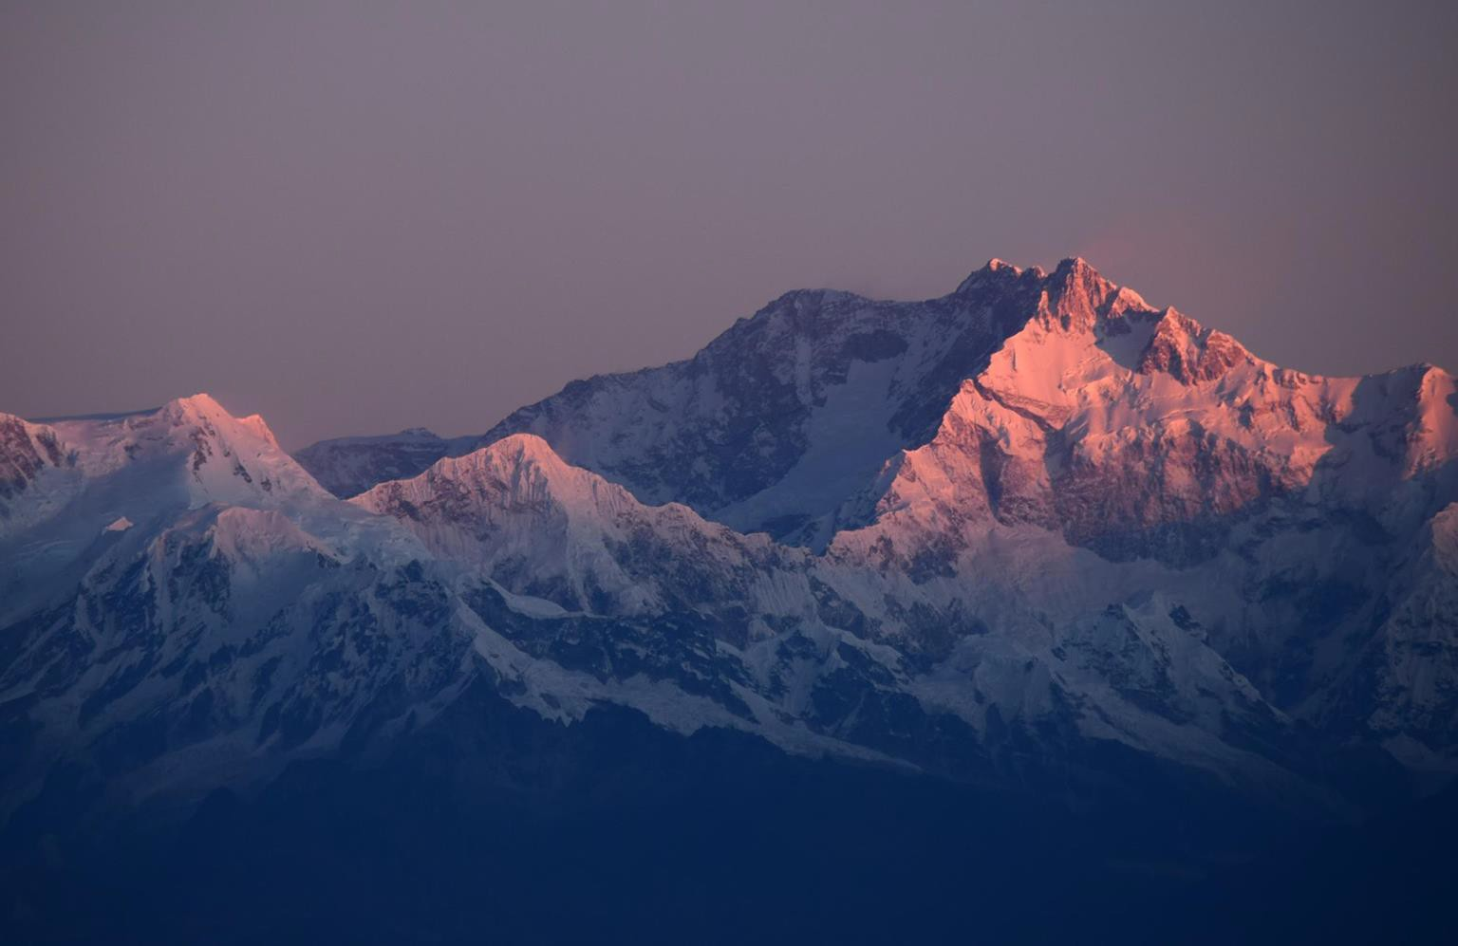
Join us in saving lives and reducing the devastating impact of earthquakes around the world.
Find out more:
www.astroteq.ai
Email our founders:
noemi@astroteq.ai itamar@astroteq.ai kevin@astroteq.ai

