Slide 1
European Regional Symposium
September 28 – 29 | 2023 Matera, Basilicata Region | Italy
Second Edition of the European Regional Symposium, on space data for tourism & agriculture, by NEREUS Regions
Fusion of Remote Sensing and Geospatial Data:
Enhancing Information Capacity
for Agricultural Crop Monitoring
Krystyna Michałowska, PhD
University of Agriculture in Krakow, Poland

Slide 2
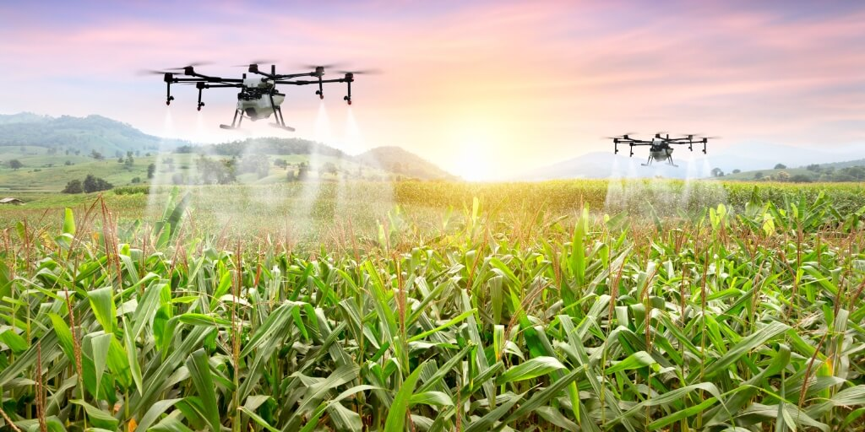
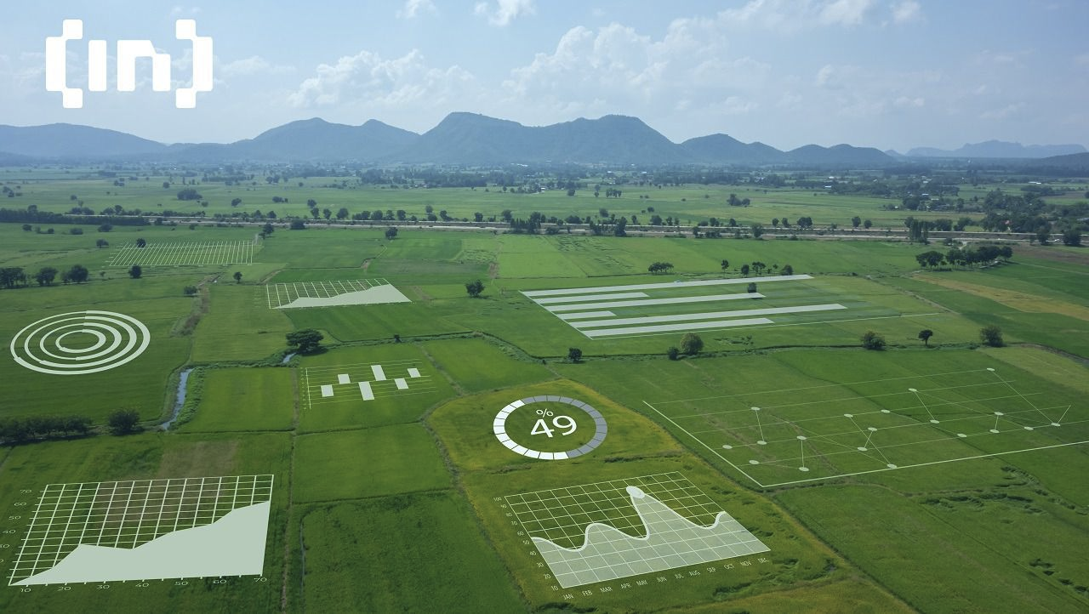
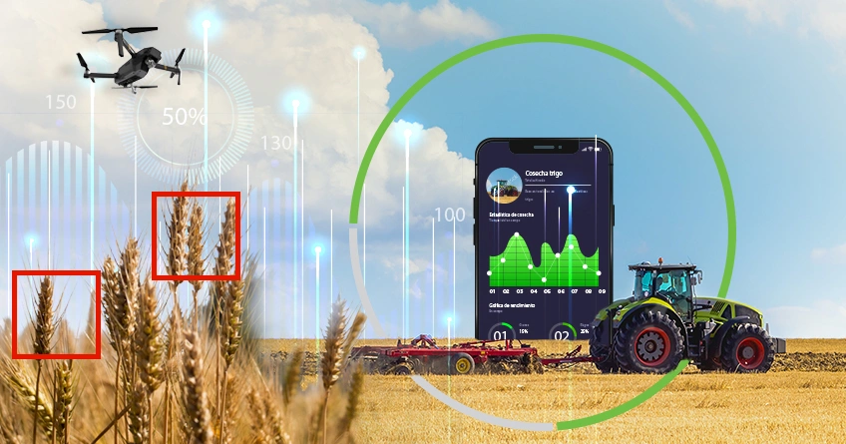
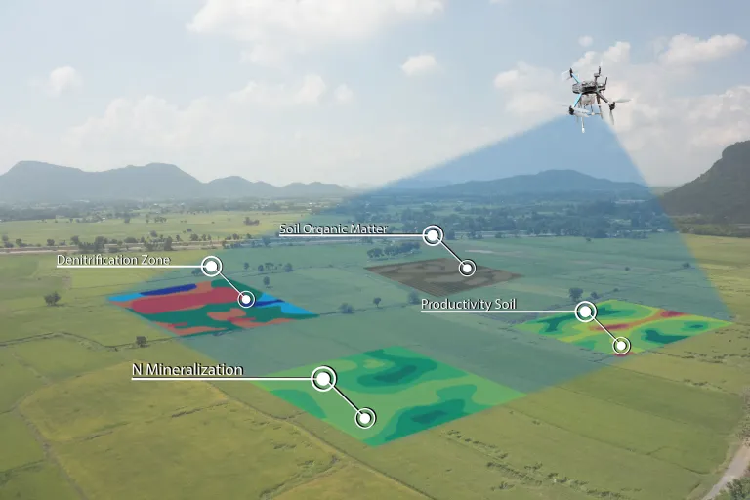
University of Agriculture in Krakow
The Agency for Restructuring and Modernisation of Agriculture (ARMA)
The National Support Centre for Agriculture (KOWR)
Agricultural Advisory Centre (ODR)
Individual farms and companies
Notes:
Our university strongly supports the conceptual and technological approach towards initiatives
related to the development of precision agriculture and the implementation of innovative space (remote sensing) technologies

Slide 3
The challenges
National level
IACS - direct payments system
AMS - Area Monitoring System
Regional/local level
individual farms
agricultural holdings
(yield prediction, fertilisation, irrigation)
Support for innovation in agriculture for better life
Notes:
Slide 3: The challenges we face can be categorized into two different levels: national and local.
- -At the national level, we focus onthe crop identification and monitoring of agro-technical operations.
These tasks are carried out by the AMAR agency under the IACS program.
At the national level, the Aerial Monitoring System AMS has been established .
--At the local and regional scale, we focus on the needs of individual farmers, such as yield prediction, fertilization, and irrigation.

Slide 4
The challenges – national level Management of the direct payment system The Agency for Restructuring and Modernisation of Agriculture (ARMA)
Area of Poland | 312 000 km²
Reference parcels | 34 696 000
Number of farmers | 2 000 000
Average farm size | 11,2 ha
Number of applications for subsidies | 1 373 000
These numbers are crucial for managing the system of direct subsidies for farmers, overseen by ARMA, the largest agency in Poland, playing a key role in driving innovation and agricultural management development.
Notes:
Slide 4: Let me provide some key statistics to illustrate the scale of challenges at the national level:
• These tasks are carried out by the AMAR agency under the IACS program.
These numbers are crucial for managing the system of direct subsidies for farmers, overseen by ARMA,
the largest agency in Poland, playing a key role in driving innovation and agricultural management development.

Slide 5
Area Monitoring System (AMS)
Increasing the scale of use of satellite data to monitor large agricultural areas
Reducing the cost of administrative issues
Pursue the use of satellite data to support decision-making
Notes:
Slide 5:
One of the most critical challenges at the national level is to build the Area Monitoring System (AMS).
This system aims to:
Reduce administrative costs.
Increase the scale of use of satellite data to monitor large areas
Using satellite data to support decision-making processes.

Slide 6
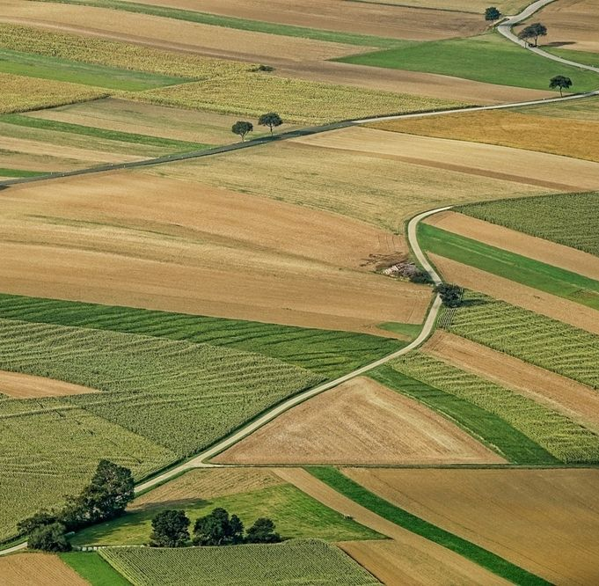
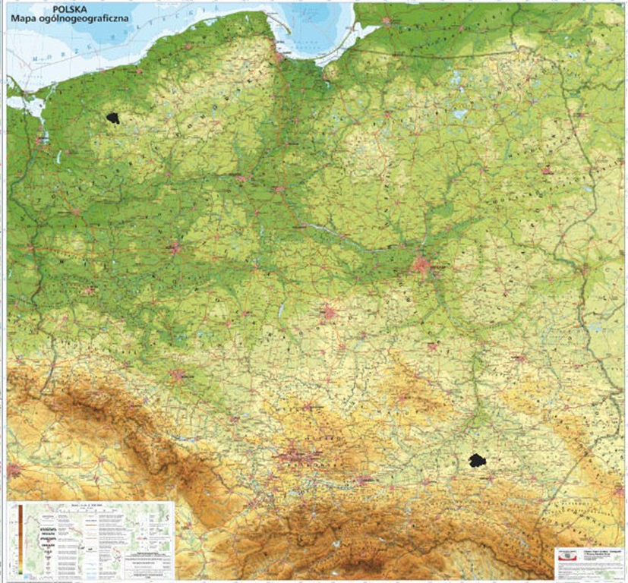
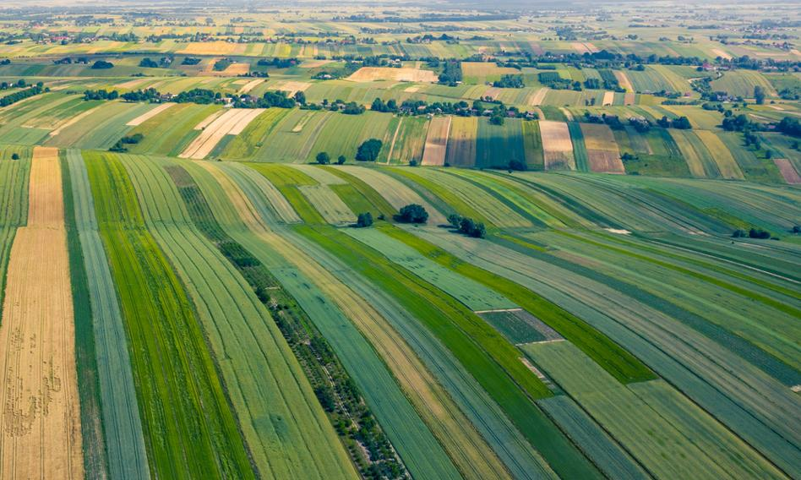
Different structure of land parcels in Poland - North - crops on large parcels of land - South - fragmented structure of parcels - different climatic conditions
Poland
The challenges
Notes:
In Poland, there are differences in the structure and size of parcels between the northern and southern regions.
- In addition, the issue is complicated by different climatic conditions and types of crops

Slide 7
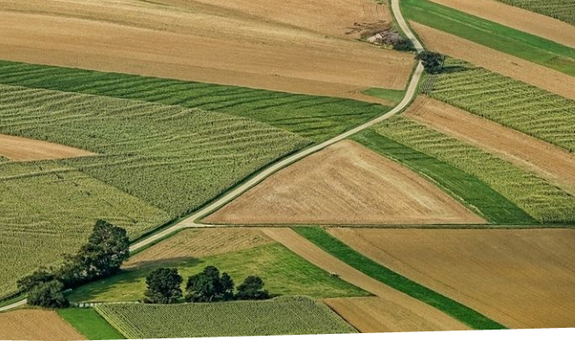
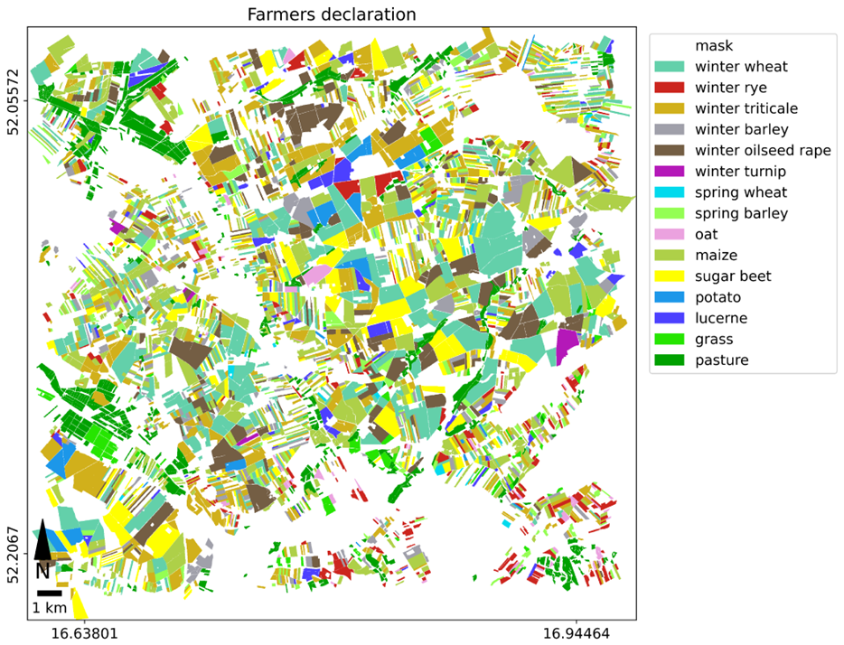
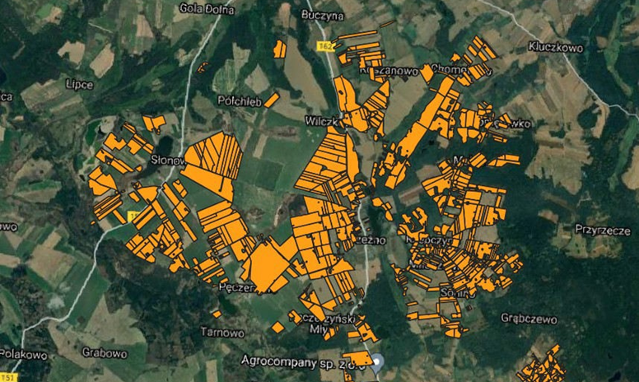
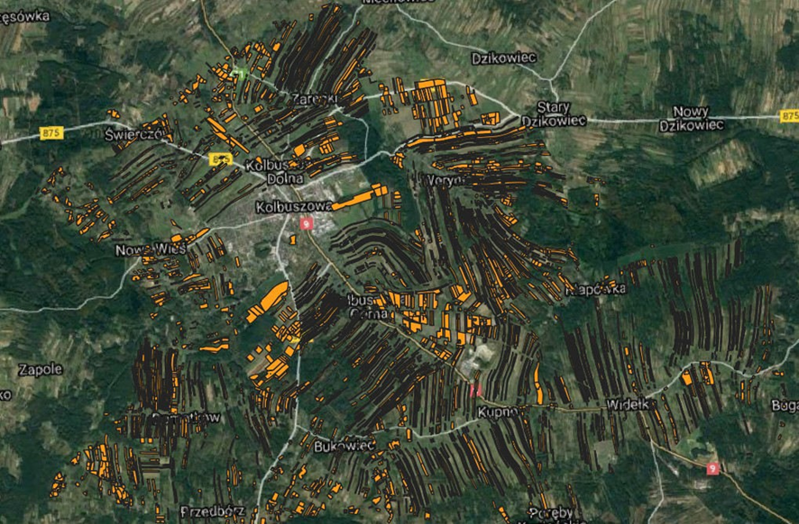
Visualisation of the different structure of parcels in the regions of Poland
North South
Different size of agricultural parcels
Spatial data with different resolution
Notes:
Slide 7: On this slide, we can see example of the of the land parcels strakture
- In the north, we have large parcels with more uniform shapes,
- while in the south, parcels tend to be much smaller, elongated, or irregularly shaped.
That why we need stelitte with different spatial resolution
when working with medium-resolution satellite data such as Sentinel-2 (an example of which is shown on the slide).

Slide 8
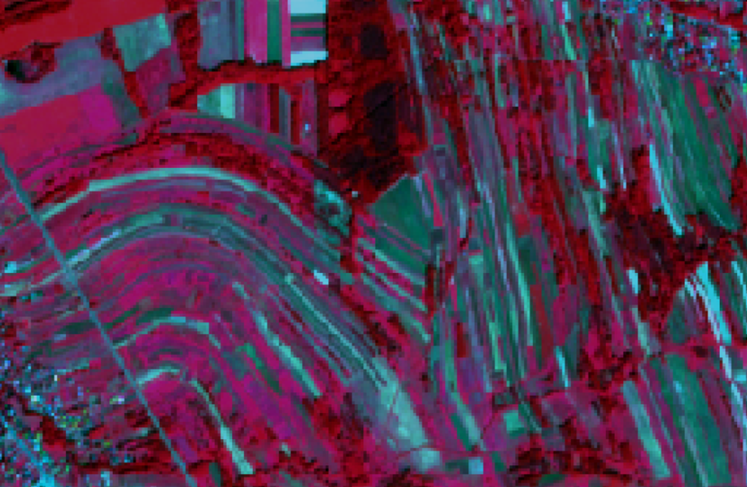
SENTINEL 2
HySpex
430 bands
Field pixel size: 0.5 m
VNIR 400 - 1000 nm
SWIR 930 - 2500 nm
12 (9) bands 443 - 2190 nm
Field pixel size: 10, 20, 60 m
Notes:
Slide 10: As you can see in
the example from the southern region of Poland with highly fragmented land parcels, Sentinel-2 images alone may not suffice for tasks related to crop recognition and identification of agrotechnical operations. In such situations, substantial support can be provided by hyperspectral imagery from airborne platforms and UAVs.
In Southern Poland, where land parcels are highly fragmented, Sentinel-2 images are not enough for crop identification and moniotoring agrotechnical operations. Hyperspectral imagery from airborne platforms UAV data can be helpful in such cases.

Slide 9
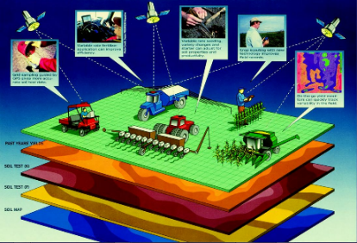
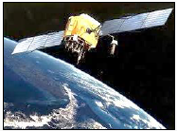
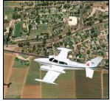
The challenges - national level
Platforms
GIS database
satellite
airborne
UAV
Notes:
Slide 8: Copernicus image data needs to be supplemented with higher spatial resolution data, both from very high-resolution satellites (VHRS) and aerial or UAV imagery. In national agricultural management systems, we employ data fusion techniques that combine imagery, vector data (e.g., farmers' declarations), and information from current GIS databases

Slide 10
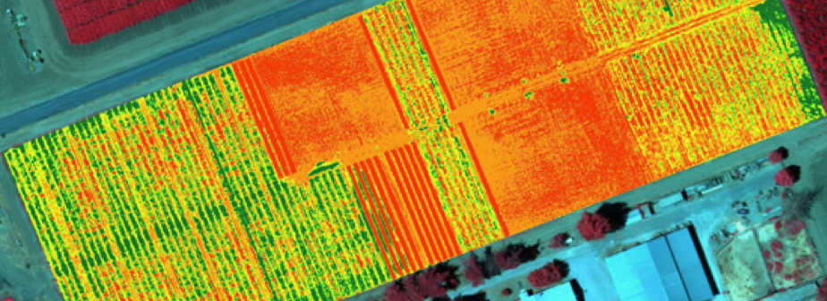
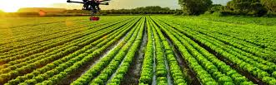
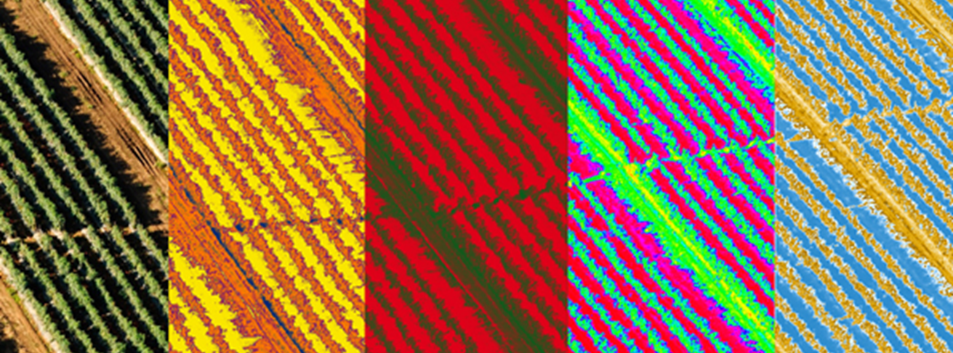
UAV data
Qualitative information
-crop recognition,
-plant condition,
-moisture level, etc.
Quantitative informations - precise area measurement
Notes:
Slide 11: Images from UAVs serve as an excellent complement to quantitative (e.g., precise area measurement) and qualitative (e.g., crop recognition, plant condition identification, moisture levels, etc.) information.

Slide 11
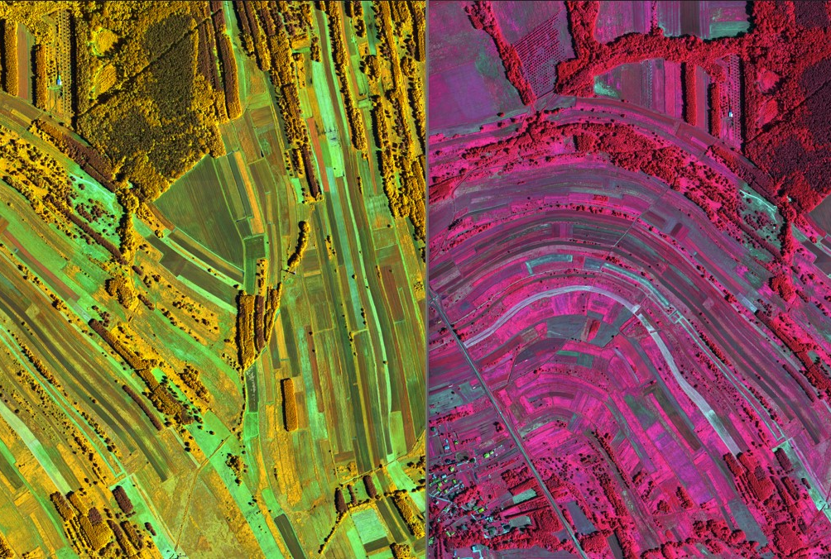
Data fusion
vector data – farmers declarations
Multi-temporal Sentinel 1, 2
Hyperspectral data
UAV data
Notes:
Slide 9: On this slide, we present examples of various types of data, both vector and imagery, including hyperspectral data with very high spatial resolution (1m) and spectral resolution (480 spectral channels).

Slide 12
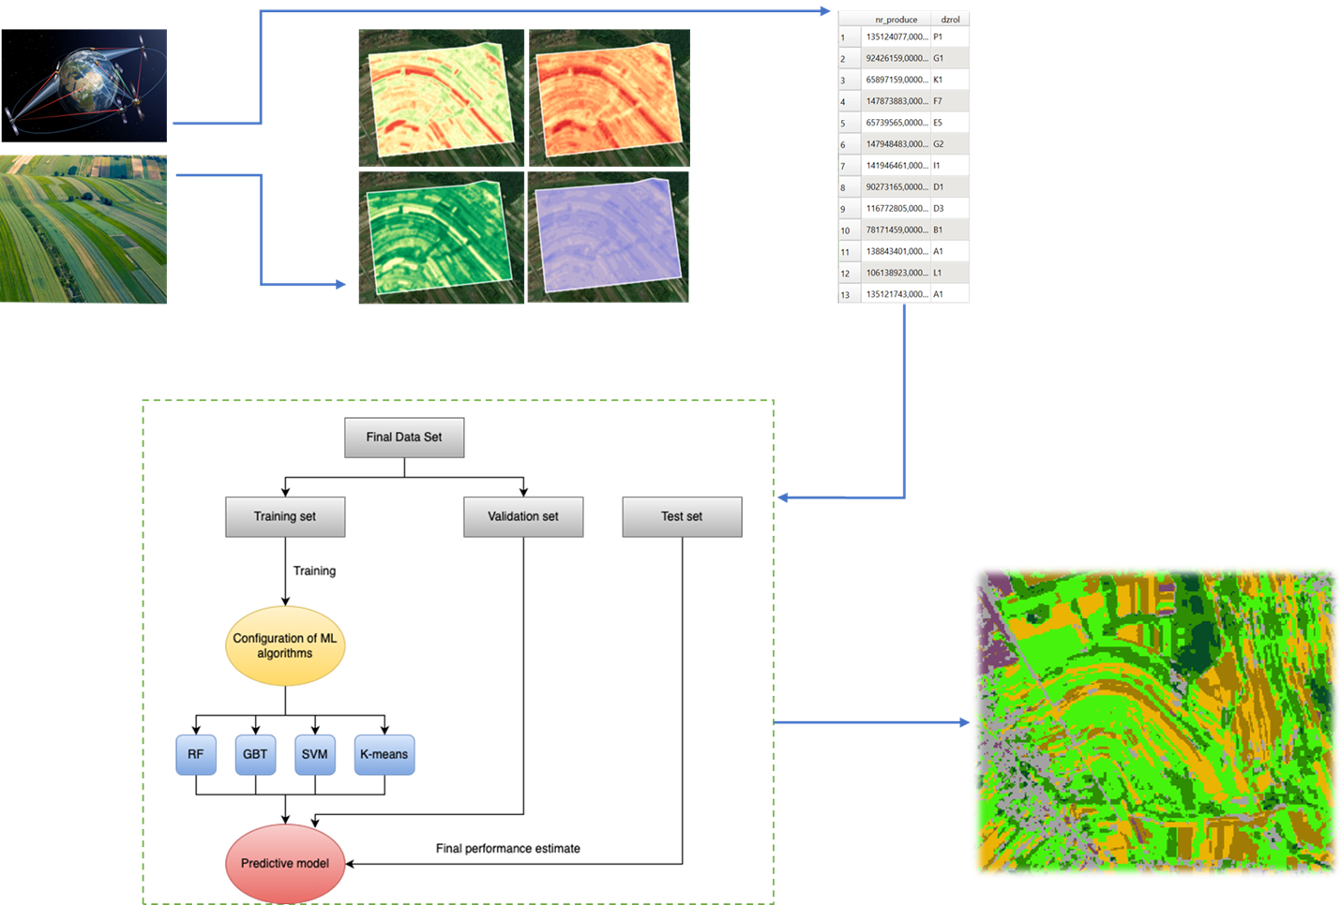
Data Fusion workflow
image processing products (e.g. spectral indexes)
test & validation samples:
Spatial database,
farmers declaration
Satelitte images,
field data
classification or prediction results
Machine learning image classification models, prediction models
Notes:
Slide 12: Here, we present the most relevant workflow for integrating remote sensing and geospatial data.
The initial step involves
proper processing of image and non-image data,
preparing maps like spectral indices and other products.
Moreover reference vector data (e.g., farmers' declarations) can be training or validation samples for predictive or classification machine learning models like SVM, RF, etc. As output we obtain classification map, such as crop types or yield predictions for a specific area.

Slide 13
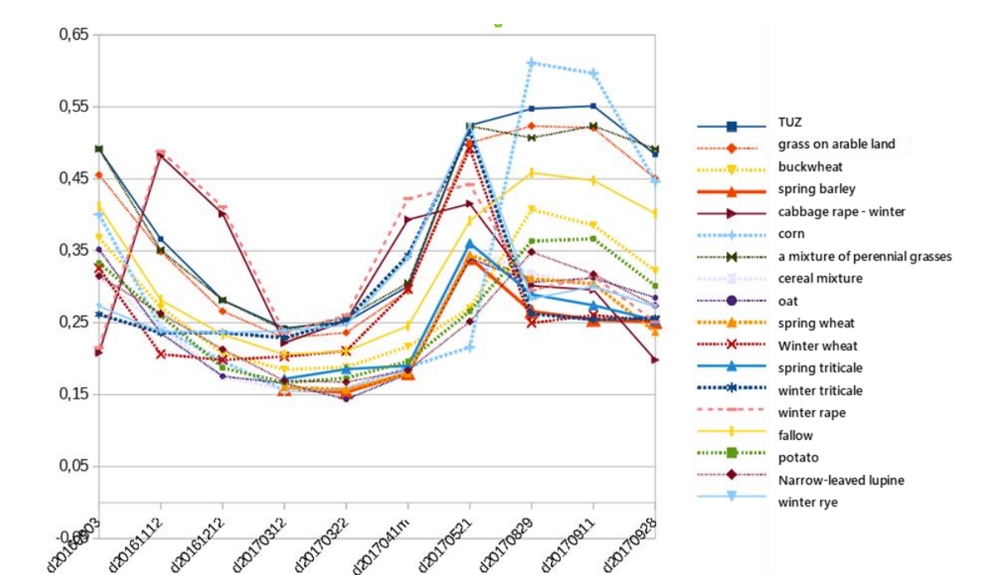
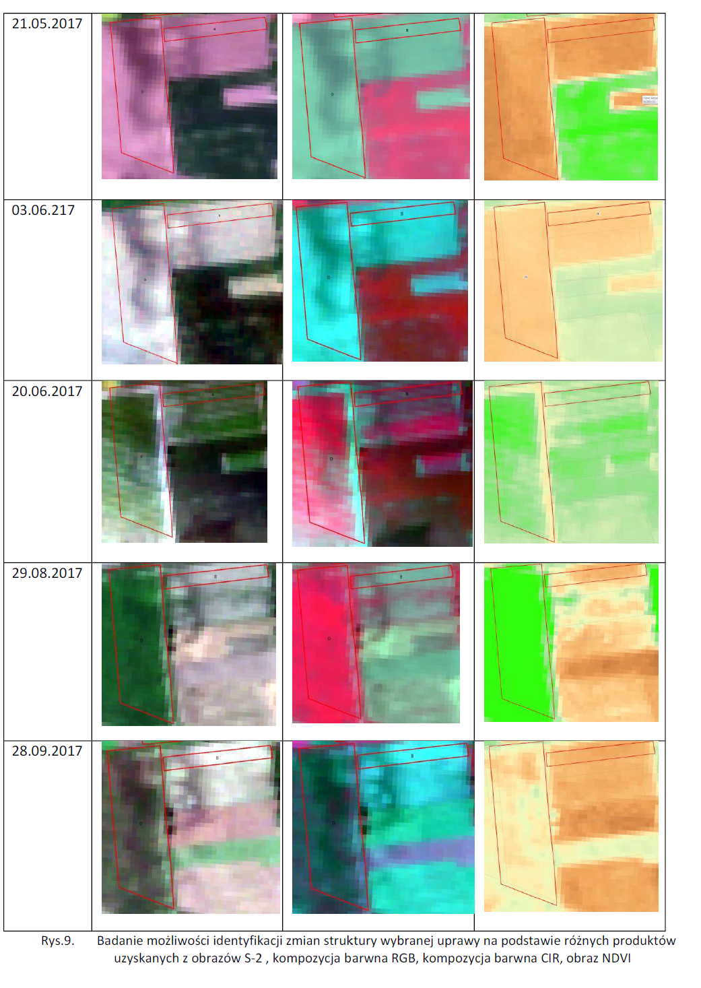
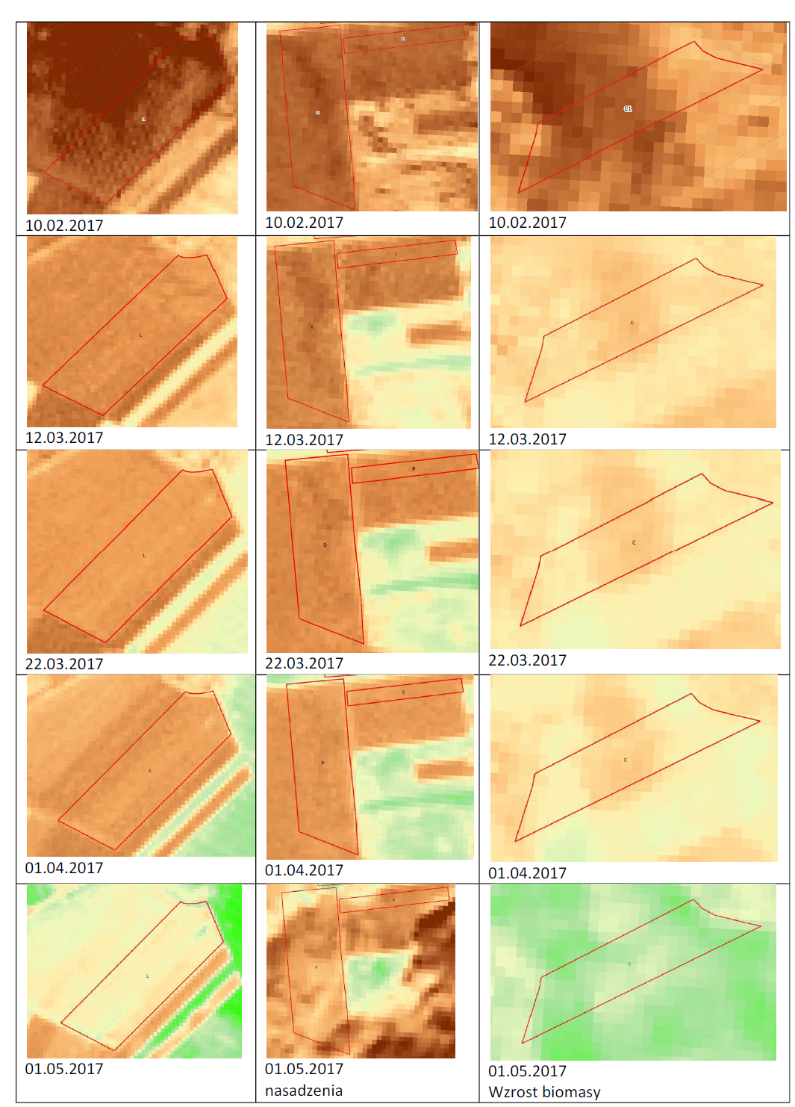
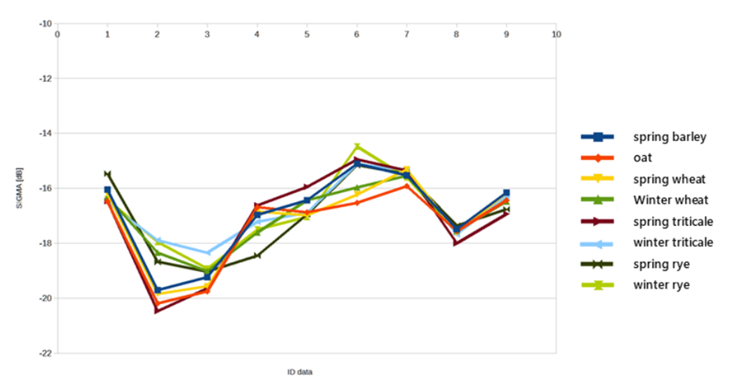
Data fusion S1, S2 – crop monitoring
Spectral indexes Monitoring of agro-technical treatments (ploughing, grass mowing)
Averaged charts of NDVI values obtained on the basis of S-2 imagery for selected crop types (period from 03/09/2016 - 28/09/2017)
SIGMA backscattering coefficient cof variation over time for selected crops (average values)
Notes:
Slide 13: Prepared spectral indices like NDVI, derived from Sentinel-2 imagery, are valuble data sources for monitoring agricultural activities.
Indexes used at both national and individual farm levels. Multi-Temporal curves obtained from NDVI images and sigma backscatter coefficient (from Sentinel-1), provide a lot of information about crops types, irrigation, soil moisture fertility, and more.

Slide 14
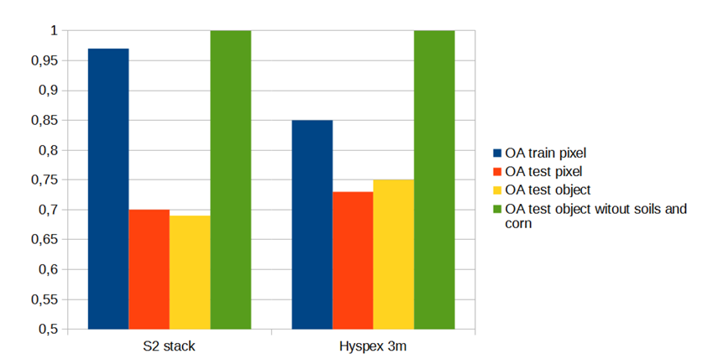
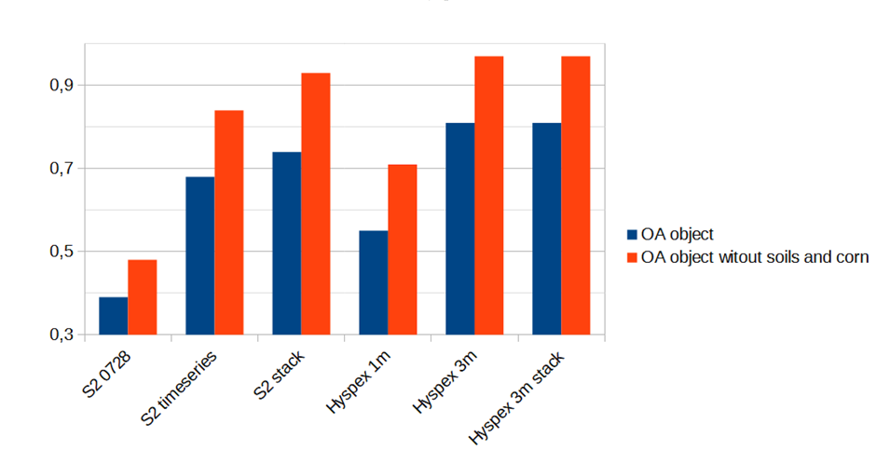
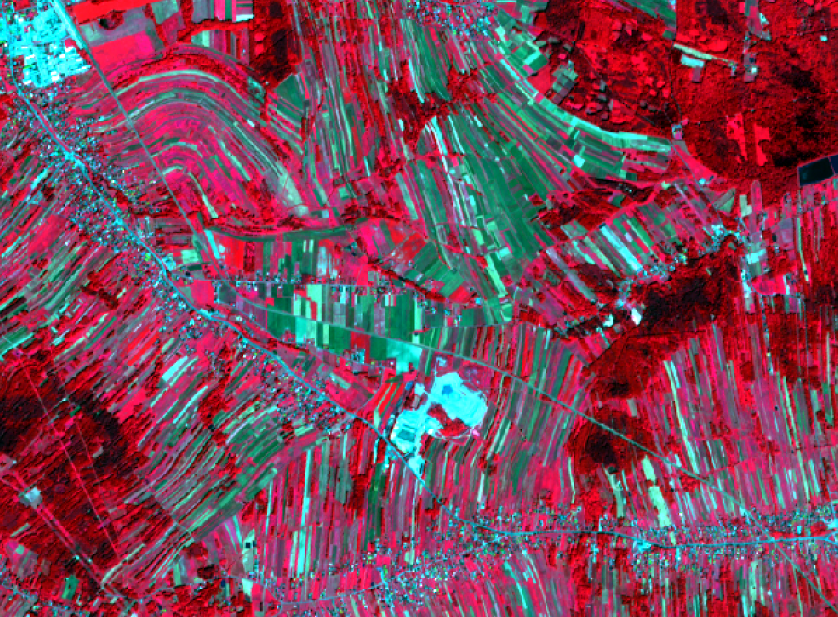
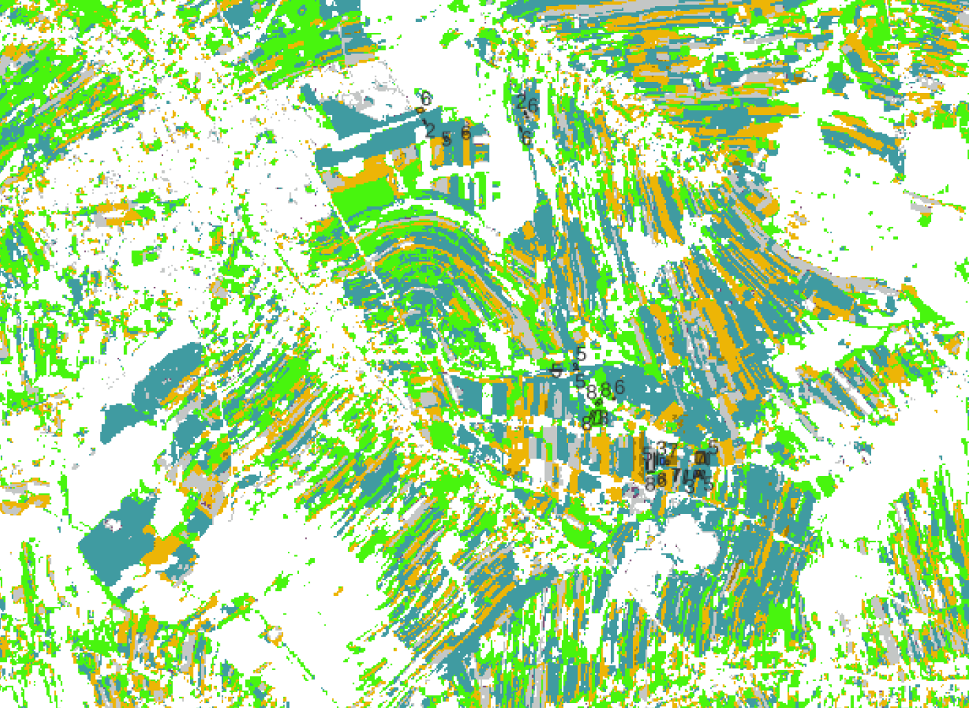
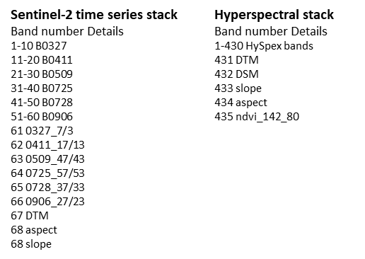
Data fusion
Sentinel-2 time series stack vs Hyperspectral stack
Comparison of accuracy obtained in RF classification
Notes:
Slide 14: Furthermore, vegetation index images and other geosptial data (e.g., slope, aspects, DEM, DSM) can be fused with other channels from Sentinel-2 and Sentinel-1 (VV, VH).
This creates images (stacks) that offer much valuble information which enhancee the accuracy of classification and prediction models.
Spectral data and other oeosptial data as DTM, DSM, slope, aspects

Slide 15
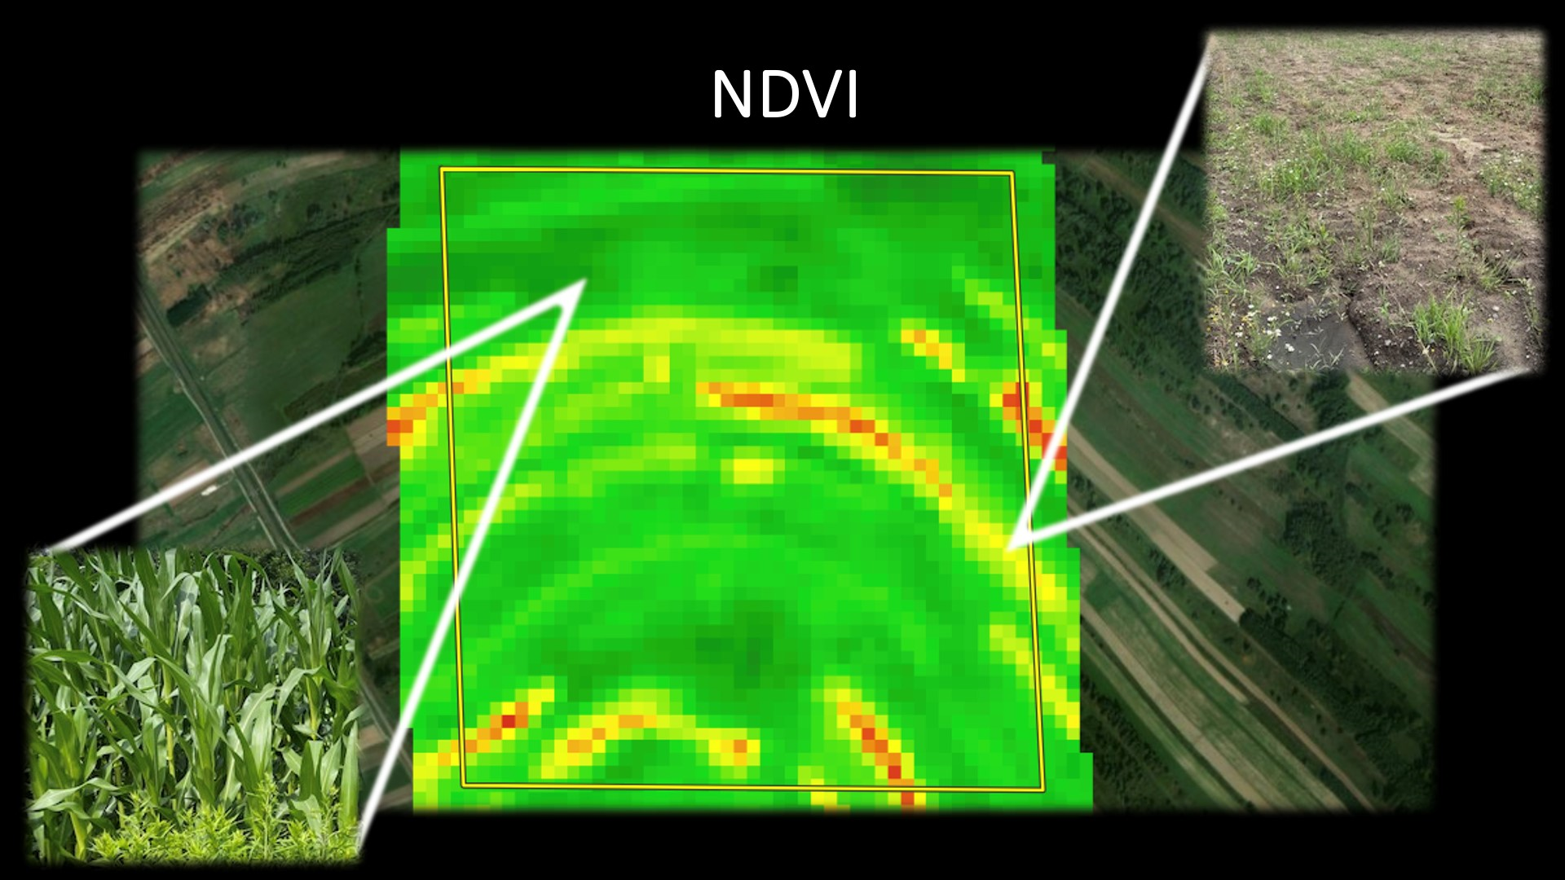
The challenges – local level
Individual farms - use of systems based on remote sensing solutions e.g.:
- AgroSat
- CropMonitoring
- OneSoil
Internet platforms that use RS data
monitoring & management of agricultural activities
Notes:
Slide 15: The second level of our challenges is the local/regional level, primarily focused on supporting individual farmers, agricultural holdings, and the development of precision agriculture.
Solutions proposed for this level often rely on internet platforms that use remote sensing data, enabling monitoring and management of agricultural activities.
web-based platforms using remote sensing data to monitor and manage agricultural activities.
Examples include platforms like AgroSat, OneSoil, Crop Monitoring, and many others.

Slide 16
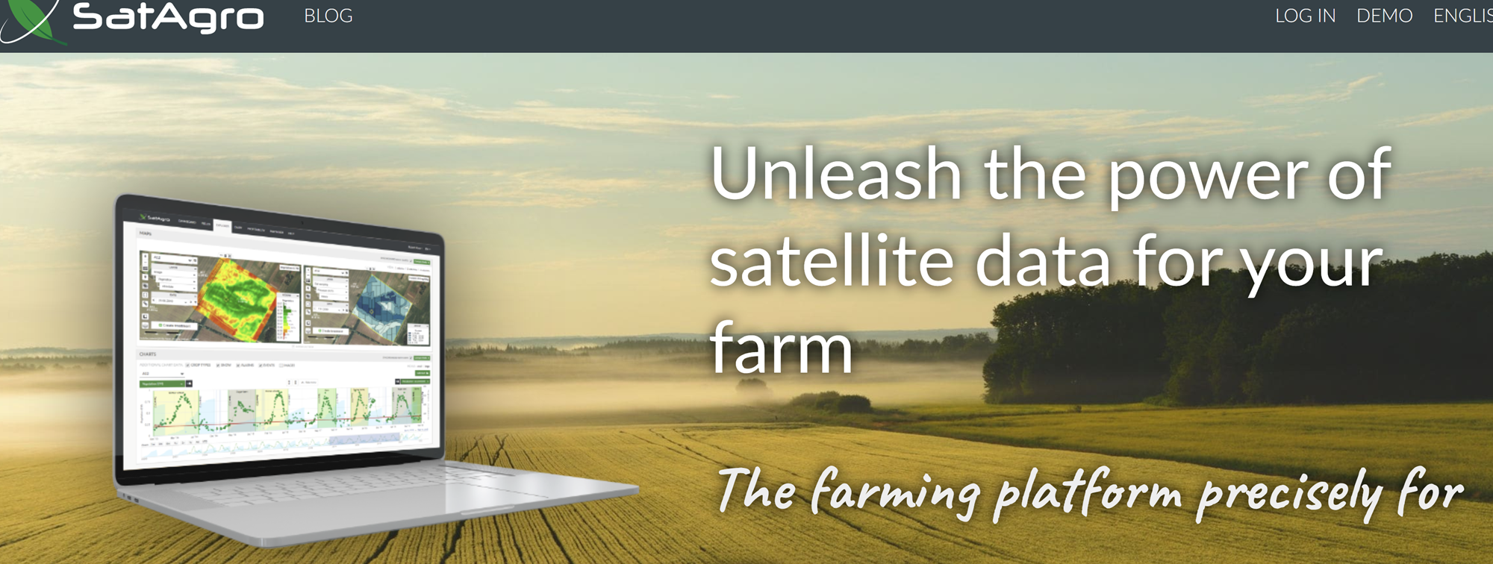
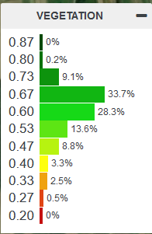
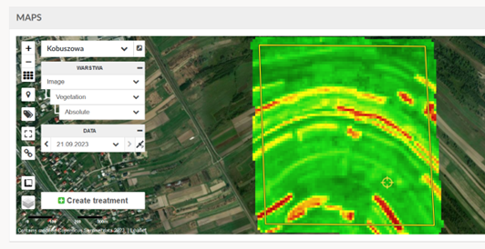
Fusion of image and geospatial data: - Sentinel-2 - Spatial data - meteo data
Platform example
Data fusion enables comprehensive analysis of:
crop conditions
crop types
environmental factors
Notes:
Slide 16: Data fusion enables a comprehensive analysis of:
Crop conditions.
Crop types.
Environmental factors.

Slide 17
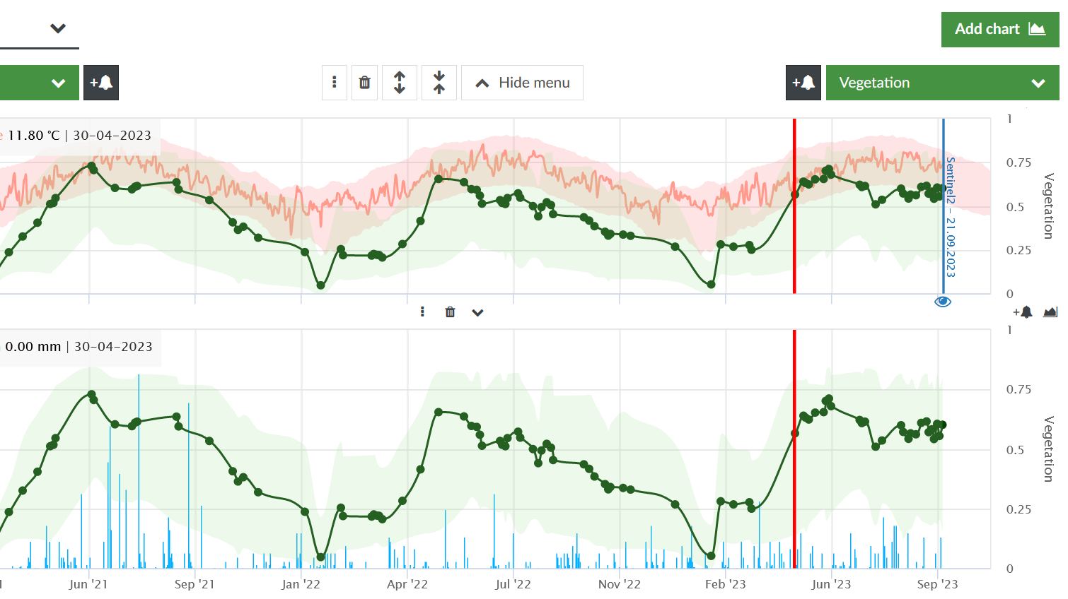
Fusion of meteorological and geospatial data:
real-time monitoring and more accurate decision-making for irrigation, fertilization and pest control
moisture and temperature conditions for monitoring vegetation growth
providing valuable information for precision agriculture
Notes:
Slide 17: Fusion of meteorological and geospatial data offers several benefits:
Real-time monitoring and more accurate decision-making for irrigation, fertilization, and pest control.
Monitoring moisture and temperature conditions for vegetation growth.
Providing valuable information for precision agriculture.

Slide 18
Fusion Data Conclusions
Higher accuracy - precise determination of the condition of agricultural crops
More frequent monitoring - the ability to monitor on a regular basis, allowing rapid response to changes
Improved analysis of crop types - deeper understanding of plant growth processes
Optimization of resource management - more efficient use of water, fertilizer and pesticides
Notes:
Slide 18: What conclusions can we draw from our experiences with satellite and geospatial data fusion?
Higher accuracy: Precise determination of agricultural crop conditions.
More frequent monitoring: The ability to monitor regularly, enabling rapid responses to changes.
Improved analysis of crop types: A deeper understanding of plant growth processes.
Optimization of resource management: More efficient use of water, fertilizer, and pesticides.

Slide 19
Supporting innovation in agriculture for better life

