Slide 1
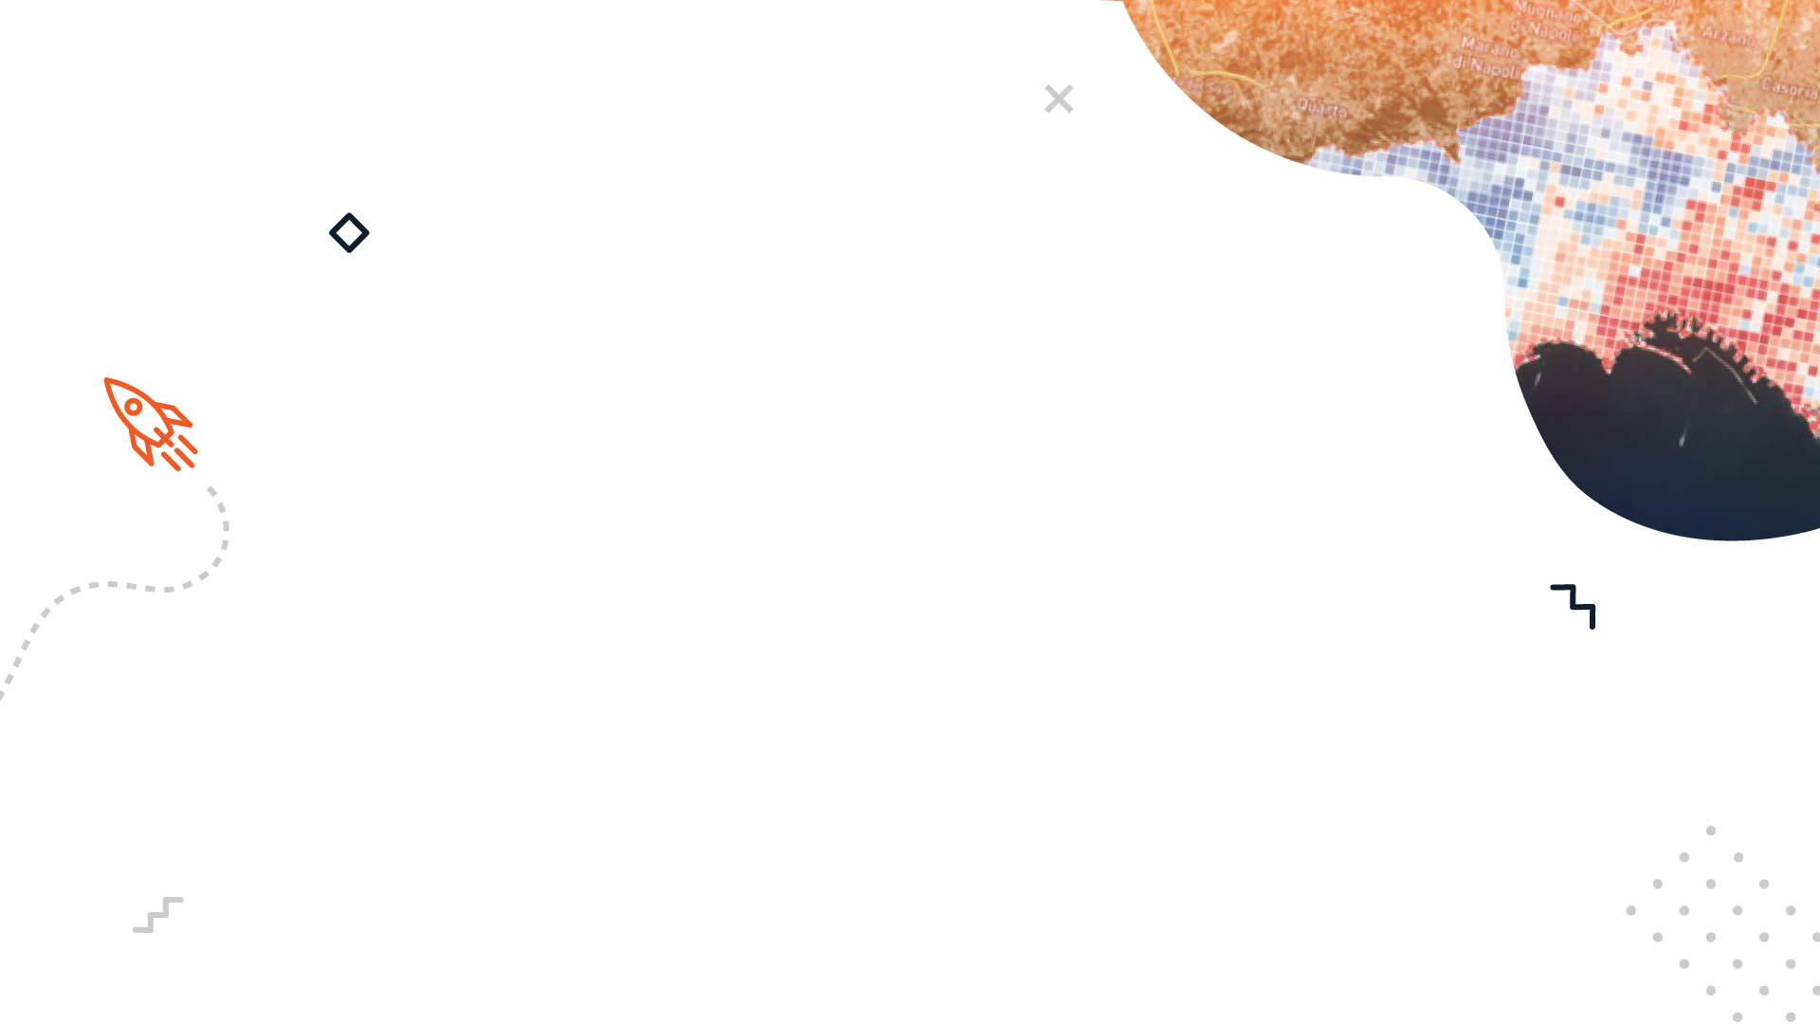


DATA DRIVEN TOOLS FOR RISK ASSESSMENT IN AGRICULTURE
2ND EDITION EUROPEAN SYMPOSIUM BY NEREUS REGIONS: SPACE DATA FOR TOURISM & AGRICULTURE
28-29 SEPTEMBER 2023, MATERA/BASILICATA

Slide 2
CLIMATE CHANGE EXPONENTIALLY INCREASES RISKS IN AGRICULTURE AND IMPACTS OVER 90% OF THE WORLD'S POPULATION
UNITED NATIONS ENVIRONMENT PROGRAMME (UNEP) ESTIMATED THAT THE GLOBAL ECONOMIC COST OF CLIMATE CHANGE-RELATED AGRICULTURAL PRODUCTION LOSSES COULD RANGE FROM $2.5 TRILLION TO $7.4 TRILLION BY 2050.

Slide 3
PROBLEM
Insurance and monitoring projects in agriculture struggle to meet performance targets due a lack of comprehensive and actionable data!
DATA GAP
(inaccurate, incomplete o inaccessible)
CHALLENGES WITH ACCURATE REPORTING
(unable to identify solutions)

Slide 4




OUR SOLUTION
Fully Integrated and Automated Crop Data Analytics Platform
DATA FROM SPACE
(REMOTE SENSING)
ARTIFICIAL INTELLIGENCE
ROVER-IN-THE-BOX
WITH 5G SERVICES
MAKING ACTIONABLE DATA A REALITY

Slide 5


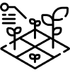

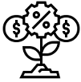

OUR TECHNOLOGY
CROP RISKS
4/5G MEC
AI BASED MISSION PLANNING (ROVER)
SATELLITE DATA PROVIDERS
LATITUDO 40 EARTH DATA PLATFORM
Crop Damages
Anomalies Identification
SATELLITE AND ROVER AI DATA FUSION
CROP DAMAGES
ROVER-IN-A-BOX MISSION
Remote Control (Low Latency)
Fast Data Transfer (Wide Bandwidth)

Slide 6

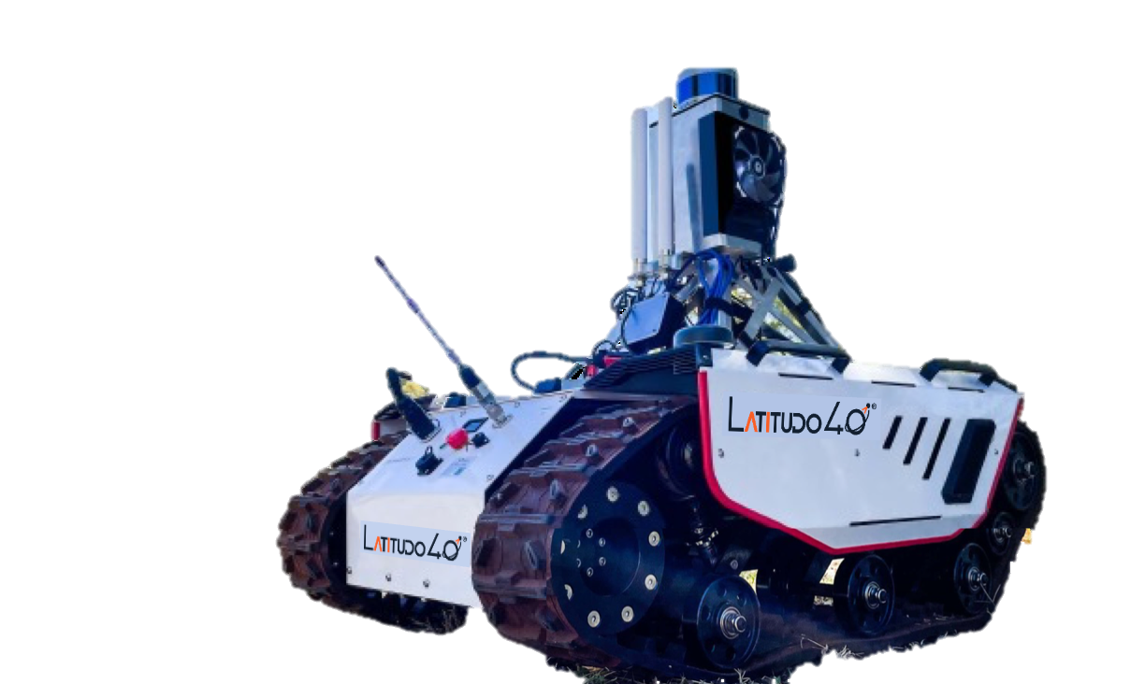
OUR PRODUCT IN ACTION DEMO
NEW VERSION Q3 2023

Slide 7
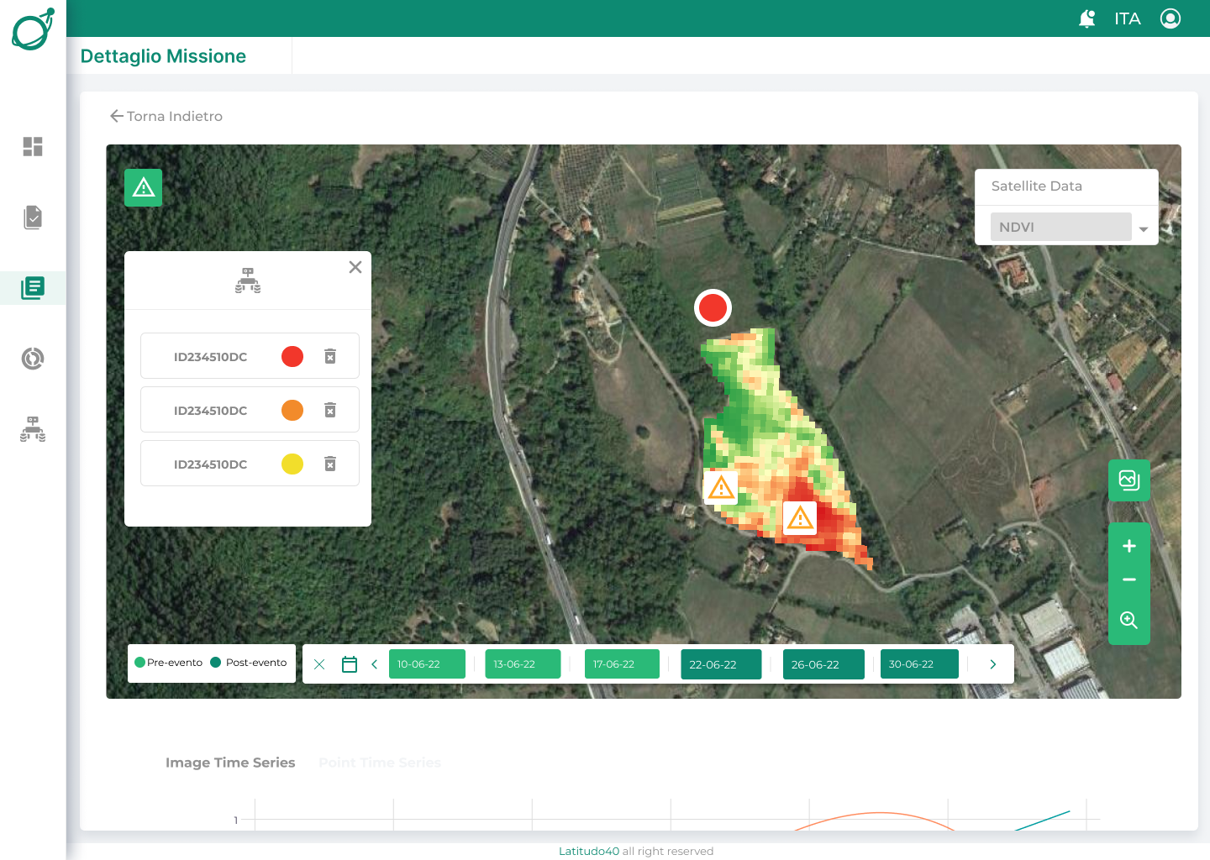
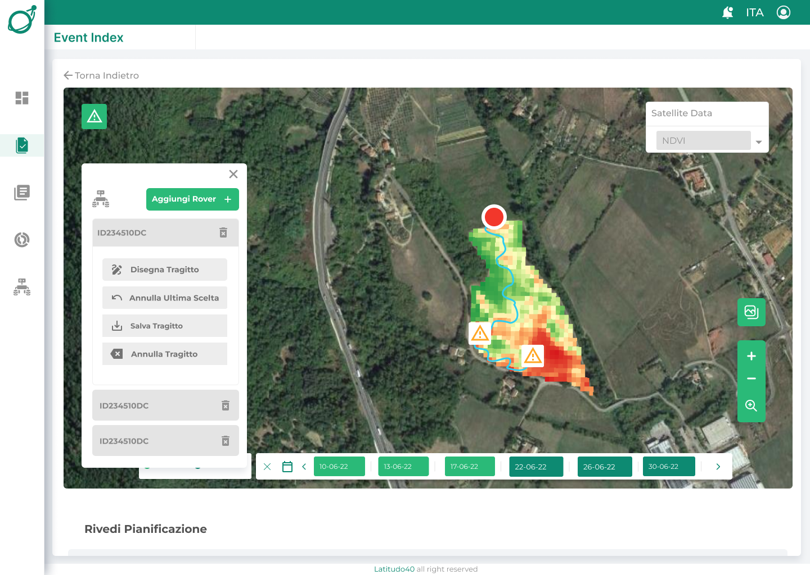
OUR DIGITAL PLATFORM
IDENTIFICATION OF RISKS IN CROP VIA SATELLITE
AI BASED ROVER ROUTE PLANNING

Slide 8
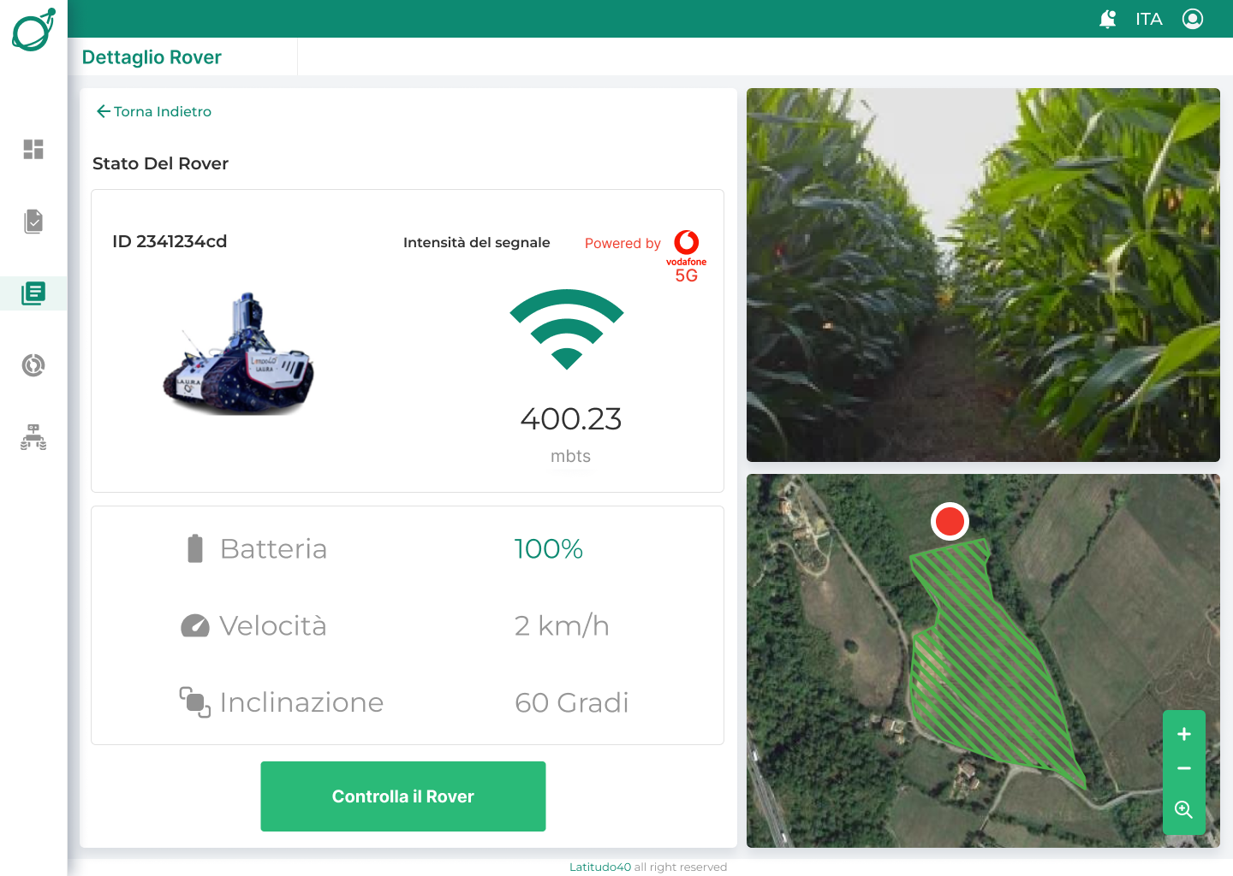
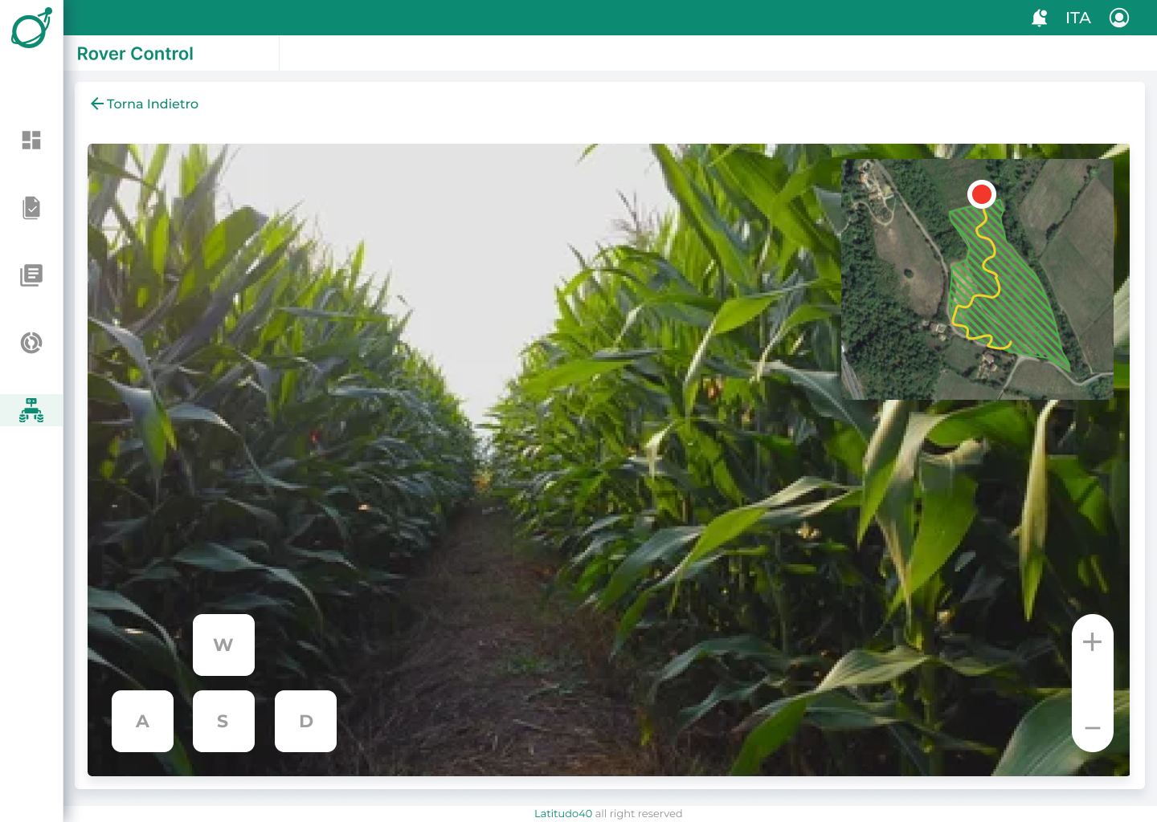
OUR DIGITAL PLATFORM
REMOTE TELEMETRY AND CONTROL OF THE AUTONOMOUS ROVER
REAL TIME VIEW AND EMERGENCY MANUAL ROVER CONTROL

Slide 9
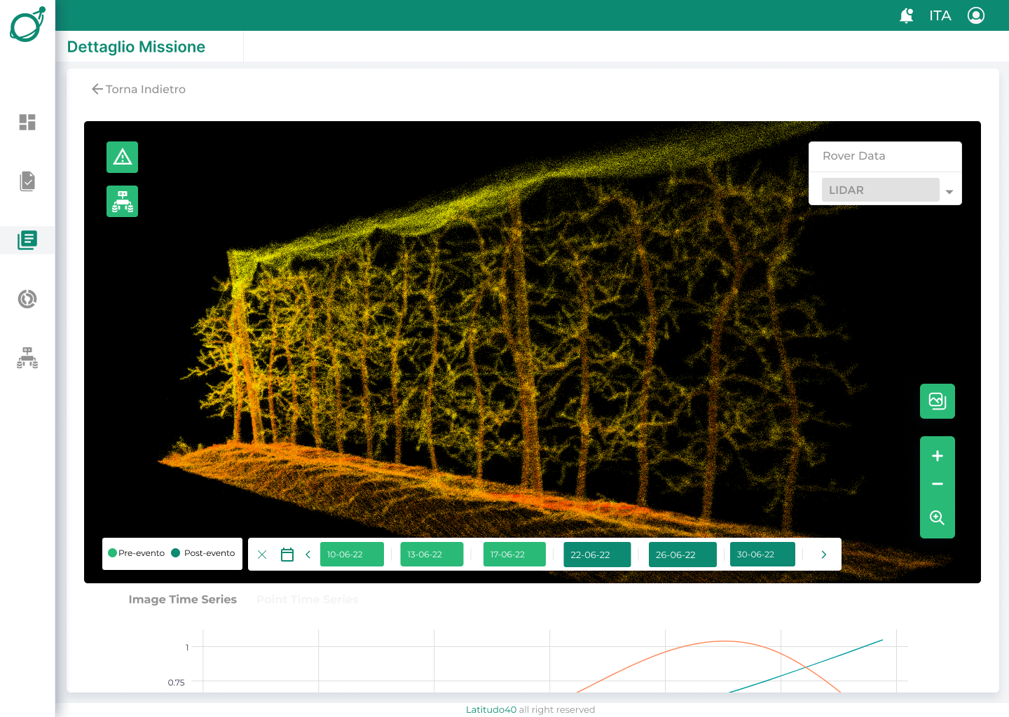
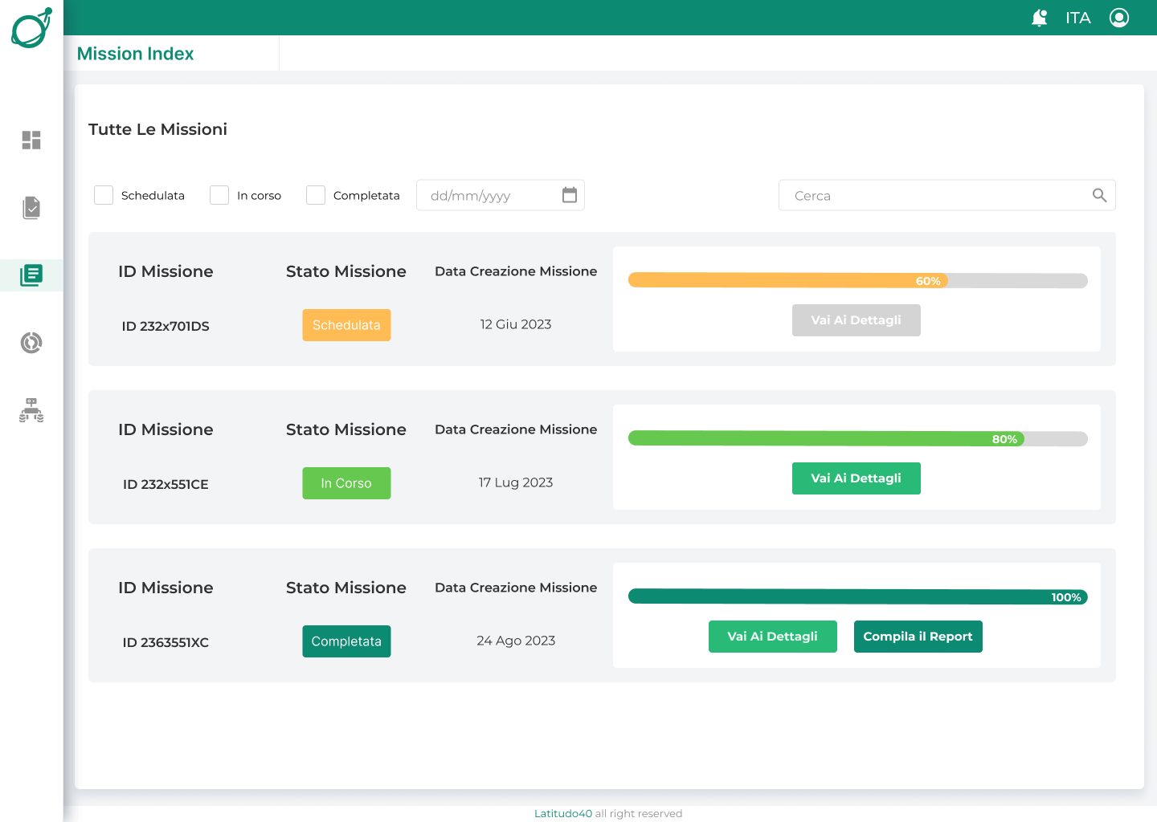
OUR DIGITAL PLATFORM
3D RECONSTRUCTION OF THE FIELD WITH DAMAGES/RISKS IDENTIFICATION
AUTOMATIC ANALYSIS OF DAMAGE IN THE FIELD (SUPPORT FOR EXPERTISE) OR RISKS (SUPPORT FOR MITIGATION)

Slide 10
MARKET OPPORTUNITY
Global Worldwide Crop Insurance Market (Cagr 2021-2027 7%)
25,80 B USD 2021
Climate Insurance Inspections and Analysis
1,8 B USD
Our Target
2% of EU Market
35 M USD
Source: EIB/EUSPA market report 2022

Slide 11
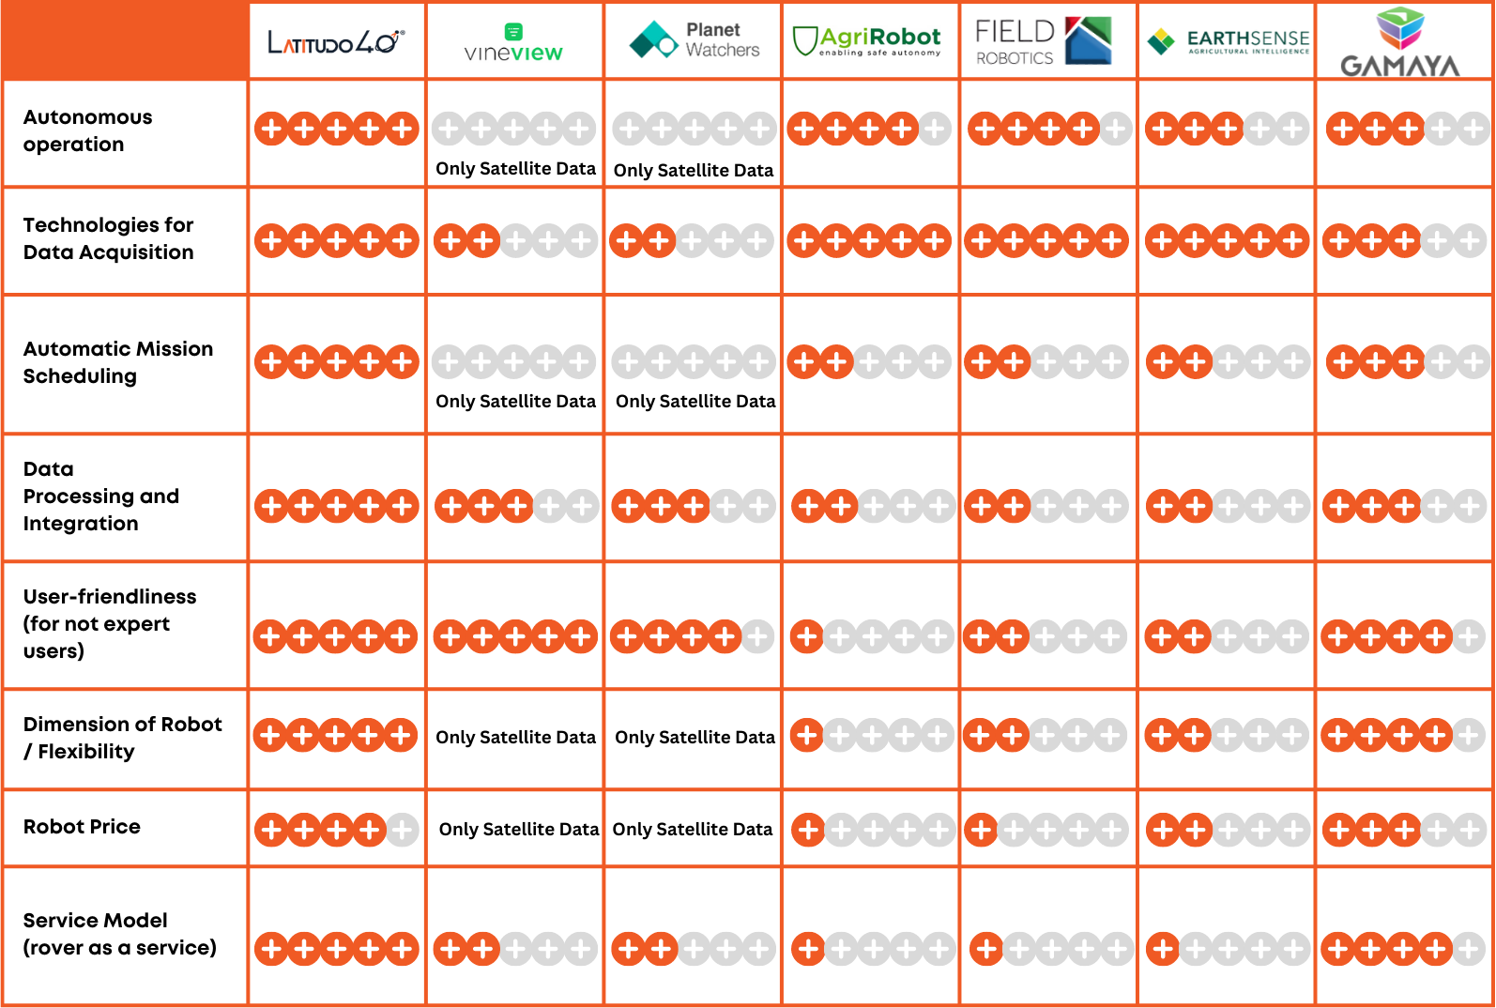
COMPETITION
The only solution offering integrated monitoring with multi-temporal satellite observations and high-precision monitoring with unmanned rovers

Slide 12





CUSTOMERS & BUSINESS MODEL
CROP INSURANCE
DIGITAL FARM
Actionable understanding of CLIMATE RISK and VULNERABILITY across their portfolio
Learn from the PAST, look at the PRESENT and make the best decisions for the FUTURE
YEARLY FEE – starting at 20K€/year
BUY – starting at 1.700 EUR month
SAAS PLATFORM –
included in rover lease
SAAS PLATFORM –
Included in the monthly fee

Slide 13
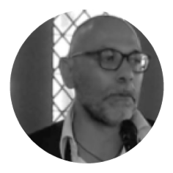
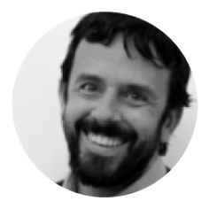
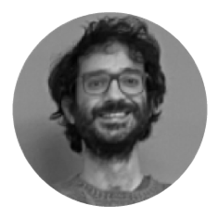
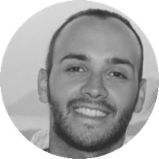
MEET OUR TEAM
Gaetano
Volpe
Mauro
Manente
CEO/Founder
COO/Founder
20 years in the space tech market
20 years in IT and Critical Mission SW
Donato
Amitrano
Giovanni
Giacco
R&D/Founder
CTO
Phd in Remote Sensing and University researcher
Phd in Artificial Intelligence and 10 years in SW design
We are a team (12) of scientists, technologists and creatives working together towards the same goal: a thriving planet. We are proud of our diversity, it's what makes us grow and succeed.

Slide 14








WHY NOW?
The current options are:
Empirical analysis
(95% chose this)
Drone
(5% chose this)
Satellite + ROV
Satellite + ROV Vs. Other
HISTORICAL
DATA
HIGH PRECISION LOCAL DATA
WORLDWIDE
COVERAGE
SAVE
MONEY
RISK IDENTIFICATION

Slide 15
THANK YOU!
Mauro Manente
COO
mauro.manente@latitudo40.com
+39 334 6535110
www.latitudo40.com

