Slide 1
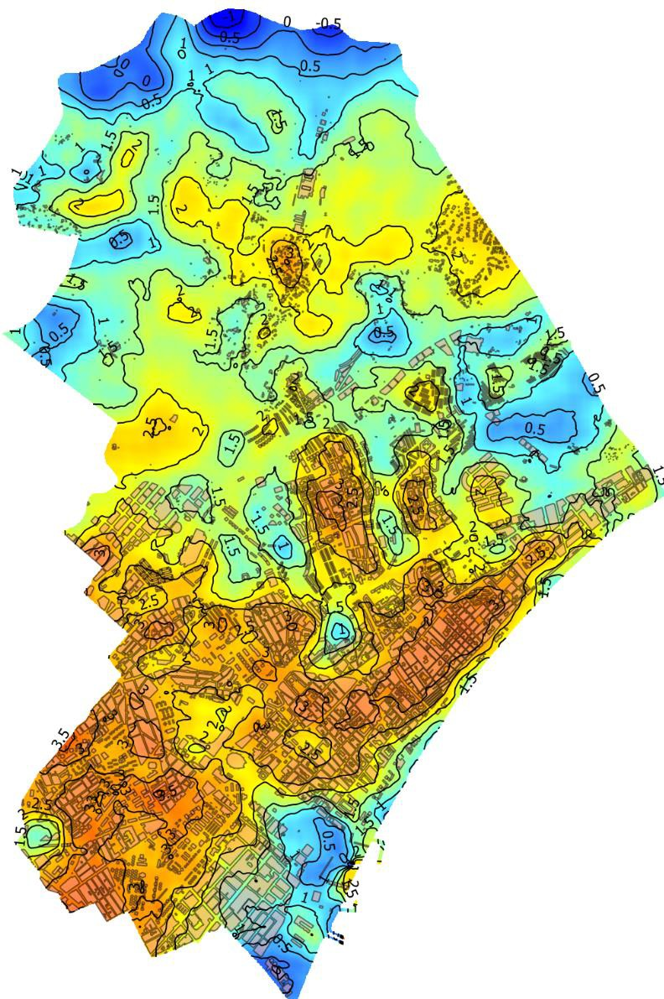
Earth Observation and climate impacts over economic activities as tourism: a Catalan perspective
Dr. Jordi Corbera

Slide 2
MAIN COMPONENTS AT
CATALONIA: CLIMATE
PRESENTATION
Impacts on tourism
The Component about extreme heat and comfort (direct impact)
The Component on water resources (indirect impact)
SITUATION:
Tourism sector prefers to focus on more obvious, immediate processes and phenomena and easily quantifiable.

Slide 3
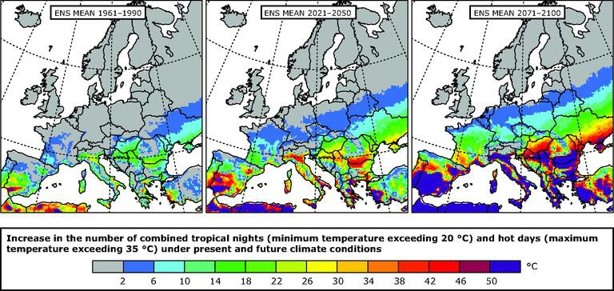
PRESENTATION
EXTREME HEAT

Slide 4
PRESENTATION
EXTREME HEAT

Slide 5
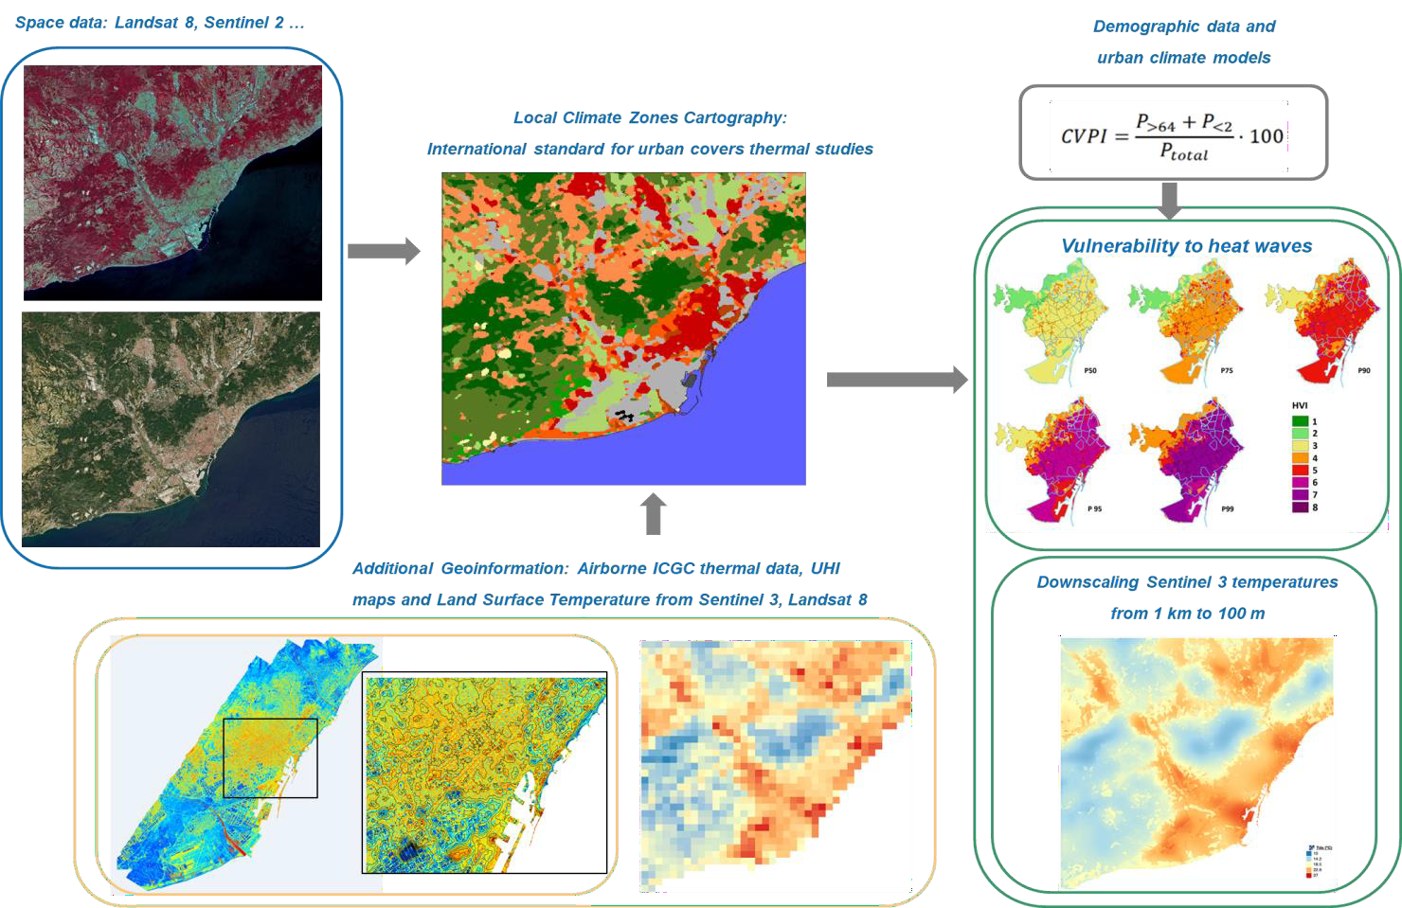
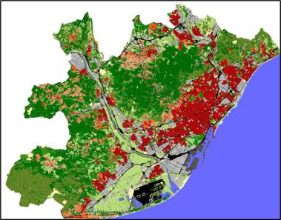
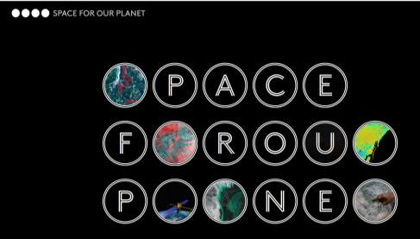
PRESENTATION
EXTREME HEAT

Slide 6
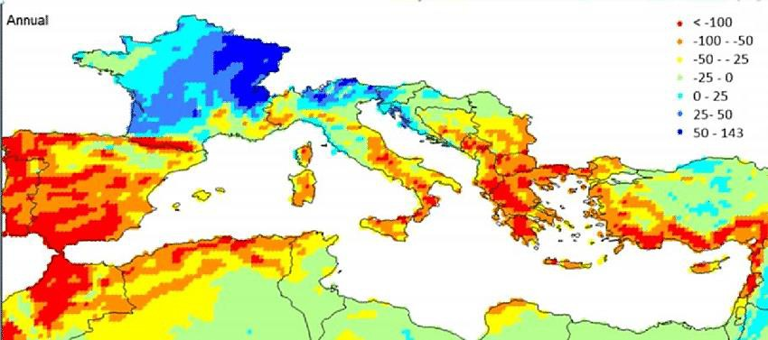
PRESENTATION
WATER AVAILABILITY

Slide 7
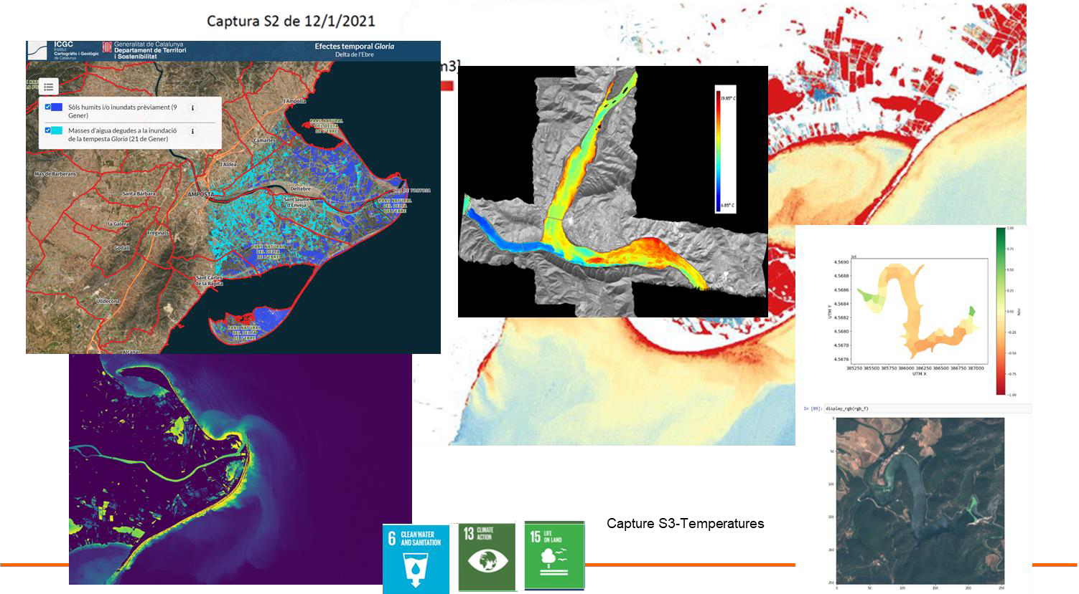
PRESENTATION
WATER AVAILABILITY

Slide 8
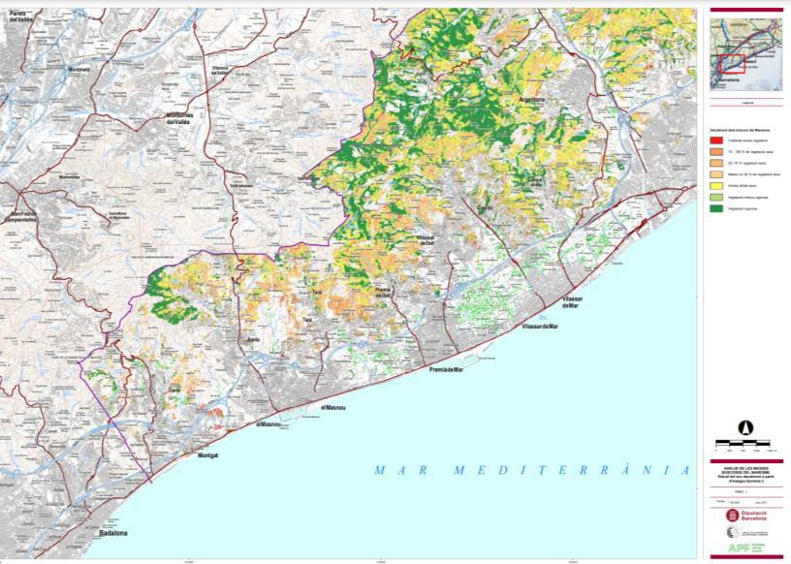
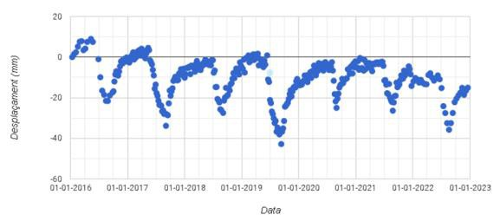
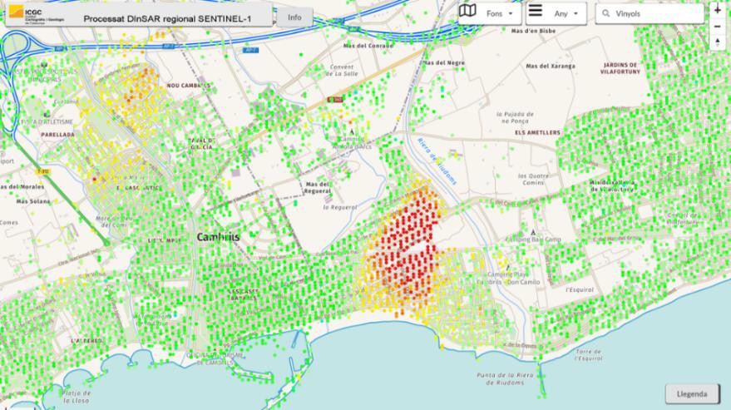
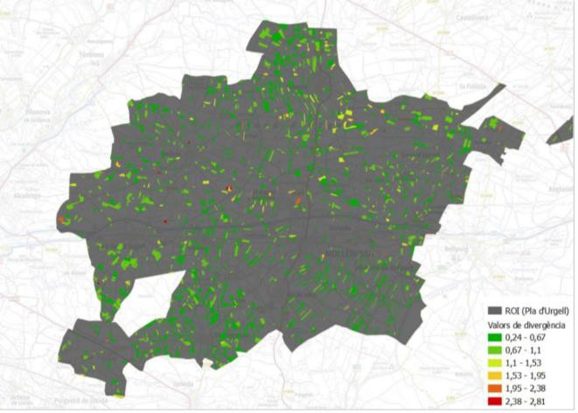
PRESENTATION
WATER AVAILABILITY
https://visors.icgc.cat/subsidencia-projectes/

Slide 9
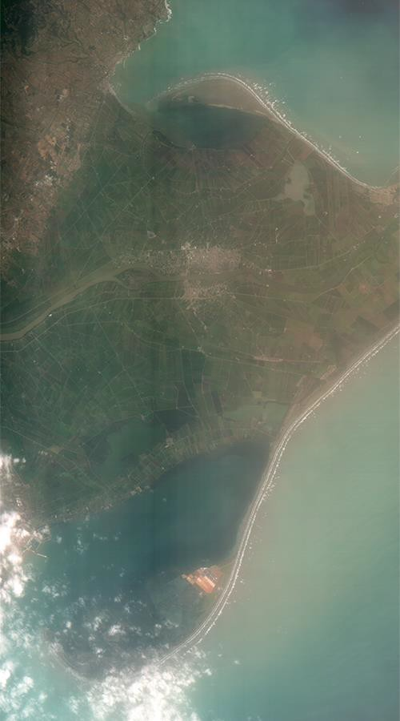
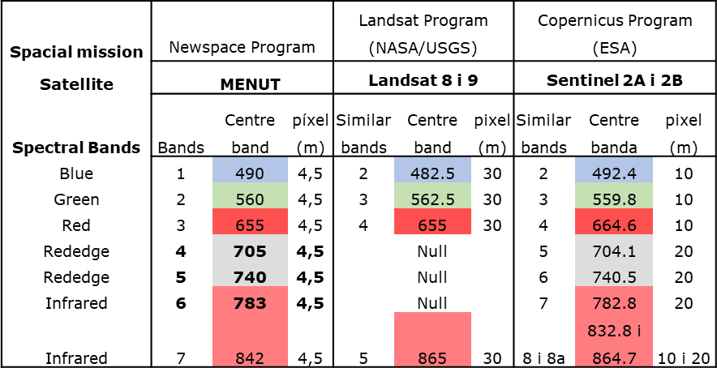
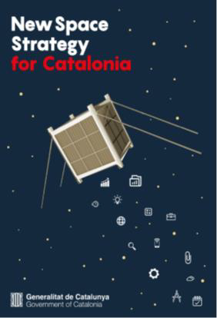
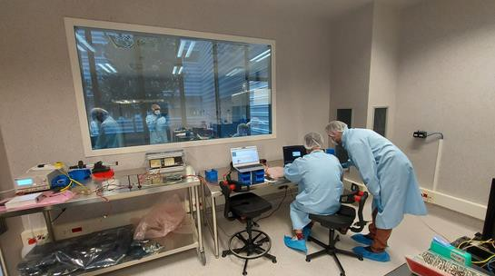
PRESENTATION
DISCUSSION

Slide 10
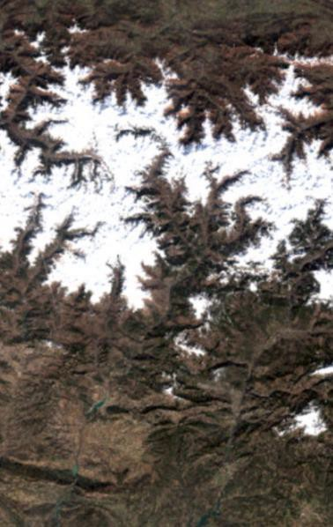
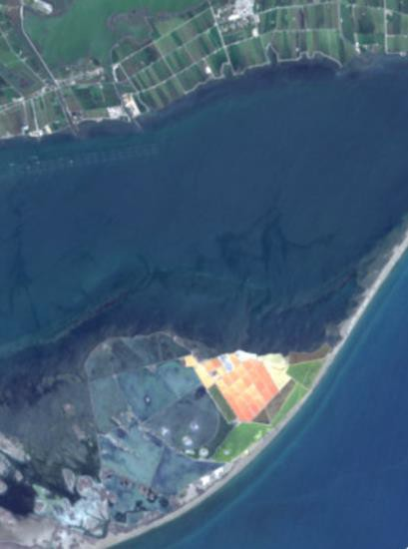
PRESENTATION
DISCUSSION
Loss of attractiveness of thermal comfort during summer nights
The increase in the supply of tourist places in the coastal municipalities can endanger a declining resource, which, in future scenarios, is expected to decrease substantially.
Towards a lower guarantee of available water resources, or a greater and more expensive difficulty in obtaining them in sufficient quantity and quality.
It is not expected that the main consequence of climate change will be a significant decrease in snow tourism, but rather its redistribution and territorial concentration in a few resorts, especially Baqueira-Beret.
https://www.icgc.cat/Descarregues/Imatges-aeries-i-de-satel-lit/Ortoimatges-Sentinel-2-mensuals

