Slide 1

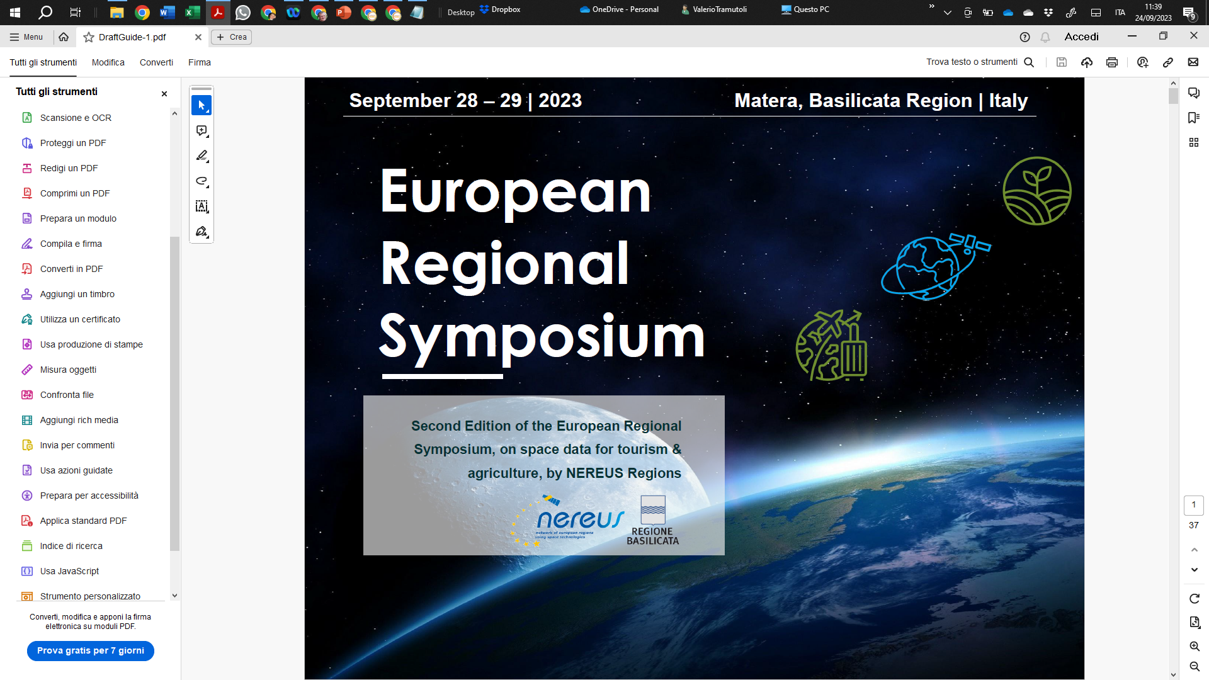
How to prepare workforce and talents to address space skills in business, research and public administration
Valerio Tramutoli
University of Basilicata
valerio.tramutoli@unibas.it

Slide 2
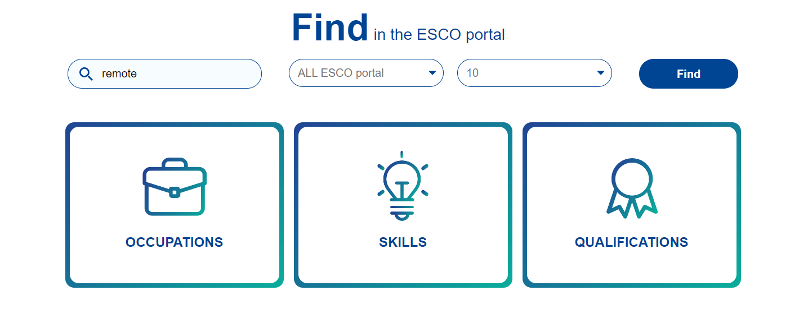
Facts 1
European Skills/Competences, Qualifications and Occupations
(ESCO)
In the catalog of the almost 3000 qualifications recognized at European level by ESCO the reference to experts on the development of applications/services based on EO technologies is still absent
(they instead exist with reference to GIS, aeronautics, ITC, etc.)
?

Slide 3
Facts 2
Presently the required knowledge is fragmented in different academic curricula
Sensors and EO systems
design
The lack (at European level) of a unique academic curriculum, offering the opportunity to researchers and professionals to acquire the full chain of knowledge required to move from the design of advanced EO systems and sensors up to the development of applications and services based on EO data, has been, since last decade, recognized by the Commission as an important gap in the Copernicus User Uptake Strategy.
space has been recognized as an
Data transmission, management and analysis
Applications/Services development

Slide 4
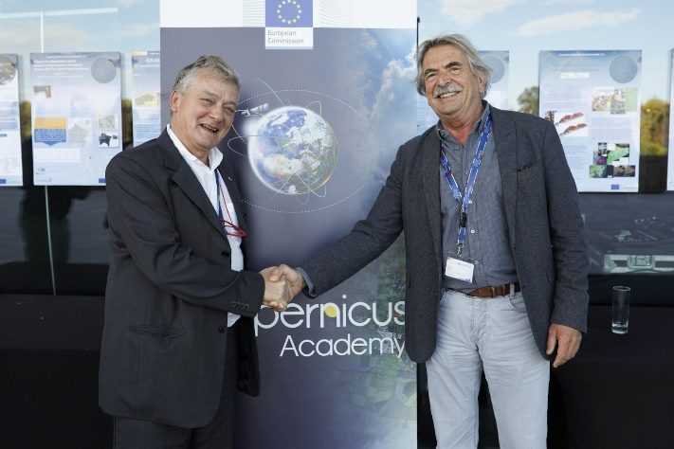

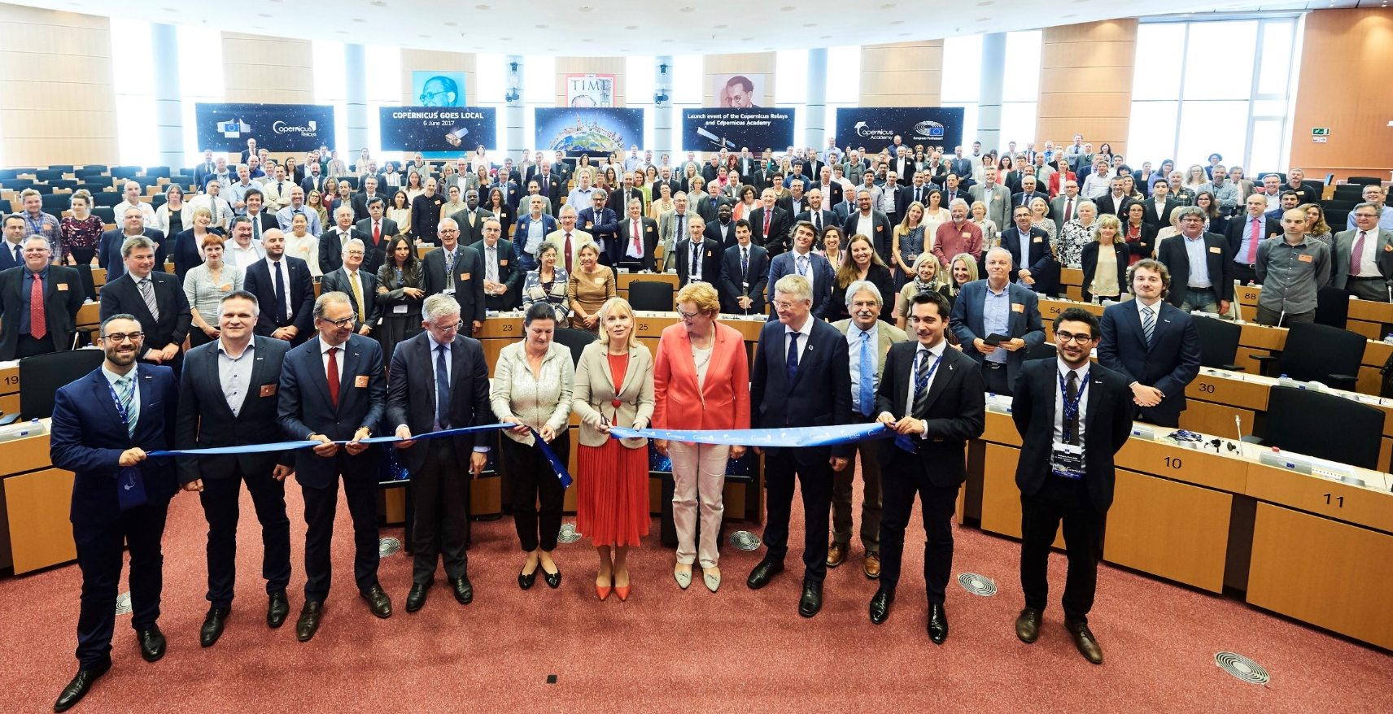
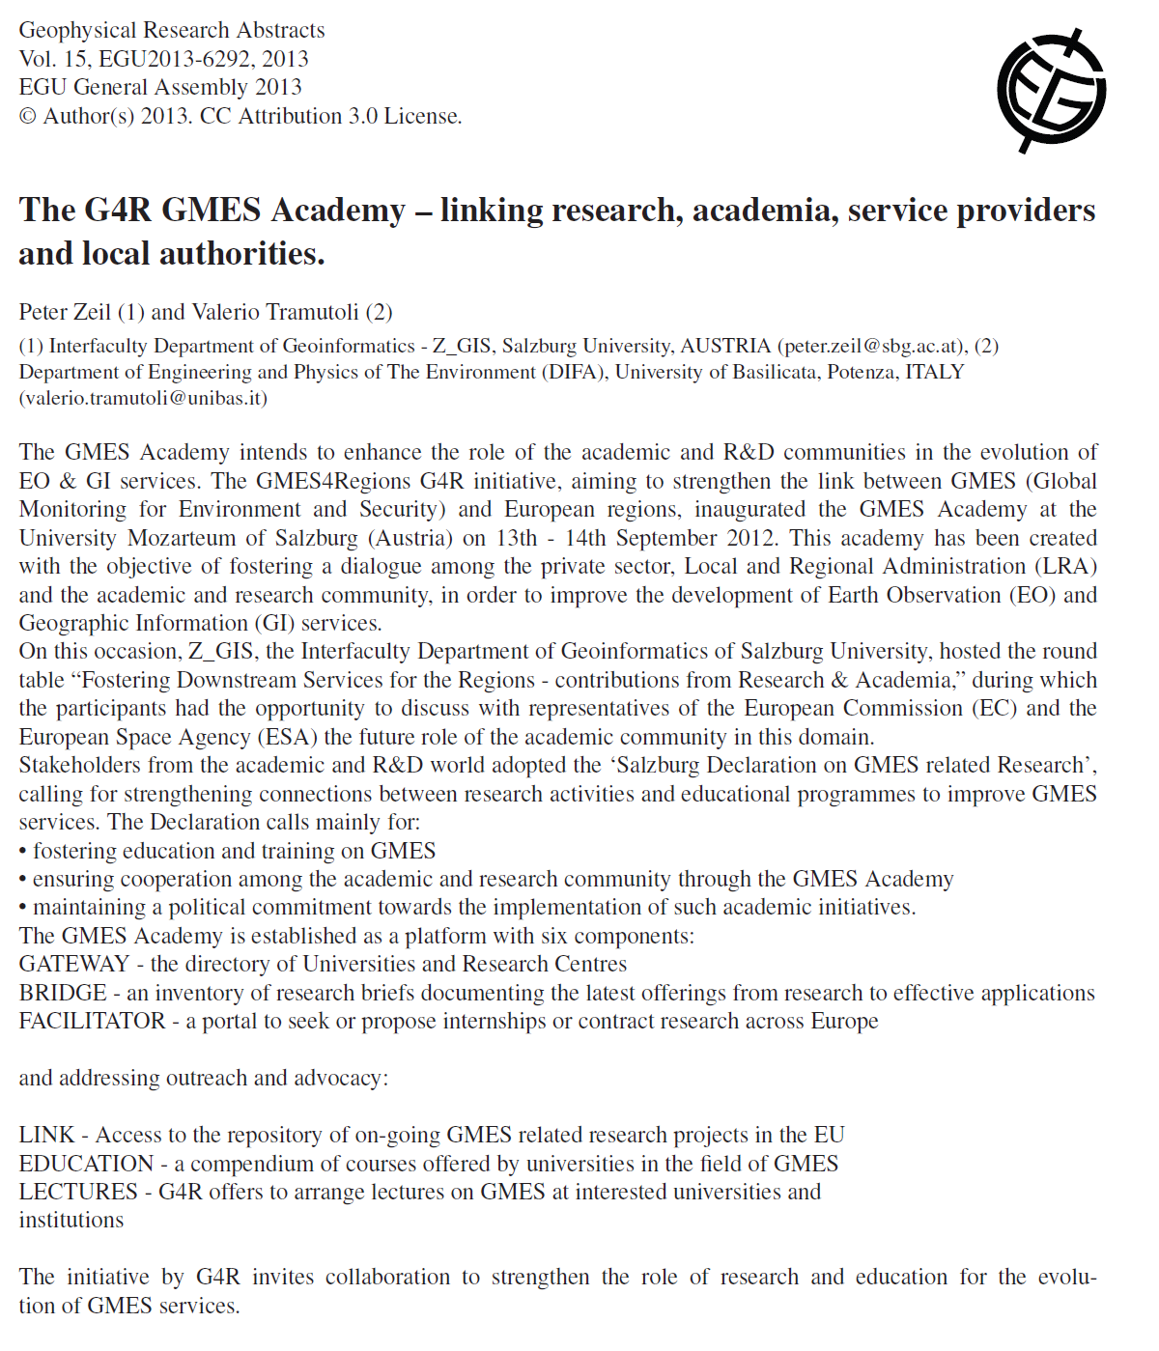
Actions 1
2014. The establishment by the Commission, in the framework of the Copernicus User Uptake Strategy, of the Networks of the Copernicus Academies an
Brussels, 6 June 2017 First Copenicus Academy Assembly
Valerio Tramutoli (UNIBAS) and Peter Zeil (PLUS) the Copernicus Academy «fathers»

Slide 5
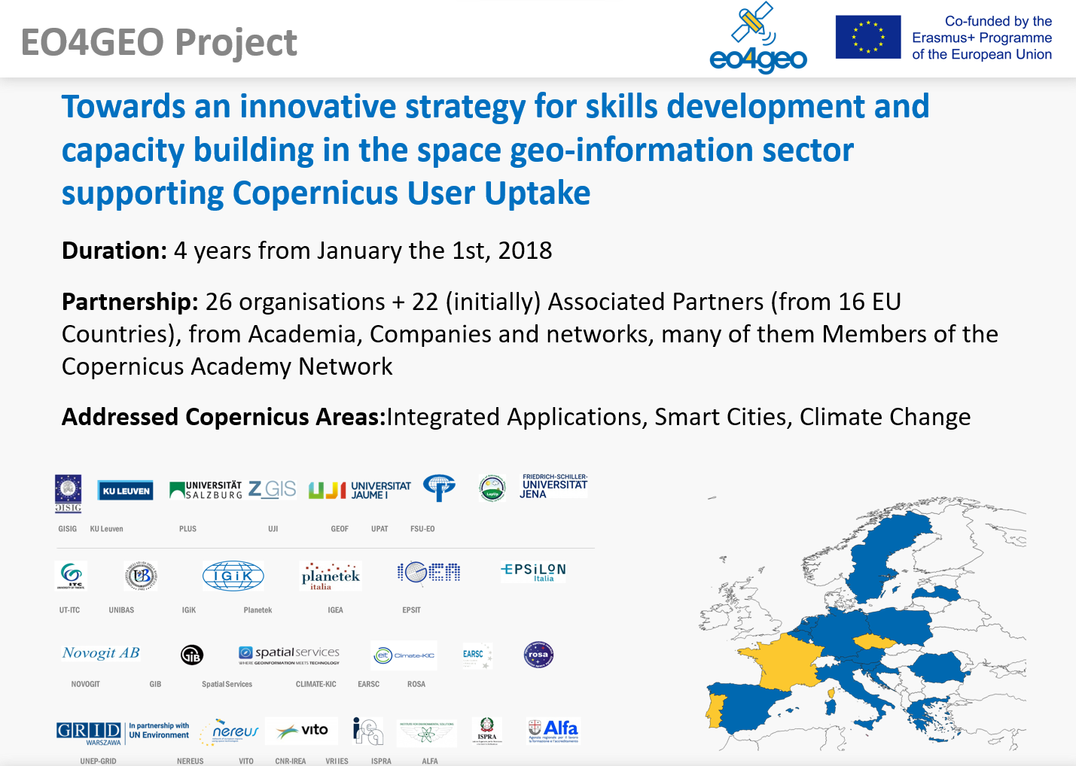
Actions 2
Among the 28 projects funded …
2016. The introduction of the Blueprint for sectorial cooperation on skills by the Skills Agenda for Europe 2016 (confirmed by the European Skills Agenda 2020) to address sector skills by creating new strategic approaches and cooperation.
2021-2027. Continuing under the new Erasmus+ programme with the Alliances for Innovation (Lot 2: Alliances for sectoral cooperation on skills)

Slide 6

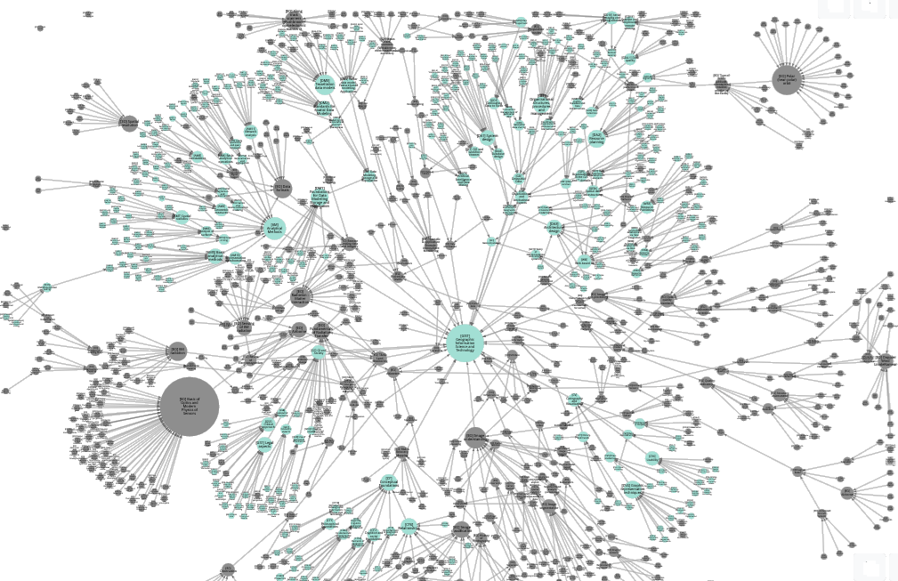
Some achievement 1 the EO-GIS body of knowledge (EO4GEO)
A formal description of the EO-GIS knowledge domain made by:
thousands of Concepts (theory, models, methods, technologies)
and relations among concepts
elaborated by the joint effort of hundreds of worldwide experts

Slide 7
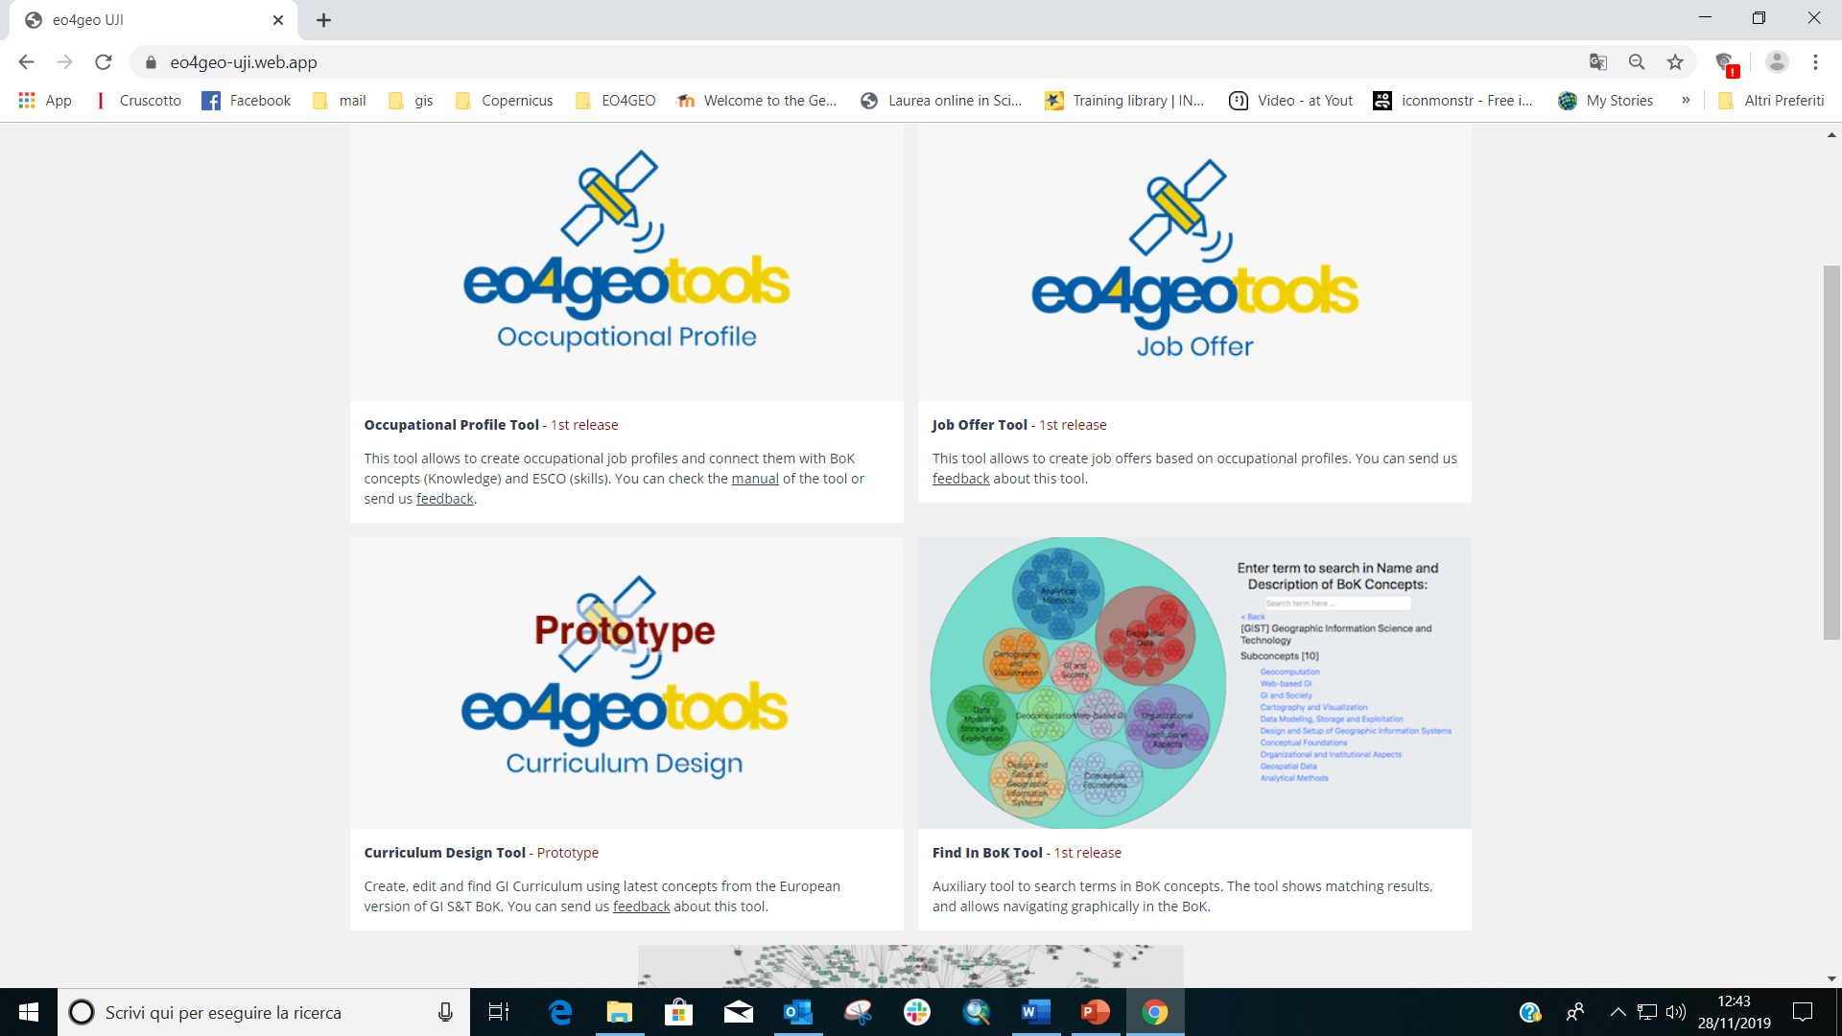
Some achievement 2 the EO4GEO Tools
To match job offer and demand on the base of specific and formalized elements of knowledge
To draw new educational/training curricula

Slide 8
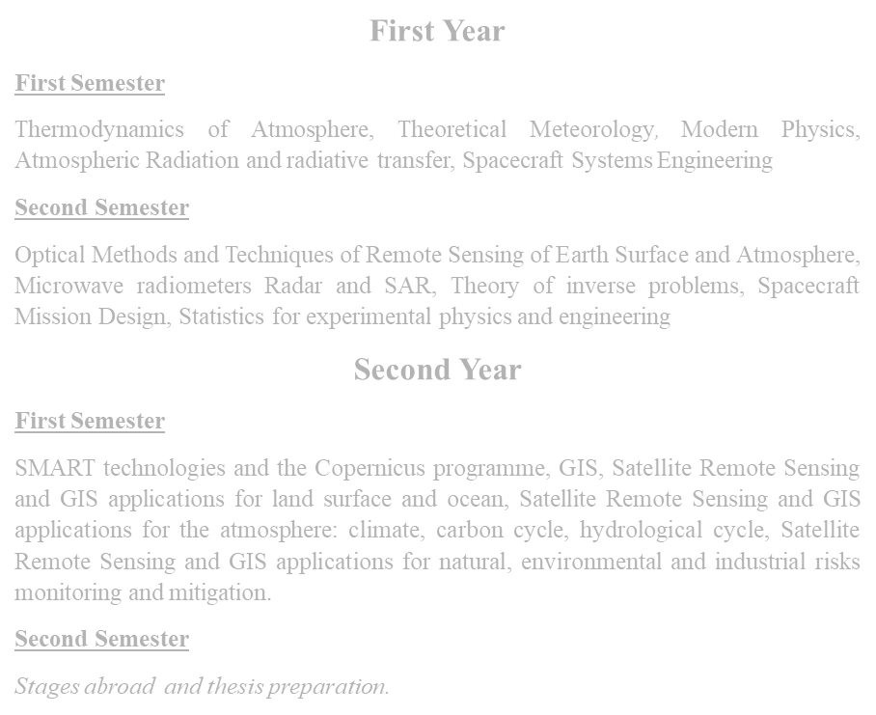
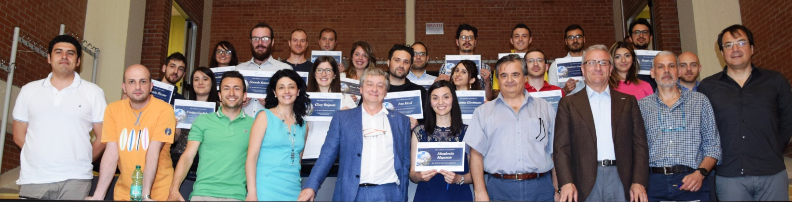
Practise on academic edu: Example 1 the first European MoS on «Earth Observations from
Space: Advanced Technologies and Applications» at UNIBAS
Based on the EO4GEO BoK offers the full chain of knowledge required to move from the design of advanced EO systems and sensors up to the development of applications and services based on EO data (selected by MUR and funded with 1,6M€)

Slide 9

Practise on adults re-skilling e.g. Local/Regional Administration Workforce
Objective: to provide to LRAs staff the basic (non trivial) knowledge required to evaluate/promote the use of EO-based solutions in their specific institutional work
Specific Issues:
Difficult/costly to have LRAs workforce available long-time for training
Heterogeneous backgrounds and motivations (resistance?) toward innovations
Fundamental the appropriate selection of contents and methods in order to increase motivation to actually come into the game (purely informative effort useless for this target!)

Slide 10

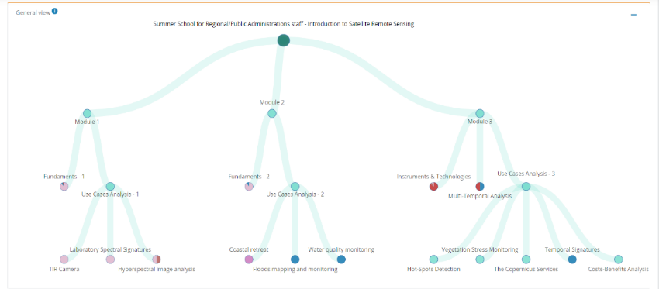
Example 2
The UNIBAS Summer School for Local/Regional Administration Workforce
Main choices:
A modular 3,5 days course
Strictly in local (Italian) language
Offered in mixed form (in presence & remotely)
Entirely video-registered
All lessons and additional material for insights provided before
No public call ! Selection made through the Local Administrations Directors (education is an investment!)
Module 1
[IP3-1-2-3] Normalized Difference Vegetation Index (NDVI)
[PP1] Basics of Optical Remote Sensing
[PP1-1-1] Electromagnetic Waves and Photons
[PP1-1-11] Earth's radiation (intensity, spectrum, etc.)
[PP1-1-2] Electromagnetic spectrum
[PP1-1-4] Planck law for the black body. Wien's displacement law
[PP1-1-6] Stefan–Boltzmann law. Kirchoff law
[PP1-1-7] Concepts of Spectral Emissivity and Brightness Temperature.
[PP1-2-10] The Rayleigh roughness criterion
[PP1-2-5] Concepts of Transmittance, Absorbance, Reflectance, Scattering.
[PP1-2-8] EM rad. penetration in the matter: Attenuation Length
[PP1-3-1] Radiometric quantities: radiance, irradiance, flux, brightness, emittance, luminosity, etc.
[PP1-3-3] Spectral Signatures of the matter
[PP1-4-5] Beer-Bouguer-Lambert law.
[PP2-2-5-2] Attenuation lenght and penetration depth
[PS1-2] Passive vs. active sensors
Module 2
[IP1-7-1] Atmospheric correction
[PP1-1-11] Earth's radiation (intensity, spectrum, etc.)
[PP1-1-5] Rayleigh-Jeans approximation. Wien's approximation
[PP1-6-1] Structure and chemical-physical composition of Earth's atmosphere
[PP1-6-2] Absorption and scattering of solar radiation in the Atmosphere
[PP1-6-3] Mie Scattering in the Earth's Atmosphere
[PP1-6-4] Rayleigh Scattering in the Earth's Atmosphere
[PP1-6-6] Light scattering by atmospheric particulates
[PP1-6-7] Earth's (standard) Atmosphere Transmittance
[PP2-2-2] Scattering and emission
Module 3
[GD11-2] Platforms and sensors
[PP1-8-4] Satellite orbits parametrization and choice
[PS1] Types of remote sensing sensors
[PS1-2-1-1-1] Along track scanners
[PS1-2-2] Radiometers
[PS1-4] Imaging vs. nonimaging sensors
[PS1-5-1-2] Across track scanners
[PS2-2-3-2] Types of satellite orbits
[PS2-2-3-4] Swath
[PS3-4-1] Spectral resolution
[PS3-4-2] Spatial resolution
[PS3-4-3] Radiometric resolution
[PS3-4-4] Temporal resolution

Slide 11
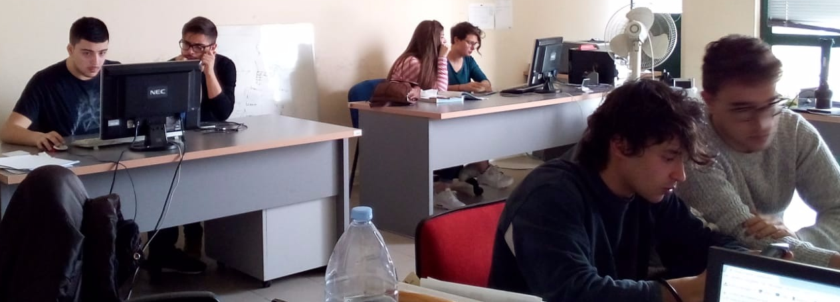
Practise with scholars the School-Work Alternation at UNIBAS
Objectives:
to introduce high school students to the basic (non trivial) knowledge of remote sensing methods, instruments and applications
to leverage their curiosity (and smartness) to encourage them to continue their studies in that direction

Slide 12
At all education levels:
In order to avoid volatile space skills long lasting knowledge (fundamentals) should always precede whatever advanced, specialized/updated knowledge (which changes every year).
Space skills at European level (ESCO) should be jointly established (e.g. based on EO4GEO BoK) and corresponding curricula and professional qualifications reciprocally recognized by the Member State
Basic module of GIS and Space EO methods should be introduced in the ordinary programs of (at least high) schools
(some) Lessons learned

Slide 13
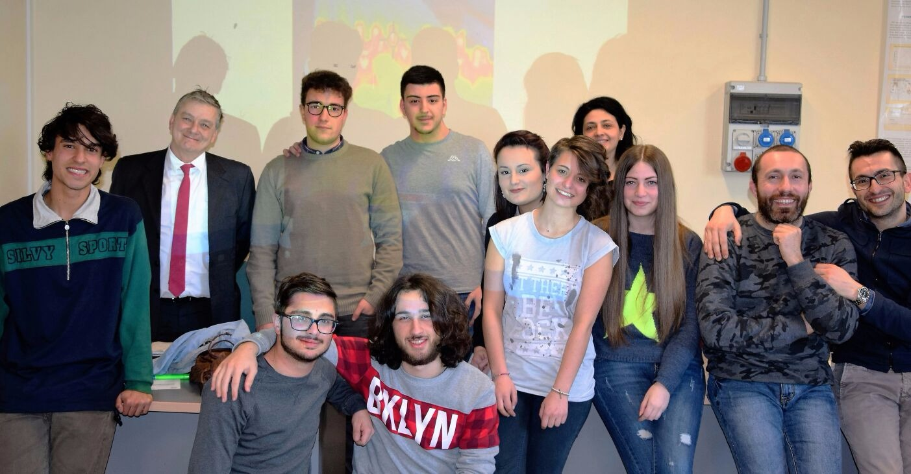
Thanks

