Slide 1
European Regional Symposium
September 28 – 29 | 2023 Matera, Basilicata Region | Italy
Second Edition of the European Regional Symposium, on space data for tourism & agriculture, by NEREUS Regions

Slide 2
SPARKme SPACE ACADEMY
Openet started its business in the satellite TLC sector, designing, developing, and managing advanced networks for both public and private clients. For over 20 years, it has maintained constant collaborations with institutions, industrial groups and research entities (i.e. ASI, ESA, FAO, UNDP, etc). Within the scope of research and demonstration projects, it develops and implements, at both national and international levels, SATCOM applications supporting various sectors: electoral processes, tele-education, eHealth, edutainment, and acceleration programs.
In 2018 with the support of ASI and ESA in a demonstration project, Openet launched :
the SPARKme Accelerator to attract, support and validate new application and service ideas using Satcom in association with other space technologies. Two Competence centres have been created in Matera (IT) and in Nairobi (KE). Several local entrepreneurs have benefited from space technologies improving their businesses.
The SPARKme Space Academy, to disseminating the scientific culture with special regard to “space related themes”, offering to students and professionals, immersive experiences, events, education initiatives, sensitizing NEXT GEN about the STE(A)M opportunities and contributing to enlarge the tourism offer for an “educational and experiential” tourism.

Slide 3
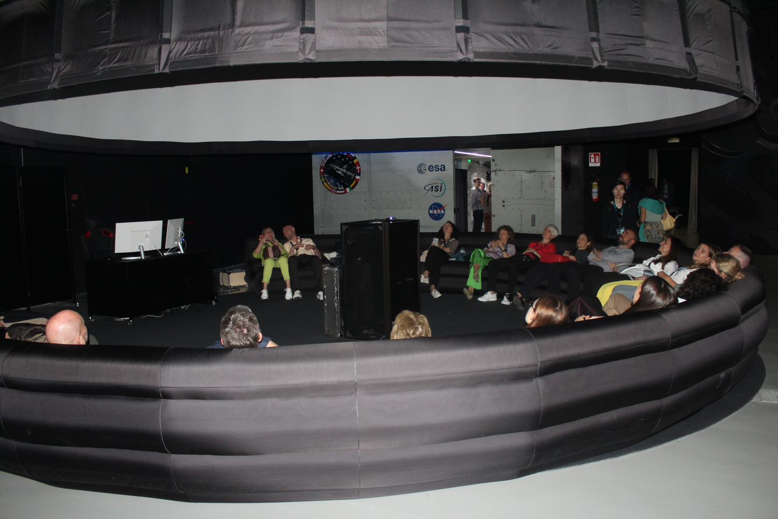
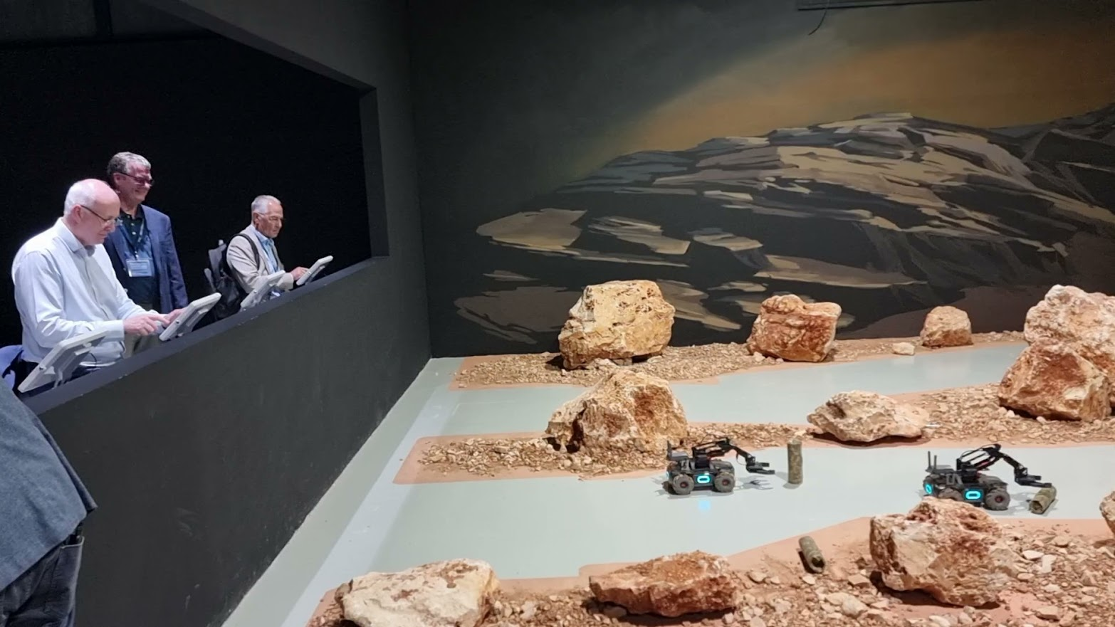
SPARKme: challenges and opportunities
The challenges are two-fold:
From a tourist perspective, the Academy can contribute to enriching the local and regional offering by promoting the scientific culture through immersive experience thanks to ICT and technology-based solutions as well as thematic exhibits. This is also a way to propose an "educational" and “experiential” tourism with an eye towards everything that "space“ and “space related themes” in a broad sense represents in terms of innovation and environmental protection.
From the educational side: to promote the outreach education to talk about and share innovation and opportunities linked to the space sector with special regard to the NEXT GEN contributing to make a difference and reverse the negative trend that sees a decreasing number of young people deciding to take up STEM-related (Science, Technology, Engineering and Mathematics) studies and careers. Often, even from the feedback received from the students who have visited the Academy, space and everything revolving around, it is considered as a distant world, certainly exciting but also with significant entry barriers. Through the Academy, we want to narrate with the use of advanced technologies (VR, AI), and thanks to skilled expertise, how those barriers do not exist and how, instead, there are many opportunities to guide one's path of studies and professional career.

Slide 4
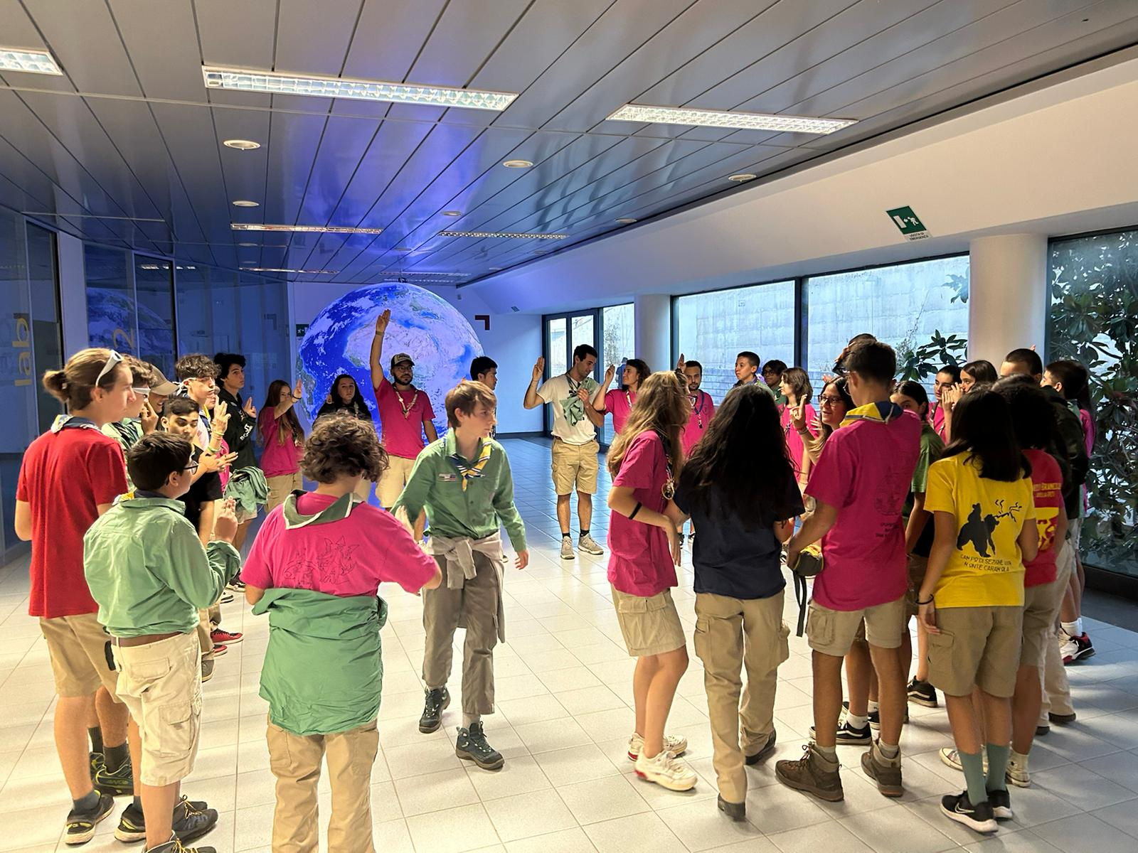
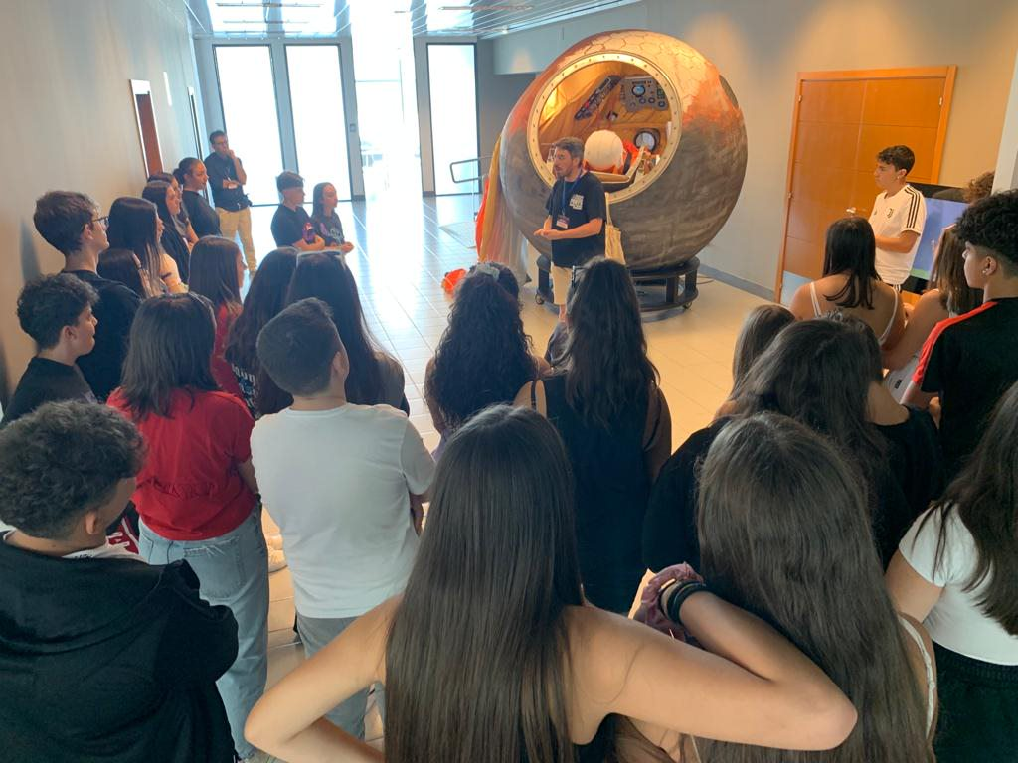
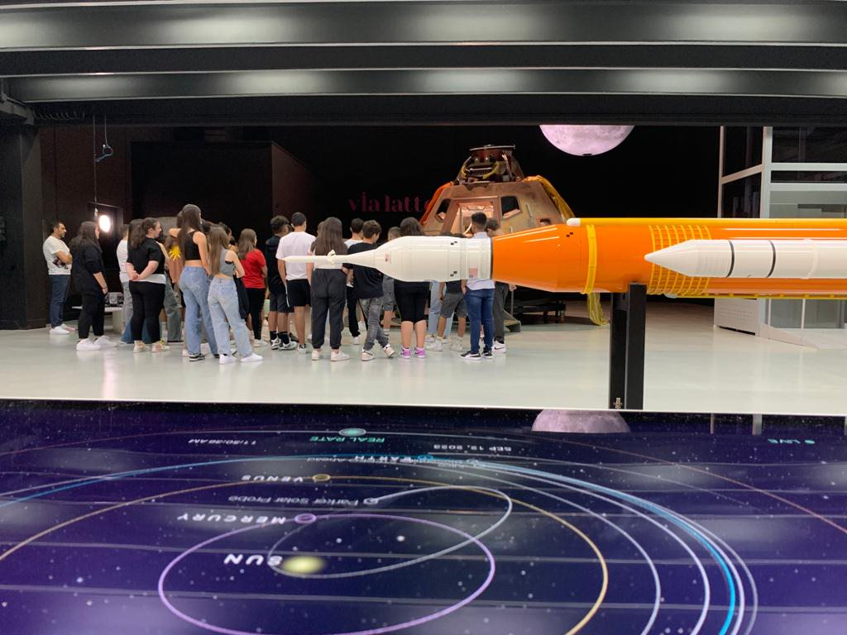
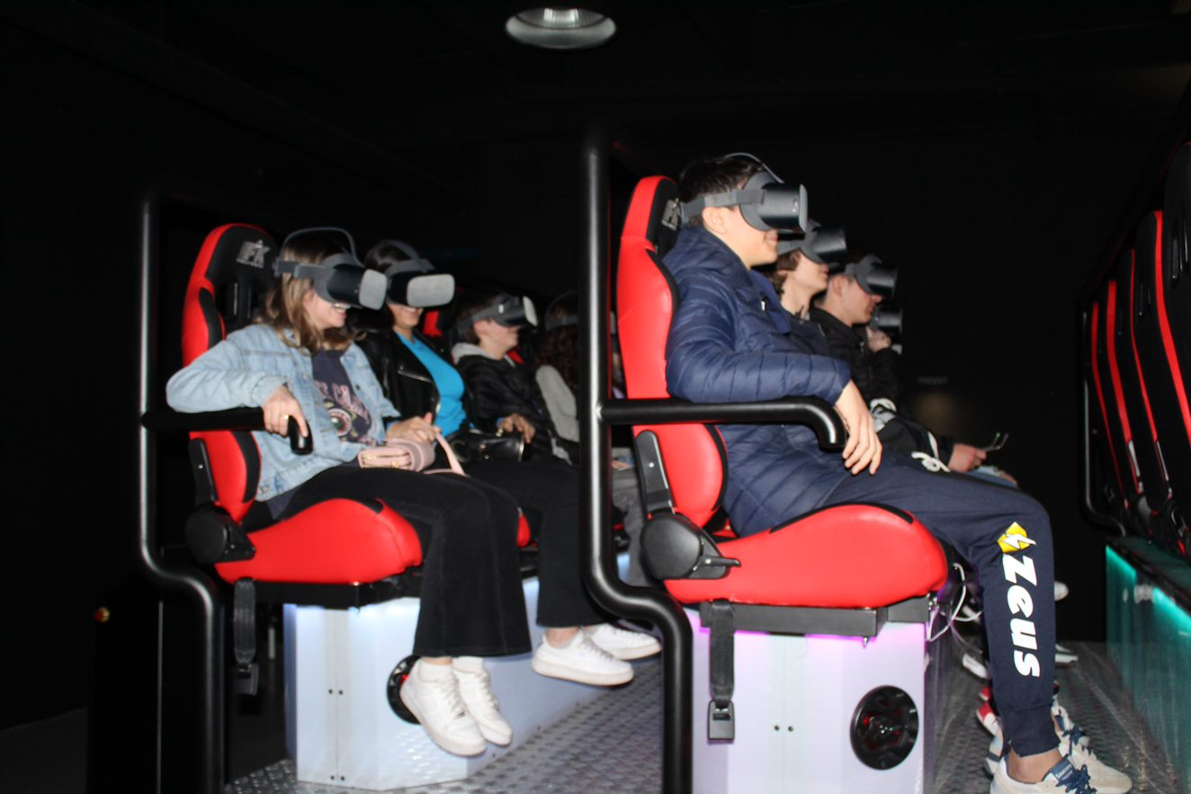
SPARKme service proposition
The Academy hosts within a single structure of approximately 4000 square meters, exhibits and advanced technological systems (VR), including the Planetarium, a 5D cinema, as well as training sessions and laboratories to live an immersive journey that starts from Earth and reaches the Moon and then the planet Mars. This journey provides stimulation and knowledge, narrating how space data, space technologies, space exploration, research and applications contribute to improving human life and safeguarding our planet.
All of this is made possible thanks to the presence of expert communicators, laboratory activities, thematic workshops, distance live and interactive connections with centers of excellence (i.e. Universities, CERN, Astronomical Observatories, INAF, other research centres, etc.).
Since early 2023, about 4,000 visitors including students, teachers, families and “space dreamers” have visited the site and were excited about this experience!

Slide 5
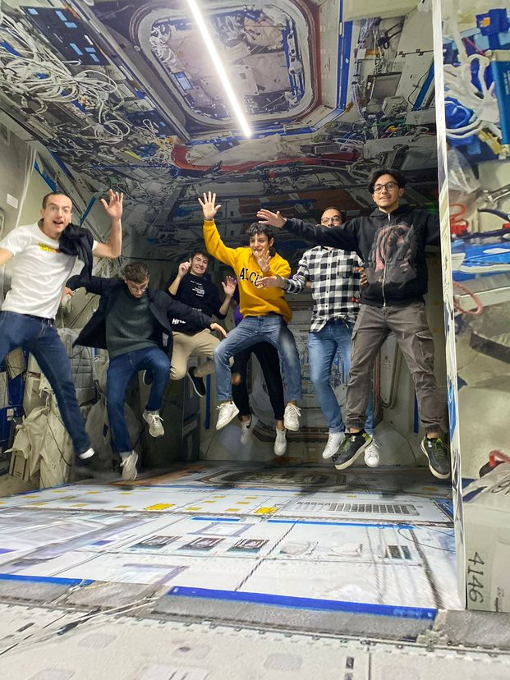
SPARKme: Benefits and risks
Benefits:
contributes to increase the tourism offer and enlarge the opportunities for cooperating in such a field with benefits for the territory image as well as economic impacts along the service value chain.
Offers distance live and interactive visits at other cultural, scientific and tourism entities providing a perspective of global and inclusive tourism.
Offers an innovative approach to discussing “space” and the related opportunities through a storytelling method designed to engage both young and old, experts as well as those encountering these topics for the first time.
Uses technology-based system to “storytelling” the space and the results reached, with an opened eye on future innovations facilitating the dissemination and the sharing of this scientific and cultural heritage
contributes to orienting to future careers in the space sector
Risks:
Private initiative needing significant investments and operational costs to maintain the Academy aligned with both the results coming from the space sector research programs and sector trends
Future steps:
Increase partnerships and collaboration agreements
Increase marketing and communication actions to reach the largest part of potential visitors

Slide 6
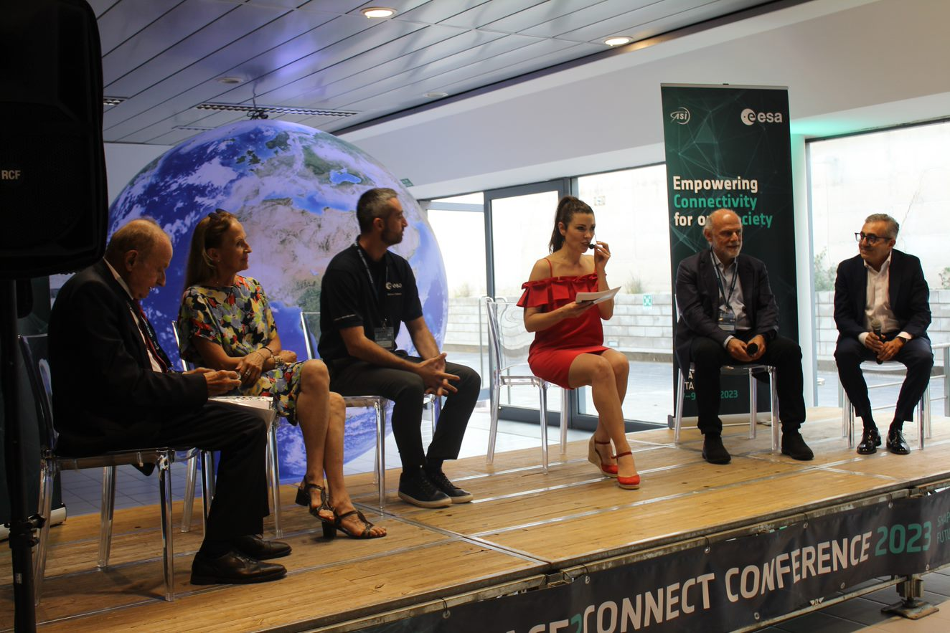
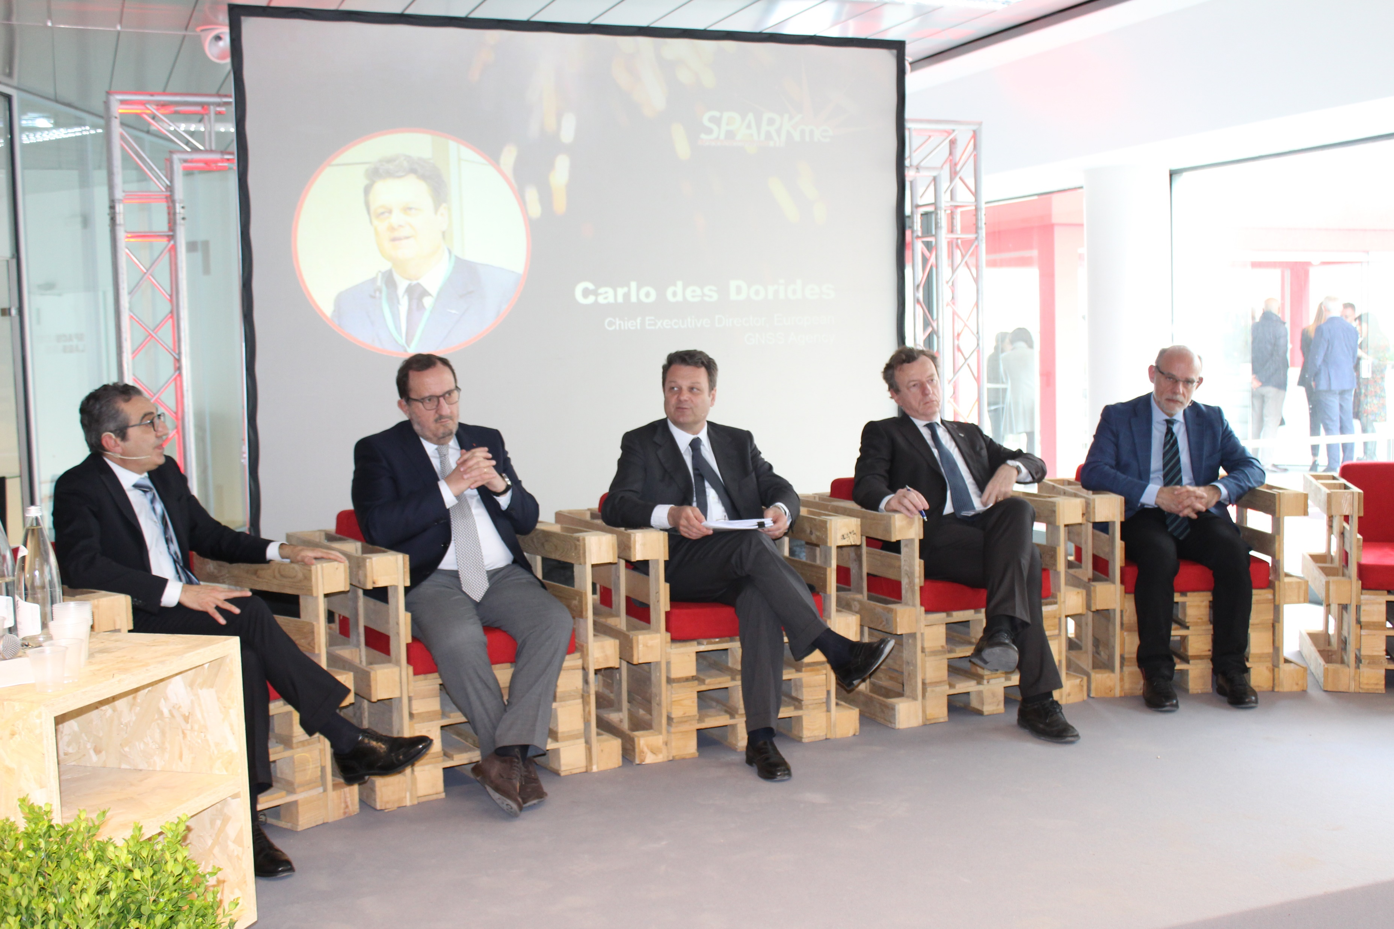
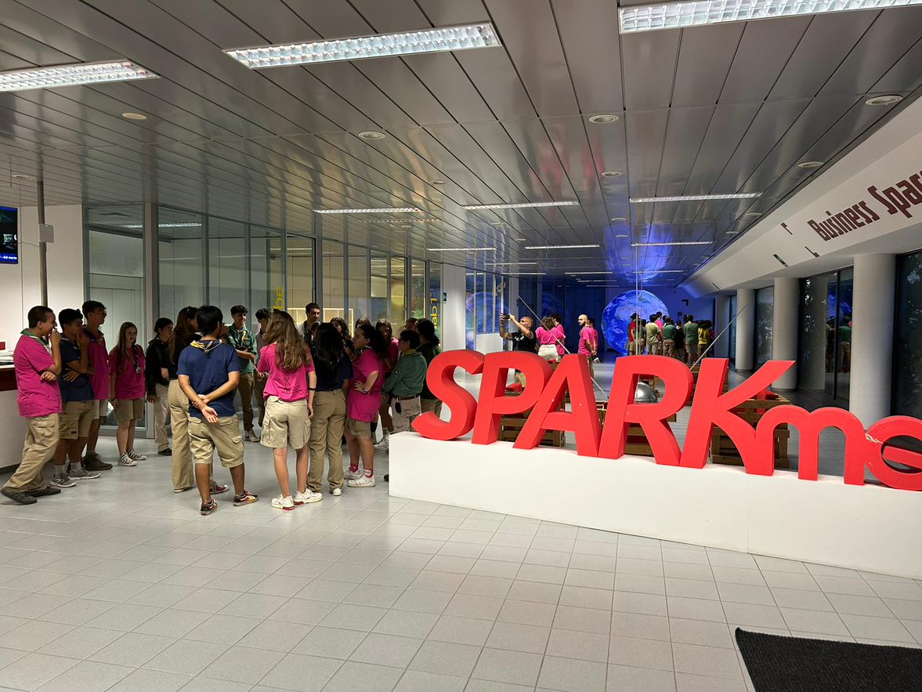
Thank you
Filomena Cuccarese
Openet Technologies S.p.A.
Managing Director
fcuccarese@openet.it

