Slide 2
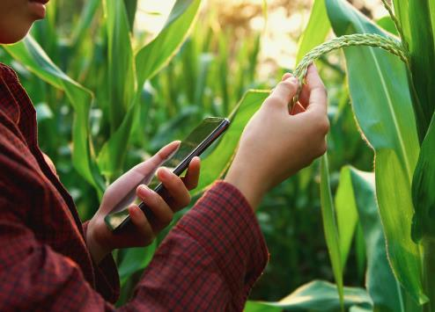
Agricolus
The complete platform for AN efficient and innovative management of your farm
Economic and environmental sustainability of the farm
Reduction of input
Optimization of the crop operations
Improvement of the yield
Data-Driven Decisions

Slide 3
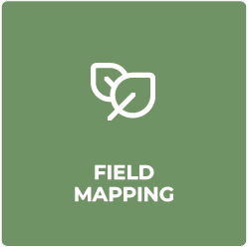
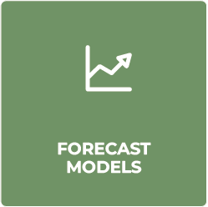
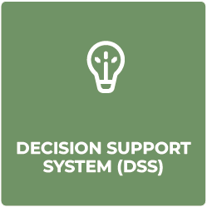
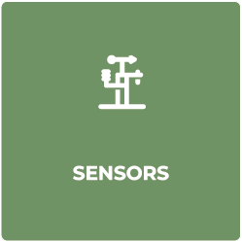
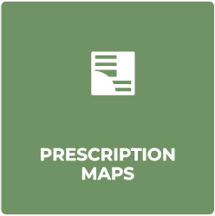
Innovative technologies for agriculture
AVAILABLE IN A SINGLE SAAS CLOUD PLATFORM AND MOBILE APP
Proprietary technologies, developed by Agricolus' agronomists and IT experts
Notes:
Manca monitoraggio

Slide 4
Numbers
2.304.000/mese Satellite images
+4.399
Certified experts
37
Global partners and resellers
82 Countries
8
Languages
13
International projects

Slide 5
Agricolus &
ESA
AGRICOLUS ricognises the value of research activities and partecipates in several projects
ESA PA
AGRICOLUS HAS 3 ONGOING PROJECTS WITH ESA AND ONE WAS CONCLUDED LAST YEAR

Slide 6
AgriTrack Full DSS Stack
AgriTrack full DSS Stack is a project proposed by AGRICOLUS SRL which received funding from ESA
We are here
FIRST PITCH
KOM
RR
CDR
FAT
SAT
FR
December 2021
14 November 2022
15 May 2023
27 July 2023
May 2024
Sept 2024
November 2024
AgriTrack Full DSS Stack is an advanced Full Decision Support System able to combine modeling and remote sensing information to highlight the hot-spots of a vegetative stress and provide a diagnose computing a data fusion of agronomical, meteorological, pedological and forecasting models.

Slide 7
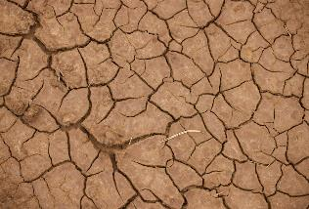
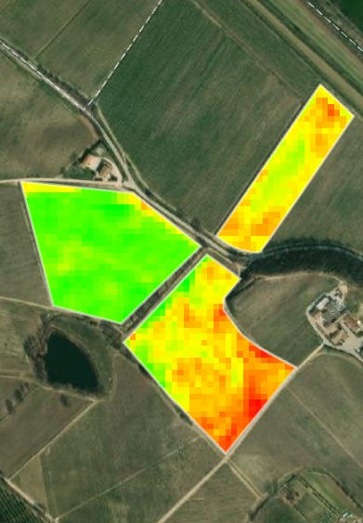
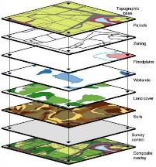
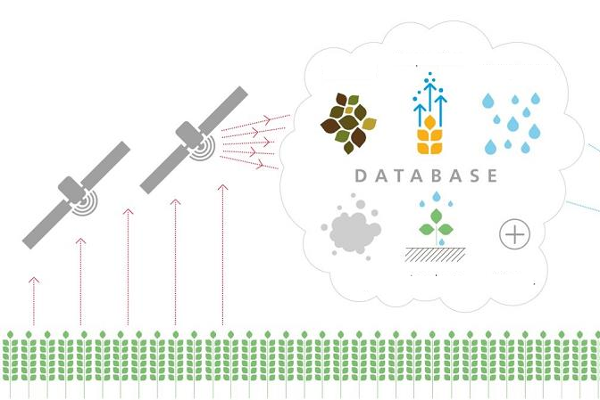
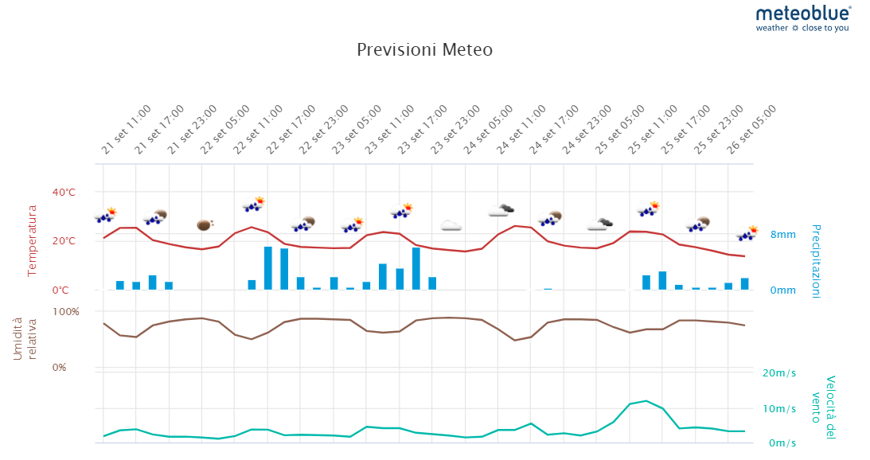
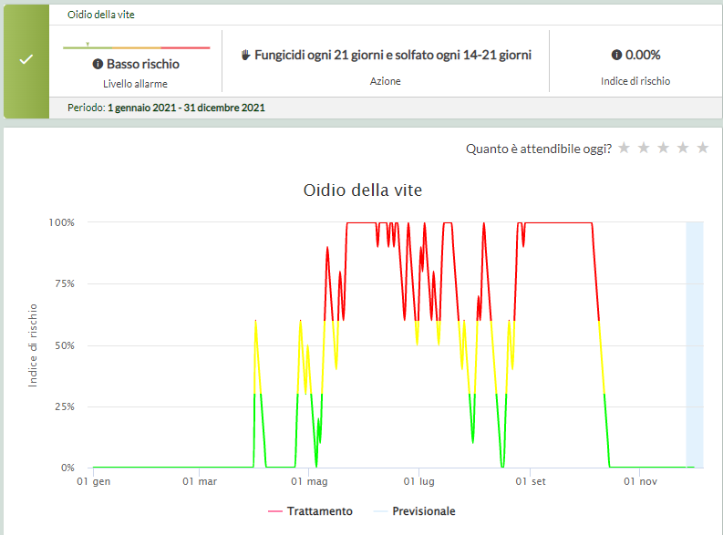
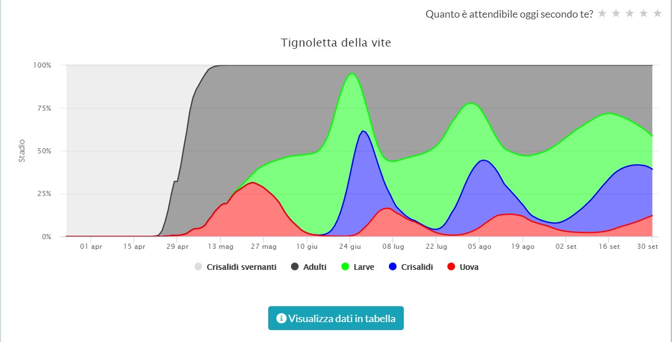
Core Concept
PROBLEM
CURRENT SOLUTIONS
AgriTrack SOLUTION
Climate Change and Biodiversity Loss​
Changing of consumers’ tastes and expectations​
Pests and infectious crop diseases​
Limited land resources​
Broken supply chain
Data Collection and DSS
Two common problems of agricultural DSSs:
Information overload
Lack of spatial information of the prescriptions
Traditional DSS + Spatialization
“The full-DSS can integrate all information that now are not in a spatialized domain to provide feedback about what and where is happening in the red dots!”
“Red pixels identifies a vigor problem, but do not provide precise information on what is happening”

Slide 8
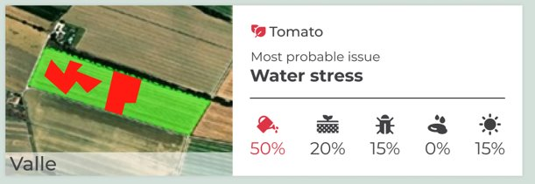
Product Description
AgriTrack Full DSS Stack uses all existing and new model outputs and sensed data (e.g., satellite, in-situ sensors) to obtain a probabilistic diagnosis of the agronomic issues affecting specific areas within the identified critical field.
This will be achieved testing different Machine Learning and data-fusion approaches.
4 Core Innovations:
Critical area diagnosis from interpretation of satellite images
Spatial model outputs on specific issues at sub-field level
Integration of several data sources into a single information
Sharing and aggregation of information at different levels

Slide 9
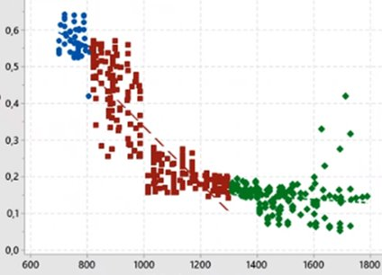
Winter Weath
Durum Wheat
Corn
Tomato
Data collection on 49 experimental fields
User engagement activities for User Experience study, identify User Needs and validate the product
Farmer’s association
Cooperatives
Large Farms
Consortia
Industrial Research to create new models and integrate existing ones into the Full DSS
Creation of the digital architecture, code-writing of the models and creation of a user friendly and inutitive interface.
Verification and validation are planned after the development activities

Slide 10
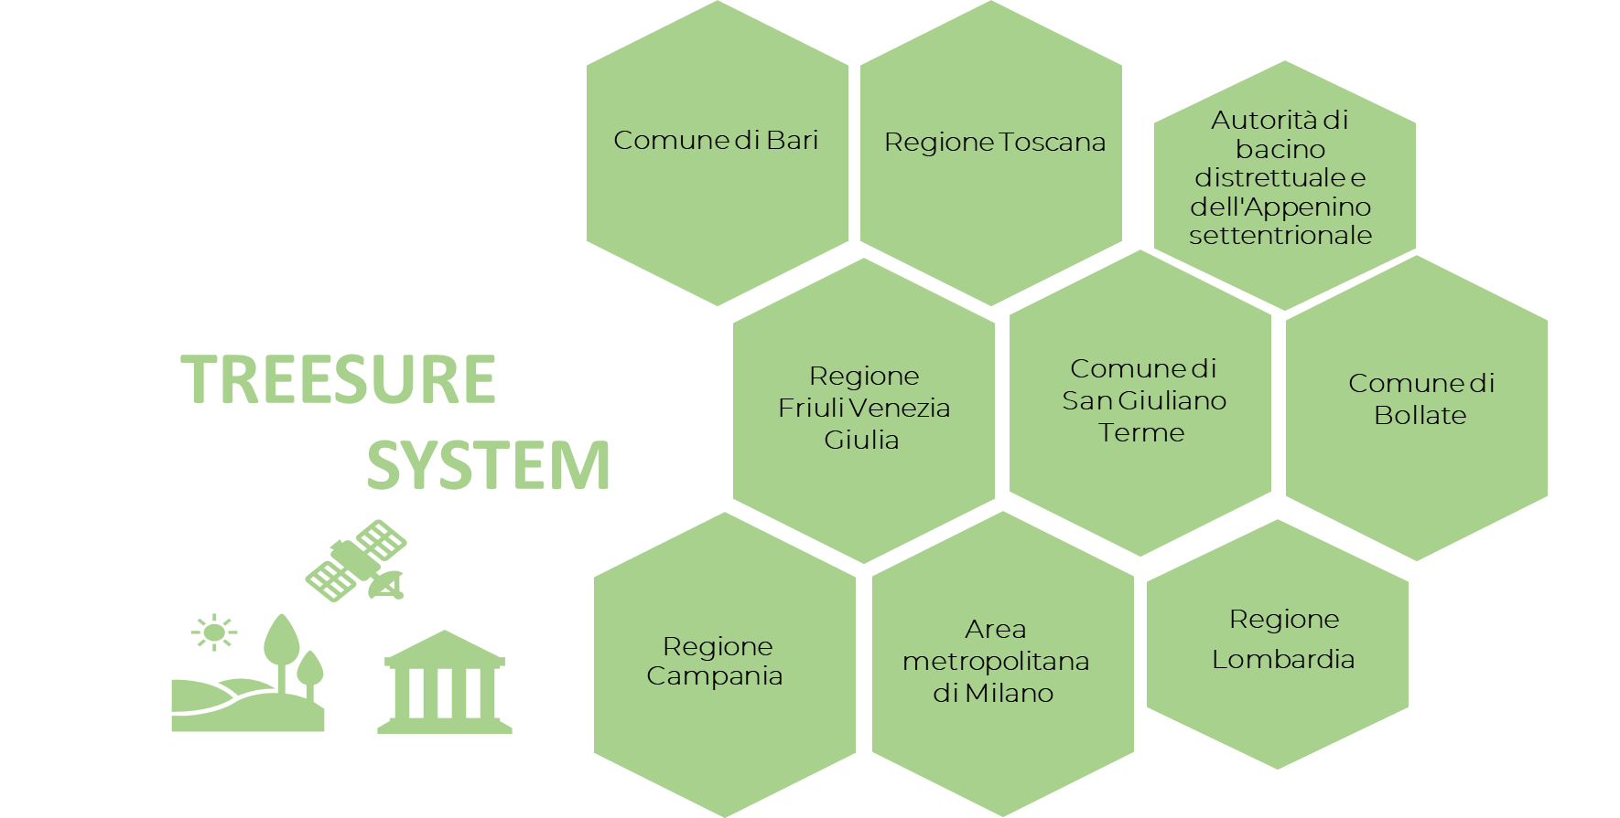
Treesure
Prime
Subcontractor
EO PNRR PROJECT
Layers for the identification of Small Woody (SWF) Features updated annually;
integrated approach that involves geometric and machine-learning algorithms ;
involvement of Local Public Administrations (LPAs) in the development of the Treesure System to support them in:
identify and monitor the presence of SWF that provide important ecosystem services for biodivesity, soil and landscape characterisation;
collect information to make more conscious decisions about the territory and be able to plan activities to mitigate environmental impacts and increase resilience.
training sessions for users to help them adopting the system
PHASE 2:​
PHASE 1:​
March 2023- Dicember 2024​
January 25-June 26

Slide 11
ESA PA
SVC SE-S4-16 Identification of indexes for crop health assessment
-Open software for downloading Sentinel 2 satellite data that allows images to be processed and 13 vegetation indexes to be calculated;
Output of the Service Value Chain:
calculation of 13 vegetation indexes;
zonal statistics of calculated indexes;
External provider
-NDVI
-EVI
-LAI
-STVI
-NDRE
-FAPAR
-MSAVI2
-SIWSI
-NDDI
-NDMI
-NDWI
-NBR2
-TCARI/OSAVI
weekly and monthly aggregation.

Slide 12
MAKING AGRITECH SUSTAINABLE
www.agricolus.com

