Slide 1






European Regional Symposium
September 28 – 29 | 2023 Matera, Basilicata Region | Italy
Second Edition of the European Regional Symposium, on space data for tourism & agriculture, by NEREUS Regions
ALESSANDRO GENTILE
Aerospace Division
Intecs Solutions Spa
alessandro.gentile@intecs.it

Slide 2


Intecs Solutions SpA
Intecs is a leading company founded in 1974 and is one of the oldest software company in Italy. Founded with only four people in a large garage in middle of “Tiburtina Valley” (Rome). It now has offices in Rome, Naples, Milan, Turin, Pisa and Reggio Emilia, with more than 300 workers with different profiles, the majority of which are software and electronic engineers.
Intecs designs and develops applications, tools, software, hardware components and products for the Aerospace, Defense, Transport and Automotive, Railway, Telecommunications, Fintech and Smart Systems markets in collaboration with the main European and Italian industries, organizations, Universities and Research Centers.

Slide 3
The space-based solution
MONICAP is a research project co-financed by the Italian Ministry of University and Research (MUR), as part of the «Development of precision farming and sustainable agriculture for the purpose of increasing productivity and industrial sustainability.
The main mission is to assess the environmental stress of vine plants using different sensors coming from the Earth Observation technologies and ground measures (weather station). With MONICAP we are trying to integrate products generated by remote sensing techniques applied to data acquired by multispectral and hyperspectral sensors installed on aerial platforms (small airships and drones) with medium resolution satellite products (e.g. Sentinel 2).
Vite App is the web/mobile app developed to make accessible the generated products to the local users (winemakers).

Slide 4
MONICAP, MONItoraggio di Colture Agricole Permanente
MONICAP is a continuous monitoring of agricultural crops, it presents itself as a solution for the systematic monitoring of agricultural areas (vineyards) over time, able to acquire thermal, multispectral and hyperspectral images at different times of the day (dawn, midday and evening).
The provision of data and services for precision farming is based on the use of an energy-independent constrained aerostatic system.
From the data acquired by the different cameras installed on the aerostat platform, MONICAP provides information on the water, nutritional and phytosanitary status of the vine plants, aimed at supporting the management of the vineyard.

Slide 5
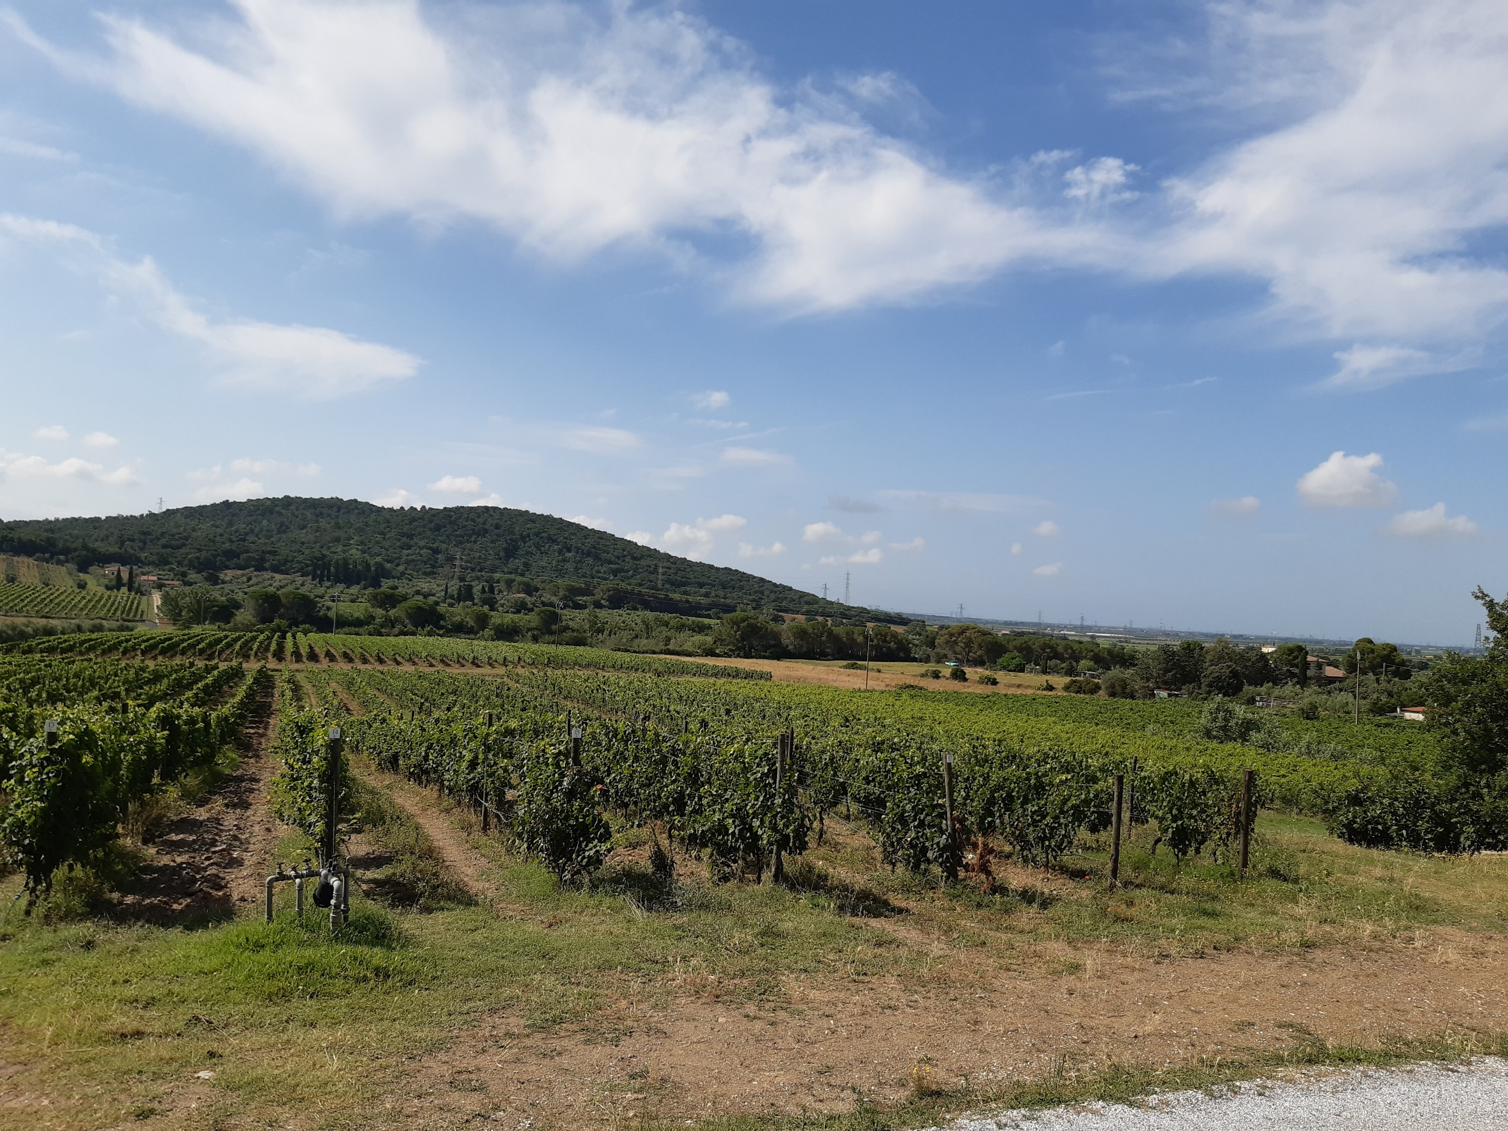
Case study: Agriturismo «La Bulichella» in Suvereto (Tuscany, Italy)

Slide 6
MONICAP Architecture
Monicap is a flexible system composed by hardware and software elements.
The hardware component is formed by an aerostatic platform, a gondola having several electronic devices, a gimbal carrying the spectral cameras, and a transport trolley containing the winch which regulates the altitude of the balloon with a remote control.
The software component consists mostly of several Python routines
that manage data from the acquisition system to the cloud passing through various processing and storage elements. The two main elements of the software are the Gateway and the Cloud.

Slide 7


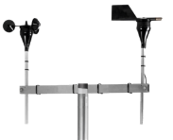
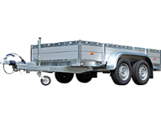
Smart Gateway Component
The Smart Gateway is the device installed on the ground station. It receives the acquired data and telemetries, both from the aerial platform and from the other devices displayed in the field (sensor nodes, and weather station), carries out pre-processing on them and sends the results to Cloud services.
The Smart Gateway also has the function of making the Cloud services communicate in both directions with the air and ground elements installed in the field, continuously exchanging telemetry to allow remote configuration.
Aerostatic tetherd platform
Telemetries
EO Data
Cloud
Meteo Data
Telemetries
Smart Gateway
Remote Control Unit
Weather Station

Slide 8
Cloud Component
The Cloud (coded in Python) hosts several components such as the Catalog Manager to manage all the typology of products the Event Manager, the Processing Scheduler, the Core and the Processor Engine.
The Catalog Manager manages all the data archiving to and from the database (OpenSearch); the Event Manager service, has the task of receiving MQTT notifications, for the availability of new acquisitions, new weather measures, etc.; the Processing Scheduler manage and synchronize all events to perform acquisitions, to start the processing workflows and so on.
Core and Processor Engine contain all the necessary workflows and processors capable of calculating the water, nutritional and phytosanitary stress of vines.
The flexibility is guaranteed because the software component can manage different type of spectral sensors, which only need to be initially defined in the system configuration, and the ability to ingest different DSS integrated into specified workflows and processors.

Slide 9
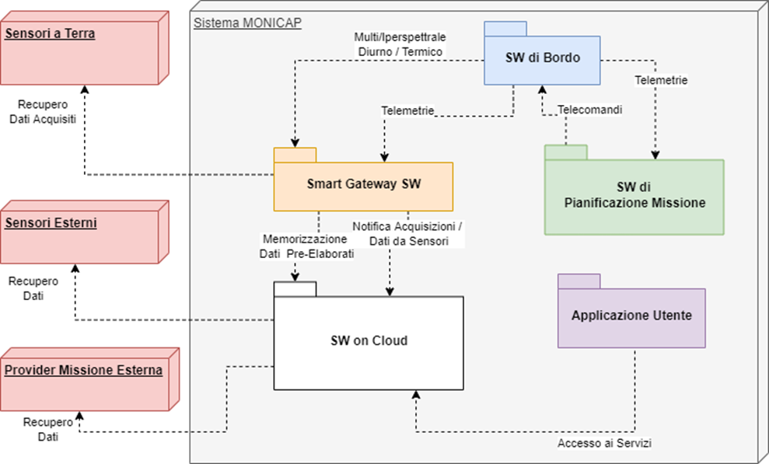
SW System Components

Slide 10
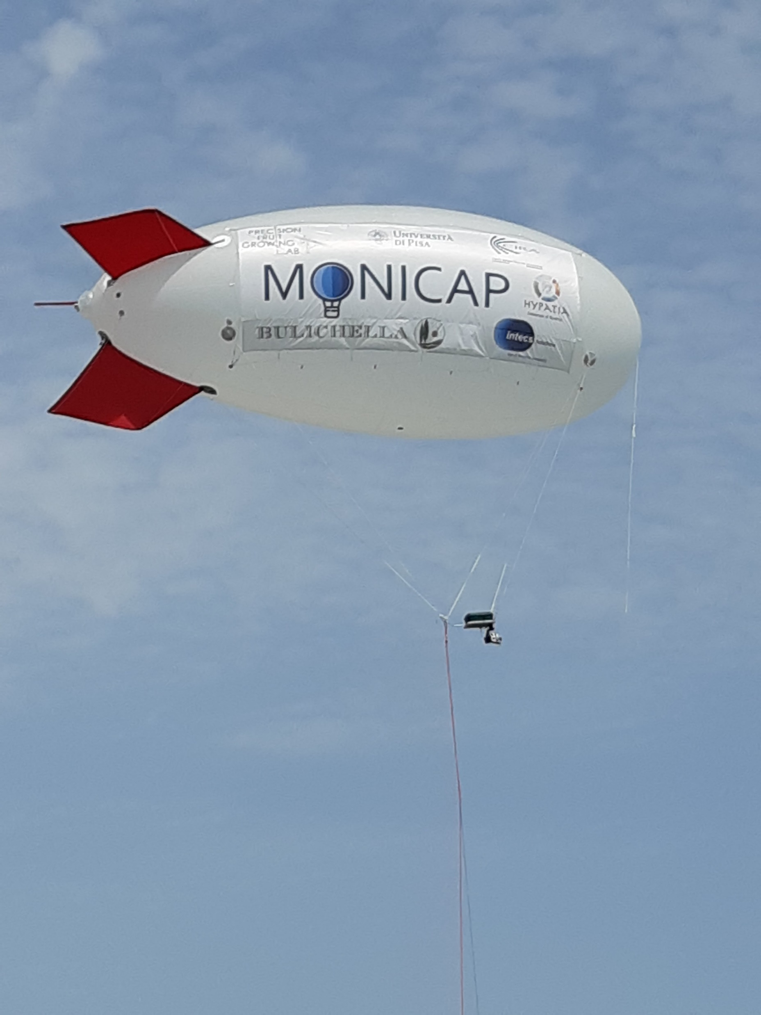
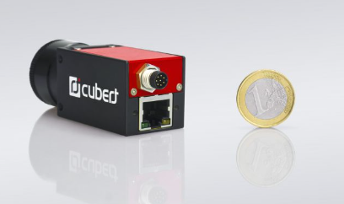
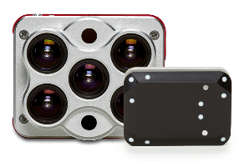
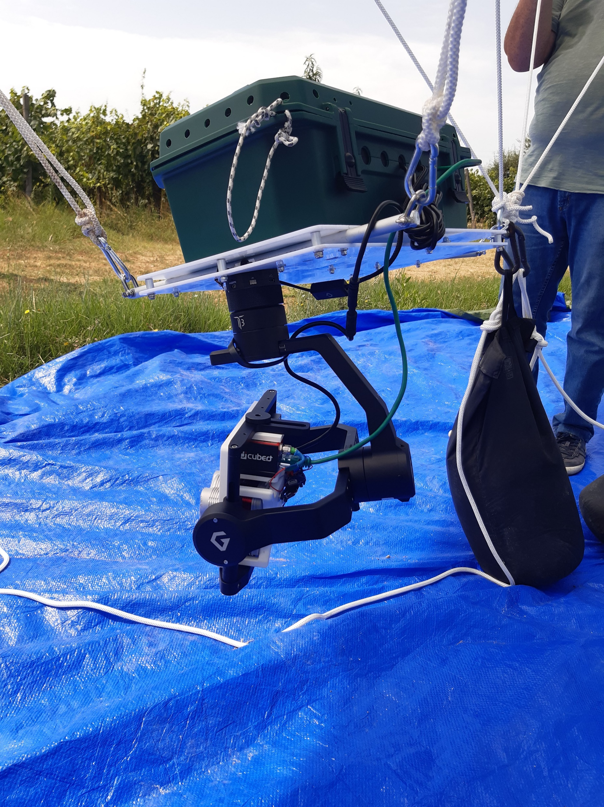
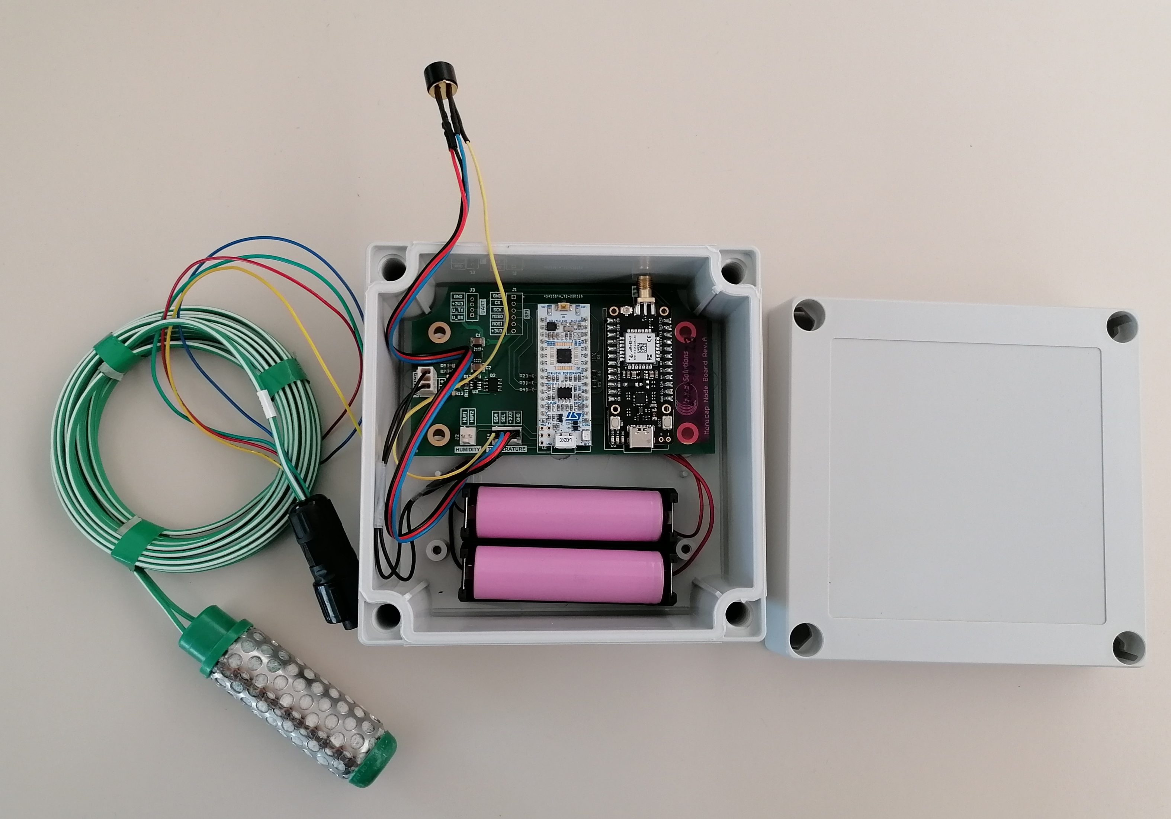
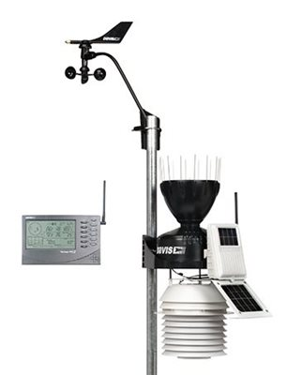
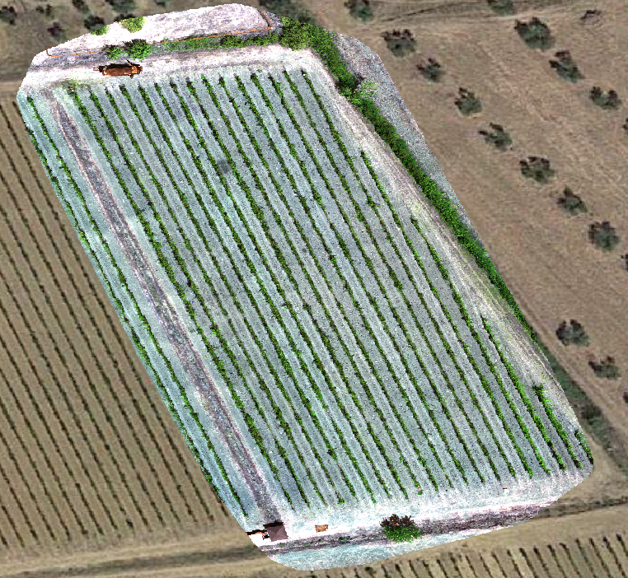
HW System Components
Hyperspectral Camera
Cubert Ultris5
51 bands (VIS/NIR)
Multispectral Camera
Micasense Altum
6 bands
(RGB/RedEdge/NIR/LWIR)
temperature/humidity sensors, LoraWan nodes
Stazione Meteo Davis Vantage Pro2

Slide 11
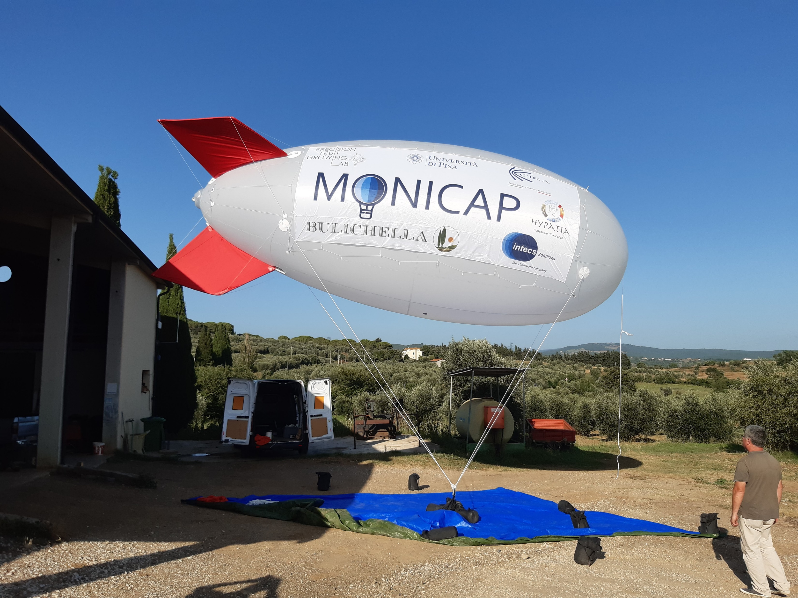
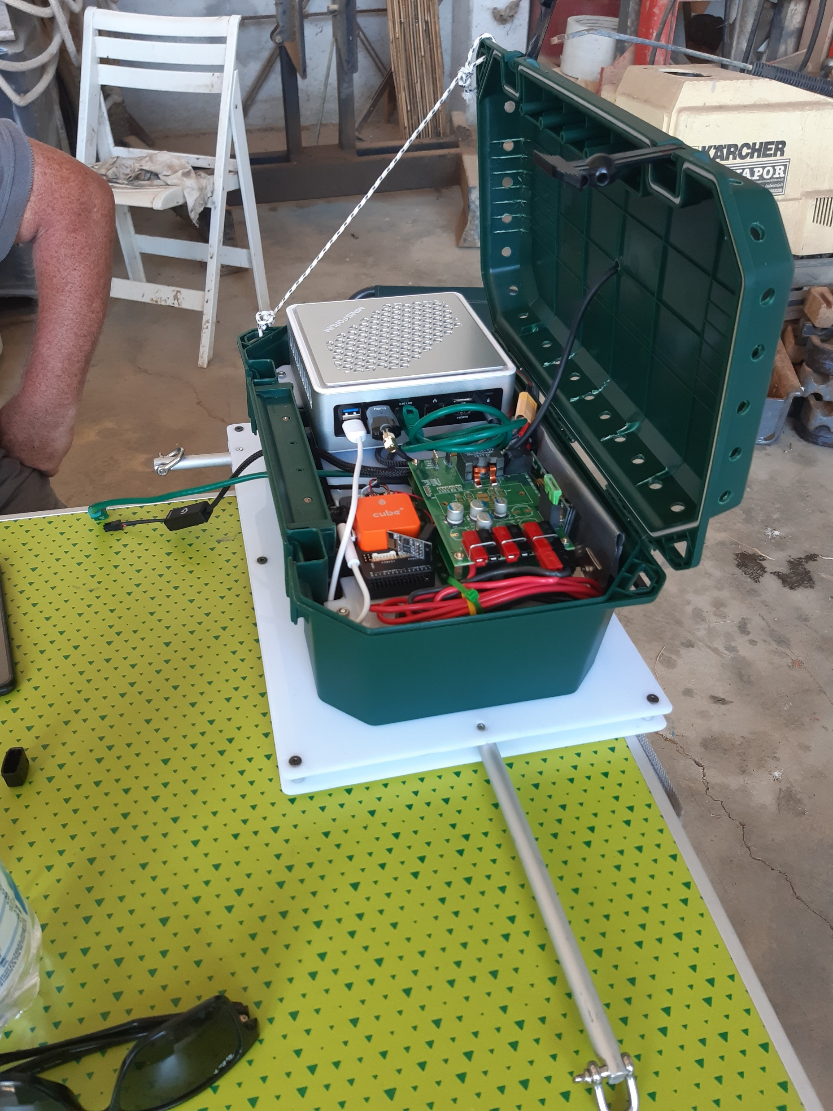
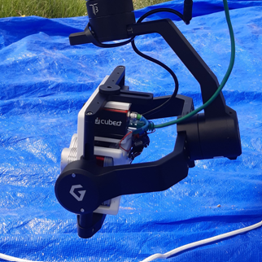
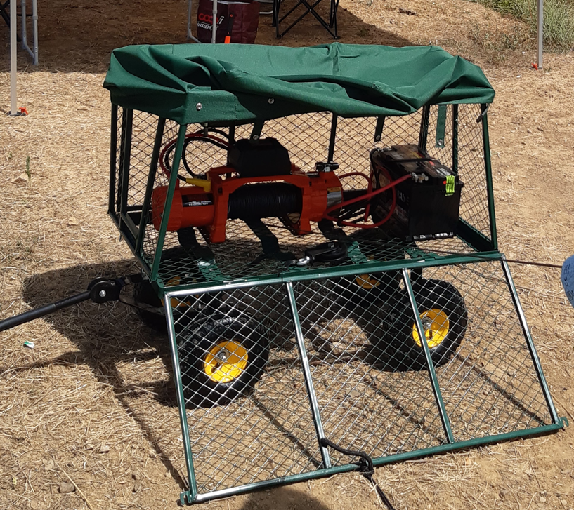
HW System Components
on-board software for the
managment of the different hardware components
rechargeable batteries
GPS sensor
Flight Control Board
Airship lenght 8 m, helium volume 55 mc, rigid ailerons, lifting force 34 kg
Ground segment components:
Transport trolley is the control base of the aerostatic platform;
The winch is the electromechanical mechanism on which the cable for the balloon is wound.
Gimbal 3 axis, automatic positioning of cameras controller

Slide 12
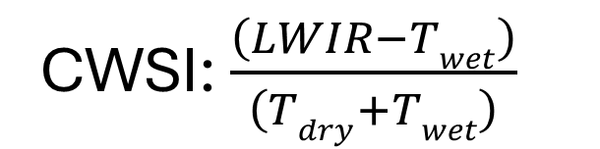
Vine Water Stress
One of the most important stress that afflicts vine plants is the lack of water during the different phases of the growing season. Correct and rapid identification allows growers to make the correct decisions to compensate for it.
CWSI: $\frac{\left(LWIR−Twet\right)}{\left(Tdry+Twet\right)}$
(Crop Water Stress Index)

Slide 13
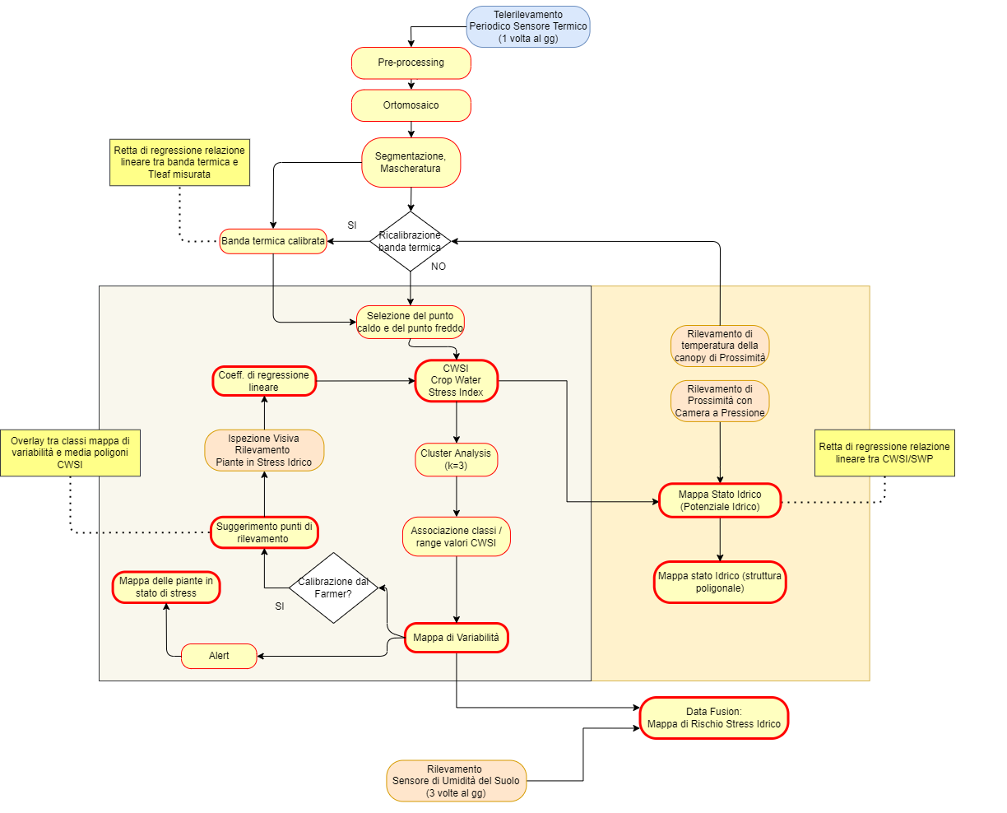
Vine Water Stress Workflow

Slide 14
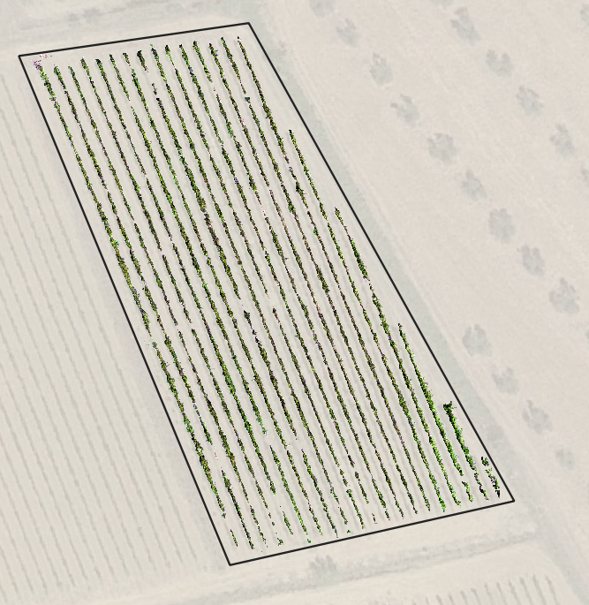
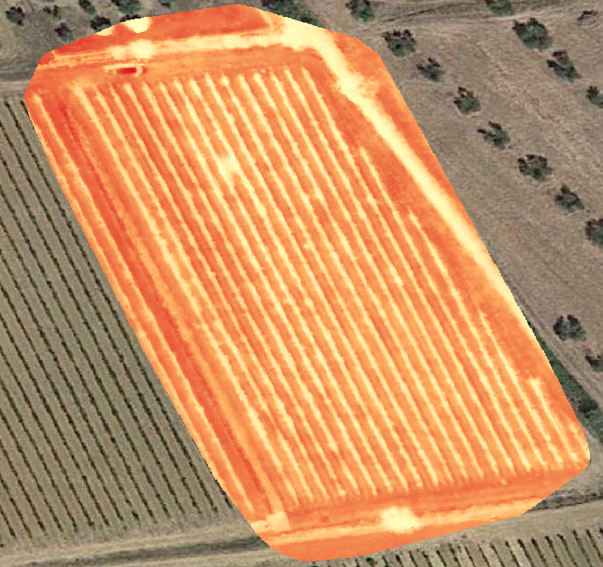
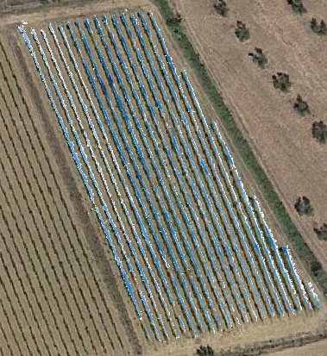
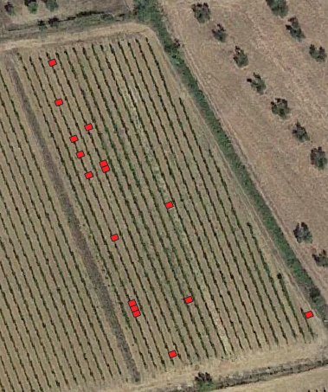
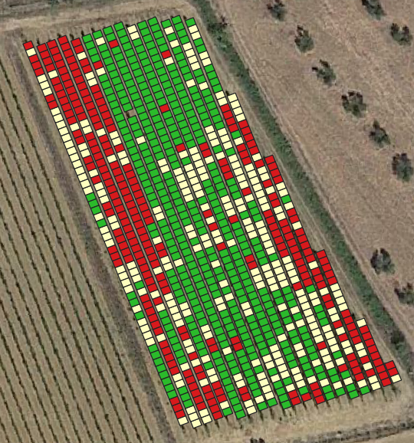
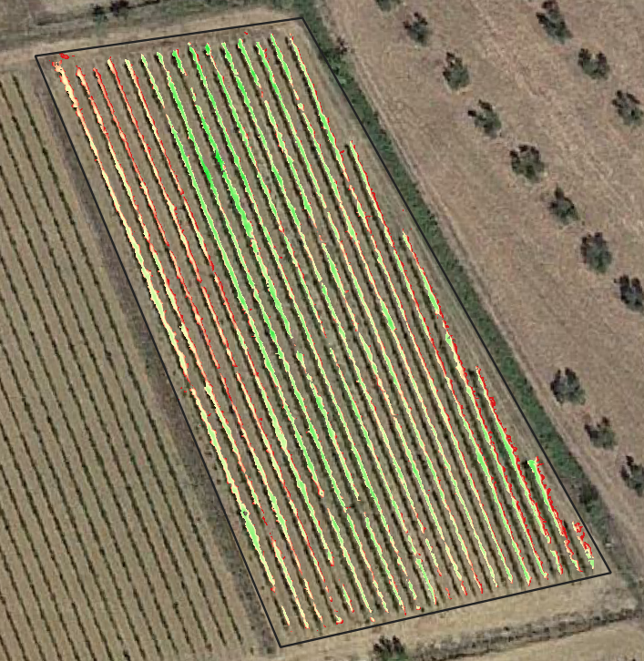
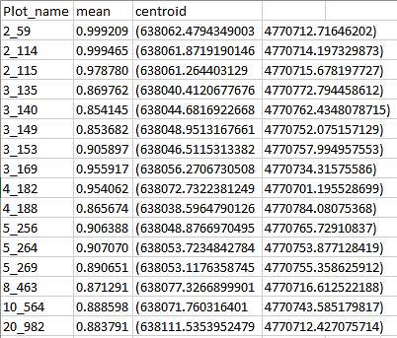


Vine Water Stress Products
CWSI Map
Orthomosaic and thermal image of the parcel
Canopy
Segmentation
Cluster
analysis
CWSI Variability Map
Water Stress Alert Map
list of plots with high water stress
Output to the Farmer

Slide 15
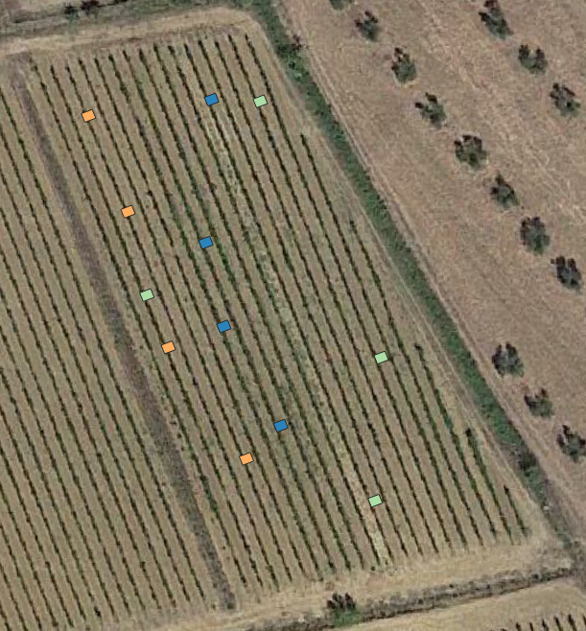
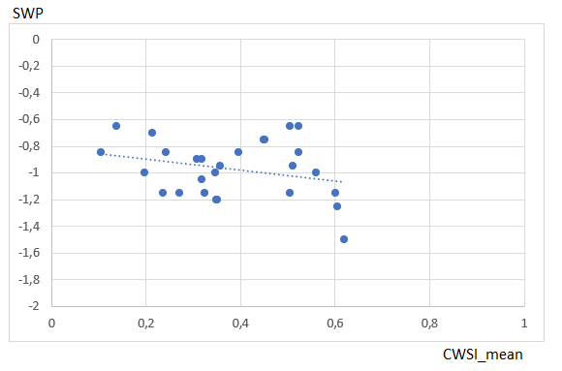

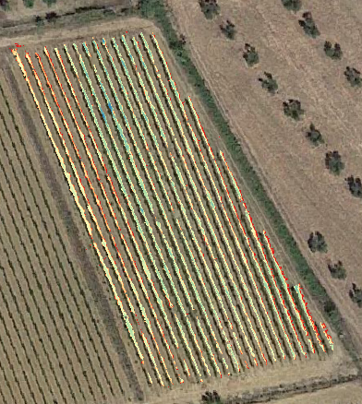

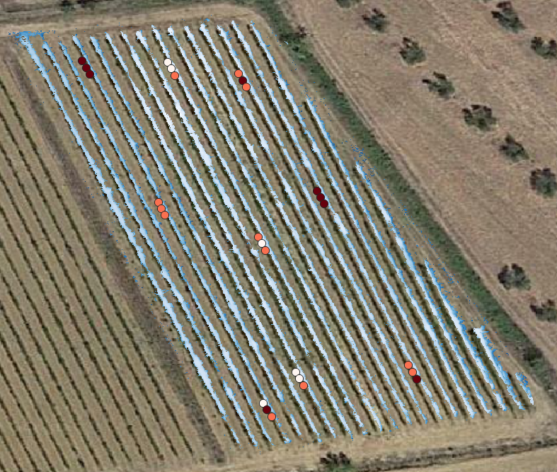
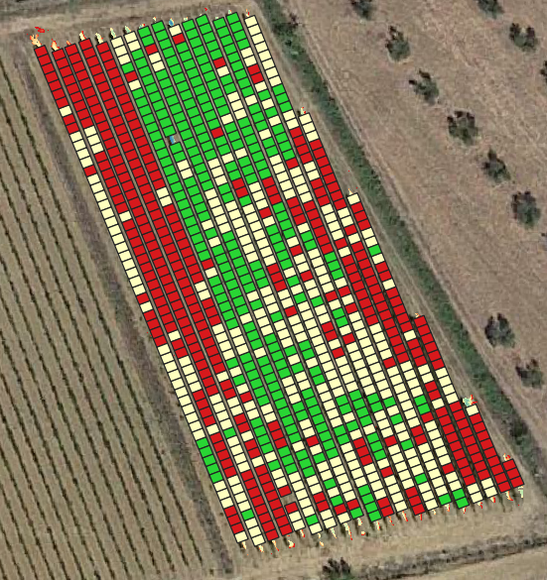

Vine Water Stress Calibration
Plot Map for visual inspections
Calibration Request
Qualitative assessment
Richiesta valutazione SWP
Quantitative assessment
SWP Map
Stem Water Potential field Measure Map

Slide 16
Vine Nutritional Stress
Nitrogen is the element most related to the vigor and vegetative development of the vine. In the absence of other stresses (biotic/abiotic) the daily growth rate of the shoot can provide indications about possible nitrogen deficiencies.
To assess the nutritional stress of vines we have developed different workflows based on the estimation of the LAI and the NDVI and its relationship with the percentage of leaf nitrogen using the following equations:
%N = $\left(SPAD ∗0,027+1,641\right)$ (Eq. 1, Porro et al., 2000)
%N = $\left(NDVI ∗1,384+2,014\right)$ (Eq. 2, Caruso et al., 2017)

Slide 17
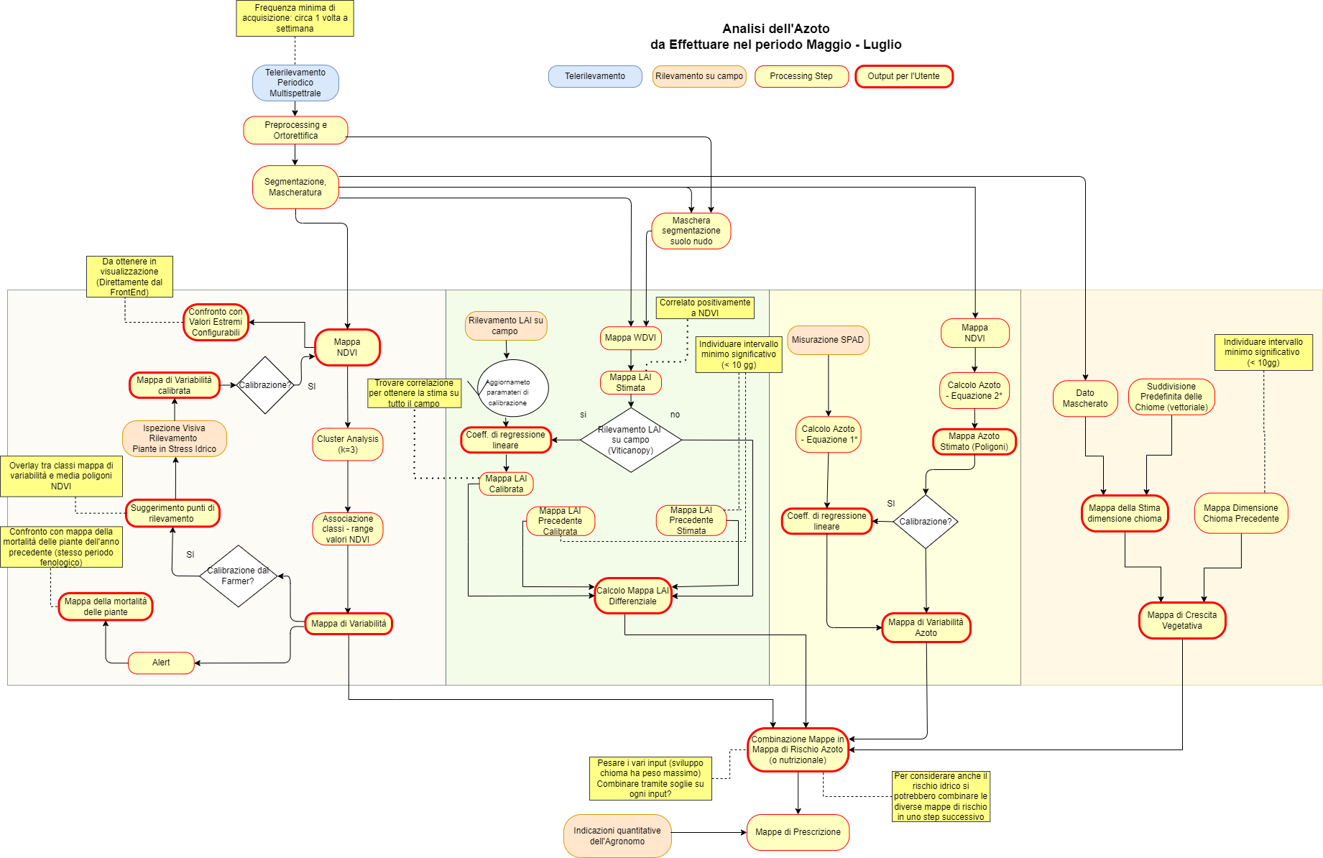
Nutritional Stress Workflow

Slide 18
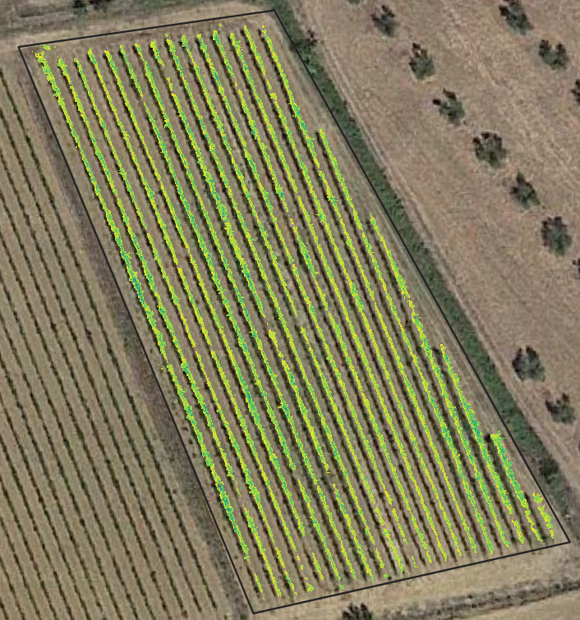
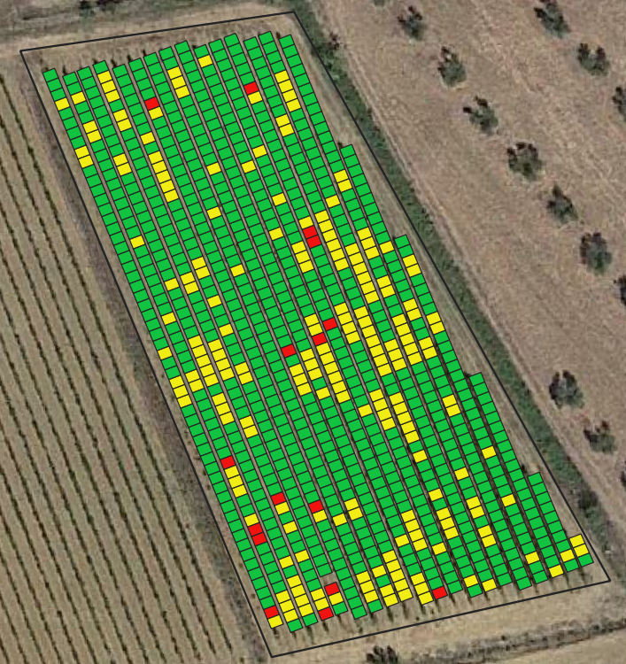
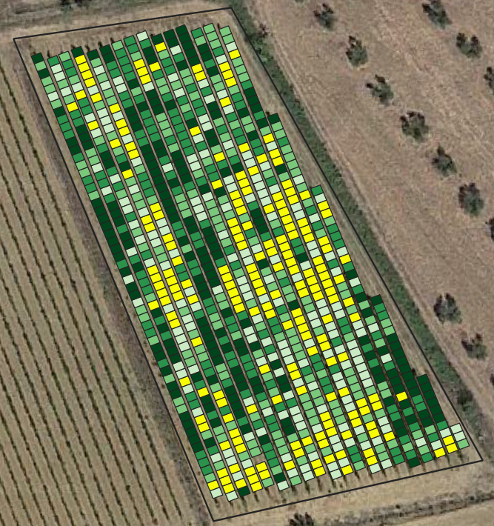
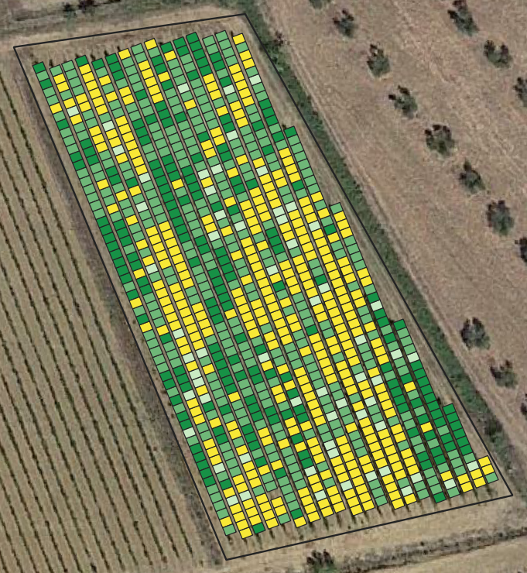

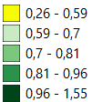
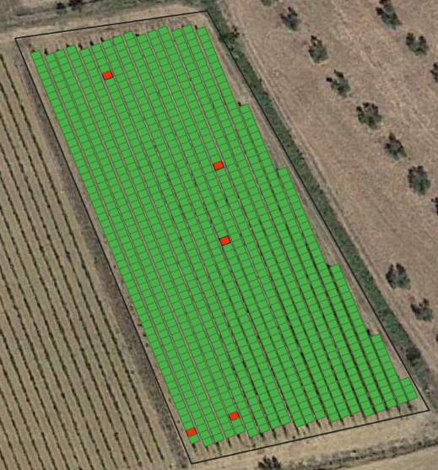
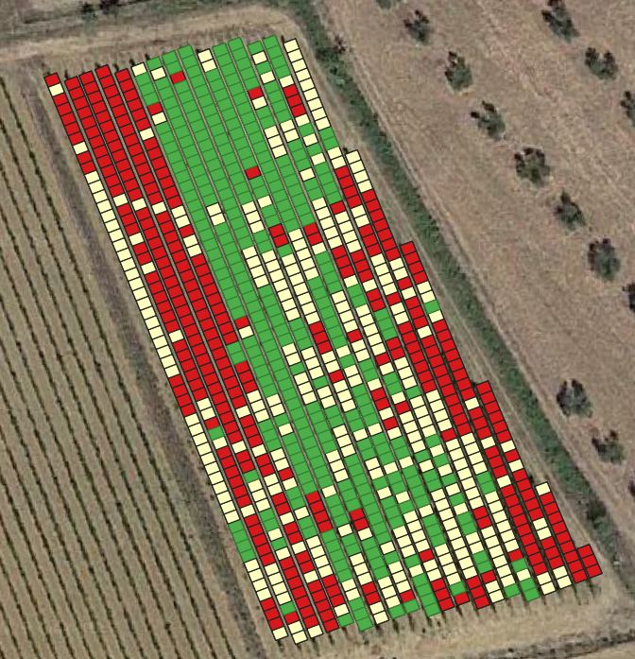
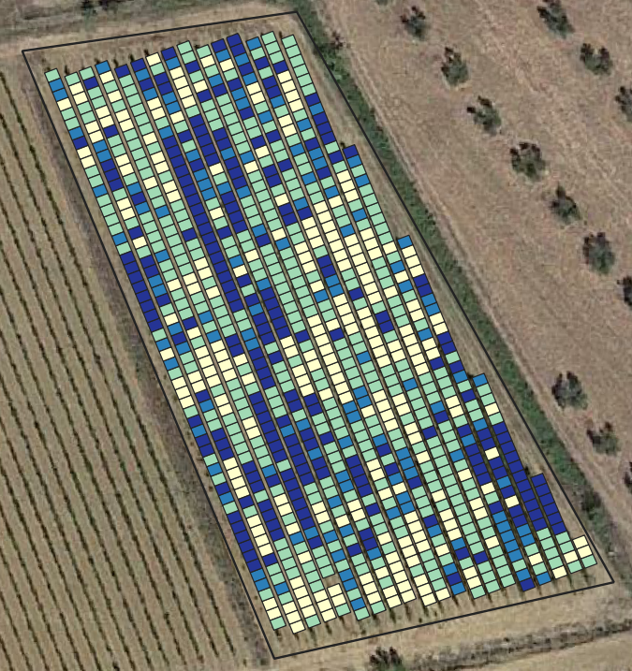
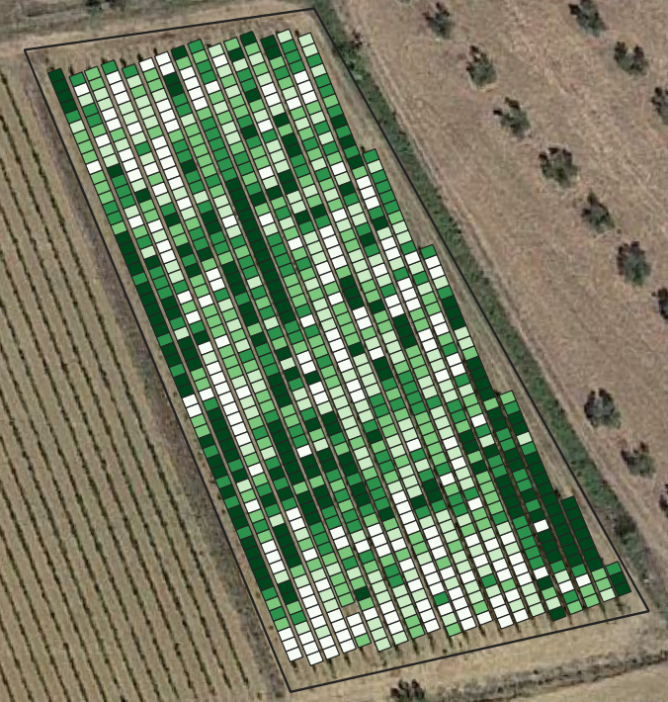
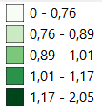
Nutritional Stress Products
NDVI Raster Map
Comparison with previous period
NDVI Variability Map
LAI Variability Map (m²/m²)
LAI Differential map
Comparison with previous period
Alert
Nitrogen Percentage Map
Green Canopy Cover Map (m²)
Basso
Medio
Alto
Fusion Map for the
Risk Nutritional Map

Slide 19
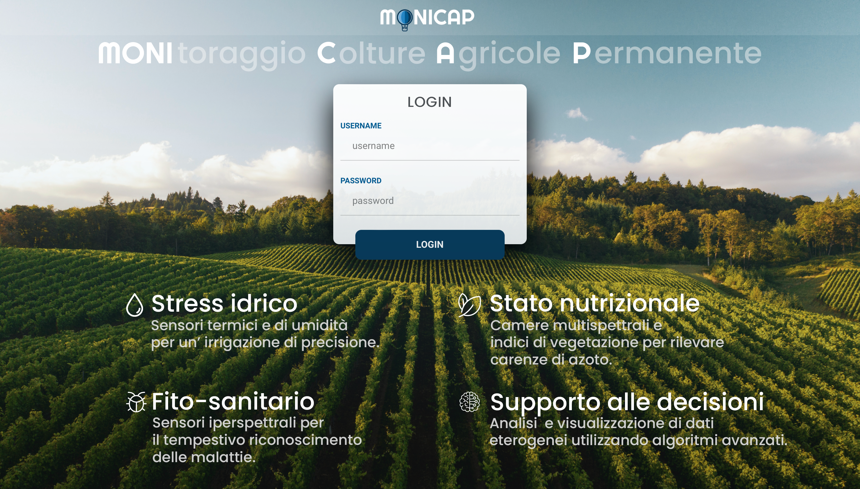
User App

Slide 20
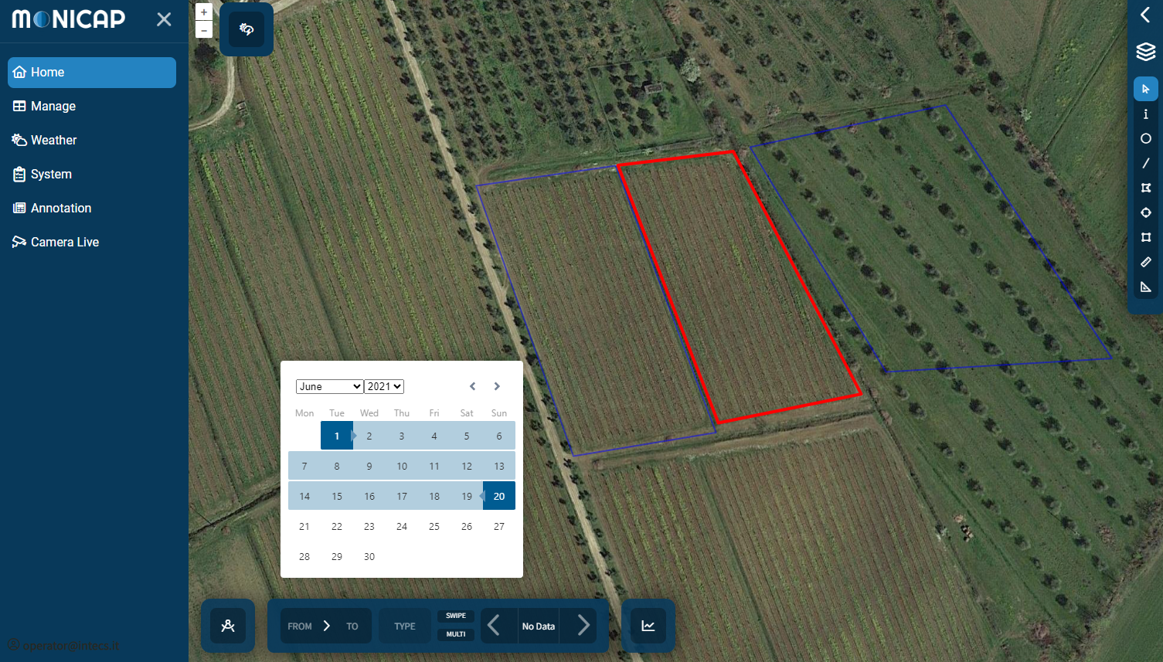
Farmlands Management

Slide 21
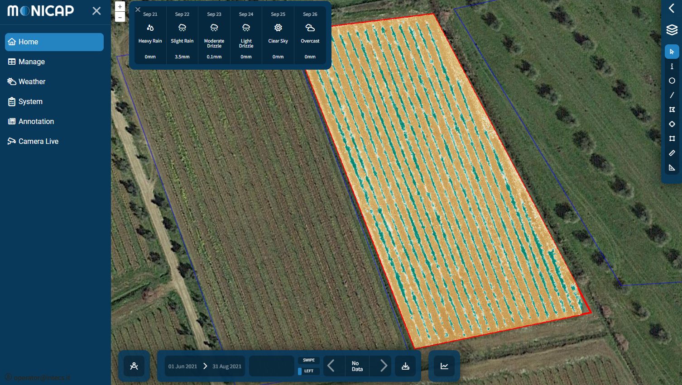
Products Visualization

Slide 22
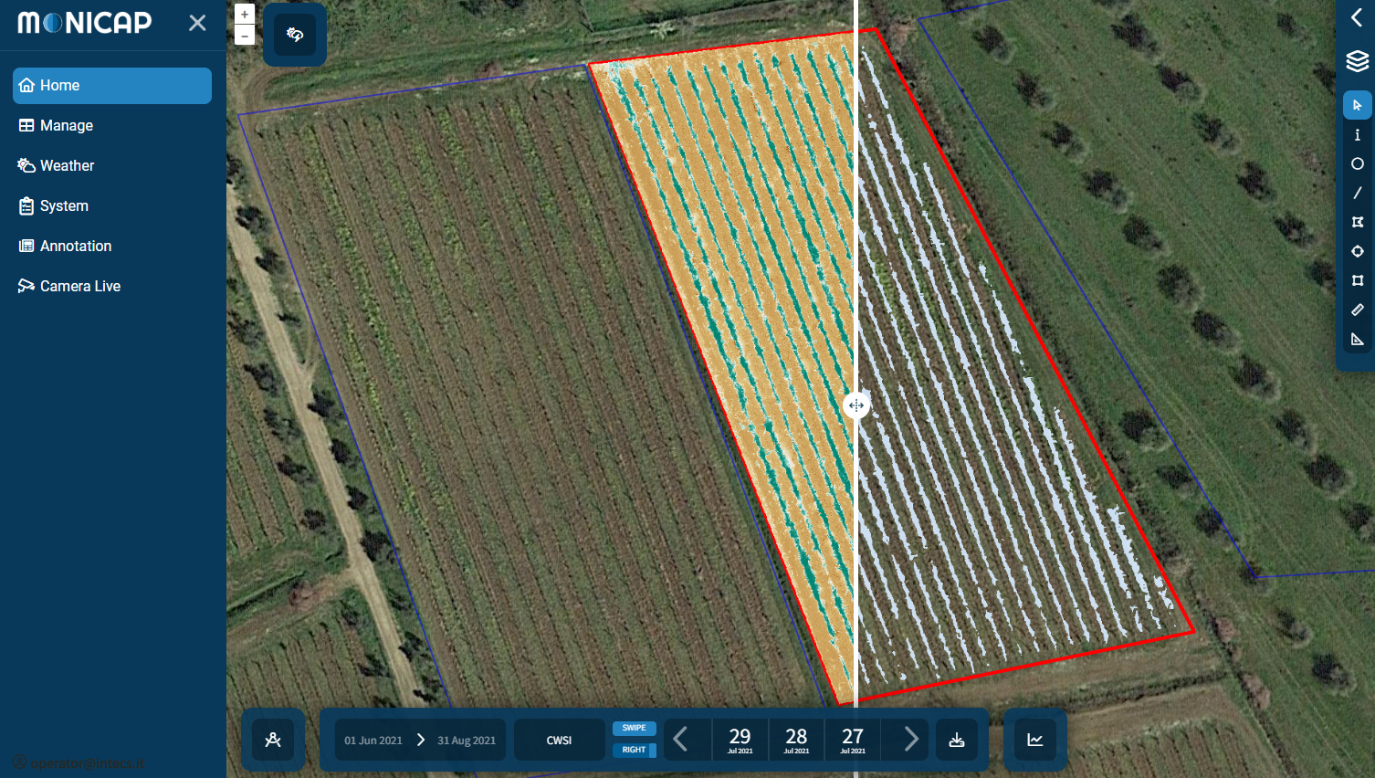
Swipe mode for products comparison

Slide 23
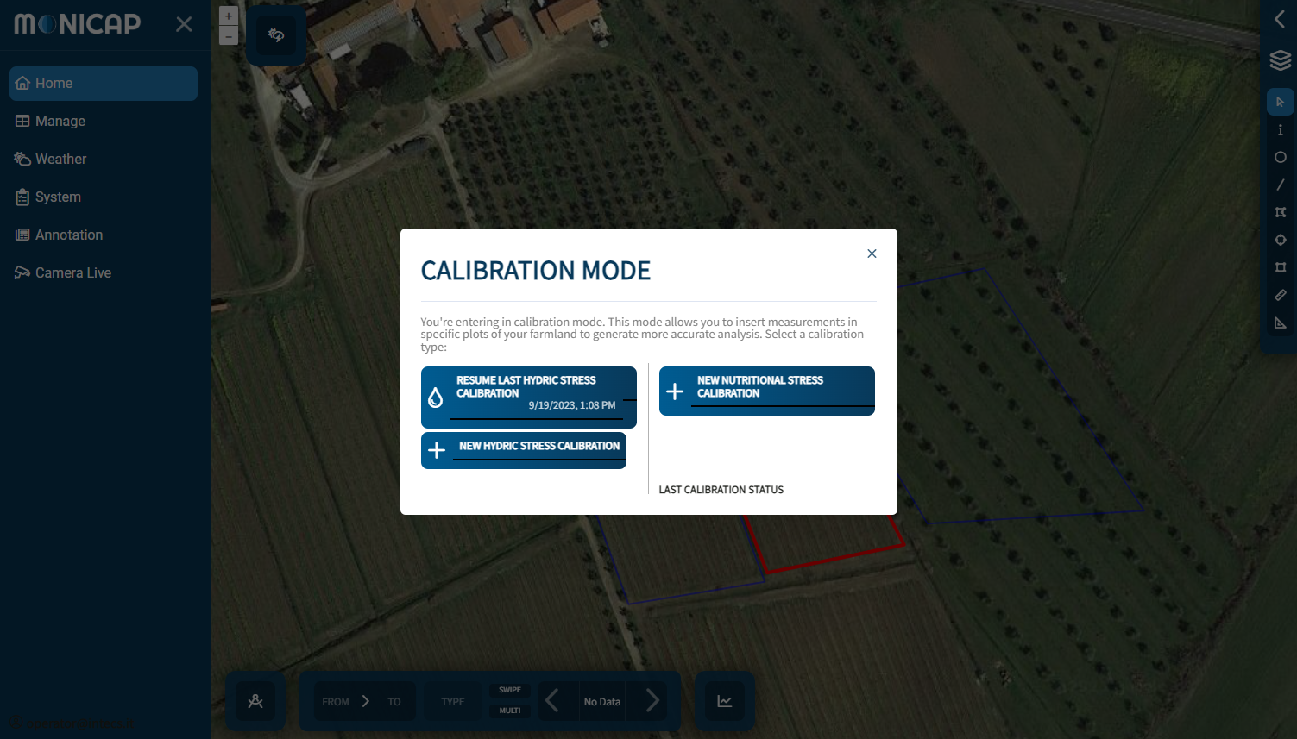
Activation of the calibration mode

Slide 24
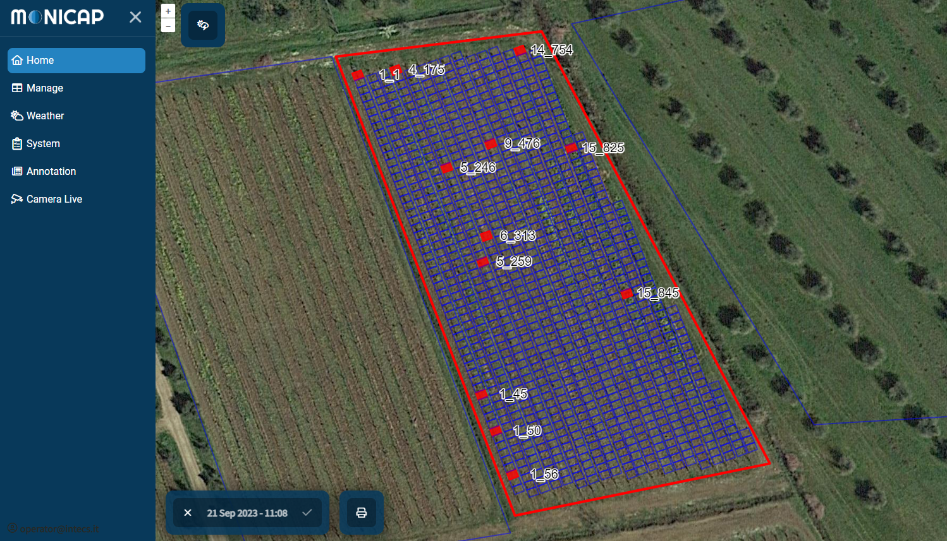
Management of field measures

Slide 25
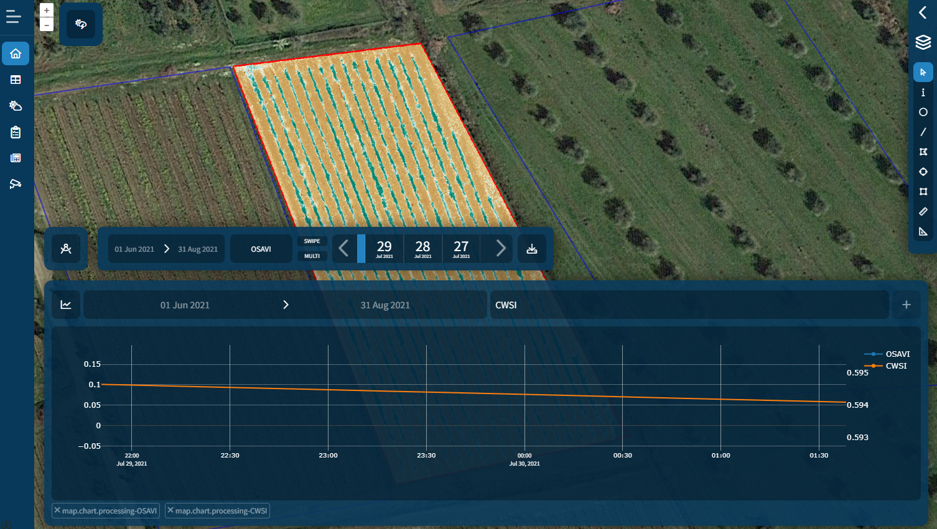
Plotting of several parameters

Slide 26






















Technologies
Visual Studio Code
Deeplabv3

Slide 27
Thank you
ALESSANDRO GENTILE
Software Architect, EO Expert
Aerospace Division
Intecs Solutions Spa
alessandro.gentile@intecs.it

