Slide 1
European Regional Symposium
September 28 – 29 | 2023 Matera, Basilicata Region | Italy
Second Edition of the European Regional Symposium, on space data for tourism & agriculture, by NEREUS Regions
Joint use of EO, IoT, AI, IoT and Digital Twin Technologies for the management of tourist flows and the safeguarding of fragile tourist sites
Angelo R. Donvito
Digimat S.p.A.

Slide 2
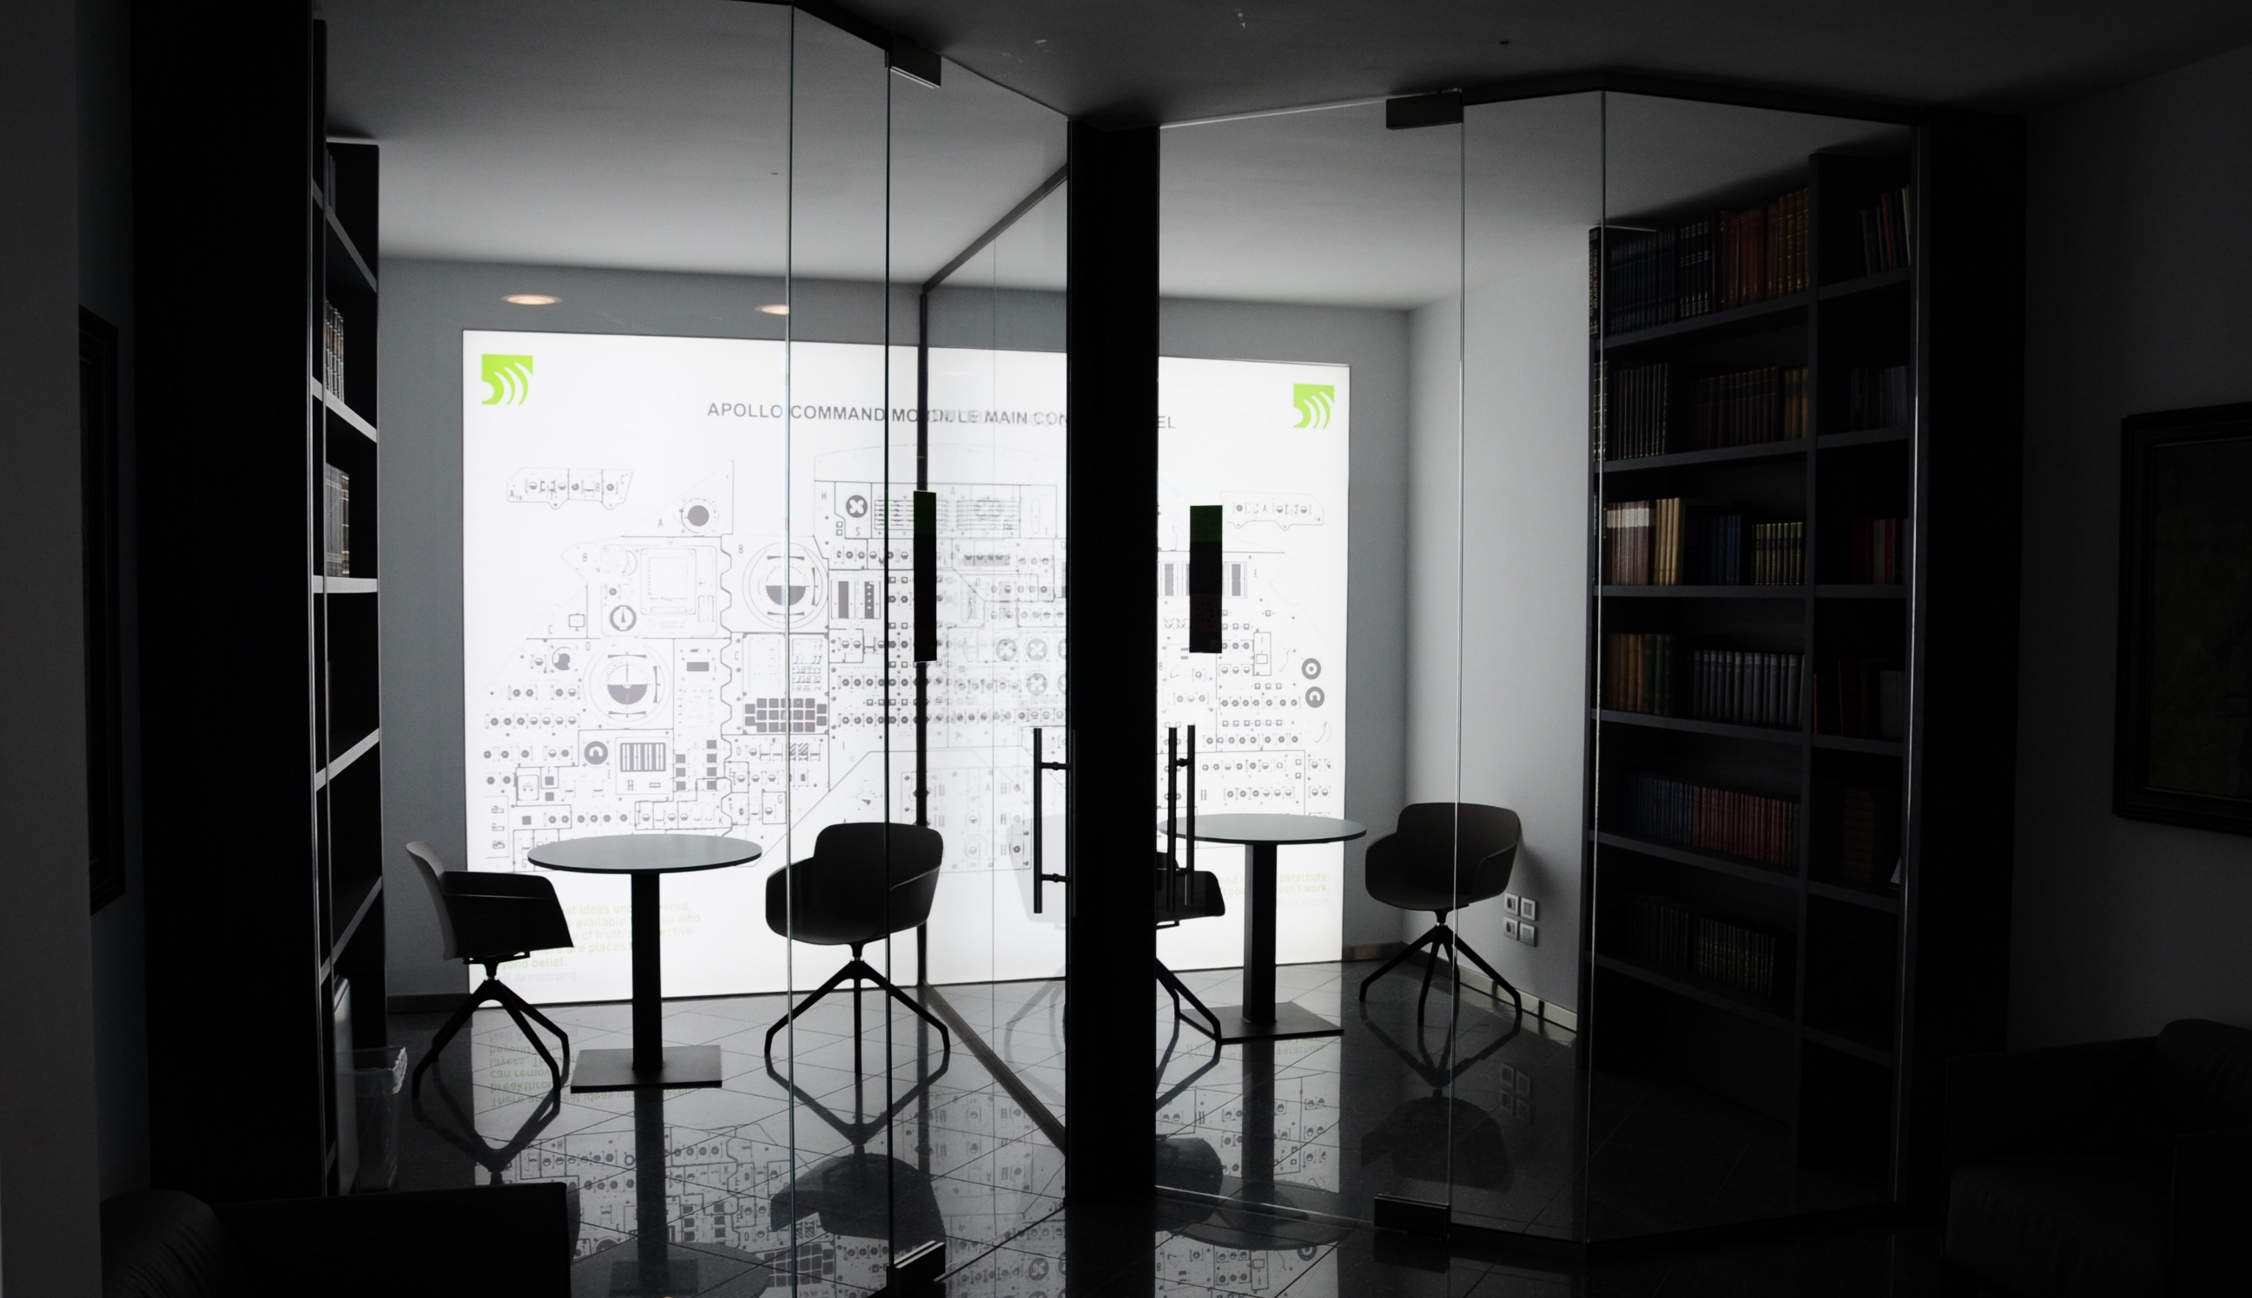
The space-based solution
Our mission
Digimat develop SW for Ground Segment of satellite mission.
We develop SW for analyse satellite data and supply high added value services
To use DIGITAL TWIN and Space Technologies for sustainable and safe tourism
A platform that combining Digital Twin with GNSS/GPS, satellite data and data from cultural sites aims to:
monitoring and management of tourist flows
preserving fragile sites and the safety of the tourist.
Who we are
The Digimat group is recognized among the main innovation SMEs and has its strong point in its capacity
to translate research activity into concrete products and services useful to companies.
Our team
more than 70% with a degree in computer engineering, physics and other technical-scientific disciplines.

Slide 3
The space-based solution
for Sustainable tourism
To preserve fragile sites monitoring the condition of the places in relation to the flows and generating alerts on the concentration of attendance with suggestions for alternative routes
for SAFETY of tourists
Monitor the crowding of places and suggest alternative routes or visiting plans avoiding gatherings. Alerting the tourist of any risks (such as weather risk)
to QUALIFY
Providing data on tourist flows useful for the ordinary and extraordinary maintenance of fragile cities
for ACCESSIBILITY
Suggesting ideal route solutions also in relation to any disabilities

Slide 4
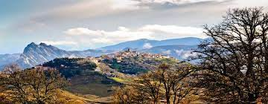
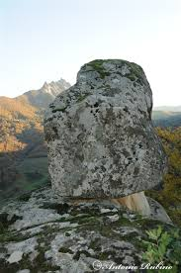
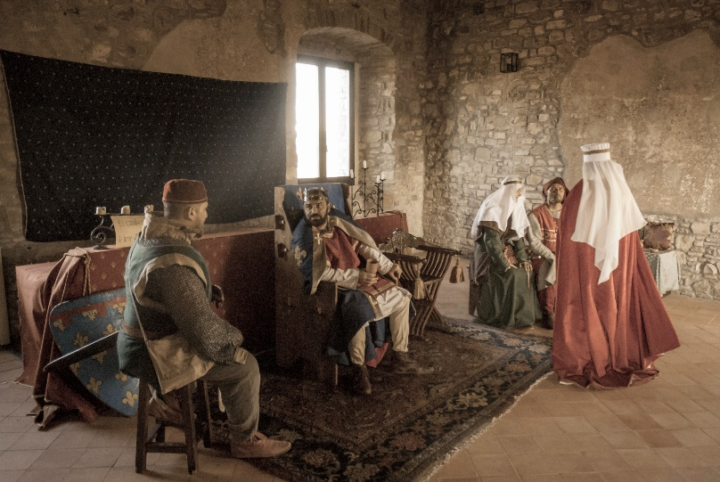
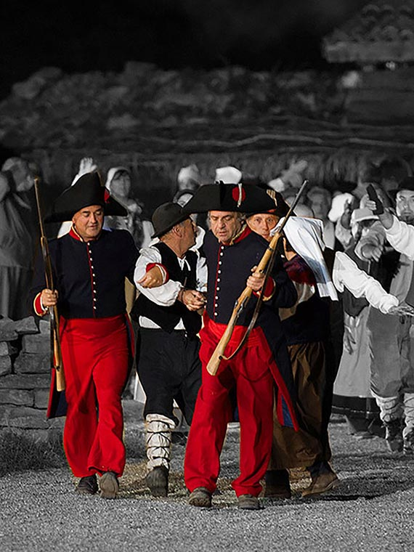
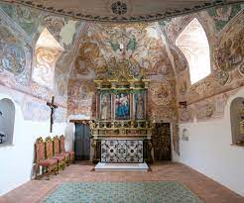
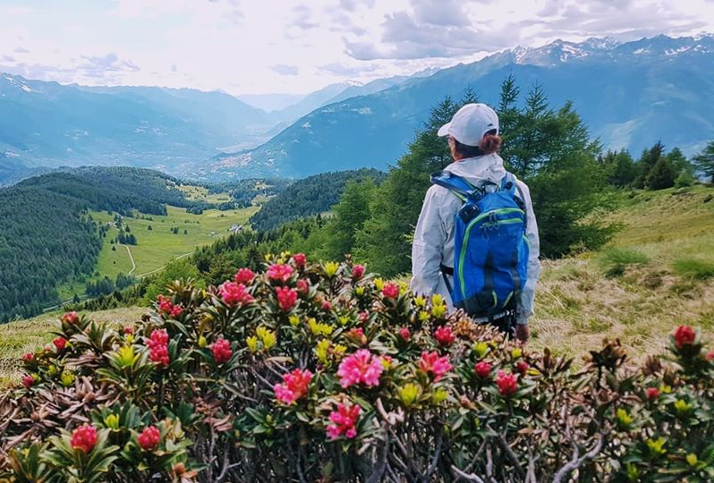
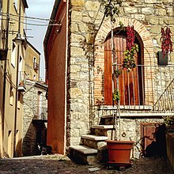
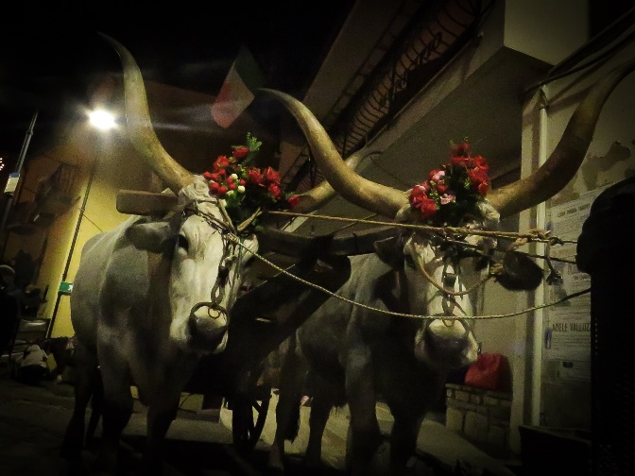
Challenges at regional and local level
Our challenge is to develop ICT platforms that allow us to promote and manage sustainable tourism even in fragile or disadvantaged sites.
What is the customer or end user pain?
Uncontrolled tourist flows generate stress on the most popular places, also causing discomfort to tourists.
The Digimat solutions allows regional and municipality administrations to generate data on tourist flows (number of walkers, travel times, most visited places, etc ...), in order to facilitate the use of the heritage by tourists, including those with special needs (disability, fragility)
Is there currently a problem/unmet market need?
relatively satisfied with knowledge of the local market, regardless of any satellite solution
Tell a short story about how your innovation is unique in alleviating this pain or fulfilling customers’ /end users needs.
For example, the “Matera in 3 days” App anonymously collects data on the distances and stops of each walker who uses it.
Cammino del Basento: a platform to support villages in actracting and handling tourists
APP. PORTAL. COMMUNITY.
BASILICATA
MATERA

Slide 5
What is the added value?
Our services aim to:
support the municipality using both digital twin data end satellite data to manage the city using AI technique to simulate scenario.
Support tourist to improve their experience and interaction with the local population.
Satellite data is very useful for updating the DT model and feeding the data lake.
Use of our platform will:
predict the impacts of tourism on the city and take corrective actions.
avoid stressful situations for the city and reduce maintenance costs
reduce stress for the tourist and improve their visiting experience
predict risk situations

Slide 6
What are the benefits to citizens and the region, now and in the future?
The benefits
predict the impacts of tourism on the city and take corrective actions.
avoid stressful situations for the city and reduce maintenance costs
reduce stress for the tourist and improve their visiting experience
predict risk situations
Innovativeness of the service
The use of DT, Satellite data and AI technique will support municipality to study scenarios throught simulation.
The tourist will be supported to plan his visit and improve the interaction with local population
Risks
The use of DT, Satellite data and AI technique will support municipality to study scenarios throught simulation.
The

Slide 7
What are the benefits to citizens and the region, now and in the future?
THE PARTICIPATED TOURISM.
APP. PORTAL. COMMUNITY.
Thanks to the experience gained by Digimat with the App for Matera Capital of Culture 2019, an App and a Portal of the «Basento Way» in Basilicata (Italy) will be created; funded through PIC REGIONE BASILICATA INTEGRATED CULTURE PLANS 2022 (PIC).
A Community will be created connected to the Portal and to the App within which both tourists and inhabitants of the municipalities can register to interact and share experiences and have the opportunity with the support of satellite features to recommend places that deserve to be visited, attractions, paths, experiences, not to be missed.
BASILICATA

Slide 8
Thank you
Angelo Donvito, Digimat S.p.A., R&D director : angelo.donvito@digimat.it

