Slide 1
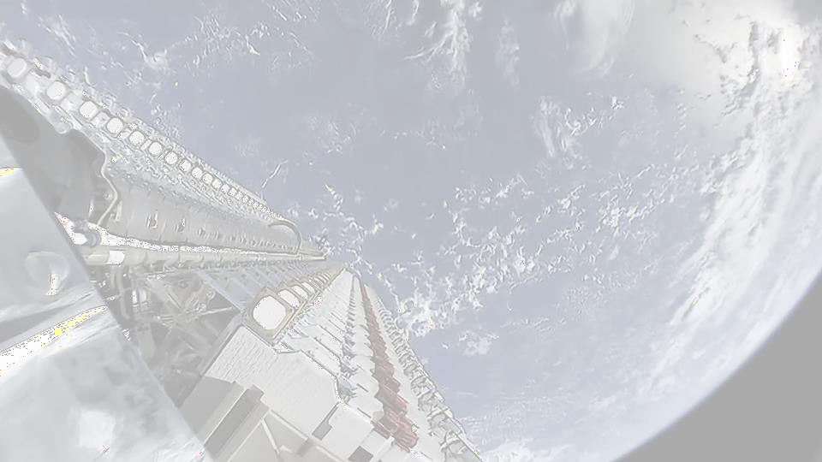
2nd edition European Symposium by NEREUS Regions: Space data for tourism & agriculture
Matera, 28-29 September 2023
Space and non-space business in a joint transition
Vito ALBINO
Agenzia Regionale per la Tecnologia e l’Innovazione, Regione Puglia European Centre for Space Economy and Commerce

Slide 2
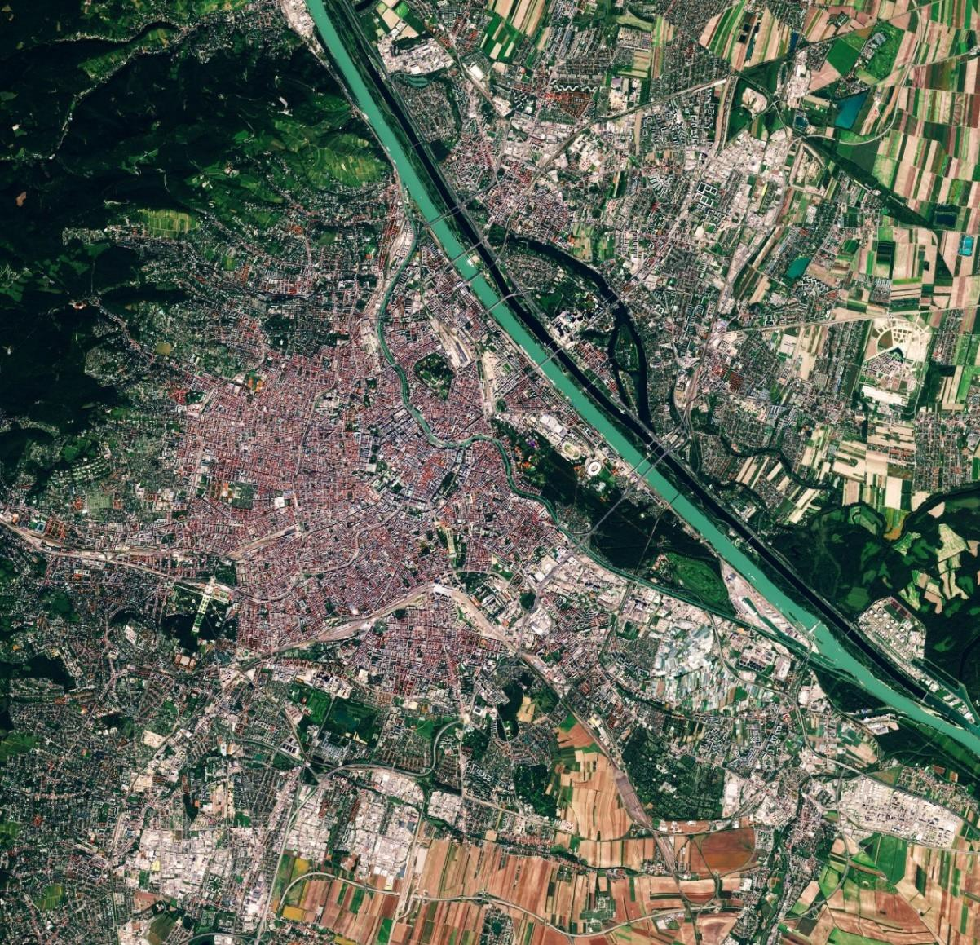
About ECSECO
ESA Director General Josef Aschbacher established in 2022 the European Centre for Space Economy and Commerce (ECSECO)
Main objective of ECSECO: to provide a European platform for interdisciplinary discussions and research on space economy and commerce
The Secretariat of ECSECO is located in Vienna, Austria, and managed by the European Space Agency (ESA) with support from the European Space Policy Institute (ESPI)
Vienna, image captured by the Copernicus Sentinel-2 mission.

Slide 3
Our members
ECSECO gathers 200 members who represent diversified profiles. Interdisciplinarity lies at the heart of ECSECO and creates a unique community.
ECSECO connects individuals from various
professional backgrounds:
private sector
public institutions
international organisations
academia
By joining ECSECO you will become a part of a vibrant community which fosters the European collaboration towards the further development of the space sector!
businesspeople
economists
scientists
lawyers
engineers
others

Slide 4
Pillars of ECSECO
Network
Knowledge
Create a unique community
Engage in interdisciplinary networking
Stay up-to-date
Attend exclusive events
Participate in working groups
Research space economy & commerce
Impact
Transmission
Identify and anticipate trends
Influence the development of the sector
Provide inputs to the European decision-makers
Mentor the next generation
Assess innovative ideas and projects
Share expertise, train and educate

Slide 5
Events in 2023
Spring School on Startups
and Commercialisation
2023 General Meeting of
members
Online networking sessions
Commercial Space Days
Paper competition
Thematic workshops

Slide 6
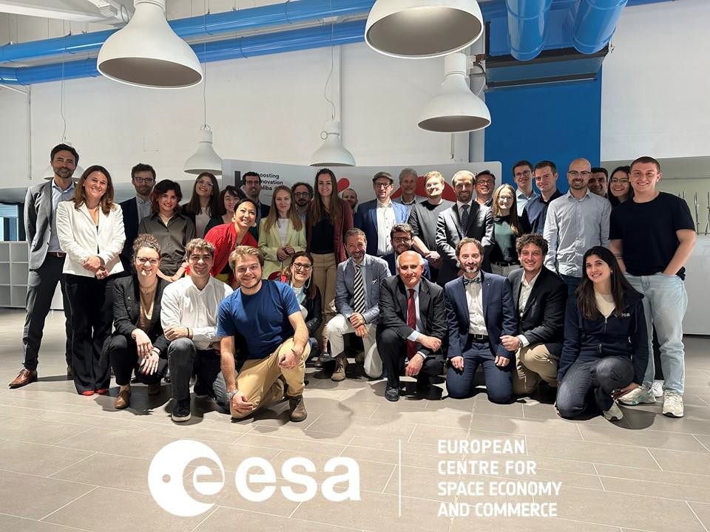
Spring School
23-24 May at Politecnico di Bari
Event for students and young
professionals
Around 40 participants
A broad range of speakers representing the private and public sectors, and academia
Pitch competition for start-ups – the
final of ESA Payload Masters

Slide 7
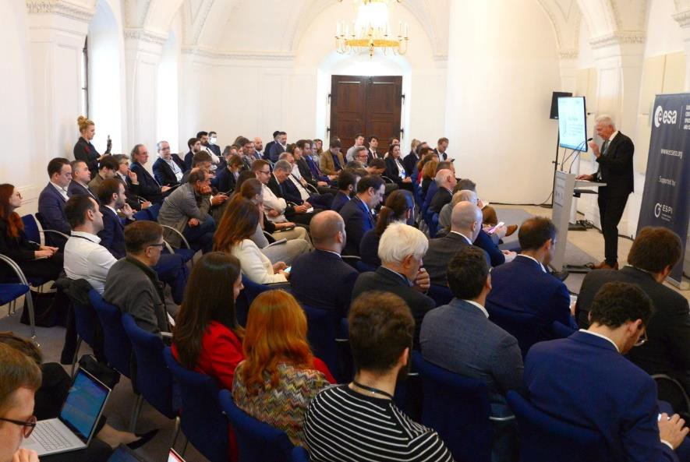
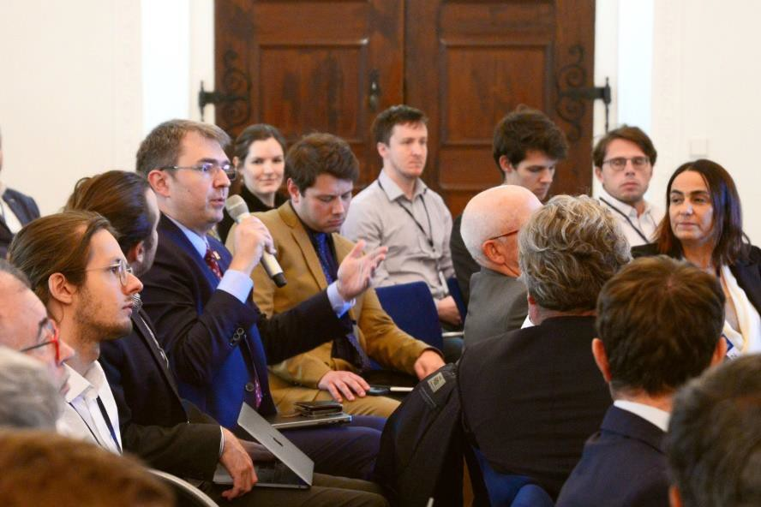
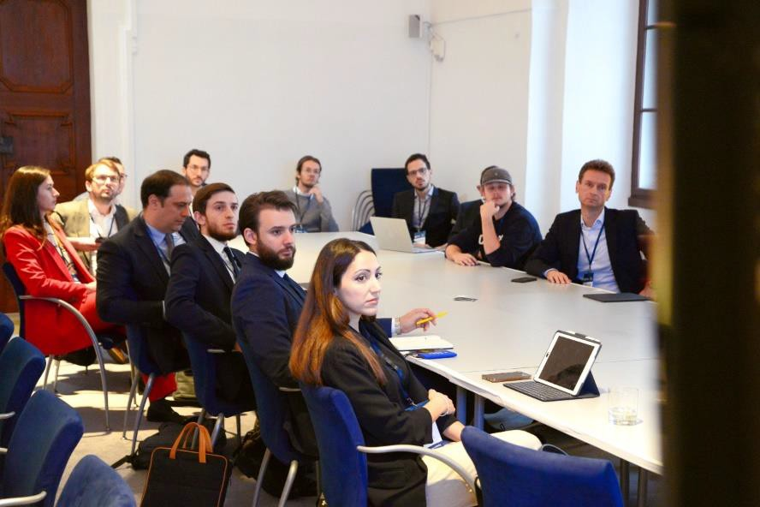
General Meeting of members
Last year
Presentations on the space economy and commerce by ESA and ESPI, respectively
Interactive sessions facilitating fruitful discussions and exchanges
Nearly 100 participants
General Meeting 2023
Whole day event on 1 December in Vienna
Reviewing the activities and discussing the way forward
Election of the Board

Slide 8
Contact
To find out more about ECSECO and apply for membership, please visit: www.ecseco.org
If you have any questions, please do not hesitate to contact the Secretariat: ecseco@esa.int
You can also follow our activities on
LinkedIn and Twitter/X.

Slide 9
Space & non-space business: a transition
From space economy to new space economy
Transition perspective
Space & non-space business

Slide 11
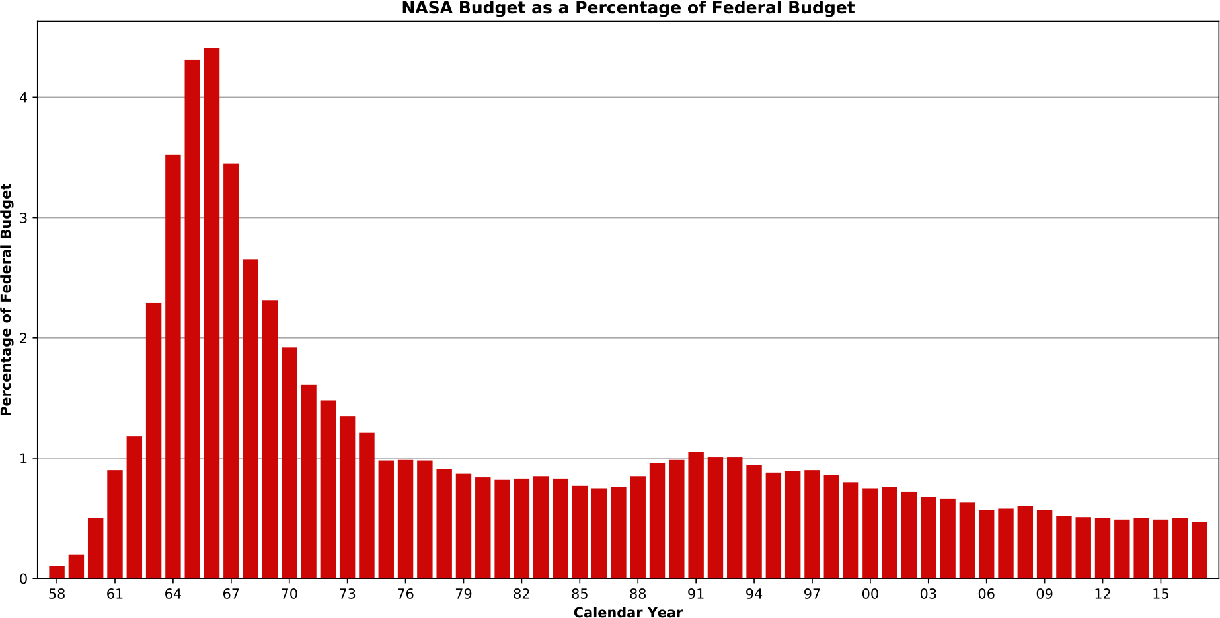
NASA Budget History

Slide 12
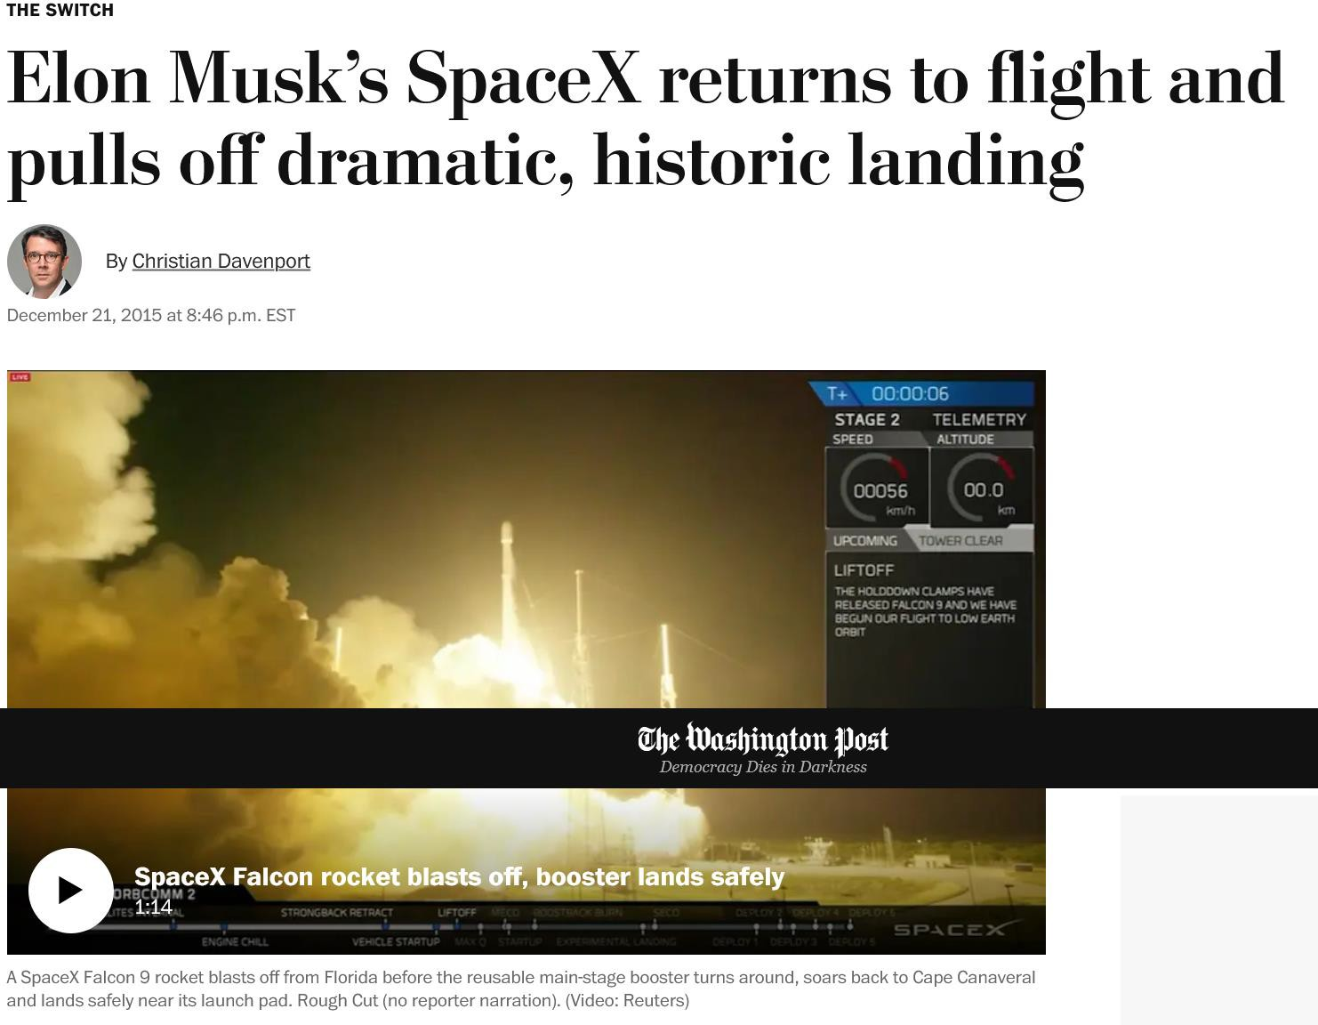
New Space Economy

Slide 13
Space Economy
Full range of activities and the use of resources that create value and benefits to human beings in the course of exploring, researching, understanding, managing, and utilising space (OECD 2012)
Main current trends
A still increasing public interest and investment in
space activities worldwide
An unprecedented level of private investment in space ventures
The further development of commercial
activities worldwide
The further integration of space into the society and economy

Slide 14
Space Economy
Full range of activities and the use of resources that create value and benefits to human beings in the course of exploring, researching, understanding, managing, and utilising space (OECD 2012)
Main current trends
A still increasing public interest and investment in
space activities worldwide
An unprecedented level of private investment in space ventures
The further development of commercial
activities worldwide
The further integration of space into the society and economy

Slide 15
Macro trends
Global push for sustainability
Digitalization
Dynamic geopolitical environment

Slide 16
The next 50 years in space
The Moon landing inspired awe, pride and wonder around the world
It was an aberration, a goal achieved not as an end in itself but as a means of signalling America’s extraordinary capabilities
The next 50 years will look very different
Falling costs, new technologies, Chinese and Indian ambitions, and a new generation of entrepreneurs
Space will become ever more like an extension of Earth – an arena for firms and private individuals, not just governments

Slide 17
Transition perspective
Technical
Transition perspective
Holistic
Economical
Social

Slide 18
Transition nature
Structural
Transition nature
Ideological

Slide 19
Structural
Supply: new technologies available
Incentive: realigning public incentives
Demand: new private and public demand of
products/services
Standards and Regulations: new ones and adjustments

Slide 20
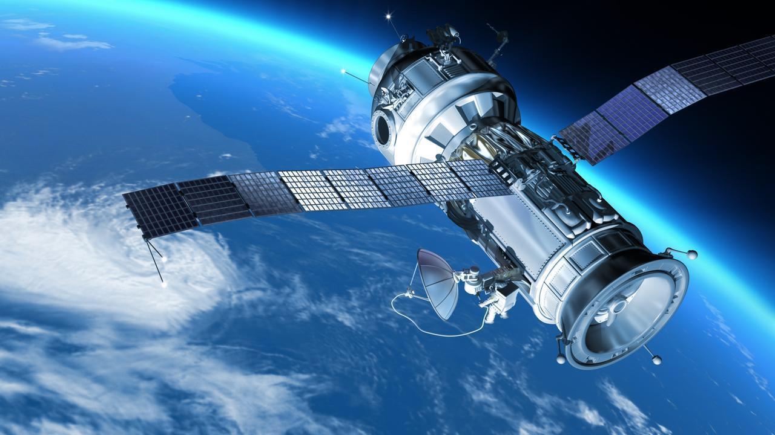
Space and non-space businesses

Slide 21
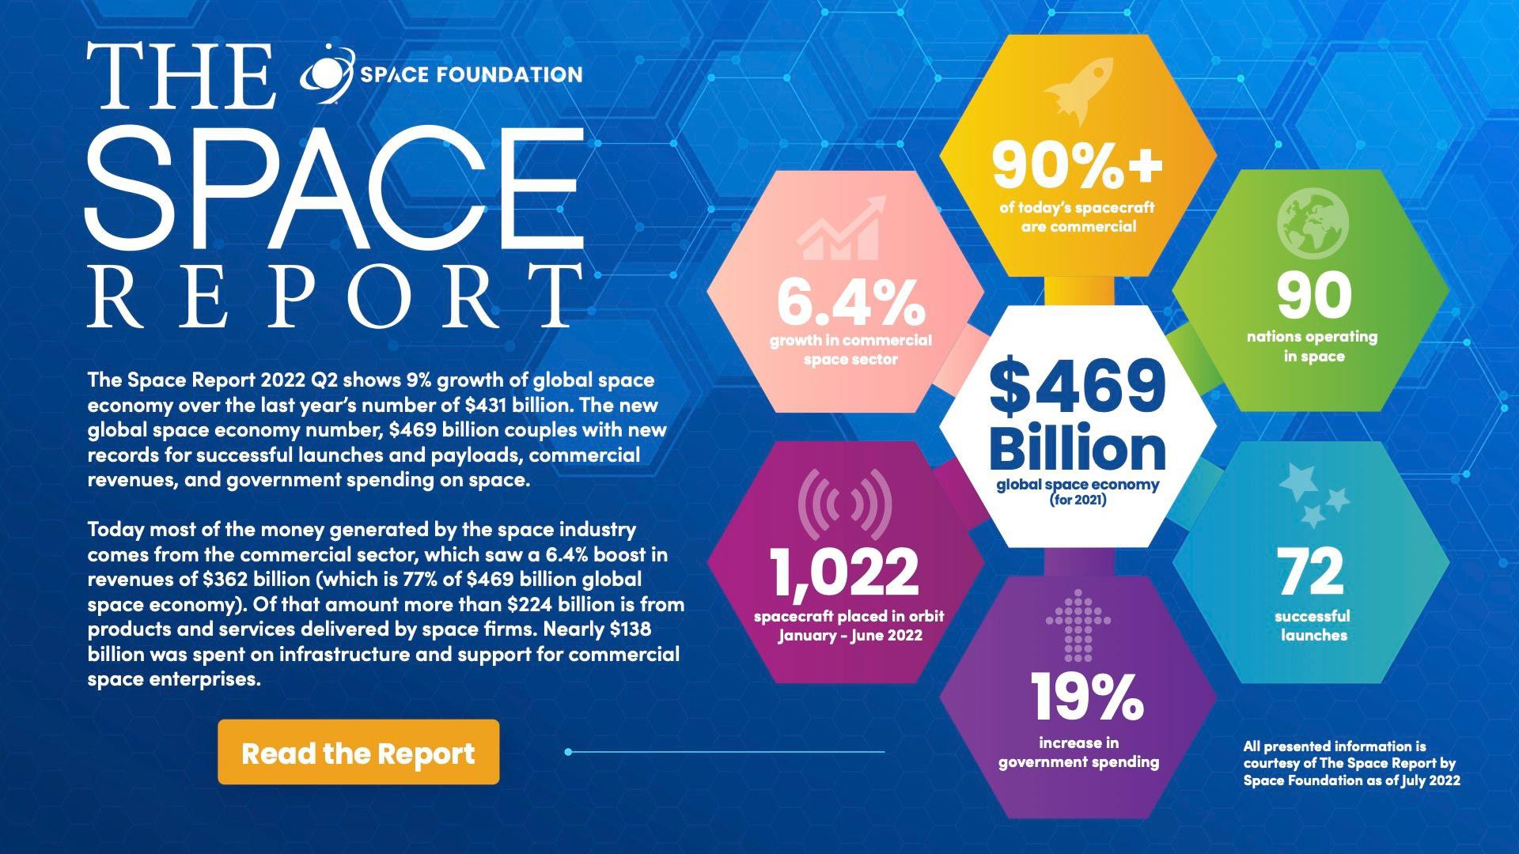

Slide 22
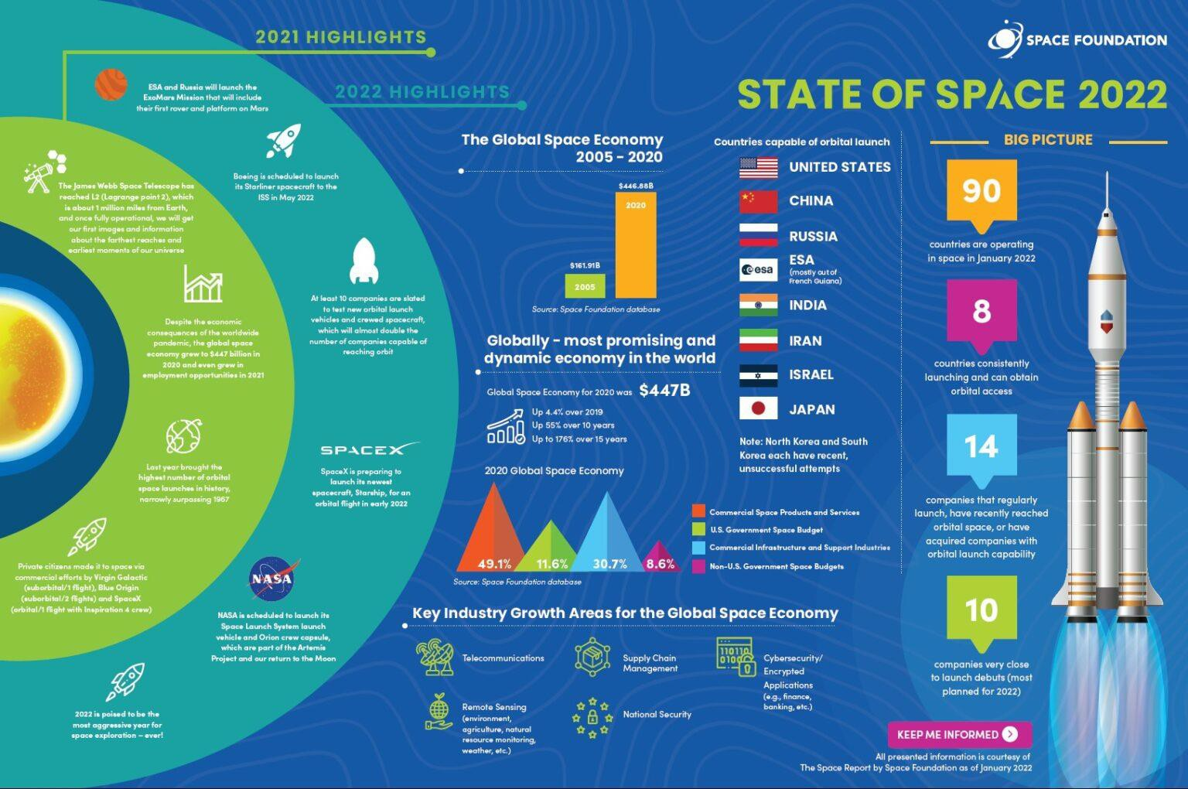
State of space

Slide 23
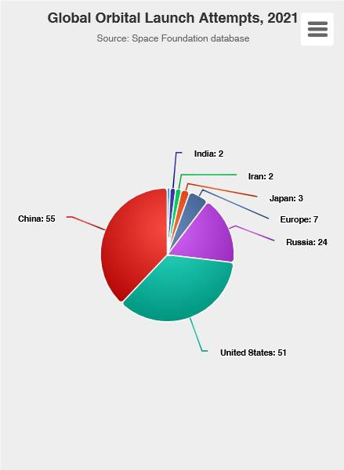
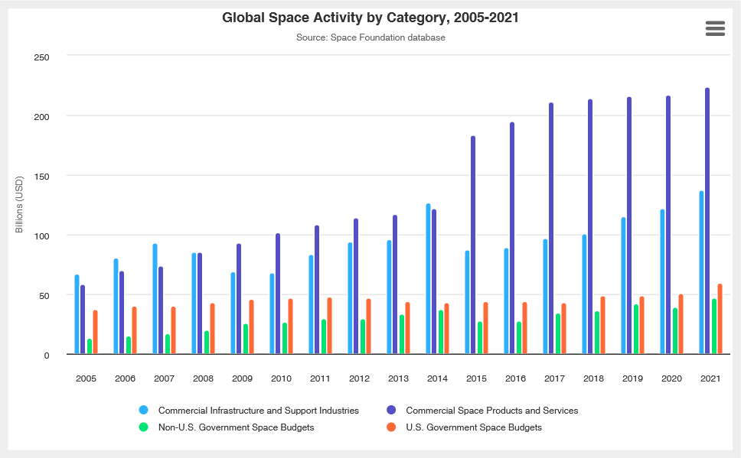
Global Space Activity

Slide 24
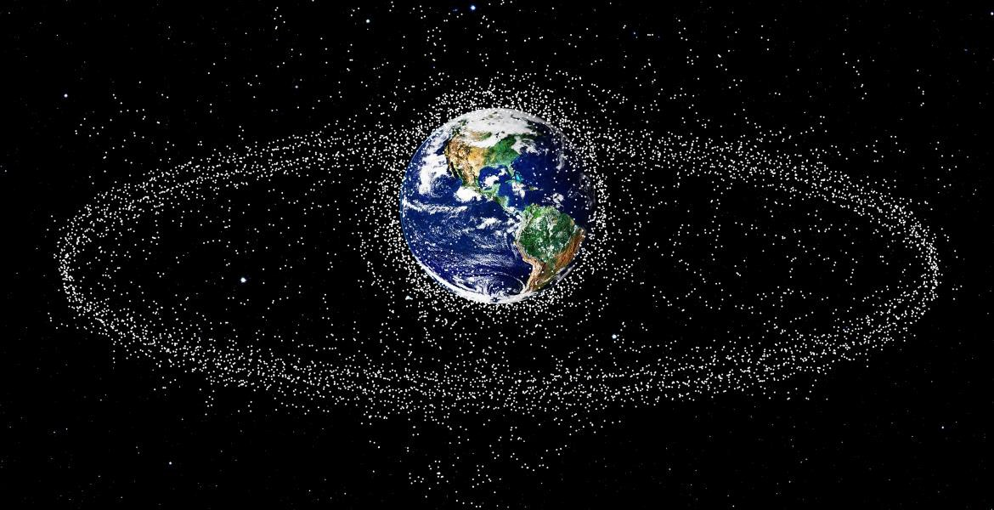
Space congestion
An increasingly contested and crowded frontier
According to UNOOSA records, there are 8,261 satellites orbiting the Earth as on January 2022, out of which only 4,852 satellites are active (as at the end of December 2021), confirmed by the Union of Concerned Scientists (UCS), who maintains the record of the operational satellites.

Slide 25
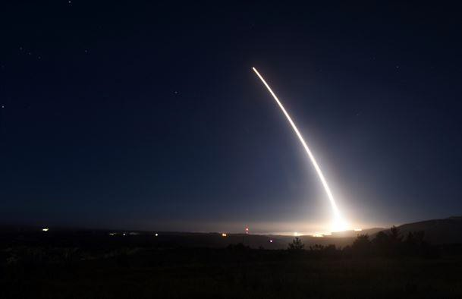
Space Sectors
Space endeavors are grouped into sectors:
Civil
National Security (i.e., defense and intelligence)
Commercial (*)
(*) All space-related endeavors - including goods, services and activities - provided by private sector enterprises with the legal capacity to offer their products to nongovernmental customers (from satellite communication to space tourism)

Slide 26
Tourism sector
Data consumer and data producer industry
Complexity of the tourism value chain
Data-sharing initiatives and GDPR respect
Quality of the tourism experience

Slide 27
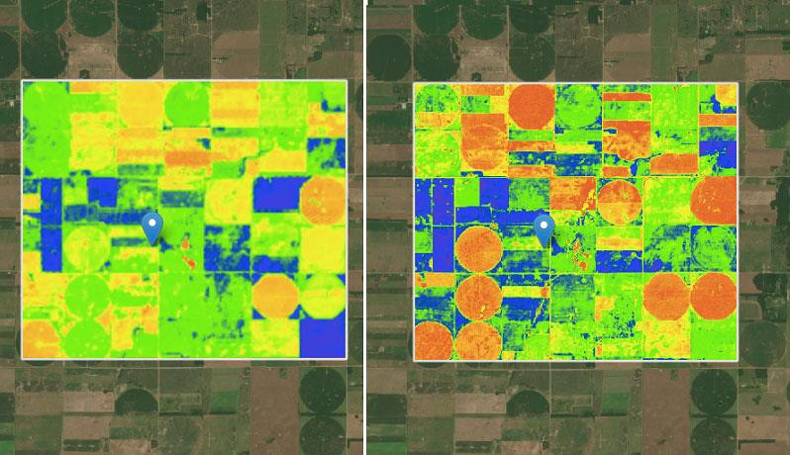
Agriculture sector
Basis of the world's food supply
Monitoring soil conditions, water availability, weather extremes, climate change
Timing and amount of irrigation for crops, etc.
To enhance production and profitability
To predict a region's agricultural output

Slide 28
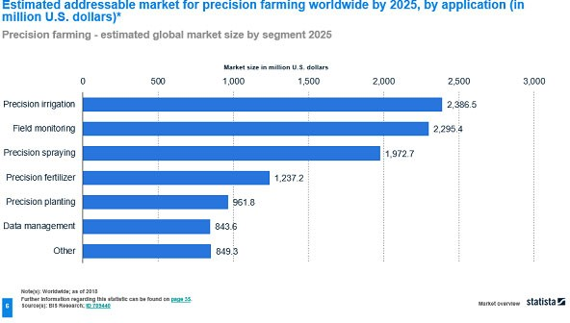
Precision farming

Slide 29
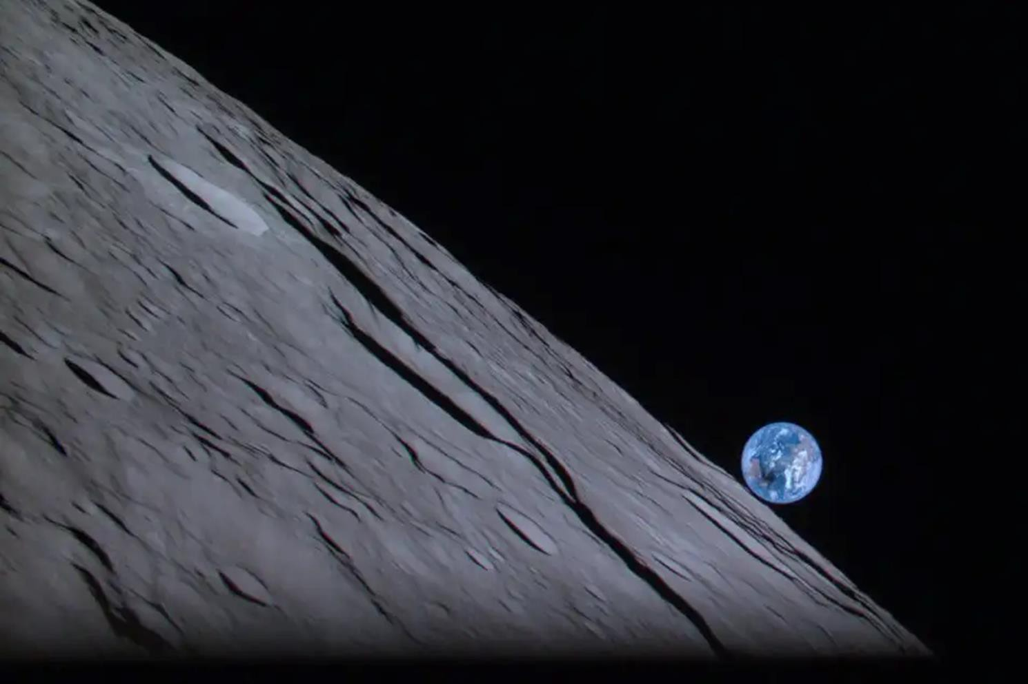
Thank you

