Slide 1
Copernicus User Uptake Strategy & market development
2nd European Regional Symposium by NEREUS Regions:
Space data for tourism & agriculture, 28-29 September 2023 Matera
Jacopo Ovarelli – Market Development and Innovation Department

Slide 2
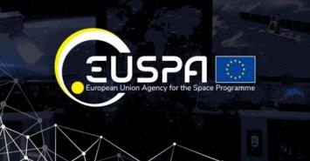
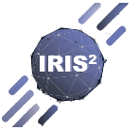
EUSPA – Linking Space to user needs
New EU Space Regulation
((EU) 2021/696)
To acknowledge the growing role of space in supporting EU priorities in terms of growth, competitiveness, sustainability, and security
Setting the ground for the creation of EUSPA, officially launched on 12 May 2021
With the new regulation, space data is at the heart of a technological revolution
EU space activities under one umbrella:
Galileo
EGNOS
Copernicus
GovSatCom
SSA
Global satellite navigation and positioning system (GNSS)
10% of the EU GDP enabled by satellite navigation
Makes navigation signals more accurate and reliable
Operational in 360+ airports & helipads in 23 countries
Earth Observation (EO) and monitoring based on satellite and non-space data
Nr.1 world provider of space data and information (>20TB/day)
Secures satellite communications for EU governmental actors
Delivering rapid support over crisis areas
Space Situational Awareness monitors and protects space assets.
User uptake - ‘’other users’’
Notes:
EUSPA embraces all the different components of the Space Programme under one umbrella

Slide 3
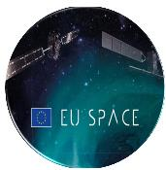
Integrating the EU Space Programme with a synergetic approach
Biodiversity, Ecosystems and Natural Capital
Consumer Solutions, Tourism and Health
Agriculture
Aviation and Drones
Climate Services
Navigation
Emergency Management and Humanitarian Aid
Energy and Raw Materials
Environmental Monitoring
Fisheries and Aquaculture
Forestry
Secure Satellite Communication
Insurance and Finance
Maritime and Inland Waterways
Road and Automotive
Rail
Infrastructure
Earth Observation
Urban Development and Cultural Heritage
Space
Space Situational Awareness (SSA)/
Space Surveillance & Tracking (SST)
Integrated Use Cases
+ New enabled applications
+ Enhanced user technology

Slide 4
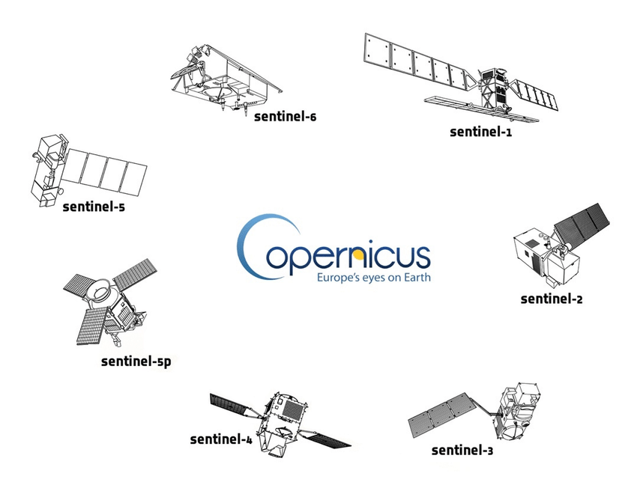
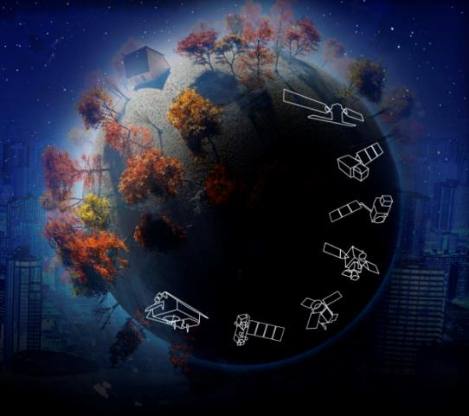
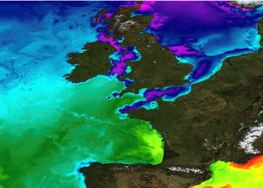
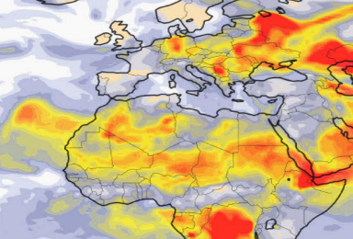
Copernicus delivers unique EO data
European Union's Earth observation programme, looking at our planet and its environment to benefit all European citizens Copernicus provides free and openly accessible data to all users around the world
SPACE
IN SITU
SERVICES
Nr.1 world provider of space data and information
Notes:
- On the other hand, we have Copernicus, the well known EU Earth Observation programme, providing free and open global data about the earth and its environment.
- What is important to mention is that Copernicus is not only about satellite images. A part from the sentinel missions, existing and future ones, Copernicus has two other components, that are the In Situ component and the Copernicus services.
The In situ component is composed of myriads of sensors distributed across the world providing complementary data to those captured by the satellites.
Whereas the Copernicus services offer processed and analysis ready data for different thematic areas, which are atmosphere monitoring, marine services, land monitoring, climate change, security and emergency management.

Slide 5
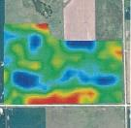
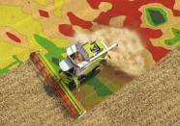
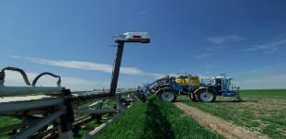
Multiple synergies for crop and soil management in agriculture
Prescription map: A geo-referenced map which contains rate information controllers shall apply within Variable Rate Application
Normalized difference vegetation index (NDVI), health of crops, soil moisture, evapotranspiration data etc.
Soil moisture through GNSS reflectometry or in-in-situ data collection for EO data validation
Highly accurate positioning of the machinery that shows where fertilisers/ pesticides should be applied
Shows where fertiliser/ pesticides should be applied
GNSS Meteorology, improving numerical weather prediction (now-casting and severe weather monitoring)
Weather and Climate data
Information on atmospheric variables, also about the past, present and future climate
Precision agriculture Lower environmental footprint
More efficient use of manpower Higher productivity and profitability
Notes:
Precision agriculture contributes to reducing poverty and hunger, environmental monitoring supports healthy living

Slide 6
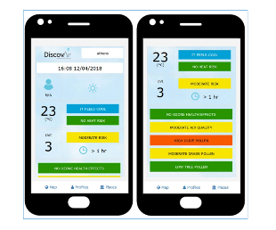
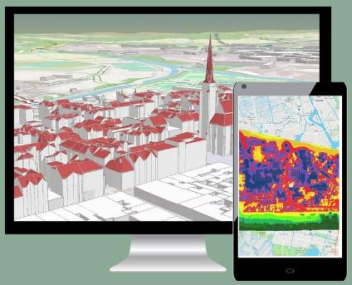
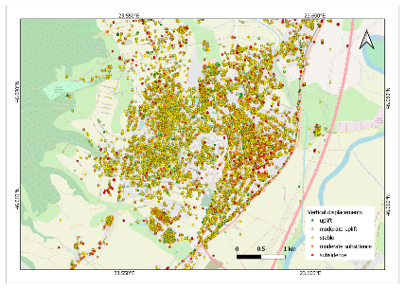
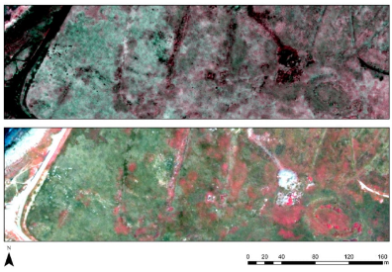
EU Space data also supports tourism, with applications spanning from archeological sites spotting to consumer solutions
Research of archeological sites
Monitoring of cultural heritage
Consumer solutions for tourists
Copernicus data and services (e.g. CAMS) are used to provide quantitative information in-app such as climate condition and forecasts, pollen tracking, UV index levels, water and air quality
GNSS enables several apps boosting tourists’ experience, including: Mapping and GIS, Geo tagging, Virtual tours and Geo advertising
The Copernicus Land Monitoring Service (CLMS) is used for monitoring of cultural heritage, identifying and mapping risks such as coastal erosion or ground subsidence
Archeologists also use satellite imagery to spot archeological sites covered e.g. by vegetation
GNSS provide key tools for surveying activities

Slide 7
Market uptake roadmap
Uptake Objectives
Strengthen enabling factors (e.g. EO data standardization and regulation) for Copernicus-enabled downstream services
Support European entrepreneurship and R&I
Create new market opportunities for Copernicus-enabled downstream services in industrial market
Increase adoption of Copernicus by EO service providers offering services that support EU policy initiatives and plans
Increase adoption of Copernicus-enabled downstream services in downstream applications
Support RD&I
Promote role of Copernicus in monitoring and implementation of policies and regulation
Demonstrate value of Copernicus in various operational scenarios
Awareness raising
Establish Key Accounts with strategic partners
Support Entrepreneurship
Monitor State of Play and level of adoption
Mapping of Copernicus Offering vs User Needs
Monitor the Market and Technology Trends
Collect and update User Requirements

Slide 8
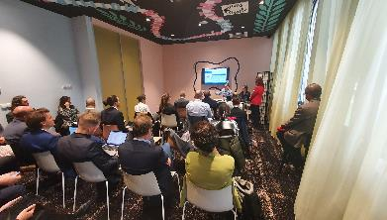
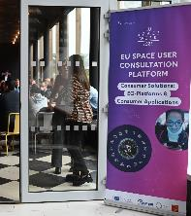
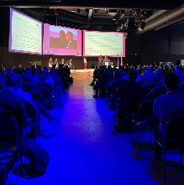
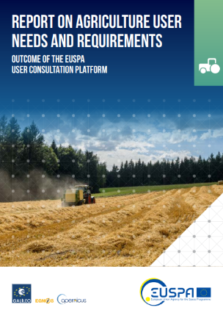
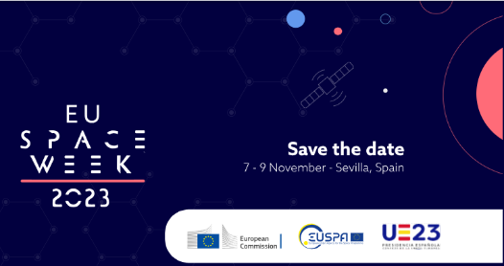
Collect and update User Requirements
7TH November in Seville during the EU SPACE WEEK
Registrations will open soon
Extensive exchanges and in-depth discussionss expected at EUSPA’s User Consultation Platform 2023 in Sevilla
The platform for business leaders, entrepreneurs, service providers, innovators and space user communities to express their needs, share best practices, discuss market&technology trends, R&D&I priorities, and present case studies
Policy makers
Associations
Business Leaders
Entrepreneurs
Investors
Service providers
Innovators
End-users
AGRICULTURE
Focus sessions on agriculture robotics, carbon farming and traceability
Debate on priority areas and requirements validation
User Knowledge
Validation of RUR - User Needs and Requirements
Outcomes of the UCP are used to compile and update a series of Reports on User Needs and Requirements (RUR) per market segment that serve as one of the crucial inputs for the service/system provision and evolution
Primary activities to focus
R&D priorities
To be published in Q2 2024
Market & Technology trends
Use Cases

Slide 9
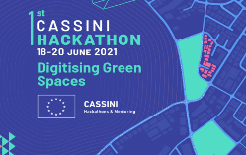
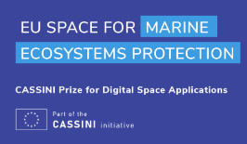
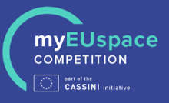
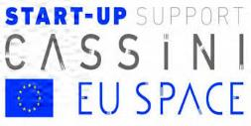
EUSPA funding tools stimulating innovation and fostering EU Space ecosystem, incl. start-ups & SMEs
Support Entrepreneurship & RD&I
Offer Creation
CASSINI initiative
Horizon Europe
Foster EU’s innovative spirit to deliver applications and services
Stimulate innovation and entrepreneurship in the space ecosystem
Foster adoption of Galileo, EGNOS and Copernicus via downstream application development and commercialisation
Support the development of fundamental technologies for enabling integration of space services in downstream applications

Slide 10
Support for start-ups under Cassini
Support Entrepreneurship
Develop your solution
Connect with investors
Cassini Hackathons
Cassini MyEUSpace
Cassini Business Accelerator
Horizon Europe
Fundamental Elements
Very early stage – EBAN, crowdfunding
EIC Accelerator
Venture capitals
European Investment Fund
European Investment Bank
Get advice
Find customers
Technical advice
Business advice
EUSPA Space Academy
Contacts with industry
Networking events
Dedicated promotion

Slide 11
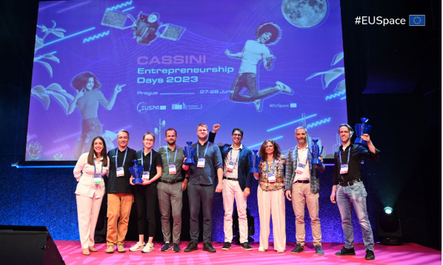
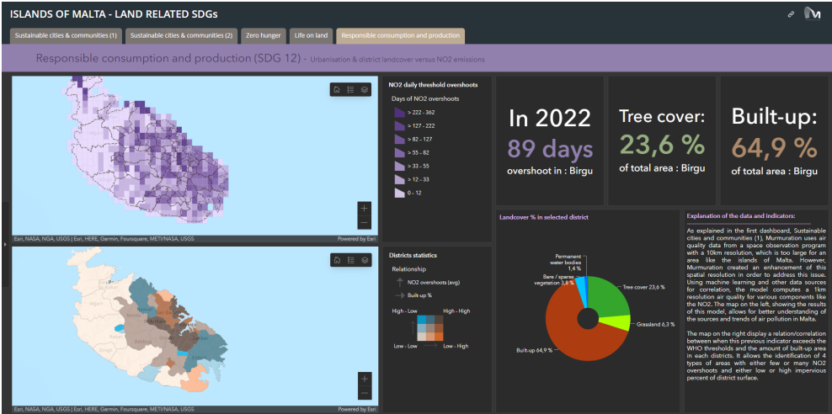
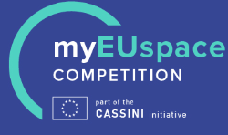
Murmuration: monitor the environmental impact of tourism by utilizing satellite data
Support Entrepreneurship
MURMURATION uses Copernicus data and artificial intelligence to calculate indicators to assess and anticipate the impacts of climate change on the tourism industry
Tourism stakeholders:
Can understand the environmental situation on their territory, optimizing the use of their resources
Can anticipate the impacts of climate change on their destinations and territories
Can reinforce their competitiveness and resilience on the medium to long term
100,000 EUR cash prize to further scale up their business

Slide 12
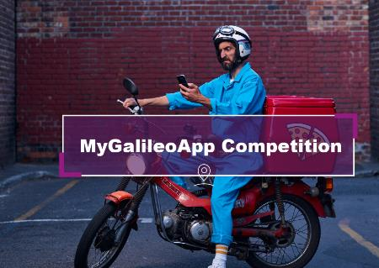
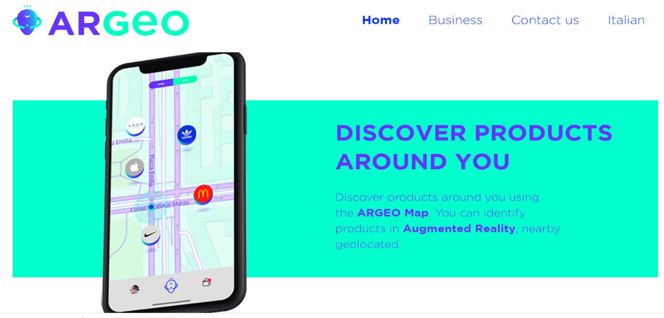
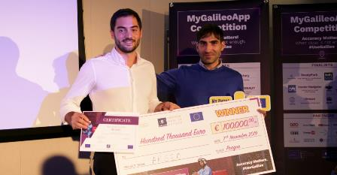
ARGEO: Augmented reality and games
Support Entrepreneurship
Mobile app based on geolocation, augmented reality and blockchain which allows users to catch prizes, coupons in specific places
100,000 EUR cash prize to further scale up their business
https://theargeo.com/engindex.html
Notes:
Winner of MyGAlileoApp
ARGEO is a mobile app based on geolocation, augmented reality and blockchain which allows users to discover and catch content, such as prizes, coupons and shopping cards geolocated around the streets of a city or in specific places by companies as part of their marketing activities
At the end of the competition they had fully developed application
•4 persons working part-time (2 FTE)
•2.000 users tested the beta version
One year after the competition:
Application available commercially
•4 persons working full time (4FTE)
•6.000 users (revised from planned 20.000 due to COVID impact)
•5 large B2B customers
Internal info:
•20-30K/year revenue planned for Q2 2020 once premium services will be activated

Slide 13
Support RD&I
Horizon Europe Call 2023
Strategic autonomy in developing, deploying and using global space-based infrastructures, services, applications and data
Preliminary planning
Opening: October 2023
Deadline: February 2024
Type of Action | Topic | Indicative budget (EUR mln) | Funding rate
IA | EGNSS - Transition towards a green, smart and more secure post-pandemic society | 3.5 | 70% (except for non-profit legal entities, where a rate of 100% applies)
IA | EGNSS - Closing the gaps in mature, regulated and long lead markets | 8 | 70% (except for non-profit legal entities, where a rate of 100% applies)
RIA | Copernicus-based applications for businesses and policy-making | 7 | 100%
RIA | Designing space-based downstream application with international partners | 6 | 100%
IA | EU GOVSATCOM for a safer and more secure EU | 10 | 70% (except for non-profit legal entities, where a rate of 100% applies)
TOTAL budget: |  | 34,5
Innovation action (IA)
Activities to produce plans and arrangements or designs for new, altered or improved products, processes or services.
Research and innovation action (RIA)
Activities to establish new knowledge or to explore the feasibility of a new or improved technology, product, process, service or solution.
Copernicus related

Slide 14
European GNSS and Copernicus is powering cutting-edge and innovative solutions – from R&D to the market
Support RD&I
METEOROLOGICAL ASSIMILATION FROM GALILEO and DRONES for AGRICULTURE
The MAGDA project aims at developing a toolchain for atmosphere monitoring, weather forecasting, and severe weather/irrigation/crop monitoring advisory, with GNSS (including Galileo) at its core, to provide useful information to agricultural operators.
SPACE4GREEN propose a technological solution that enables a trusted platform among agricultural stakeholders of different natures for the automated certification that activity occurs or a thing is in a location at a certain point in time, without requiring a third-party human certification
Artificial intelliGence applied to pRecision farmIng By the use of GNSS and Integrated Technologies
AgriBIT aims to increase the precision, accuracy and continuity of services to deliver improved Precision Agriculture services to farmers, leading to a reduction in costs through decreased use of inputs (water, energy, fertilisers, pesticides), lower environmental impacts and increased production yields, combining augmented GNSS and EO information with on-field and on-machine sensors and actuators

Slide 15
Looking ahead
Showcasing success through use cases, demonstrators and pilots
Empowering decision makers by facilitating access to space data
Fostering partnerships among stakeholders at public and private level

