Slide 1
Max Gulde: max.gulde@constellr.com
Tobias Leismann, tobias.leismann@constellr.com
Measuring temperature and water resources for agriculture and the environment
European Regional Symposium on space data for tourism & agriculture
Matera, Balilicata Region, September 29 2023

Slide 2

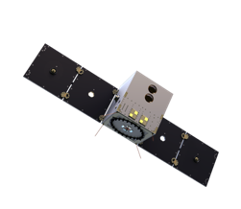



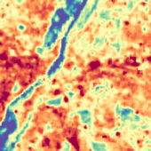
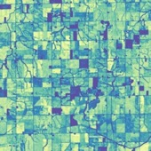
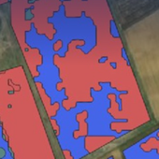
constellr builts satellites to address the combined temperature, water and carbon challenges posed by climate change.
Our Mission
Through temperature measurements, we aim to steward water and carbon resources effectively.
CO2
C
2
www.constellr.com

Slide 3






constellr’s mission is designed for agriculture and environmental monitoring
Our Mission
Through temperature measurements, we aim to steward water and carbon resources effectively.
CO2
3
www.constellr.com

Slide 4
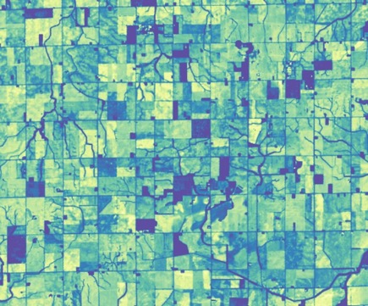
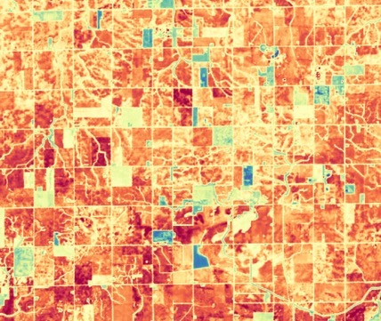
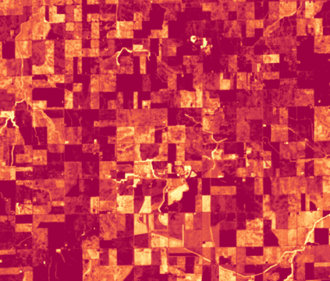

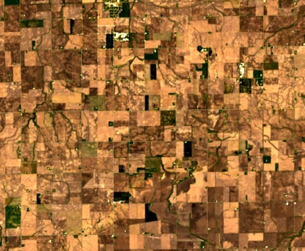
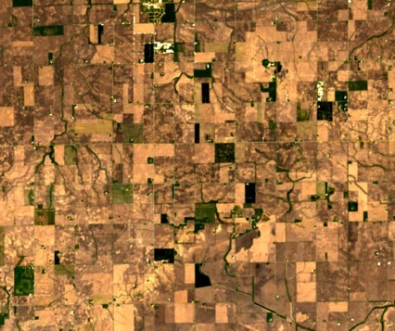
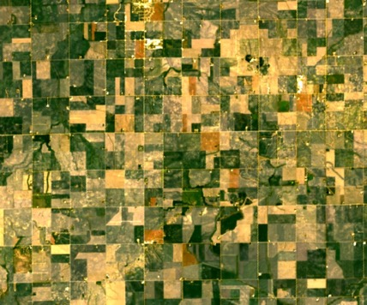
thermal infrared
3rd of May 23
10:30 am
11th of May 23
10:30 am
20th of May 23
10:30 am
visual near-infrared
4
www.constellr.com

Slide 5


constellr’s solution that detects stress symptoms before crops get damaged
Healthy
H₂O
Stressed
H₂O
Damaged
H₂O
high
lower
Days to weeks later
Symptom
None
None visible
Visible wilting & browning of leaves
Underlying cause
None
Reduced transpiration
Chlorophyll disappears
Effect
None
Leaf temperature rises
Yield loss
Existing space imagery
only notices when the plant is already damaged

Slide 6

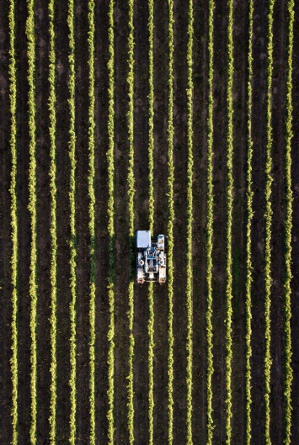
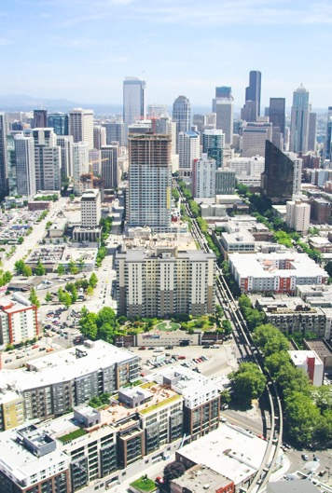
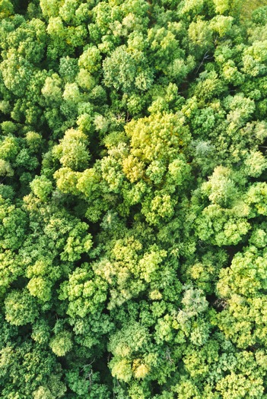


Use cases
Agriculture
Urban and industrial
environmental monitoring
Forest monitoring
& disaster management
Coastal monitoring
6
www.constellr.com

Slide 7

High resolution Land surface temperature is used across the season
Increasing yield from before seeding to harvest
How our customers use temperature today
Soil Temperature Monitoring
Early Stress Detection
Insect & Disease Pressure
Growing Degree Days
Yield prediction
Know which field is warm enough to plant
Adjust planting depth to field variation
Apply stress management products earlier
Increase spatial resolution of growth stage prediction and pest and disease pressure
Monitor temperature events for impact on yield

Slide 8


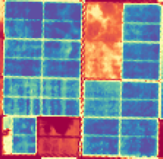
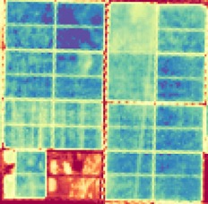
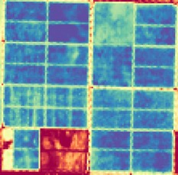
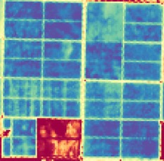

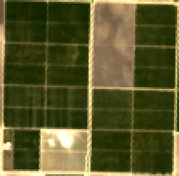
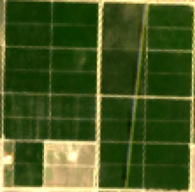
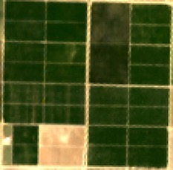
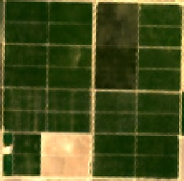
Case study with Yara*
Improving and documenting ESG parameters in perennial crops
Determination of water use efficiency
Increasing water efficiency by 1,7x
Increasing nutrient uptake by 1,5x
10 March 27 April 21 May 14th June
* Yara gave their consent to speak about the collaboration and share limited data.
8
www.constellr.com

Slide 9
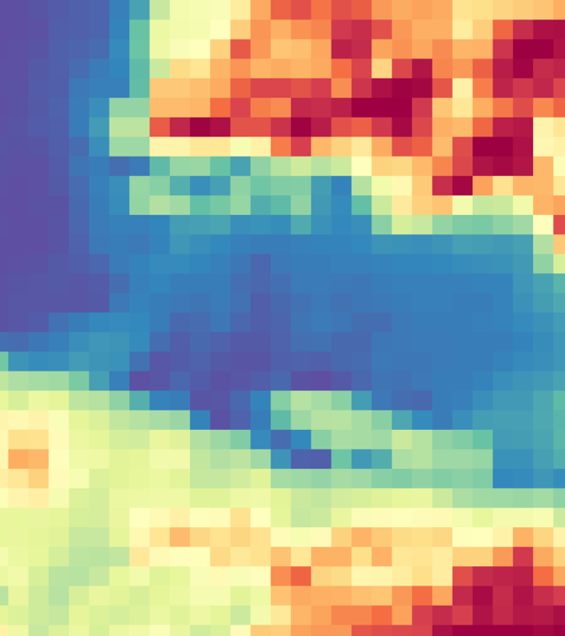
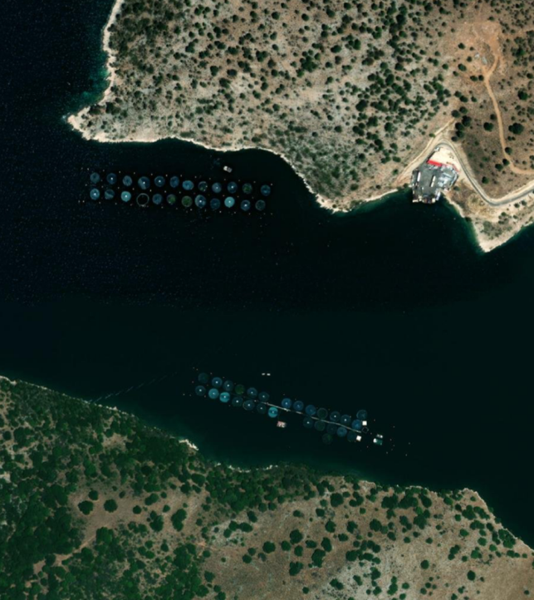
Coastal water resilience in face of climate change
Monitor fishery temperatures
Monitor and predict algal blooms
Monitor coastal and sea surface temperatures impact on local climates
Assess coastal land cover impacts on Sea Surface Temperature
9
www.constellr.com

Slide 10
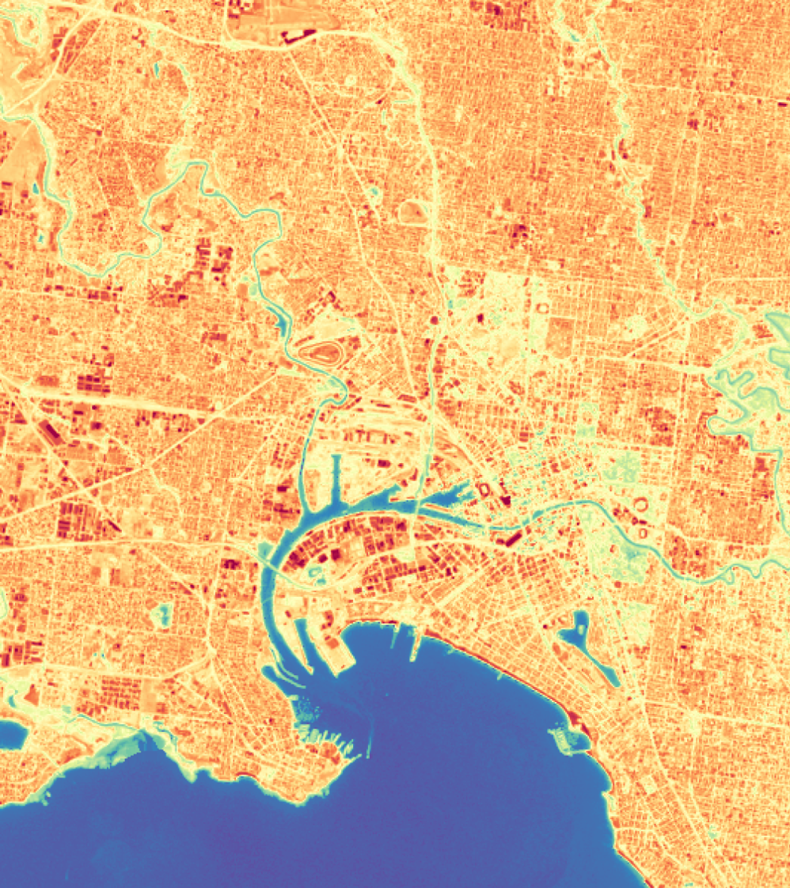
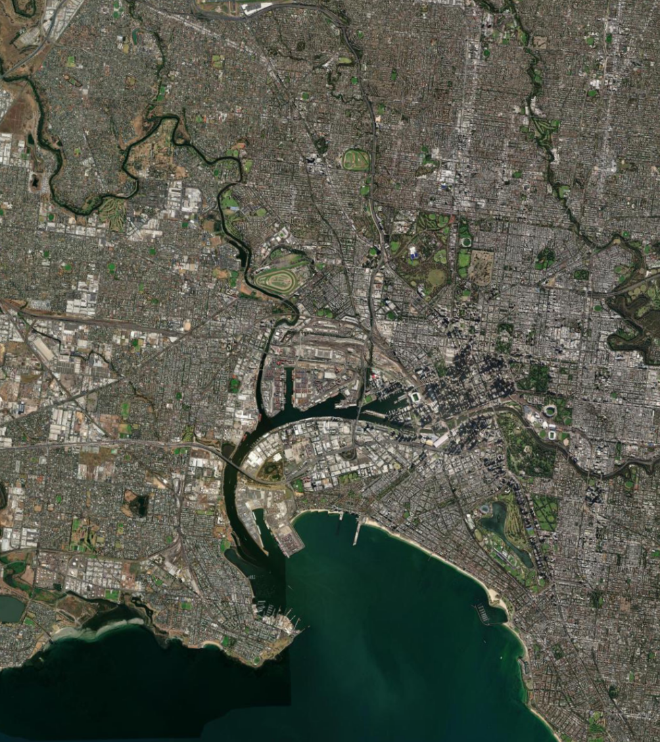
Case study: Urban Heat Island localization and quantification
Early warning system and quantification of mitigation measures
Localization of urban heat islands
Quantification of heating and cooling effects
Enabling planning for heat resilient
thermal infrared
visual
10
www.constellr.com

Slide 11

Let’s work together for creating more crop per drop!
Products 2023
Products 2024
Collaboration
celestR: Land Surface temperature (LST) data for your area of interest – incl. historic data
High-resolution LST data
with the highest quality on
the market.
Be ready to hit the ground running: Engage with and
pre-empt future data standards for thermal and hyperspectral satellite data
etR: Evapotranspiration data for your area of interest –
incl. historic data
Absolute evaporation, transpiration data – guaranteed revisit times by active tasking
If you want to apply for our early access program, click
here
From 2026: Hyperspectral data with tailored revisit times
SocR: Soil Organic Carbon measurements: on field level and subfield level (beta)
11
www.constellr.com

Slide 12



Email & Phone
Looking forward
to talking to you!
tobias.leismann@constellr.com
+49 170 769 5101
Website
https://constellr.com
Linkedin
constellr

