Slide 1
MURMURATION
Technology for sustainable tourism

Slide 2
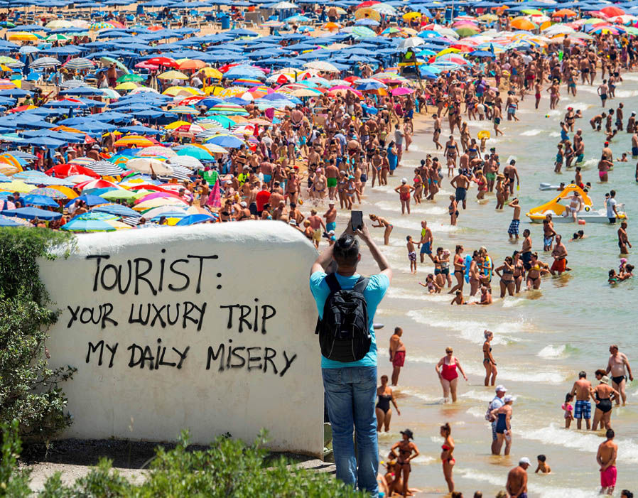
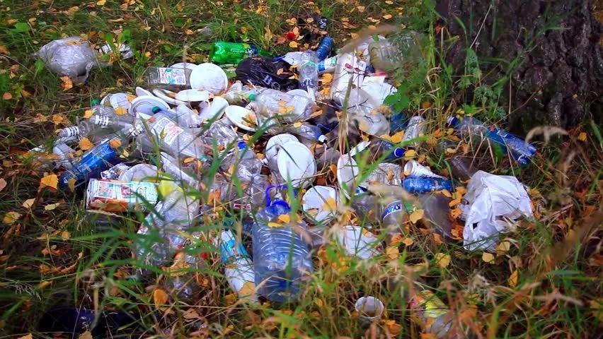
#MURMURATION
Problem and Opportunity
Tourism at the crossroads: pressure on the environment and conservation potential
Problem
8% of GHG and 70% of international air traffic
Pressure on local resources
Increased pollution
Biodiversity losses
Lack of accurate quantitative and qualitative metric data on the effects of tourism on sustainability (EU parliament, March 2021)
Opportunity
Impact - 10% of world GDP – 1 in 11 jobs across the globe
Stakeholders - 250000+ potential target clients across the globe
Timing - On the 25th of March 2021, the European adopted a text to Strengthen: transition to sustainable, responsible and smart tourism
Timing – on the 19th of June 2023 the French government proactively detailed a national strategy to manage tourism flows, imposing observation of environment impact
Size – Market estimated at 1B€ YRR
Notes:
Expliquer les indices agrégés - CO2 : 3 km / 2 mois – s’inscrit sur le long terme , pas d’impact sur le santé – orienté climat global. Potentiel d’une forêt à séquestrer du CO2 – mesure de l’évolution impotant.

Slide 3
#MURMURATION
Identity record
Our references
Founded in march 2019
Based in Toulouse, La Cité
20 employees
An engineering team of
21 persons
Winner of the Awake Tourism Challenge, in the «Tourism Tech for Good » category

Slide 4
#MURMURATION
Innovation: satellite data
MURMURATION uses satellite data and artificial intelligence to calculate indicators dedicated to monitoring sustainable development. Past, present and future, anywhere on the planet.
Historical study or at a given time to highlight the evolutions and policy impacts.
Coverage of the whole globe allowing benchmarking of best practices.
Indicators based on satellite earth observation data from the European Copernicus program.
Notes:
Expliquer les indices agrégés - CO2 : 3 km / 2 mois – s’inscrit sur le long terme , pas d’impact sur le santé – orienté climat global. Potentiel d’une forêt à séquestrer du CO2 – mesure de l’évolution impotant.

Slide 5
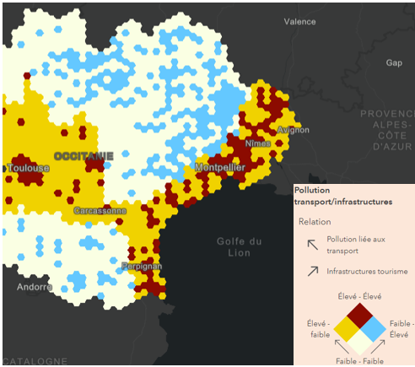
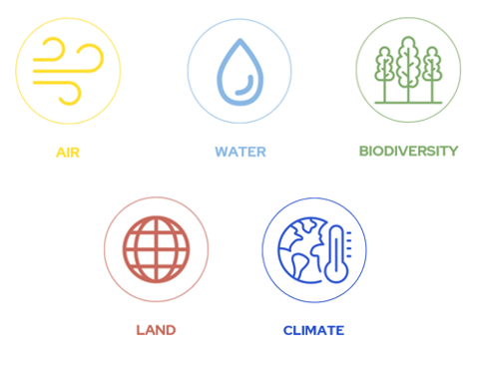
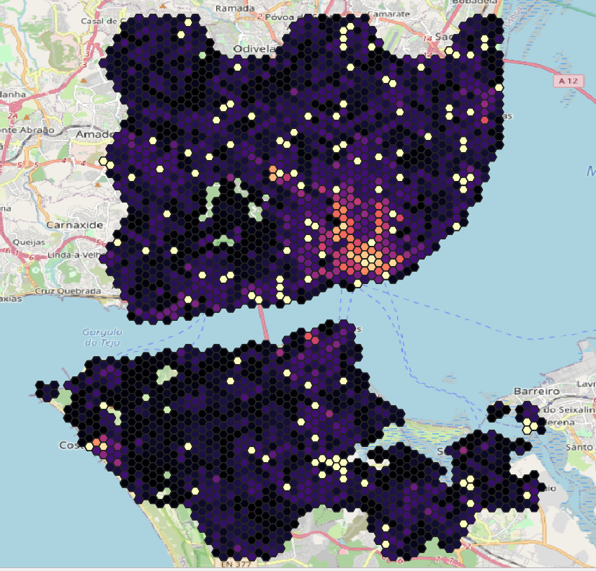
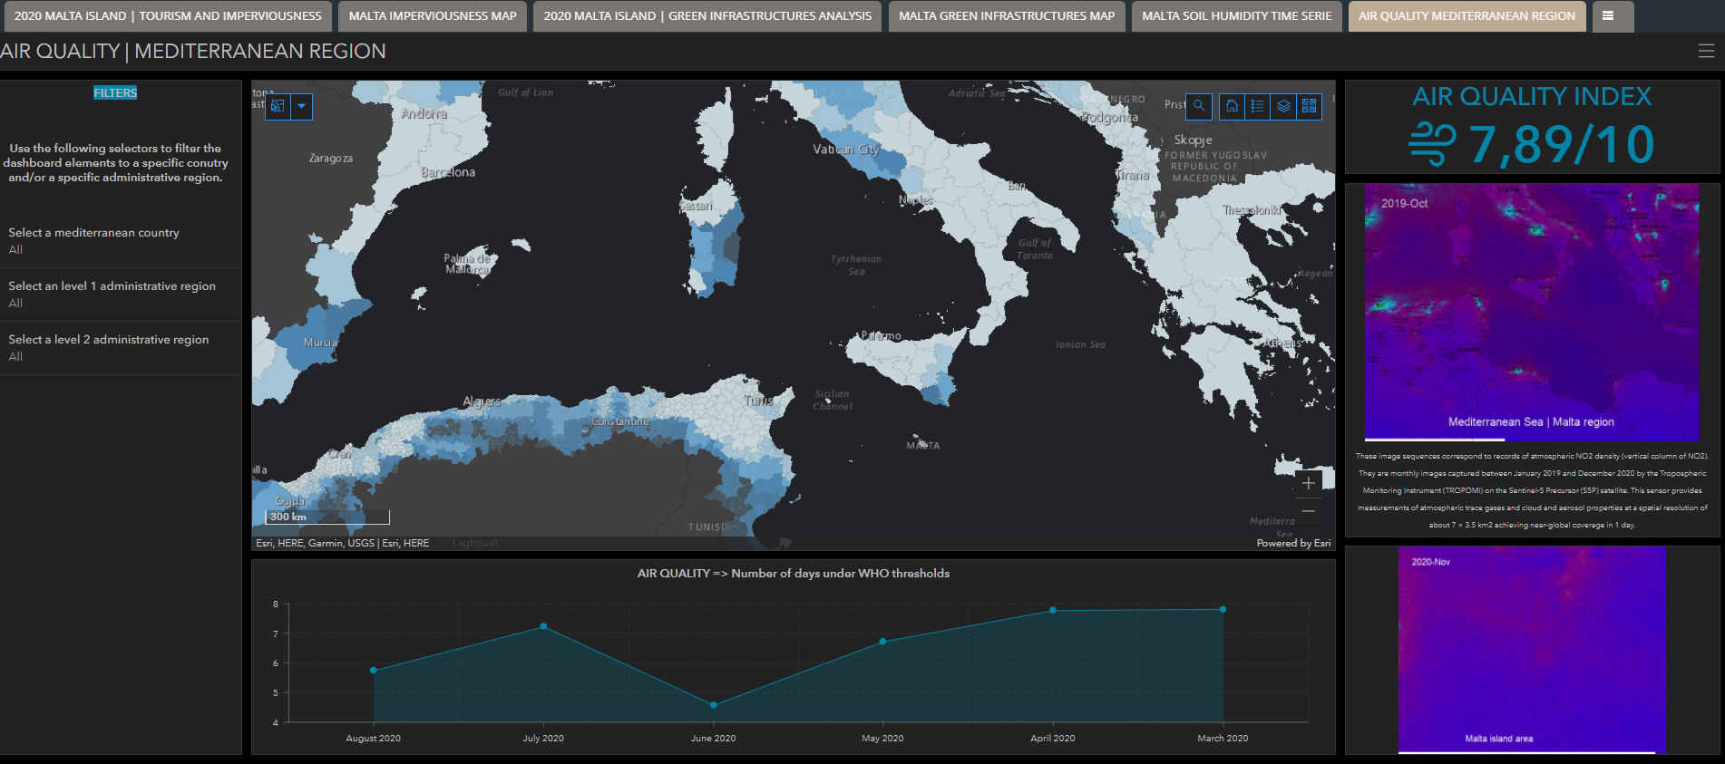
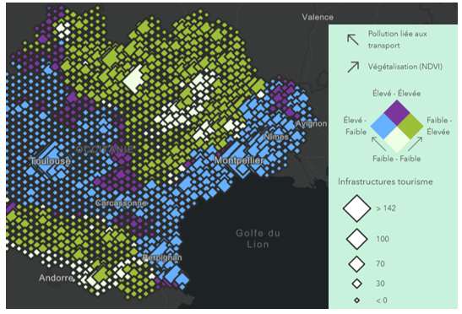
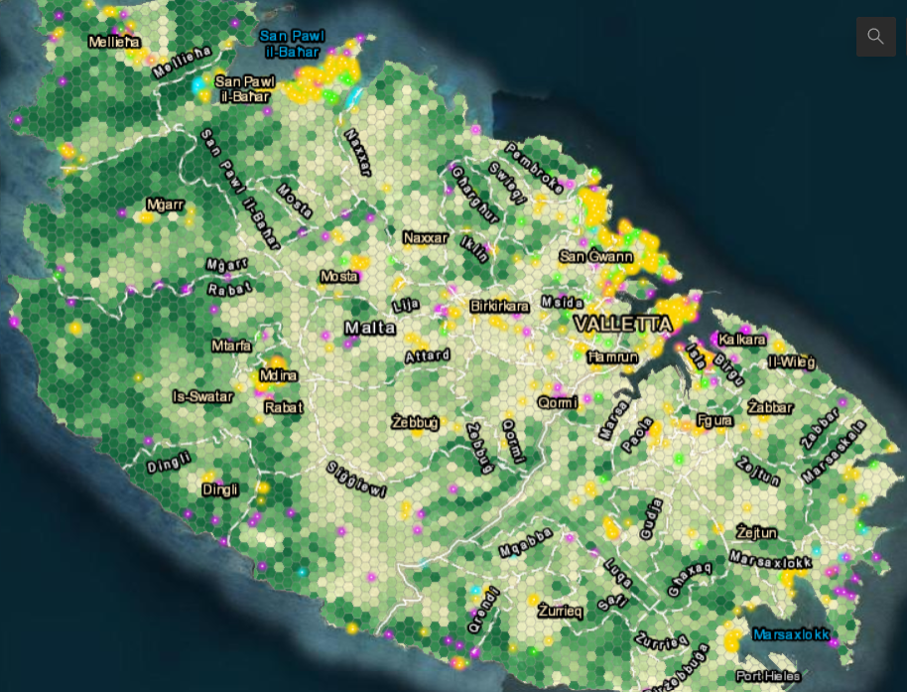
#MURMURATION
Measures to understand and support decision making
CATALOGUE
USE CASES
TOOLS
ENVIRONMENTAL INDICATORS
Impact of tourism on air quality
DASHBOARDS
Online dashboard to explore the data produced, updated monthly.
Urbanisation and tourism infrastructure
Sustainable tourism potential
SIMPLE WARNING SYSTEM
Sending an alert (e.g. by e-mail) when a threshold is exceeded
HUMAN ACTIVITY INDICATORS
RAW DATA
Environmental carrying capacity
In Excel, CSV, SHP or API format
Notes:
Expliquer les indices agrégés - CO2 : 3 km / 2 mois – s’inscrit sur le long terme , pas d’impact sur le santé – orienté climat global. Potentiel d’une forêt à séquestrer du CO2 – mesure de l’évolution impotant.

Slide 6
#MURMURATION
Murmuration Indicators
AIR
WATER
BIODIVERSITY
LAND
HUMAN ACTIVITIES
CLIMATE
Water quality
Aquatic coverage
Vegetation health
Forest cover
Vegetation classification
Protected areas
Endangered species
Land use
Soil artificialization
Urban heat
Climate historical Data
Weather conditions Climate projections
Rising sea levels
Snow cover projections
Tourist infrastructure
Tourist flows
Road infrastructure
Air pollutants
Aggregated Air
Quality Indicator
Air Quality -
Super Resolution
Notes:
These indicators are related to water, air, biodiversity, infrastructures and tourism statistics

Slide 7
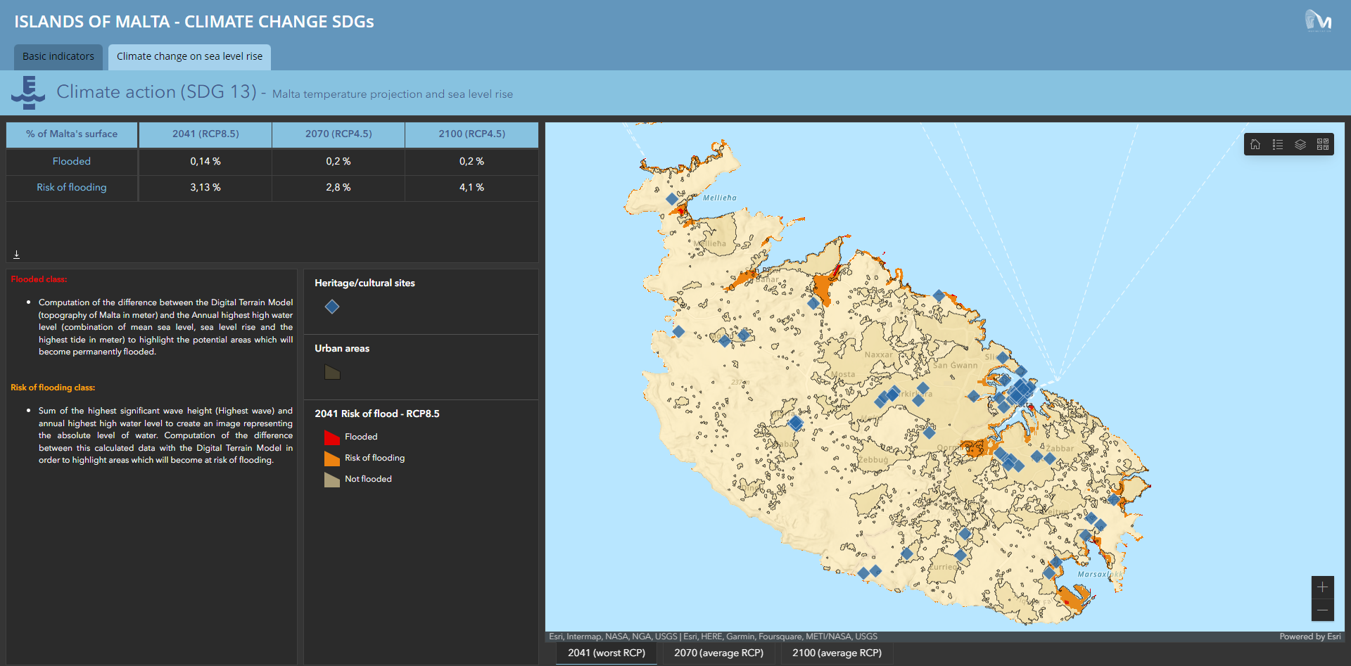

Slide 8
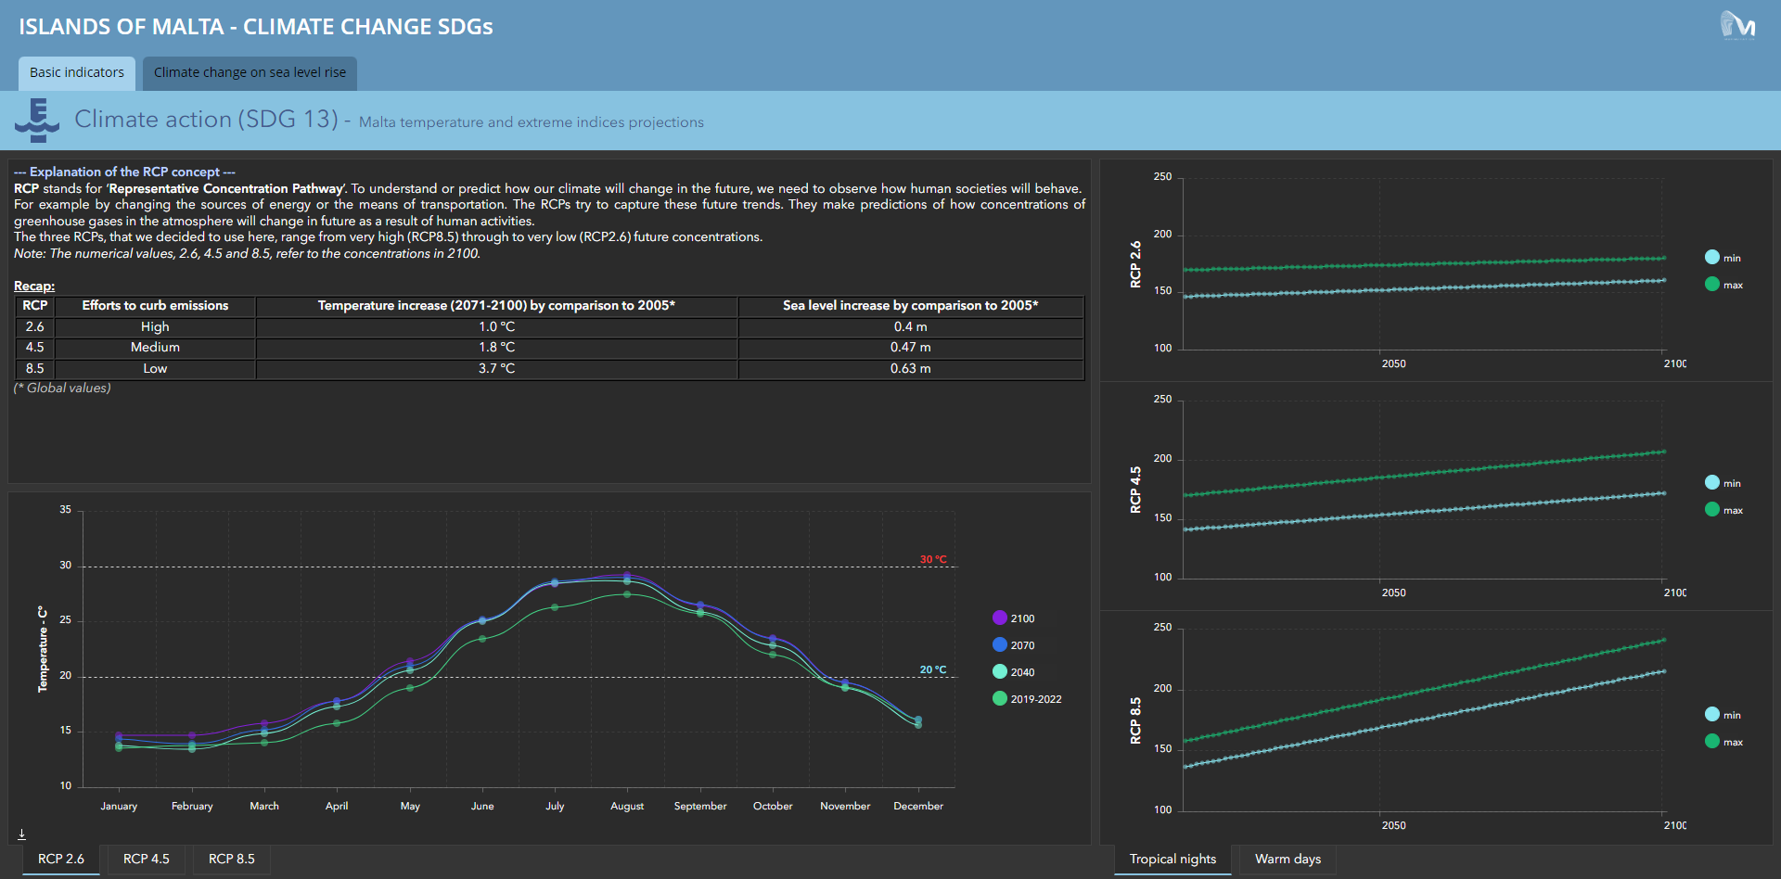

Slide 9
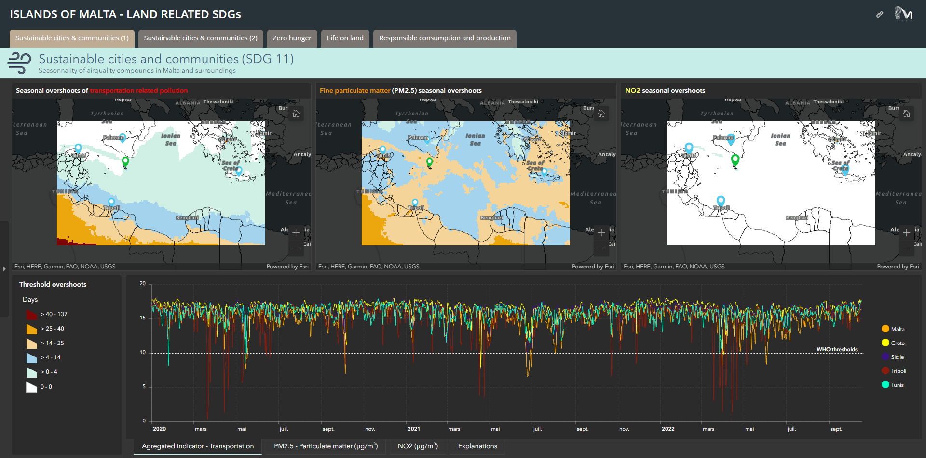

Slide 10
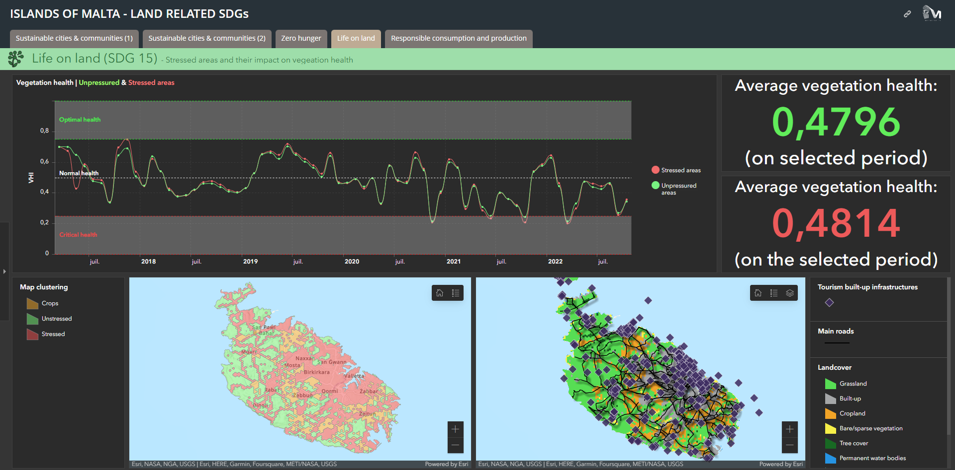

Slide 11
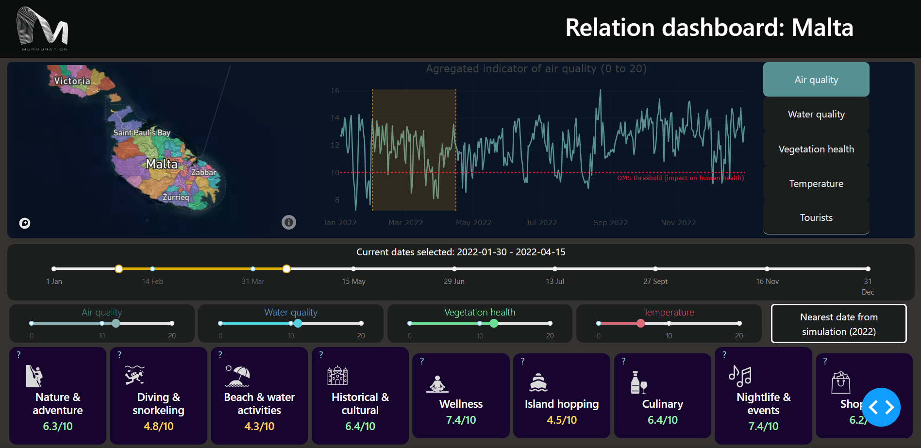

Slide 12
Tarek.habib@murmuration-sas.com
murmuration-sas.com
@Murmuration SAS

