Slide 1
2ND EDITION EUROPEAN SYMPOSIUM BY NEREUS REGIONS
SPACE DATA FOR TOURISM & AGRICULTURE ON 28-29 SEPTEMBER 2023, MATERA/BASILICATA
Space technology for agriculture and tourism: practices, challenges and opportunities in the Italian ecosystem
Maria Libera Battagliere
Head of Pilot Projects Office, Downstream and Application Services Department
Italian Space Agency (ASI)
1/15
2ND EDITION EUROPEAN SYMPOSIUM BY NEREUS REGIONS, MATERA/BASILICATA
28-29 SEPTEMBER 2023

Slide 2
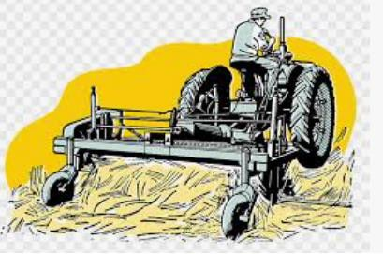
Premise and Context
It is well known that space technology represents a powerful tool to address the most pressing challenges that the world has to face , also to stimulate the innovation and economic growth.
The downstream sector continues to thrive and the future of commercial space industry has never looked so promising.
EO/NAV/TLC represent the space sectors with the most significant growth, not only in terms of infrastructure, but above all for the potential of related applications and services.
KEY MESSAGE
In the Space Economy era, satellite services and applications represent a key element that must be valued and promoted by institutions at local and global level in order to reap the maximum benefit from the opportunities offered by this developing market.
For this reason, they have been recognized as the top strategic priorities of Italian space policies (Resolution of the President of the Council, March 2019)
2/15
2ND EDITION EUROPEAN SYMPOSIUM BY NEREUS REGIONS, MATERA/BASILICATA
28-29 SEPTEMBER 2023

Slide 3
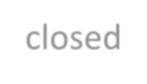
Opportunities in the Italian ecosystem
To facilitate this task, considering that most spatial data are not directly used by end-users, the Italian Space Agency has proposed a financial instrument to support the national ecosystem of service providers (public or private) : "I4DP - Innovation for Downstream Preparation", which represents the backbone for the implementation of a progressive ASI’s roadmap in this
sector.
What we did
Modality of implementation: periodic thematic calls
I4DP PA
I4DP Market
I4DP Science
I4DP
TRL>=8 TRL>=6
TRL>=6
SRL>=4
Total budget 8,8 M€
(2022-2024)
2 Calls for Ideas (1 in preparation)
4 selected projects
Total budget 13,5 M€
(2022-2024)
3 Thematic Calls (2 in progress)
7 selected projects
Total budget 6,5 M€ (2022-
2024)
2 Calls for Ideas
4 selected projects (first call)
3 selected projects (sec. call)
First cycle closed
28,8 M€ for 2022-2024 period
18 new Pilot Projects

Slide 4
Innovation for Downstream Preparation
I4DP TOPICS
I4DP-PA
The main focus of this program is to stimulate the downstream sector growth, offering a concrete support to set-up innovative and powerful space solutions for emerging demand and, at the same time, consolidating and enriching existing national know how both at scientific and industrial level
Articulated in three intervention lines based on the different categories of users to which it is addressed and to better leverage on needs of that communities: Public Institutional entities, Scientific community and Commercial operators
I4DP-Market
I4DP-Science
I4DP PA
I4DP Market
I4DP Science
Topics
Effects of climate change and extreme events
Monitoring the infrastructure stability
Precision farming/Agriculture
Transport and sustainable mobility
Smart Cities and urban effects of climate changes
Sustainable cities
Agriculture and Sustainable use of water resources

Slide 5
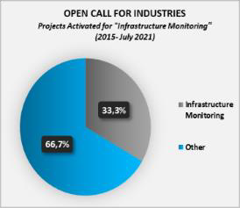
Previous preparatory programmes: observed trend and challenges faced
PRISMA Scienza
SAR Multifrequenza
Open Calls COSMO-SkyMed
Data exploitation from the hyperspectral "PRISMA" mission by the scientific and industrial community
Definition, experimentation and demonstration of methodologies, innovative algorithms and products based on the use of multi-mission / multi-frequency SAR data
Promotion of the COSMO-SkyMed data utilization (1st / 2nd Gen) to basic and applied R&D in view of scientific and toward operational utilization of the products/services developed
Highlights
Budget: 3 M€
Co-fund ≤ 200 k€ / proposal
15 PROJECTS co-funded
AI, ML, Data Fusion, Resolution
Projects ongoing
Highlights
Budget: 2 M€
10 PROJECTS co-funded
Multithematic call
Integration with other EO data or non EO data
Highlights
Permanently open since 2015
2 types of call (Science/Industry)
National industry / international scientific community
Max 100 scenes free of charge
Among the others, the interest in infrastructure monitoring, as well as the exploitation of satellite SAR data for this purpose, have been growing in the last decade.
Projects themes
Agriculture
Air quality
Water and coasts monitoring
Study of the cryosphere
Classification of vegetation
Focus
Use of data from national missions (COSMO Sky-Med) or acquired in the context of international cooperation (e.g. ASI-CONAE for SAOCOM data in L-band)
Results
94,5% proposals for scientific call
2000 products/year delivered
> 200 proposal submitted
Major interest in Disaster Risk Reduction (DRR)

Slide 6
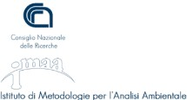
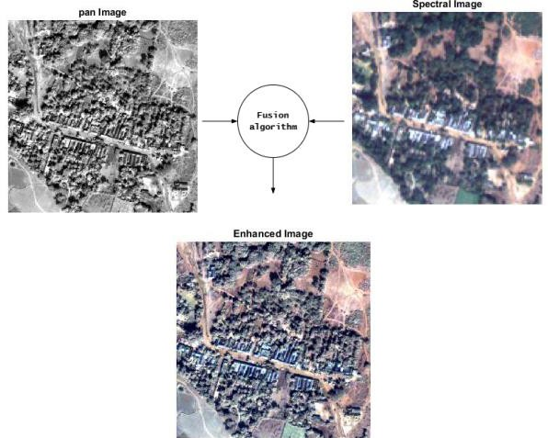
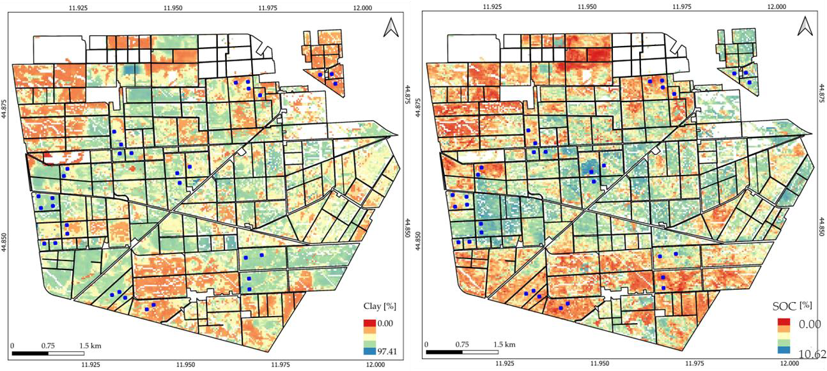
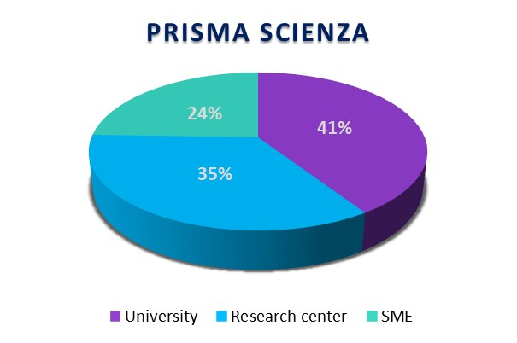
PRISMA Scienza - Pilot projects – focus on Agriculture
The aim of the call is to encourage and promote the scientific use of PRISMA mission data by the Italian community, in order to support the full data exploitation of the mission and strategically promote the development of Italian know-how in the hyperspectral remote sensing sector.
TEHRA Topsoil properties Estimation from Hyperspectral Remote sensing for Agriculture
Focus
Develop methods and algorithms for PRISMA product generation to monitor and map soil properties of agronomic and environmental interest, in support of more sustainable and climate-smart precision agriculture strategies and environmental policies (reduction of waste, optimize production)
Projects themes:
Agriculture & Forestry
Cultural heritage (>> tourism)
Air quality
Soil properties
Cryosphere
Inland and coastal water
Mapping of clay (left) and soil organic carbon (right) on the Jolanda di Savoia farm from PRISMA using a multi-date approach

Slide 7
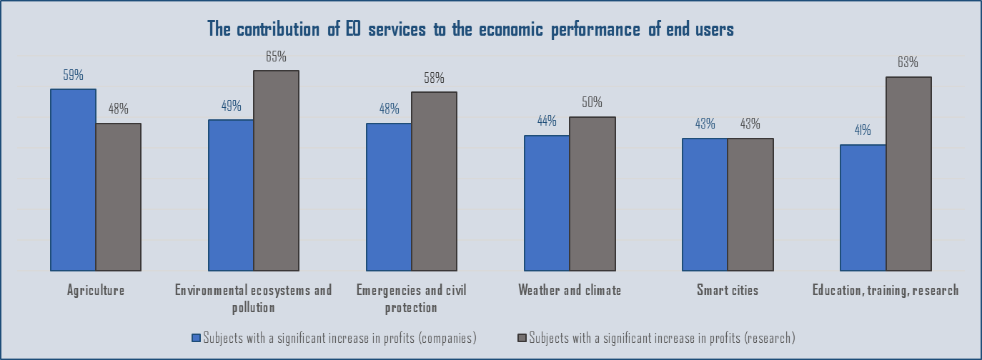
Preparatory and Dissemination activities: practices
2021
In order to expedite the process of interaction between space industry actors and traditional market communities, the Downstream and Integrated Application Unit hosts several thematic workshops
Cost-benefit analysis of public policies in the space sector
ASI – UNIMI project
3 years study
120 participants
63 companies
57 research organizations
Selected topic for the first call I4DP Market
Sectors with the major increase in the economic performance of users are agriculture, environmental protection, emergency management / civil protection
infrastructure
Workshop with the national community operating in large infrastructures sector

Slide 8
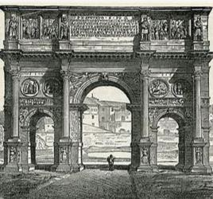
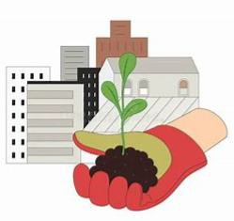
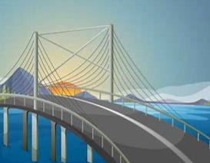
I4DP – Innovation for Downstream Preparation - Market
I4DP Market – First call
Safe Bridge - Monitoring services with satellite techniques for safe bridges
Rheticus Safeway
Fixyll - Fight Xylella
Management and monitoring of Infrastructures / Precision farming
MODISAT - Bridge buffering by displacement measurements derived from satellite technologies
SAT4FARM
Budget 6 M€
Financing ≤ 1 M€ - TRL ≥ 8
Financing ≤ 500 k€ - TRL 6÷8
18 months
MIDS - Water infrastructure monitoring with satellite data
DEM-EO - Democratization of Earth Observation

Slide 9
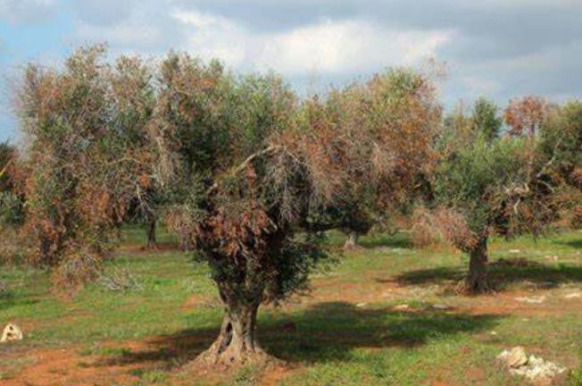
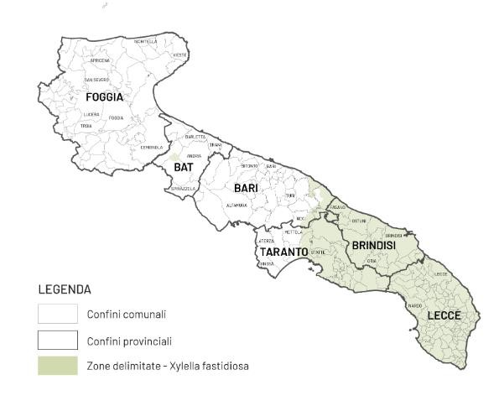
I4DP Market- Pilot Projects- focus on Agriculture
Fixyll - Fight Xylella
The FIXYLL project aims to create services to support the containment action of Xylella disease, a bacteria causing tree death.
This is an invasive pathogen that can infect hundreds of species of plants. It was discovered in Europe in 2013, after the beginning of an epidemic among the olive trees in Puglia region, and then spread to France, Spain and Portugal.
At the moment the only way to eliminate the bacterium is the eradication of infected plants.
The project is based on the use of multi-mission / multi-frequency EO data (PRISMA hyperspetracl data, COSMO-SkyMed SAR data, Copernicus data, SAOCOM data) and will capitalize the experience and results coming from previous research projects, such as REDOX (source https://www.dtascarl.org/progetti-e-iniziative/use-case- trasferimento-tecnologico/redox/) and TEBAKA

Slide 10
I4DP Market- Pilot Projects- focus on Agriculture
SAT4FARM
AgriWeb IBF Servizi
GIAS®
Agronica Group
The main objective of this project is the development of a platform of services able to integrate and processing both satellite data and information coming from the operational management of crops, that are collected by Farm Management Software (FMS) , GIAS®
Integration of satellite data with crops information (non- space data)
CHALLENGES
The market is still fragmented
Companies providing EO solutions for agriculture find too complex provide products directly to farmers;
Many farmers continue not to make operational use of EO value-added solutions, due to the difficulty of using these data
Many farmers do not have access to infrastructure supporting the digitalization process and present gap of competences in the use of products
The platform represents an add-on, being an extension of products already developed and operational.
Crops information tipically are used in the phase of model development. In this service these data are used in the operational phase too, with an upstream flow, or a constant process of reworking of algorithms and their calibration

Slide 11
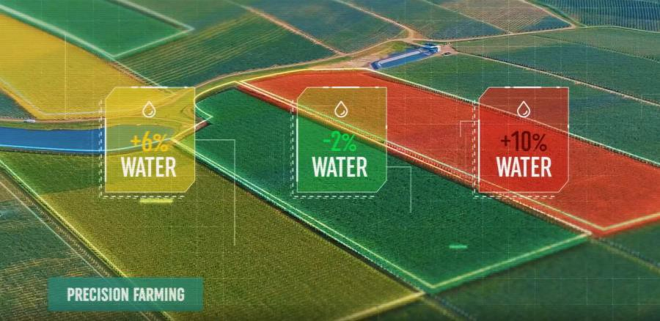
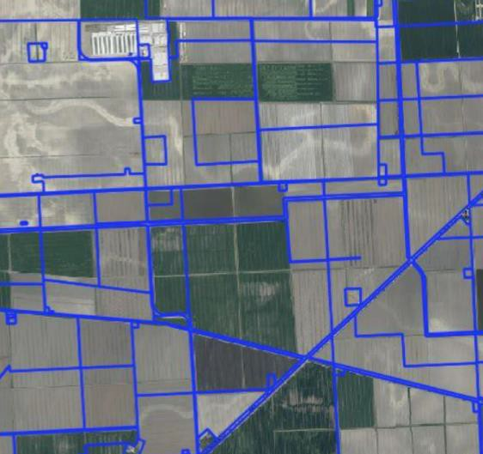
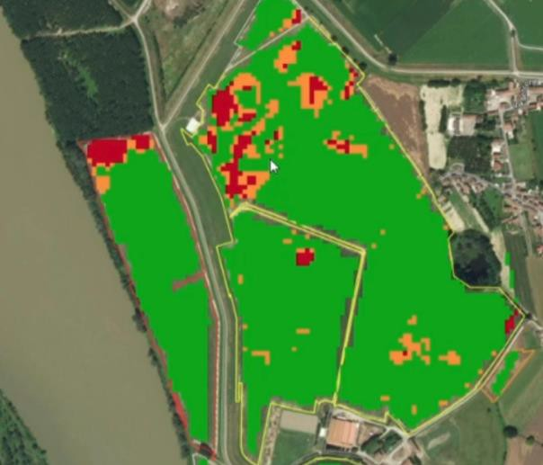
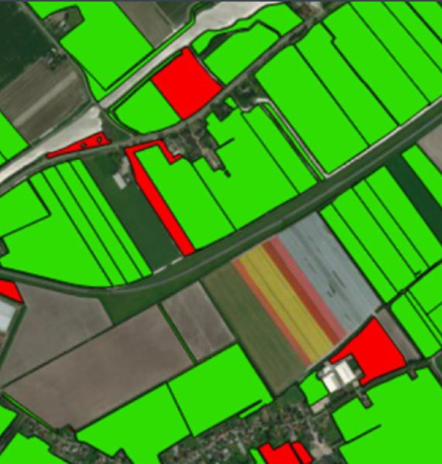
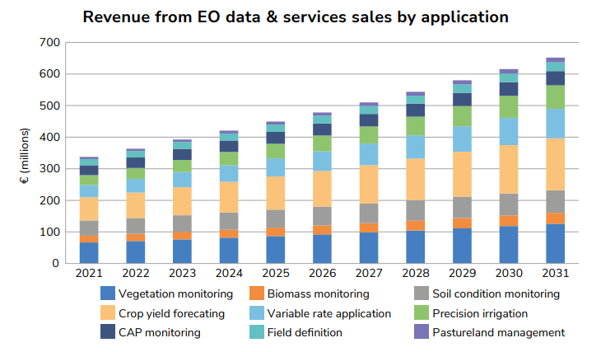
Space for Agriculture
Services and applications powered by EO and GNSS data and technology:
Site Characterization and Crop Zooning
Historical Analisys
Anomalies detection
Crop Monitoring
Farm machinery guidance
Certification control
€652
with the aim to
€337
reduce waste of water resources
differentiate irrigation
monitor the land use
make crop yield predictions
provide guidelines for the differential use of fertilizers
differentiate between different methods (organic agriculture with respect to conventional agriculture)
(source EUSPA EO and GNSS market report 2022)

Slide 12
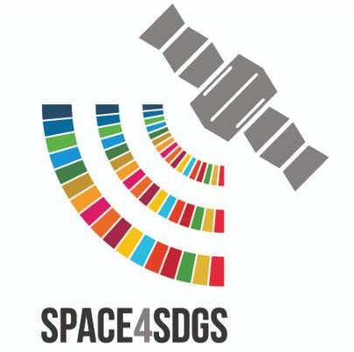
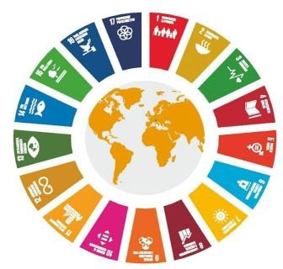
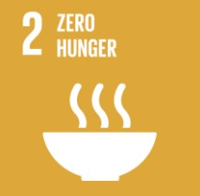
We are a space society
KEY TAKEAWAYS
Space is driver for sustainable socio-economic development
Starting from 2022, the Earth has 8 billion human beings. By 2050, the population is expected to grow to 10 billion.
Modern agriculture requires constantly improved tools to satisfy the world population’s demand for sustainable food, for the protection of the soil, for the reduction of the use of pesticides and the prevention of water waste.
Soil not only supplies the food we eat, but also provides invaluable ecosystem services such as ensuring we have clean water, maintaining biodiversity and regulating the climate
The agricultural sector started to emphasize sustainability in the face of global challenges, including climate change, population growth and the increasing competition for land, water and energy resources

Slide 13
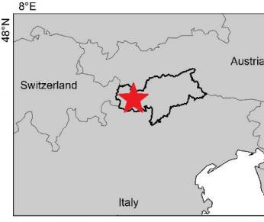
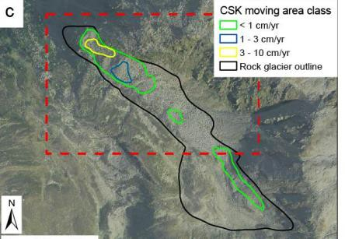
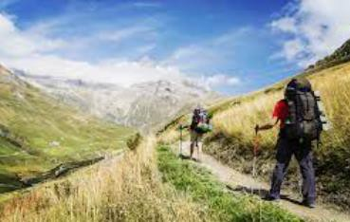
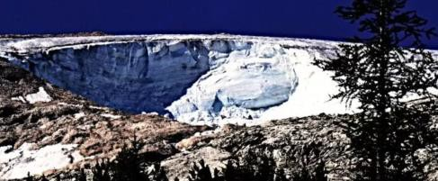
Space for tourism
Tourism is strongly connected with environment, ecosystems, society and economy. Tourism industry, for example, impacts on greenhouse gas emissions and climate change effetcs.
Sustainable Tourism Services
Safe Tourism
Tourism is one of the economic activities with most significant
potential to generate future growth and employment in EU.
Rock glaciers monitoring
Open Call ID 751
Space technology can be a useful tool to support a transformation of this sector towards sustainable management and good practises.
Space data can be used to monitor natural resources, to support efforts for safe tourism (track of tourist paths), to identify areas of potential risk
South Tyrol
For instance, during the Covid-19 pandemic, satellite communication thanks its anywhere anytime connectivity allowed museums and cultural sites to keep their virtual doors open.
Source: https://www.eurisy.eu/space-data-for-sustainable-tourism/
13/15

Slide 14
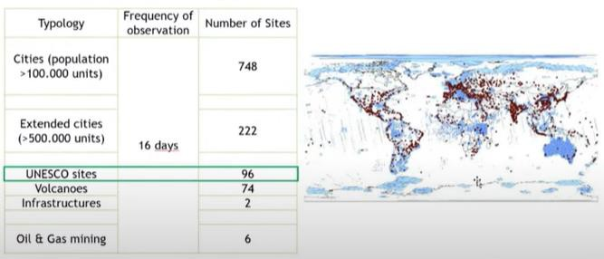
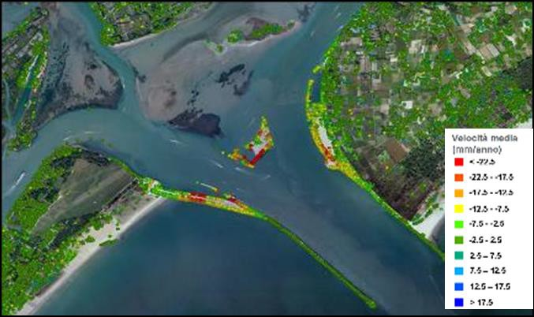
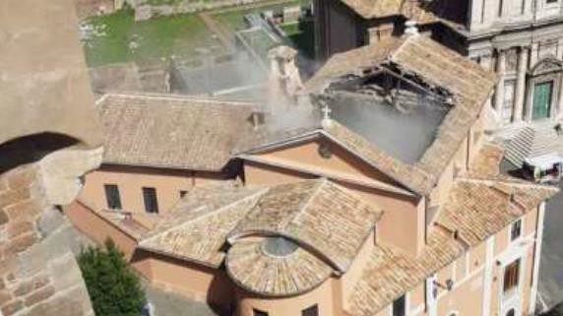
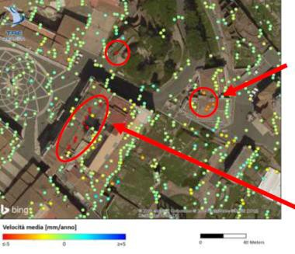
Space for tourism
Space data enable many consumer applications. They could be used to integrate tools for the monitoring of tourism flows, to facilitate mobility, to improve the travel experience or to better manage extreme weather events that can endanger seasonal tourism, which sometimes represents the only source of revenues for inhabitants.
Some apps would not function without the information from EO data, for example applications which rely on mapping, such as smartphone navigational applications, require the accurate mapping of Earth’s surface by EO satellites. Tourists can use such data for identification of interest points and route planning, for updating reliable map, for wheather report according the geografic position.
Venice Lagoon, 2009-2011 UNESCO site from 1987
Space data can be used not only to improve the travel experience but also for monitoring and control of bridges, roads, railways, cableways, in order to increase the safety of the installations and infrastructure during operation or to support the management and safeguard of historical cities and cultural sites.
In Italy, the 30% of cultural heritage sites are exposed to landslides and floods risk.
Source: https://www.eurisy.eu/space-data-for-sustainable-tourism/
13/15

Slide 15
Different market segments are strongly connected
The most of challenges we must face are global challenges
Space technology is recognized as one of the most important tools that can make a difference
Thanks for your attention
Contact: maria.battagliere@asi.it
Thanks to ASI’s colleagues who work on the different mentioned programs making possible to achieve our objectives
2ND EDITION EUROPEAN SYMPOSIUM BY NEREUS REGIONS, MATERA/BASILICATA
28-29 SEPTEMBER 2023

