Slide 1






European Regional Symposium
September 28 – 29 | 2023 Matera, Basilicata Region | Italy
Second Edition of the European Regional Symposium, on space data for tourism & agriculture, by NEREUS Regions
Illustrations of advances and innovations in the use of space data and technologies to meet the challenges of agriculture in South-West of Europe
Laurent AUGIER, Agri Sud-Ouest Innovation

Slide 2


AGENDA
1
2
ASOI short introduction
Agriculture challenges
3
4
Some illustrations of innovations and advances
Openness to future collaborations & projects

Slide 3
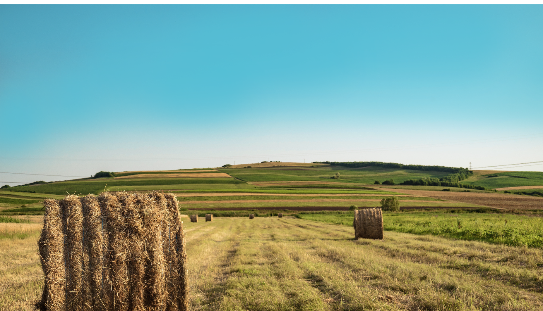

1
Agri Sud-Ouest innovation
FRENCH « PÔLE DE COMPÉTITIVITÉ »
FOR THE AGRI-FOOD SECTOR
Let’s grow together ecology-smart agrifood chains !

Slide 4
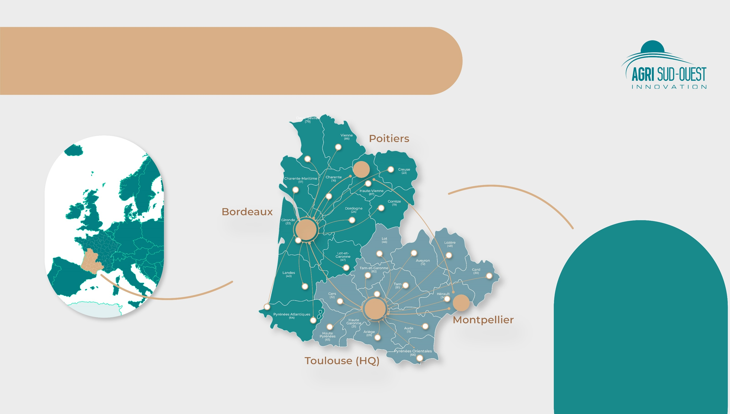
AN INNOVATION CLUSTER
for the agri-food sector in South-Western France
Limoges
4 offices - 20 employees
Bordeaux | Limoges | Toulouse | Montpellier
2 Regions
Nouvelle-Aquitaine | Occitanie
1 International border
Spain | Andorra
1

Slide 5

AN EXPERT KNOWLEDGE
on high-potential regional productions
Corn
Vine & wine
Sunflower
Soya and pulses
1

Slide 6

AN EXPERT KNOWLEDGE
on high-potential regional productions
Fruits & vegetables
Beef cattle
Sheep/goat milk
Palmipeds for foie
gras production
1

Slide 7



OUR PRIORITY
innovation areas
Agro-ecological transitions in a context of climate change
Digital technology and robotics for agriculture and the food industry
Safe, healthy and sustainable food
1

Slide 8

OUR PRIORITY
innovation areas
Biomass monitoring and valorization
Healthy, sustainable and local food
Biosolutions in agriculture
Agrifood chains data management and traceability
Sustainable and healthy food systems (including plant and animal proteins)
1

Slide 9







AGRIFOOD INNOVATION
riding the wave of the latest trends
Participate in the global food supply through an adapted production and processing capacity
Decarbonise our production systems and adapt them to climate change
Combine health, food, animal health, plant health and environment One health approach
Organise local and regional supply chains and make our economy more circular
Meet social and environmental requirements and report on our commitments
Identify new sources of value and ensure transitions in production models
2

Slide 10

AGRIFOOD INNOVATION
illustration of innovations
Soil health
Accelerate transition towards regenerative agriculture for soil health (carbon, water, biodiversity)
e.g. Geosys EarthDaily Agro, Biosphères, INRAE
https://solnovo.agrisudouest.com/
Moisture
Vegetation cover
CO₂, N₂O emissions
NDVI
Agricultural robotics
Build a roadmap to develop and accelerate innovations for a better farmers income and life and for an environmental free agriculture
e.g. Naïo Technologies, Agreenculture, CNES
https://agrobotics-land.com/
Landscape heterogeneity
Geopositioning (cm, m)
Agrifood chain traceability
Experiment and demonstrate new business models, from consumer information to specific logistic services
e.g. Food Pilot, Agriflux, Elzeard
https://www.traceabilityandbigdata.eu/
Telecommunications
Crops recognition
3
Cyber security

Slide 11

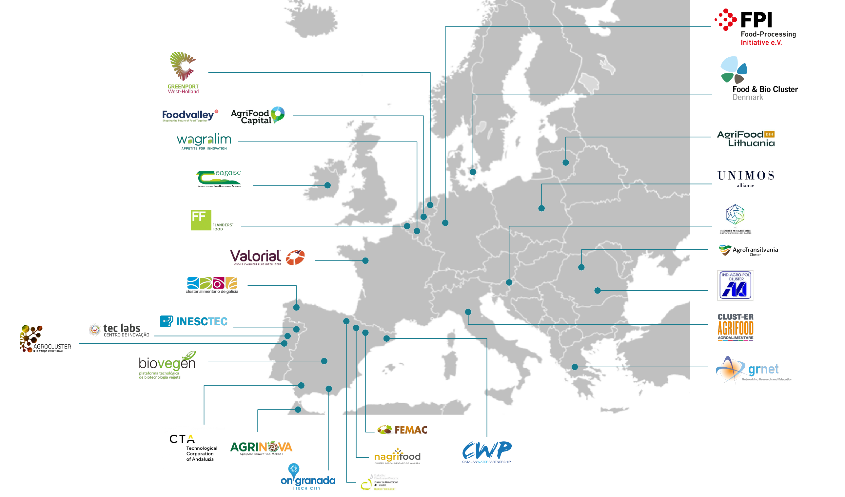





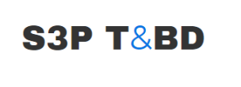

A NETWORK
of partners at EU level
4

Slide 12

ASOI IN HORIZON EUROPE PROJECTS
Value proposition
INNOVATON
SCOUTING
& MAPPING
IDEATION
& INTERACTION
WITH ECOSYSTEM
COMMUNICATION
& DISSEMINATION
BUSINESS
DEVELOPMENT
& FACILITATION
RESOURCES,
TOOLS & METHODS
LINKED THIRD
PARTIES MANAGER
Sourcing
of innovation
Identification
of stakholders
at EU level
Stakeholders survey
Innovation workshops
Project output dissemination
Organisation
of webinars,
B28 meetings
Connection with international events
B2B sessions
Qualified meetings with stakeholders
Market comprehension
study
Platform ‘’Challenges’’ (expression of interest)
Financial Support to Third Parties (FSTP management)
B2B platform
ASOI is partner as representative of a group
ACTIVITIES
CARRIED-OUT
Mapping of current trends
and gaps
of innovation
Mapping of IP
Locks, barriers and painpoints identification
Roadmap of innovation
Operationnal feedbacks
Position paper
Dissemination plan with tools and contents
Opportunity & feasability studies
EOI and Call management
ASOI managing a group of linked third-parties
(SMEs, industries, etc.)
CORRESPONDING
DELIVERABLES
ASOI network of members (>400)
DIVA community of SMEs and Partners (180)
ASOI European network of clusters (>30)
10 DIVA recommendations
Founder member of Robagri
Member of ‘’Consortium national du biocontrôle’’
RIS3 working groups
75 events / year
DIVA final event
International fair: FIRA, SIMA, SITEVI Vinitech
Cross-border matchmaking events in DIVA, Agro & Aigua, Agro TIC Hub projects
Open innovation challenge ‘’Innovative solutions against Datura’’ for Cooperatives
EOI ‘’Occitanum-Vine growers operational needs’’
DIVA (2,7 M€ of FSTP)
REFERENCES
4

Slide 13

OUR REFERENCES
NICOLAS NGUYEN THE
Head of European affairs
+33 (0) 6 14 29 16 86
nicolas.nguyen-the@agrisudouest.com
EVA MAMETZ
European project manager
+33 (0) 7 56 41 52 46
eva.mametz@agrisudouest.com
4

Slide 14

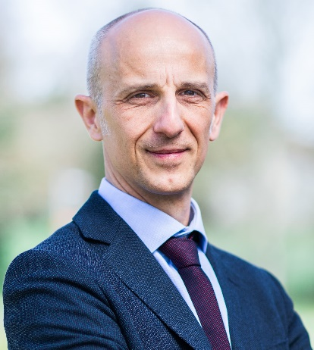

LAURENT AUGIER
General Director
+33 (0)6 09 93 48 03
laurent.augier@agrisudouest.com
They support us:

