Slide 1







European Regional Symposium
September 28 – 29 | 2023 Matera, Basilicata Region | Italy
Second Edition of the European Regional Symposium, on space data for tourism & agriculture, by NEREUS Regions
Agriculture and carbon removal: the role of satellite in supporting carbon neutrality
FABIO VOLPE

Slide 2



The space-based solution
Agriculture and carbon removal: the role of satellite in supporting carbon neutrality

Slide 3
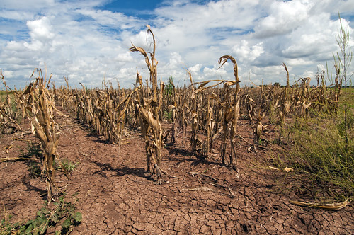

Challenges at regional and local level
Severe impact on agricultural production in Italy, France and Germany
Agriculture and carbon removal: the role of satellite in supporting carbon neutrality
https://commons.wikimedia.org/w/index.php?curid=89060994
Notes:
Apart from routinary events that can occur during the season, as you know this events are due to the climate change effect. Main reason of climate change is the contonous release of CO2 and other gases in the armosphere.

Slide 4
Agriculture and carbon removal: the role of satellite in supporting carbon neutrality

Slide 5
Targeting 2050 EU Carbon neutrality
Emission
Removal
MtCO2eq
Effect
5000
4000
3000
2000
1000
Agriculture and carbon removal: the role of satellite in supporting carbon neutrality
0
2005
2010
2015
2020
2025
2030
2035
2040
2045
2050

Slide 6
Targeting 2050 EU Carbon neutrality
Emission
Removal
MtCO2eq
Effect
5000
4000
3000
2000
1000
Agriculture and carbon removal: the role of satellite in supporting carbon neutrality
0
2005
2010
2015
2020
2025
2030
2035
2040
2045
2050

Slide 7
Targeting 2050 EU Carbon neutrality
Emission
Removal
MtCO2eq
Effect
5000
4000
3000
2000
1000
Agriculture and carbon removal: the role of satellite in supporting carbon neutrality
0
2005
2010
2015
2020
2025
2030
2035
2040
2045
2050

Slide 8
Targeting 2050 EU Carbon neutrality
Emission
Removal
MtCO2eq
Effect
5000
4000
3000
2000
1000
Agriculture and carbon removal: the role of satellite in supporting carbon neutrality
0
2005
2010
2015
2020
2025
2030
2035
2040
2045
2050

Slide 9
Targeting 2050 EU Carbon neutrality
Emission
Removal
MtCO2eq
Effect
5000
4000
3000
2000
1000
Agriculture and carbon removal: the role of satellite in supporting carbon neutrality
0
2005
2010
2015
2020
2025
2030
2035
2040
2045
2050

Slide 10
Targeting 2050 EU Carbon neutrality
Emission
Removal
MtCO2eq
Effect
5000
4000
3000
2000
1000
Agriculture and carbon removal: the role of satellite in supporting carbon neutrality
0
2005
2010
2015
2020
2025
2030
2035
2040
2045
2050

Slide 11
Targeting 2050 EU Carbon neutrality
Emission
Removal
MtCO2eq
Effect
5000
4000
3000
2000
1000
Agriculture and carbon removal: the role of satellite in supporting carbon neutrality
0
2005
2010
2015
2020
2025
2030
2035
2040
2045
2050

Slide 12
Targeting 2050 EU Carbon neutrality
Emission
Removal
MtCO2eq
Effect
5000
4000
3000
2000
1000
Agriculture and carbon removal: the role of satellite in supporting carbon neutrality
0
2005
2010
2015
2020
2025
2030
2035
2040
2045
2050

Slide 13
Targeting 2050 EU Carbon neutrality
Emission
Removal
MtCO2eq
Effect
5000
4000
3000
2000
1000
Agriculture and carbon removal: the role of satellite in supporting carbon neutrality
0
Emission
Removal
2005
2010
2015
2020
2025
2030
2035
2040
2045
2050

Slide 14
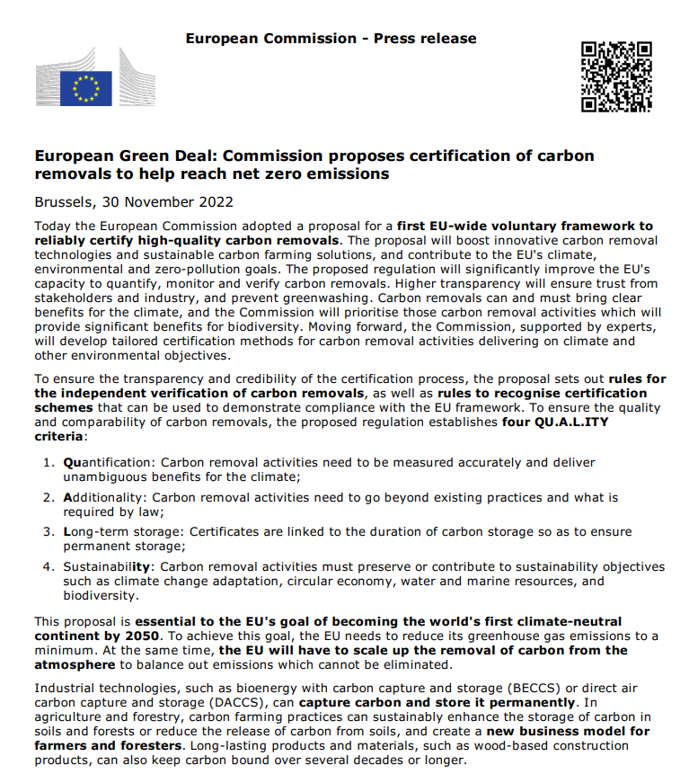
Targeting 2050 EU Carbon neutrality
Agriculture and carbon removal: the role of satellite in supporting carbon neutrality

Slide 15
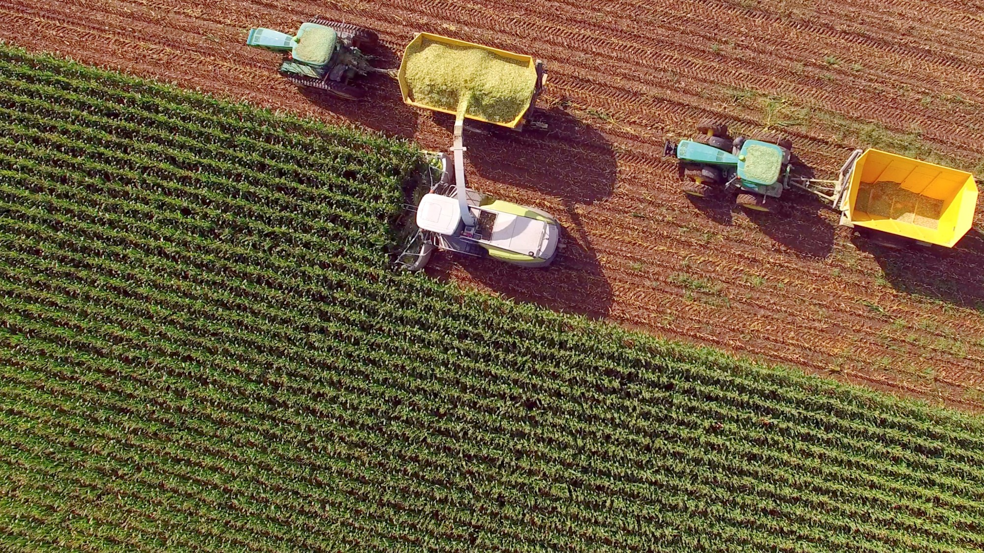
Usage of satellite images
In general, satellite data can support:
  Monitoring and measuring carbon stocks: map and monitor the extent and health of forests, wetlands, and other ecosystems that store carbon.
  Verifying carbon removal: provide evidence of carbon removal actions
Agriculture and carbon removal: the role of satellite in supporting carbon neutrality

Slide 16





Challenges at regional and local level
Certify actions
Make actions on the ground
Agriculture and carbon removal: the role of satellite in supporting carbon neutrality
Define models for carbon removal/capture
Verify actions and provide data

Slide 17
Challenges at regional and local level
Planting trees on agricultural land
Mantaining winter crop cover
Crop rotation
Usage of organic fertilizers
Avoid chemical fertilizers
Reduce pesticides (herbicides, insecticides)
Mantaining ecological features along water bodies
Avoiding crop burning
Mantaning grass in woody cultivation
Limiting actions on the terrain when ploughing
Adopt precision farming techniques
Adopt rice cultivation tecniques with low methan emissions
Make actions on the ground
Agriculture and carbon removal: the role of satellite in supporting carbon neutrality
Notes:
(N₂0 300 times more powerful than CO₂)
Pesticidi e insetticidi possono rilasciare metano (CH4), un gas serra 25 volte più potente della CO2.

Slide 18
The space-based solution
Planting trees on agricultural land
Mantaining winter crop cover
Crop rotation
Usage of organic fertilizers
Avoid chemical fertilizers
Reduce pesticides (herbicides, insecticides)
Mantaining ecological features along water bodies
Avoiding crop burning
Mantaning grass in woody cultivation
Limiting actions on the terrain when ploughing
Adopt precision farming techniques
Adopt rice cultivation tecniques with low methan emissions
Make actions on the ground
Agriculture and carbon removal: the role of satellite in supporting carbon neutrality
Notes:
(N₂0 300 times more powerful than CO₂)
Pesticidi e insetticidi possono rilasciare metano (CH4), un gas serra 25 volte più potente della CO2.

Slide 19
Challenges at regional and local level
Certify actions
Make actions on the ground
Agriculture and carbon removal: the role of satellite in supporting carbon neutrality
Define models for carbon removal/capture
Verify actions and provide data

Slide 20
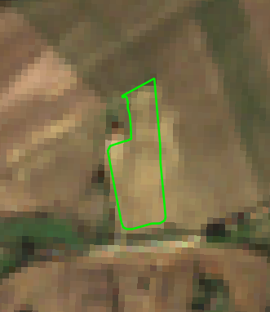
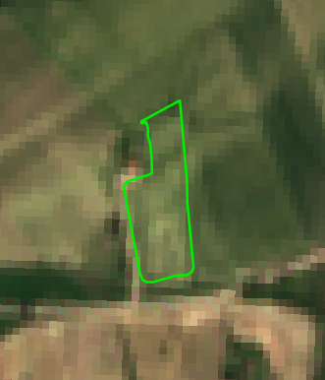
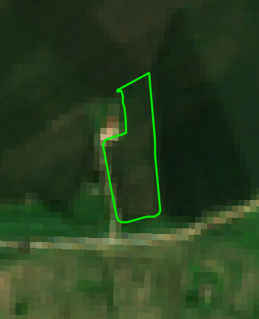
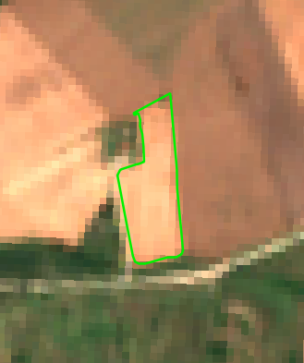
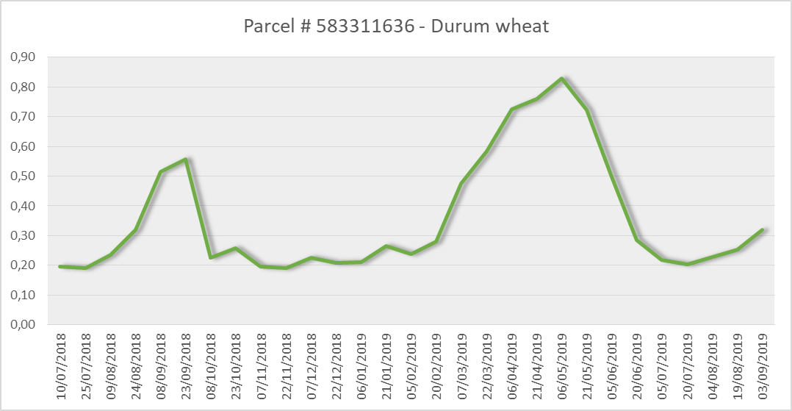
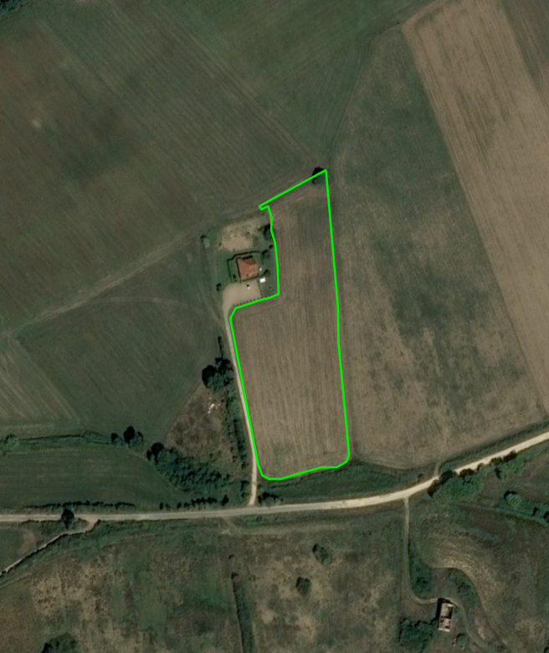
Challenges at regional and local level
PLOUGHING
GROWTH
HARVESTING
Agriculture and carbon removal: the role of satellite in supporting carbon neutrality

Slide 21
Challenges at regional and local level
Certify actions
Make actions on the ground
Agriculture and carbon removal: the role of satellite in supporting carbon neutrality
Define models for carbon removal/capture
Verify actions and provide data

Slide 22
Challenges at regional and local level
Farmers benefit in different ways from carbon removal actions
Improvement in land quality and resilience → increase production
Revenues from carbon removal certification
Make actions on the ground
Agriculture and carbon removal: the role of satellite in supporting carbon neutrality
On the financial side, carbon credits need to be more attractive for farmers → Support from policy (i.e., Common Agriculture Policy) should be mandatory.
Revenues schemas from carbon removal certification may be based on:
  results (only following evidence of an envi-improvement),
  actions (only on the certification of having completed the required actions, regardless of the result)

Slide 23
What are the benefits to citizens and the region, now and in the future?
Perform carbon removal actions will improve EU resilience versus climate change, supporting the 2050 EU carbon neutrality target
Farmers will take benefit from their actions, in terms of more environment-oriented cultivation, improved quality and resilience of their land, support from certification revenues
Citizens will enjoy the improvement of the environment and will benefit of more healthy food
In this framework satellite can provide objective measures of what is present on the ground, and can properly support MRV on carbon removal actions

Slide 24
Thank you
FABIO VOLPE
Head of Agriculture
fabio.volpe@e-geos.it
Agriculture and carbon removal: the role of satellite in supporting carbon neutrality

