Slide 1
Space for Tourism
Borja Pickering
Business Applications
ESA BASS

Slide 2
Agenda
ESA BASS introduction
2. Space for tourism funding call
3. Successful stories from BASS
4. How to apply to our funding call in tourism

Slide 3
The largest space innovation network in the world
ESA Business Applications Space Solutions - BASS
Program started in 2009 → BASS invested + €250M in launching innovative services in over 1200 Business
Around 35 Activities only related to Tourism sector
The go-to place for great business involving space to improve everyday life.
Supporting European companies regardless size to develop businesses using space technology and data.
Offering funding, business and technical support to help to generate successful business and create jobs.
Notes:
Additional points for the socio-economic:
To Establish space as a pillar of the new digital economy
Additional points for space use:
Support the establishment of a resilient, fair and inclusive society through the integration of space with disruptive digital technologies
Additional points for industry competitiveness:
Support companies through short time to contract and seed funding tools
Increase uptake of space solutions through networking opportunities and access to investors

Slide 4
Space Assets…
BASS - Space assets, users & markets
… coupled with…
… to serve Users & Market
Earth
Observation
Big Data analytics VR/AR Artificial Intelligence Mega-constellations Crowdsourcing IoT Cybersecurity Blockchain
5G (https://artes.esa.int/esa-5g6g-hub)
Agriculture
Maritime
Satellite Navigation
Environment
Healthcare
Satellite
Communication
Financial
Transport
Spaceflight
Technologies
Education
Media
Space Weather
Energy
Aviation

Slide 5
BASS - Cooperations

Slide 6
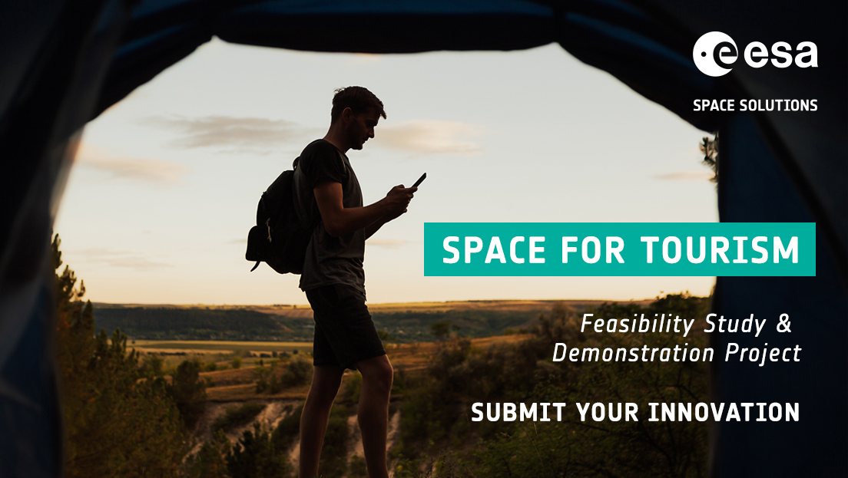
Opening Date 25 April 2022
Closing Date 31 December 2023
https://business.esa.int/funding/intended-tender/space-for-tourism

Slide 7
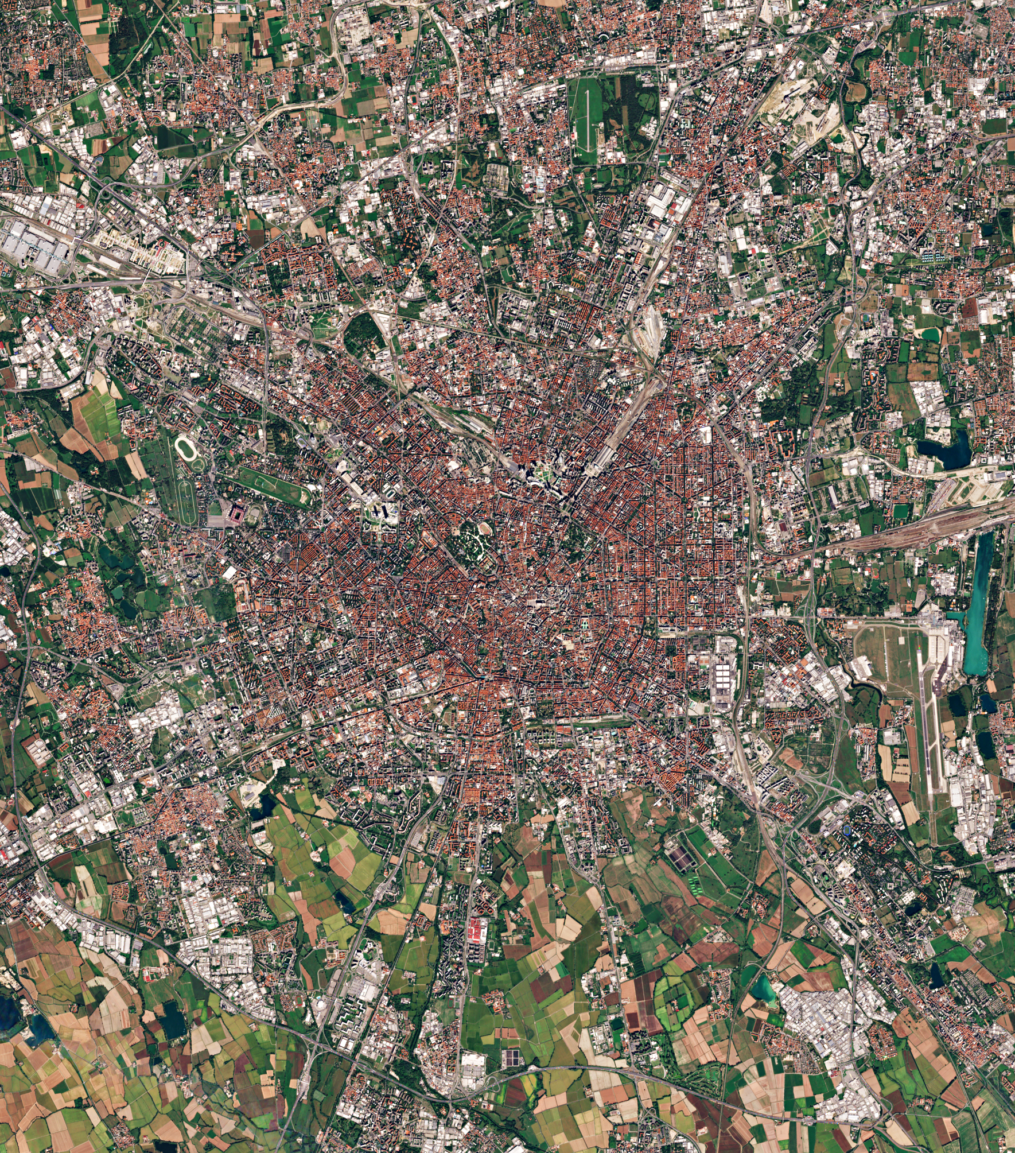
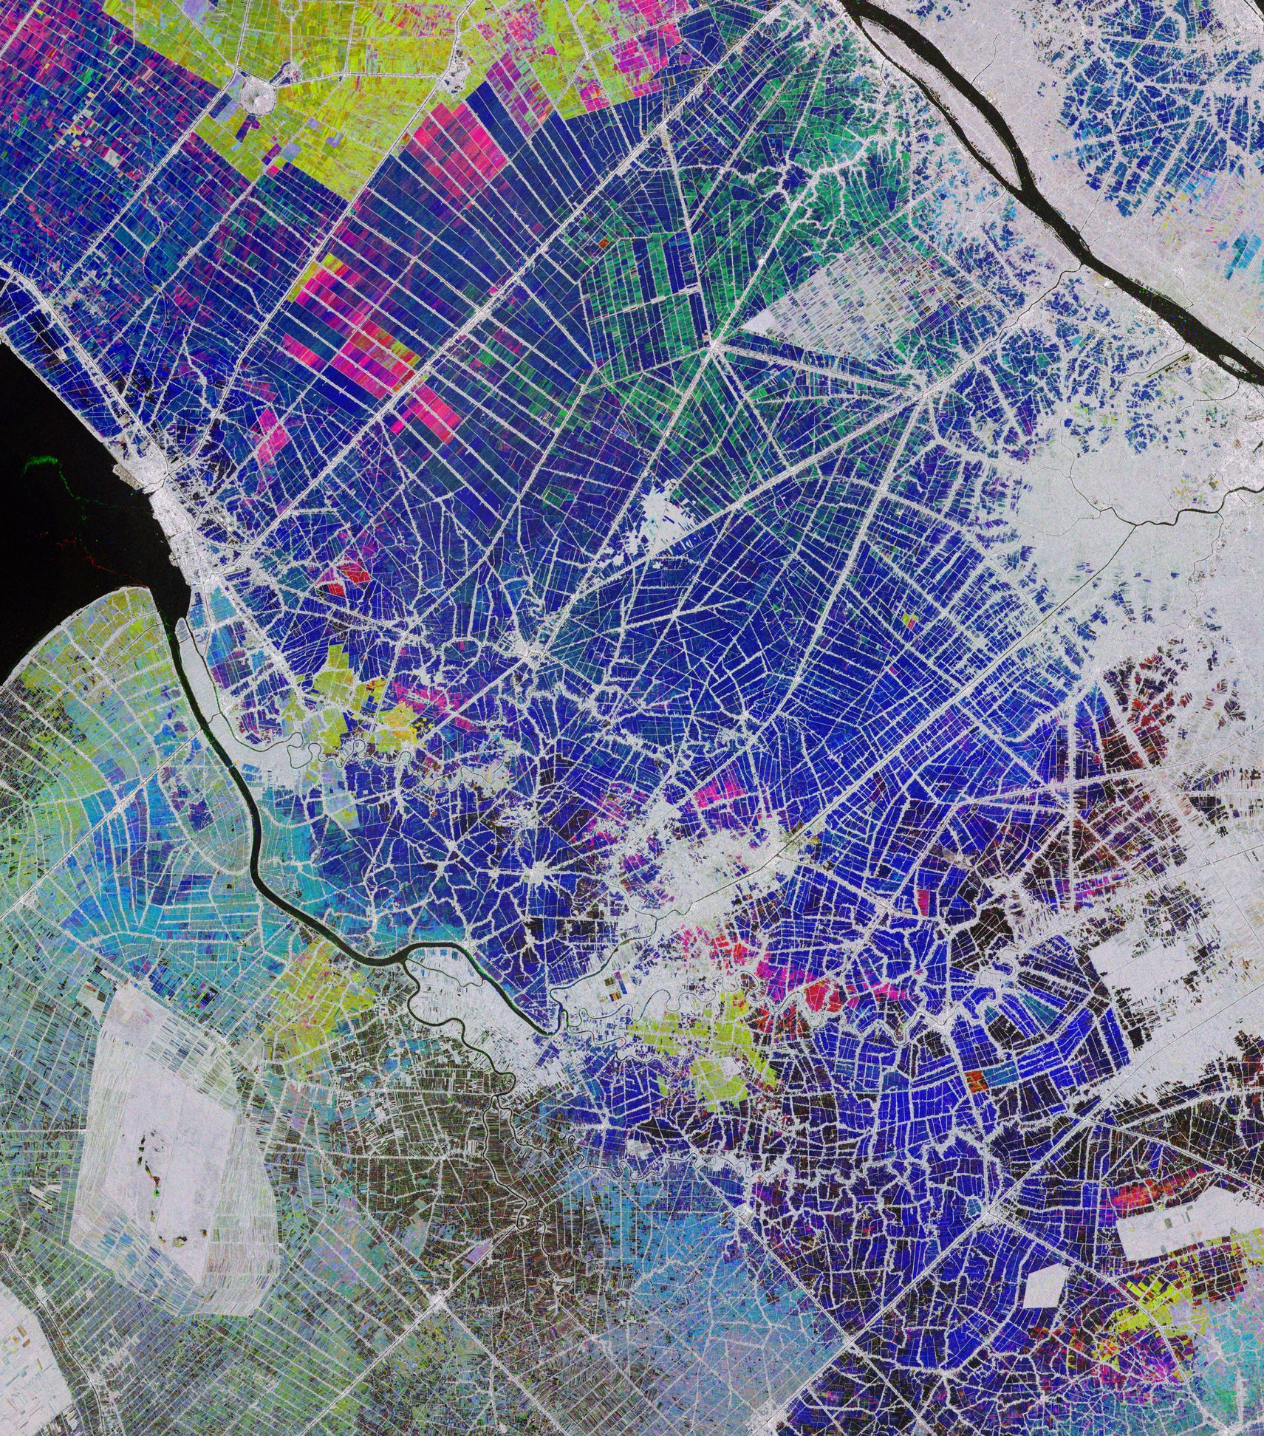
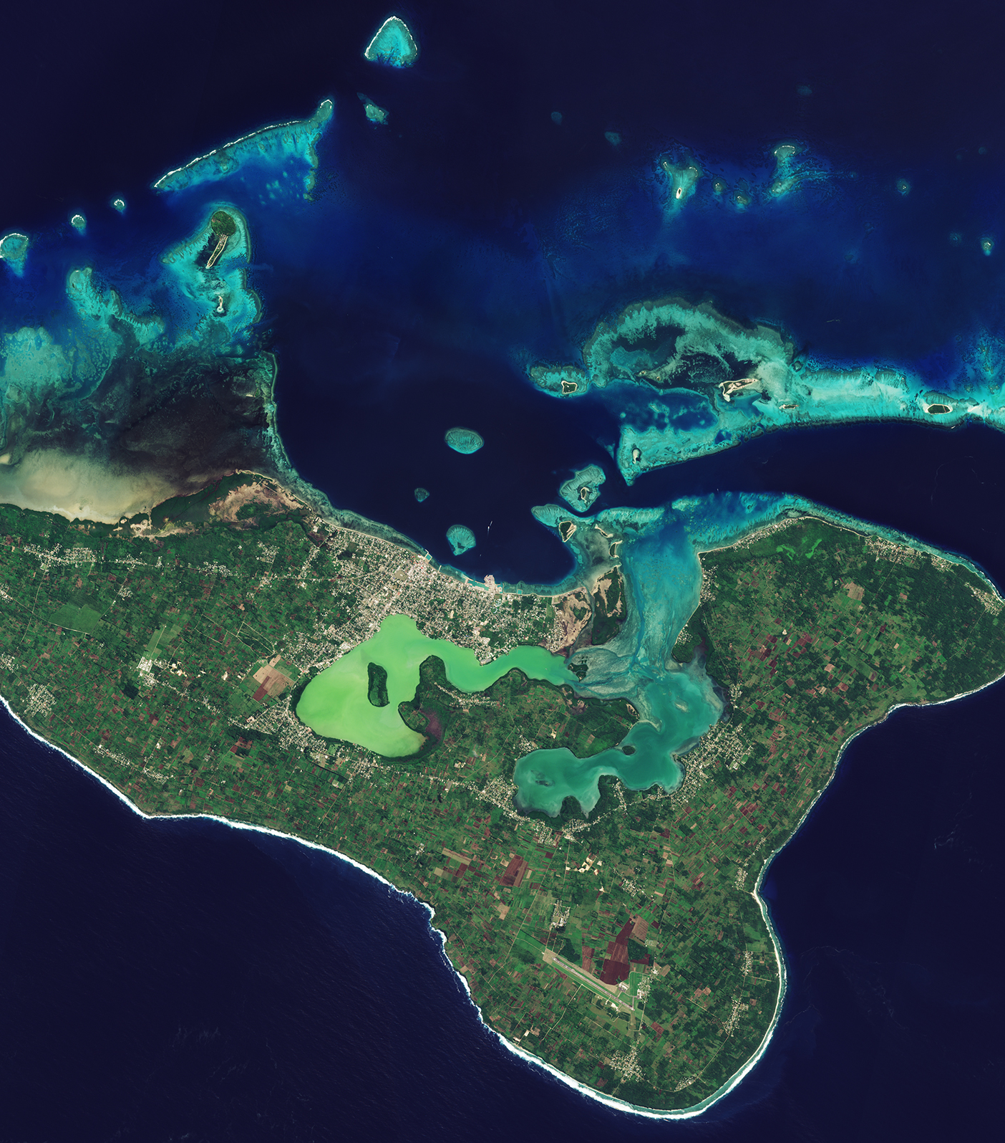
How Space can contributes to the tourism industry
Areas of relevance
Examples: value of space
SatCom is essential to ensure communications whenever the terrestrial communications are absent or not reliable and to support digital solutions
Use of digital and connectivity solutions to help the sector embrace new business models required in post-COVID 19
Unmanned transport (automation & robots)
Rural tourism
Everywhere connectivity to travellers
Active engagement with rural communities
Seamless travel
Safe travel
Guide investments and measuring impact
Drive sustainable tourism development
GNSS can be used track and trace tourists and provide information to search and rescue teams. Enable visitor flow-monitoring and location-based services to geo-localise points of interest in the tourist maps.
Urban & rural development/ real estate
Change detection/ land cover
SatEO for monitoring and planning of infrastructure (e.g. buildings, roads, parking lots, airports). Monitoring of big events for logistics planning and monitoring (e.g. sports, festivals, big trade fairs. Identification of open air “safe” and “unsafe” areas (e.g. parks, squares, big markets, touristic spaces with crowds).
Touristic Seasonality
Mobility & tourism capacity

Slide 8
Areas of relevance
Areas of relevance
Examples
Project name / Country
Space asset
Solution
New business models required in post-COVID 19
Unmanned transport (automation & robots)
Rural tourism
Everywhere connectivity to travellers
Active engagement with rural communities
Mobile based solution + AR for the 50Ha Grunwald battlefield site in Poland
Gsot - Poland
GNSS
Mobile based solution + AR/VR + 5G sat services for a fully immersive virtual visit of inaccessible sites
Quickbird2
Ikonos
Wolrdview
Vadus - Italy
Galileo
5G
Mobile based solution to allow users to find the quickest routes at both indoor and outdoor venues
GNSS
EO
Xploit - UK

Slide 9
Areas of relevance
Areas of relevance
Examples
Project name / Country
Space asset
Solution
2. Seamless travel
Technology and services to ensure transparency and traceability according to relevant protocols (including border controls) and enable efficient implementation of new regulations.
Through St’ART® web platform. The solution aims at improving the decision-making by moving from an emergency interventions approach into a predictive restauration and conservation model
GNSS
SAR-MS
5G
AMOR - Italy
Mobile solution where users experience an immersive soundscape of voice, music and sound effects triggered by GNSS derived locations as they move through the landscape
GeoA - UK
GNSS
AI based smartphone app platform to guide tourist providing multimedia content and orientation services in touristic venues like zoos
GNSS
Connie AI - Germany

Slide 10
Areas of relevance
Areas of relevance
Examples
Project name / Country
Space asset
Solution
3. Safe travel
Applications and services to help tourism sector become more resilient to natural/man-made disasters and health issues promoting the safety of the destination.
This is expected to be largely supported by seamless (always-on) connectivity and digitalisation. Always-on connectivity will re-ensure travellers of assistance for unforeseen circumstances.
Advanced Mountain Rescue Team Management (MRTM) to better coordinate teams during S&R missions through an Infotainment platform that provides 3D outdoor maps and mobile guidance for visitors + Drone technology.
GNSS
Weather
Forecast
WLAN
SIS-SREM - Czechia
Integration of high-resolution weather forecasts into outdoor routing and navigation solutions by combining maps, elevation profiles and route descriptions in dynamic spatio-temporal user interfaces.
MiLoW – RSS - Germany
NOAA, S2, MODIS
GNSS
Sentinel 1-2-3
Landsat 7-8
MODIS Agua and Terra
Terrain status information source for providers of Digital Outdoor Platforms as well as tourism offices managing a region focusing on outdoor activities like hiking, biking, skiing and other outdoor sports.
DeFROST - Switzerland

Slide 11
Areas of relevance
Areas of relevance
Examples
Project name / Country
Space asset
Solution
4. Guide investments and measuring impact
Measure the net impact of tourism activities - focusing on rural tourism as well as investments and planning, including tourism seasonality, trends monitoring, managing and mitigating risks.
Explore the feasibility of using satellite earth observation data, complemented with in-situ information, to assess the environmental impact of the tourism activity
Sustainable Tourism Indicators - France
Copernicus
A baseline map that provides information about the sustainable tourist destination assessed through sustainable indicators and the assessment, strategy planning, monitoring and protection recommendations of existing tourist destinations
Tourism Impact Monitoring Service - Netherlands
Advanced location based services that transform a park visit in a pleasure experience, boosting the local and often rural economy, and enabling at the same time the monitoring and control of vessels inside the Protected Area to the benefit of marine resources conservation.
Sympa - Belgium
AIS & GNSS
Copernicus

Slide 12
Areas of relevance
Areas of relevance
Examples
Project name / Country
Space asset
Solution
5. Drive sustainable tourism development.
Helping to protect natural environments
Reducing the tourism impact that affects Climate change
Promoting economic growth in local communities
Fostering cultural appreciation and preservation
The project aims at the creation of services for the safeguard, conservation, promotion and enjoyment of the cultural heritage by using Space assets, AR and 5G network. Starting in the City of L’Aquila
GNSS
InSAR
5G and MEC
Extension - Italy
is a demand-responsive transport solution to improve the viability of public transport in rural areas. It combines a new experience for discovering tourism destinations, with booking bus tickets in rural areas.
DARTT – Germany
LocalB encourages tourists to ‘be local’ by connecting them directly and dynamically with vendors where they are visiting. Through a common platform, vendors can dynamically advertise products and services directly to the tourist consumer, indicating location, distance, price and a number of other factors.
GNSS
LocalB - UK

Slide 13
How can I apply?

Slide 14
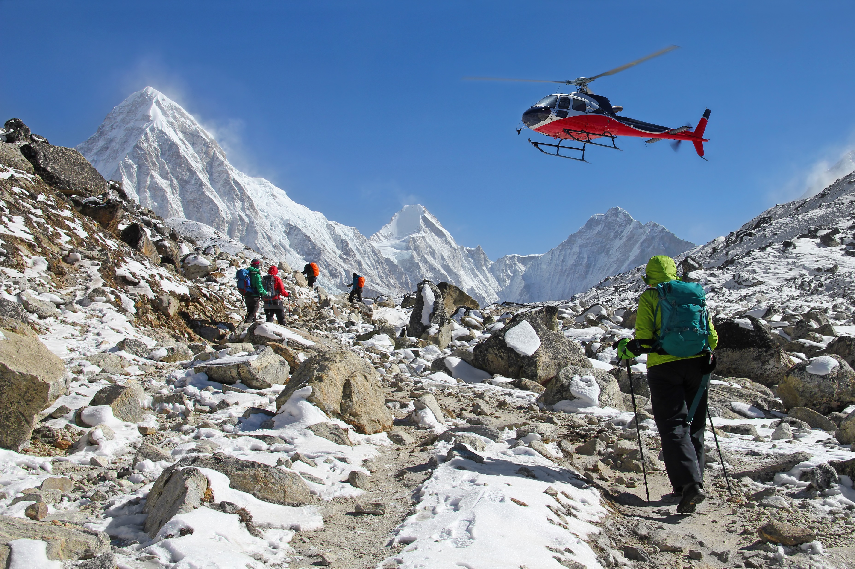
Who can apply?
ESA will support Feasibility Studies and Demonstration Projects. https://business.esa.int/funding/space-for-tourism
To be eligible for funding, your team must be based in one of the following countries: Austria, Belgium, Czech Republic, Denmark, Estonia, Finland, France, Germany, Hungary, Ireland, Italy, Luxembourg, the Netherlands, Norway, Poland, Portugal, Romania, Sweden and the United Kingdom.
If you are considering applying, you must inform your National Delegation to obtain a letter of authorisation allowing the funding of the proposed activity. Contact details of each National Delegate can be found here → https://business.esa.int/national-delegations
ESA will bear up to 50% of the eligible total project or study costs. Micro, small and medium-sized enterprises or research institutions can be funded up to 80% depending on the funding level authorised by the related National Delegation(s).

Slide 15
How can apply?
1. Register your team on ESA-STAR registration today! → Click here
2. Access https://business.esa.int/funding/space-for-tourism. Scroll down to the ‘Downloads’ section of this webpage to download all of the official documents.
3. Download the Activity Pitch Questionnaire template and Submit your pitch as instructed in the Activity Pitch Questionnaire guidelines, through the form online.​
4. ESA will evaluate your pitch. If the pitches are positively evaluated will be invited to prepare an Outline Proposal and then a Full Proposal. Teams must obtain a Letter of Authorisation from their respective National Delegation before submitting a Full Proposal. Contact details of each National Delegate can be found here → Click here

Slide 16
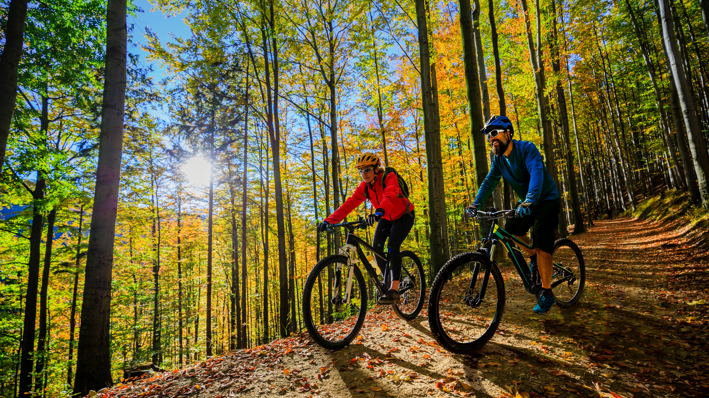
Before applying, check that
1. Your team is proposing a service that could become operational in
the near future (1-4 years).
2. Your idea tackles a challenge relating to the Tourism sector.
3. Your idea uses satellite data or space technology (e.g. satellite
communication, earth observation or navigation).
4. Your team is eligible for funding and has attained a letter of
authorisation from the National Delegate (if applicable).
5. There is a market for your service and potential users/customers
will be involved during the activity.

Slide 17
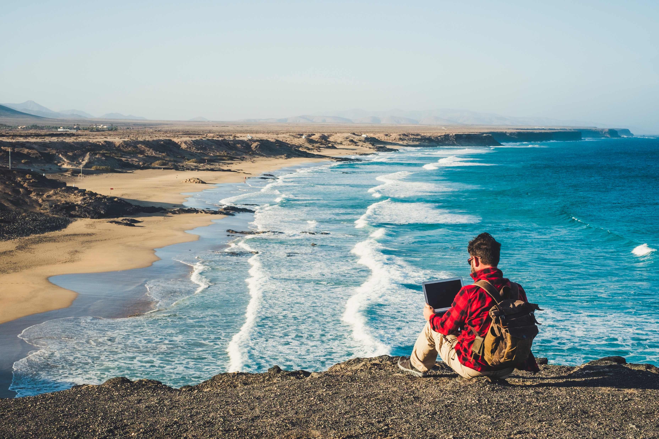
QA session
Closing Date
31 December 2023
Click here and visit Space for Tourism | ESA Business Applications

Slide 18
Thank you!
Borja Pickering
Business Applications
ESA BASS borja.pickering@esa.int

