Slide 1
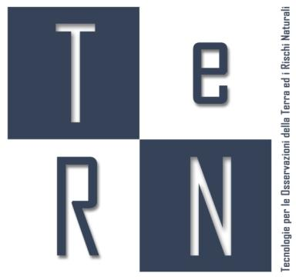


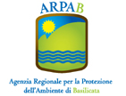
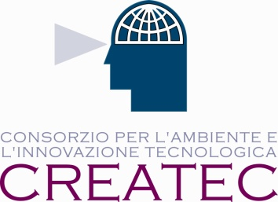
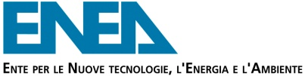
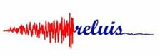
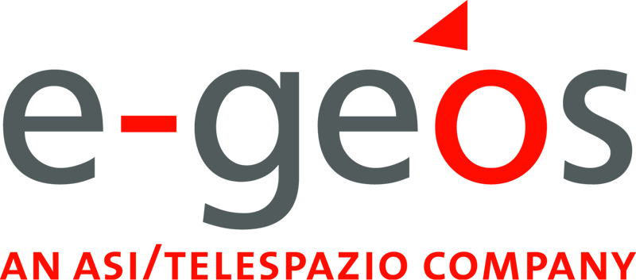
The Basilicata Earth Observation Cluster
2nd Edition European Symposium by Nereus regions Space Data for Tourism & Agriculture
Notes:
TeRN Consortium is the Basilicata Earth Observation Cluster. It brings toghether the University, research centres, big and small enterprises. All of them have gained experience in the earth observation field or in the ICT sector, both in research and business. Basilicata is a small region in the South of Italy.

Slide 2






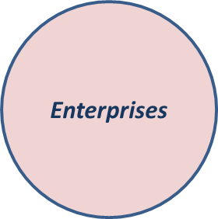
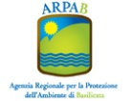

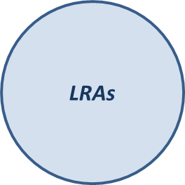


TeRN and evolution of Basilicata aerospace sector
PUBLIC – PRIVATE PARTNERSHIP AND TRIPLE-HELIX CLUSTER
CNR
ENEA
PRIVATE
E-GEOS
ARPAB
UNIVERSITY of
BASILICATA
RELUIS
CREATEC
(SMEs)
TELESPAZIO
ITALIAN SPACE ACENCY
PUBLIC
TERN
The Technological District | TeRN
and
Aerospace
Cluster | CLAS
of
Basilicata Region
The TRIPLE-HELIX ORGANIZATION
Research | Local Authorities | Enterprises
of the Consortium is in agreement
with the European policies which
concern technological Clusters
TeRN established in 2005 – Program Agreement: Italian Ministry of Education, University and Research, Italian Ministry of Economy and Finance and Basilicata Region | www.tern.it

Slide 3




TeRN and evolution of Basilicata Aerospace Sector
Basilicata Aerospace Sector in a nutshell
40
Enterprises
900
Employees
200 M€
Turnover
100 M€
Projects Amounts

Slide 4
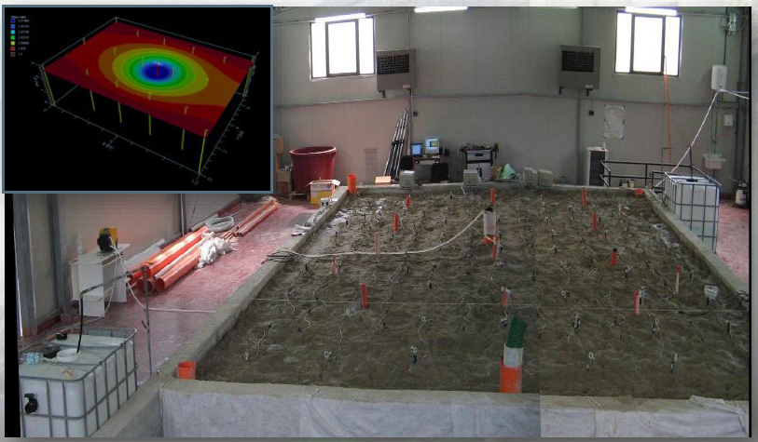
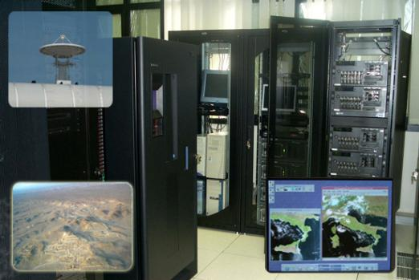
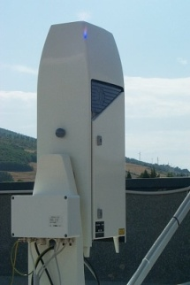
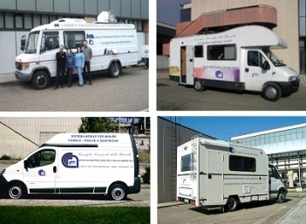
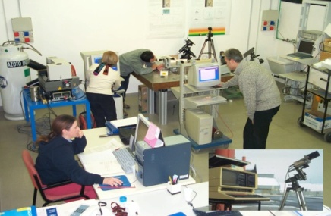
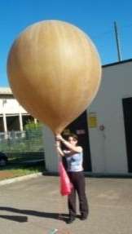
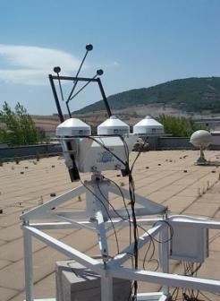
TeRN in a nutshell
HYDROGEOSITE
SATELLITE RECEIVING
AND PROCESSING FACILITIES
MOBILE LABS
ATMOSPHERIC OBSERVATORY

Slide 5
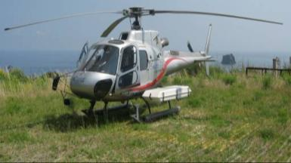
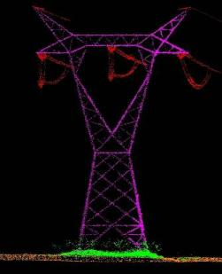
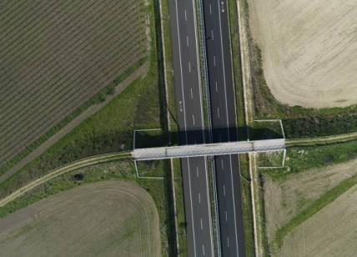
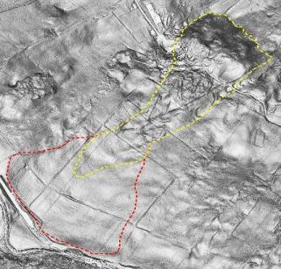
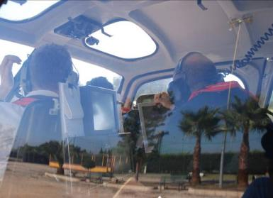
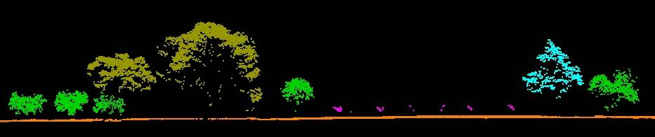

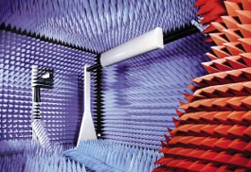

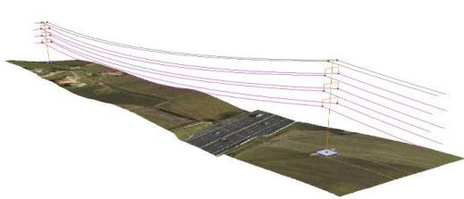
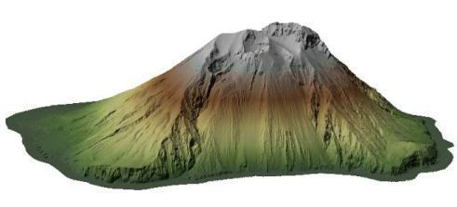
TeRN Capabilities
AERIAL SURVEYS application
Anechoic chamber
Airborne multi-sensors platform
5

Slide 6
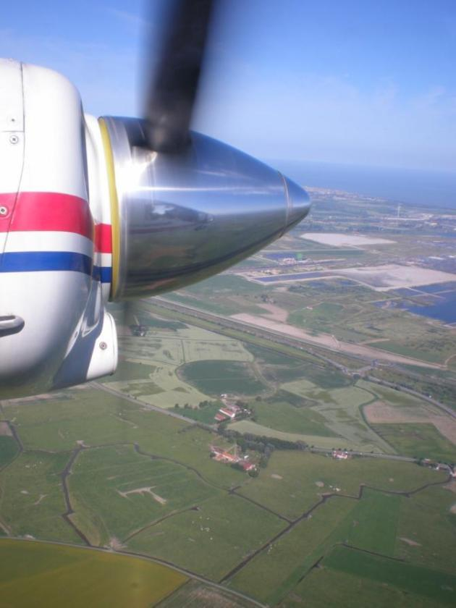
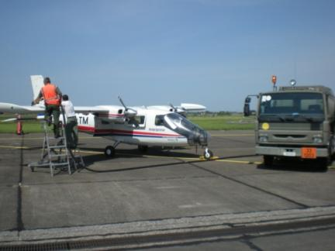
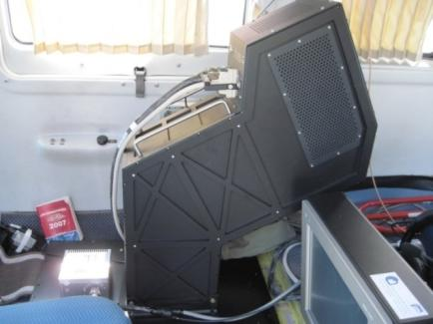
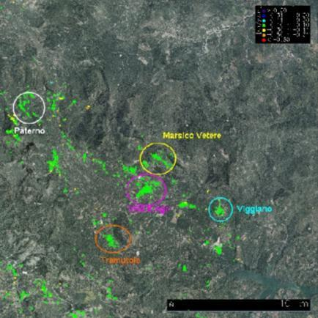
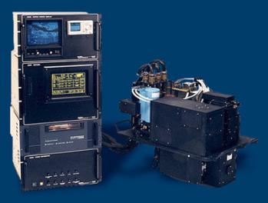
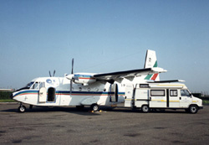
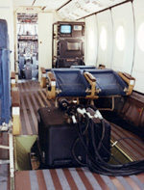
TeRN Capabilities
Aircraft Instruments
DINSAR
HYPERSPECTRAL
LASER SCANNERS

Slide 7
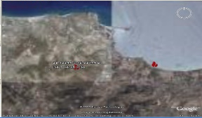
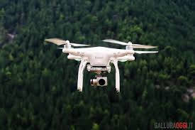
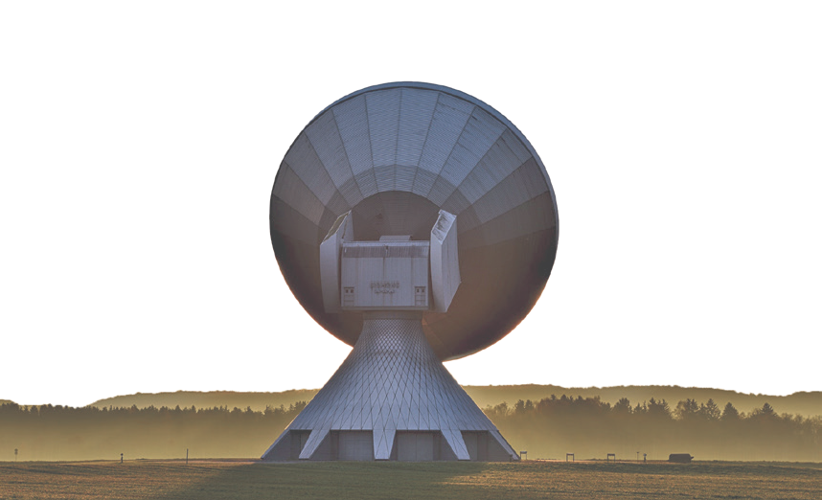

TeRN Capabilities
EARTH OBSERVATION (EO)
INTERNET OF THINGS (IOT)
ARTIFICIAL INTELLIGENCE (AI)
SAC (Satellite Application Centre)
development of Level-2/3 EO products/services for SMEs and LRAs
MONITORAGGIO E ANALISI
DEI DATI
DIGITAL TWIN (DT)
HIGH PERFORMANCE COMPUTING
(HPC)
ARA (Aerial Robotics Arena)
out-door and in-door arenas for development and test of robotized/active drones for application in civil protection, infrastructures monitoring, environmental studies.
AERONAUTICA
3C (Cloud Computing Centre)
development of applications fo AI and IoT to EO big data

Slide 8
TeRN main Projects

Slide 9
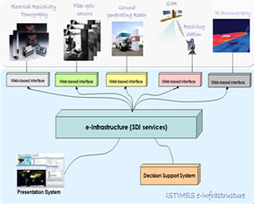
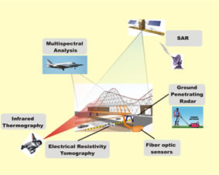
TeRN Main Projects
ISTIMES
“Integrated System for Transport Infrastructures surveillance and Monitoring by Electromagnetic Sensing”
The main purpose of the project is to design, assess and promote an ICT-based system, exploiting distributed and local sensors, for non-destructive electromagnetic monitoring in order to achieve the critical transport infrastructures more reliable and safe.
This has the overall aim to developing a high situation awareness by providing detailed information and images of the infrastructure status in a fast time and so to improve decision support for emergency and disasters stakeholders.
The integration of electromagnetic technologies with new ICT information and telecommunications systems enables remotely controlled monitoring and surveillance and real time data imaging of the critical transport infrastructures.

Slide 10
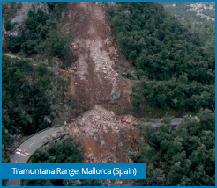
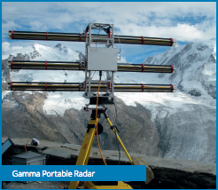
TeRN Main Projects
DORIS
“Ground Deformations Risk Scenarios: an Advanced Assessment Service”
Is an advanced downstream service for the detection, mapping, monitoring and forecasting of ground deformations, at different temporal and spatial scales and in various physiographic and climatic and environments.
Integrates traditional and innovative Earth Observation (EO) and ground based (non-EO) data
delivers innovative products at the regional and local levels, tailored on the needs of national and local Civil Protection authorities.
Exploits the unique ESA ERS-1/2 and ENVISAT C-band Synthetic Aperture Radar (SAR) archives to provide unprecedented, very long time-series of ground deformations. DORIS will evaluate new SAR sensors, or constellation of sensors, including ALOS, COSMO-SkyMed and TerraSAR-X.

Slide 11

TeRN main Projects
DORIS_NET
“Downstream Observatory organized by Regions active in Space network”
DORIS_Net has set up the European network of Copernicus-GMES Regional Contact Offices (RCOs) to raise awareness and strengthen regional involvement in Copernicus-GMES.
The Downstream Observatory facilitates links between both regional and European level GMES stakeholders;
The regional users and service providers are supported by dedicated interfaces as well as a network of Regional GMES Contact Offices (RCOs) which create the European GMES Downstream Service Platform
This Platform allows more effective coordination of individual activities both within and between the regions of Europe and European GMES governance which is vital for growth in the downstream service sector.

Slide 12

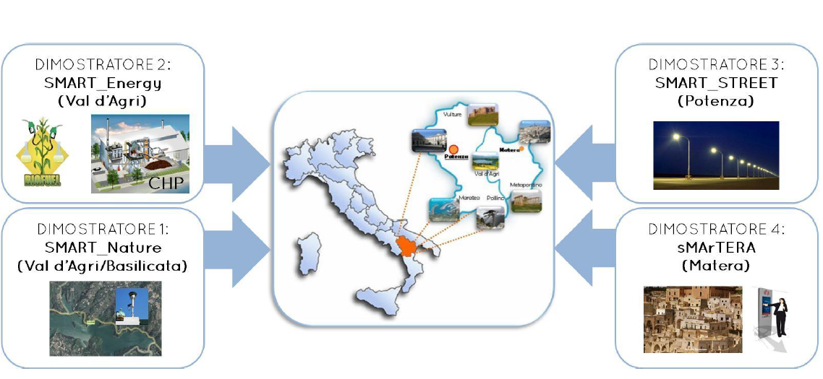
TeRN main Projects
SMART BASILICATA
“Smart Cities and Communities and Social Innovation”
Systemic approach to the region as the "city widespread“ in order to make it "intelligent community“ through the use of modern technologies for Earth Observation and ICT
The project aims at identifying and developing technological and innovative solutions in order to manage:
Efficiently environment;
Energy;
Mobility;
Culture and Tourism;
Social participation;

Slide 13
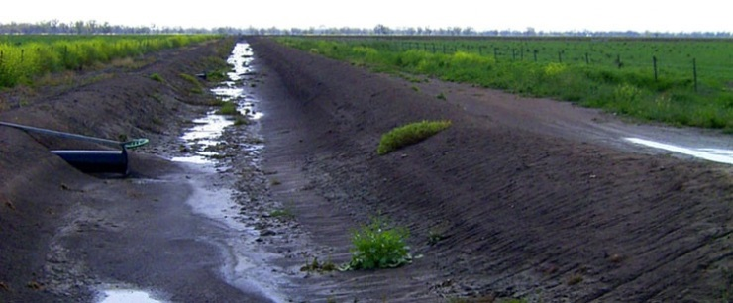
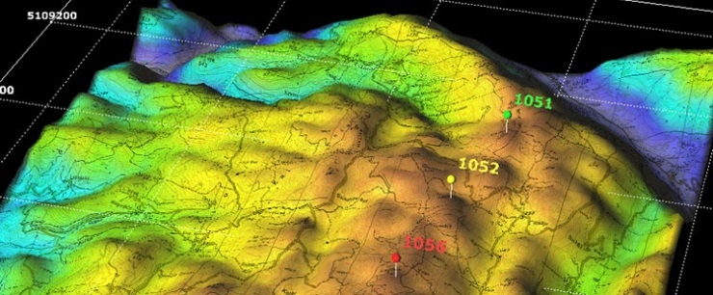
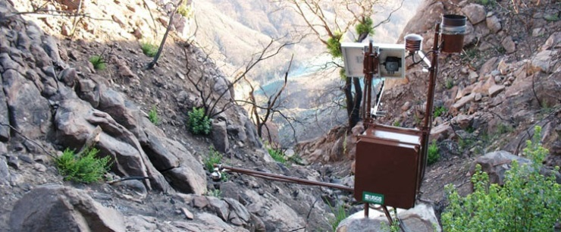
TeRN main Projects
SESAMO
“Integrated information system for the acquisition, management and sharing of environmental data for decision support”
The main objective of SESAMO project is the development of an ICT platform that can manage spatial information coming from heterogeneous sources in order to provide advanced monitoring services that can support decision.

Slide 14
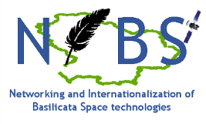
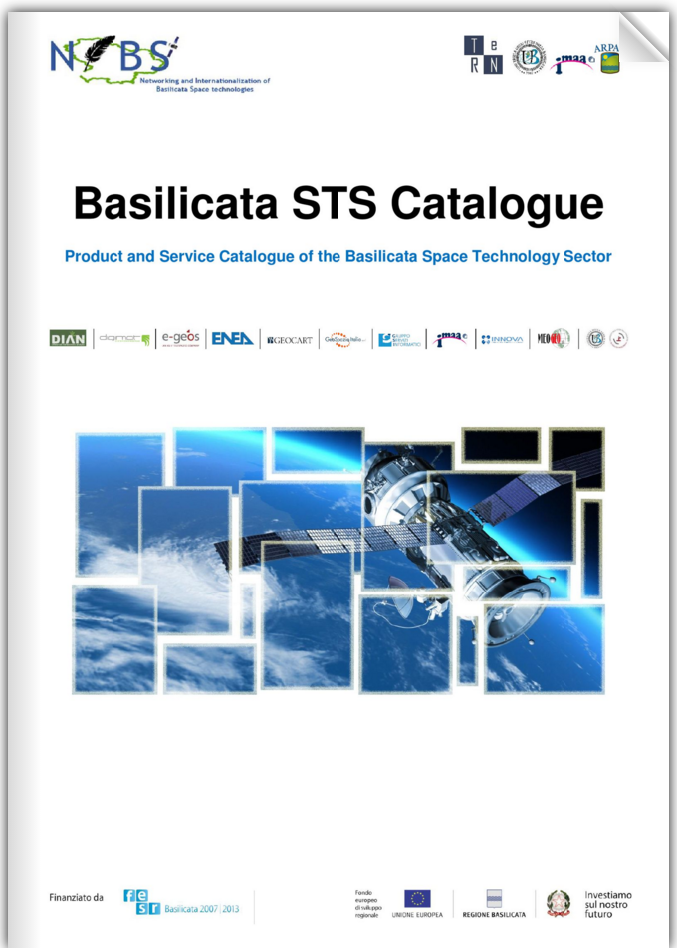
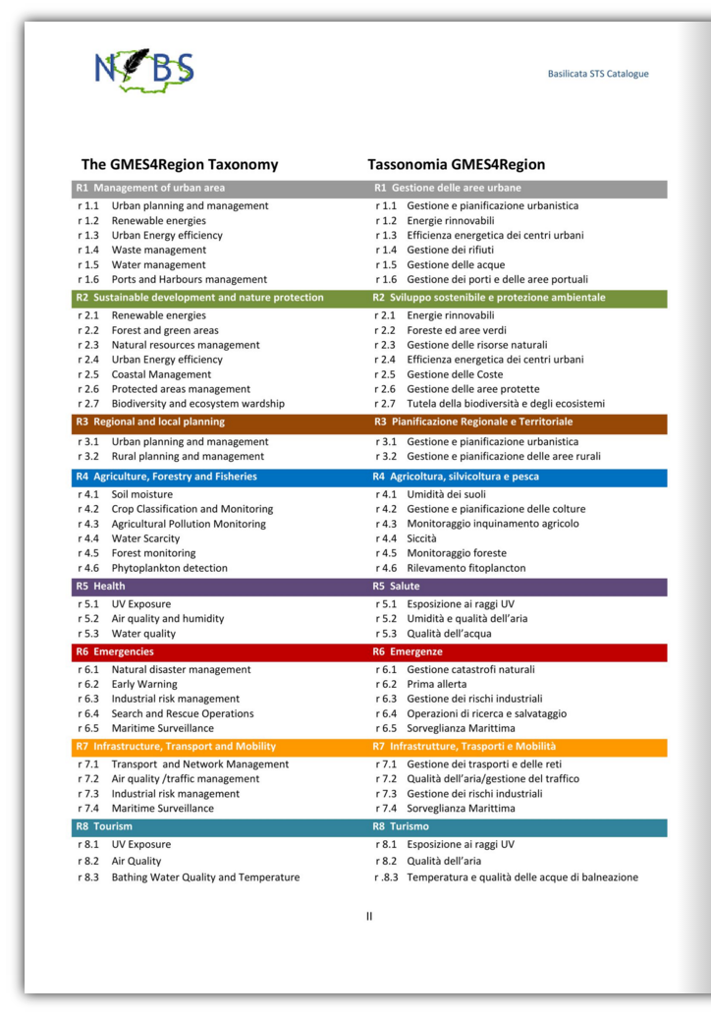
TeRN Main Projects
NIBS
“Networking and Internationalization of Basilicata Space Techologies”
To structure and consolidate the supply chain of Space Technology in Basilicata;
To promote technology transfer from the research system to the private sector;
To promote the internationalization of the SMEs and the research system;
To promote and support the demand for products and applications in the STS.

Slide 15
TeRN Services and Applications
Notes:
The following slides describe the services and the products which TeRN partners can offer.

Slide 16
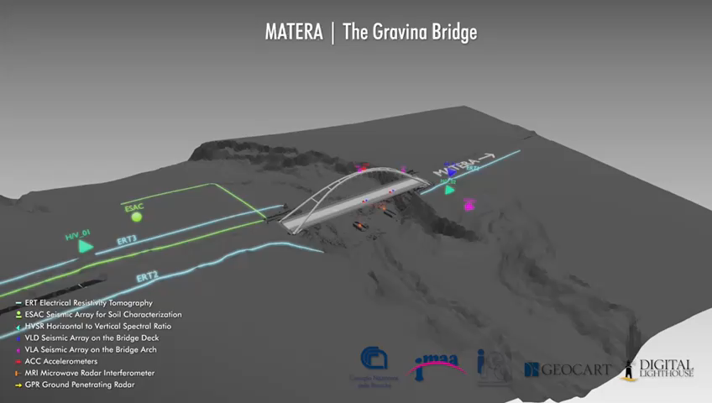
Infrastructures Monitoring

Slide 17
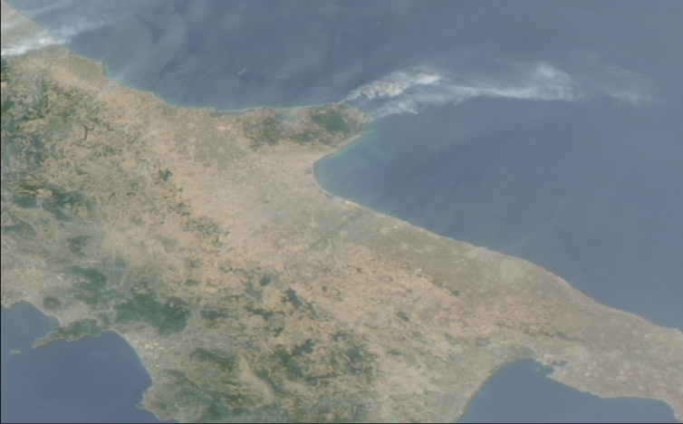
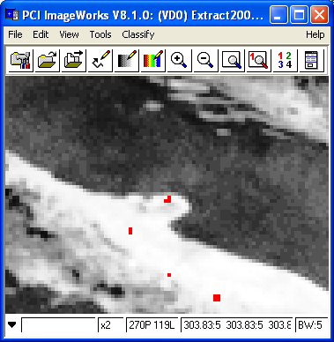
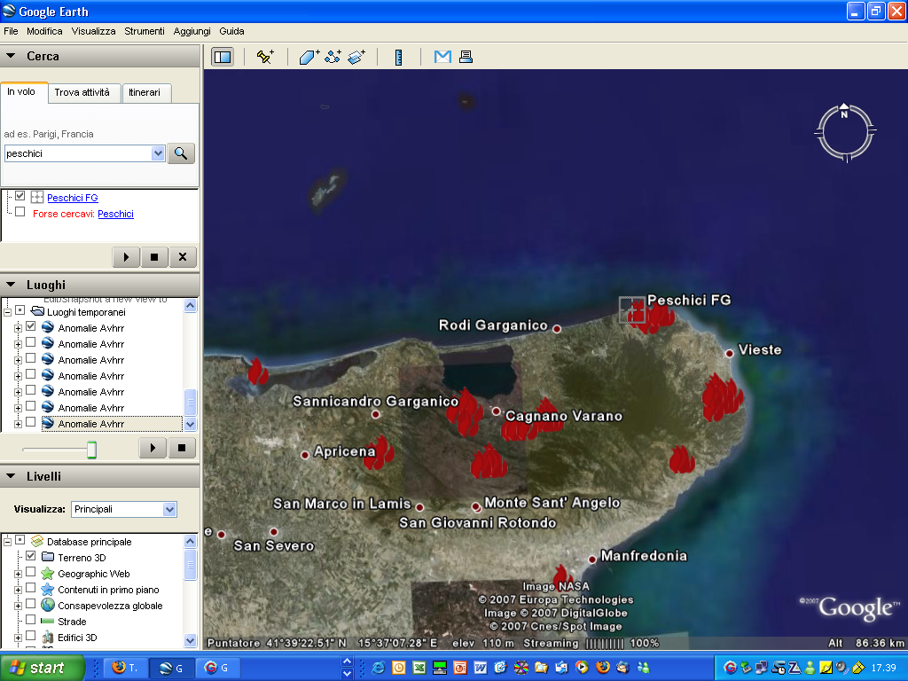
TeRN Services
Robust Satellite Techniques for early warning of forest fires
SEVIRI Thermal anomaly map
Peschici, 24 July 2007: 3 casualties
NOAA-AVHRR fire product on GoogleEarth
24 July 2007
MSG-SEVIRI daily curve of BT
Fire warning
First RST detection
Notes:
Using an innovative methodology (RST, tramutoli), it is possible to detect thermal anomalities related to fires, with particular attention on small events (beginning phase). With this technique it is possible to assure a quasi-continuous monitoring of big areas.

Slide 18

TeRN Services
Forest Risks Management
Environmental assessment, forest resources monitoring, forest types assessment, wildfires detection, land and natural resources studies, land cover and plant conditions analysis, through the use of a multi-sensor airborne platform (laser scanner, digital camera, two hyperspectral sensors operating VNIR and SWIR and a thermal camera)
Spectral signatures of different vegetation species

Slide 19

TeRN Services
Precision Mapping
Multi-sensor airborne platform (laser scanner, digital camera, two hyperspectral sensors operating VNIR and SWIR respectively and a thermal camera) data acquisition for fast generation of three dimensional models, for vegetation and land conditions detecting and for intensive farming and forests monitoring.
Sheet of NDVI Index

Slide 20

TeRN Services
Agri-Environment Monitoring
Crop disease and stress monitoring, illegal or undesired crops detection, land use measurement, environmental assessment, vegetation monitoring, land and natural resources studies through the use of a multi-sensor airborne platform (laser scanner, digital camera, two hyperspectral sensors operating VNIR and SWIR and a thermal camera).
DSM derived by laser cloud points for trees classification

Slide 21

TeRN Services
Early stress detection in agricultural and natural ecosystems
Multispectral and hyperspectral remote sensing techniques allow the early detection of vegetation stress , before the appearance of visible symptoms. Among different monitoring methods we use: direct monitoring methods with remote sensing indices, image classification methods, same-period comparing methods.
Accumulated Relative NDVI Decrement (ARND_index) obtained by MODIS images on a Southern Italy area to detect vegetation stress

Slide 22

TeRN Services
FIRE-SAT
Management of satellite data for surface parameters monitoring with particular attention to fire risk assessment, spectral analysis and burned areas detection by using remote sensing data.
Fire Danger Map of Basilicata region for August 2011, generated by integrating MODIS and LANDSAT satellite data.

Slide 23










TeRN Services
Volcanic Hotspot detection
Ash cloud detection and tracking
t
NRT Products generation
Notes:
We detect volcanic hotspots near real time, to mitigate risks associated with volcanic phenomena, such as lava flows, hot gas emission, tracking volcanic ash clouds.

Slide 24








TeRN Services
Satellite and Lidar observations for ash cloud monitoring (FP7-ACTRIS Project)
Notes:
CNR IMAA also participated in ACTRIS project.
ACTRIS (Aerosols, Clouds, and Trace gases Research InfraStructure Network) is a European Project aiming at integrating European ground-based stations equipped with advanced atmospheric probing instrumentation for aerosols, clouds, and short-lived gas-phase species. ACTRIS will have the essential role to support building of new knowledge as well as policy issues on climate change, air quality, and long-range transport of pollutants.

Slide 25



OUR PROPOSALS
«There is not Space economy without Digital Economy»
Human capital investment
Centralization and homogenization of geographic data for the provision of spatial information

Slide 26


14 August 2018
Collapse of the Morandi Bridge in Genoa
43 dead and 600 displaced.
The Enterprises Network
«MILLE INFRASTRUTTURE»
Static and dynamic monitoring of infrastructures

Slide 27







Enterprises Network | MILLE INFRASTRUTTURE
Promoters !!!
4 Regional Technological Districts
15 Large Enterprises
TeRN | BASILICATA Region
SSIIT | LIGURIA Region
TORINO WIRELESS | PIEMONTE Region
DAC | CAMPANIA Region
LEONARDO, TELESPAZIO, TAS-I, VITROCISET, e-GEOS, ENGINEERING, SANTER REPLY, TESMEC, SCAI group, ETT, MARINI IMPIANTI, etc...
56 SME Enterprises/Start-up
7 Research/Competence Centers
MILLE
INFRASTRUTTURE
Enterprises Network
GEOCART, CREATEC, TECNOIN, PAGANO, PUBLISYS,TECNO PIEMONTE, FOS, GENEGIS-GI, HARPACEAS, TECNOSISTEM, AITEK, INNOVA, DIGIMAT, FAMAS SYSTEM, STRESS VALUE, etc...
IIT Istituto Italiano di Tecnologia
SSSA Scuola Superiore Sant’Anna
CNR National Research Council
ENEA
Fondazione Links
Artes 4.0
CGIAM
3 Strucutral Engineering
Consortia
46 Universities
FABRE
EUCENTRE
STRESS

Slide 28

THANK YOU FOR YOUR ATTENTION

