Slide 1



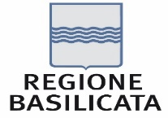

European Regional Symposium
September 28th – 29th | 2023 Matera, Basilicata Region | Italy
Second Edition of the European Regional Symposium, on space data for tourism & agriculture, by NEREUS Regions
Remote sensing in coastal erosion monitoring for a sustainable development of the tourism sector
Salvina Sist – Head of Directorate for Spatial Planning/Veneto Region
Carlo Masetto – GIS Specialist at Directorate for Spatial Planning/Veneto Region

Slide 2


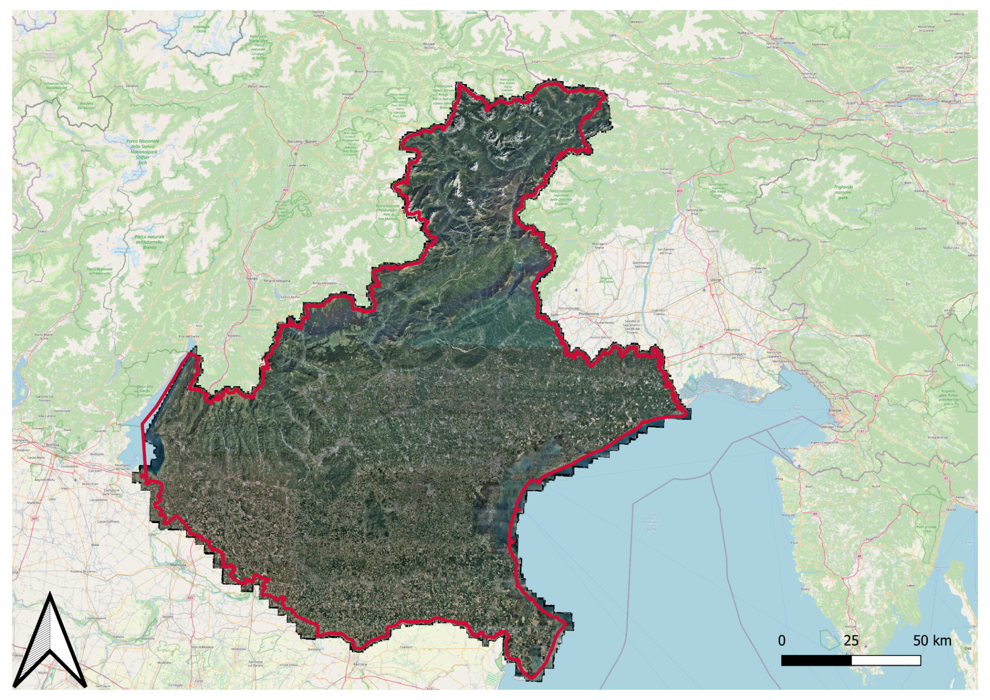
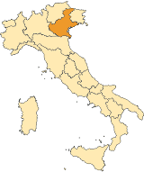
Veneto Region - profile
Population: about 5 million, (4th in Italy);
Region capital: Venice;
Total area of 18,398.9 km²;
Location: North-eastern of Italy bordered to the east by Friuli-Venezia Giulia, to the south by Emilia-Romagna, to the west by Lombardy and to the north by Trentino-Alto Adige/Südtirol. In its northernmost corner it also borders Austria;
7 metropolitan cities/provinces;
GDP (nominal) €164 billion (2022);
GDP per capita €33,834 (2021)

Slide 3
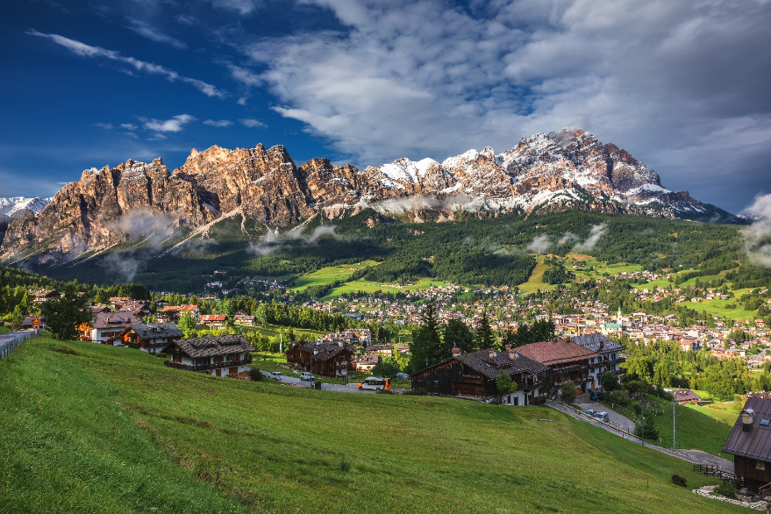

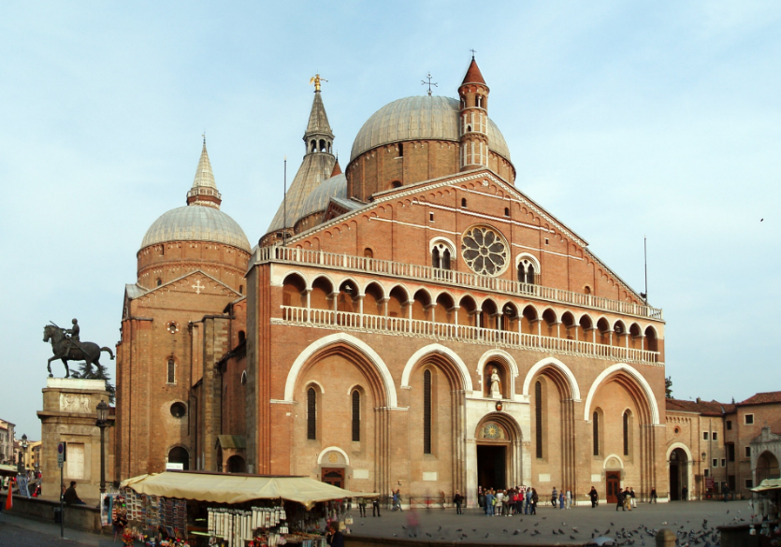
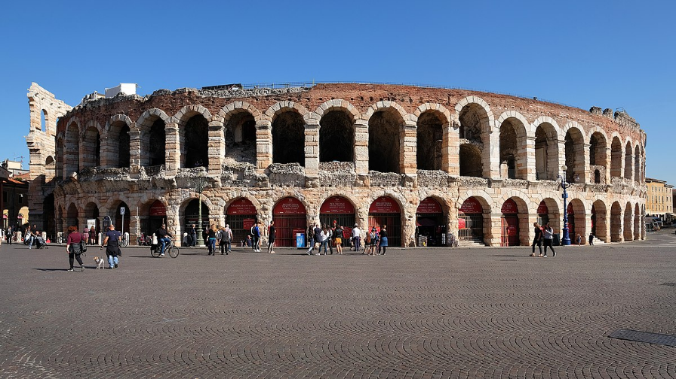
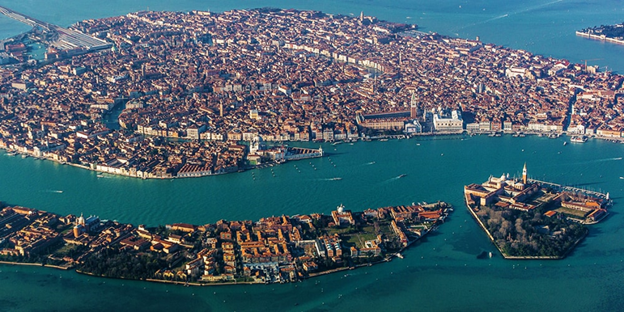
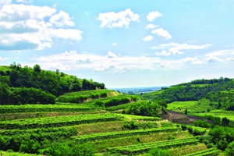
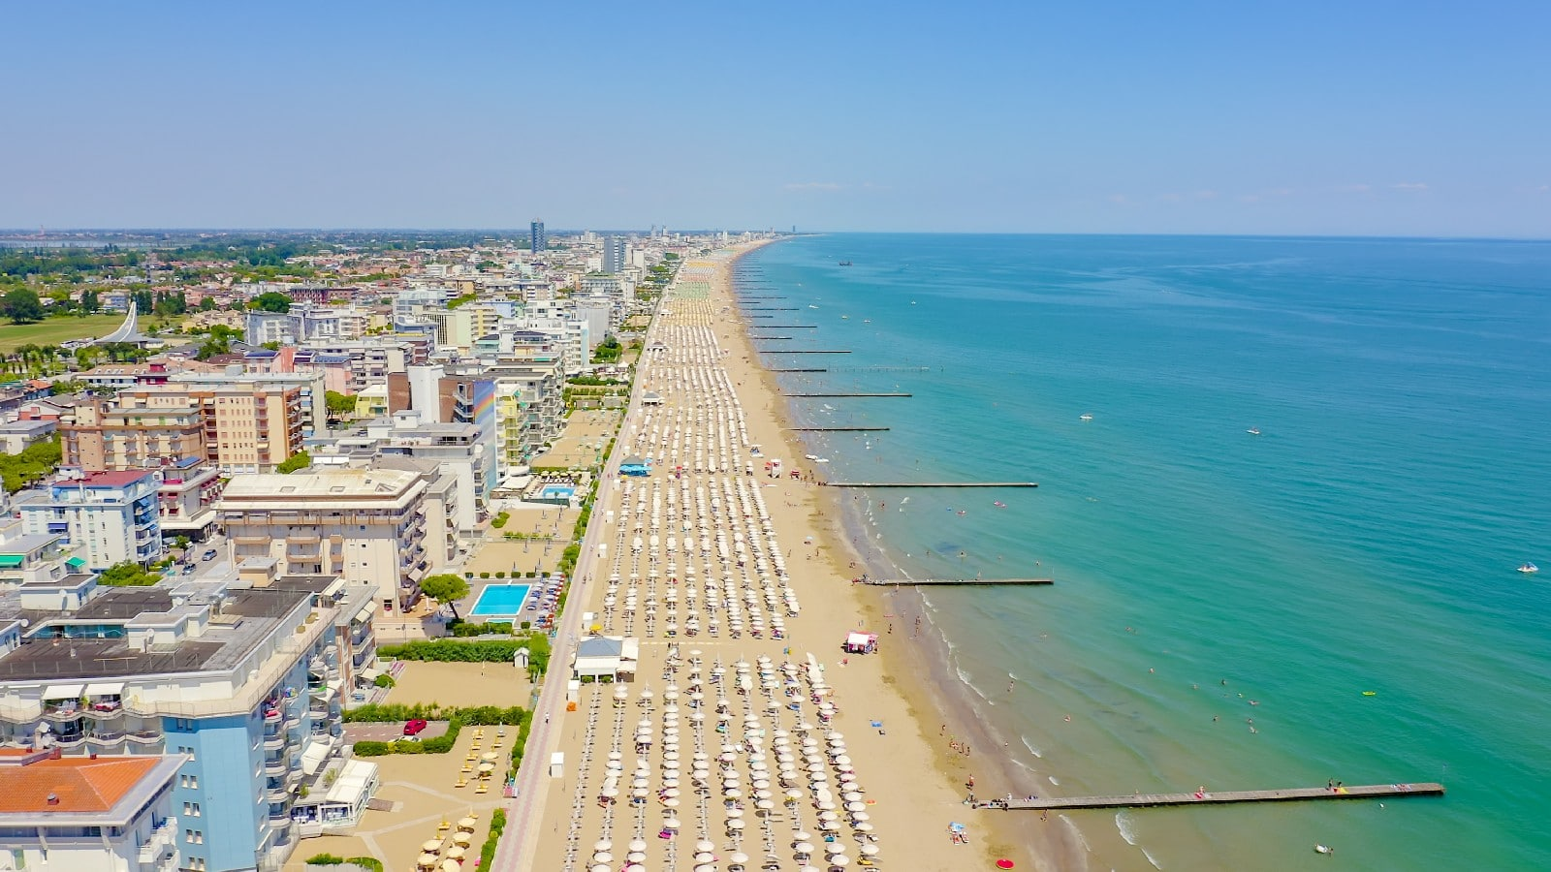


The tourism sector in Veneto
Art tourism (cultural and artistic heritage)
Seaside resorts
Natural and artificial landscapes, countryside
Lake environments
Mountain
Thermal resorts
Notes:
Veneto is one of the best known and most sought-after tourist destinations in Italy. Thanks to its cultural heritage, its landscape and the variety of environments and ecosystems, it is able to satisfy a wide range of needs and present visitors with numerous offers: from art tourism to seaside tourism, from spa to sports, from mountain to the countryside.

Slide 4
The strategic vision of tourism sector in Veneto
TOURISM VISION
TERRITORY, COMMUNITY, PEOPLE
ENTERPRISES, PRODUCTS, R&D
TOOLS
MARKETING
Pillars:
VENETO TOURISM STRATEGIC PLAN 2022-2024
VENETO REGION TOURISTIC PLAN (annual)
PNRR (national recovery and resilience plan)
Notes:
The Regional Tourism Program 2022-2024 has been approved at the conclusion of a participatory process which involved over 200 people
stakeholders of the regional tourism system in 4 thematic tables (product innovation; digital innovation and Big Data; hospitality and knowleggde/skills of people who are working in touristic sector; promotion e communication) as well as a transversal axis connecting with national and regional programs.

Slide 5
The evolution of tourism sector
A fast world evolution introduced different factors that are having impact on tourism in Veneto Region:
Really fast economy evolution changes
Recovery after Covid restrictions
Changes in citizen habits (rise in e-commerce)
New tendencies in terms of tourism needs: slow tourism (bike and walking), sustainability, higher attention to health & fitness
VENETO TOURISM STRATEGIC PLAN 2022-2024 → A new «olisitc» approach for tourism sector

Slide 6
Land management & tourism sector: the challenge of sustainability
LAND
MANAGEMENT
TOURISM
SECTOR
SUSTAINABILITY
SPACE DATA
Benefits for host communities and travellers, environment, local governments
Notes:
Land management and tourism development represent two crucial elements for the sustainable progress of local communities. Finding a meeting point between these two aspects is essential to guarantee the preservation of the environment, the protection of cultural heritage and the promotion of economic opportunities. This synergy allows us to create unique tourist destinations that attract visitors, but at the same time, protect delicate natural ecosystems and respect local culture and traditions. In this balance lies the key to responsible and sustainable tourism that benefits both host communities and travellers, promoting the long-term prosperity and well-being of all actors involved.
Space data can help land management and tourism sectors by providing valuable information on land use, environmental changes, and natural attractions, enabling better planning, conservation, and promotion of tourist destinations.

Slide 7
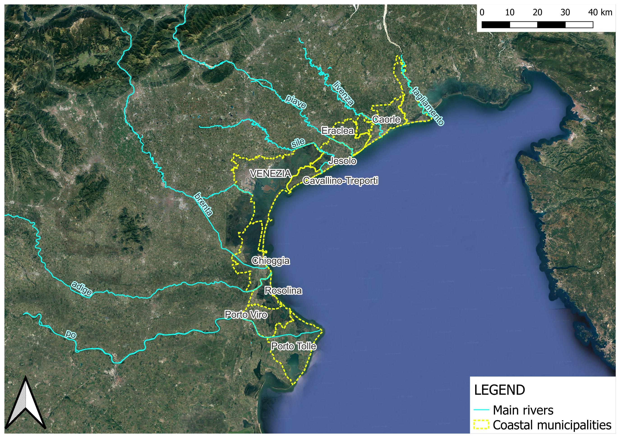
Veneto region coastal area

Slide 8
Tourist numbers for Veneto region
Source: annual statistics report – Veneto Region, 2022)
Notes:
Seaside tourism represents the most important sector in terms of number of annual presences, therefore representing a crucial asset from an economic point of view

Slide 9
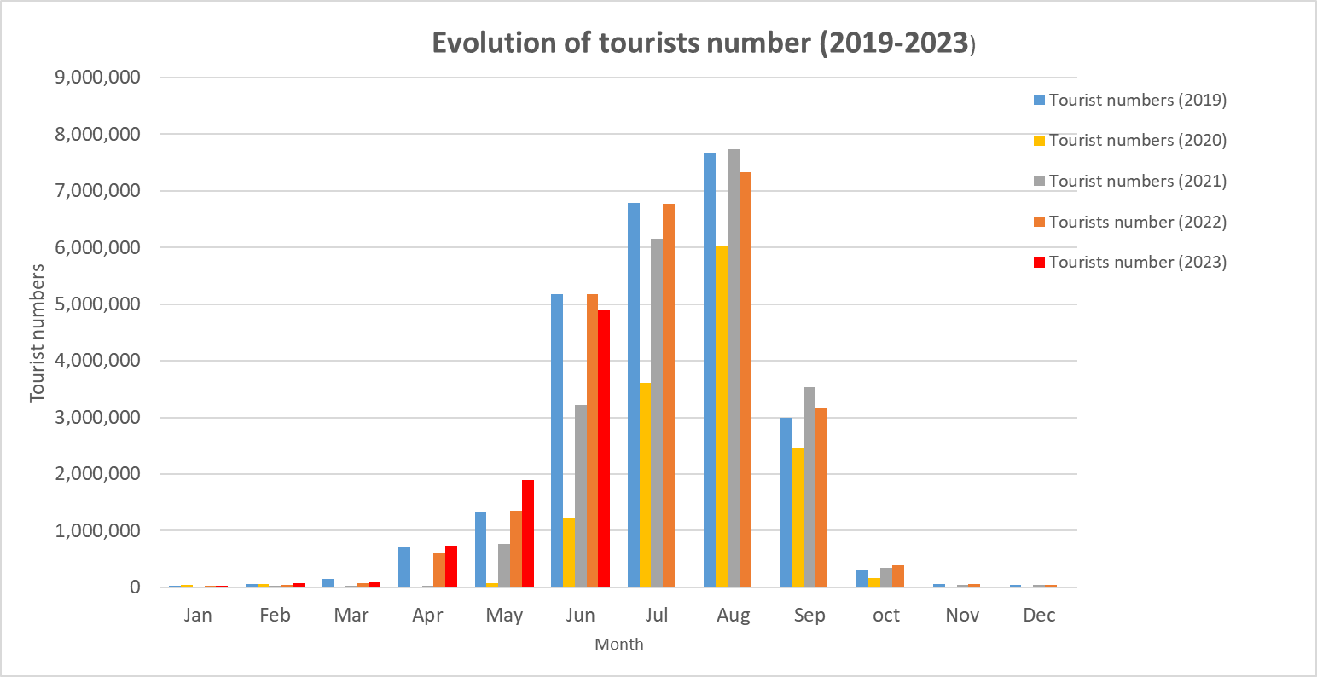
Tourist numbers (seaside resorts)
Source: annual statistics report – Veneto Region, 2019-2023)
Notes:
After a sharp slowdown in the tourism industry, due to Covid restrictions, a constant recovery in attendance was observed, until pre-Covid levels were reached.

Slide 10
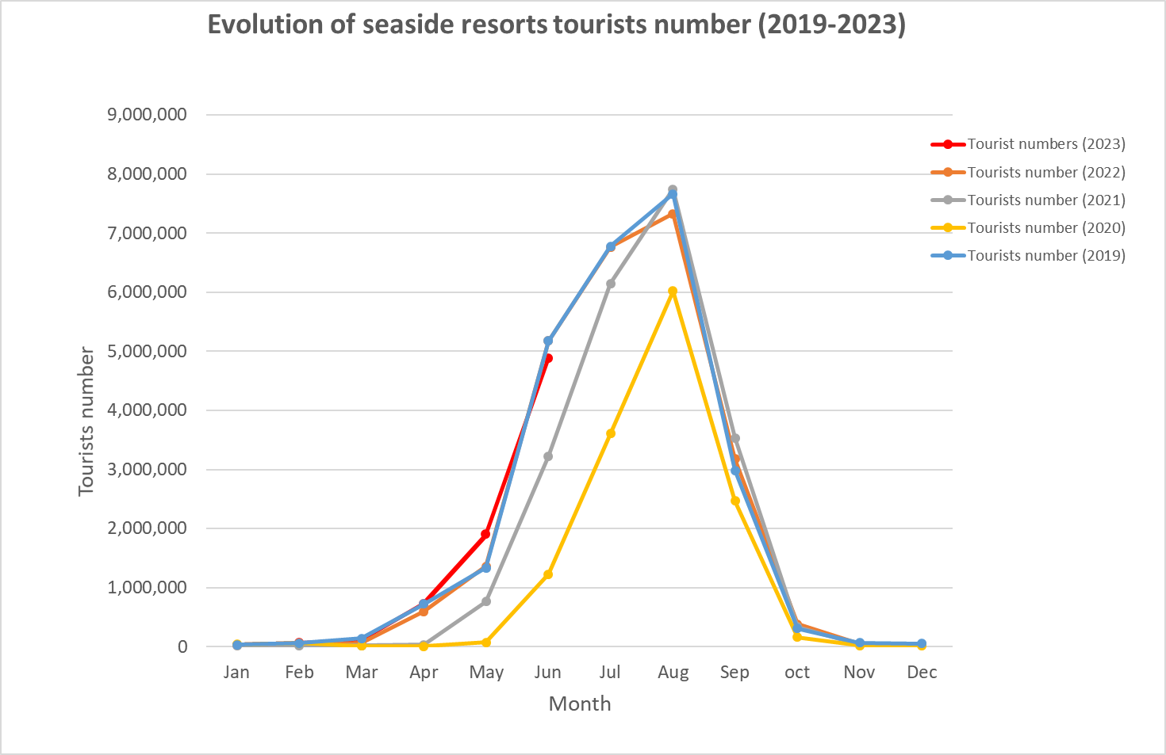
Tourist numbers (seaside resorts)
Source: annual statistics report – Veneto Region, 2019-2023)

Slide 11
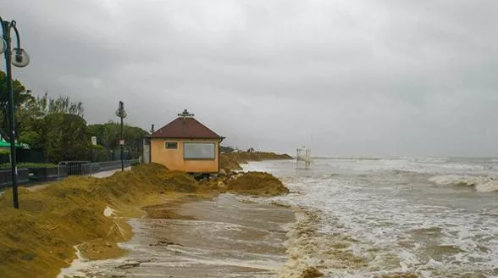
Driving environmental factors
There are various environmental factors that affect the Venetian coast, that can have direct or indirect effects on its usability for tourism purposes:
Coastal erosion and solid transport balance
Subsidence (Venetian coast and Po river delta)
Natura 2000 sites (SIC/ZPS)
Mean sea level rise forecasts
Marine inlet and salt wedge
Interactions with other activities/needs (water reservoir)
Coastal erosion and subsidence has a direct and measurable effects. Remote sensing and space data can help in monitoring.
Notes:
During recent years, coastal erosion has become a phenomenon of growing importance, which has been more severe by the increase (in the frequency and intensity) of extreme events as a result of climate change.
Coastal erosion and subsidence has a direct and measurable effects. Even if on a different scale, remote sensing and space data can help to monitor the shoreline.
In the future, another driving factor could be the rise in average sea level (different scenarios).
The Venetian coastal area is affected by subsidence due to the phenomenon of subsidence. Such phenomenon originates from both natural and anthropic causes. The phenomenon of subsidence which occurred in the period 1940-60, due to the extraction of methane and water from the subsoil, has determined along the coast and in particular in the Po Delta area new problems and imposed the all-round design and implementation of a series of works defense and management of the territory, from river to marine ones, from reclamation to irrigation to the road network. In the Po Delta, anthropogenic subsidence occurred at a rate of lowering of the order of 20-30 cm per year in very large areas.

Slide 12
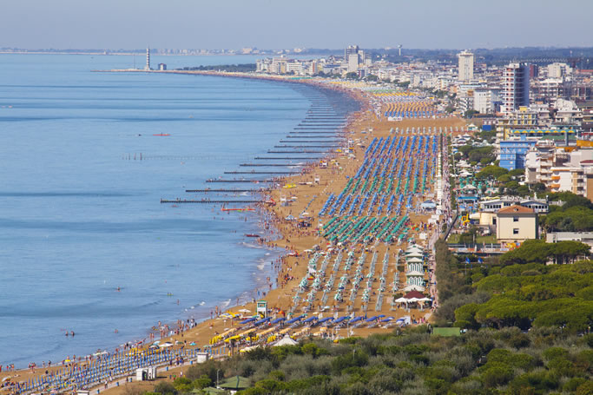
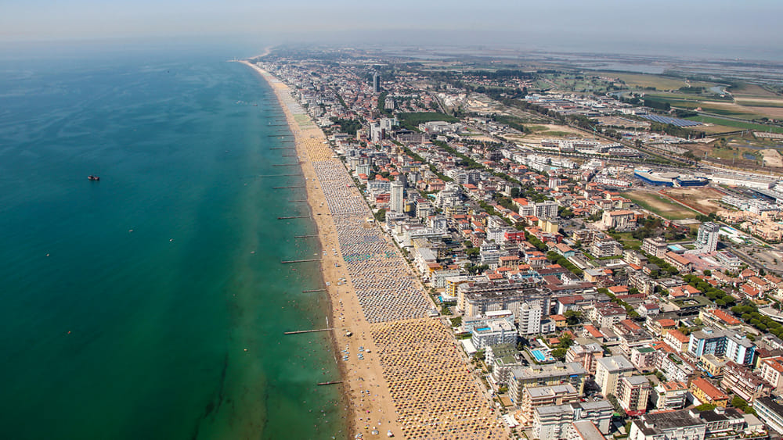
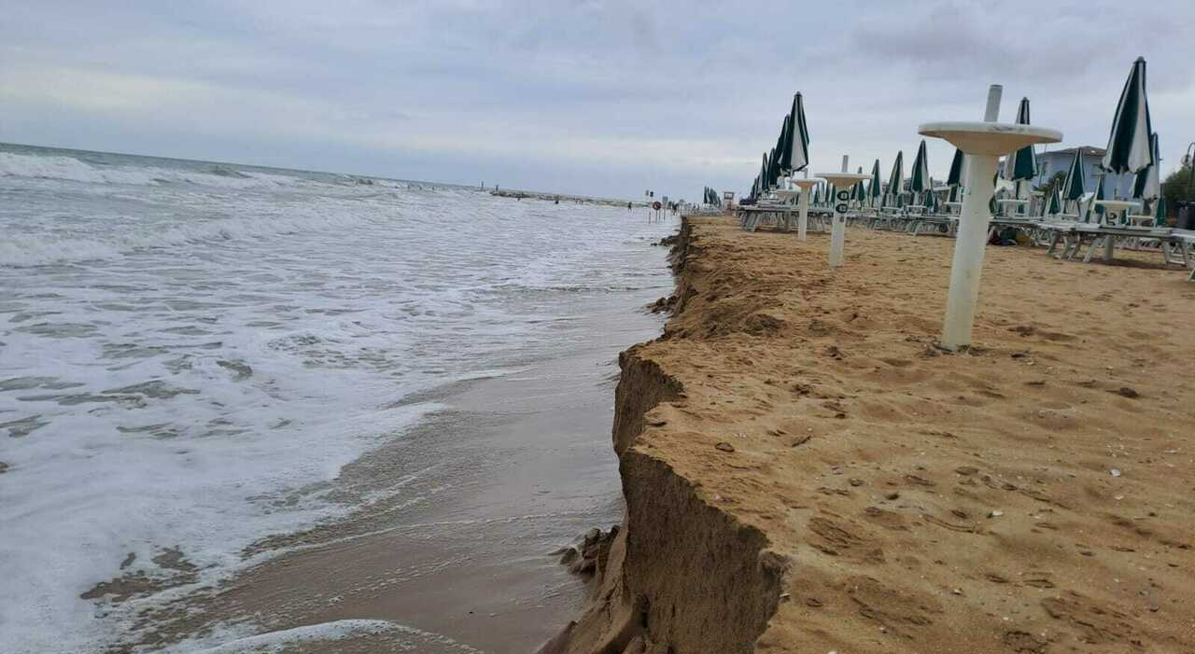
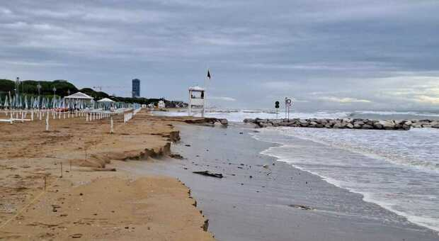
Environmental challenges – focus on coastal erosion
The effects of erosion phenomena are also visible on the Veneto coast, mainly made up of sandy granulometry and low-sloping shore. These effects therefore have a direct impact on the tourism sector: touristic coastal areas that usually find themselves facing the retreat of the coastline.

Slide 13
Interventions for coastal protection
The management of the coastline and therefore the coastal interventions on the Veneto are managed and scheduled by Civil engineering department of Venice and Rovigo territory.
Types of interventions carried out in 2017-2022 period:
dredging and nourishment operations;
groynes (longitudinal and trasversal brushes);
artificial cliffs;
other ordinary and extraordinary maintenance of coastal works
Nourishment interventions in Jesolo (VE)

Slide 14
Nourishment interventions (2017-2022) and assigned priority of intervention
Zone and priority | Volume [m³] | Place | Zone and priority | Volume [m³] | Place
VE1 – Tagliamento/Baseleghe | 235 000 | Bibione | RO1 – Adige/Caleri | 231 600 | Rosolina
VE2 - Baseleghe Harbour /Falconera |  | Valle Vecchia | RO2 – Caleri/Po Levante |  | Albarella
VE3 – Falconera /Livenza | * | Caorle | RO3 – Po Levante/Po Maistra | * | Scanno Cavallari
VE4 – Livenza/Piave | 138 000 | P.S. Margherita – Duna V. – Eraclea – Laguna del Mort | RO4 – Po Maistra/Busa di Tramontana | 85 500 | Scanno Boccasette
VE5 – Piave/Sile | 318 793 | Cortellazzo - Jesolo | RO5 – Busa di Tramontana/Busa Dritta |  | Scanno Batteria
VE6 – Sile/Lido |  | Cavallino | RO6 – Busa Dritta/busa di scirocco |  | Scanno Boa
VE7 – Lido/Malamocco | * | Lido di Venezia | RO7 – Busa di scirocco/Busa Storiona | 288 888 | Scanno Canarin e Scanno Bastimento
VE8 – Malamocco/Chioggia | 67 000 | Pellestrina | RO8 – Busa Storiona/Foce Po di Tolle |  | Scanno Barricata
VE9 – Chioggia/Brenta | 200 000 | Sottomarina | RO9 – Po di Tolle/Po di Gnocca | * | Scanno Conchiglie – Scanno Scardovari
VE10 - Brenta /Adige | 158 000 | Isola Verde | RO10 – Po di Gnocca/Po di Goro |  | Bonello - Bacucco
TOTAL |  |  |  | 1 722 781
* = other types of intervention
Notes:
Coastal region is divided in cells, where a balance of solid transport is calculated. Nourishment interventions are concentrated in seaside resorts. According to the previous Coastal Management Plan, each cell was assigned an order of priority. The main interventions implemented are concentrated in the areas marked as high and very high priority.

Slide 15
The role of the remote sensing for coastal erosion monitoring
Remote sensing and satellite data play a crucial role in monitoring coastal erosion (and subsidence) and supporting the development of sustainable tourism in coastal regions.
Main sources of information:
  Satellite data:
    High-resolution optical images → changes of the shoreline through time
    SAR & interferometry data → subsidence monitoring
  Lidar surveys: detailed topographical information→ detailed measurements of coastal elevation changes and erosion rates, DTM
  GNSS positioning data
  Bathymetric surveys
Notes:
Coastal areas are dynamic and vulnerable to various natural processes, including erosion, sea-level rise, and storms. Sustainable tourism development requires a comprehensive understanding of these processes to minimize environmental impact and ensure the long-term viability of tourism activities.
High-resolution satellite imagery allows for the assessment of shoreline changes over time. This data helps identify areas experiencing erosion and the rate of erosion.
Interferometry and optical satellites play a key role in monitoring subsidence, as it has been in Po river delta.
Lidar: Lidar data provides detailed topographical information, allowing for precise measurements of coastal elevation changes and erosion rates.
For the evaluation of erosion and growth volumes it is essential to have updated data bathymetric surveys. Through the processing of this data it is possible to evaluate the state of a section of the coast: erosive phenomena can in fact occur even in the absence of retreat of the coast line coast (typical condition of a coast protected by rigid adhesion structures). The comparison between successive ones bathymetric surveys are therefore of extreme interest, also for evaluating the influence of interventions carried out on the coast and on its morphological evolution.
In summary, remote sensing and satellite data are essential tools for monitoring coastal erosion, understanding coastal dynamics, and supporting the sustainable development of tourism in vulnerable coastal areas. By leveraging these technologies, stakeholders can make informed decisions to balance tourism growth with environmental preservation.

Slide 16
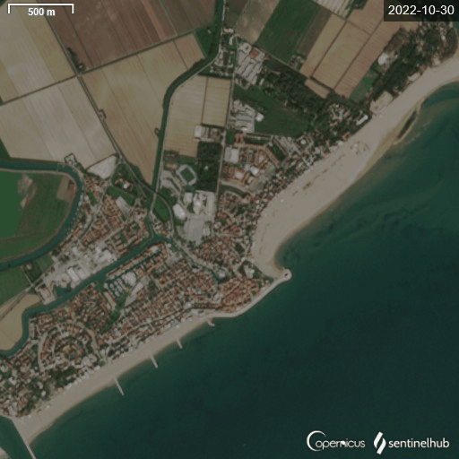


Coastal erosion in seaside resorts
(optical satellite images)
A greater frequency of extreme events leads to violent storms and localized erosion phenomena which also affect the major tourist beaches in Veneto region.
Source: Sentinel-2, L2A. Acquisition date: 30/10/2022, 06/11/2022
Location: Caorle

Slide 17
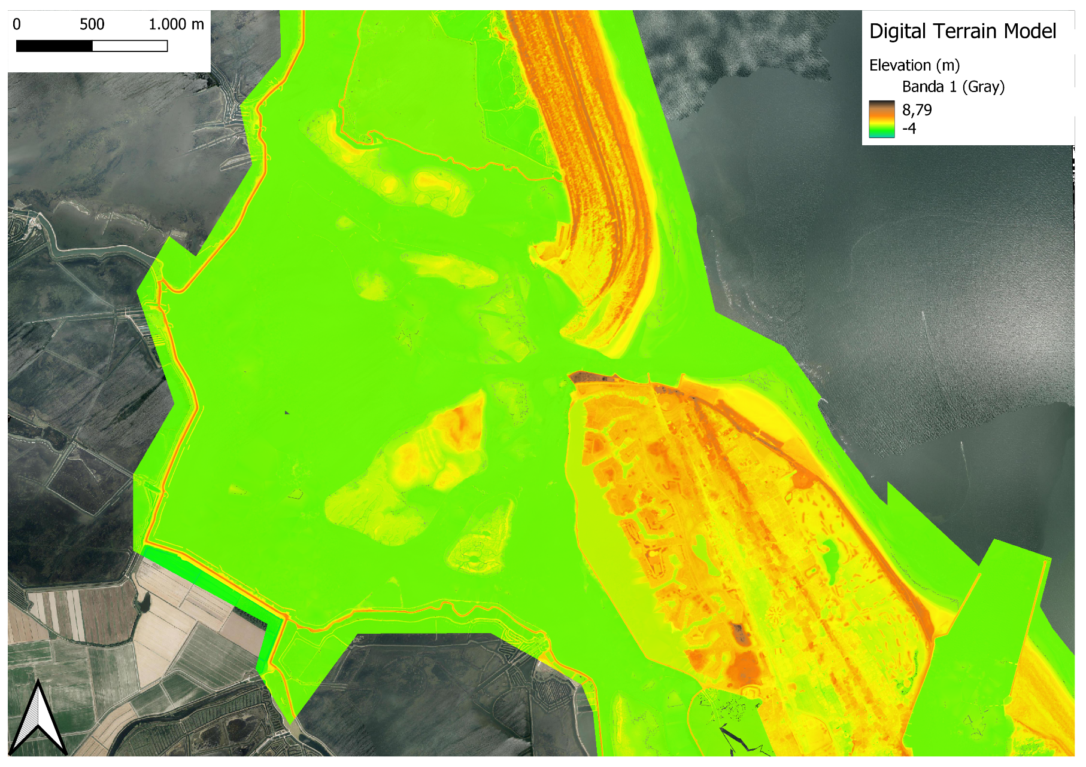
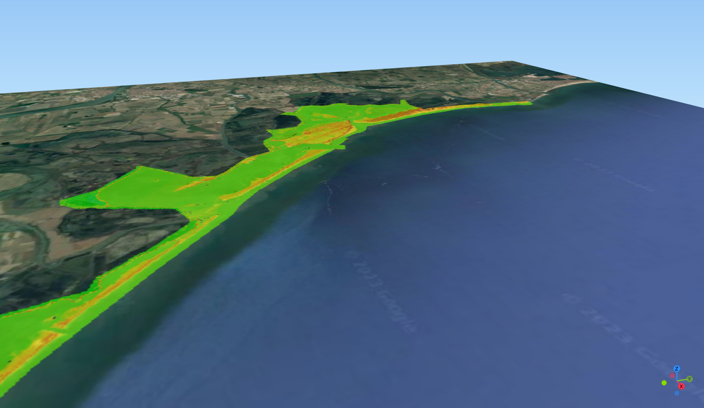
Lidar data and derived DTM (Digital Terrain Model)
* Source: Lidar data acquired in 2018, Veneto Region
Notes:
Coastal areas are dynamic and vulnerable to various natural processes, including erosion, sea-level rise, and storms. Sustainable tourism development requires a comprehensive understanding of these processes to minimize environmental impact and ensure the long-term viability of tourism activities.
In summary, remote sensing and satellite data are essential tools for monitoring coastal erosion, understanding coastal dynamics, and supporting the sustainable development of tourism in vulnerable coastal areas. By leveraging these technologies, stakeholders can make informed decisions to balance tourism growth with environmental preservation.

Slide 18
Change detection over time: Lidar surveys
Source: Lidar surveys of Caleri mouth, Po river delta area between 2008-2022
Notes:
Lidar surveys are useful for evaluating the evolution of the shoreline and for localizing erosion on the emerged beach. These findings are also essential data for estimating the risk coastal flooding. In this slide you can see the evolution of the shoreline of porto Caleri.
For the evaluation of erosion and growth volumes it is essential to have updated data bathymetric surveys. Through the processing of this data it is possible to evaluate the state of a section of the coast: erosive phenomena can in fact occur even in the absence of retreat of the coast line coast (typical condition of a coast protected by rigid adhesion structures). The comparison between successive ones bathymetric surveys are therefore of extreme interest, also for evaluating the influence of interventions carried out on the coast and on its morphological evolution.

Slide 19
Synthetic Aperture Radar (SAR) and interferometry for subsidence monitoring
Analysis of the land subsidence for the Po delta river (Fabris, 2019 – Fabris, 2022)
SAR Sentinel-1 data, COSMS Sky-Med;
GNSS survey
Traditional levelling measurements
Average: 8-12 mm/year
Credits: M. Fabris (University of Padua, 2019)
Notes:
Fabris (2019) compared geometric smoothing data with results obtained from SAR data Sentinel-1A satellites (17 November 2014 to 17 May 2017). GNSS data, relating to the years 2016 and 2018, refer to a new GPS network made up of 46 vertices which, integrated by the 3 stations permanent operations in the Po delta area. The comparison is presented in where the points bordered in black are the results of GNSS leveling while the colored areas refer to the SAR data. The GNSS leveling points correspond to the west side of the Sacca di Scardovari indicate rates of the order of 10-14 mm/year and in general, the Sacca area has a rate of subsidence of 8-12 mm/year.

Slide 20
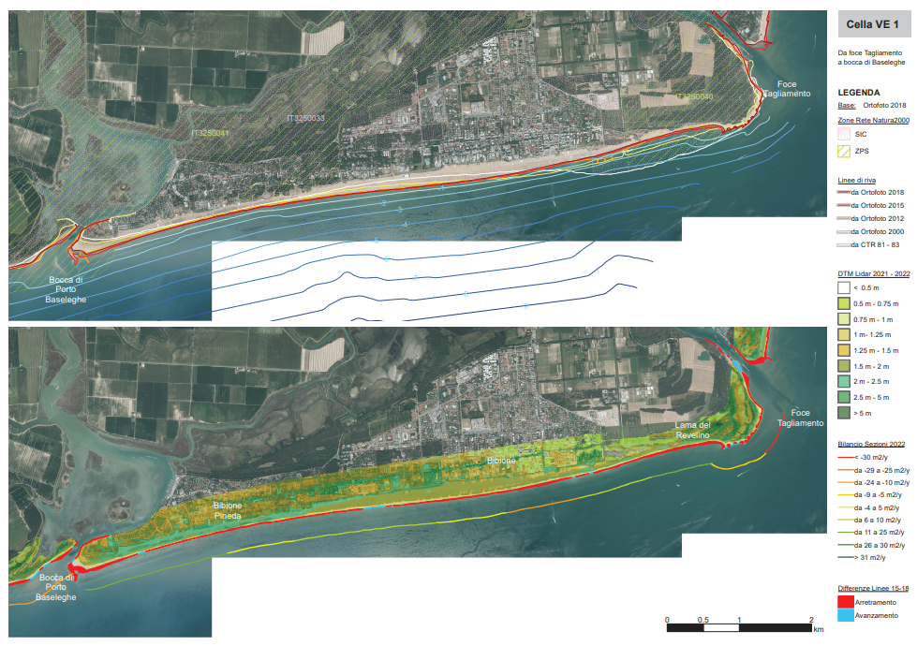
Shoreline evolution
Orthophoto
Lidar data
Source: Regional coastal protection plan (2023)
Notes:
In this slide you can see the evaluation of the coastline modification in Bibione. The basemap is the orthophoto of 2018. The evaluation of the erosion and accumulation areas of the shoreline also takes into account the manual restoration interventions. On the right you can see, near the mouth of the Tagliamento, a clear area of ​​erosive action, balanced by a deposit near the port mouth of Baseleghe.

Slide 21
Space data and remote sensing for sustainable tourism
Beside coastal dynamics, space data can be source of strategic planning for sustainable tourism. In this framework, they are and they will be more crucial in the future. Some other examples:
Policy and planning
Vegetation and Habitat Mapping
Sea-Level Rise Monitoring
GIS (Geographic Information Systems)
Storm and Weather Monitoring
Tourist Infrastructure Planning
Environmental Impact Assessment (EIA)
Emergency Response
Tourist Information
Notes:
Sustainable tourism development requires a comprehensive understanding of these processes to minimize environmental impact and ensure the long-term viability of tourism activities.
Policy and Planning:
Government agencies and policymakers can use remote sensing data to formulate coastal management policies and regulations that promote sustainable tourism while protecting the environment.
Vegetation and Habitat Mapping:
Satellite Imagery: Remote sensing can identify and monitor coastal vegetation, and dunes, which play a critical role in protecting coastlines from erosion. Changes in vegetation can be tracked over time.
Sea-Level Rise Monitoring:
Satellite Altimetry: Satellites equipped with altimeters measure sea levels, providing data on trends and variations. This information is vital for understanding coastal vulnerability.
Storm and Weather Monitoring:
Weather Satellites: Continuous monitoring of weather patterns and storm systems helps predict and prepare for severe weather events that can cause erosion and impact tourism.
GIS (Geographic Information Systems):
Integrating remote sensing data into GIS allows for the creation of detailed coastal erosion models and vulnerability assessments, which can inform sustainable tourism planning.
Tourist Infrastructure Planning:
Remote sensing can assist in identifying suitable locations for tourist infrastructure development, considering factors like proximity to the shoreline, elevation, and vulnerability to erosion.
Environmental Impact Assessment (EIA):
Remote sensing data can be used in EIAs to assess the potential impact of tourism development on coastal ecosystems and identify mitigation strategies.
Emergency Response:
Real-time satellite data can be crucial during natural disasters, enabling rapid response and evacuation planning to safeguard tourists and local populations.
Tourist Information:
Remote sensing and GIS can provide valuable information to tourists, such as real-time beach conditions, water quality, and safety alerts.
Community Engagement:
Utilizing satellite data in community outreach and education efforts can raise awareness about coastal erosion and the importance of sustainable tourism practices.

Slide 22


Perspectives on future common opportunities and challenges
OPPORTUNITIES
Remote Sensing Advancements (new technologies, data quality and resolution)
Cost Savings
Frequent monitoring
Data Integration
Global Coverage
Interoperability
CHALLENGES
Data Accessibility, data volume
Regulatory and Legal Challenges
Privacy and Security
Dependency on Space Infrastructure
Training and knowledge
Notes:
Remote Sensing Advancements: Ongoing advancements in satellite technology, including higher-resolution imaging and more frequent data capture, provide a wealth of information for precise territory management.
Cost Savings: Effective territory management driven by space data can lead to cost savings in various sectors, including agriculture, forestry, and disaster management.
Data Integration: Advances in data integration tools and platforms make it easier to incorporate space data into existing systems, improving decision-making processes.
Global Coverage: Satellites can capture data from remote or inaccessible regions, offering comprehensive coverage that is otherwise challenging to achieve.
Interoperability: Integrating space data into existing territory management systems can be challenging due to differences in data formats, coordinate systems, and standards. Achieving interoperability is crucial for effective utilization.
Data Accessibility: Access to space data can be costly and restricted, particularly high-resolution imagery and specialized datasets. This can limit its availability to certain organizations or regions.
Regulatory and Legal Challenges: The regulatory framework for space data usage is still evolving, and legal disputes over data ownership, licensing, and intellectual property rights can hinder its development.
Dependency on Space Infrastructure: Relying heavily on space-based data creates vulnerability to disruptions in space infrastructure, whether due to natural events (e.g., solar flares) or intentional interference (e.g., cyberattacks).
Data Security and Privacy Concerns: As space data becomes more accessible, there is an increased risk of unauthorized access, data breaches, and misuse. Privacy concerns arise when high-resolution satellite imagery can capture sensitive information about individuals or locations.

Slide 23

Thank you
Regione del Veneto – Direzione Pianificazione Territoriale
Veneto Region – Directorate for Spatial Planning
Salvina Sist – Head of the Directorate
salvina.sist@regione.Veneto.it
Carlo Masetto – GIS Specialist
carlo.masetto@regione.veneto.it

