Slide 1
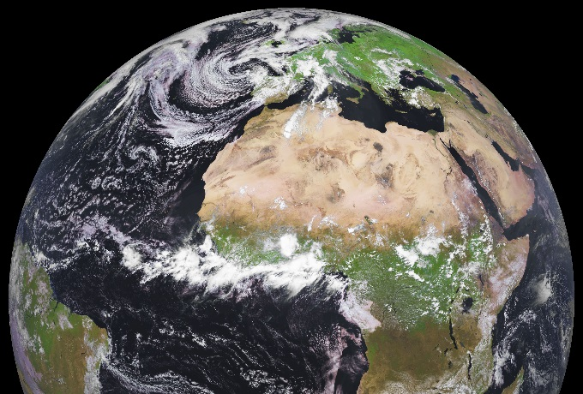
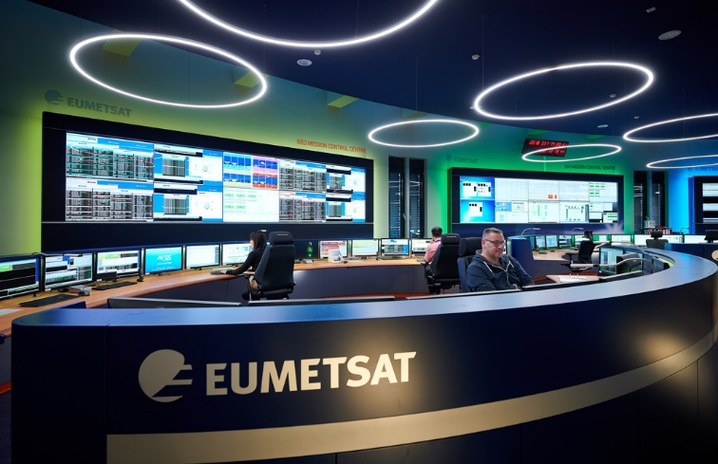
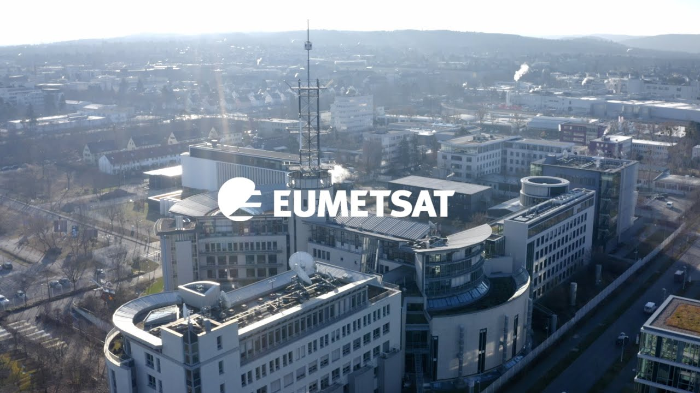
EUMETSAT Copernicus contribution – present and future data
Present and future Copernicus missions
Examples on how to support ocean & air quality monitoring
Implications on tourism / agriculture sectors at regional level
Federico Fierli, EUMETSAT
Based on the input of EUMETSAT, AC-SAF, Copernicus program

Slide 2
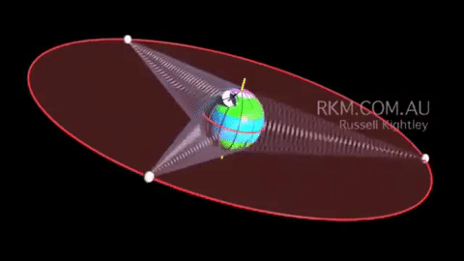


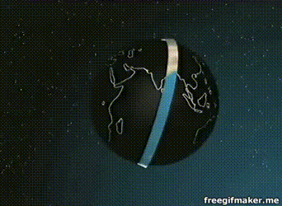
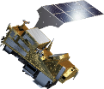
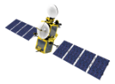

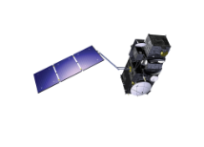
Copernicus Sentinels operated by EUMETSAT
YEAR...
07
08
09
10
11
12
13
14
15
16
17
18
19
20
21
22
23
24
25
26
27
28
29
30
31
32
33
34
35
36
37
38
39
40
METEOSAT THIRD GENERATION
Monitoring atmospheric composition
MTG-S-1: SOUNDING
MTG-S-2: SOUNDING
SENTINEL-4 on MTG-S
EUMETSAT POLAR SYSTEM SECOND GENERATION (EPS-SG)
METOP-SG A: SOUNDING AND IMAGERY
SENTINEL-5 on METOP-SG A
JASON (HIGH PRECISION OCEAN ALTIMETRY)
JASON-2
JASON-3
Monitoring the ocean
SENTINEL-6 (JASON-CS)
COPERNICUS
SENTINEL-3 A/B/C/D
YEAR...
07
08
09
10
11
12
13
14
15
16
17
18
19
20
21
22
23
24
25
26
27
28
29
30
31
32
33
34
35
36
37
38
39
40

Slide 3
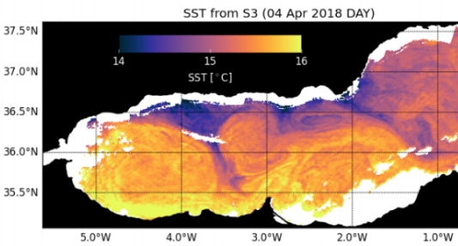
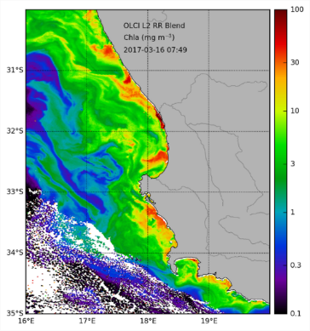
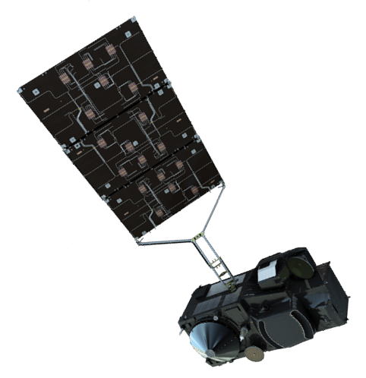
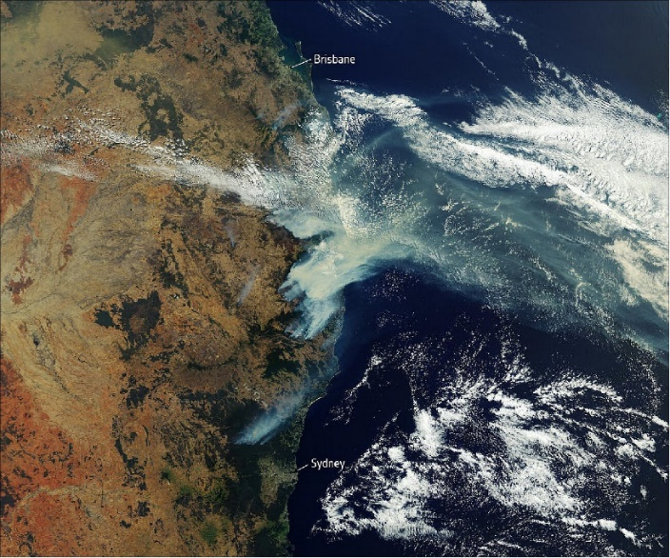
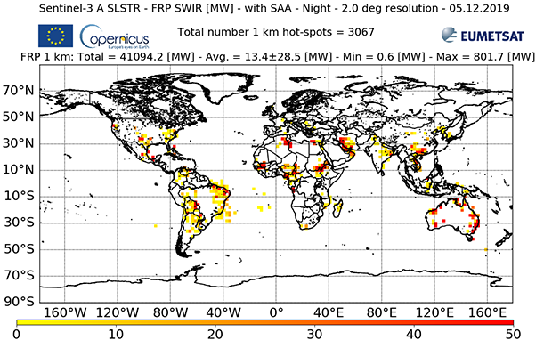
Sentinel-3: Synchronous ocean and atmosphere data
Wide variety of relevant products:
  Ocean colour, chlorophyll, TSM
  Aerosols, Fire Radiative Power
Many relevant applications:
  Water quality, Sediment dynamics, air quality fires, dust, volcanic eruptions.

Slide 4
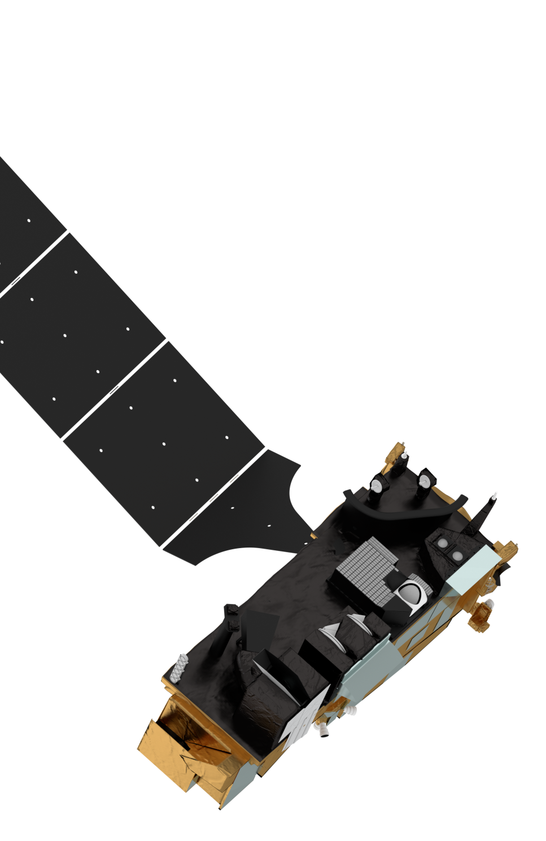

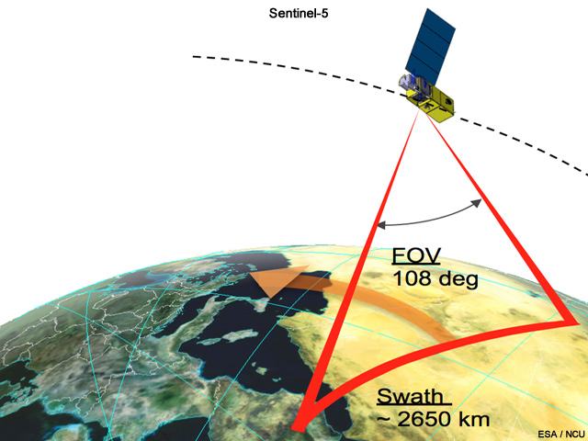

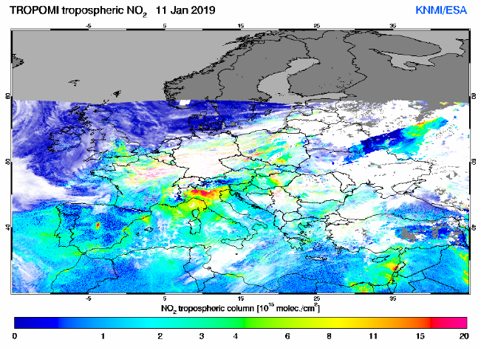
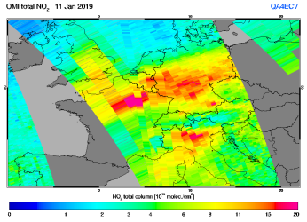
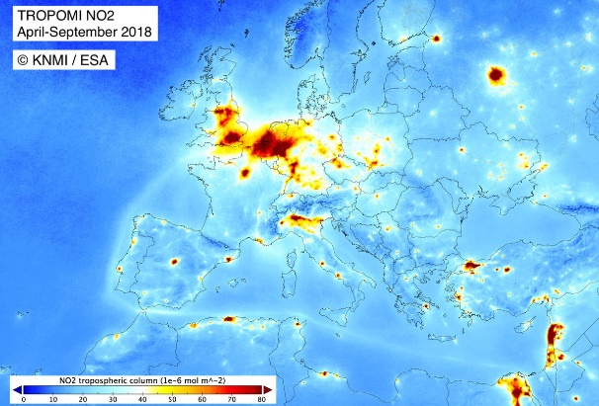
METOP (EPS-SG) – (incl. Sentinel 5)
Operational : 2023-2035
Radio Occultation
RO
3MI
Multi-viewing,
-channel,
-polarisation Imager
MWS
Microwave Sounder
Sentinel-5
UV-VIS-NIR-SWIR Sounder
Synergy with the instruments on the EUMETSAT Polar Satellites
METimage
Visible-Infrared Imager
IASI-NG
Infrared Atmospheric Sounding Interferometer
– New Generation
Notes:
Clearly mention the

Slide 5
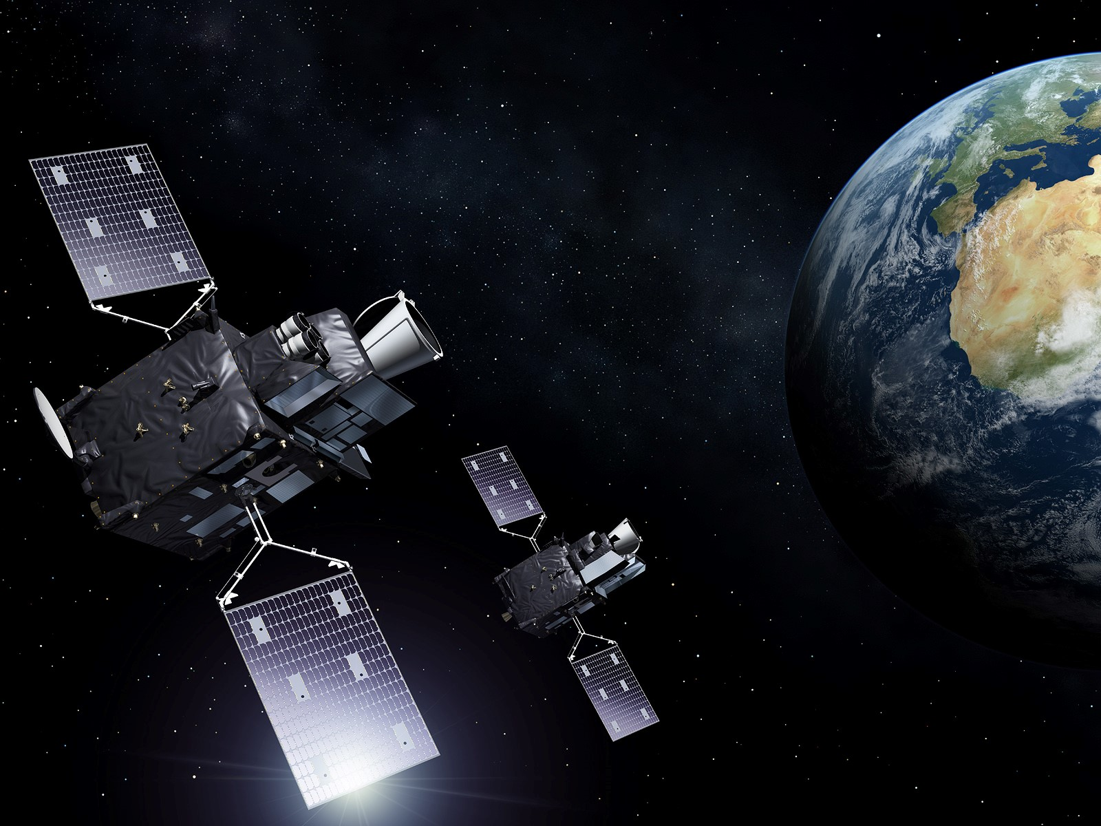
Meteosat Third Generation (MTG): Mission overview
Imagery missions (MTG-I):
  Full disk imagery every 10 minutes in
  16 spectral bands with the Flexible Combined Imager (FCI). Fast imaging of European weather every 2.5 minutes
    Day/night Lightning Imager (LI)
Sounding mission (MTG-S):
    3D mapping of water vapour, temperature with Hyperspectral Infrared Sounder (IRS)
    Air quality monitoring and atmospheric chemistry in synergy with Sentinel-4 / Ultraviolet Visible & Near-infrared
Start of operations in 2022 and 2024
Operational exploitation: 2022–2042

Slide 6
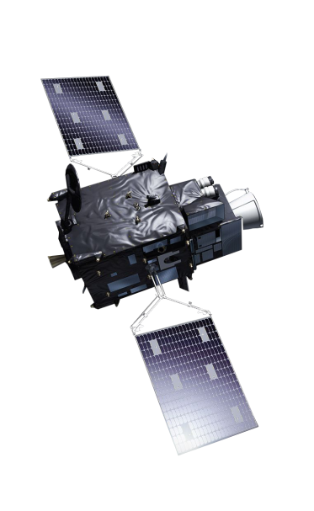
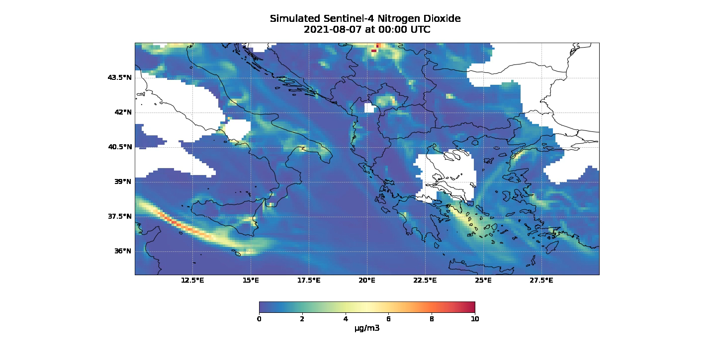

Monitoring from space: Sentinel-4
a whole new dimension will be explored by Sentinel-4:
daytime hourly air quality data over Europe

Slide 7
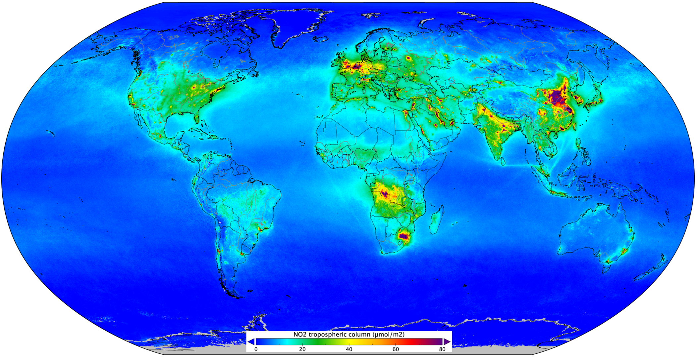
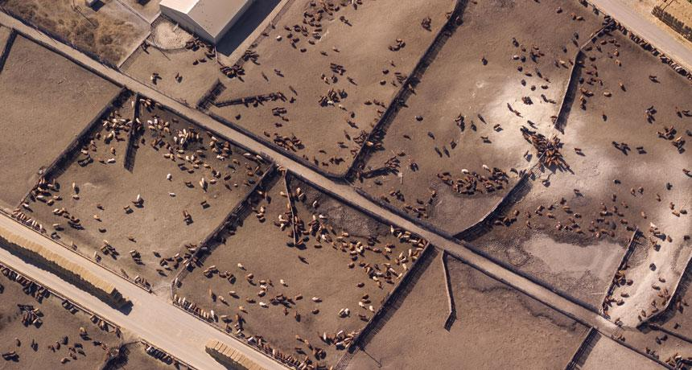
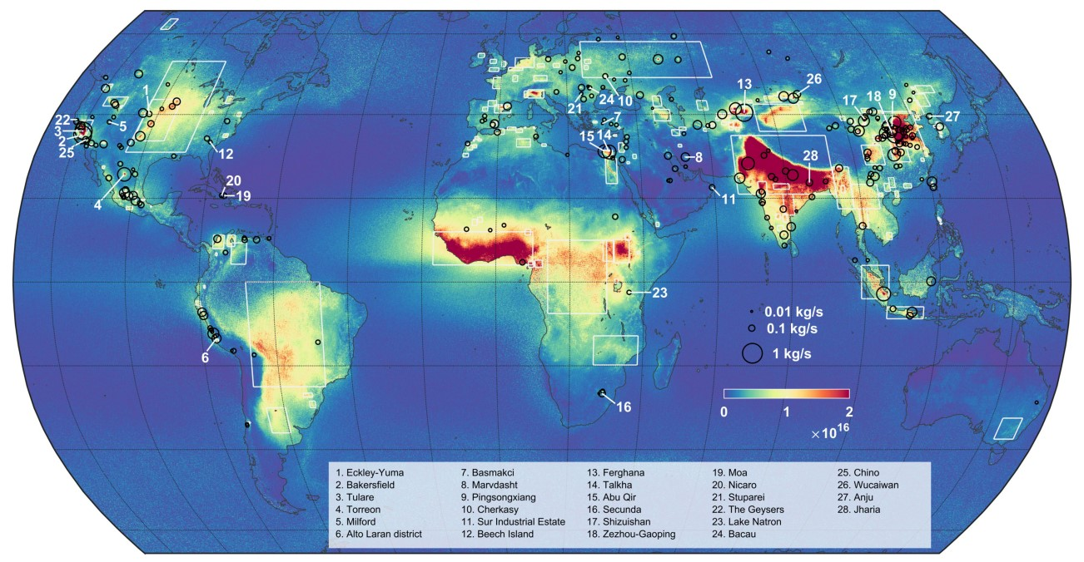
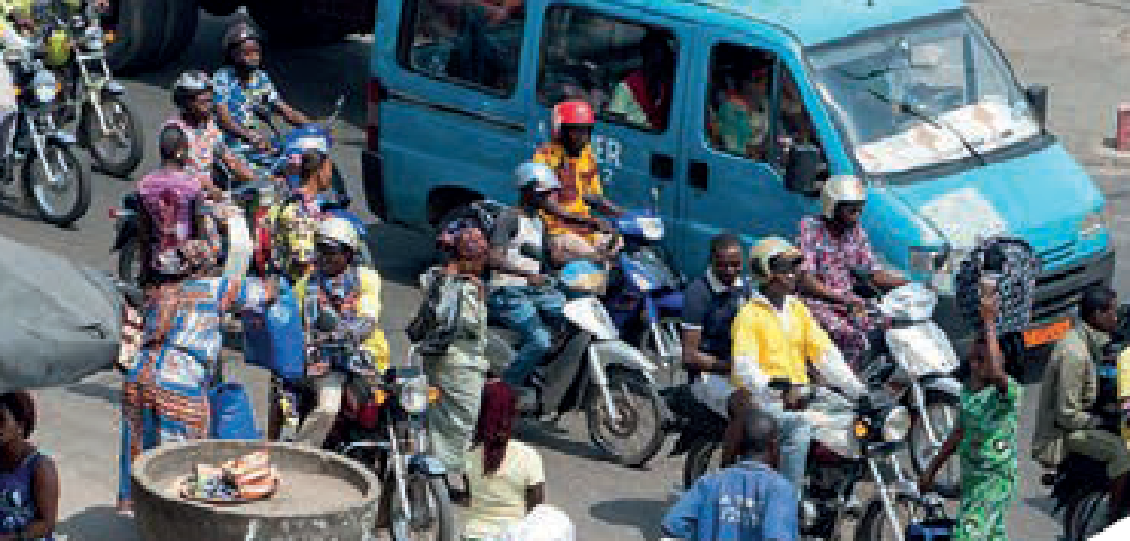
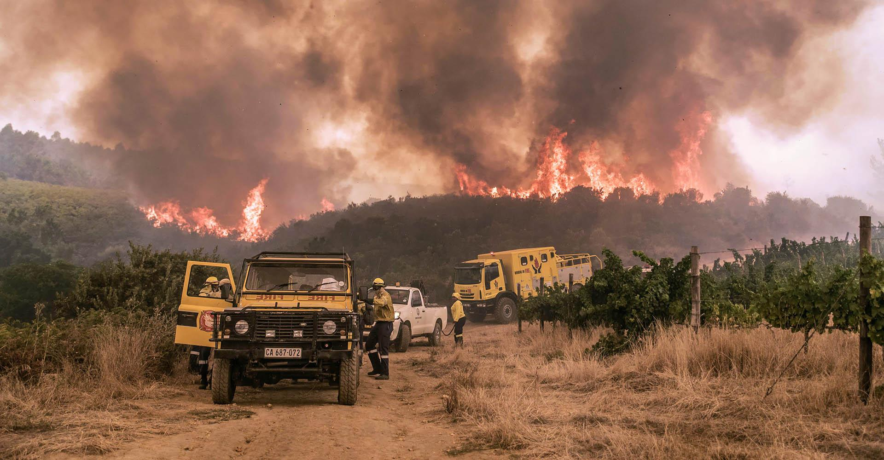
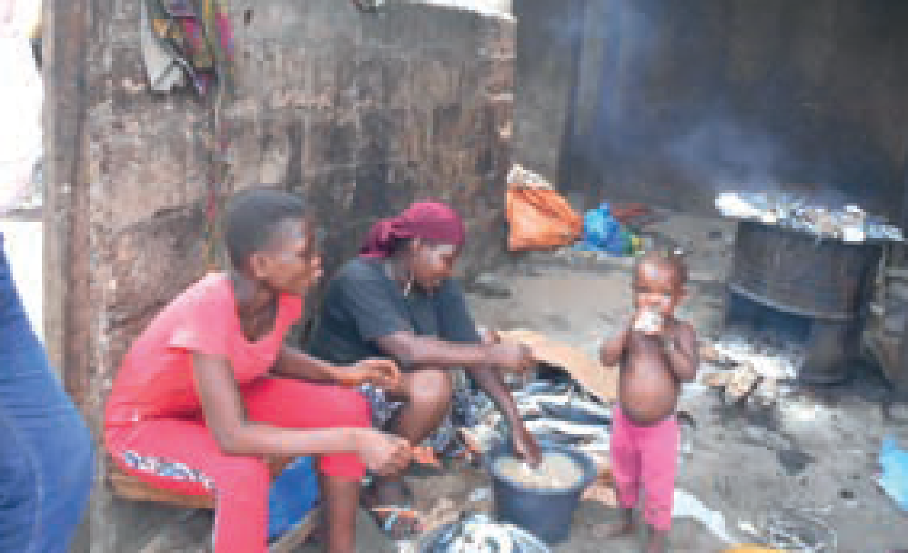
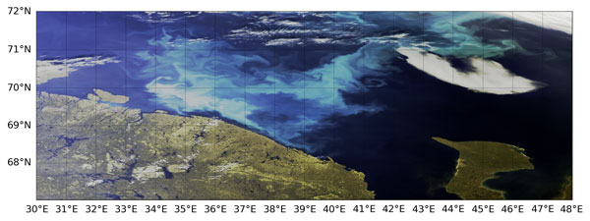
Copernicus sentinels monitor pollutants / oceans at various scales
Nitrogen Dioxide from TROPOMI Sentinel-5P
Copernicus Program
https://
Ammonia fluxes based on 9 years of IASI data
© ULB – AC-SAF EUMETSAT
Ocean color – Sentinel-3 Copernicus program

Slide 8
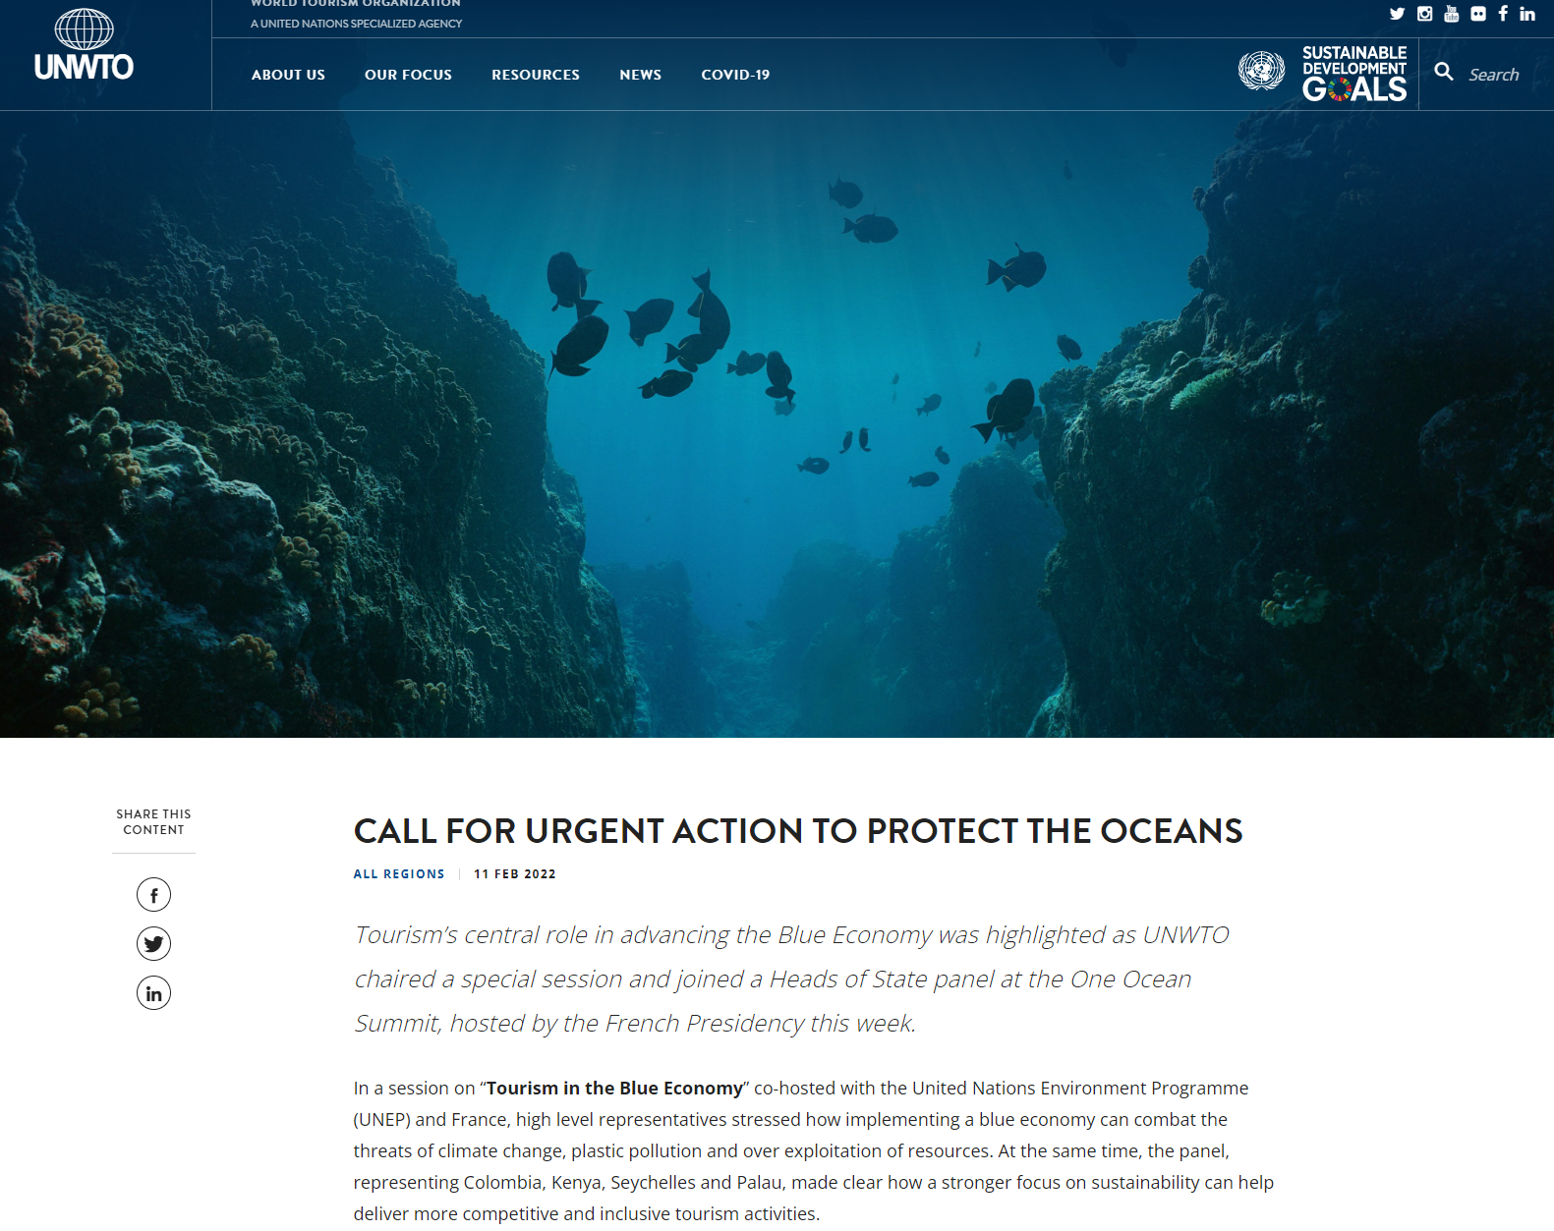
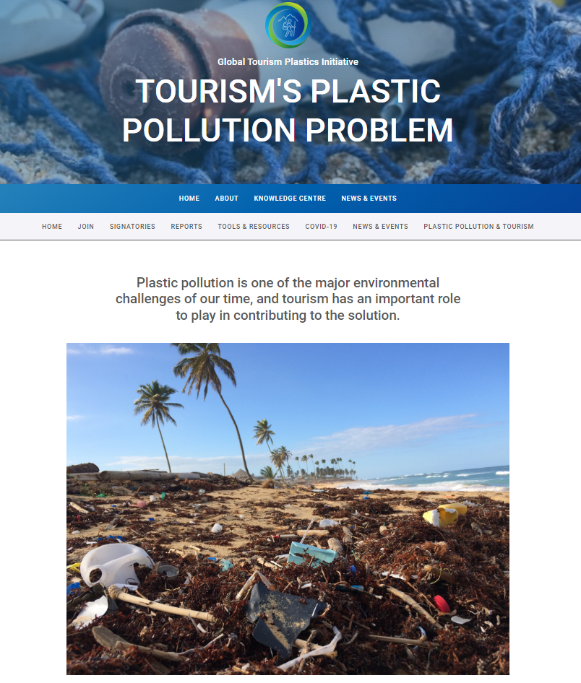
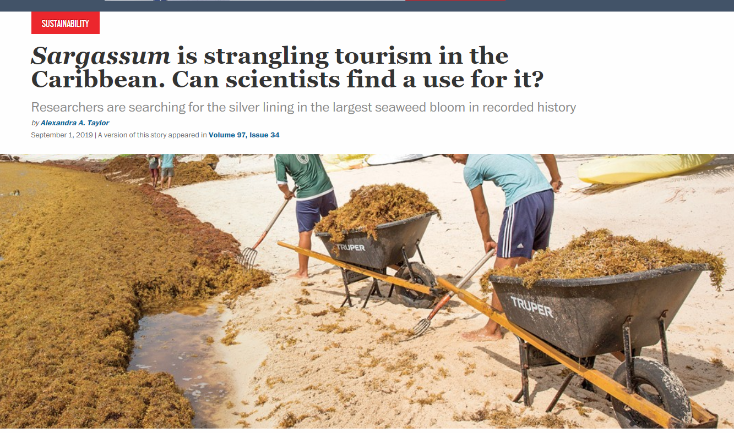
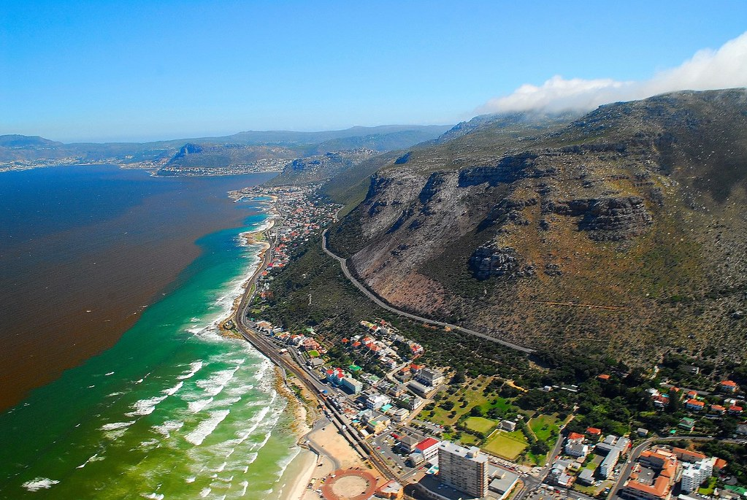
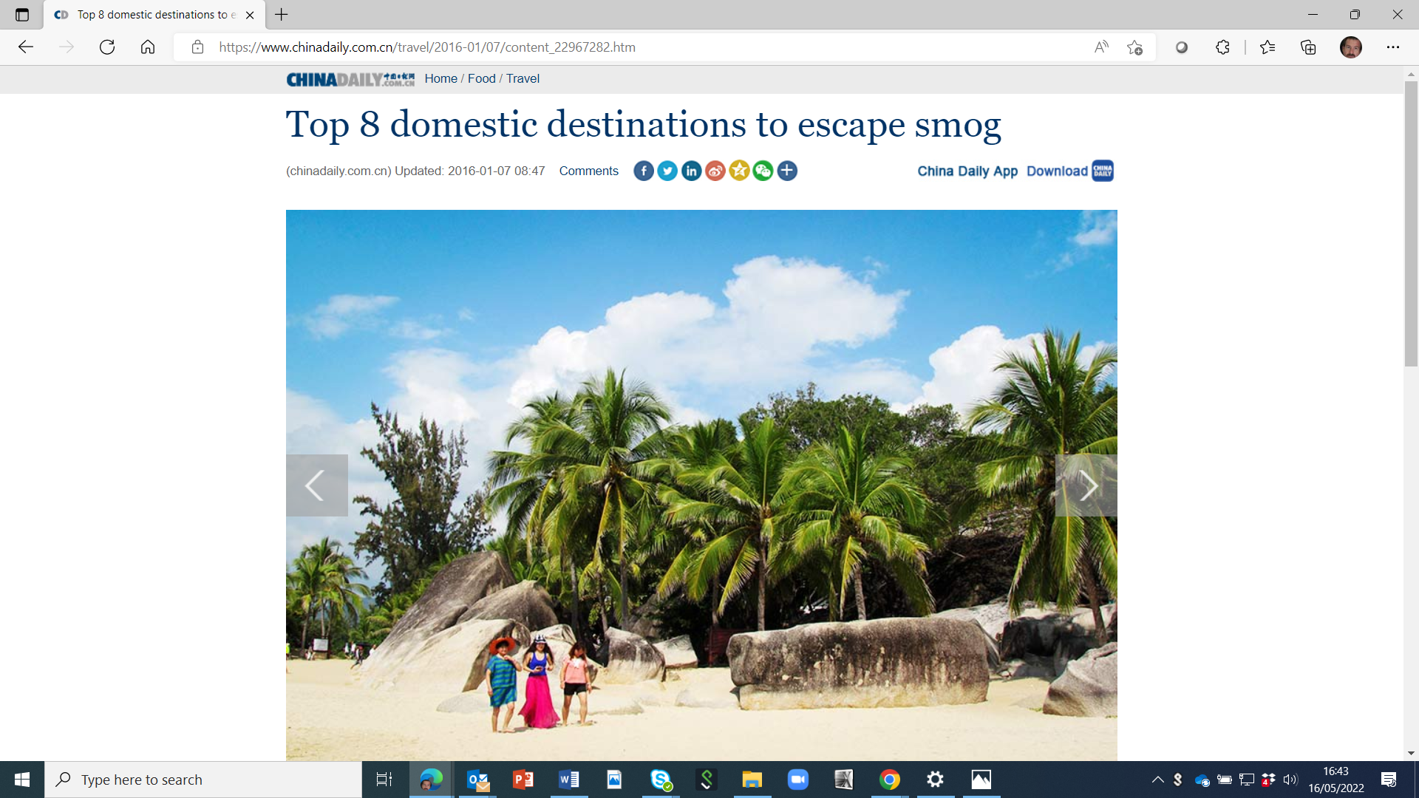

Monitor Oceans air quality –Tourism impact(s)
"Tourism has suffered. Hotels have reported alarming dips in occupancy since the seaweed started washing up. It’s difficult and expensive to remove. Mexico has spent $17 million removing the seaweed from its [beaches since] 2011."
"40% increase [in plastic waste] during tourist seasons"
"Tourism represents 40% of the blue economy"
"...additional day of red tide in a month with 17 days or more of red tide drives monthly lodging sector sales down by 1–2%, and restaurant sector sales down by 0.5–1%."
Tourism growth has an impact on air quality
Recent studies shows Austria and Italy tourism growth can deteriorate air quality, while for Cyprus and Great Britain, the poorer air quality of the destination may decrease tourism demand. Wolfgang Georg Arlt - Forbes, 2017
"Coastal drowning in the United States alone accounts for US$ 273 million each year in direct and indirect costs."

Slide 9
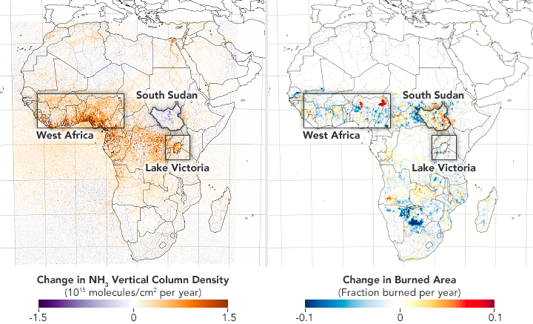
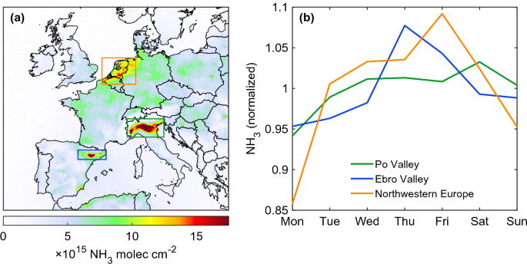
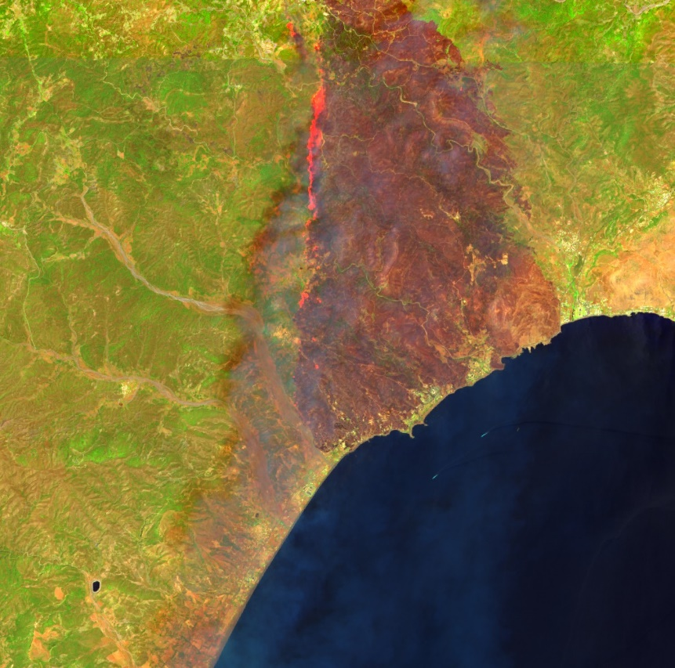
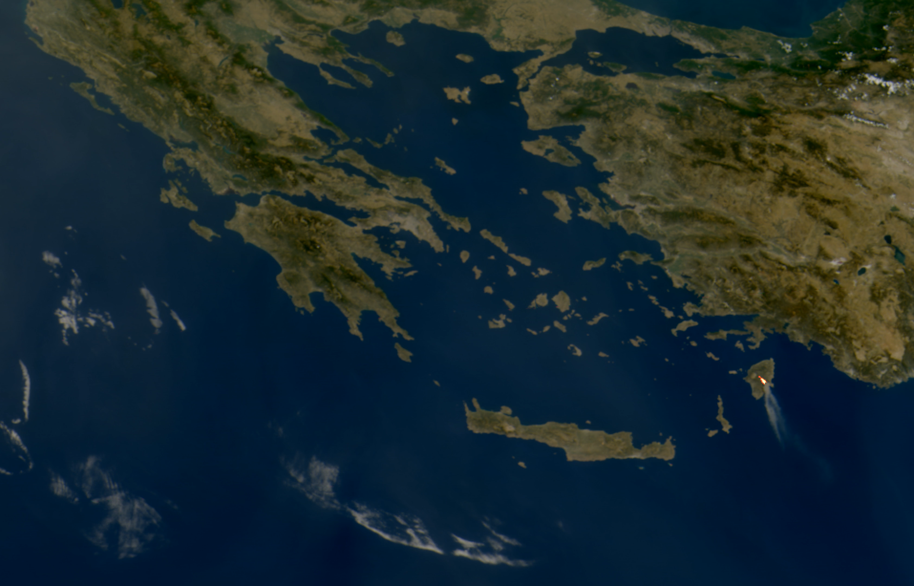
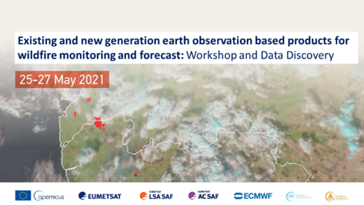
Air pollution – wildfires - impact from agriculture
Ammonia fluxes based on 9 years of IASI data
© Martin Van Damme and Lieven Clarisse / ULB
Monitor emissions from agriculture and manure – Ammonia is a primary pollutant and is difficult to measure at the ground
Wildfire life-cycle has impacts on human activities and land ecosystems
FCI-MTG – Preliminary data
Sentinel-2 Vegetation index

Slide 10
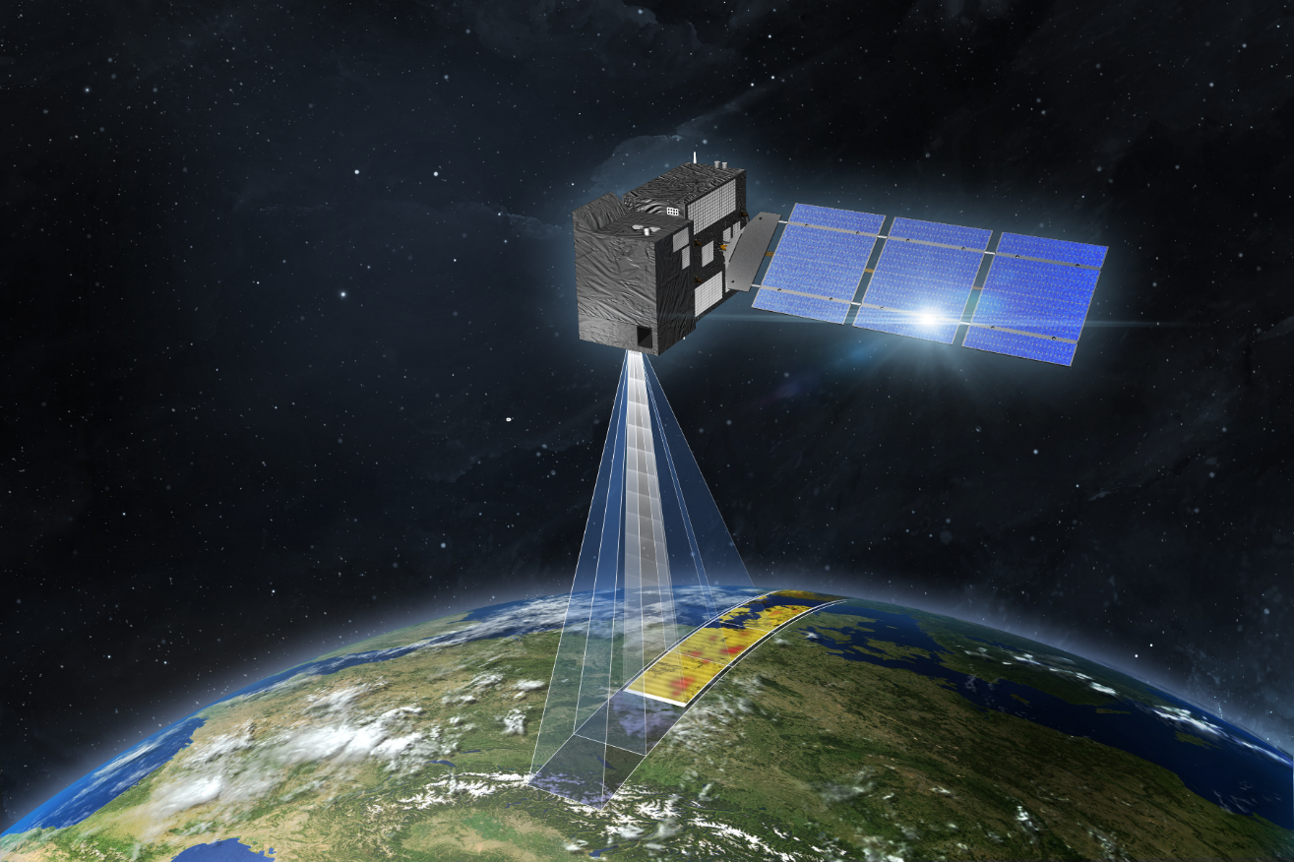
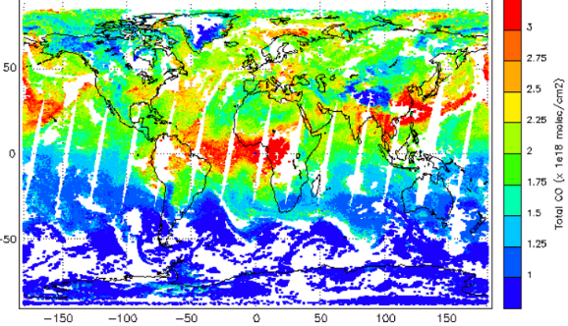
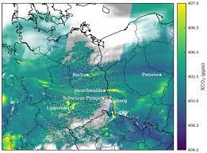
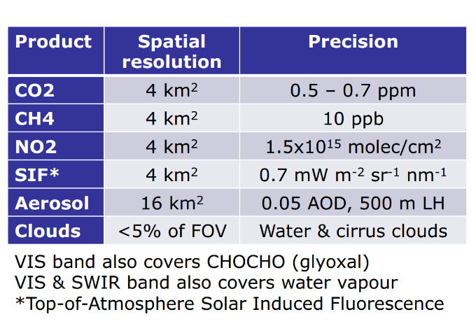
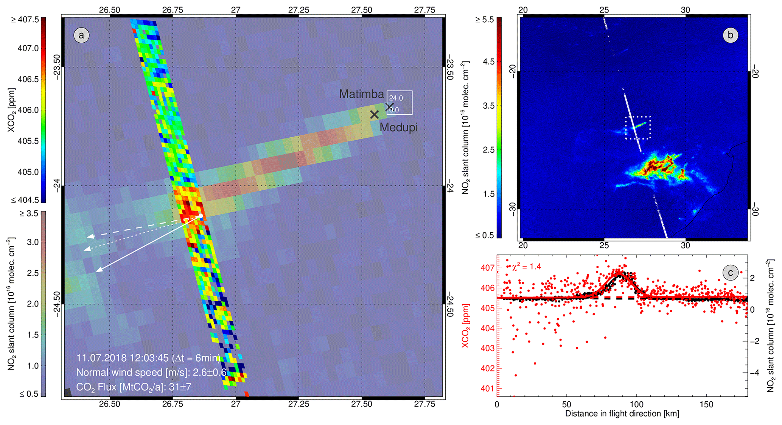
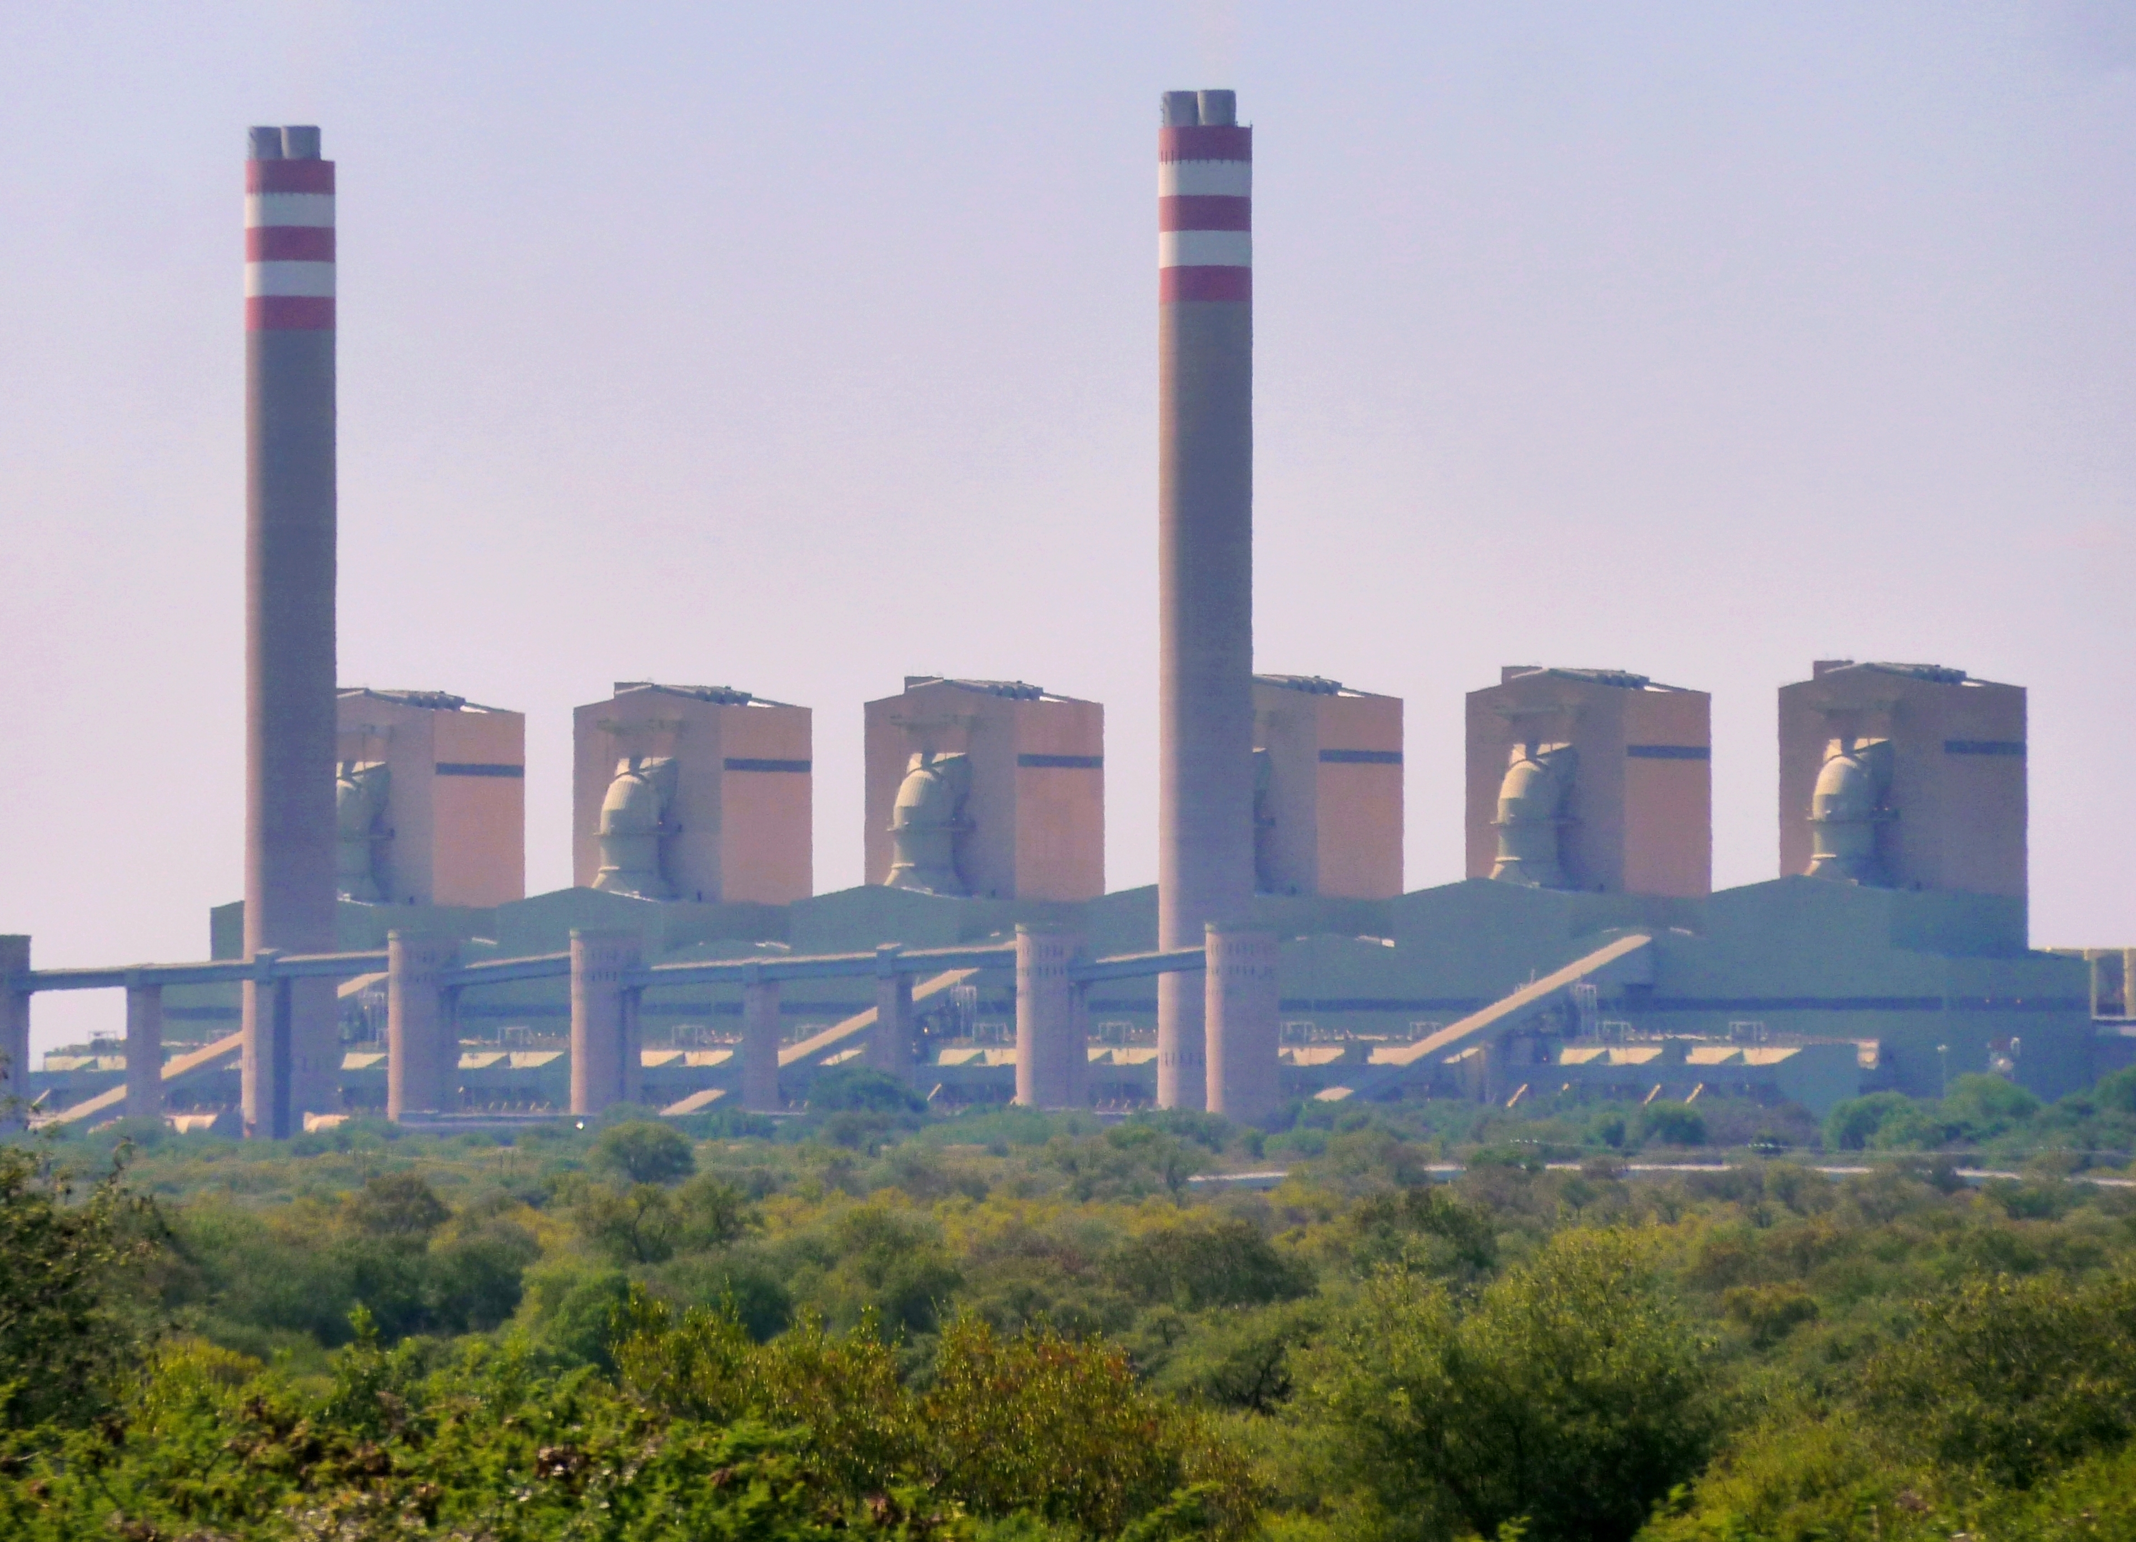
Greenhouse gases – CO2M
Nitrogen Dioxide from TROPOMI data
© Copernicus program & CO2 from OCO2
Credit – Hakkarainen et al. 2020

Slide 11
CAMS: CO2 monitoring and verification service
A new European anthropogenic CO₂ emissions monitoring
and verification support (CO2MVS) capacity will support countries
and regions with observation-based policy-relevant information.

Slide 12
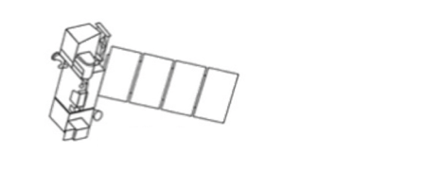
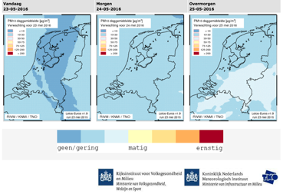
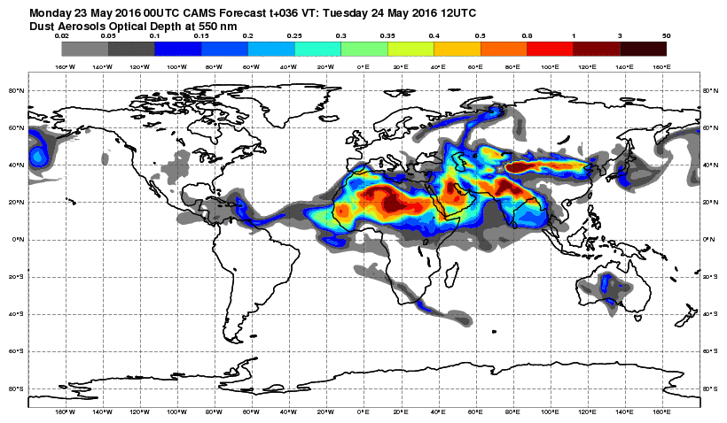

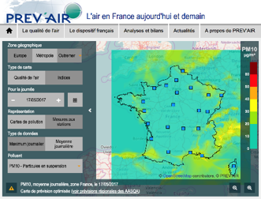
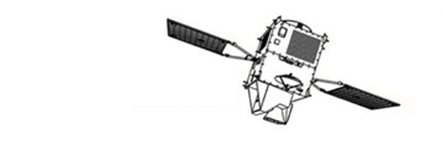
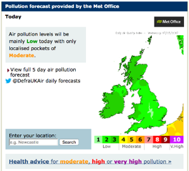






CAMS INFORMATION FLOW
CAMS users
Applications
Policy products
IFS 40km (oper) / 80km (rean) Globe
CAMS main operational data assimilation and modelling systems
Earth Observation from satellite (>75 instruments) and in-situ (regulatory and research)
11-member ensemble
10km Europe

Slide 13







Data Store
EUMETView
Data Store
Data Tailor
EWC
Wekeo
The EUMETSAT Data Store provides users with a download and linked data tailoring service for online data; providing access through an online web user interface and via a suite of APIs.
Data Store Interfaces
Data collections
Online web user interface
Near real-time products
-------
Download API
Historic products
OpenSearch API
Browse API
Climate data records
Discovery API
Subscription API
Delayed times
Integrated Services
Product customisation through the Data Tailor
Service available at: https://data.eumetsat.int/
Product viewing through EUMETView

Slide 14
Additional Material

Slide 15









Example: Synergy of observational datasets to monitor wildfires
Pollutants, hot spots & intensity from satellite observations
Measurement of fire intensity
Linked to emission of combustion gases & aerosols into the atmosphere
MSG/SEVIRI - every 15-minute allows:
Strong seasonality
Strong diurnal cycle
Fire Radiative Power
Notes:
Show how the Sentinels can see and will see one specific event

Slide 16


Monitoring from space: Sentinel-3 observations of Canadian wildfires

Slide 17

Monitoring from space: MTG observations of Canadian wildfires
MTG data are preliminary

Slide 18








Continuity – Monitoring and Climate applications

