Slide 1
The Copernicus Space Component: current status and perspectives
NEREUS Regional Symposium
Matera (Basilicata)
September 28, 2023
Alessandra Tassa
Directorate of Earth Observation Programmes
European Space Agency

Slide 2


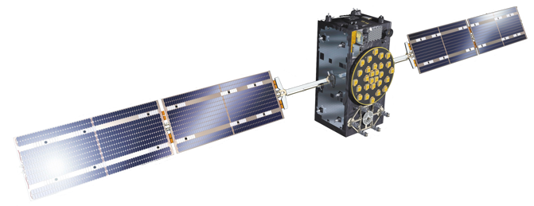
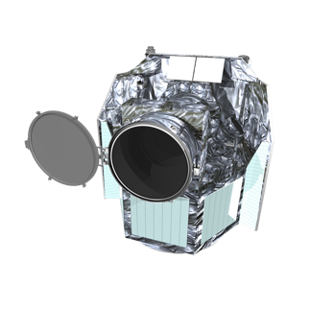

























What is the European Space Agency?
Make Space for Europe
5 500+
ESA Workforce
Over 80 satellites developed, tested, and operated since 1975
22
Member States
2022 Budget
7.2 billion =
12 per European
2
Notes:
The European Space Agency is an intergovernmental organisation of 22 member states, established in 1975, dedicated to the peaceful exploration of space.

Slide 3
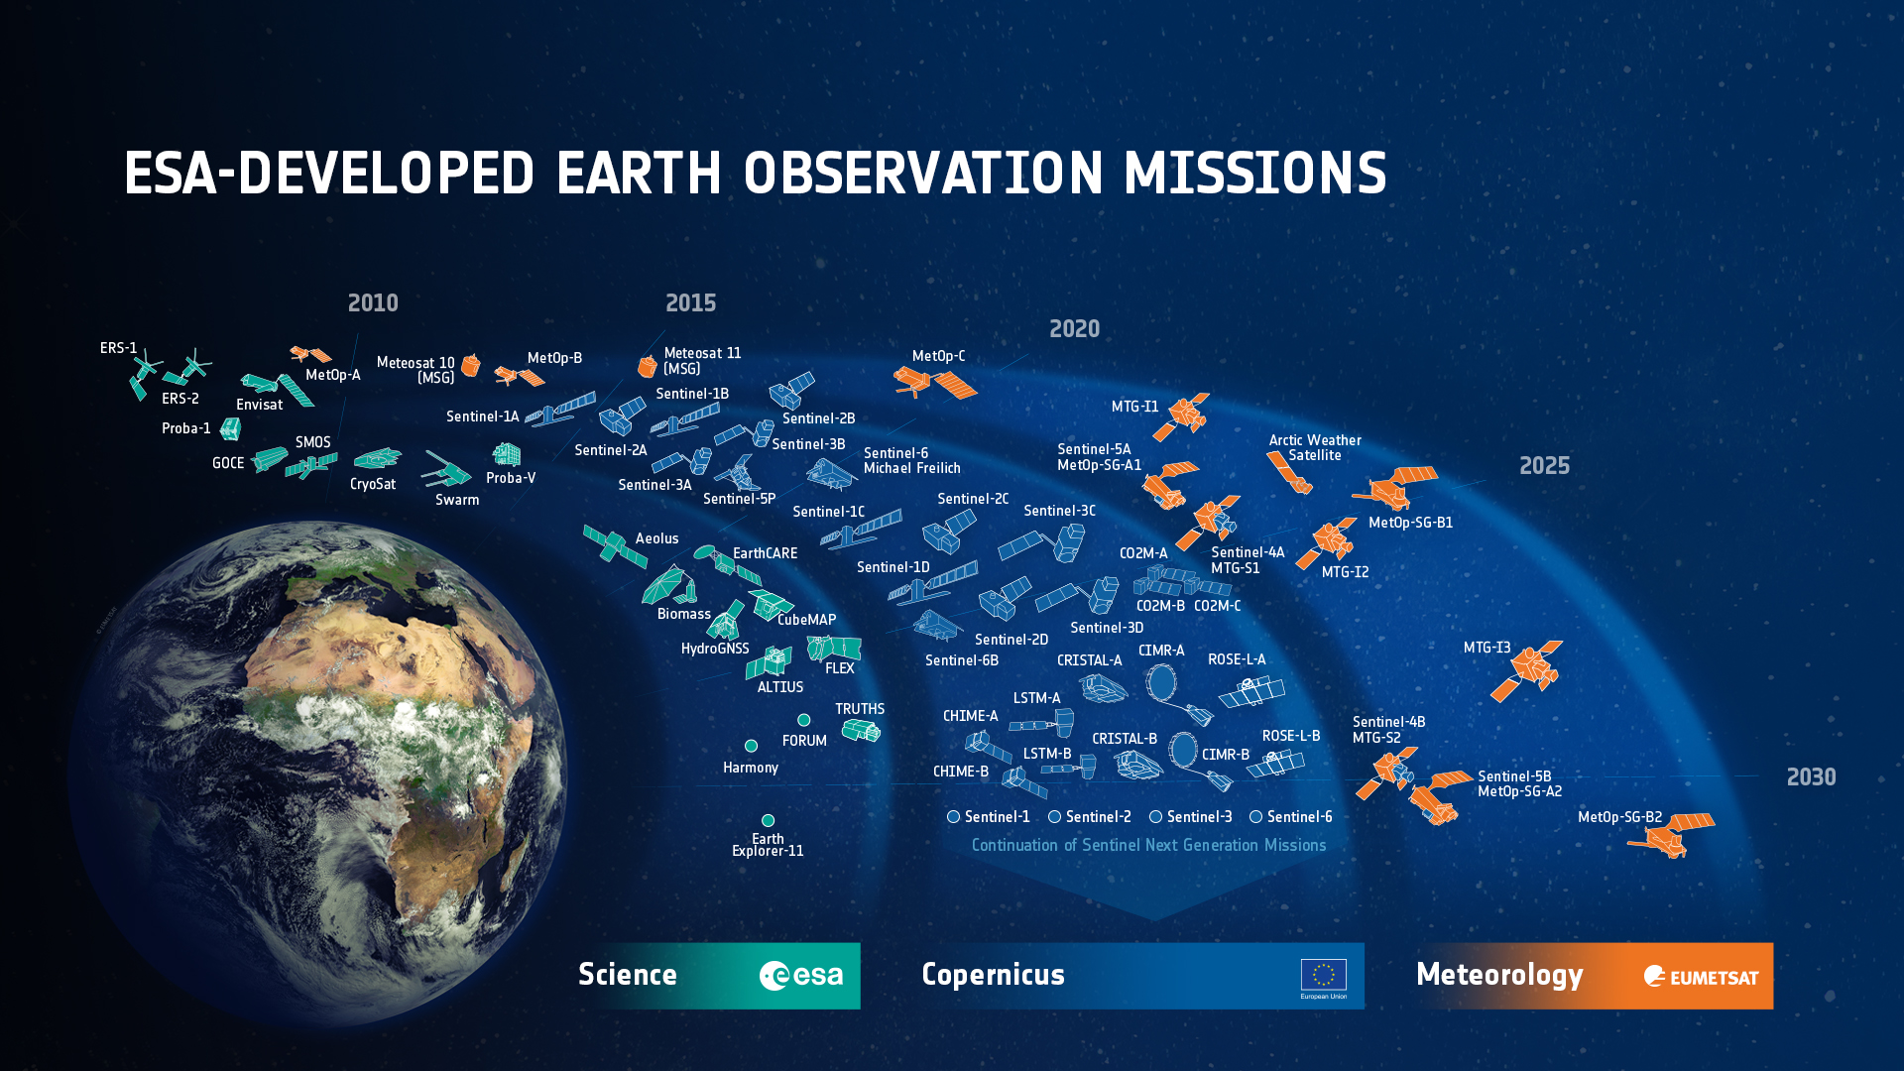

ESA’s Earth Observation Missions
Satellites
Heritage 04
Operational 15
Developing 41
Preparing 22
Total 82
*
*Pending final mission selection
3
Notes:
D/EOP has three main lines of activities: Earth Science – Copernicus – Meteorology, with
6 Missions (12 satellites) heritage data:
5 under Earth Science (ERS-1, ERS-2, Envisat + Earth Explorer 1: GOCE + Earthwatch: Proba-1, )
0 under Copernicus ()
7 under Meteorology (Meteosat 1 to 7)
10 Missions (15 satellites) in operation:
5 missions (7 satellites) under Earth Science (Earth Explorers 2 to 5: SMOS, CryoSat, Swarm (Alpha, Bravo, Charlie), Aeolus + Earthwatch: Proba-V)
5 missions (8 satellites) under Copernicus (Sentinels: S-1 A&B, S-2 A&B, S-3 A&B, S-5p, S-6 Michael Freilich)
0 under Meteorology since operated by Eumetsat (Meteosat-10-11 + MetOp-A, MetOp-B, MetOp-C )
24 Missions (41 satellites) under development
8 Missions (11 satellites) under Earth Science (Earth Explorers 6 to 9: EarthCARE, Biomass, FLEX, FORUM + Scout-1 CubeMap & Scout-2 HydroGNNS + Earthwatch: THRUTHS, ALTIUS)
12 Missions (24 satellites) under Copernicus (Sentinels: S-1 C&D, S-2 C&D, S-3 C&D, S-4 A&B, S-5 A&B&C, S-6 B + Sentinels Expansion Missions: CO2M A&B, CRISTAL A&B, CIMR A&B, LST A&B, CHIME A&B, ROSE-L A&B)
4 Missions (6 satellites) under Meteorology (Meteosat Third Generation (MTG) I1, I2 & S1 + MetOp Second Generation (MetOp-SG) A1, B1 + Arctic Weather Satellite)
12 Missions (22 satellites) under preparation
7 missions (11 satellites) under Earth Science (EE10, EE11 (4 candidates), NGGM(2 satellites)/MAGIC(4 satellites of which 2 lead by ESA), Daedalus)
4 missions (10 satellites) under Copernicus (Sentinels Next Generation: S-1 NG A&B, S-2 NG A&B, S-3 NG A&B (OPT), S-3 NG A&B (TOPO),
1 mission (1 satellite) under Meteorology (Aeolus-2)

Slide 4

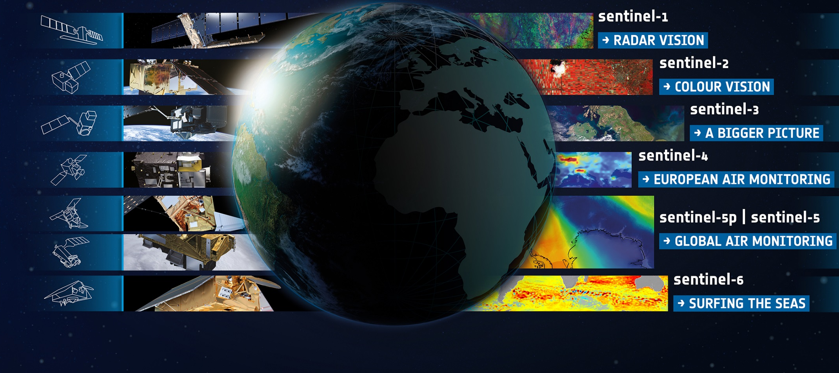
Copernicus Sentinels: overview
State-of-the-art observations
Systematic data availability
Full, free and open data policy
Long-term availability
➔ Know more: https://sentinels.copernicus.eu
Notes:
Today that all land masses are observed every 5 days at 10m with Sentinel 2 and every 12 days at 20m with Sentinel 1.
And those data is freely and openly available to anybody in the world.
All global landmass is observed every 5 days at 10m resolution
Sentinel-1 – C-band SAR imaging for All weather, day/night applications, interferometry
Sentinel-2 - High resolution multispectral Imaging for Land applications: urban, forest, agriculture, … Continuity of Landsat, SPOT
Sentinel-3 - Medium resolution multi-spectral imaging for Ocean & Global Land Monitoring Wide-swath ocean colour, vegetation, sea/land surface temperature, altimetry
Sentinel-5 - Geostationary Atmospheric sounding in UV, VIS and NIR, for atmospheric composition monitoring, pollution; S-4 is an instrument on MTG satellites
Sentinel-5P - precursor UV, NIR and SWIR sounder in low-Orbit for Atmospheric monitoring
Sentinel-5 - precursor UV, NIR and SWIR sounder in low-Orbit for Atmospheric monitoring; S-5 is an instrument on MetOp-SG satellites
Sentinel-6 – Michael Freilich; Altimetry reference mission

Slide 5
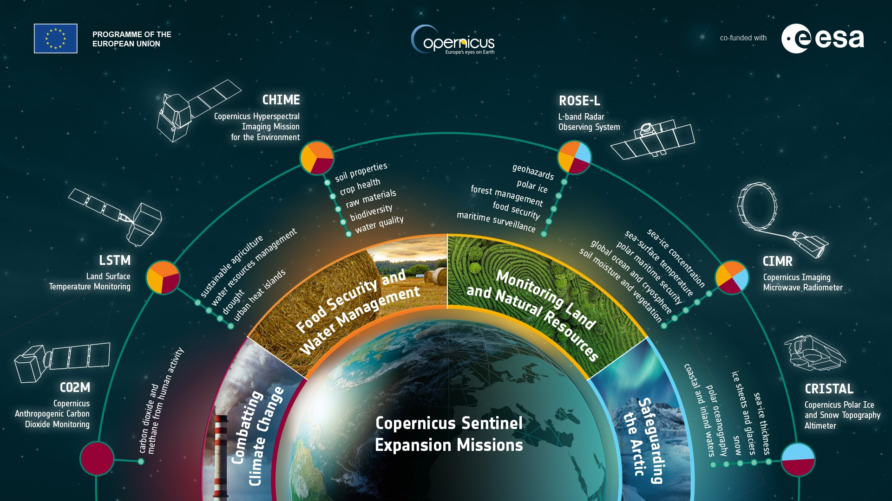

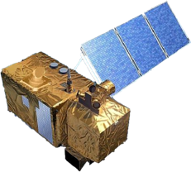
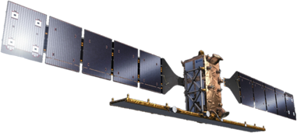
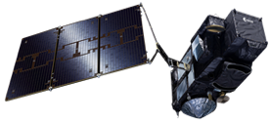
Copernicus Space Component – Evolution
Sentinel-1 NG
Sentinel-2 NG
+ Sentinels Next Generation
Sentinel-3
TOPO/OPT NG
Notes:
Beyond the expansion mission, Copernicus will also evolve into a next generation of Sentinel satellites to ensure data continuation and enhanced observations for the decades to come.
Sentinels 1 NG and 3 TOPO have been funded at CM22
Next Generation Sentinels
Sentinel-1 NG
Sentinel-2 NG
Sentinel-3 Topo NG
Sentinel-3 Opt NG

Slide 6
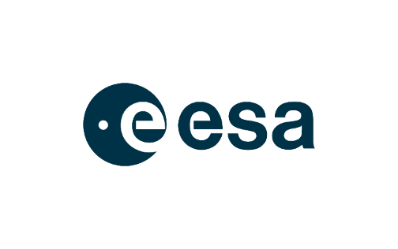

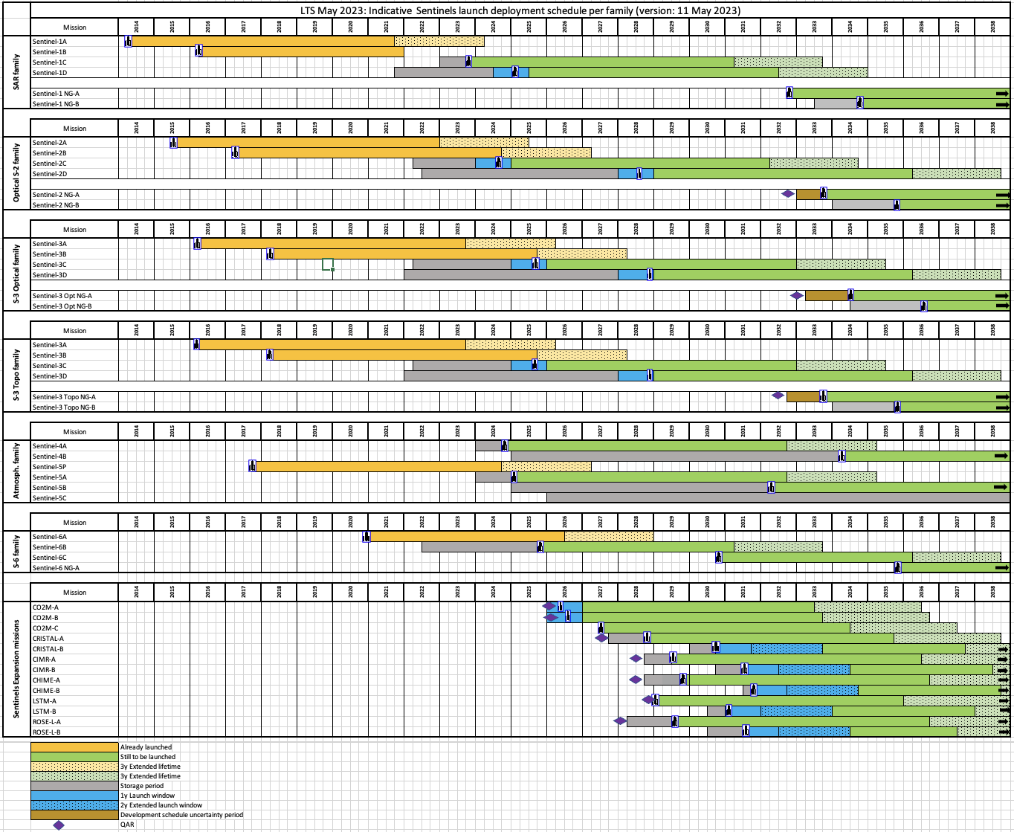
Sentinels indicative deployment schedule
To be updated following VEGA-C loss of flight in December 2022
Notes:
TWO IMPORTANT MESSAGEs:
Need for continuity for an operational Programme in support to policies ➔ obsolete units need to be replaced (typical lifetime between 7 and 12 years). Copernicus requires careful planning of replacement of space assets
Evolutions and improvements over time, following emerging needs and new technological availability ➔ Sentinels Next Generation and Sentinels Expansion Missions

Slide 7
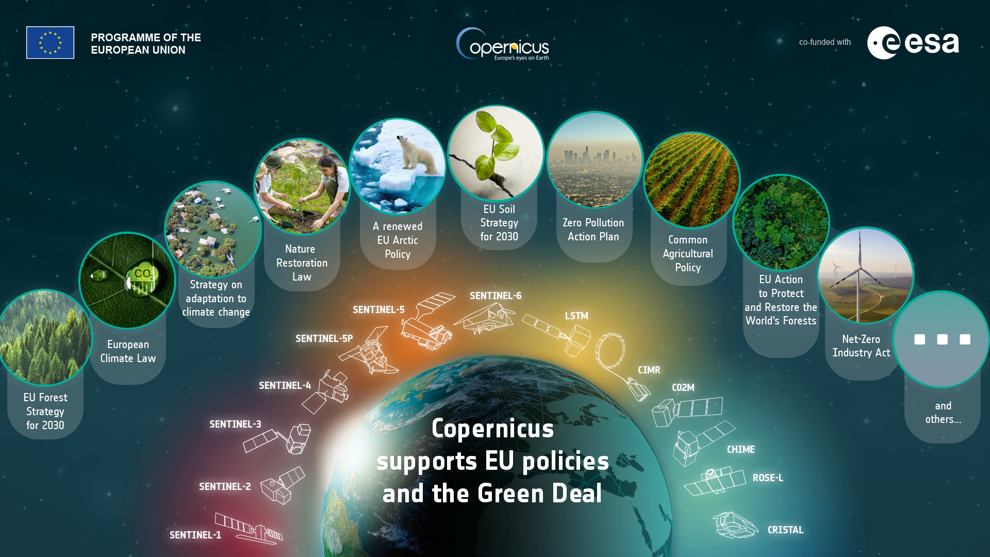
Sentinels continuity and evolution (1/2)
Notes:
Important to explain that each mission embarks different technology which is specifically designed to measure some specific parameters. They are complementary and COLLECTIVELY HELP TO BUILD THE PICTURE. The Copenricus Services merge much of this info to deliver refined products for the policy uesrs.

Slide 8
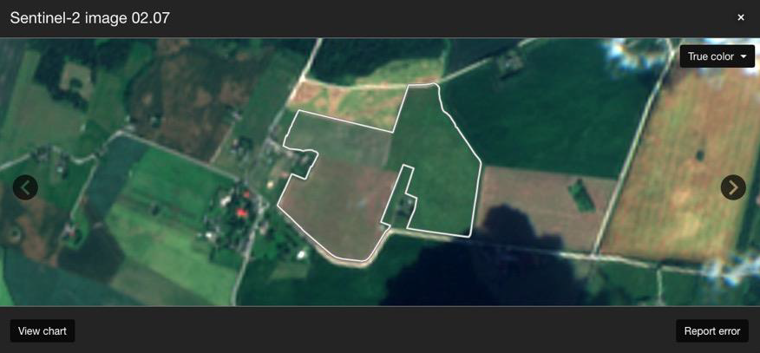
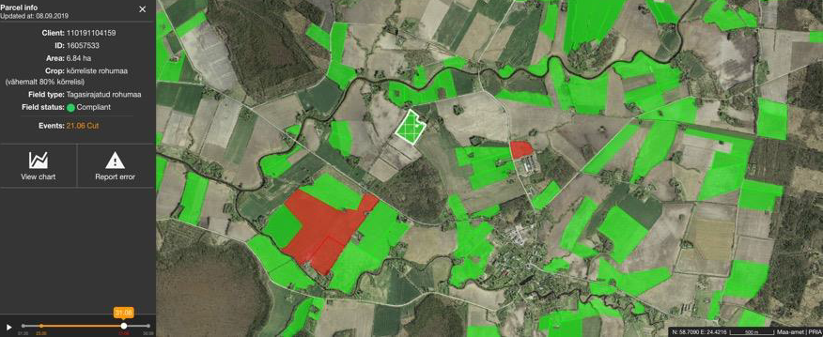
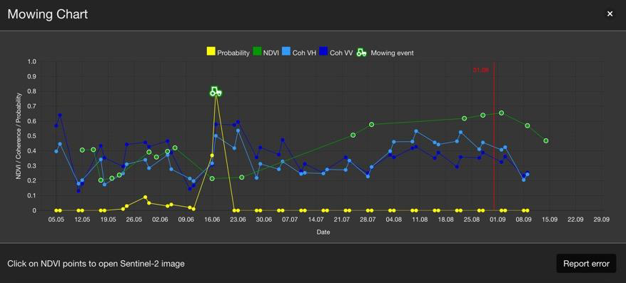
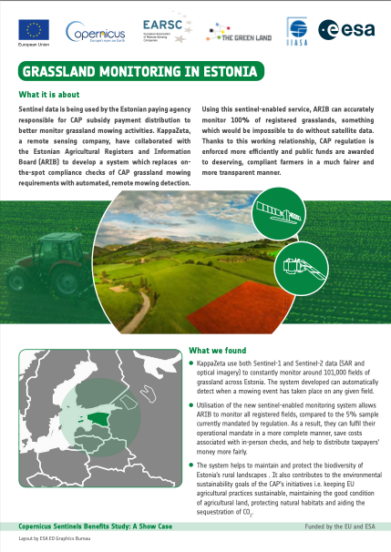
Sentinels for agriculture
Sentinels support CAP implementation in Estonia
True colour Sentinel-2 image of a randomly selected field
Example of Mowing Chart of a randomly selected, compliant field
SeBS full case analyses: https://earsc.org/sebs

Slide 9
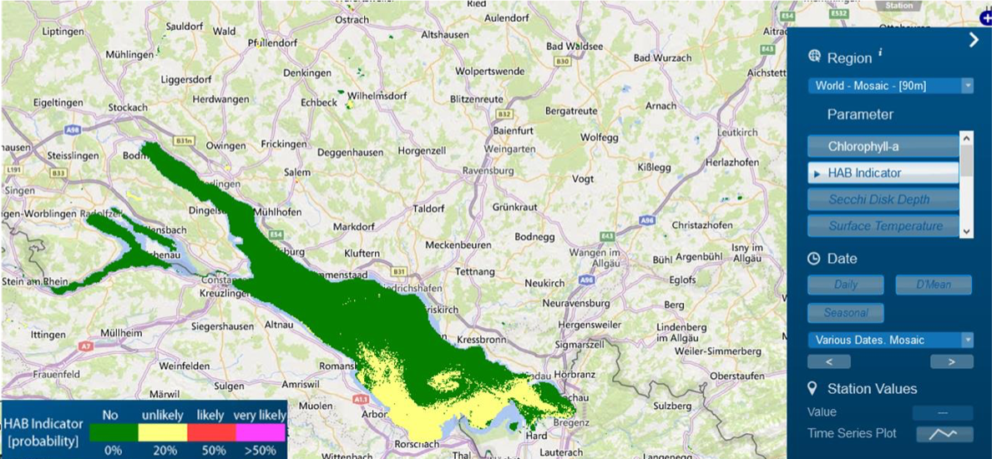
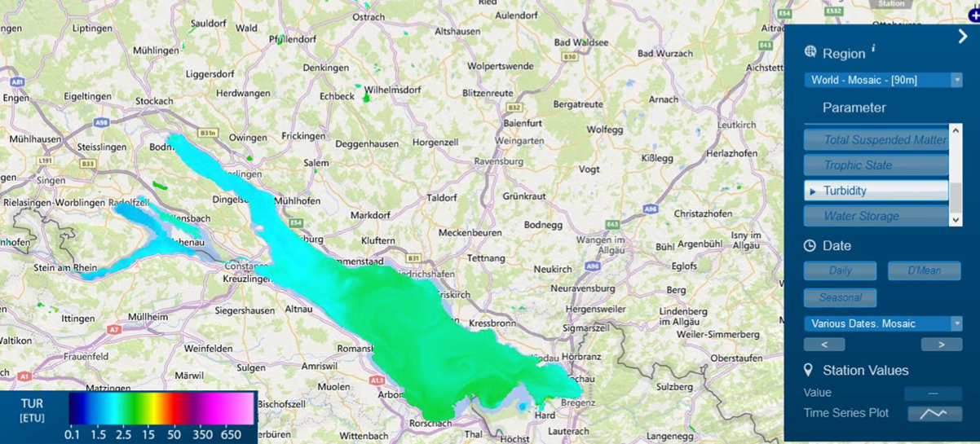
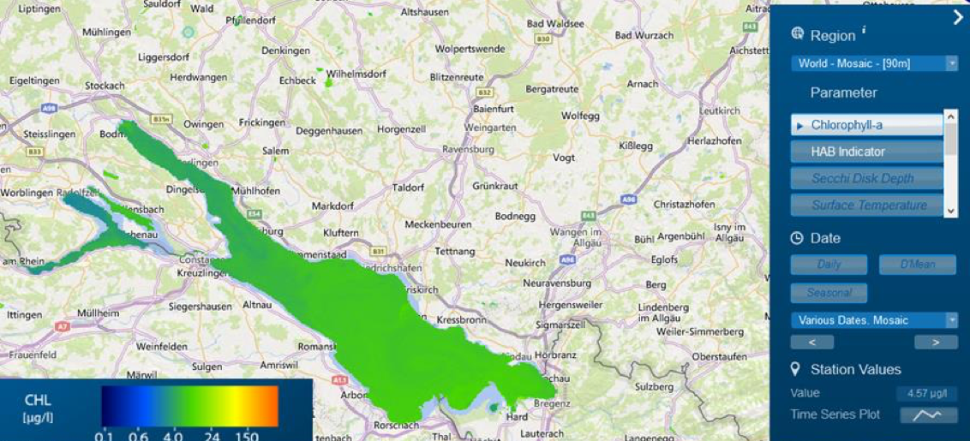
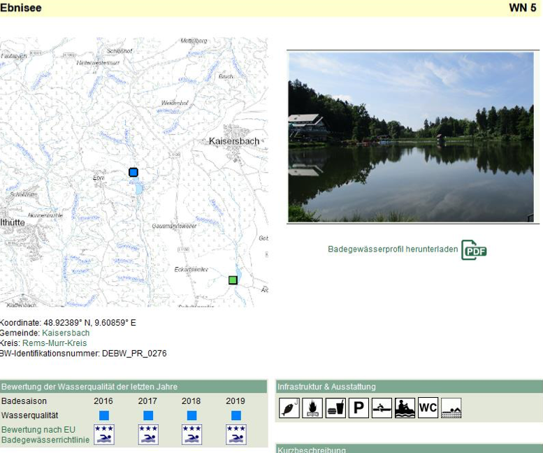
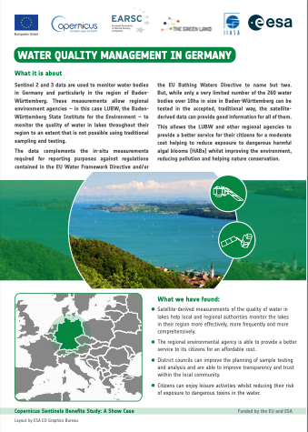
Sentinels for tourism
Lake Constance (from WWQP)
Turbidity levels
Bathing water information from the State Environment Institute of Baden Wurttenberg (LUBW) bathing sites portal.
SeBS full case analyses: https://earsc.org/sebs

Slide 10

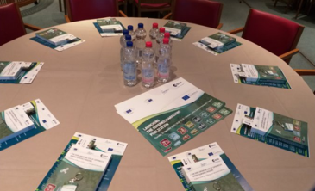
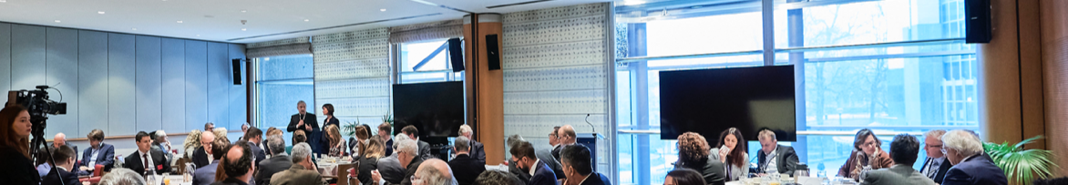
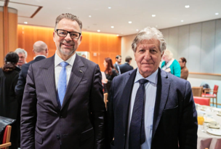

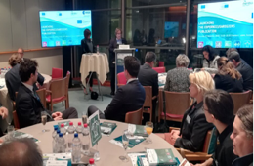
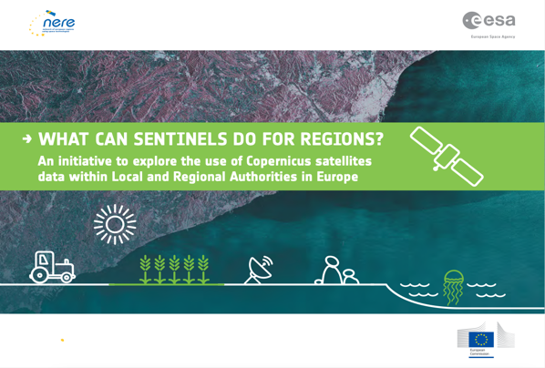
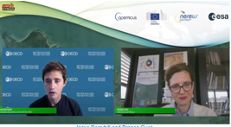
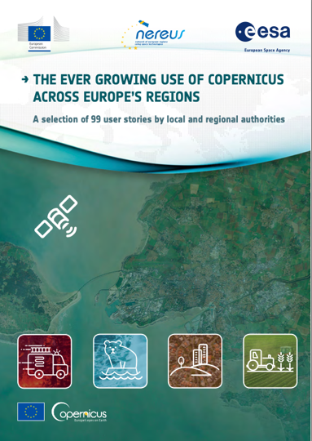
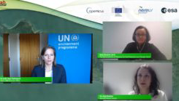
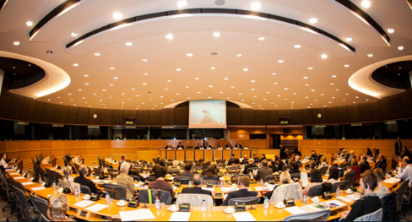
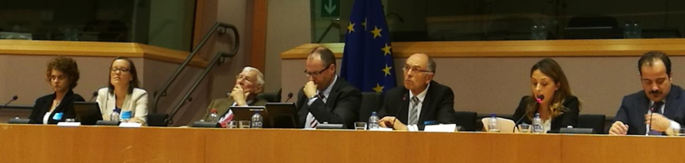
A long and fruitful cooperation with NEREUS
EP, Brussels, 2018
EP, Brussels, 2020
Covid, 2021
EP, Brussels, 2012
EP, Brussels, 2016
2013-2015
Notes:
ESA-NEREUS-EC cooperation based on sharing of knowledge and experience in use of Copernicus data and creating bridges between users, service providers and politicians at regional and EU level.
NEREUS provides an effective partner to link to these communities and acts as a facilitator to reach out to regional administrations
ESA welcomes the cooperation with NEREUS

Slide 11
Take home messages
Copernicus is an operational Programme, to remain available in the long-term. The long-term funding availability for the programme (MFF 2028-2034 and beyond) needs to be secured
➔ ESA works with the European Commission and its Member States to ensure enhanced continuity for the Space Component.
Copernicus data are a powerful tool for the implementation of a large range of policies
➔ ESA, together with the European Commission and the Entrusted Entities, promotes and supports the exploitation of Copernicus data
Showcasing successful examples of use of Copernicus data and services contributes to the long-term sustainability of the Programme
➔ ESA welcomes NEREUS efforts to advocate for Copernicus and looks forward to further developments through the Copernicus4Regions initiative and more.
Notes:
Today that all land masses are observed every 5 days at 10m with Sentinel 2 and every 12 days at 20m with Sentinel 1.
And those data is freely and openly available to anybody in the world.
All global landmass is observed every 5 days at 10m resolution
Sentinel-1 – C-band SAR imaging for All weather, day/night applications, interferometry
Sentinel-2 - High resolution multispectral Imaging for Land applications: urban, forest, agriculture, … Continuity of Landsat, SPOT
Sentinel-3 - Medium resolution multi-spectral imaging for Ocean & Global Land Monitoring Wide-swath ocean colour, vegetation, sea/land surface temperature, altimetry
Sentinel-5 - Geostationary Atmospheric sounding in UV, VIS and NIR, for atmospheric composition monitoring, pollution; S-4 is an instrument on MTG satellites
Sentinel-5P - precursor UV, NIR and SWIR sounder in low-Orbit for Atmospheric monitoring
Sentinel-5 - precursor UV, NIR and SWIR sounder in low-Orbit for Atmospheric monitoring; S-5 is an instrument on MetOp-SG satellites
Sentinel-6 – Michael Freilich; Altimetry reference mission

Slide 12


MAKE SPACE FOR EUROPE www.esa.int
ESA UNCLASSIFIED – For ESA Official Use

