Slide 1
European Regional Symposium
September 28 – 29 | 2023 Matera, Basilicata Region | Italy
Second Edition of the European Regional Symposium, on space data for tourism & agriculture, by NEREUS Regions

Slide 2
Region‘s profile: focus on agriculture
Tuscany Region is well known for its landscape and gastronomy, which are strong assets of its vast cultural and historical heritage. Agriculture and farmers are essential to keep this reputation and heritage.
> 640K hectares of UAA (10% vineyard; 12% olive; 70% arable);
> 52K farms (avg 12,3 ha);
90% of farms are individual or family business, accounting for 63,5% of the UAA;
30% UAA organic farming and >15% UAA integrated farming;
>12K farms already digitised (23,1% vs 15,8% for Italy);
Mostly hilly and mountain farmland (82% and 8%). Only 10% flatland;
5.277 Agritourism, 91 Geographic Indications, 464 Traditional Agrifood Products;
47% of the Region is forested area (>1M ha and 132 M cubic meters of timber stock).
Main values of Tuscany agriculture:
Environmentally sustainable (only few areas/sectors bear risks/concerns);
Strong contribution to landscape preservation and territorial marketing;
High share of quality productions;
Contribution to job creation (>70% 2010 → 2020 wage-labour);
Accounts for 3% of regional GDP and 2,3 Billion€ of added value.

Slide 3
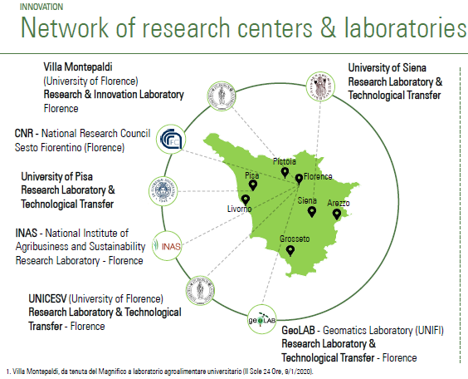
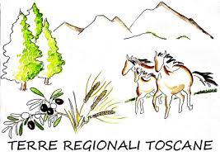
Region‘s profile: focus on agriculture
Innovation ecosystem
Demofarms as part of the regional Agricultural Knowledge and Innovation System (AKIS) in the frame of the CAP 2023-2027
…other actors involved in the AKIS process
Back office service for the AKIS (2024)
MoU
JRC-RT
Advisers/
Innovation brokers
Smart Specialisation Platform for Agri-Food
OGs-PEI AGRI, PIF, PIT, PID ...
Innovative projects (EAFRD)
ERIAFF Network
Community of Practice
EU Projects
12 Working Groups (Food Systems, Traceability and Big data etc)
Thematic Workshops & Matchmaking events
Annual Conference
HIGH TECH FARMING
PARTNERSHIP
(Coordinator: Tuscany Region)
Interreg CAMBIO-VIA (2019-2022)
H2020 NEFERTITI (2018-2021)
H2020 FOREST4EU (2023-2025)
H2020 STRATUS (2023-2028)
New Project proposals: ….. MULTISMART, etc
Precision Farming
& Digitalisation
Agenzia Regionale Toscana per le Erogazioni in Agricoltura

Slide 4
Preservation and protection of assets
ECONOMIC SUSTAINABILITY
SOCIAL SUSTAINABILITY
ENVIRONMENTAL SUSTAINABILITY
REDUCTION AND OPTIMIZATION OF PRODUCTION FACTORS
VALORIZATION OF THE PRODUCTION
IMPROVEMENT OF CROPS YIELD
TRACEABILITY OF SUPPLY CHAINS
SAFE USE OF AGRICULTURAL MACHINERIES
IMPROVEMENT OF WORKING CONDITIONS
ANIMAL WELFARE
ADOPTION OF SUSTAINABLE PRACTICES
PROTECTION OF AGROBIODIVERSITY
REDUCTION OF GREENHOUSE GAS EMISSIONS
WATER INPUT OPTIMIZATION
REDUCTION OF CHEMICAL INPUTS
PRECISION FARMING (PF) & DIGITISATION / SMART FARMING
«Various technologies are harmoniously applied to improve: working conditions, yield, production quality, efficiency and sustainability of crops»
(Osservatorio Smart AgriFood)

Slide 5
Preservation and protection of assets
Main technical and monitoring tools
Data set from the Integrated Territorial Information System for the governance of the territory (topographic, geological, pedological information bases of land use and cover, orthophoto maps, historical maps, aerial and satellite images and other information bases of the territorial heritage: hydro-geomorphological, ecosystems, urban settlements and agro-forestry);
Data set from the Information System of the Regional Agricultural Paying Agency (ARTEA): farm registry, georeferenced data from the graphic cultivation plan, the wine register, the Recording Notebook, Integrated Management and Control System (IACS), AMS monitoring system, forestry system of the Tuscany Region (SIGAF), etc;
Monitoring portal and technical support of the Regional Phitosanitary Service “agroAmbiente.info”;
Platform “IRTO – Irrigazione in Toscana” for the irrigation technical support

Slide 6
Preservation and protection of assets
Main policy and funding tools
Specific regional regulations
Regional Laws
Regional Plans and Programmes
Regional projects
Common Agricultural Policy (2014/2022 – 2023/2027)
EAGF - Direct payments and Sectoral Interventions
EAFRD - Rural Development Interventions (2023-2027)
Other regional initiatives related to innovation and digitalization
Smart Specialization Strategy and ERDF intervention
European Projects
European and International Networks and Associations
Call Type of Operation 4.1.1 of the RDP 2014-2022
Innovative investments in farms
December 2022
Call –FSC Funds 2021-2027
“Logistic and Digital Platform for E-commerce of Tuscan Agri-food Products”
October 2022
PNRR M2C1-Investment 2.3: Innovation and mechanisation in the agricultural and food sector
(Within 2023)
Intervention
«ACA 24 - Precision Agriculture Practices»
CSR Toscana 2023-2027
(November 2023)

Slide 7
Challenges and risks for your region
Climate change:
Water scarcity; droughts; new pests/diseases and invasive species; forest fires; soil erosion, floods and other extreme weather events
Socio-economic:
ageing population; depopulation of rural areas; uptake of innovation in farming practices; digital divide (rural/urban & SMEs/Large companies); competition on international markets; policy and regulatory changes
…and related needs:
Investments to improve farming and irrigation systems efficiency
Availability of reliable and accessible data: identification of areas, damages and more efficient payments/compensation
GNSS Network (Global Navigation Satellite System): implementation and "strengthening" of public GNSS stations in the region, also for needs related to PF (positioning/localization and navigation)
Space data: need for adequate spatial resolution of satellite data for control and payment purposes of the regional agency ARTEA and for PF systems (Data, Platforms, AI Systems, Decisions, Implementation, with particular attention to precision fertilization and irrigation)
Education/Training on new technologies and the potential for their application in different lines of agricultural sectors, targeting new and old generations of farmers
Ultra Wideband in Rural Areas

Slide 8
Thank you
ROBERTO SCALACCI, Tuscany Region - Director for Agriculture and Rural Development: roberto.scalacci@regione.toscana.it

