Slide 1
European Regional Symposium
September 28 – 29 | 2023 Matera, Basilicata Region | Italy
Second Edition of the European Regional Symposium, on space data for tourism & agriculture, by NEREUS Regions

Slide 2
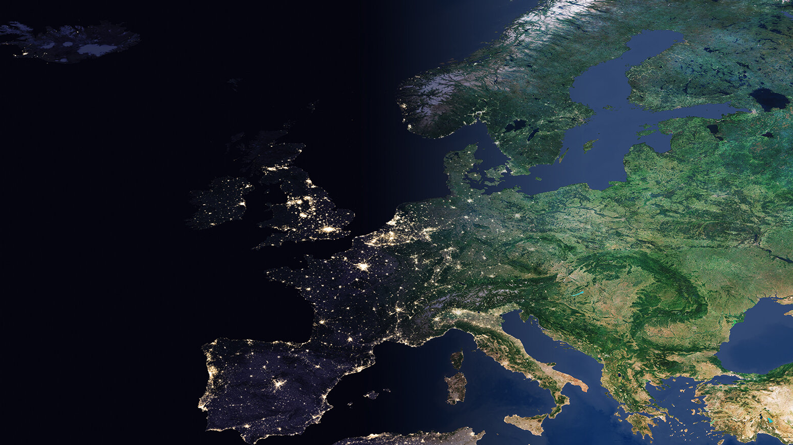
EUROPEAN SYMPOSIUM BY NEREUS REGIONS Space data for Tourism & Agriculture Thematic Session: Space data for tourism: linking space to user needs
The possible role of satellite data for the development of a digital twin for slow tourism in the Emilia Romagna Region
Morena Diazzi General Director Knowledge, Research, Labour and Enterprises
Emilia-Romagna Region - Italy
Photo: European Space Agency

Slide 3
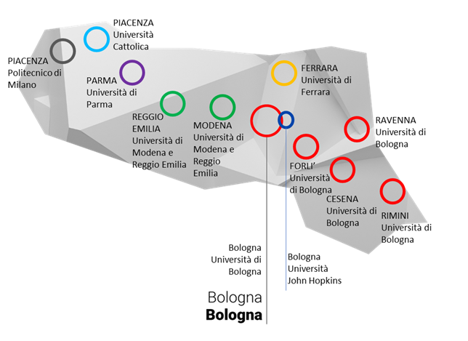
THE Emilia-Romagna ECOSYSTEM
4.500.000 inhabitants
400.000 companies | 42.000 manufacturing companies | 500 multinational companies
7 National and International Research Centres
95 Research and Innovation Accreditated Laboratories + 10 Technopoles + 65 IR ESFRI
6 Universities with 166K students + Bologna Business School + John Hopkins University
Clust-ER Tourism + 10 Clust-ER for Research and High Skills
Actively involved in over 50 European networks → NEREUS
2 European Agencies/Authorities
34 Incubators and accelerators in IT-ER Network
National Champion HPC/Quantum Computing
Co-location Center EIT Culture & Creativity
Member of European Partnerships for Regional Innovation
1° Region in ITALY
«Regional Innovation Scoreboard 2021»
ARTE-ER + APTservizi+ARPAE+LEPIDA
4 UNESCO cities (Ferrara, Modena, Bologna, Ravenna)
10 UNESCO sites
543 Museums
3 Tourist Destinations
1 Tourist Promotion Agency APT
> 10% Value Added Tourism Sector

Slide 4
Emilia-Romagna Context, Infrastructures and European Networks
New s3 2021-2027 : SPACE ECONOMY, TOURISM, CRITICAL INFRASTRUCTURES, BIG DATA
The Leonardo supercomputer (the fourth most powerful computer in the world)
The National Research Center for High Performance Computing, Big Data, and Quantum Computing
The ER2Digit European Digital Innovation Hub
The ECMWF data center
LABORATORIES (AI, CNR NANO S3) CLUSTERS, SPACE ECONOMY FORUM
NETWORKS
NEREUS
NECStouR
ISTO + CTNA (NATIONAL CLUSTER)

Slide 5
Emilia-Romagna Tourism Numbers
EMILIA-ROMAGNA TOURISM IN BRIEF:
Annual arrivals > 14 million (including second homes and short-term rentals)
Annual presences > 60 million
Tourism by Areas
Tourism by Areas
Arrivals
Nights spent
Seaside and Beach Resorts | 7.1 million | 43 million
Art Cities | 3.6 million | 8 million
Apennines & Mountains | 0.7 million | 2.9 million
Spa Places | 0.4 million | 1.2 million
Other Locations | 1.7 million | 5.2 million
Source: Regional tourist observatory - Trademark Italia
Supply Chain in Brief:
Total Accommodations | 17.278
Total Beds | 451.526
Source: Tourist offer analysis - Emilia-Romagna Region Statistics Department
The tourism industry in Emilia-Romagna generated direct tourist spending of 4.6 billion euros in 2022 which, added to related activities, brings the sector to 13% of the regional GDP
Notes:
In 2022 the tourism industry, added to related activities, constituted 13% of the regional GDP of the Emilia-Romagna region, generating a direct tourist spending of 4.6 billion euros.
With its 60 million nights spent per year, it represents a fundamental income for destinations, especially during certain seasons, such as summer.
Great part of the economy developed by seaside cities finds lots of its basis in the tourism sector, but metropolitan cities are also starting to feel the effects of the changes brought by the tourist economy, as are mountain areas

Slide 6
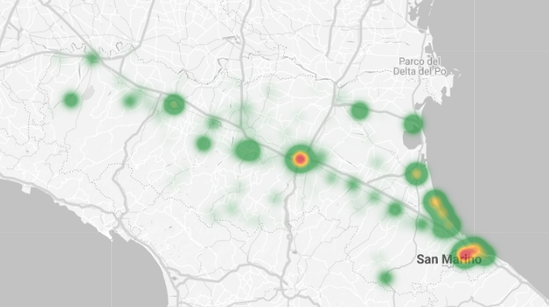
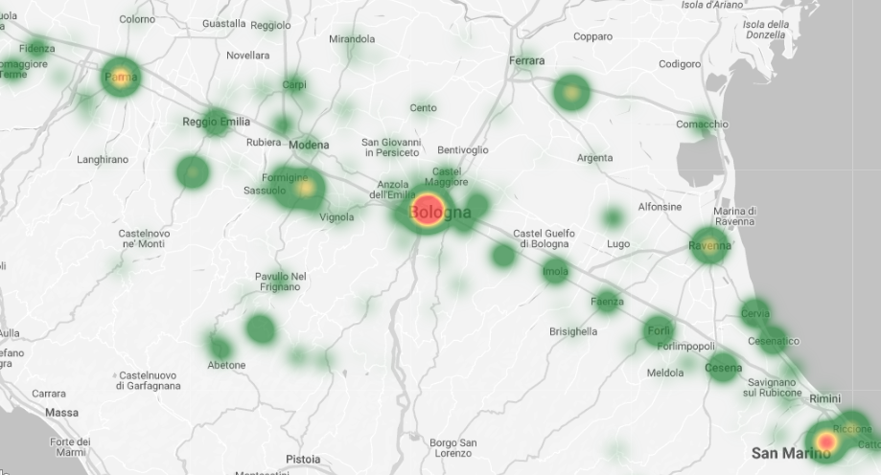
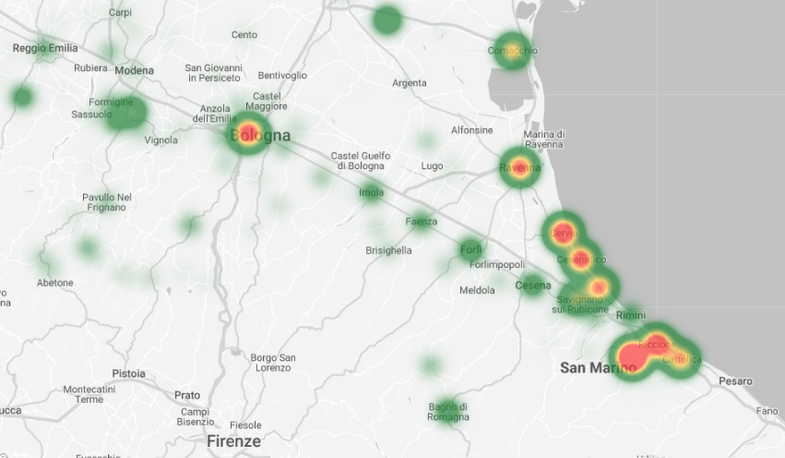
Emilia-Romagna
Tourism Distribution
TOURISM IN EMILIA-ROMAGNA IS WIDELY DISTRIBUTED ALL ACROSS THE REGION
…with different patterns and seasonality
Heat Map - Tourist Arrivals February 2022
Heat Map - Tourist Arrivals 2022
Heat Map - Tourist Arrivals August 2022
Monitoring tourism anthropic pressure, mobility and behaviours - especially in some seasons and destinations - is a key value for the long-term sustainability and planning of the Region.
Data Source: Tourism Arrivals 2022 - APT Dashboard, Emilia-Romagna Region Official Data
Notes:
Even if, from a general perspective, tourism flows in Emilia-Romagna seem to be distributed all across the Region, a more detailed look during the year unveils different patterns and seasonality.
Seaside destinations suffer from extensive anthropic pressure during summer (and a tendency to empty during autumn and winter) that needs to be managed by local authorities and stakeholders.
Art Cities need to face different city users, such as workers, inhabitants and tourists, and between tourists, face different tourism (health, work, business, study, leisure, events, concerts, etc)
Mountain resorts, on the other hand, attempt to reverse the depopulation of the ancient villages, trying to create economies that can guarantee a good standard of living, while simultaneously guaranteeing environmental sustainability.

Slide 7
Data Science and Digital Twins - focus Slow Tourism
PROJECT CONCEPT
KEY CONCEPTS
PARTNERS
TARGETS
Holistic view of tourism industry
Break the data silos among Institutions.
A federated data sharing initiative, to collect and analyse data for tourism, participated by all industry stakeholders.
Take advantages and capitalize the thesaurus of data sources, institutions built in last years.
Build Trust among stakeholders and run organic projects, bringing advantages for all
Emilia-Romagna Region
Official Tourism Board of Emilia-Romagna Region
DG Knowledge, Research, Labour and Enterprises Emilia-Romagna Region
Research and University Department Emilia-Romagna Region
Cineca - supercomputing centre for scientific research Emilia-Romagna
Alma Mater Bologna University
Digital Agenda Emilia-Romagna
Better management for tourism Industry
Promote Sustainability and new products
Build Digital ecosystem for sharing data and solutions
Join forcers together, and feed the Digital Ecosystem
Find new key analysis and patterns
Workforce knowledge enrichment
Notes:
A vision of tourism as an isolated industrial sector is no longer sufficient, especially due to the long-term effects it generates for a territory and its inhabitants.
We need a broader vision of the tourism phenomenon to:
understand the effect of choices and policies on multiple levels, in the long term and on apparently distant sectors.
remain competitive in the world tourism industry,
think of new products for our customers
seek a difficult balance between sustainability and economy.
To do this we need to team up with the authorities and local stakeholders, operating in the tourism industry

Slide 8
Data Science and Digital Twins - focus Slow Tourism
PROJECT STEPS
Building governance and trust among Administrations to retrieve and extract data from existing silos
(Transport, Environment, Smart Cities, Tourism, Culture, Accommodations, Offers, Web & Social Analytics, etc)
Map external data sources and historical data
(Demand Data, Bookings, Tourism Expenditure, Flights Data, House Rental, Satellite Data, etc, etc)
Build Components and Start Connecting Sources
(Data Model, API Ecosystem, Storage, Governance, Computation, Ownership)
Work Together and Build Culture step-by-step (Engage cross-team collaboration, Analyse Data, Visualize Insights, Share Benefits and feedbacks, Develop new Data Sources)
Try Again. Fail Again. Fail Better (Evaluate results, new findings, possible bias and problems. Build new data layers, Restart the process)
Notes:
We plan to start building a Tourism Digital Twin prototype starting from:
Sharing of the information assets that administrations already generate for their own tasks,
building rules and a governance that can increase trust between different actors,
looking together for new ways to increase the available information base,
We plan also to build the technical components and ecosystem, that promote by default a sharing and data-driven culture (that does not penalize development... and the inevitable failures).

Slide 9
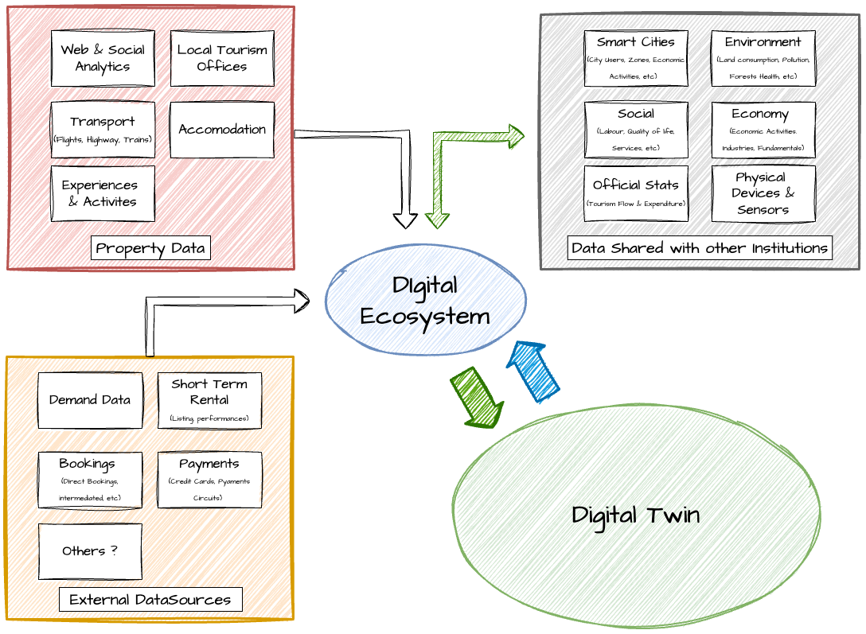
Data Science and Digital Twins - focus Slow Tourism
PROJECT SCHEMA
1.0 Defining Projects & Data Sources
What questions must the "Digital Twin" answer first?
What data sources are needed to generate the first analysis form?
Who will participate in the IT team that will manage the first Twin module?
How much economic investment is necessary to power the first module?
What is the estimated operational cost in normal conditions?
2.0 Data Governance & Acquisition
Building Distributed Ecosystem
Define Governance & Ownership
Data Acquisition
Data Exploring
Data Analysis
Data Modelling
3.0 Communication & Evaluation
Dashboards
Feedback
Update projects Targets
New Question?
Notes:
We have set three steps to be clear about what we need to do and how we want our ecosystem to be built.
Define questions and objectives
Build the architecture and start populating it
Evaluate results and improve them
To do this we need the collaboration of everyone involved, so that the project can bring value to everyone
A shared ecosystem is the best technical solution to achieve this result, a data space from which each partner can derive value based on specific policies and governance.

Slide 10
Other projects
DIGITAL TWIN FOR AIR QUALITY
A system for simulating, within the context of climate change, the effects of air quality of decision related to regional policies (transport, mobility, energy, ...)
The system will support planning effort aimed at improving air quality and the adaptation to climate change through a) the analysis of climate change scenarios; b) daily assessment of air quality; c) 3-7 days forecasts
The system will be interconnected with large-scale components of meteorology, climate, ad air quality developed by national and European initiatives (Destination Earth-ECMWF, GLORI-DWD, Cyber Italy etc.)
BOLOGNA CITY DIGITAL TWIN

Slide 11
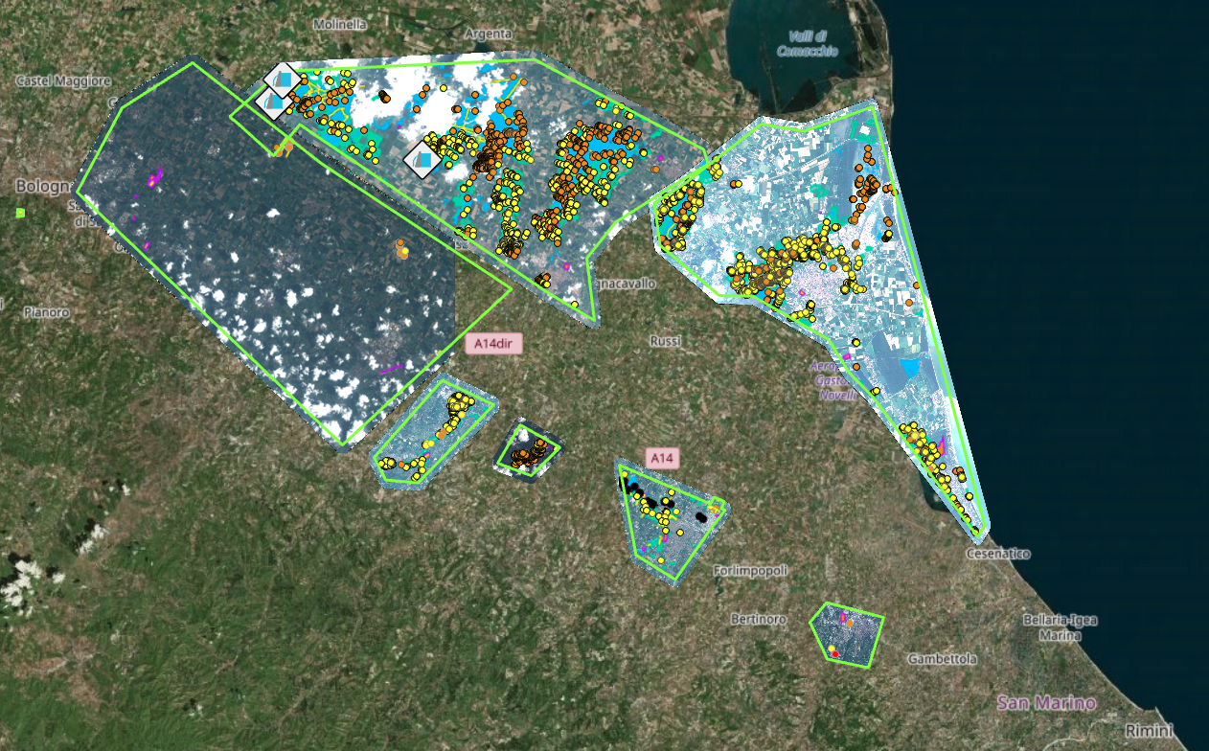
Copernicus & Tourism
A REAL USE IN EMILIA-ROMAGNA
Crisis Management
In the first 48 hours of the disastrous flood in May 16th - 17th in Emilia-Romagna, satellite data provided great support to emergency vehicles, but also to tourist communication.
(EMERGENCY MANAGEMENT SERVICE COPERNICUS)
Photo: Copernicus Emergency Management Service - EMSR664 - Flood in Italy
By combining satellite data with information from local tourist offices, it was possible to activate rapid communication with tourists, immediately reporting the areas affected by the flood and those that were open.
Notes:
Satellite data from tourism perspective: when we have already used them
Flood on May 16th - 17th, 2023 in Emilia-Romagna, satellite data provided great support to tourist communication.
By combining satellite data with information from local tourist offices, it was possible to activate rapid communication with media and tourists, defusing possible alarmism, giving exact communication, reassuring market operators, in short, limiting the losses of an unpredictable and catastrophic event.

Slide 12
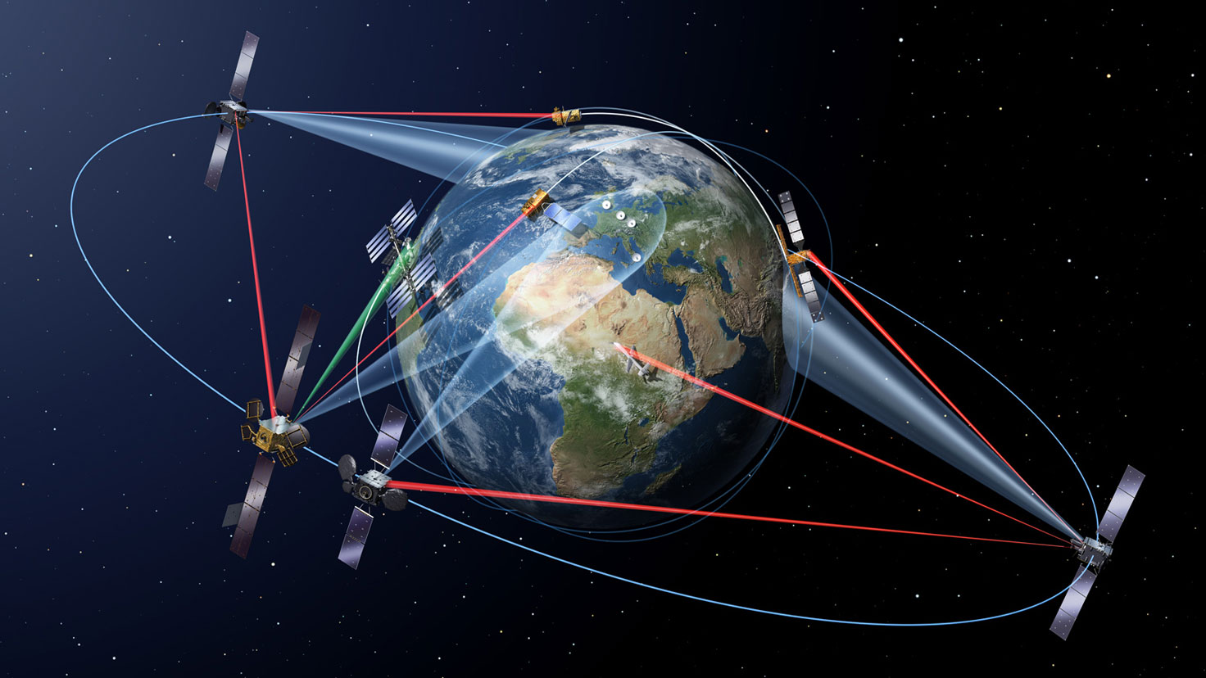
Copernicus & Digital Twin
Land, Marine Preservation and Destination Management
Monitor the marine ecosystem, coastal erosion and ship traffic
Effects of urbanization on Apennines forests
Effects of Tourism Flows in rural areas
Land consumption of large cities
Photo: Sentinel Online https://sentinels.copernicus.eu/
Information and insights for Tourism Industry management and new data to enrich Digital Twin Analysis.
Planning human activities and their impact
Being an attractive
Destination
Notes:
Starting from:
The new articulations of the tourism industry (mass flows, anthropic load, impact on the environment, impact on the lives of citizens)
Our experience using satellite data
We think that in the future this type of data source will be extremely useful for aggregate analyses and forecasts made by Digital Twin
Detecting the impacts of human and economic activities on the natural ecosystem will be an increasingly fundamental element for the well-being of a territory and for the balanced management of its economic activities.
A territory that offers a good quality of life and is culturally active is also a touristically attractive territory.

Slide 13
Other contributions of Emilia-Romagna
IRIDE (National Recovery and Resilience Plan Program)
The IRIDE program, funded by the National Recovery and Resilience Plan is a «constellation of constellations» as composed by:
a constellation of Low-Earth-Orbit Satellites (Upstream segment);
a ground infrastructure (ground segment)
a series of services dedicated to public administrations
The Emilia-Romagna Region is primary end user for the development of services dedicated to the monitoring of soil organic carbon and the quality of air
NEREUS (Earth Observation) in collaboration with Veneto Region
Region participation to NEREUS events and activities
TARGETS 2025 EMILIA – ROMAGNA tourism
More security, more sustainability , more accessibility……
And more enjoyable tourism

Slide 14
Thank you!

