Slide 1
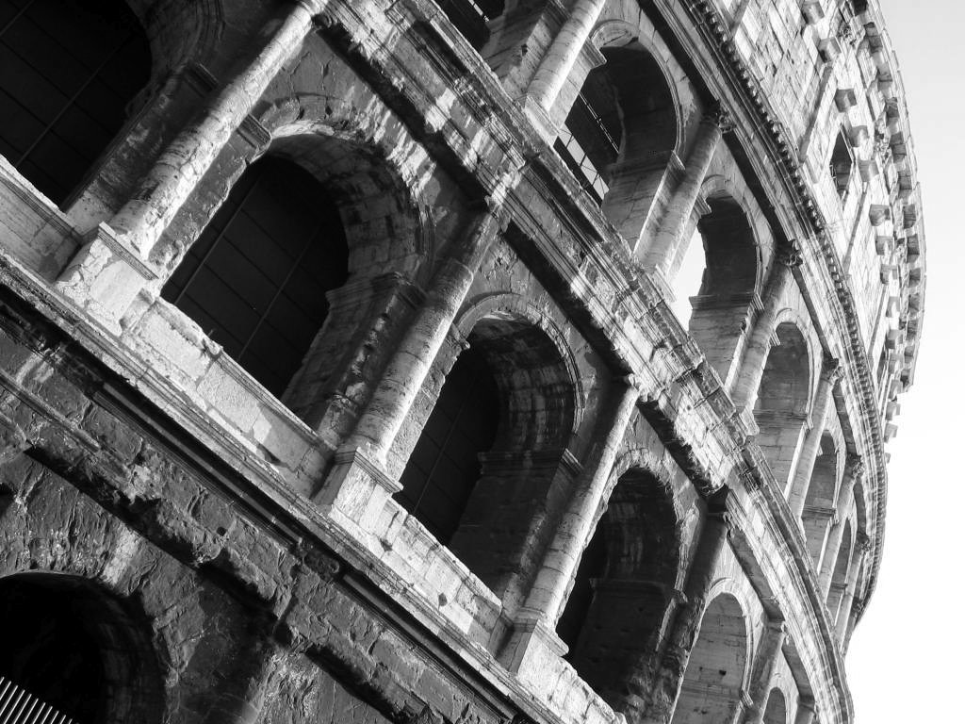
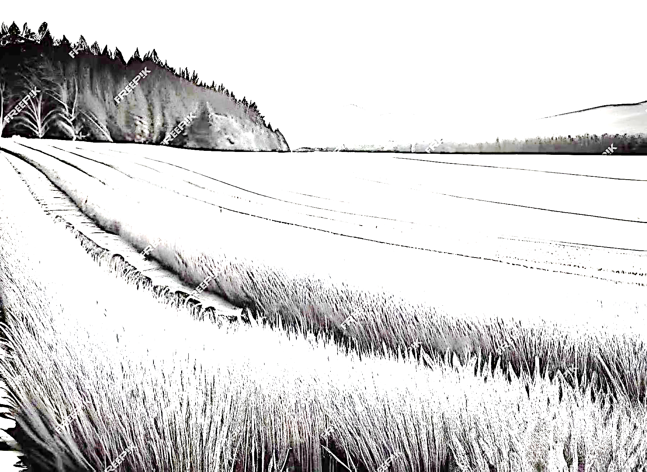
The National Copernicus User Forum coordination activities to support agriculture and cultural heritage monitoring
Nico Bonora
On behalf of Andrea Taramelli, Copernicus National User Forum Coordinator
Matera, 28 September 2023

Slide 2
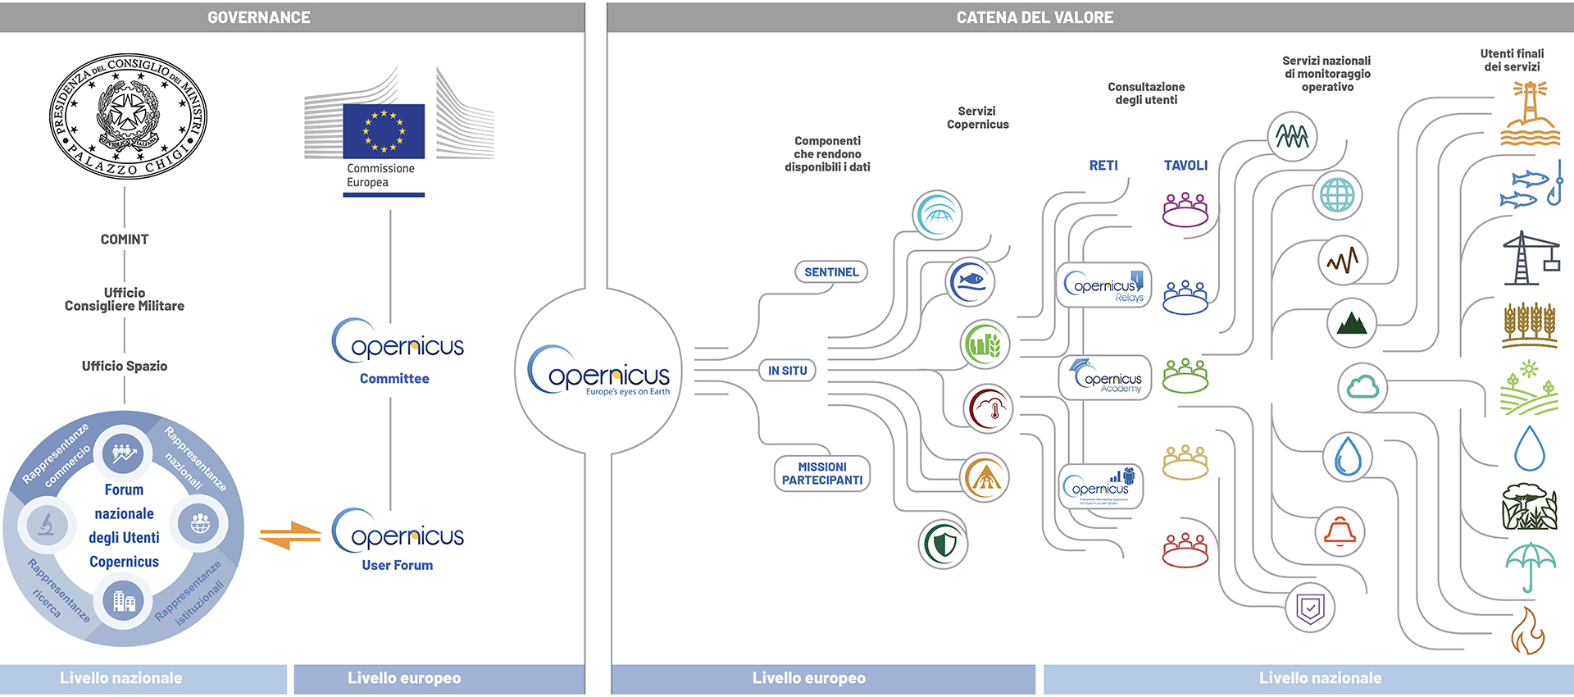
The space governance and the value chain

Slide 3
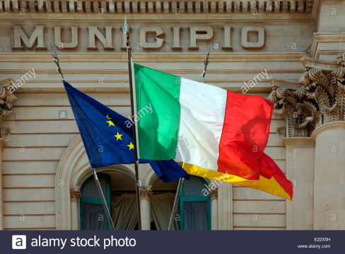
Governance
The National Copernicus User Forum
Institutional Representatives
Relay National Network
National Copernicus Users Forum
(Presidency of the council of Ministers)
National Representatives into internazionali boards
Commercial Representatives
Academy National Network
Research Representatives
Emma Schiavon – 26.03.21

Slide 4
Governance Europea e Nazionale
Forum Nazionale degli Utenti del Programma Copernicus
Consultation Boards
Security (Cheared by he Ministry of Defence)
Infrastructure & Transports (Chaired by the Ministry of Sustainable trasports)
Cultural Heritage (Chaired by the Ministry of Cultural Heritage)
Agriculture (Chaired by the Ministry of Agricoltural policies)
Environmental protection (Chaired by ISPRA)
Coastal (ISPRA)
Valorisation - Industry and Enterprises (Chaired by MIMIT)
Dissemination (Chaired by ISPRA)
Emergency (Chaired by the Department of Civil Protection)
Copernicus Network
Copernicus Relay
Copernicus Accademy
National Board contributing to the users requirements coordination
Operational Geology (Chaired by ISPRA)
Operational Climatology
Air quality (Chaired by ARPAE)
Climate (Chaired by ISPRA and ARPAE)
CO2 (Chaired by ISPRA and CNR)
Operational Idrology (Chaired by ISPRA)
GREEN-NET (Chaired by MIMIT)
Notes:
ASAS - Associazione per i Servizi, le Applicazioni e le Tecnologie ICT per lo Spazio
AIAD Aziende Italiane per l’Aerospazio, la Difesa e la Sicurezza.

Slide 5
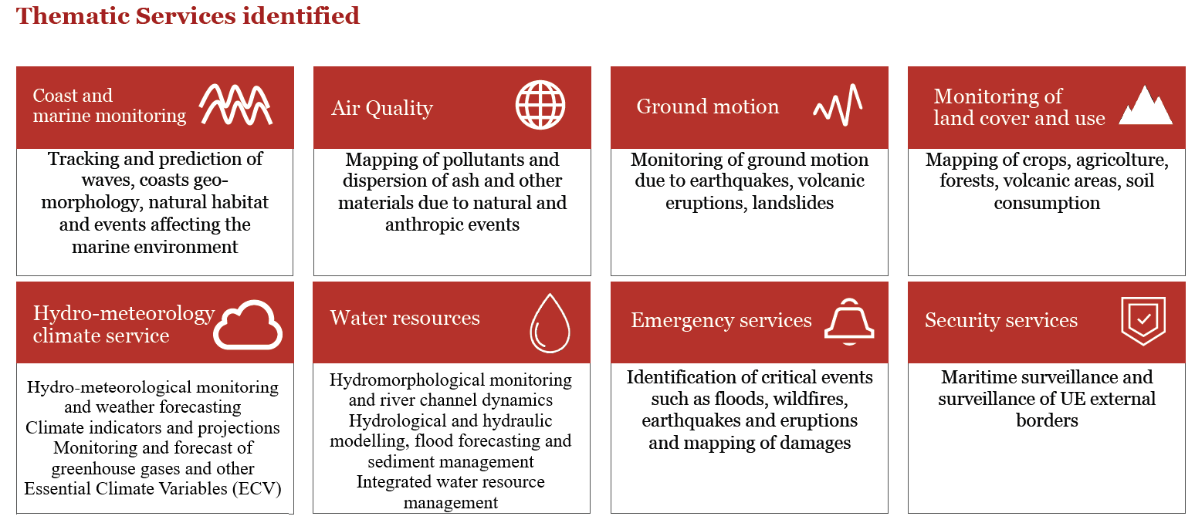
Interaction with Institutional users resulted in the identification of specific thematic services
Cultural Heritage
Agriculture

Slide 6
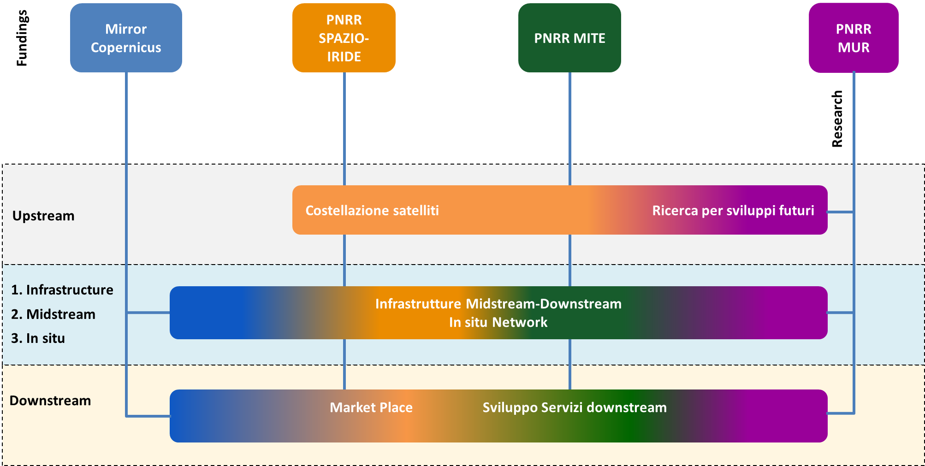
Integration of economic resources
PNRR MASE-SIM
€ 254 mln
€ 1,4 mld
SIM: € 500 mln
MER: € 400 mln
HPC only: €320 mln
HPC

Slide 7
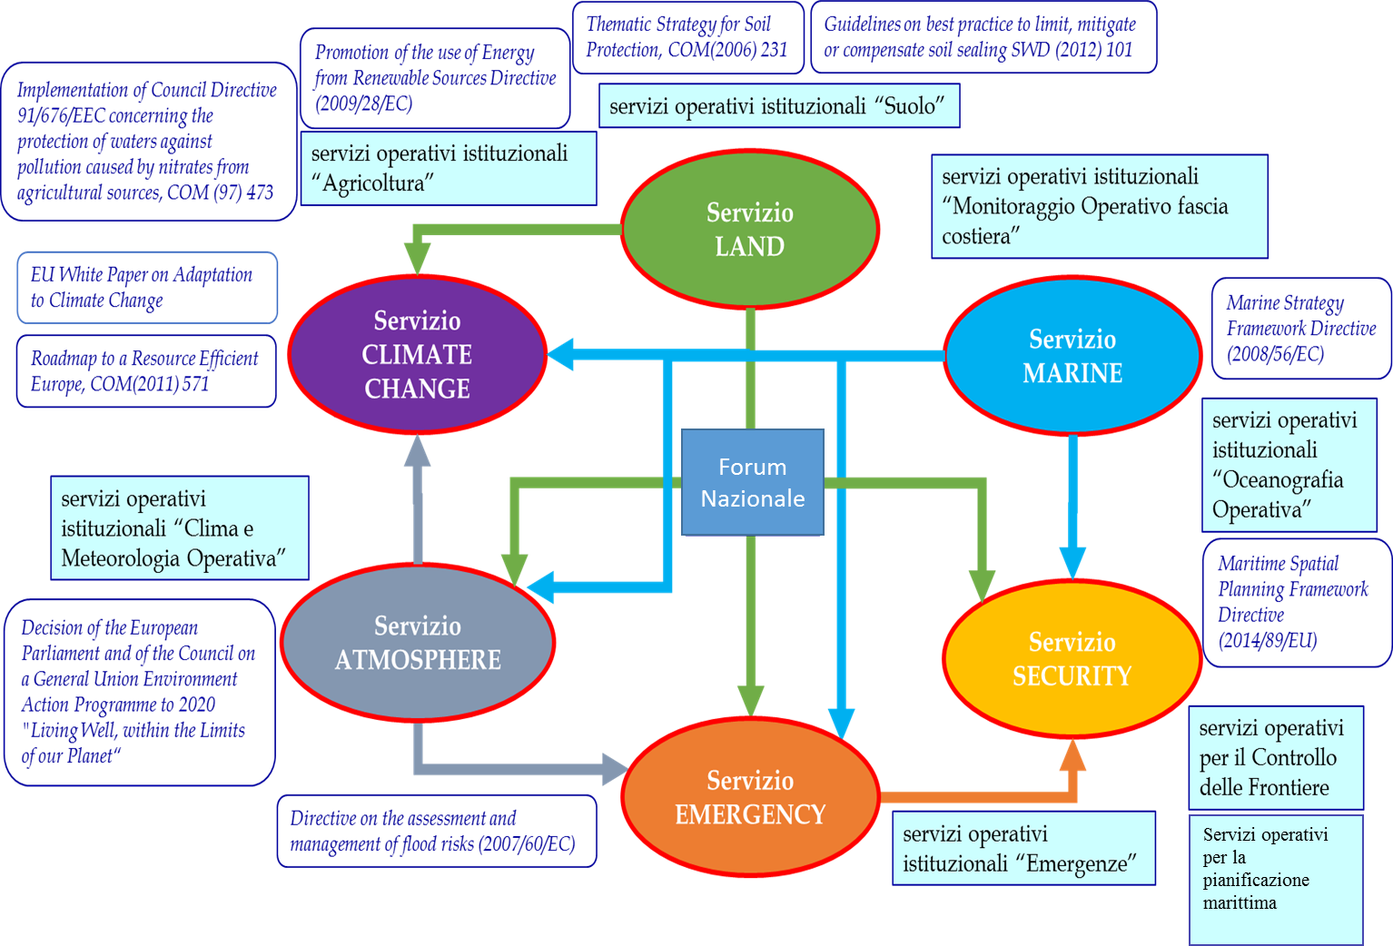
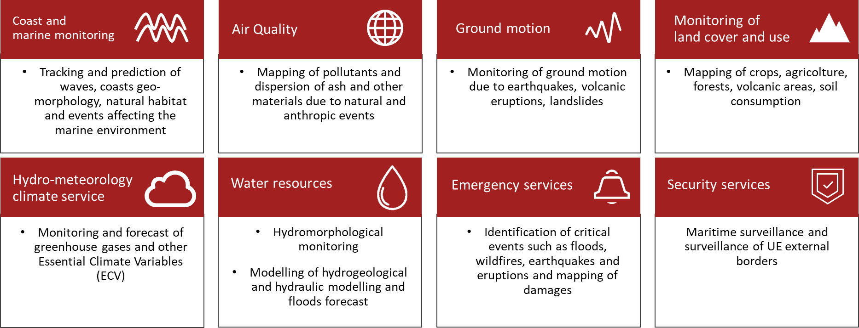
Scientific & technologic innovation applied to monitoring requirements
The scietific and technical Support
Scientific & Technologic Innovation
The role of the research community is to accompain the user to refine the requirement on top of the most advanced tecnology, even at projectual/experimental phases.
Market uptake and
downstream development
(Valorisation Board coordination)

Slide 8
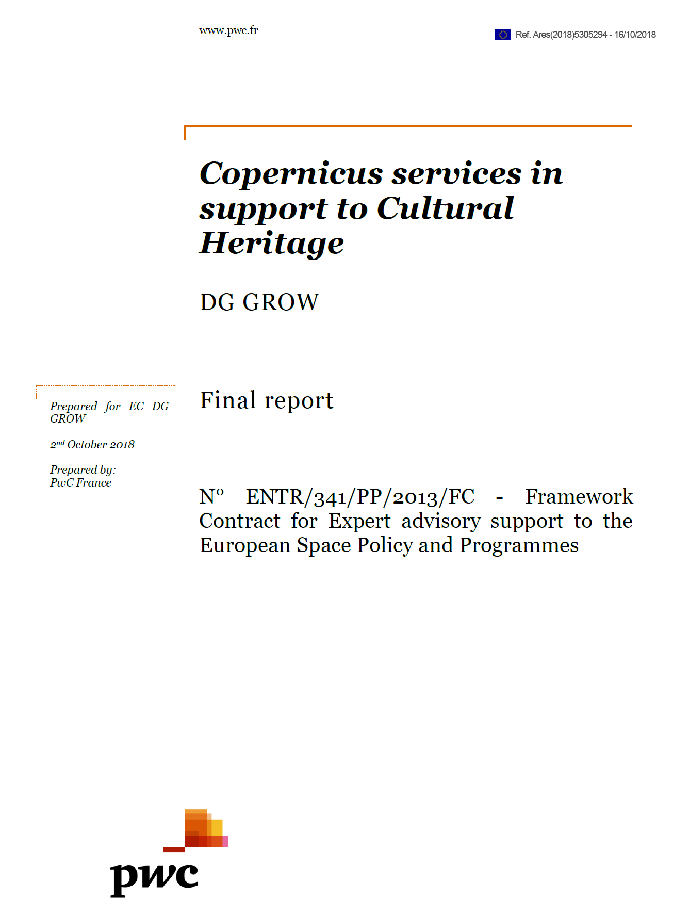
Copernicus Cultural Heritage Task Force
The activity of the Copernicus Cultural Heritage Task Force, based on the outcomes of the study “Copernicus services in support to Cultural Heritage” (PwC, 2018) was aimed at identifying the best option(s), to facilitate Cultural Heritage community access to Copernicus products.
The Task Force (Italian leadership – Ministry of CH as chair) aimed to retrace the study's approach to: a) analyze and consolidate the contents of the study in terms of user needs; b) codify the needs for the identification of unique requirements; c) Validate the requirements, through the interaction with the Copernicus Entrusted Entities, in terms of current and potential
monitoring services; d) Validate the best one of the three hypotheses envisaged in the PwC study, that are: - keep the current system for access to data by CH users (No action); - provide CH users with an interface that collects data from the different Core Services (thematic hub); - create a new Core Service for CH users.

Slide 9
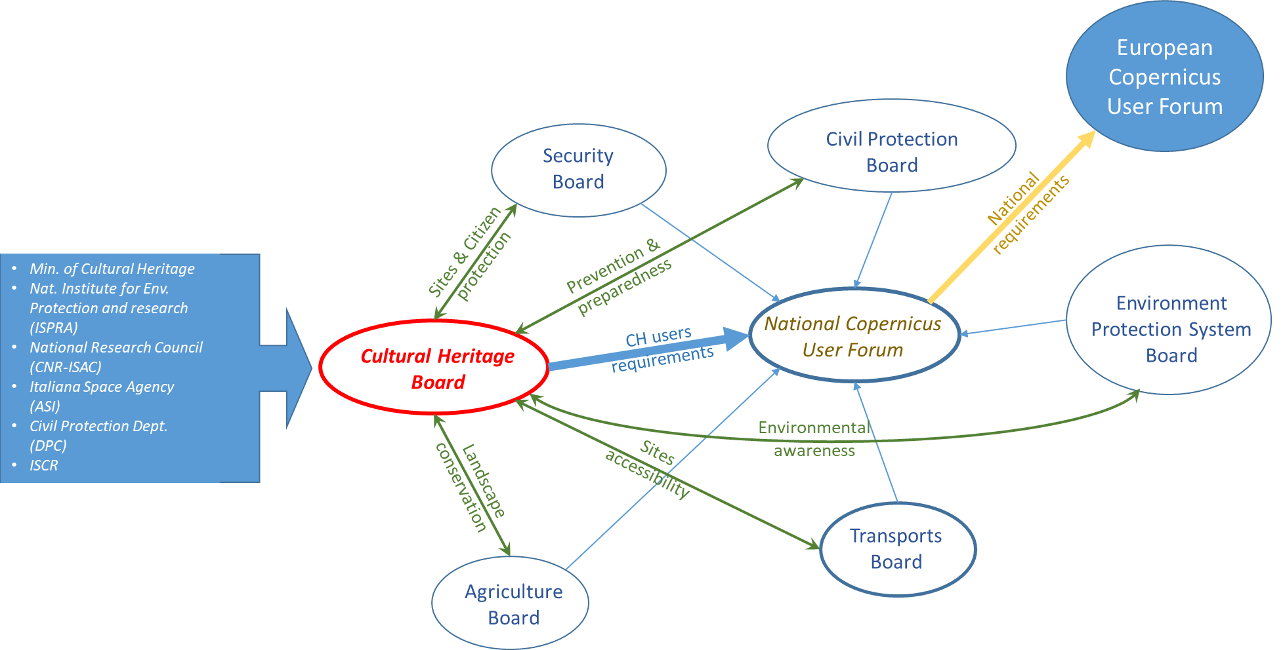
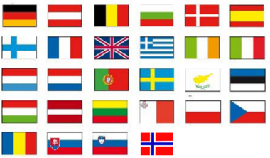
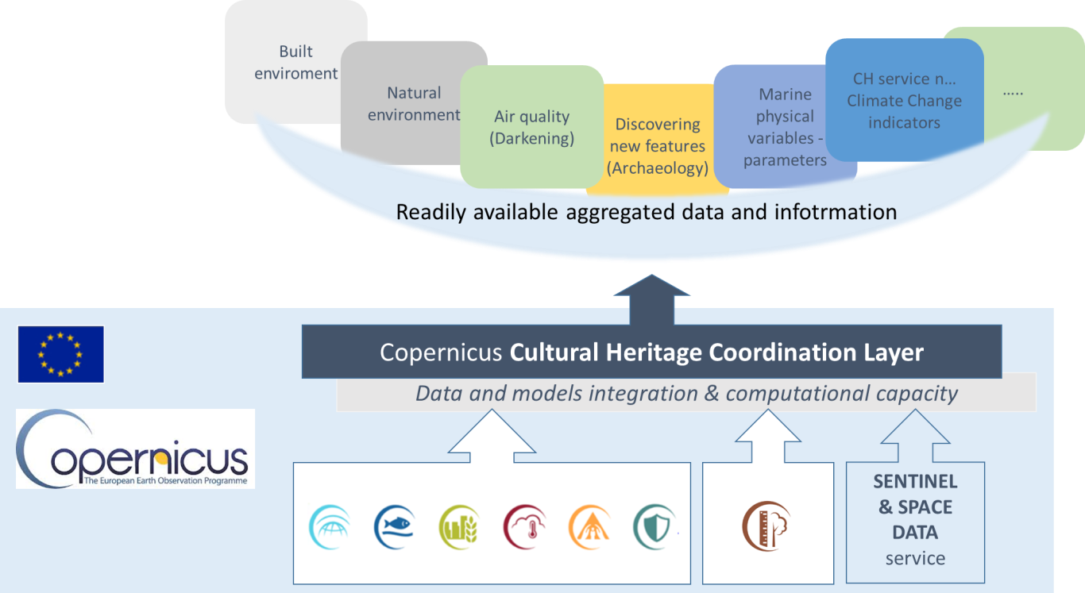
The National organisation of cultural heritage board:
toward the European coordination
EU Copernicus CH Task Force
(Led by Ialy)
75 users needs filtered and analised
41 unique requiremnts identified
identified Infrastructural
copernicus solution
Climate
Board
Many of the requiements identified by the CCH-TF are satisfied by current copernicus services & products.
A common interface (e.g. the Coordination Layer) to access aggregated services informations is needed to support the management, protection and conservation of cultural heritage EU assets.

Slide 10
FPCUP 2018-2024 program proposal
The GM Road Map will be supported at national (follow up at European scale ) also with three different FPCUP proposal (two of them already funded):
Action 2018-1-76: Workshop on Conservation and Sustainable Exploitation of Cultural Heritage: budget 15k Euros
Action 2021-2-26: Cultural Heritage Technical Group : budget 207,85K Euros – To follow up the activities identified by the Copernicus Cultural Heritage Task Force to create a permanent EU Working Group

Slide 11
AGRICULTURAL FRAMEWORK – Use of Remote Sensing Data
Regulation (EU) 746/2018: Copernicus Sentinels satellites integrated with EGNOS/Galileo monitoring data:
Continuous
Reliable
Systematic
Replaced by:
Repealed by regulation (EU) 2022/1173 laying down rules for the application of CAP instrument i.e.
Area Monitoring System exploiting Copernicus Sentinels satellites data (LC/LU) (Regulation (EU) 2021/2116)
Directive 2008/50 (EU) Air Quality: LC/LU to support environmental sustainability through the monitoring of agricultural practices (i.e. manure spreading)

Slide 12
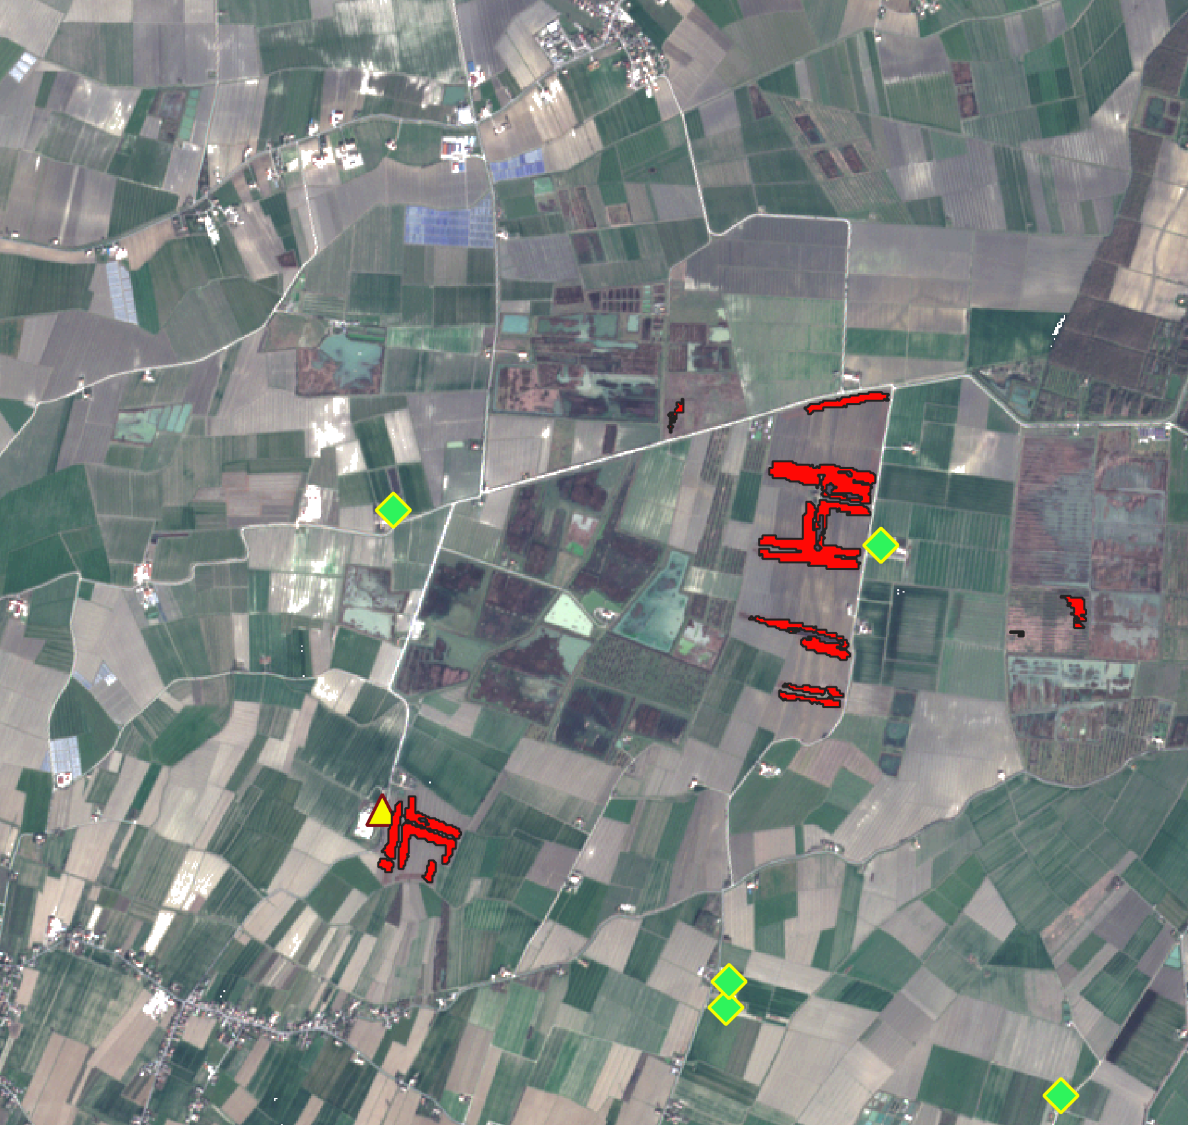
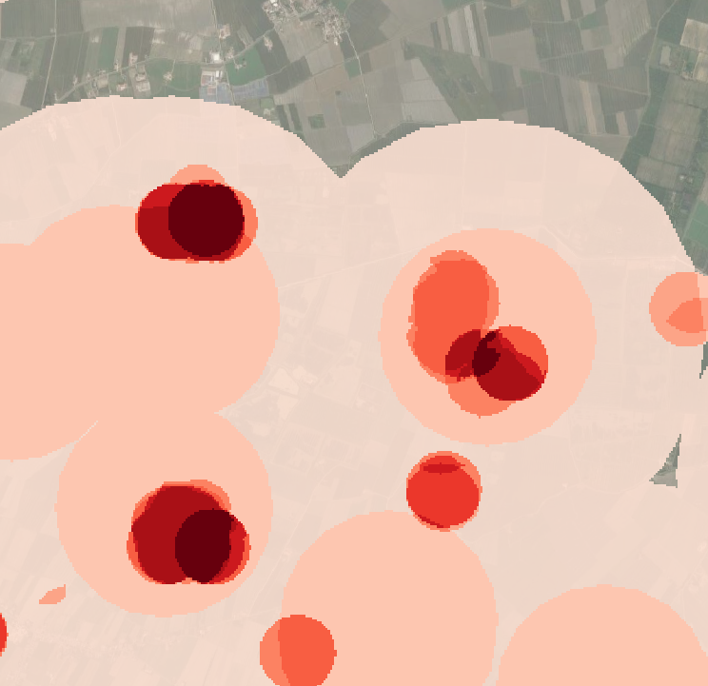
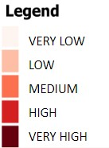
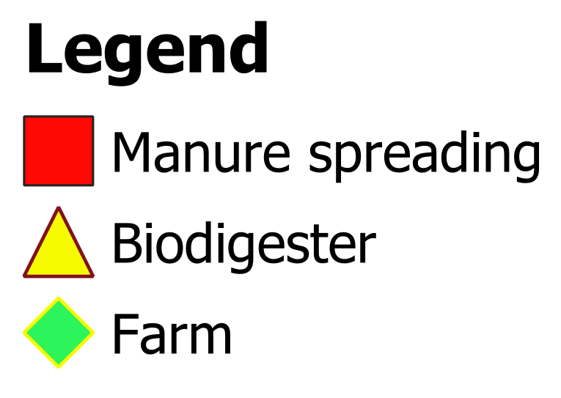
MANURE SPREADING SUSCEPTIBILITY TOOL
Integration of the following information:
Ancillary data: location of biodigesters and cattle/pig farms (Regional databases)
Satellite data: LC/LU and identification of manure spreading as agricultural practice
In-situ data: manure and bare soil characterization

Slide 13
National PhD in Earth Observation (DNOT)
54

Slide 14
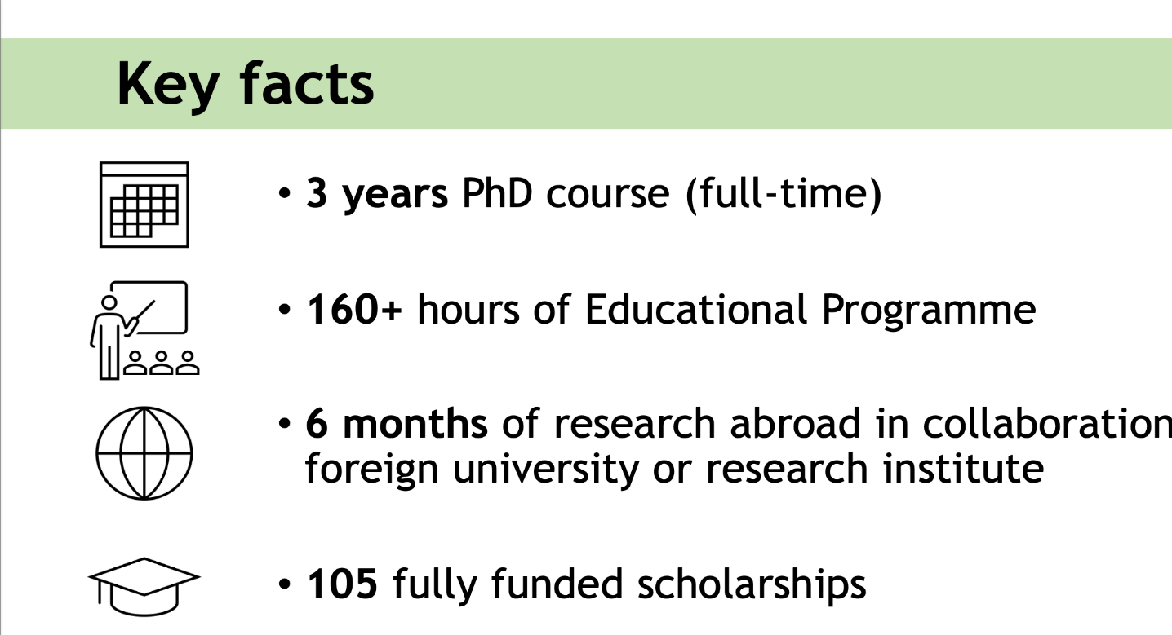
Soggetti partecipanti
34

Slide 15
Thanks!

