Slide 1
Space for Agriculture
Borja Pickering
Business Applications
ESA BASS
Notes:
Good morning and thanks the audience.
Introduce myself briefly – Commercialisation Industry and Competitiveness
Webinar slides will be available

Slide 2
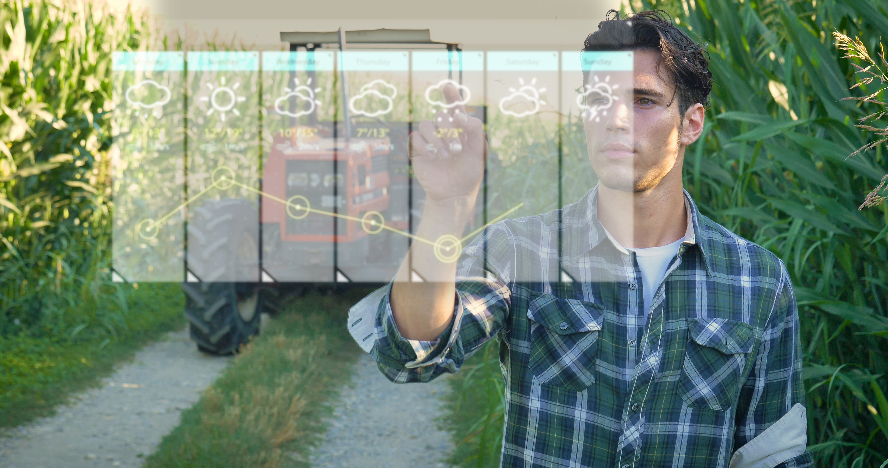
Agenda
ESA BASS introduction
2. Space for agriculture calls
3. Successful stories from BASS
4. How to apply to our funding calls

Slide 3
Contextual information and trends
Growing world population increases food production demand, making the traceability of the quality and quantity of goods through the food supply chain more challenging. (100M in the last 60 years only in Europe)
Crop yields are in decline [Eurostat 2022] and natural resources, including soils, water, and biodiversity, are stretched dangerously thin.
Agriculture is extremely vulnerable to climate change in the form of increasing temperatures, weather variability, shifting agro-ecosystem boundaries, invasive crops and pests, and more frequent extreme weather events.
Agriculture is a major part of the climate problem. It currently generates 11% of total greenhouse gas (GHG) emissions in Europe.

Slide 4
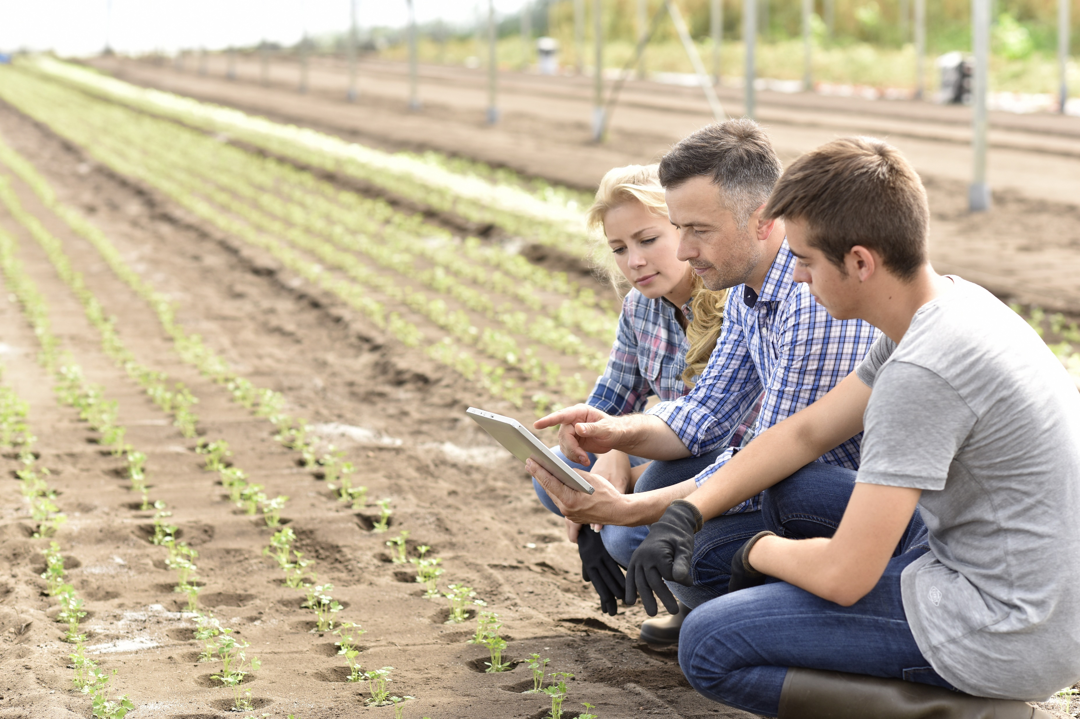
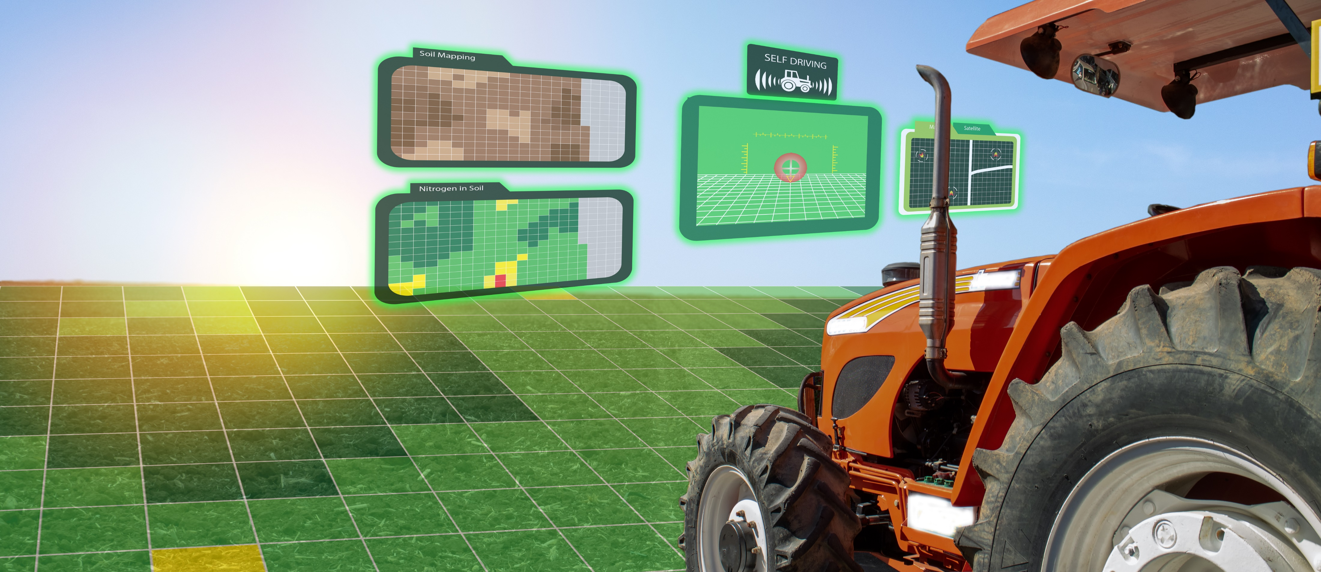
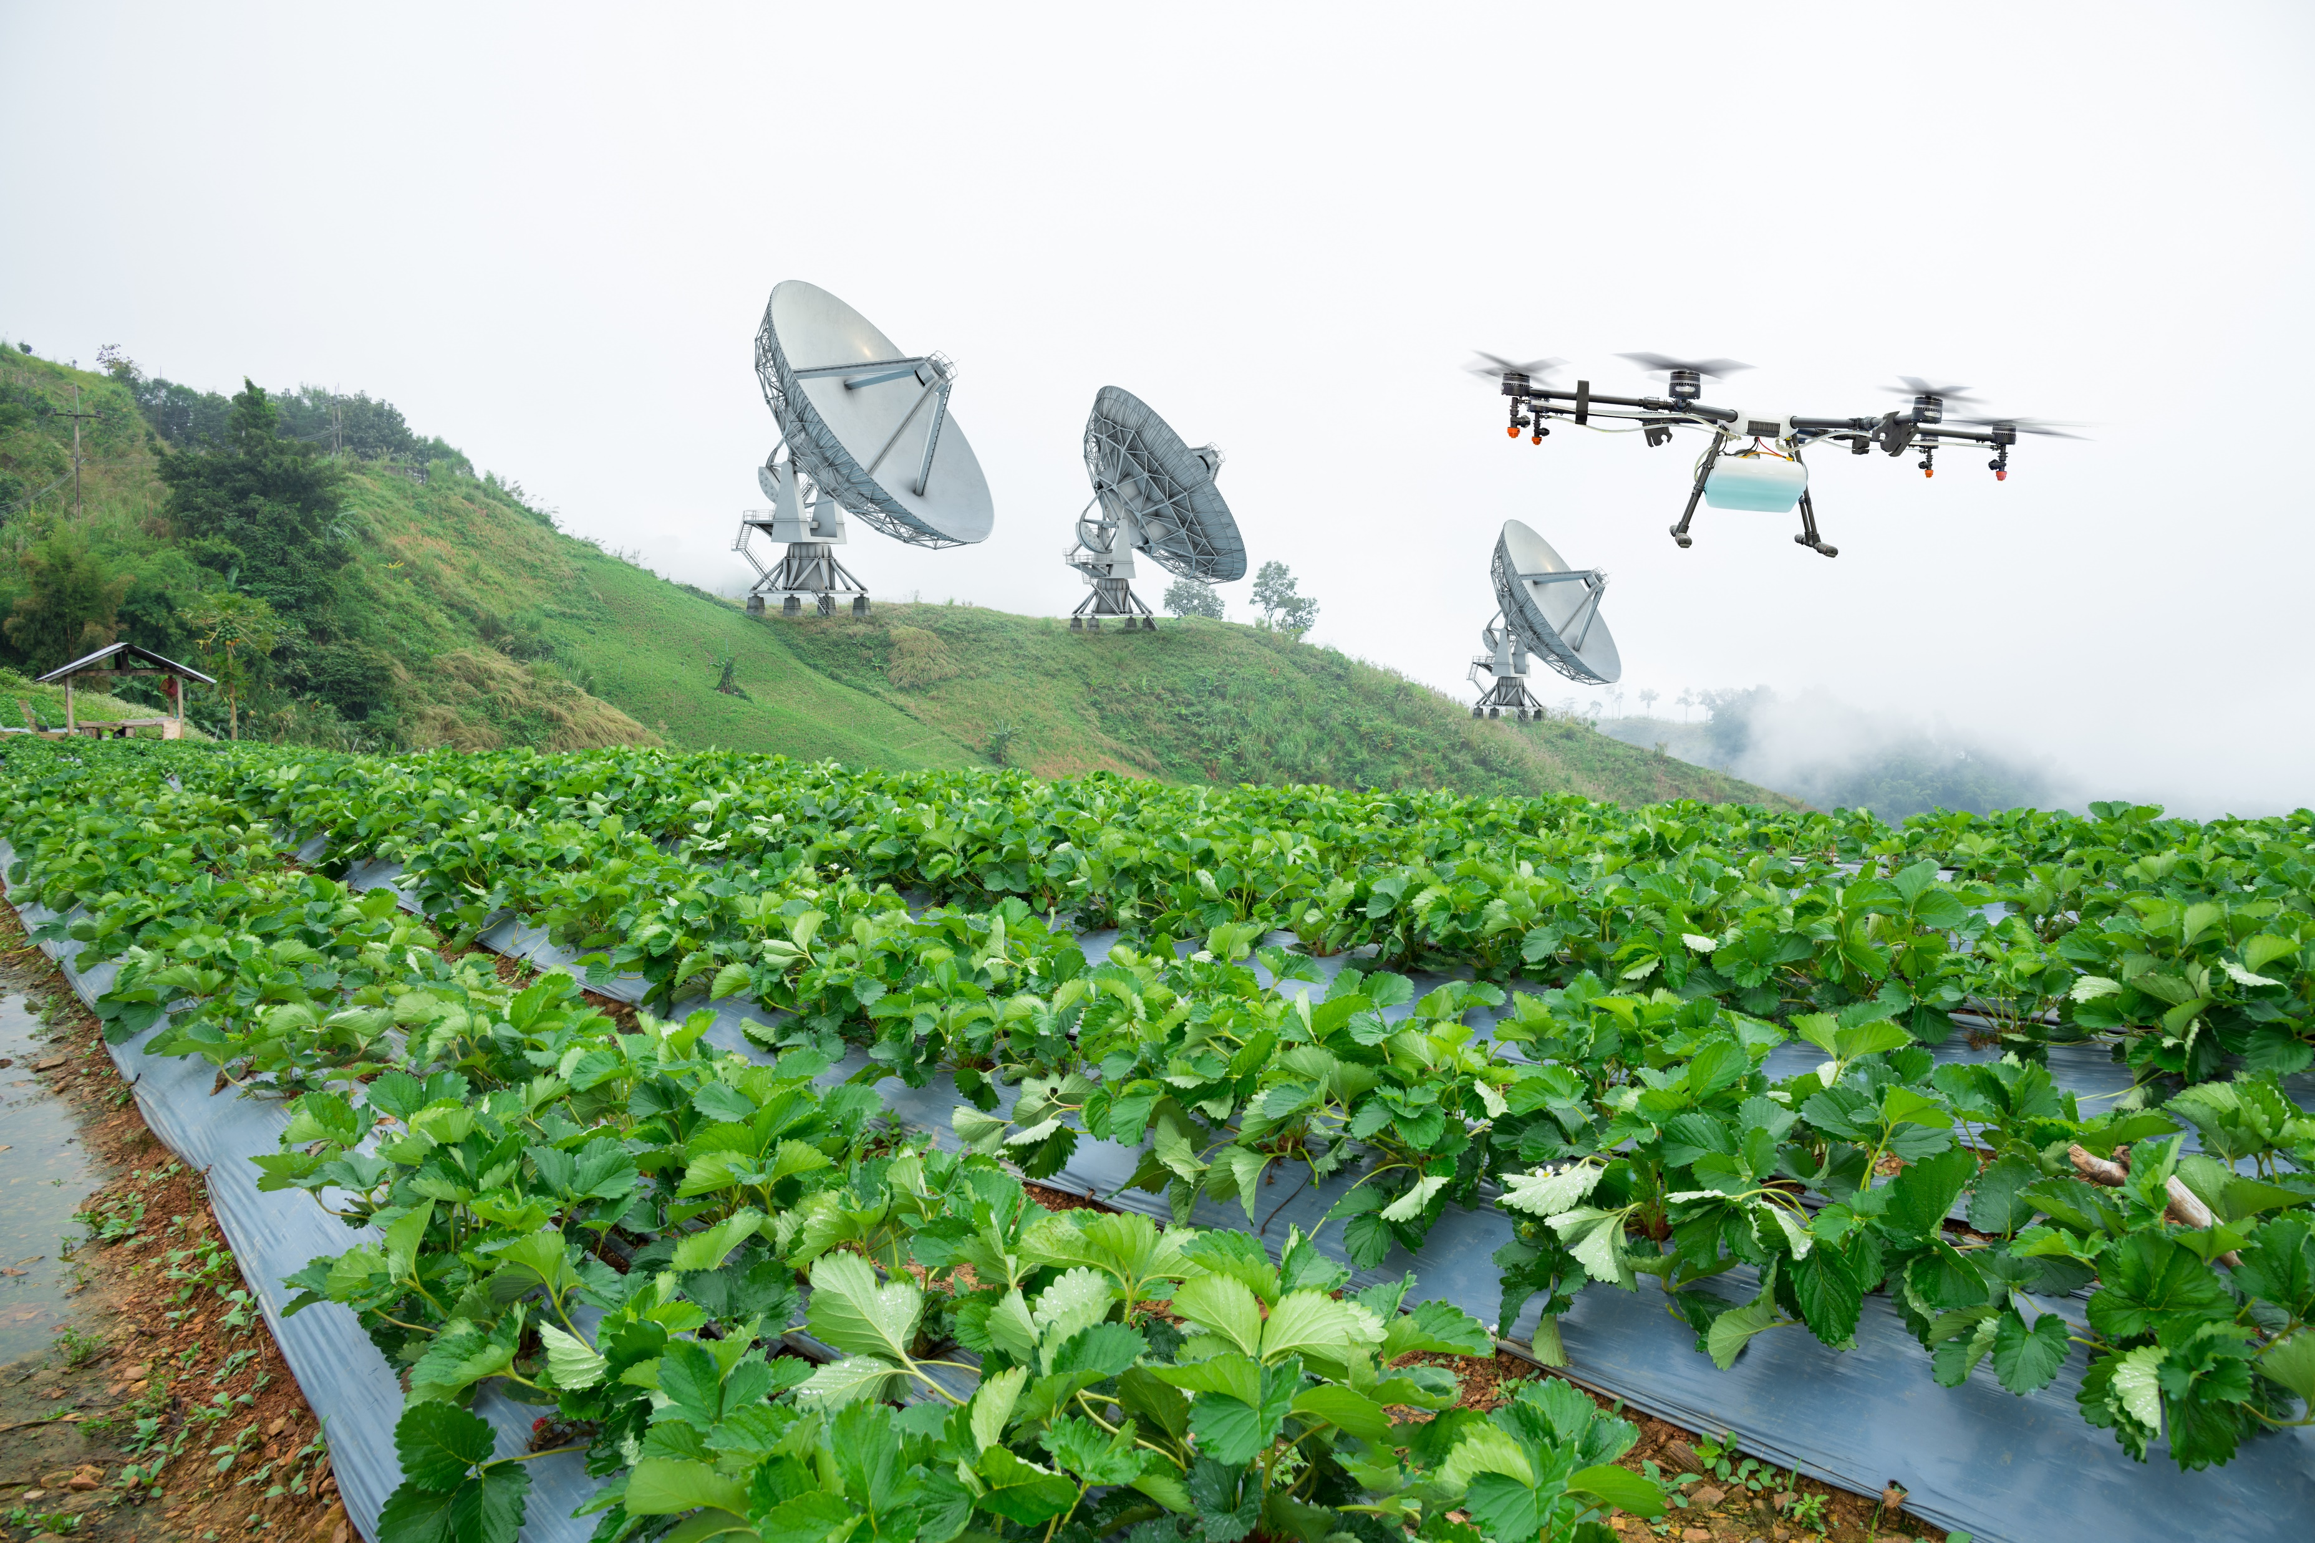
The largest space innovation network in the world
ESA Business Applications Space Solutions - BASS
Program started in 2009 → BASS invested + €250M in launching innovative services in over 1200 Business
More than 100 projects are directly or indirectly related with agriculture.
Precision agriculture
Irrigation management
Carbon sequestration
Food supply chain
Agri-Insu tech services
Notes:
BASS aims at reaching commercial exploitation of space assets, data and capabilities support in creating viable companies as well as to existing companies
Additional points for the socio-economic:
To Establish space as a pillar of the new digital economy
Additional points for space use:
Support the establishment of a resilient, fair and inclusive society through the integration of space with disruptive digital technologies
Additional points for industry competitiveness:
Support companies through short time to contract and seed funding tools
Increase uptake of space solutions through networking opportunities and access to investors

Slide 5
Space Assets…
BASS - Space assets, users & markets
… coupled with…
… to serve Users & Market
Earth
Observation
Big Data analytics VR/AR Artificial Intelligence Mega-constellations Crowdsourcing IoT Cybersecurity Blockchain
5G (https://artes.esa.int/esa-5g6g-hub)
Agriculture
Maritime
Satellite Navigation
Environment
Healthcare
Satellite
Communication
Financial
Transport
Spaceflight
Technologies
Education
Media
Space Weather
Energy
Aviation

Slide 6
Space technology value in agriculture
Satellite
Navigation
GNSS Satellite navigation is instrumental in order to geo-tagging services and tracking of e.g. robots and agricultural machines, and user devices. (e.g. smart tilling, data collection for ag. Payments under CAP program)
Earth Observation optical and radar-based data from commercial and not commercial operator can be used in combination with AI model and measurements of in-situ sensors to observe a range of physical parameters : biomass, indicators such as NDVI, soil moisture, water level stress, appearance of disease, soil organic carbon, carbon sequestration parameters, etc.
Earth
Observation
Satellite Communications provide a reliable and cost-effective access to seamless connectivity all over the world and especially in rural areas enabling IoT data transmission (narrowband). Also other technologies like Bluetooth devices placed in embarked sensors (e.g. anemometers, smart sprayers)
Satellite
Communication

Slide 7
Partnership/Stakeholders
Engaging with industry stakeholders and public entities for delivering the green transition

Slide 8
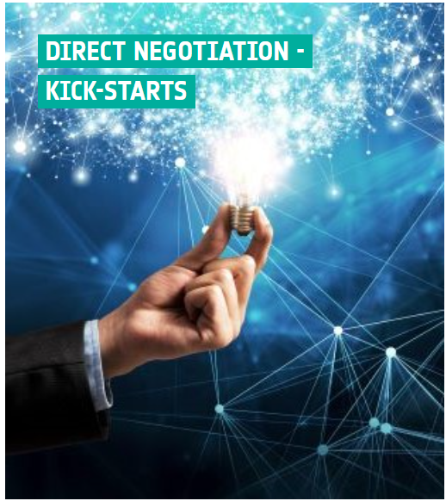
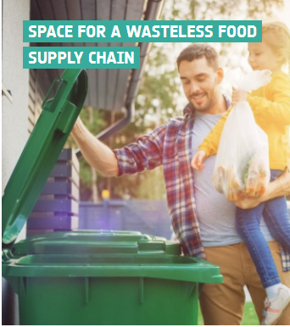
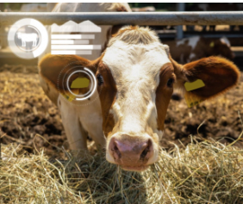
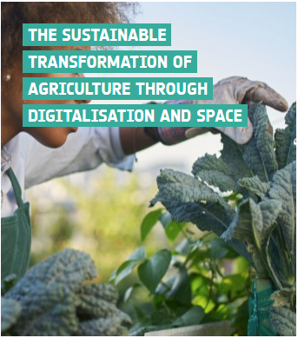
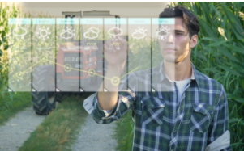
Types of calls
Temporal – Competitive calls CLOSED
Permanent – Non competitive
Temporal – Competitive calls
In preparation
09-10-23 01-12-23
Connected agriculture – Kick start
Direct Negotiation - Kick Start
Space for a Wastless Food Supply Chain – Kick start
13-10-23 13-12-23
Responsible Agritech - KickStart – Feasibility Study
Direct Negotiation - Generic programme Line
The sustainable transformation of agriculture through digitalisation and space Demonstration Projects

Slide 9
Examples of Business Applications in BASS

Slide 10
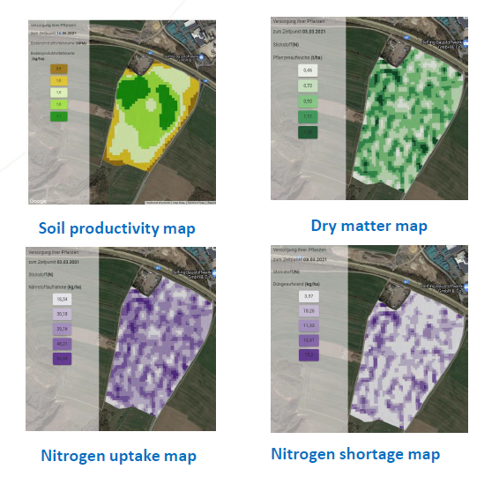
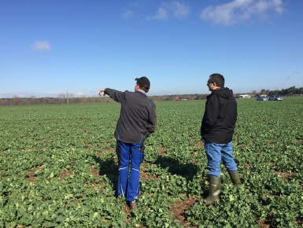
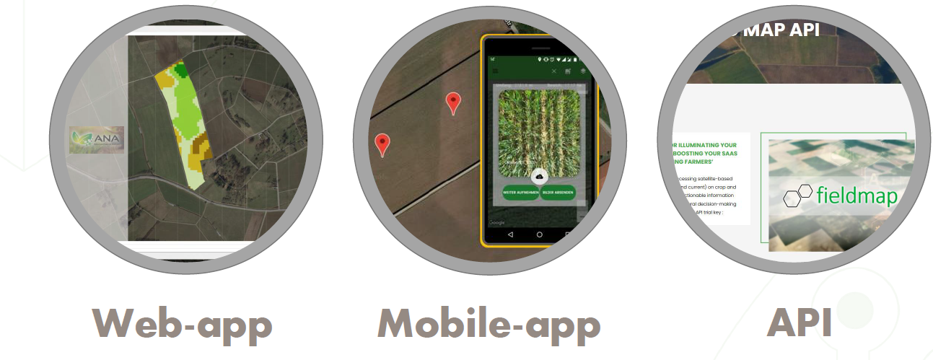
Satellite-enabled Intelligent IoT for Agriculture (SIITAg)
Artificial Intelligence and Satellite enabled Variable Rate Fertilization Map
Farmers and crop advisors require a better tool to help them make better fertilization decisions.
https://business.esa.int/projects/siitag-project
Targeted Users: Farmers, agricultural consultants, fertiliser companies
EO data (Sentinel-2), combined with GNSS information for computational applications for generation of Field Boundaries, relative nutrient deficiency maps and field productivity
Service allows to save between 15% to 30% of nitrogen fertilizer.
Notes:
Spacenus(DE)
Project cost(project+CCN1): 2.2MEuro
ESA Price:1.1MEuro
Farmers can visualize their fertilizer needs using fertilization recommendation maps and adapt these recommendation maps according to their knowledge of the spatial variability of their fields

Slide 11
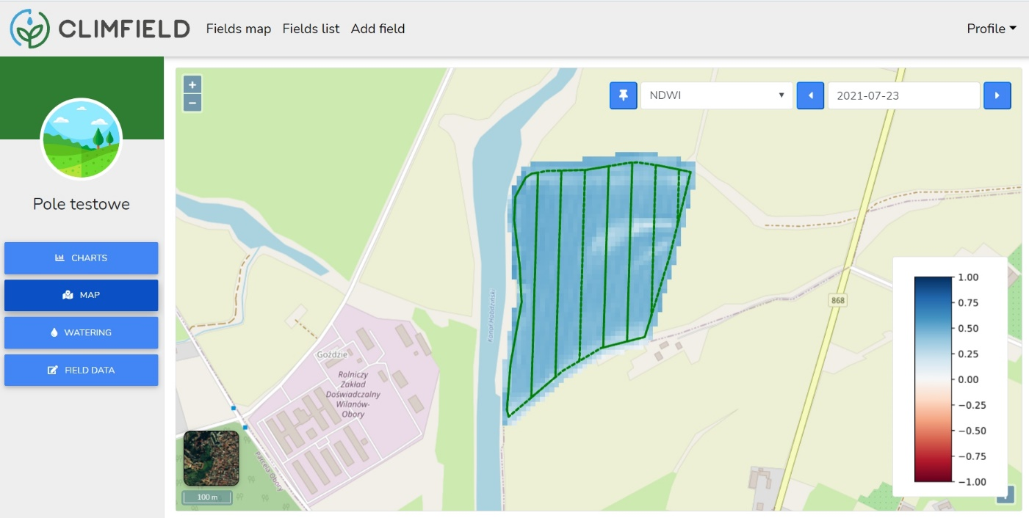
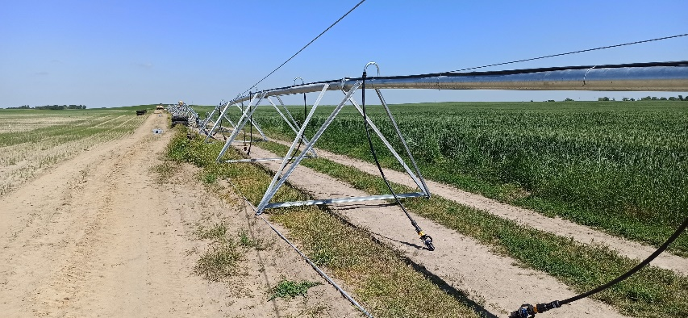
Climfield
Smart Irrigation Service
Satellite Support of crop irrigation
Precise information on the current crop water requirements in the field.
Extensive map and intuitive charts to facilitate decision-making on irrigation.
https://business.esa.int/projects/climfield
https://irriget.com/#home
Targeted Users: Farmers, agricultural advisors
Service allows to save 14% of water consumption on average depending on weather condition
EO data (Sentinel-2&Sentinel-3), combined with GNSS information for water balance model and DEM
Notes:
Wasat(PL)
Subco: Warsaw University of Life Sciences (SGGW)(PL) Polski Farmer Sp. z o.o.(PL)
Project cost: 1,5MEuro ESA Price:788KEuro

Slide 12
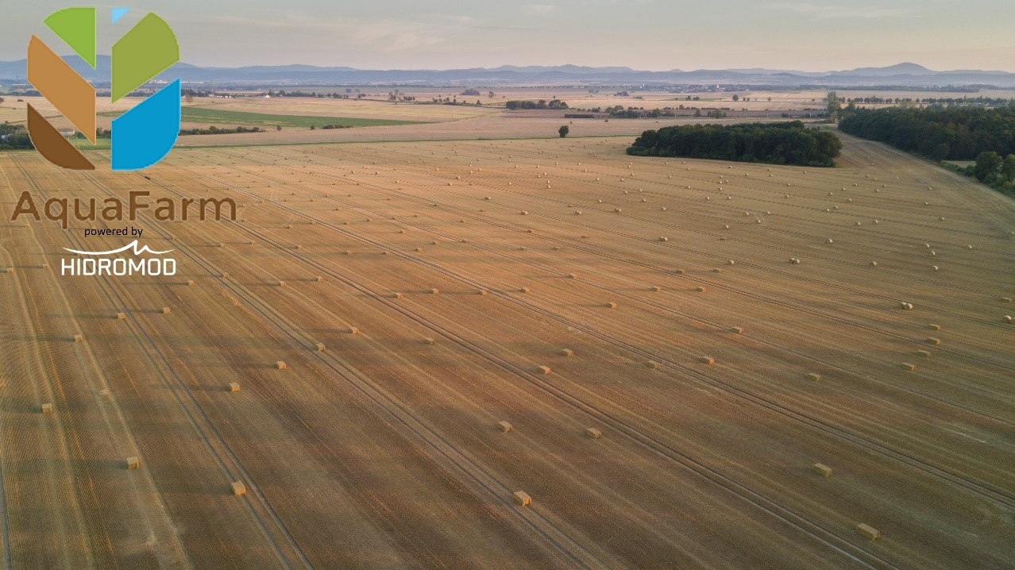
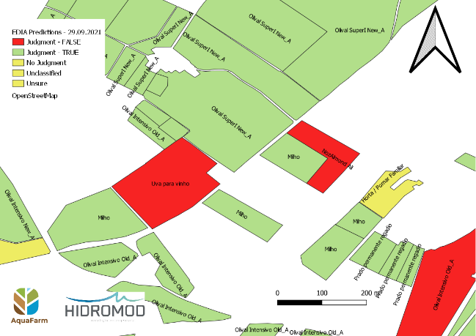
Aquafarm 2.0
Aquafarm 2.0 is a digital agriculture platform that provides reliable and up-to-date information for institutions and service providers.
Aquafarm delivers a range of products such as vegetation Indices, biomass health, crop classification and moisture content, over large areas
Targeted Users: local, regional and national agriculture institutions and agronomy service provider
Pilot users : IFAP (Portuguese paying agency), EDIA (Portuguese public company managing water resources), Wisecrop (Agritech service provider)
Sentinel 2 optical data is the corner stone of the service, allowing for the monitoring of vegetation. The service can process other satellite EO data as needed.
In 2021, IFAP has awarded a contract to Aquafarm 2.0 for the monitoring of rice and tomato culture over all of Portugal
Notes:
Hidromod(PT)
Project cost:598KEuro
ESA Price:299KEuro

Slide 13
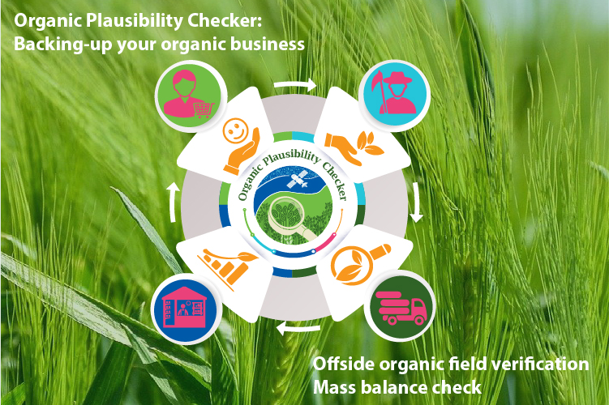
Organic Plausibility Checker
Organic Plausibility Checker aims to minimize fraud in the organic food supply chain and to increase trust in the sector.
Key benefits
Reduces the organic field inspection time by 25%
Ensures transparency and authenticity of inspection
Drives digitalisation of certification process and organic control
Targeted Users: Organic Control Bodies, farmers, traders and organic authorities. Control Bodies were identified as the best opportunity.
Image Credits: GreenEO Gmbh.
Satellite navigation: Using GPS, Galileo for field location
Earth Observation: Sentinel 1, sentinel 2, Landsat 8, Landsat 9, Planet Scope
Over 100 control bodies interviewed to define the service specifications
Notes:
Prime GreenEO(DE)
Subco: OrganicServices (DE) and DextroGroupGermany(DE)
Study cost:200KEuro
ESA price:200KEuro
Combining satellite imagery and state of art AI with a supply chain mass-balance system, the service provides an API that covers the remote monitoring of fields, checks the organic integrity, and ensures the transparency of organic food from growers to consumers

Slide 14
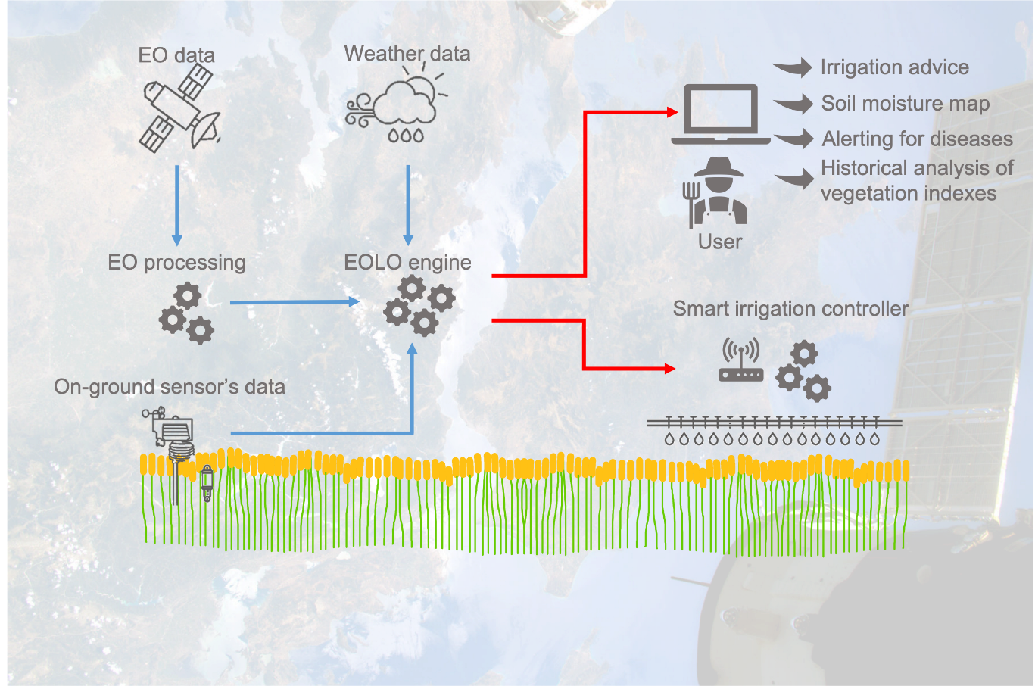
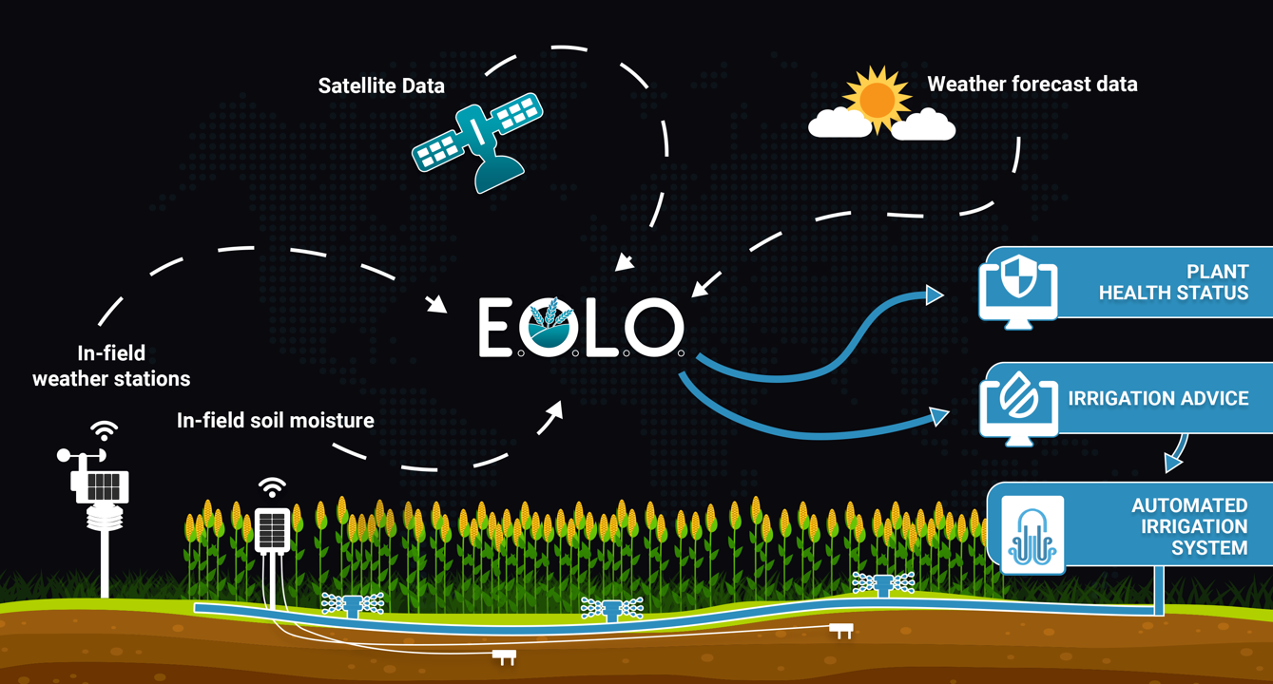
EOLO

Slide 15
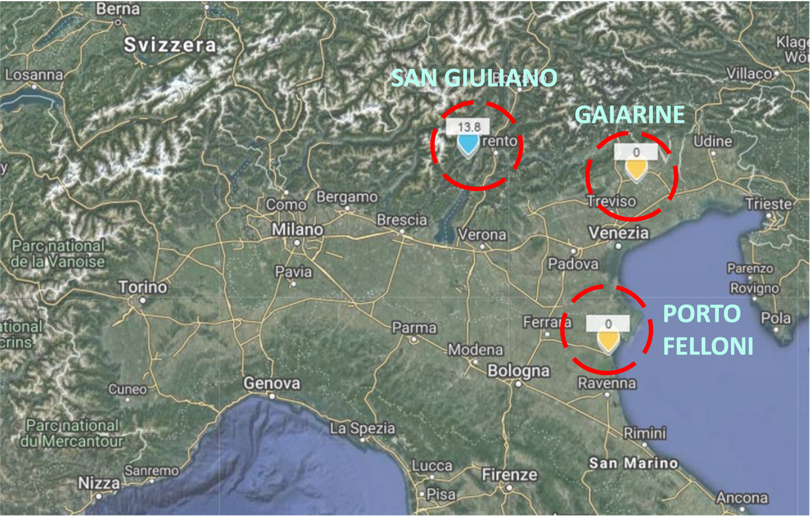
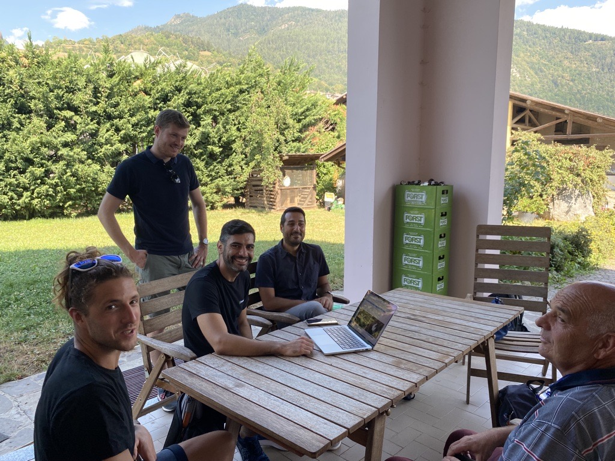
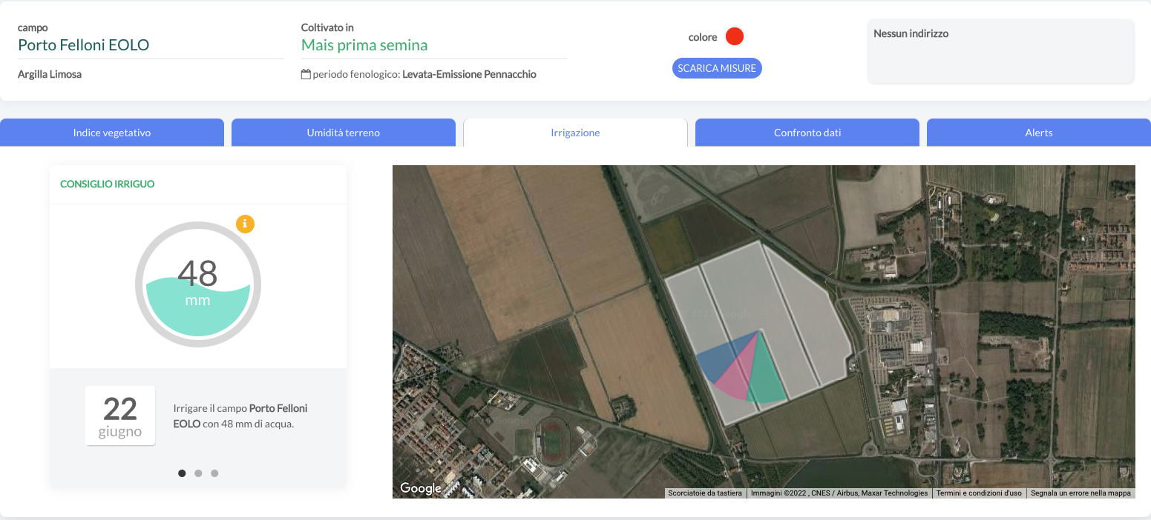
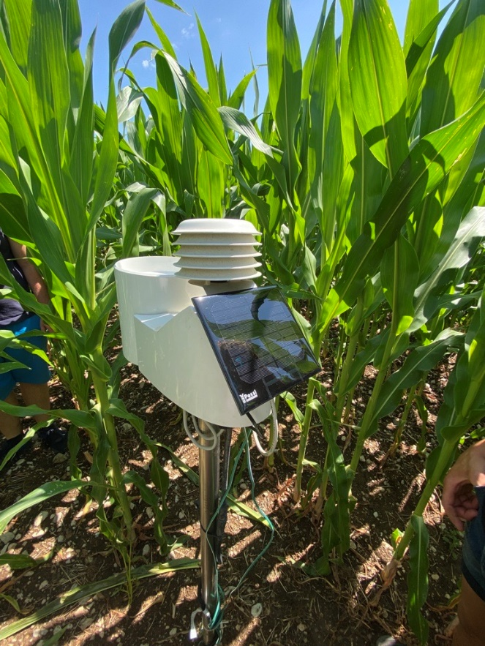
EOLO
Earth Observation Low Orbit for Agriculture integrates data from EO satellites together with IoT devices remotely controlled, and meteorological local now-casting service, for the monitoring of crops and soil and the provision of highly accurate irrigation advice. It helps farmers preserving their crops and saving water and additional costs.
Targeted Users: Farmers and agronomists
Pilot test partners: 3 Farms in the North of Italy
Water saving 16%
Satellite Earth Observation (optical and radar)
https://business.esa.int/projects/eolo

Slide 16
IBISA Climate Insurtech
IBISA is a global Insurance and Space Tech company providing climate insurance solutions. They harness satellite data for tailored products and work with local stakeholders to ensure these solutions are cost-efficient, scalable, transparent, and offer fast payouts, catering effectively to real-world needs.
Pilot test partners and results
Generated more than 250K insurance policies
Converted 4 pilot users into commercial clients
Acquired 5 new clients in India
Fostered strong partnerships with insurers and distribution partners
Developed advanced insurance technology solutions
Doubled team size
IBISA video

Slide 17
How can I apply?

Slide 18
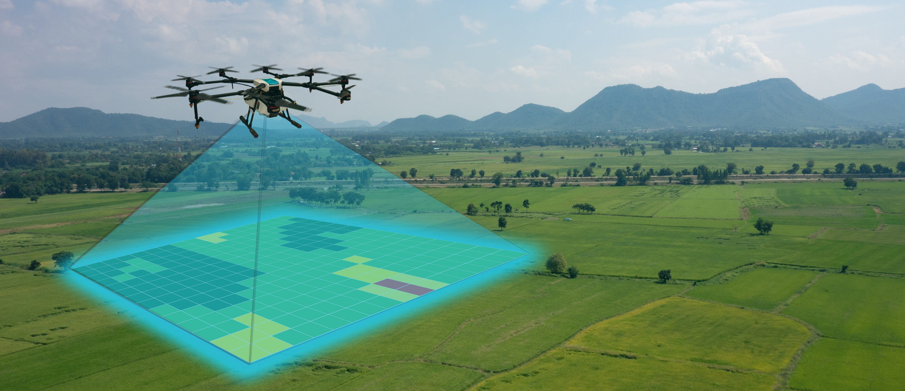
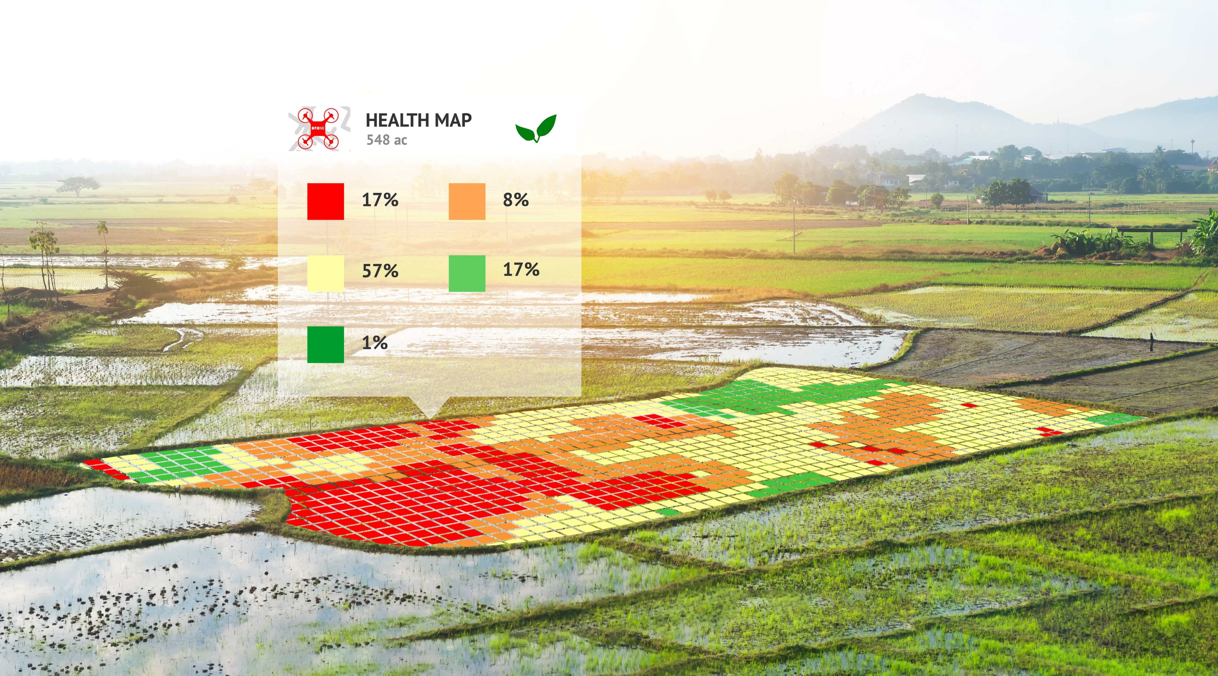
Who can apply?
ESA will support Feasibility Studies and Demonstration Projects. Depending on the type of call.
To be eligible for funding, your team must be based in one of the ESA member states that support ESA BASS program (19 out of 22 member states). Note that some National Delegation decides to opt out specific calls.
If you are considering applying, you must inform your National Delegation to obtain a letter of authorisation allowing the funding of the proposed activity. Contact details of each National Delegate can be found here → https://business.esa.int/national-delegations
The percentage ESA will bear will depend on the type of call and depending on the wishes of National Delegations. More information can be found here. https://business.esa.int/funding-schemes
Notes:
ESA will support Feasibility Studies and Demonstration Projects under this ‘Announcement of Opportunities’:
Feasibility Studies will allow successful teams to analyse, design and plan their intended service.
Demonstration Projects will allow successful teams to put their intended service into practice. Teams will test their service in the market by running a pilot with significant users and, by the end of the project, the service should be operational.
ESA will bear up to 50% of the eligible total project or study costs. The remainder must be financed by the Tenderer through private sector directly and/or indirectly via co-funding and/or by the users based on terms and conditions to be agreed upon.
Activities by micro, small and medium-sized enterprises or research institutions can be funded up to 80% by the Agency, depending on the funding level authorised by the related National Delegation(s).

Slide 19
How can apply?
OPEN CALLS FOR PROPOSALS
You propose your ideas directly to ESA, setting out the opportunity you wish to pursue. These applications will each be considered on their own merit.
There is a generic open call for proposals, permanently open and where you are free to propose services/applications in any sector. There may be thematic calls, open for a limited period and addressing specific needs or themes identified with one or more of our partners. Activities are always in Direct Negotiation.
https://business.esa.int/funding/direct-negotiation-call-for-proposals
COMPETITIVE TENDERS
You submit your proposal in response to one of our regular open competitions. These are directed at a specific problem or opportunity raised by us. Each application received is assessed in competition with other proposal applications.

Slide 20
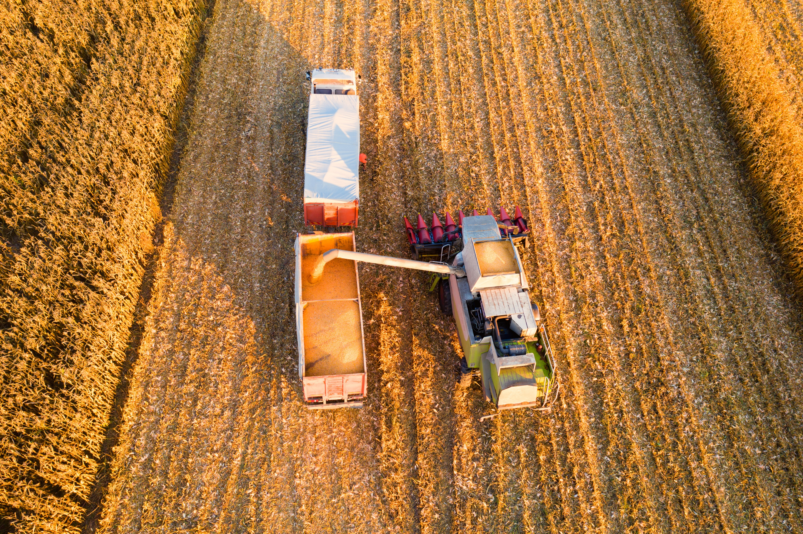
Before applying, check that
1. Your team is proposing a service that could become operational in
the near future (1-4 years)
2. Your idea tackles a challenge relating to the Agriculture sector (check the topics of relevance if you are applying to a thematic or competitive call.
3. Your idea uses satellite data or space technology (e.g. satellite
communication, earth observation or navigation)
4. Your team is eligible for funding and has attained a letter of
authorisation from the National Delegate (if applicable)
5. There is a market for your service and potential users/customers
will be involved during the activity.

Slide 21
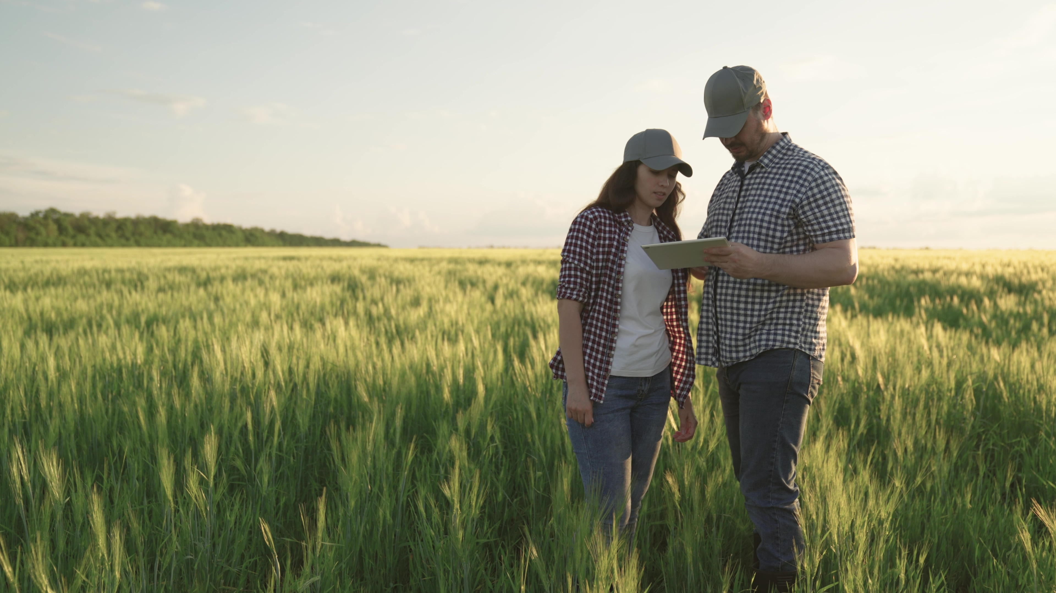
QA session
Click here and visit ESA Business Applications Space Solutions website

Slide 22
Thank you!
Borja Pickering
Business Applications
ESA BASS borja.pickering@esa.int

