Slide 1
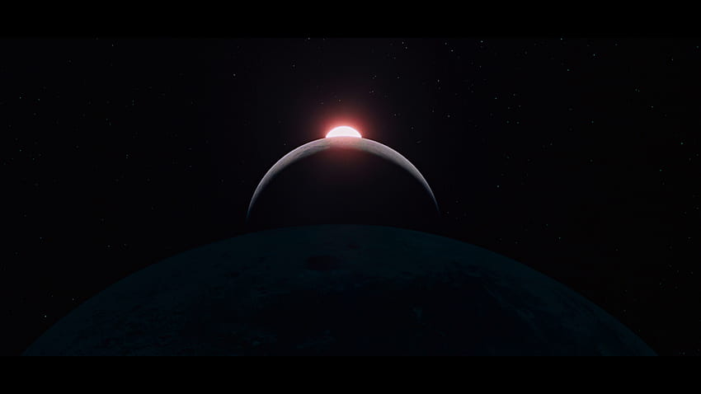
Space and tourism in Basilicata From applications, to motivation
Antonio Nicoletti
Director General, Agency for the Territorial Promotion of Basilicata

Slide 2
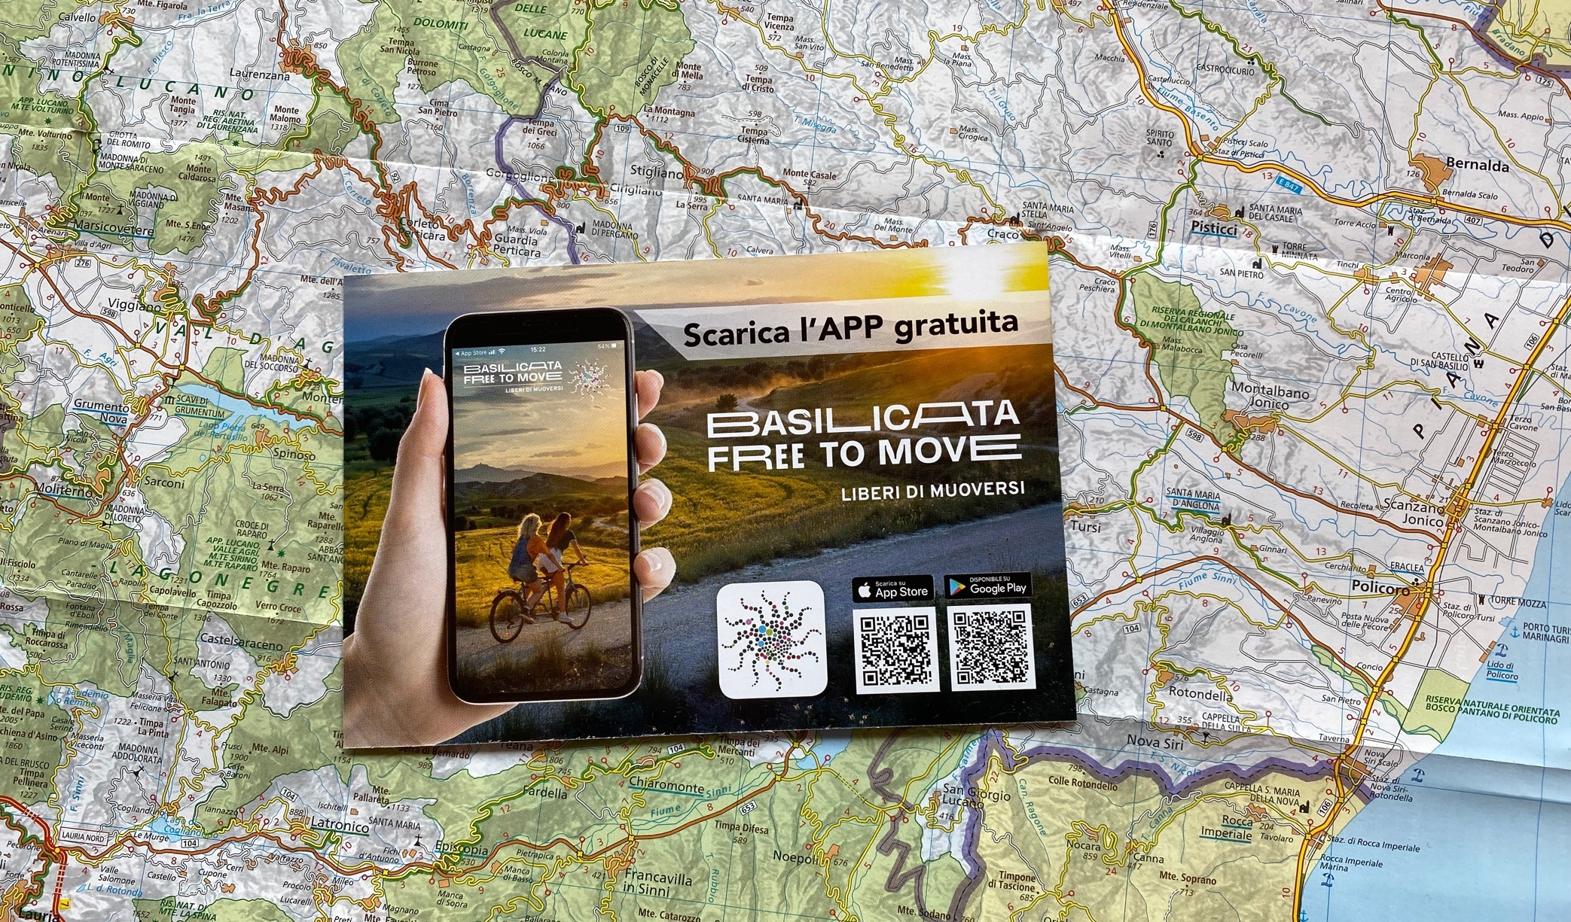
Common applications for common needs, here as elsewhere…
Services for mobility (satellite-driven apps, …);
Improvement of connectivity in mountaineous, coastal, and remote areas;
Data mining (monitoring flows, behaviours, …);
Maps availability (for tourists, hikers, bikers etc.);
Safety systems for random outdoor experiences (e. g. first rescue);
Services for powerboat activities;
Fire detection and risks management;
Monitoring for historic heritage and landscape preservation, coastal erosion …;
…

Slide 3
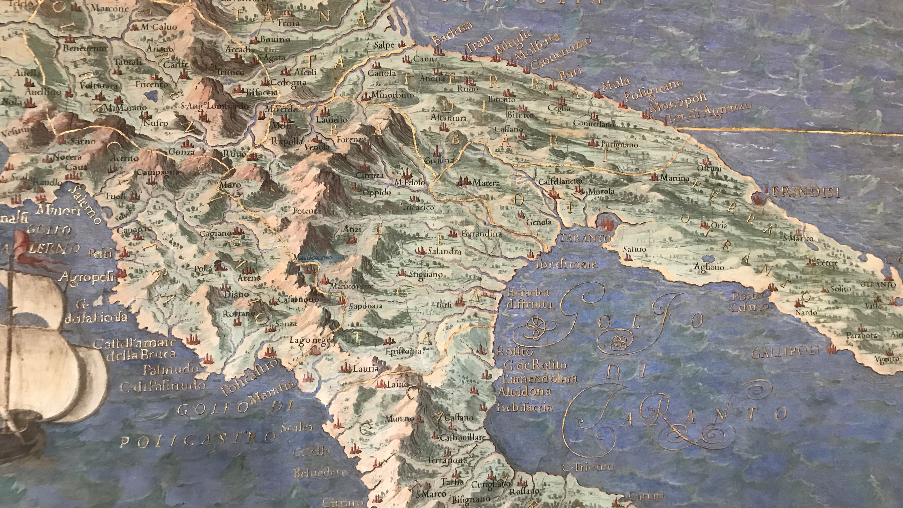
…but how striking is to think about the Space, from a place like Matera, one of the oldest cities in the world, and Basilicata, one of the most unspoiled regions in Europe

Slide 4
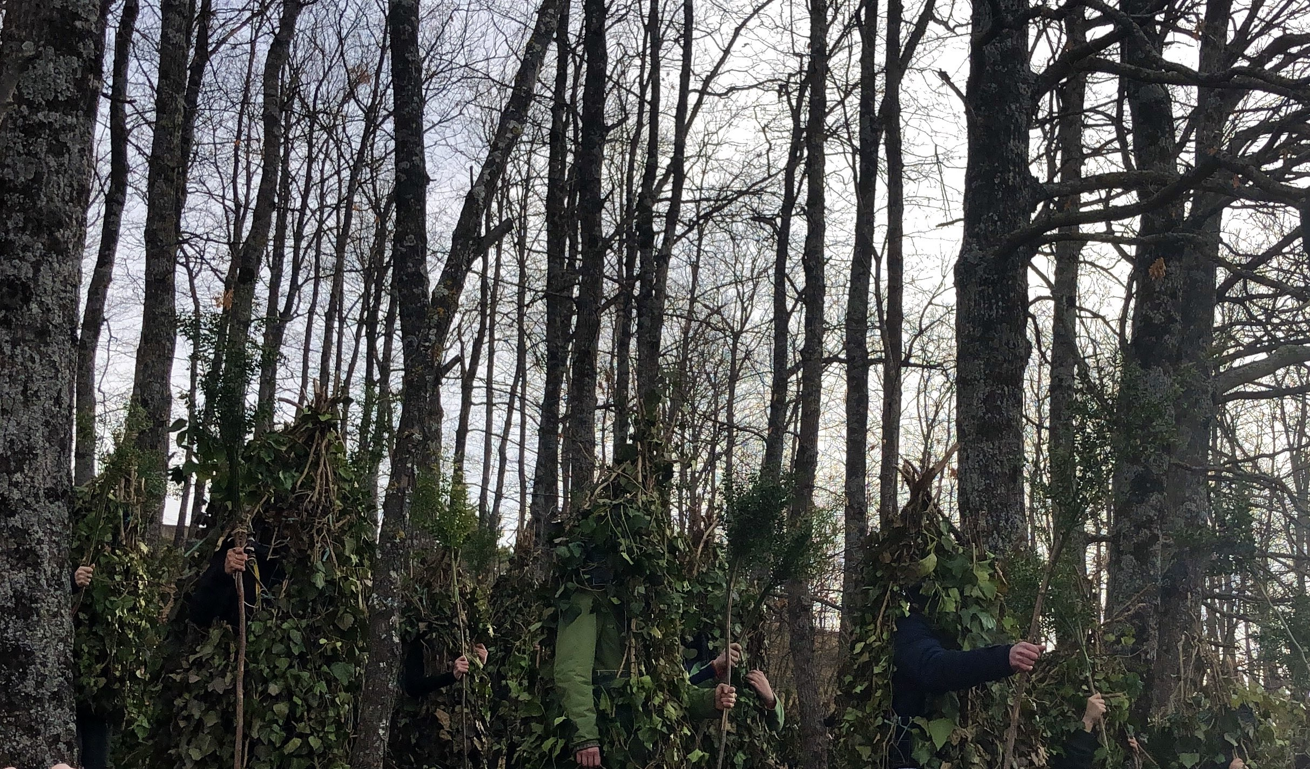
Notes:
A region where people get dressed like the trees to celebrate an ancestral relation with nature

Slide 5
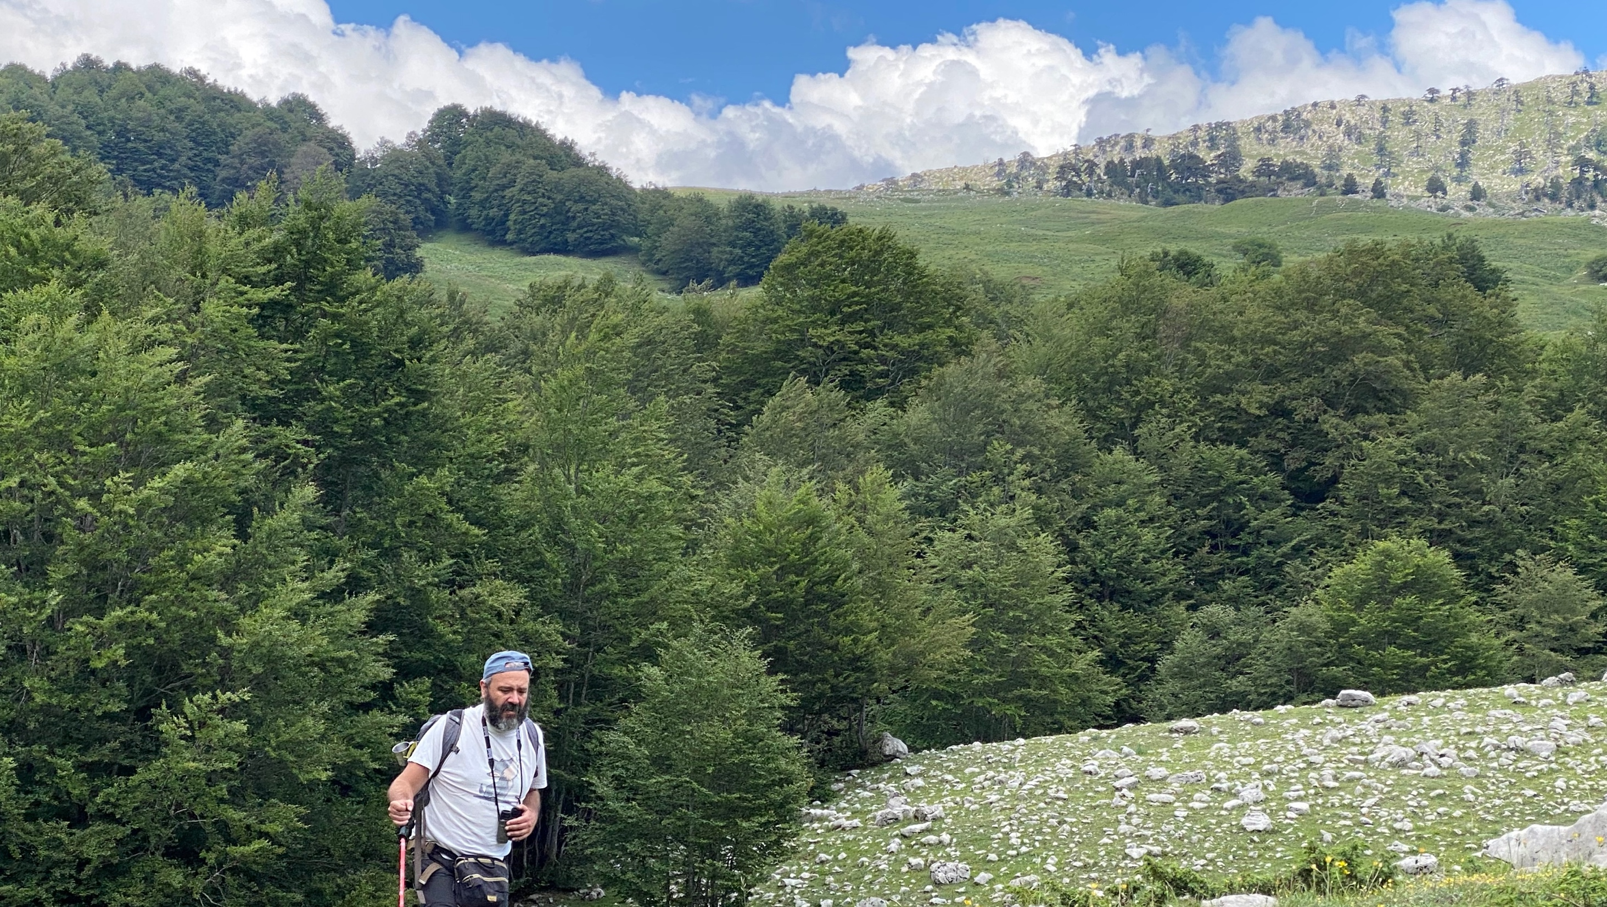
Notes:
Where you can walk through unesco-heritage forests and get to a high plateaux named “the garden of the gods”

Slide 6
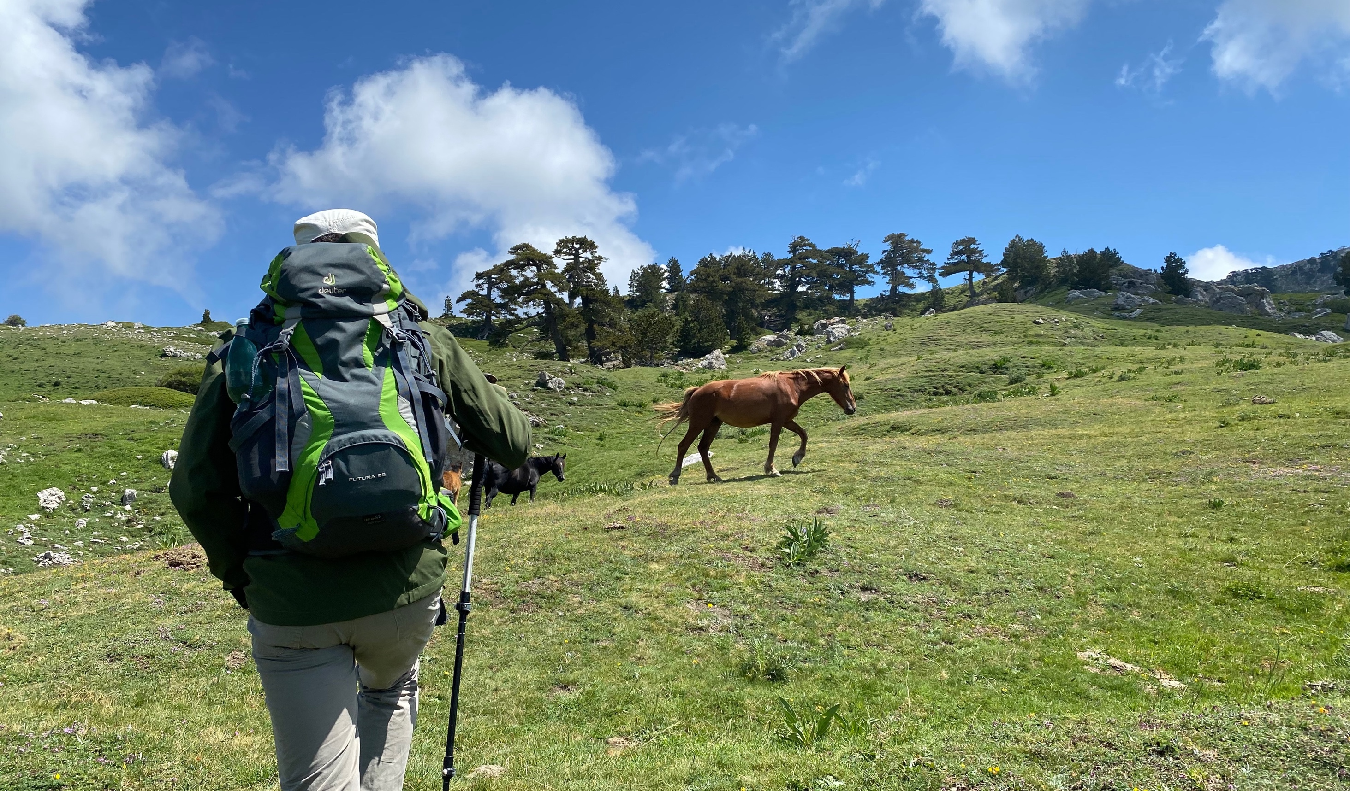

Slide 7
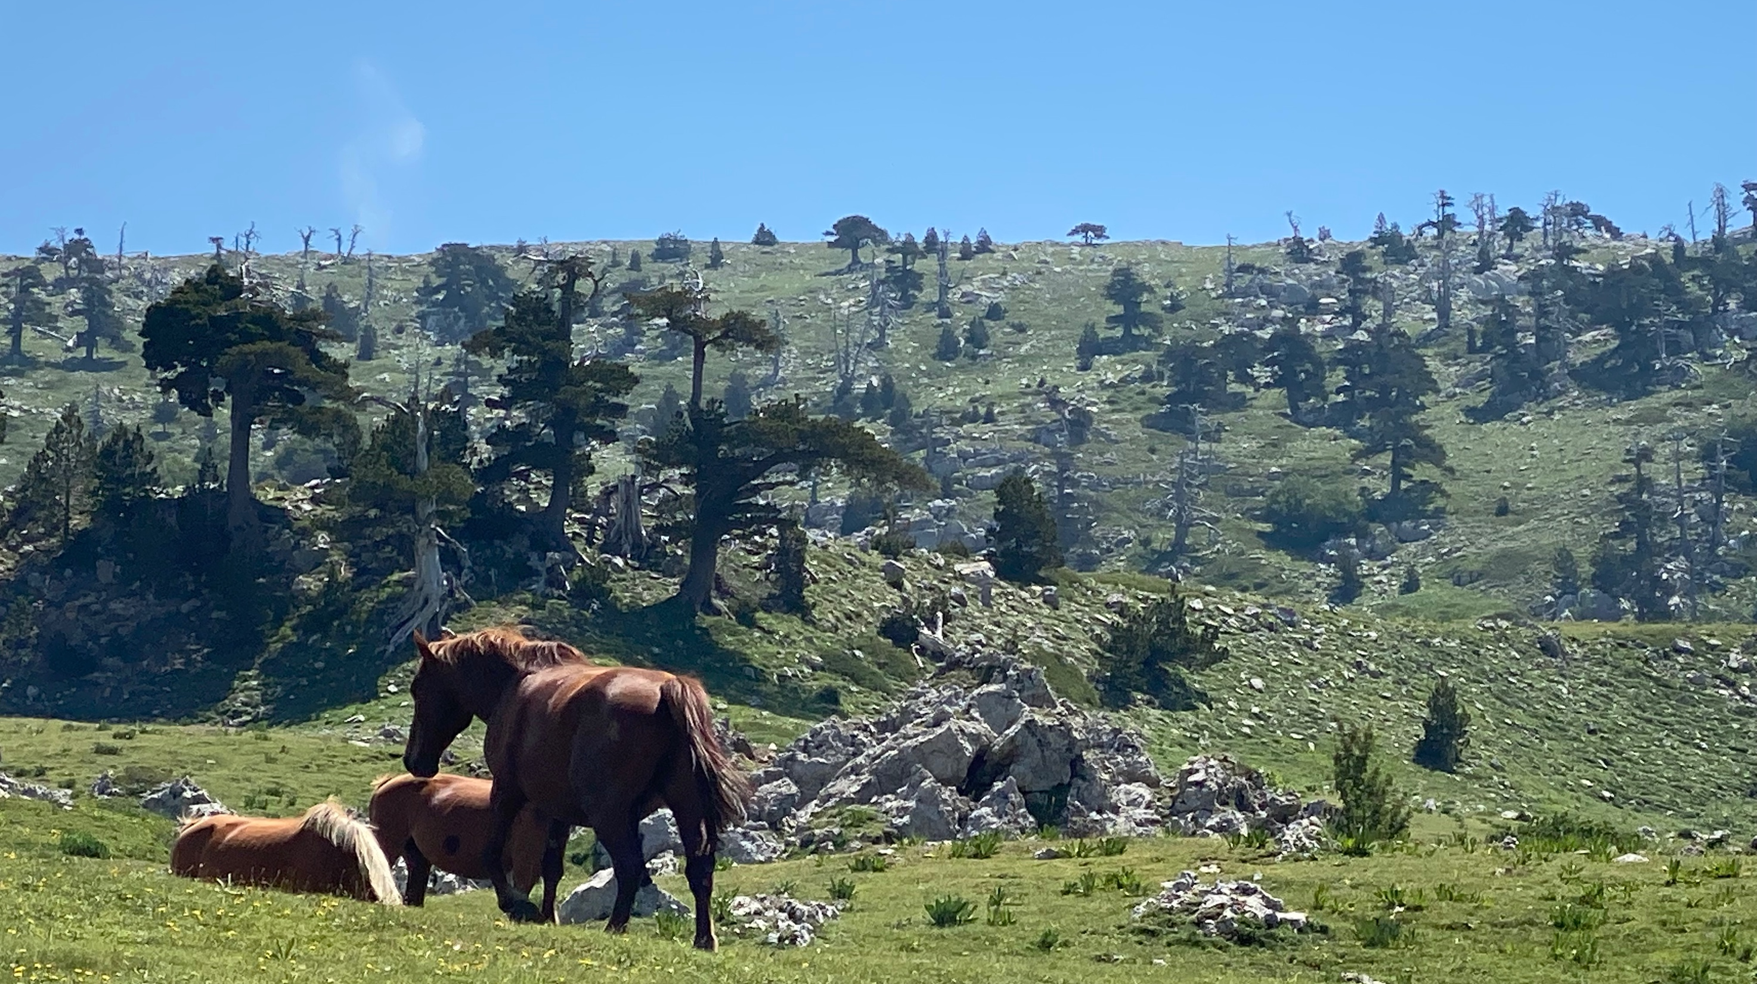
Notes:
And meet wild horses

Slide 8
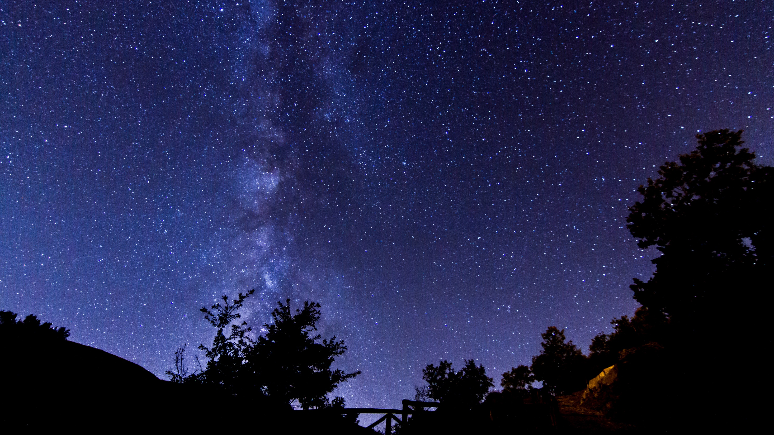
One of the cleanest skies in continental Europe

Slide 9
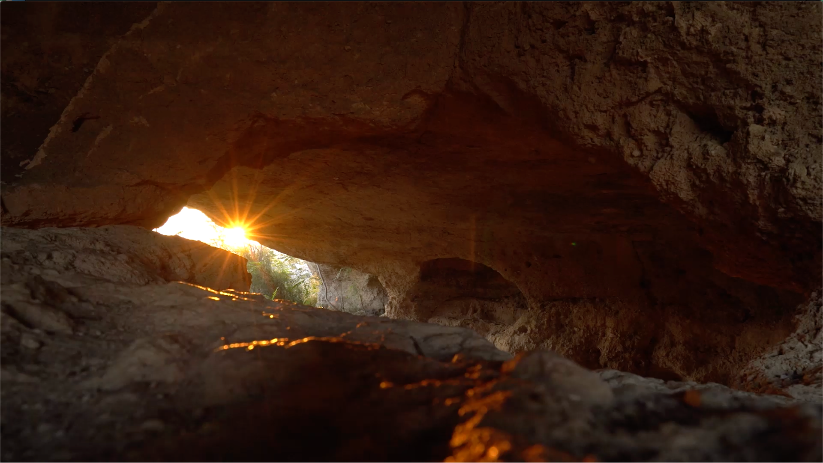
A place where people dug their home in a way for sun-rays to heat them… since the Paleolithic

Slide 10
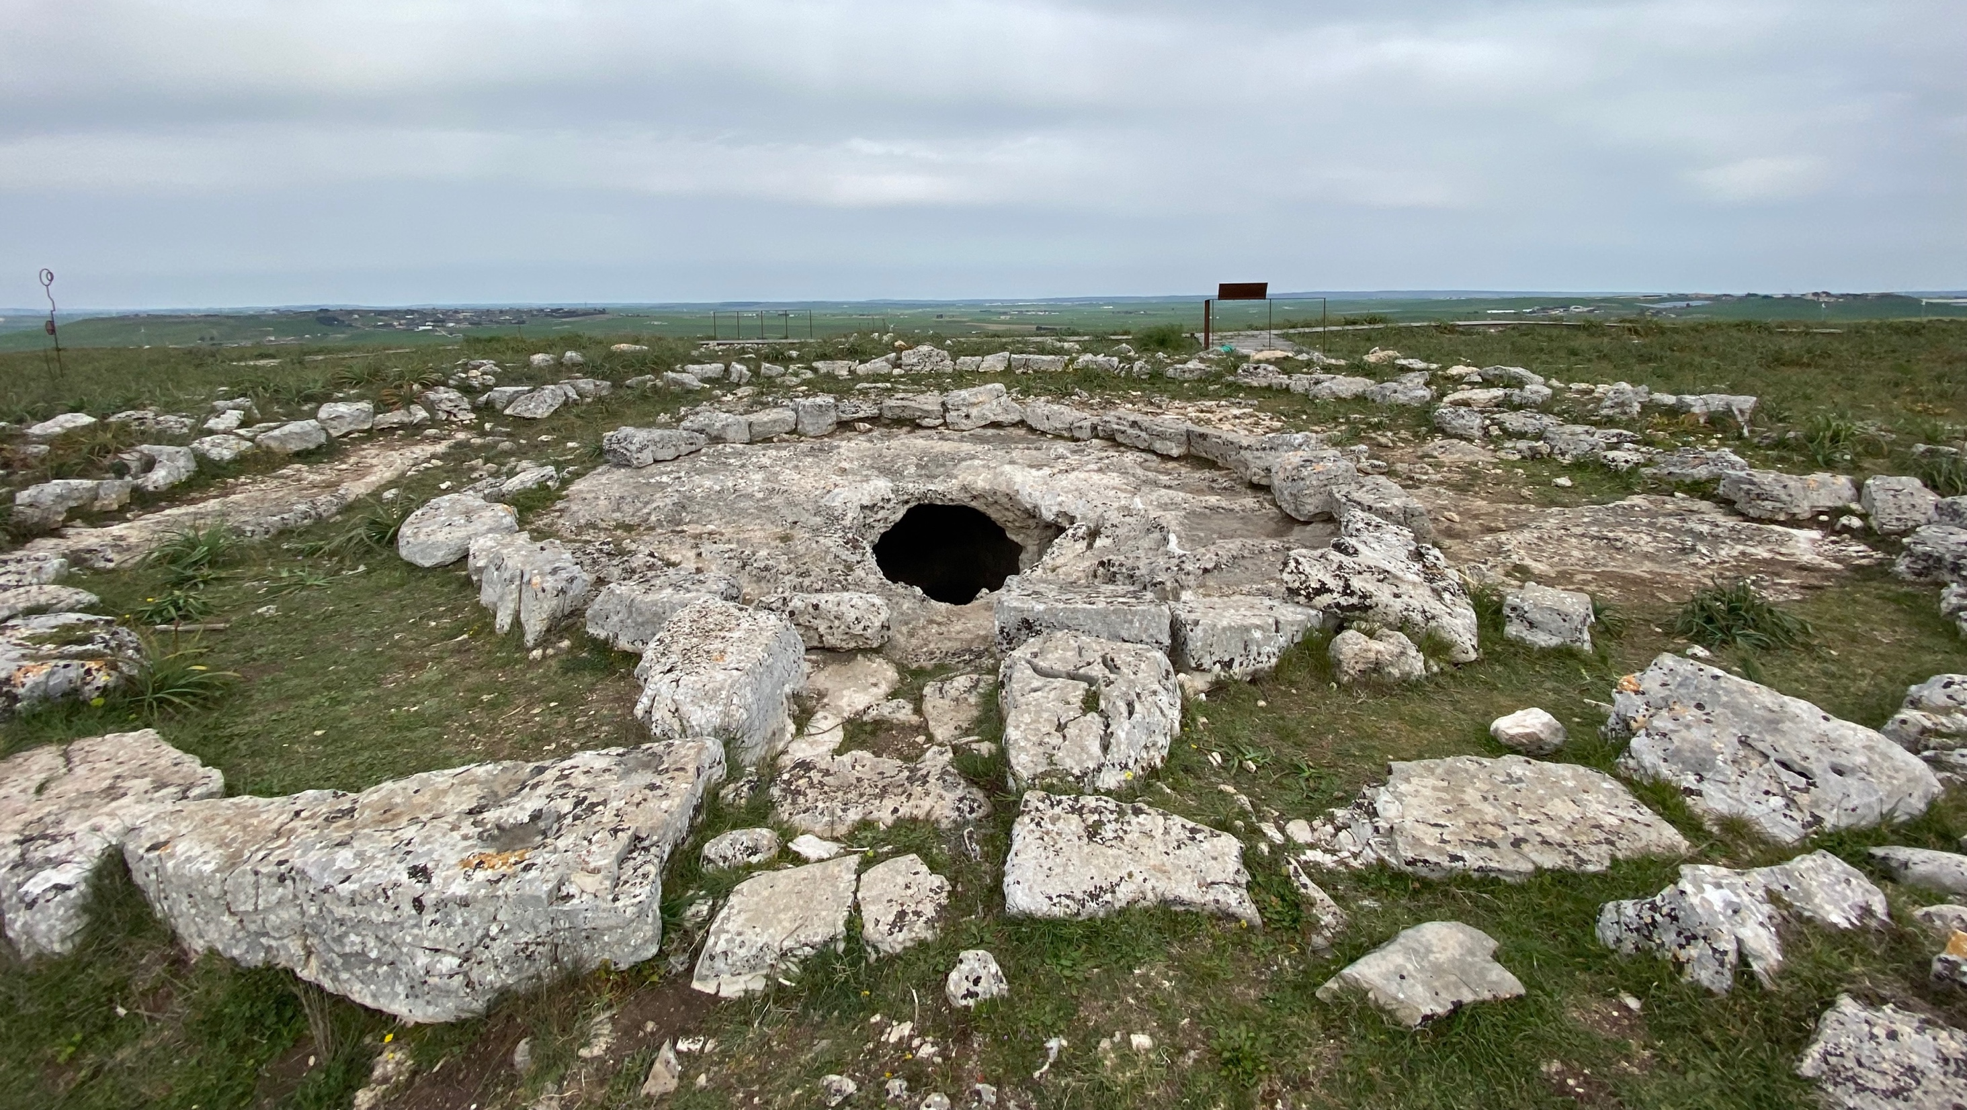
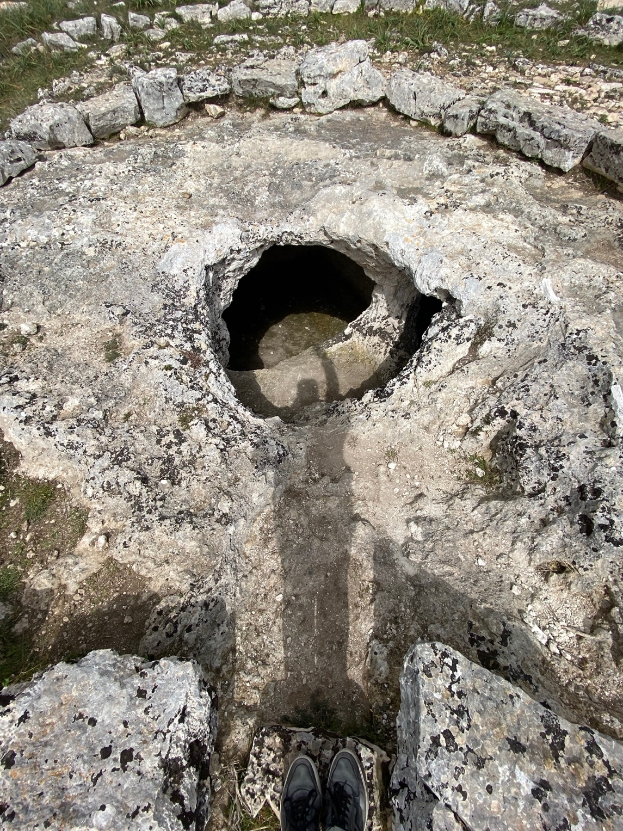
…where the entrance to the grave of a Neolithic king is a corridor that lets the Sun in, everyday at noon, since millennia…

Slide 11
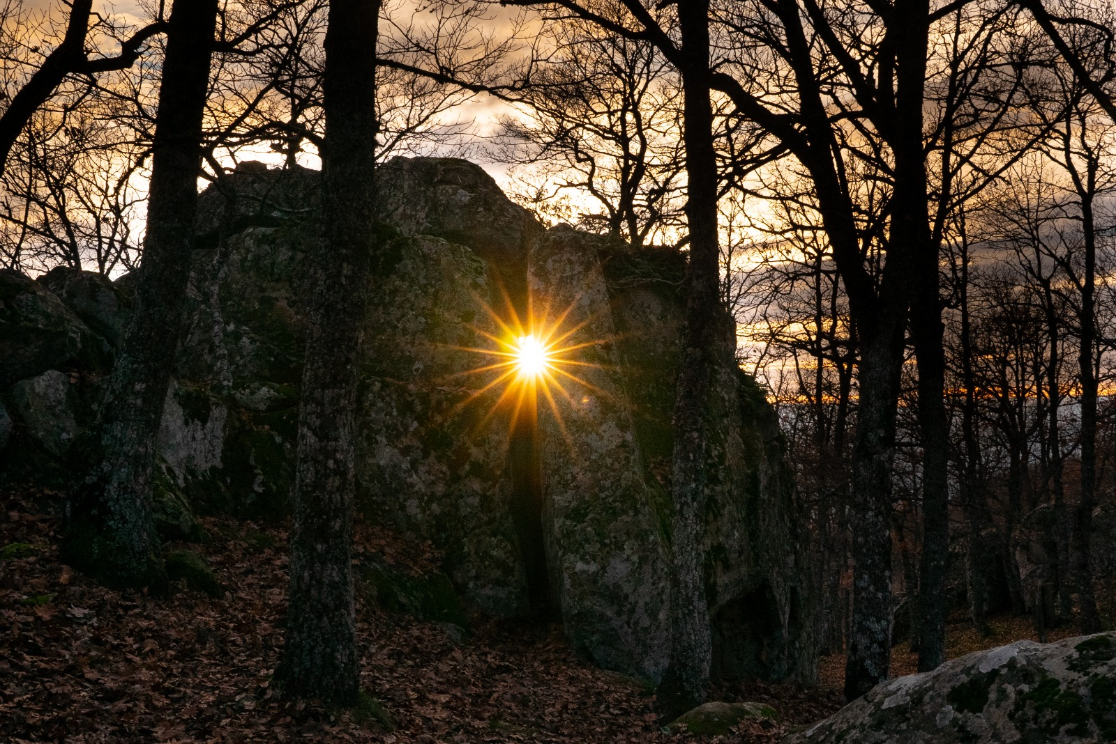
… where the Sun sets down, at every solstice, in a narrow cleft left open between two dolmens …

Slide 12
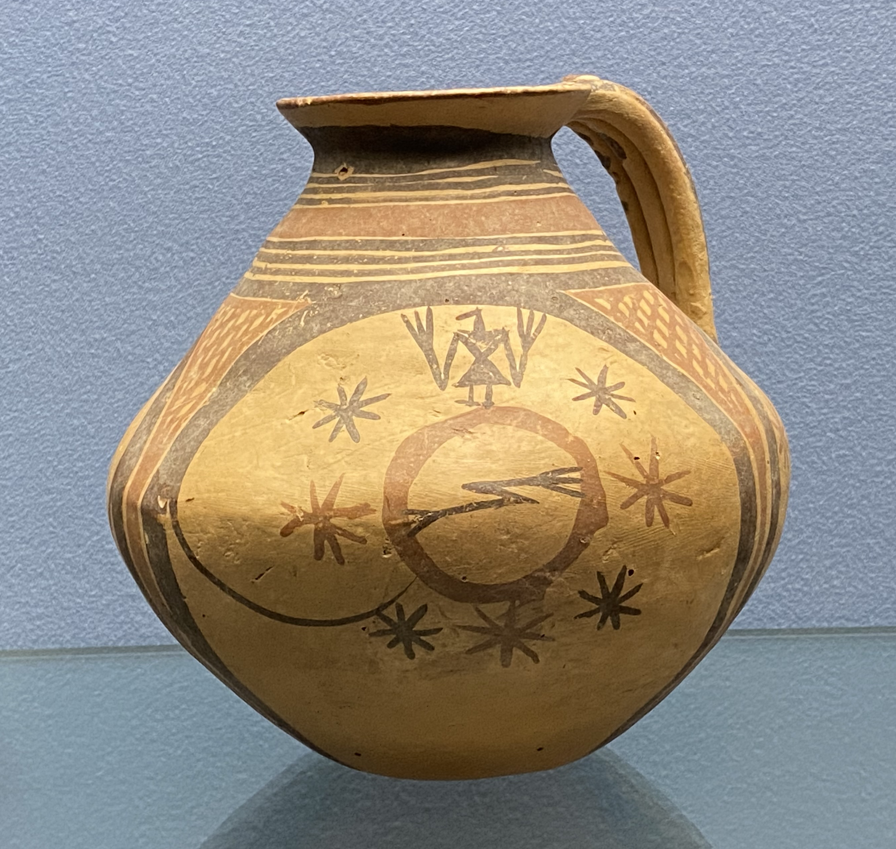
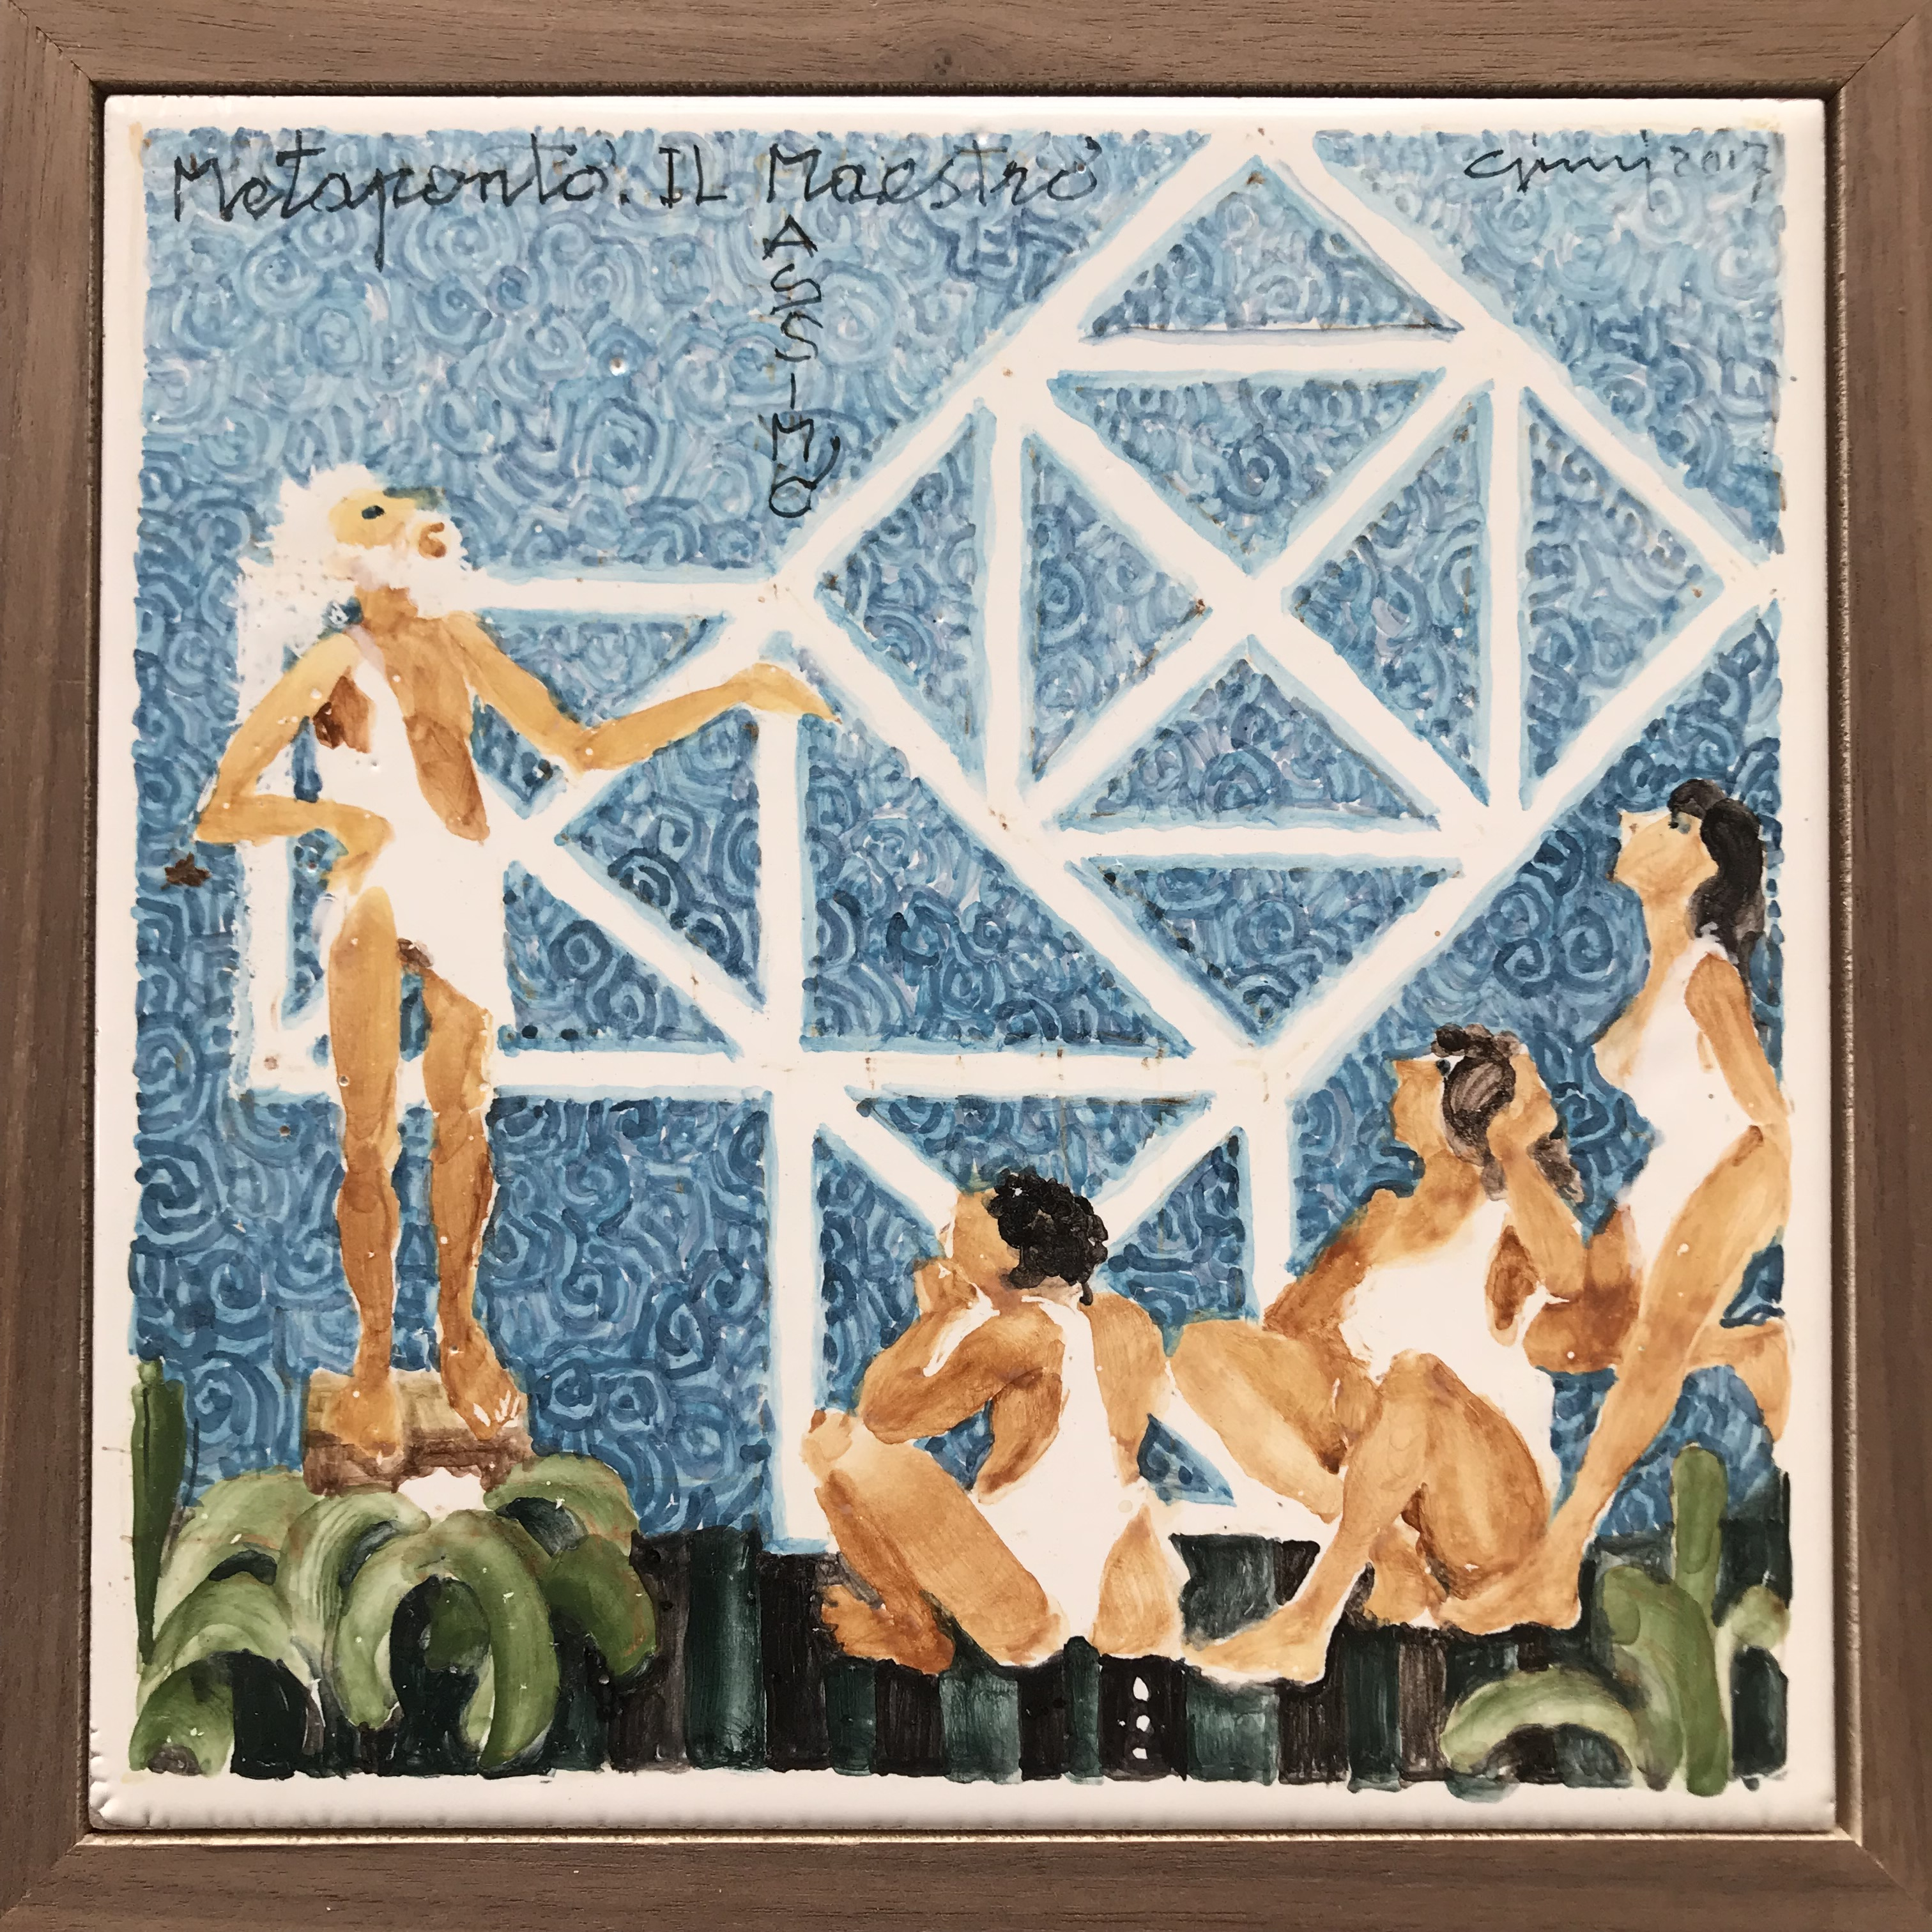
Here the sky is studied by scientists, and provides ispiration for artists, since the ancient Greeks until now…

Slide 13
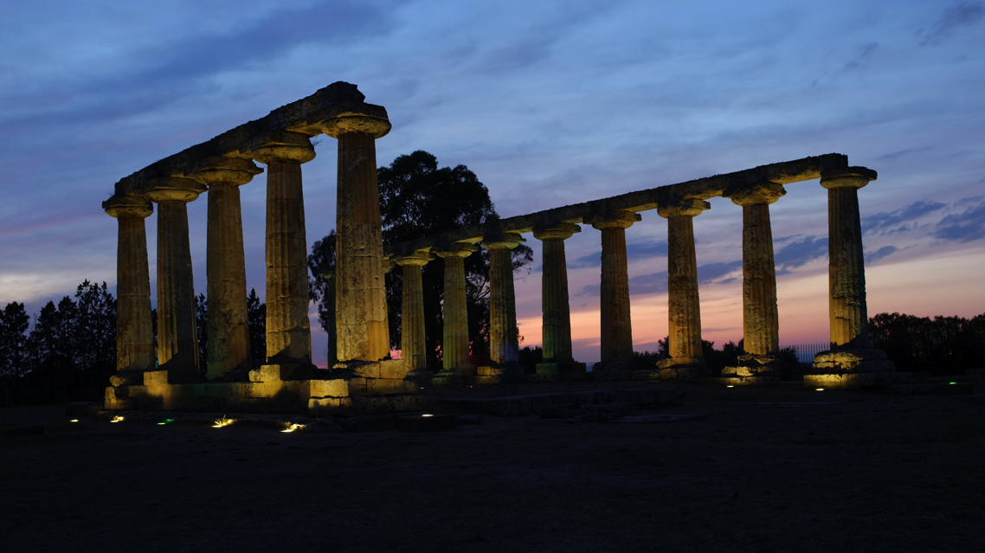
In the land where Pithagoras has lived and taught, there are plenty of reasons for the Space to meet the needs of travellers

Slide 14
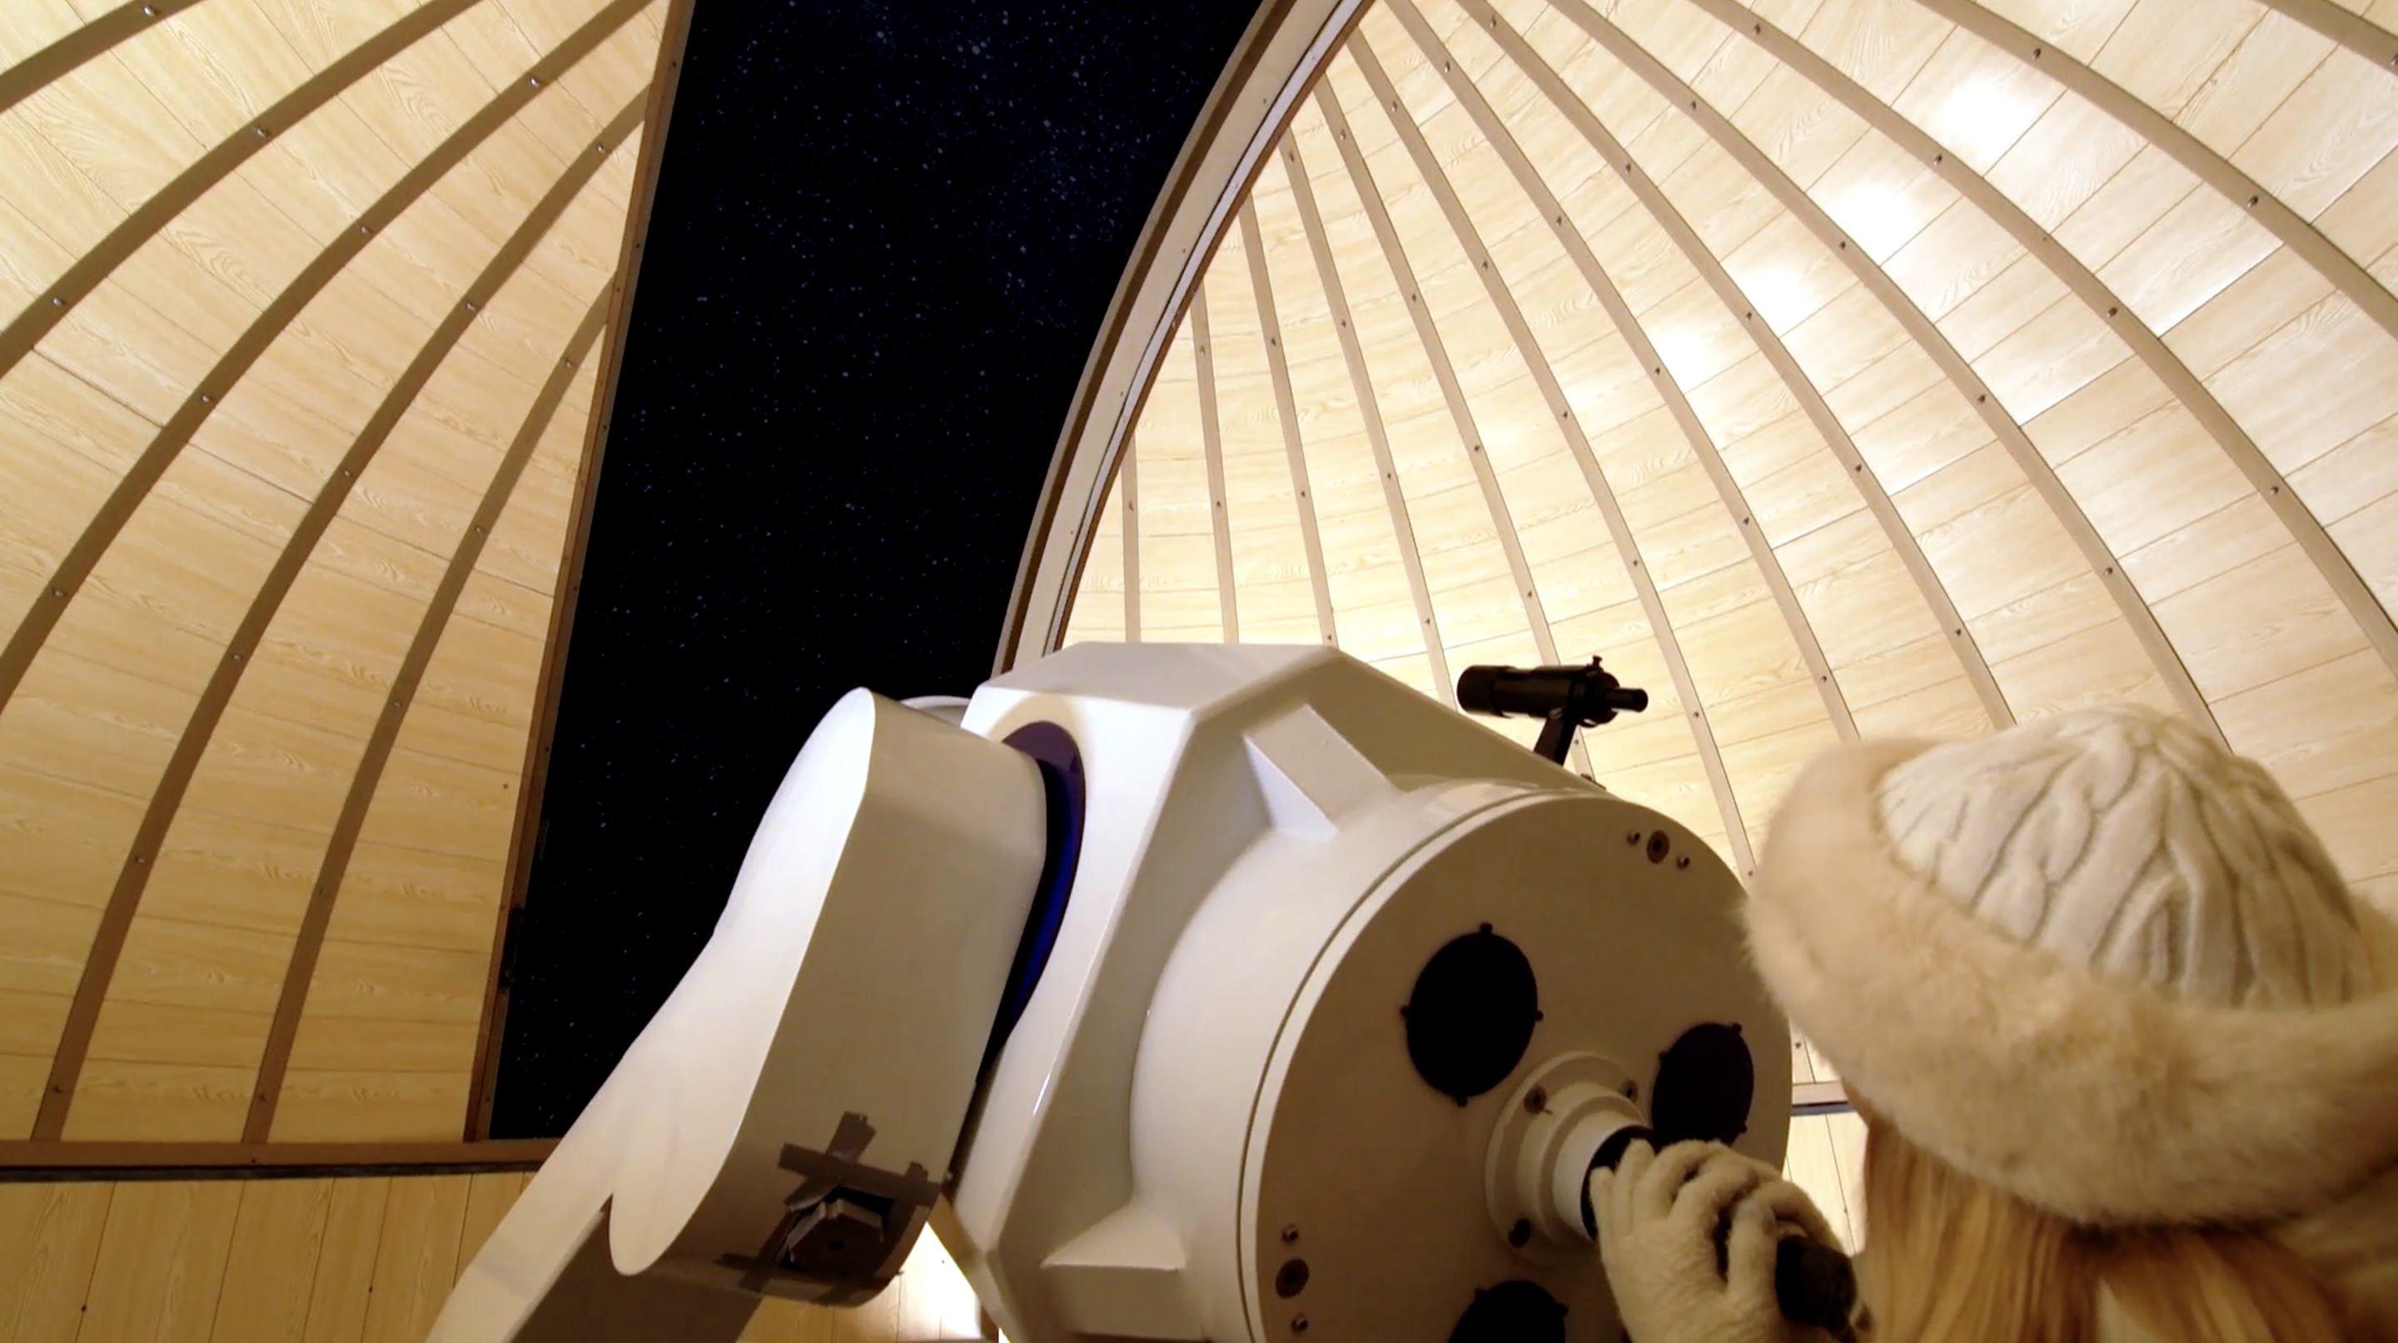
The need to experience

Slide 15
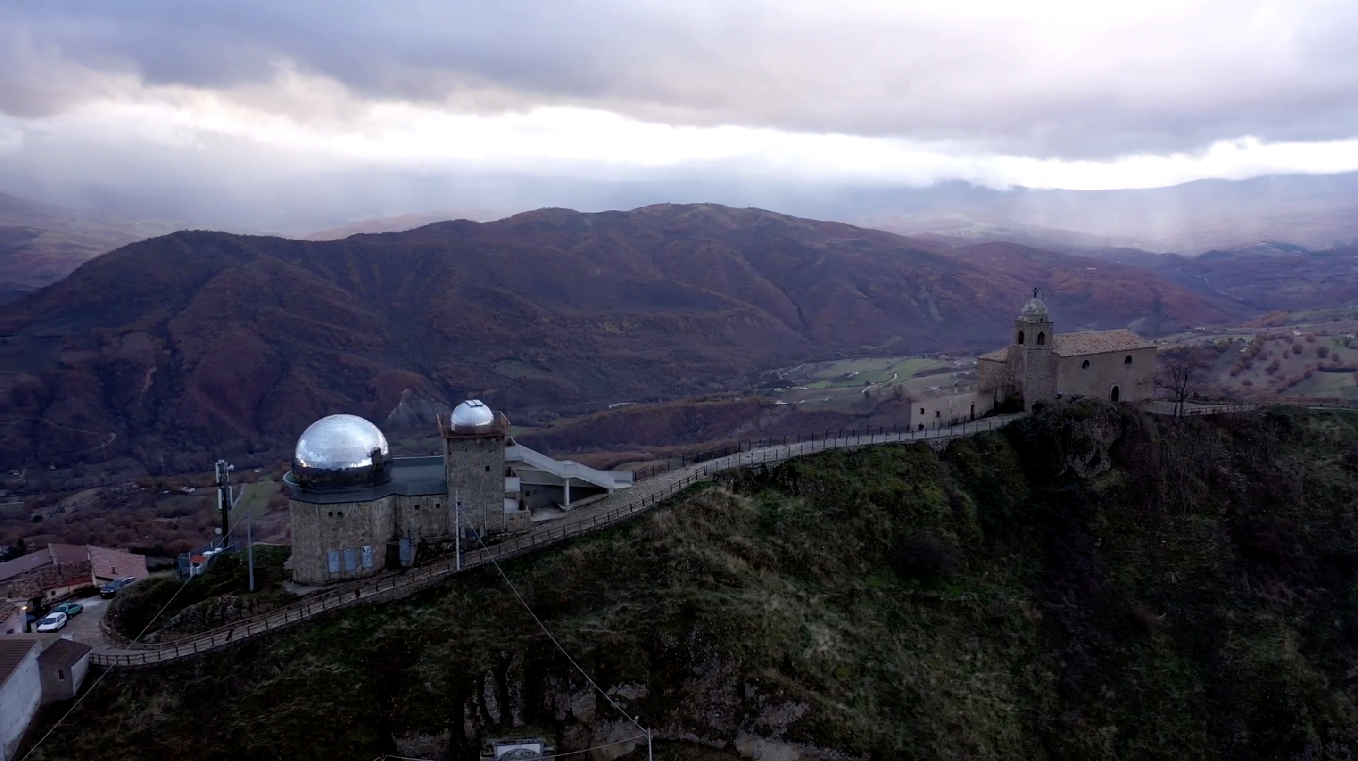
The need to experience

Slide 16
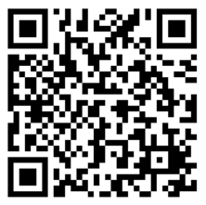
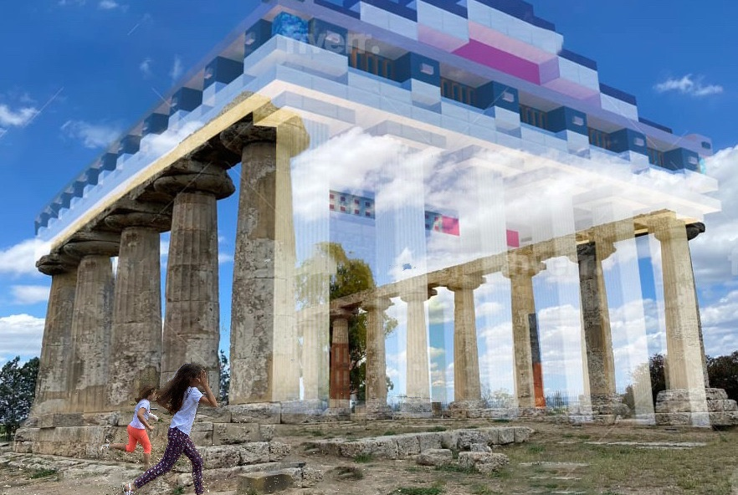
The need to enjoy, and to learn
Minecraft "Metapontum"
New tools for edu-tainment and "discovery"

Slide 17
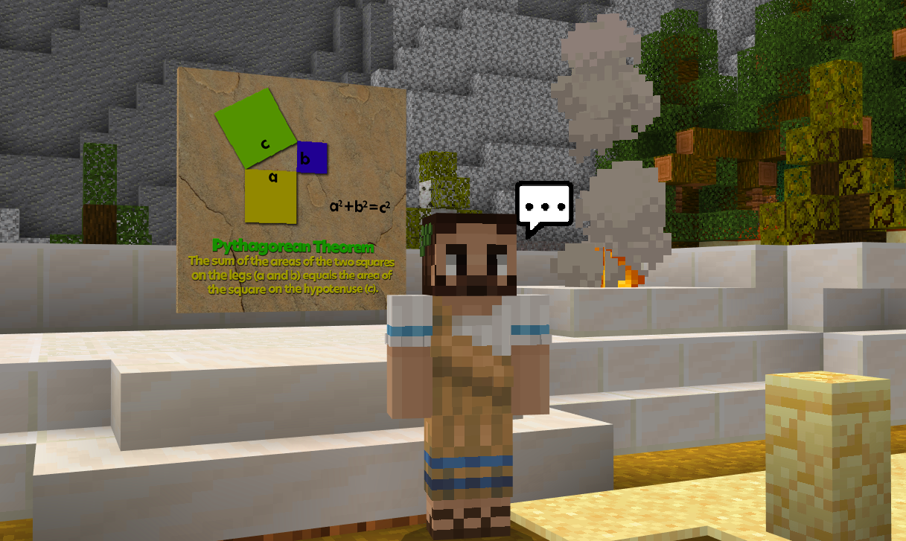

Slide 18
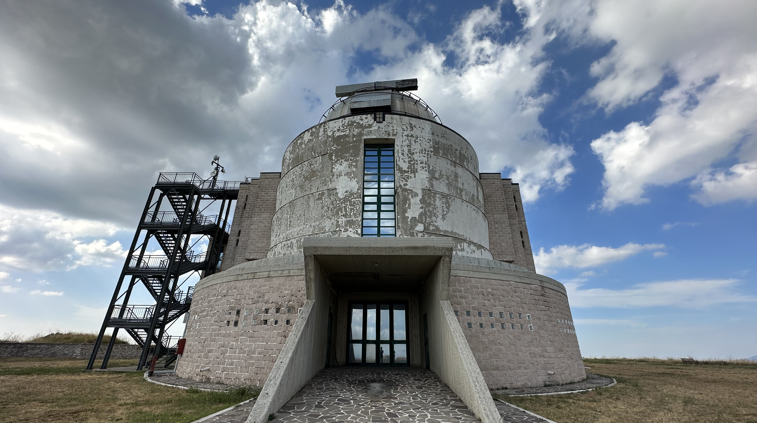
The need to discover new fascinating places

Slide 19
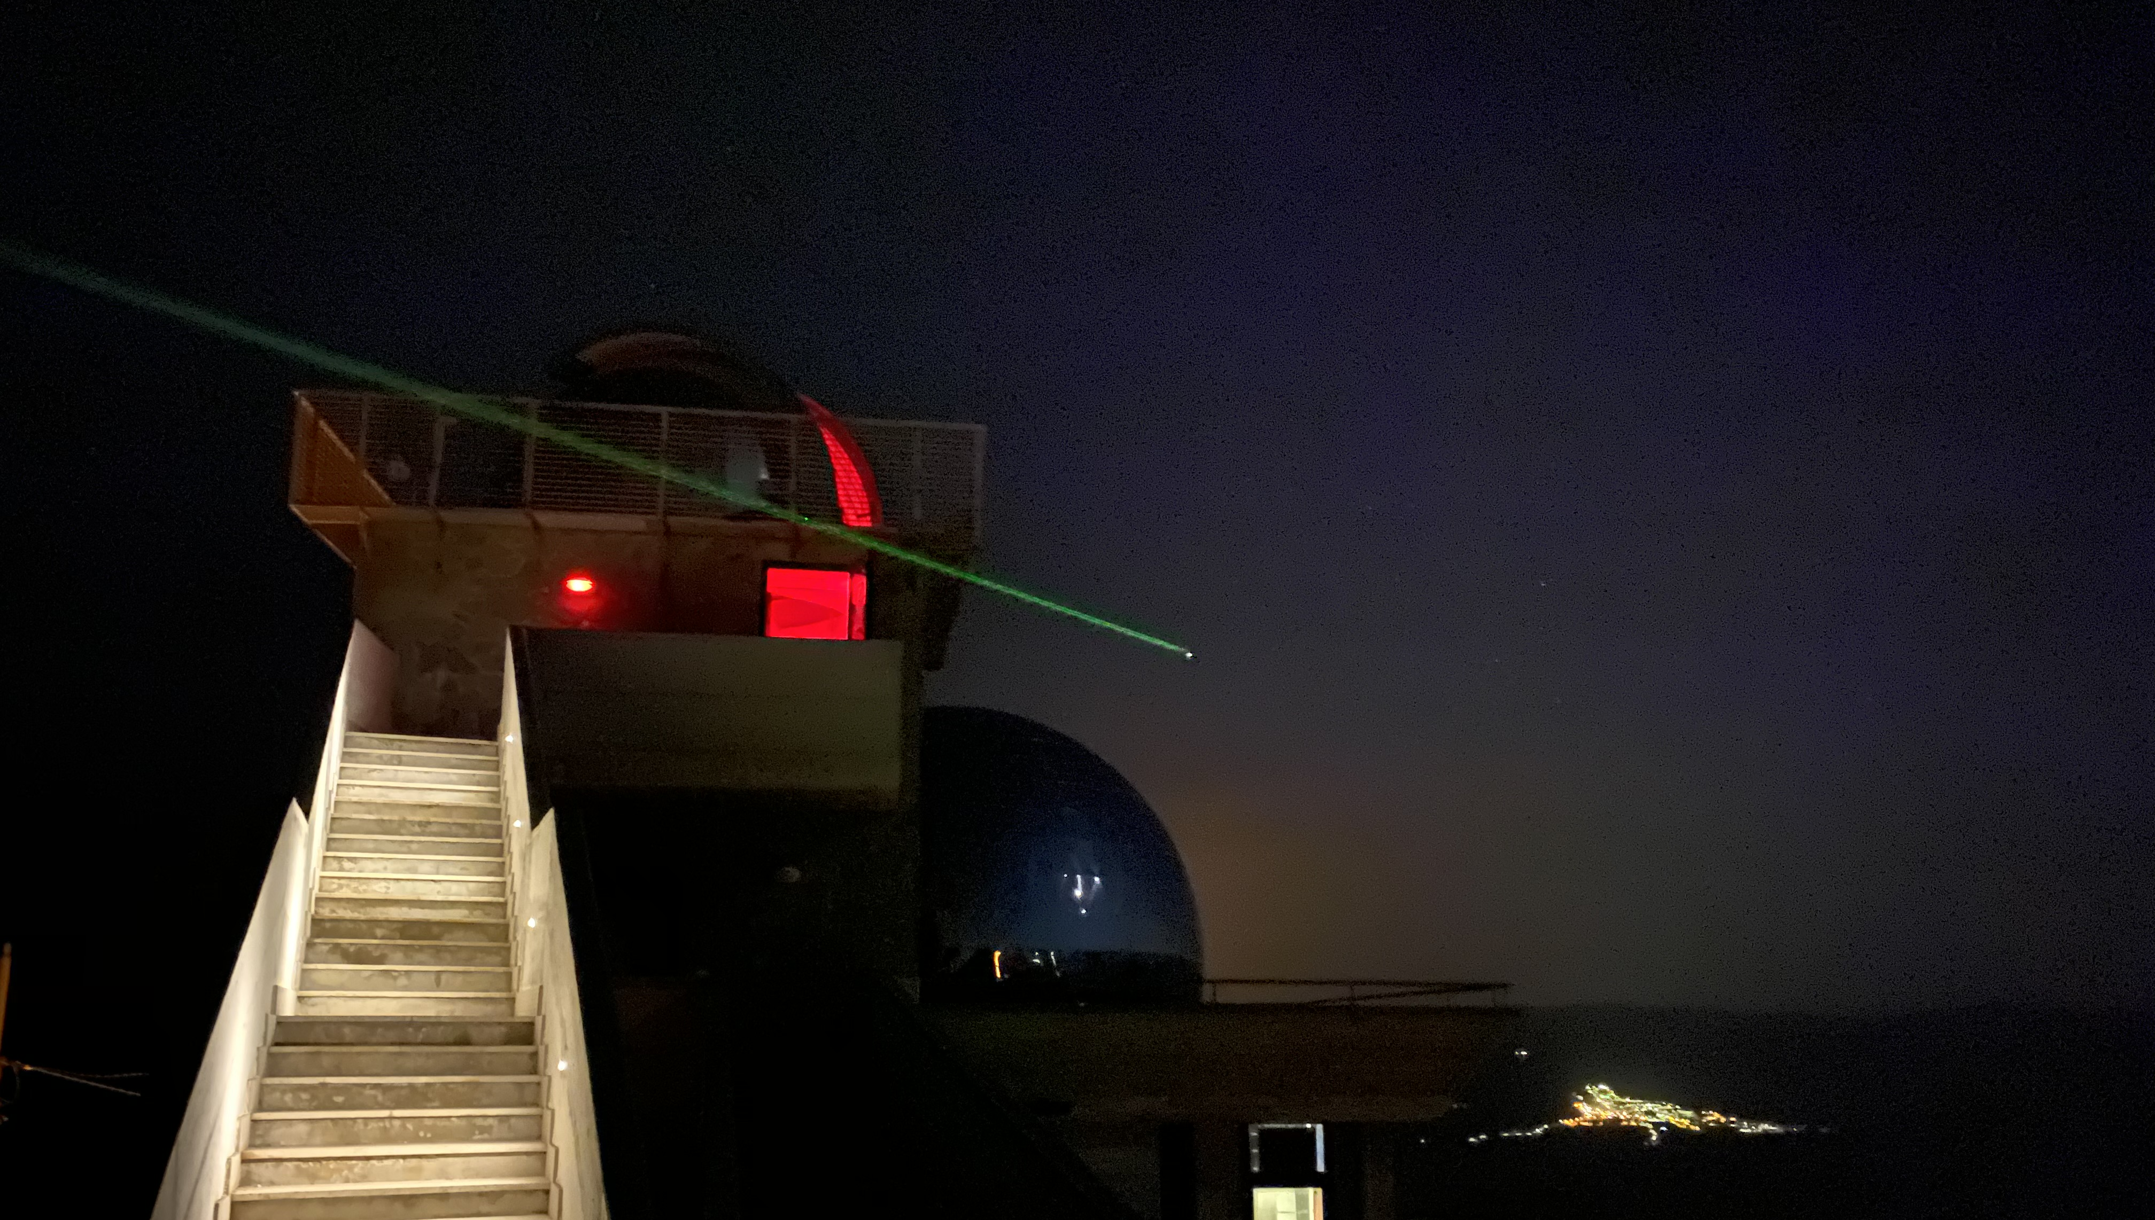
The need to live their dreams and to nurture their passions

Slide 20
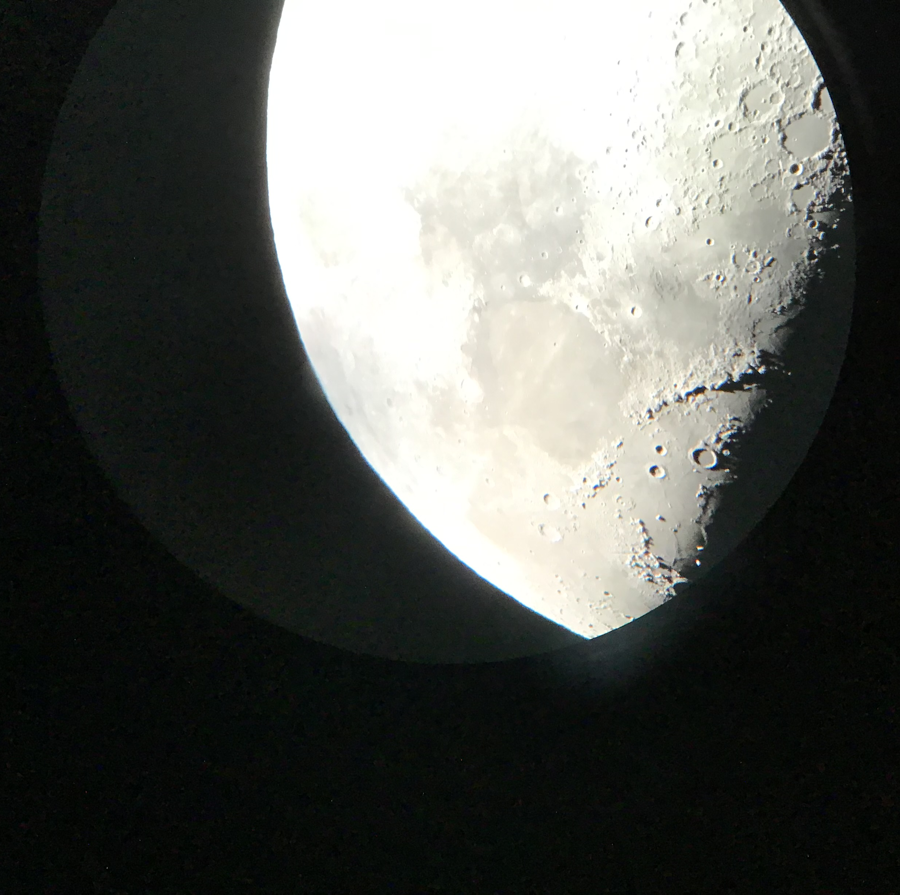
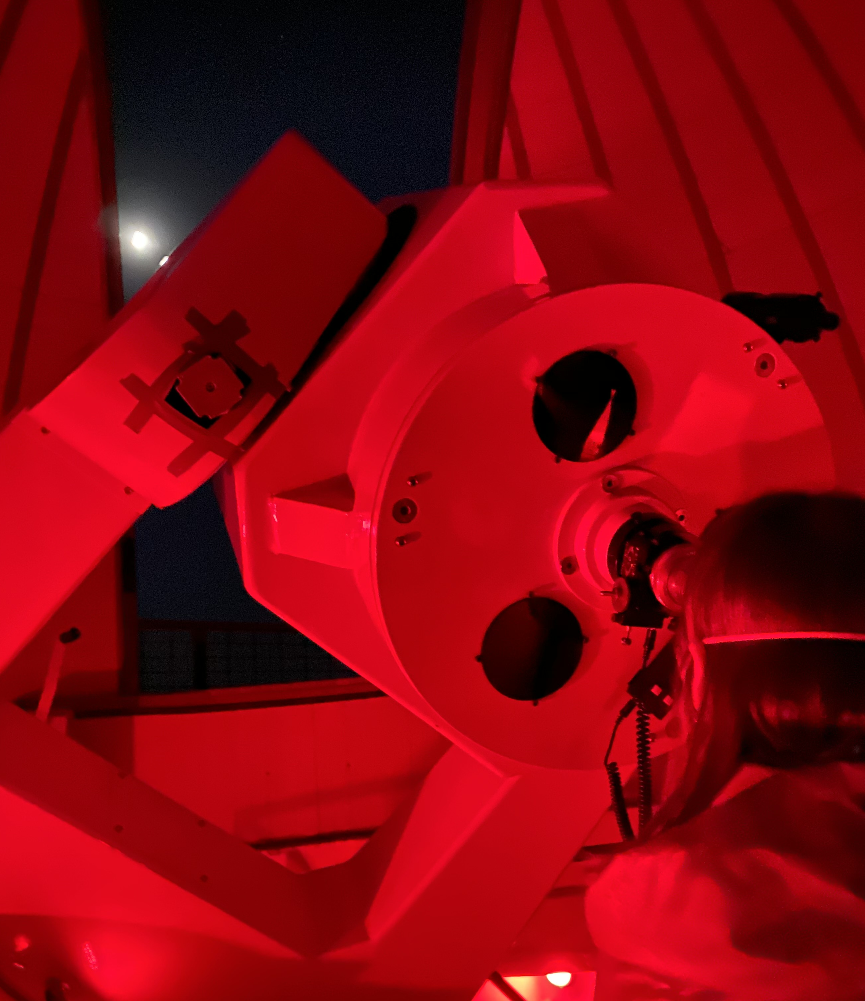
The need to live their dreams and to nurture their passions

Slide 21
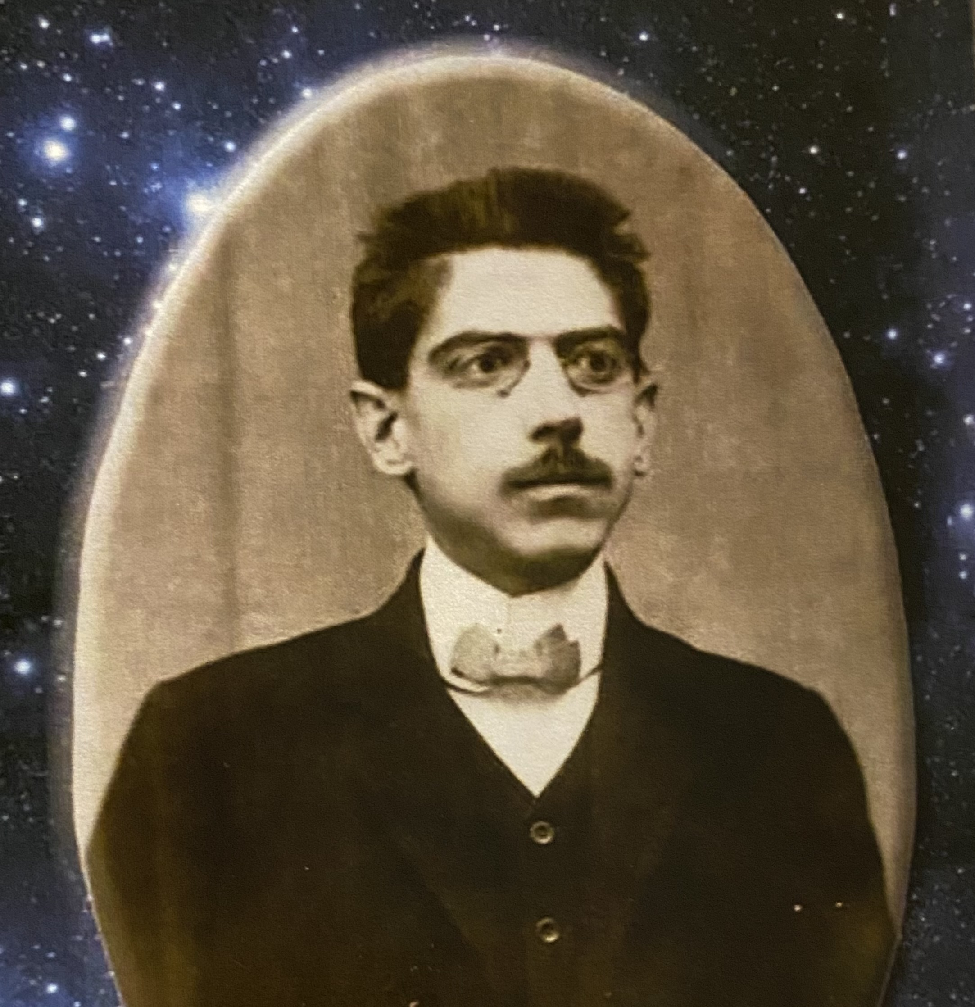
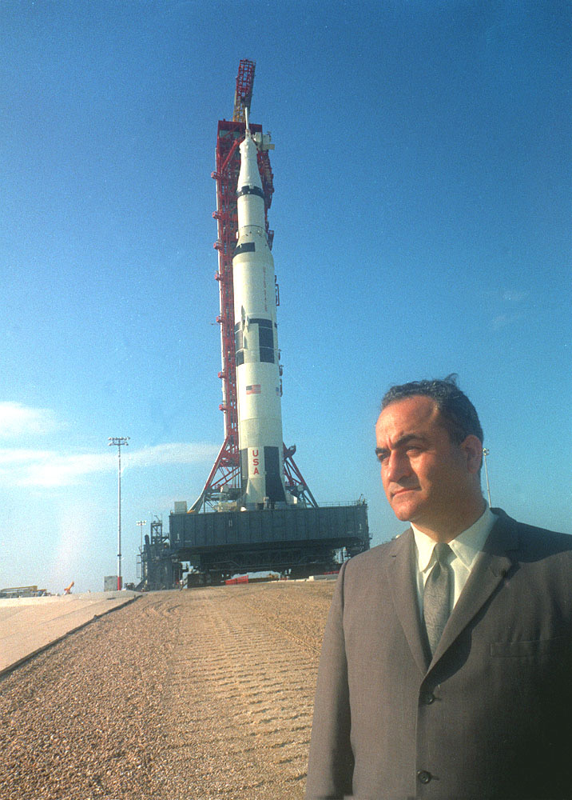
A passion that seems to be quite frequently shared by people from here

Slide 22
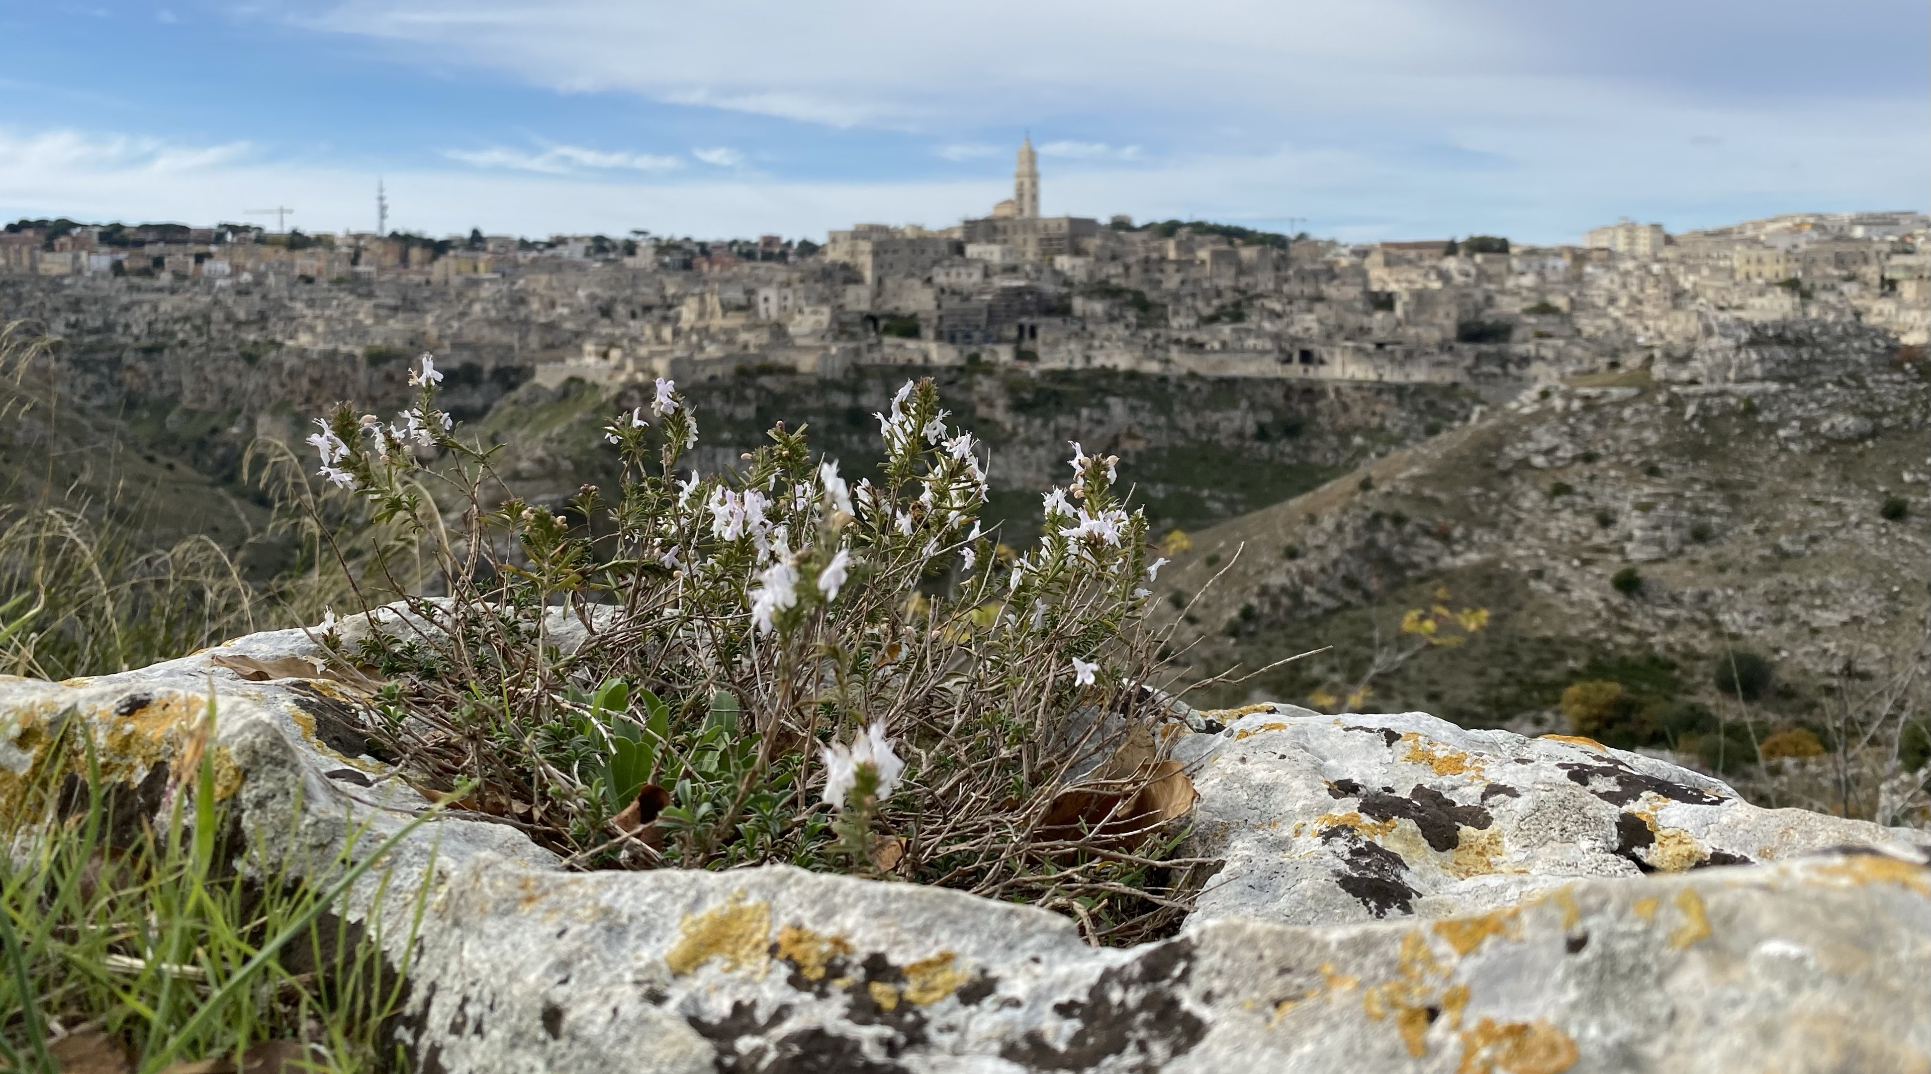
Thank you for your attention
www.basilicataturistica.it
nicoletti@aptbasilicata.it
FB @basilicataturistica
IG @basilicataturistica

