Slide 1
Copernicus
Luca FASANO Earth Observation Directorate-General for Defence Industry and Space
European Commission

Slide 2
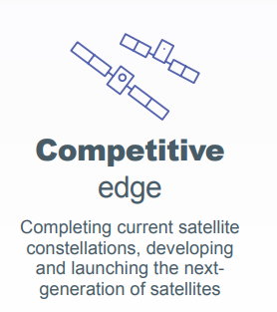
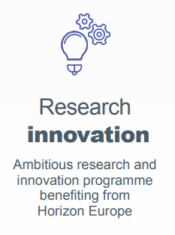
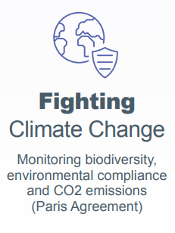
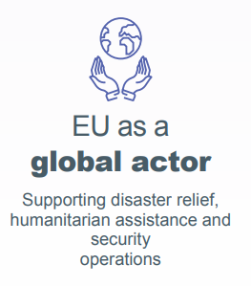
The EU Space Programme

Slide 3
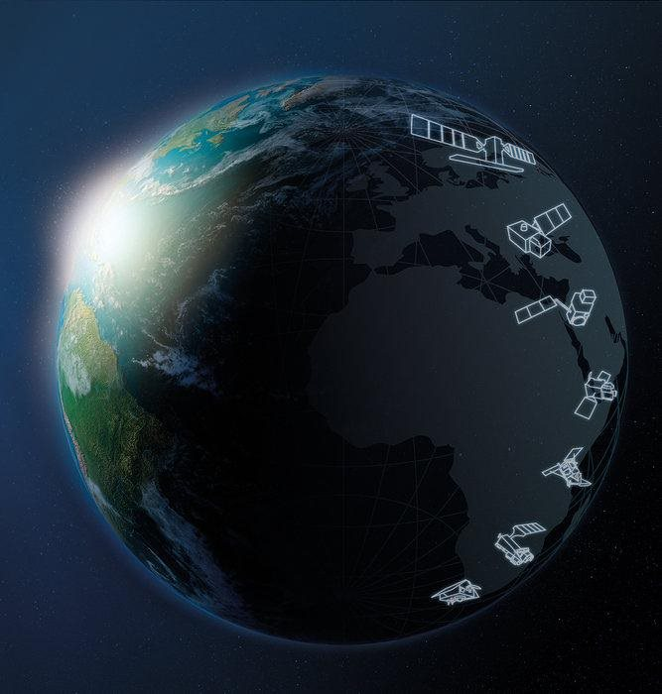
THE SENTINELS
Sentinel Mission and Status
Key Features
SENTINEL-1:
4-40m resolution, 3 day revisit at equator
1 Sat in orbit
Full, free and open data policy
Polar-orbiting, all-weather, day-and-night radar imaging
SENTINEL-2:
10-60m resolution, 5 days revisit time
2 Sats in Orbit
Polar-orbiting, multispectral optical, high-res imaging
SENTINEL-3:
300-1200m resolution, <2 days revisit
2 Sats in Orbit
Optical and altimeter mission monitoring sea and land parameters
SENTINEL-4:
8km resolution, 60 min revisit time
1st Launch in 2024
Payload for atmosphere chemistry monitoring on MTG-S
SENTINEL-5p:
7-68km resolution, 1 day revisit
1 Sat in Orbit
Mission to reduce data gaps between Envisat, and S-5
SENTINEL-5:
7.5-50km resolution, 1 day revisit
1st Launch in 2024
Payload for atmosphere chemistry monitoring on MetOp 2ndGen
SENTINEL-6:
10 day revisit time
1 Sat in Orbit
Radar altimeter to measure sea-surface height globally

Slide 4
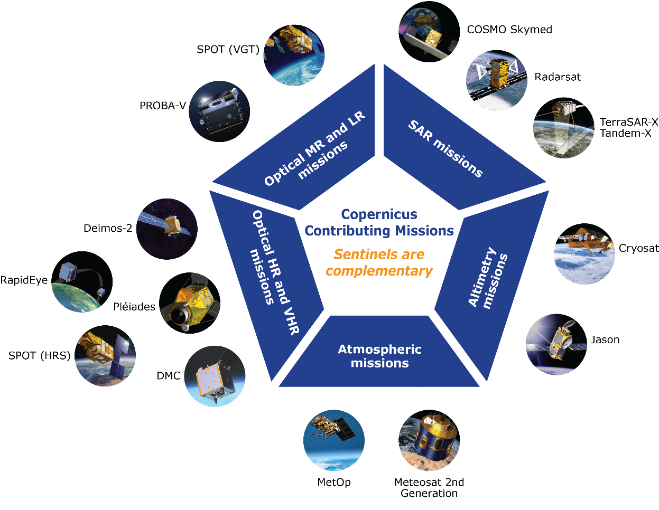
THE CONTRIBUTING MISSIONS
Subject to Data Owner’s Data Policy

Slide 5
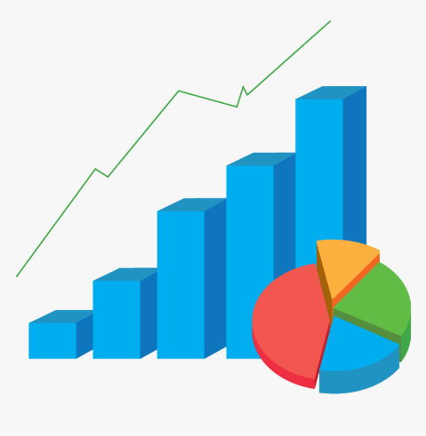
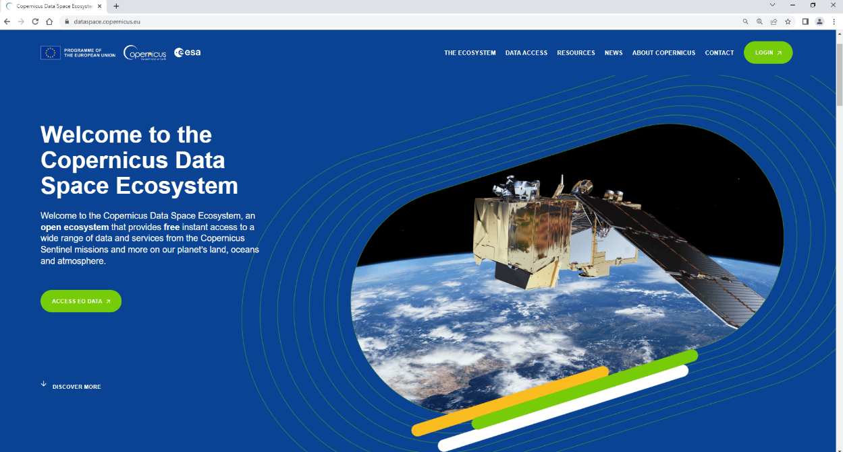
Copernicus Data Space Ecosystem
Some statistics on Copernicus data and users:
>57 million products (36 PiB) available*
~ 1 billion ( ~ 500 PiB) products downloaded*
> 640 thousands registered users*
NEW Copernicus Data Space Ecosystem
The only access point for all the Copernicus users and other Data access systems
Full operational; incremental improvements
*available on OpenHub at the end of 2022

Slide 6
COPERNICUS SERVICES
COPERNICUS SERVICES
Full, free and open data policy

Slide 7
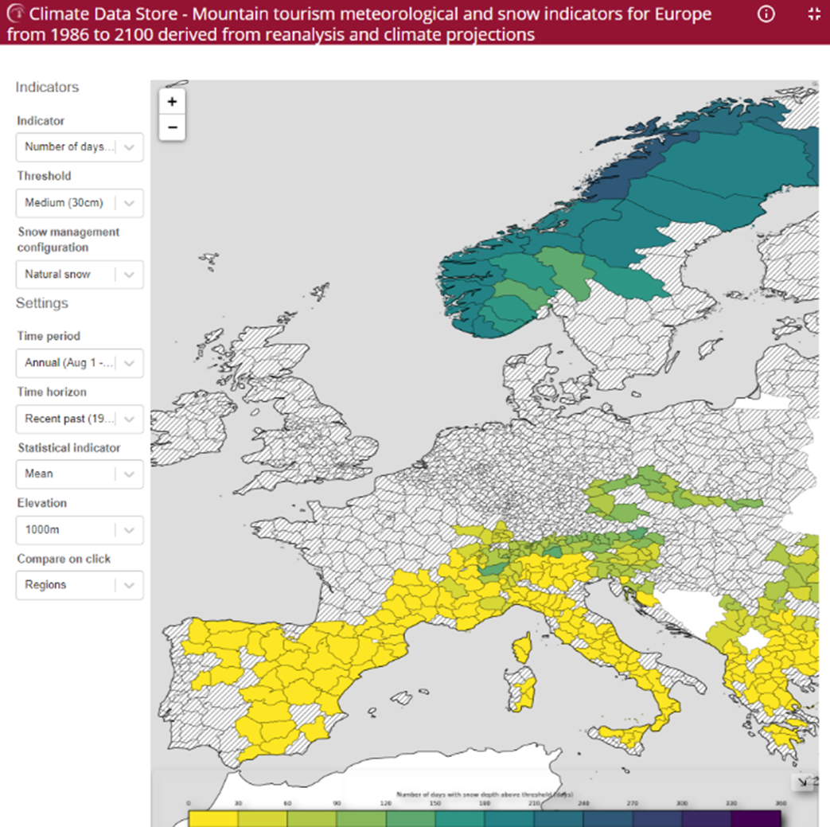
Copernicus for tourism
Mountain Tourism Meteorology and Snow Indicators
→ snow reliability

Slide 8
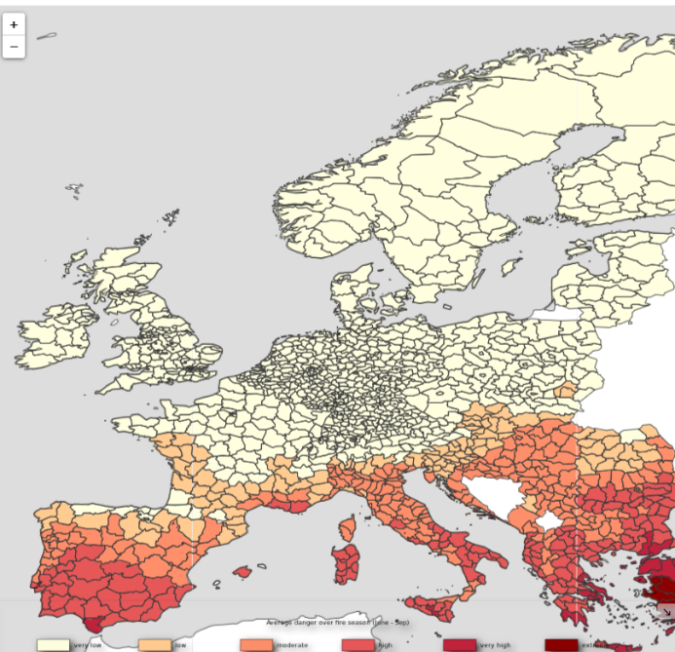
Copernicus for tourism
Fire Weather Index
→ Fire danger

Slide 9
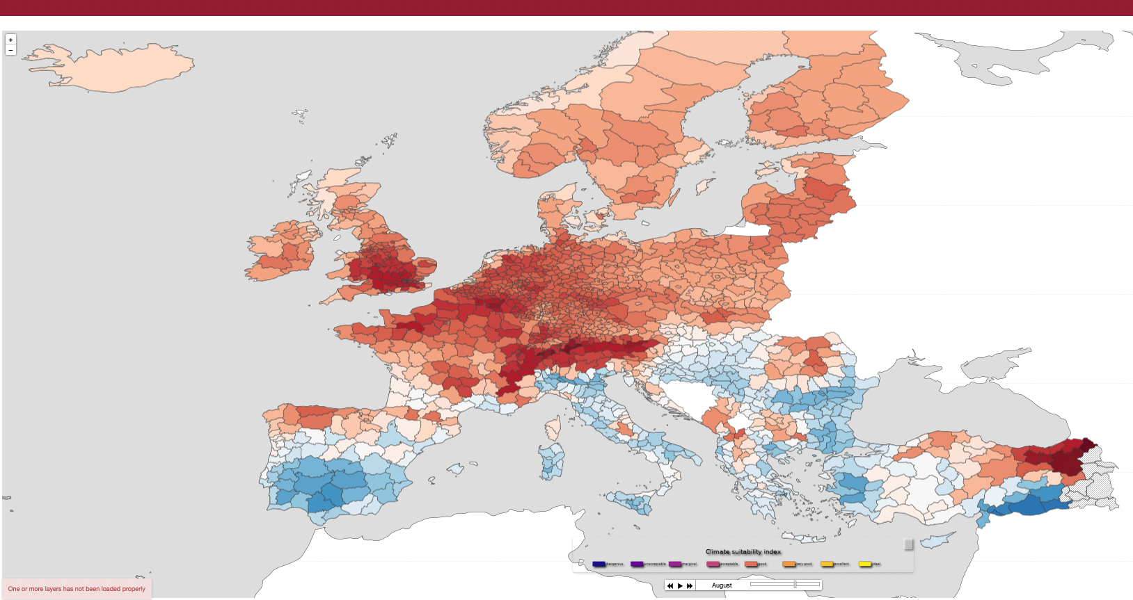
Copernicus for tourism
Holiday Climate Index → Climate suitability for urban tourism in 2100

Slide 10
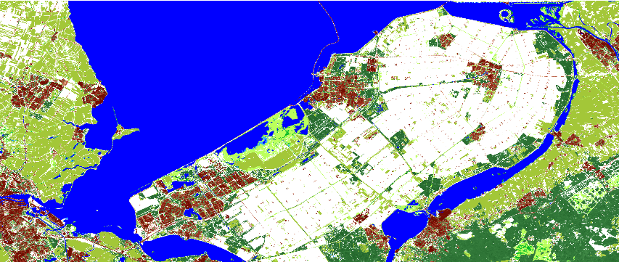
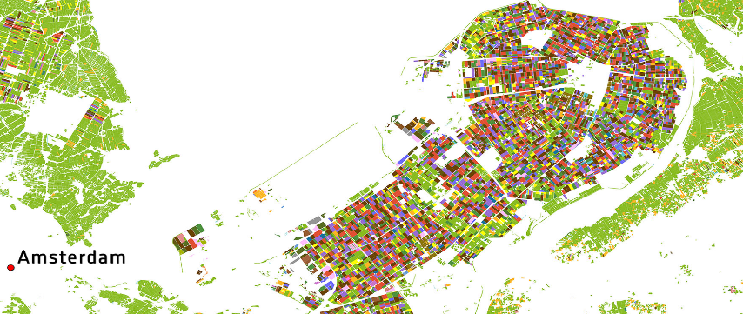
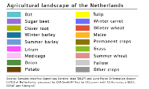
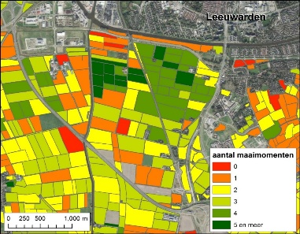
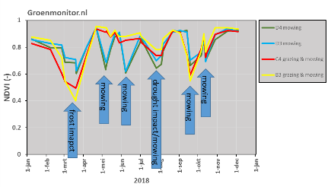
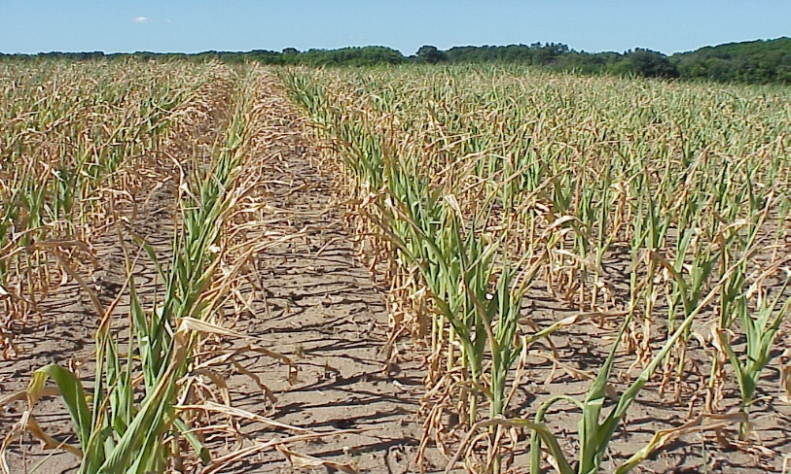
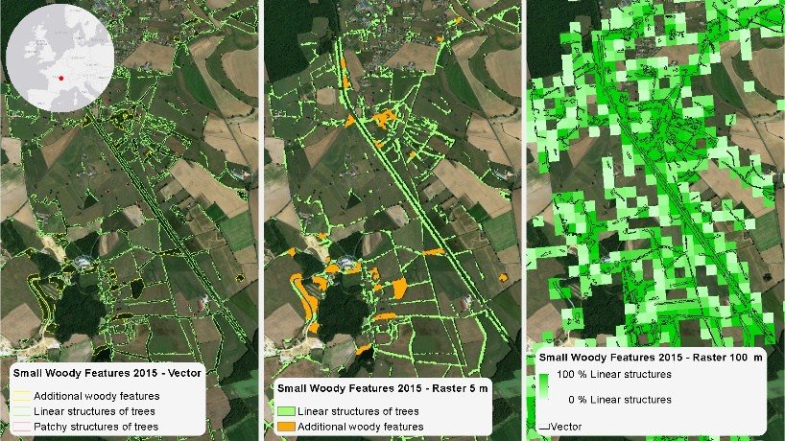
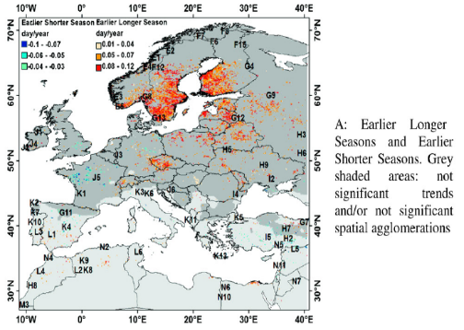
Support to Agriculture and Common Agriculture Policy
Crop type mapping
Grassland activities monitoring
Earlier and longer season
Earlier
and
shorter
season
Crop phenology monitoring (climate change)
Environmental indicators (Woody features)

Slide 11
Toward 2.0 – Continuation & Evolution
Copernicus
1.0
Continuation
Copernicus
2.0
E v i o n

Slide 12
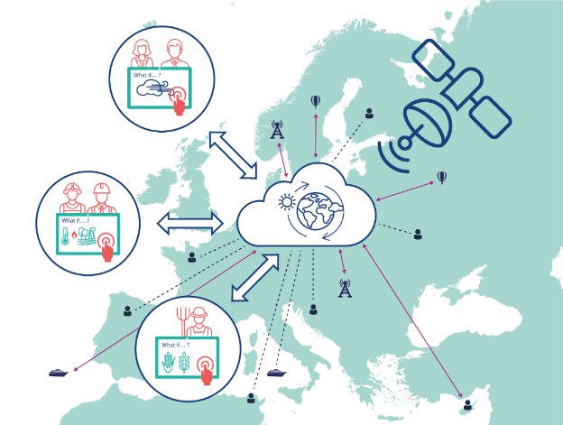
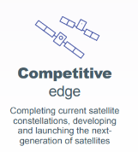
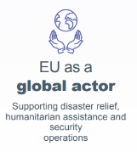
Copernicus digital DestinationEarth
Weather-induced and Geophysical Extremes
Climate Change Adaptation
AI Urbans
Oceans
Biodiversity
Next generation of satellites
New space
Co-designed services
AI, cloud, HPC
Operational services
Rooted in science
benefiting from Horizon Europe
EU Digital
platform
Monitoring environment
routinely
Anticipating Extreme events
Support adaptation and resilience
Supporting disaster relief, global reach in climate adaptation, fostering green policies

Slide 13
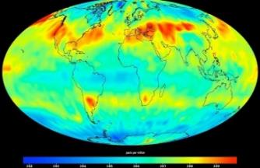
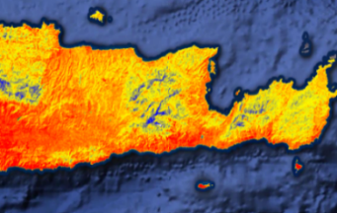
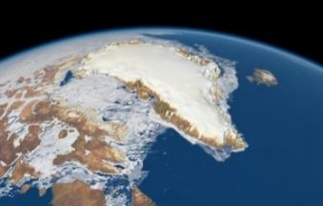
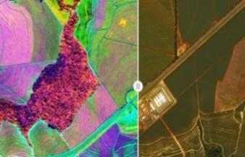
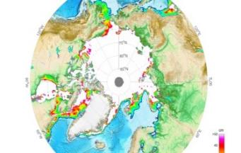
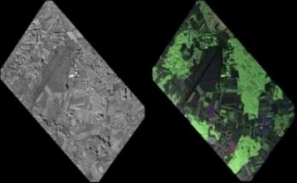
Sentinel expansion missions
CO2M
Copernicus Anthropogenic CO2 Monitoring
CO₂, NO₂, Aerosols Imaging Spectrometer (VNIR/SWIR), Polarimeter
LSTM
Land Surface Temperature Monitoring
VNIR/TIR scanning radiometer
CRISTAL
Copernicus Polar Ice & Snow Topography
Radar altimeter
HR microwave radiometer
CHIME
Copernicus Hyperspectral Imaging Mission for the Environment (VNIR/SWIR)
CIMR
Sea-ice, sea surface temperature, salinity
Copernicus Imaging Microwave Radiometer
Multi-frequency L-band Radiometer
ROSE-L
Observation under vegetation, cryosphere, soil
L-band SAR
13

Slide 14
Hybrid Constellation
Hybrid constellation
Copernicus Sentinels - REFERENCE
COPERNICUS
HYBRID
CONSTELLATION
New Space – AGILE
Expansions - GREEN

Slide 15
Thank you

Slide 16
BACKUP SLIDES

Slide 17
Facilitating uptake of New Space
New Data Purchasing System DPS
open enrolment
electronic and automated procurement (submission of proposals and evaluation)
more competition
more and better proposals
fast-track contracting
Competition
Pool of tenderers
Quality
Learning process
Speed
Electronic procedure

Slide 18
The new Governmental Service
Some limitations experienced with current Services:
Not designed to deal with classified service information
Restrictions to access commercial high-resolution satellite EO data over crisis areas
Today Sentinels data and Copernicus services are not designed to meet defence needs
The new Service will provide a fully reliable and continuously available situation awareness services based on EO data to EU and MS (for civil security and defence), addressing relevant use cases/needs

Slide 19
Copernicus evolution
CONTINUATION: is the FIRST KEY PRIORITY!
1-
Data
Acquisition
2- Services
4-
User uptake
3-
Access & distribution

Slide 20
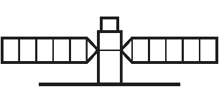
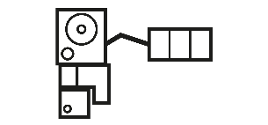
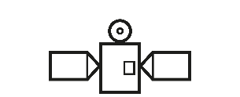
Block 1: data acquisition
The SENTINELS and their main uses
Sentinel-1
Sentinel-2
Sentinel-3
Sentinel-4
Sentinel-5
Sentinel-5P
Sentinel-6
Agriculture/vegetation monitoring, soil and water cover, forest management, border and maritime surveillance, emergency management: floods, fires
Ocean forecast, climate change and operational oceanography: sea surface height, ocean color, oceanic carbon fluxes, monitoring river or lakes level
Continuous monitoring of atmospheric composition focused on air quality over Europe, with main products Ozone (O3), Nitrogen Dioxide (NO2), Sulphur Dioxide (SO2), Formaldehyde (HCHO) and aerosol properties
(Precursor of Sentinel-5) daily global monitoring of the main atmospheric pollutants (CH4 and O2 NO2 CO2 HCHO, SO2) and two major greenhouse gases (CH4 and tropospheric O3)
Daily global monitoring for climate, air quality and ozone/surface UV applications, with key parameters O3, NO2, SO2, HCHO, CHOCHO, Aerosols, CH4 and stratospheric Ozone
Ocean forecast, climate change and real time ocean topography: wave height, ocean surface, wind speed
All-weather, day and night observations to support services for sea-ice monitoring, marine environment surveillance, ship detection, land-surface motion risks, mapping of forest, water and soils, humanitarian aid and crisis management
C/D launch
1st launches 2024

